Slide 1
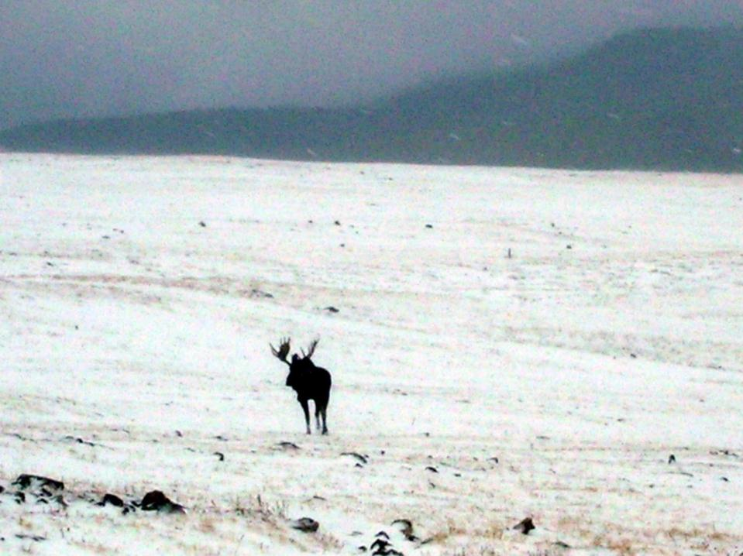

Understanding and managing mountain soils
Michele Freppaz
Università di Torino, DISAFA– Chimica Agraria e Pedologia
Laboratorio Neve e Suoli Alpini (www.natrisk.unito.it)
michele.freppaz@unito.it

Slide 2
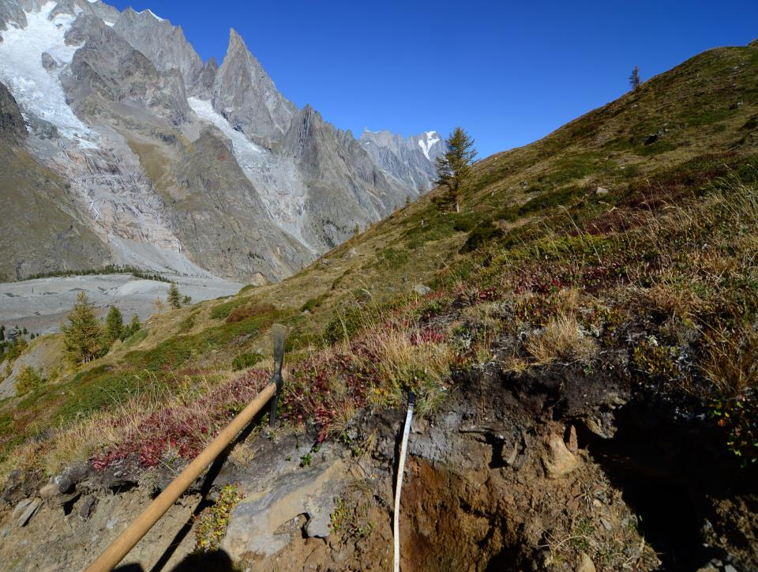
Mountain Soils

Slide 3
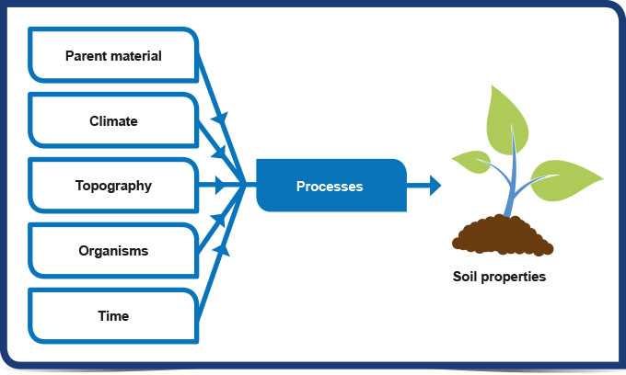

The soil forming factors in mountain areas

Slide 4
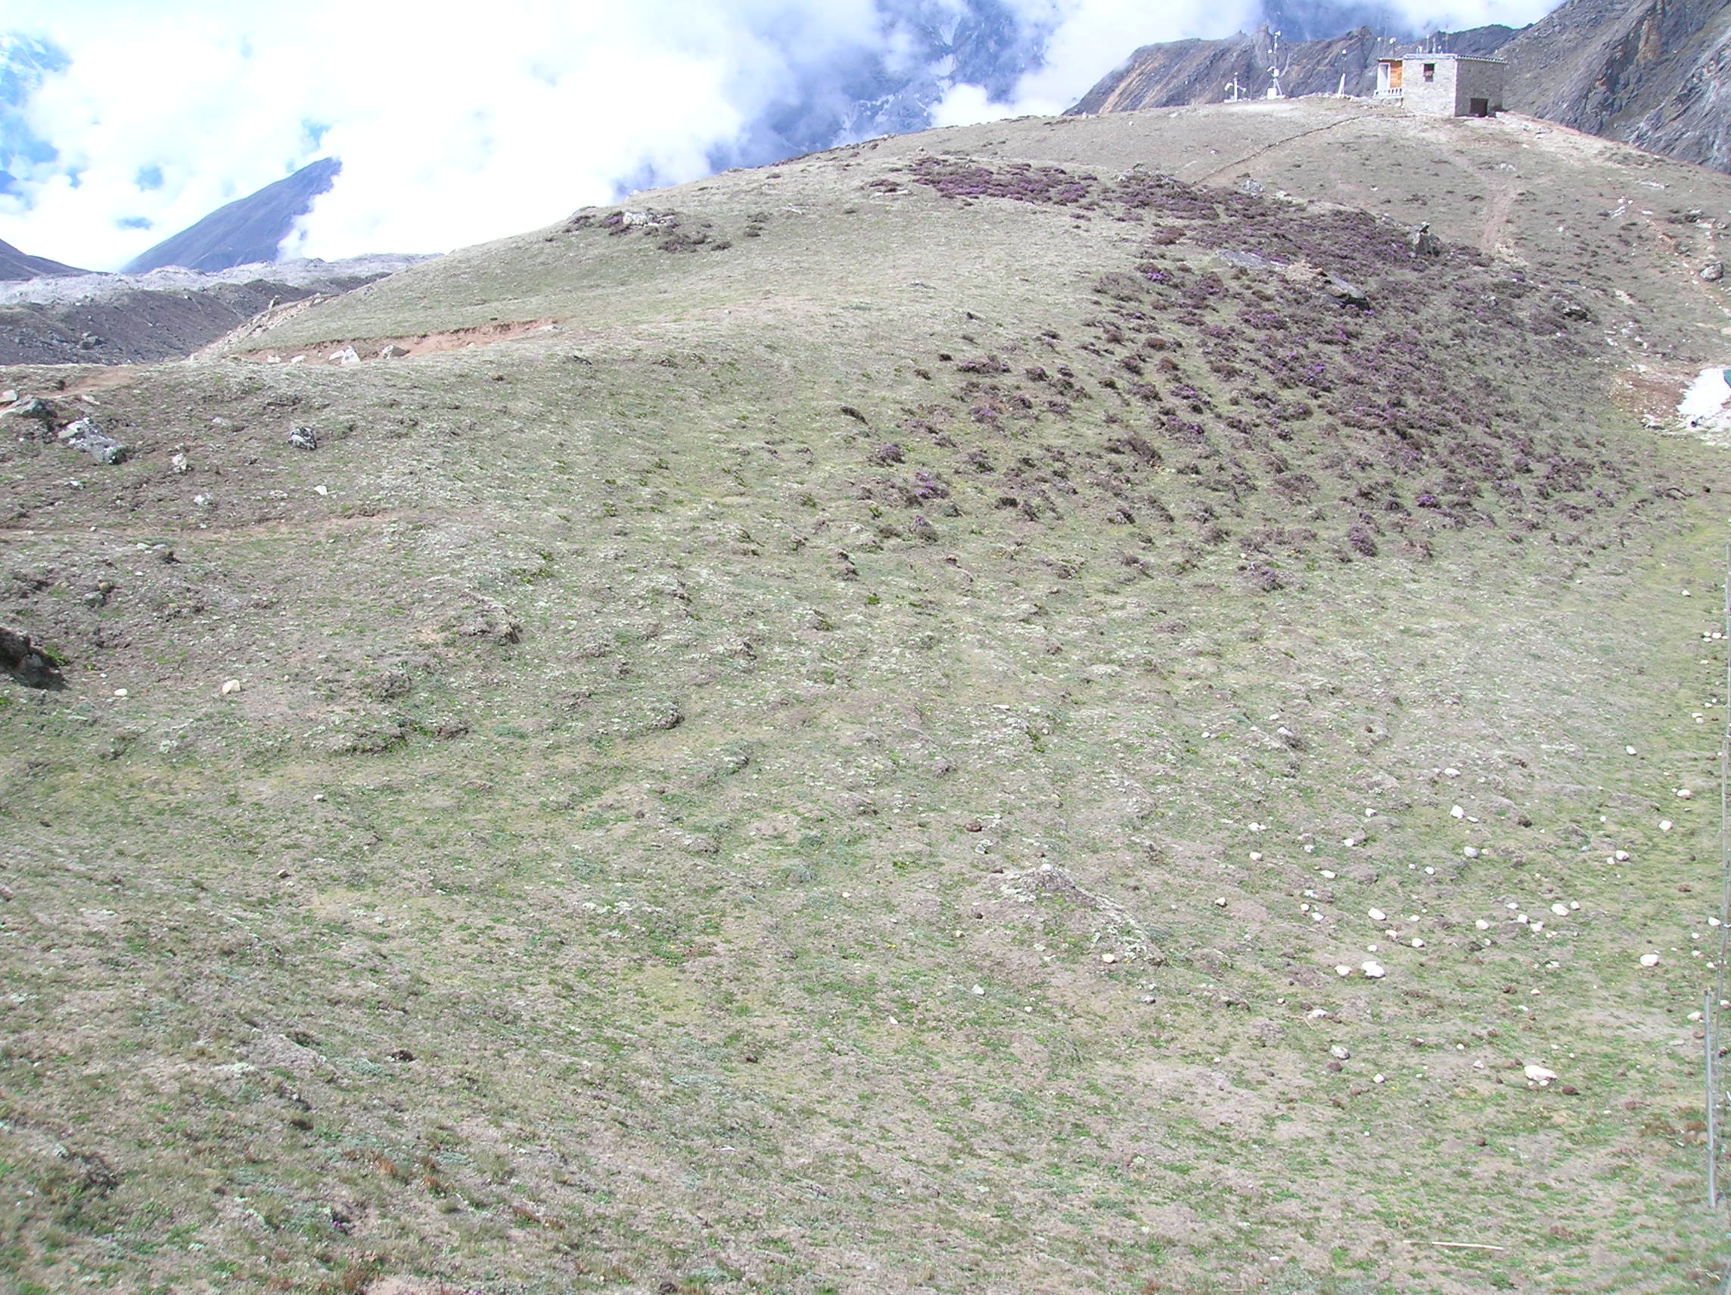
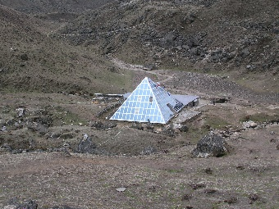


Topography
Ridge
Slope
The Sagarmatha National Park (Nepal), 5070 m asl

Slide 5
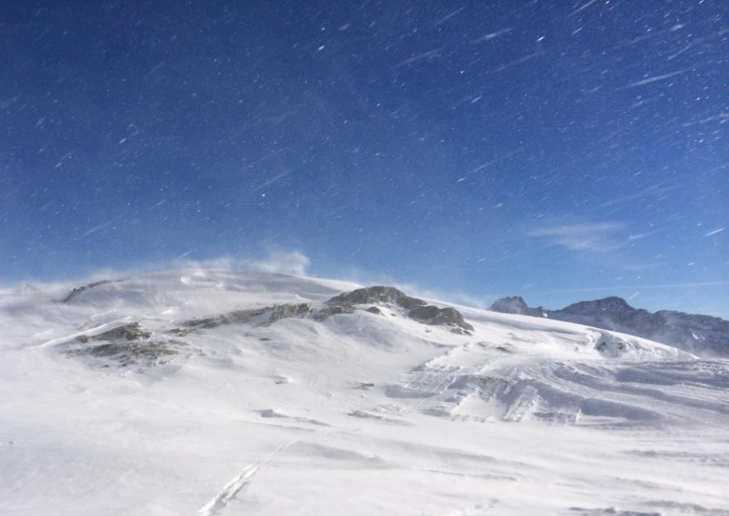

Slide 6
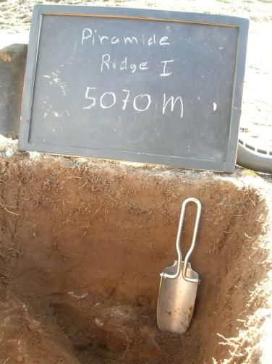
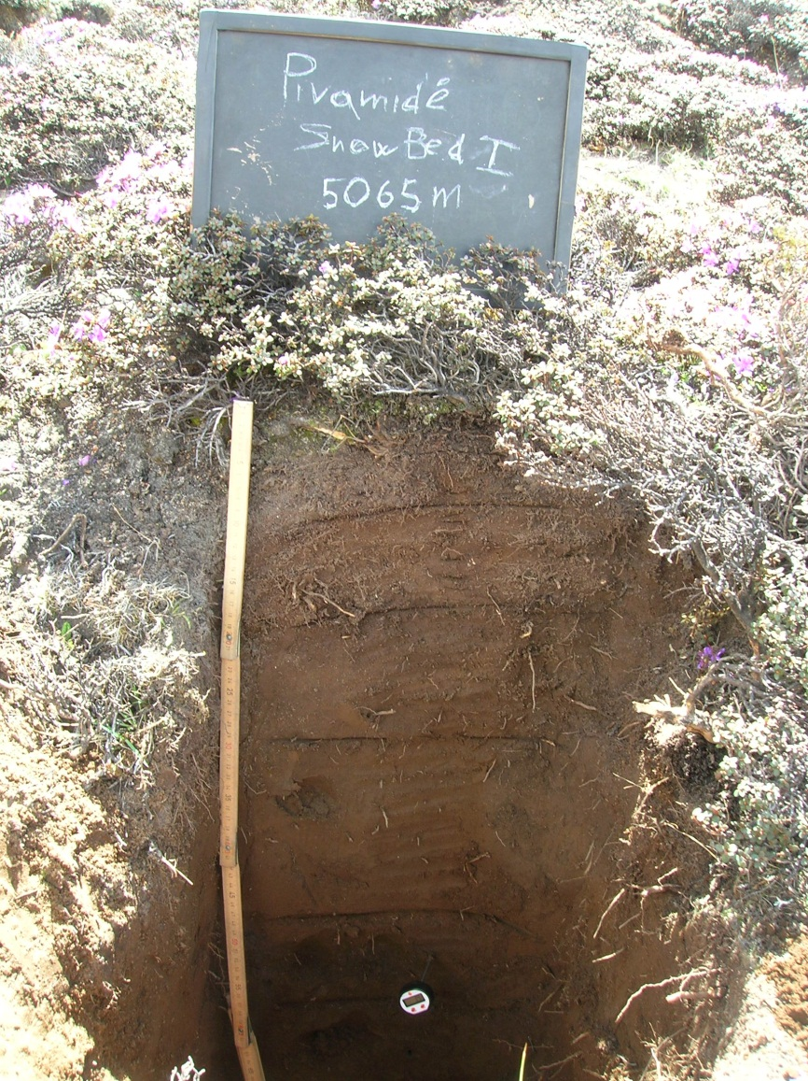
Different soil properties
0
0
TOC = 6.1%
TOC = 3.2%
30+
85+

Slide 7
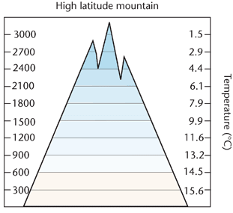
Climate
This is probably the most important factor (soils produced from the same parent material under different climates contrast. Zonal Soil).
Climate governs the rate and type of soil formation and is also the main determinant of vegetation distribution.
Soil climate has two major components: moisture (precipitation) and temperature, influencing evaporation. When exceeds evaporation, leaching of the soil will occur.
Temperature determines the rate of reactions; chemical and biological decay and so has an influence on weathering and humification.

Slide 8
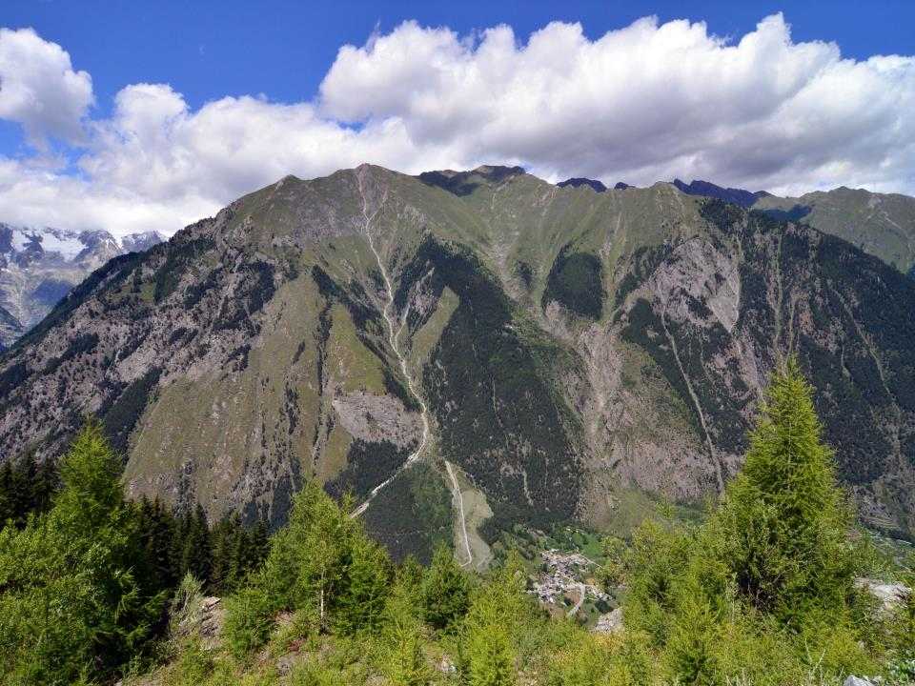
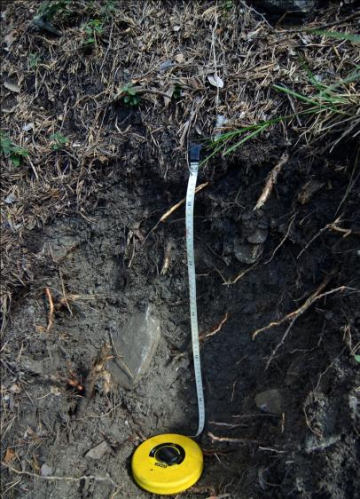
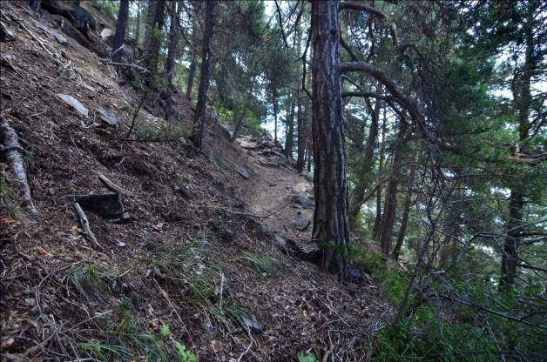
Morgex – Testa di Liconi
T <
ETP<
1350 m asl:
Calcisol
CaCO₃ in Bk
pH 8.6

Slide 9

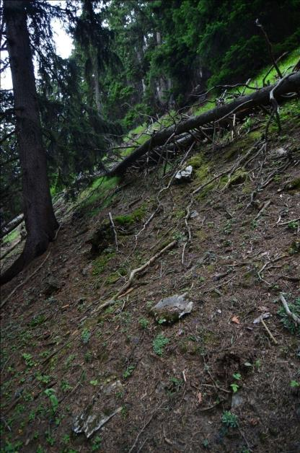
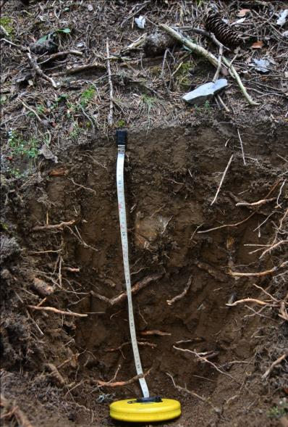

Morgex – Testa di Liconi
T <
ETP<
1800 m asl:
Cambisol
Dissolution of CaCO₃
pH 7.0
Mineral weathering

Slide 10

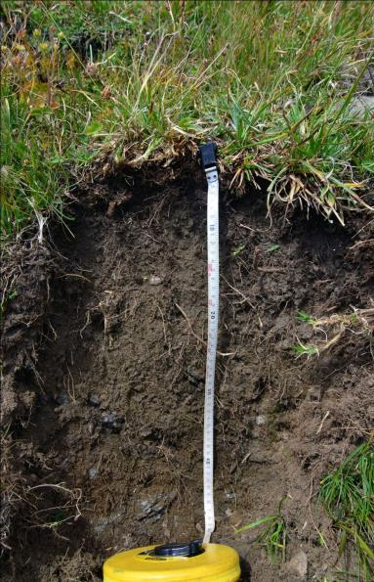

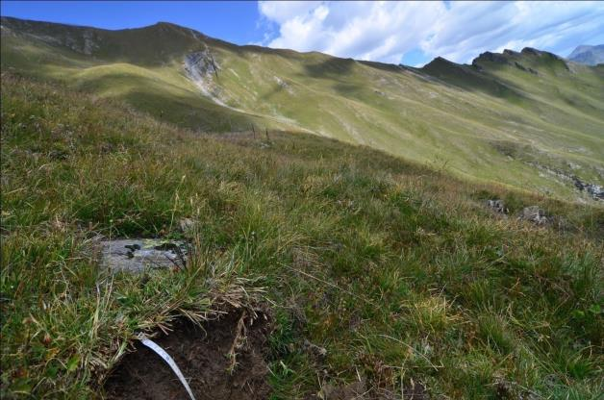
Morgex – Testa di Liconi
T <
ETP<
2400 m asl:
Phaeozem
Leaching process
pH 5.5
Organic matter input by the plants

Slide 11
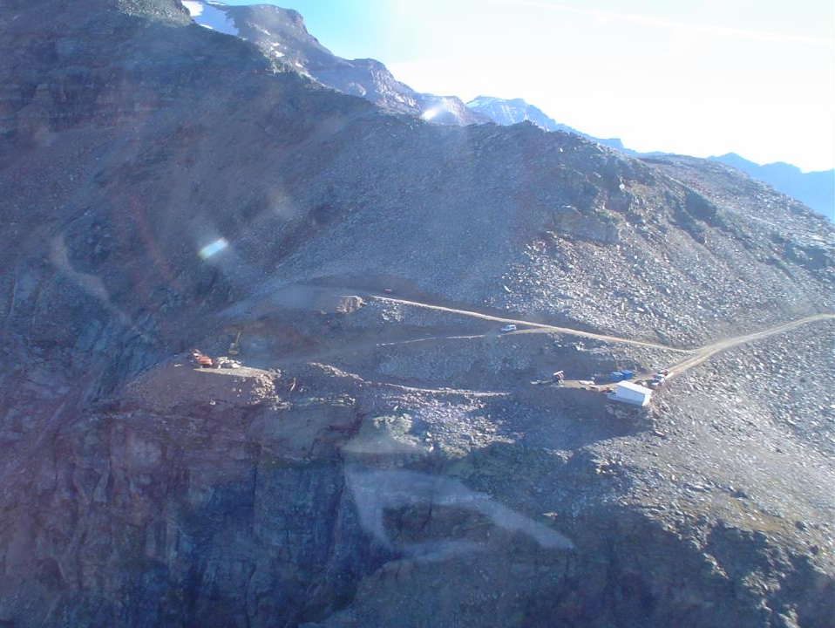
High-elevation permafrost regions
Passo Salati (AO), 2970 m slm
Permafrost: layer of soil or rock, at some depth beneath the surface, in which the
temperature has been continuously below 0 °C for at least 2 years.

Slide 12
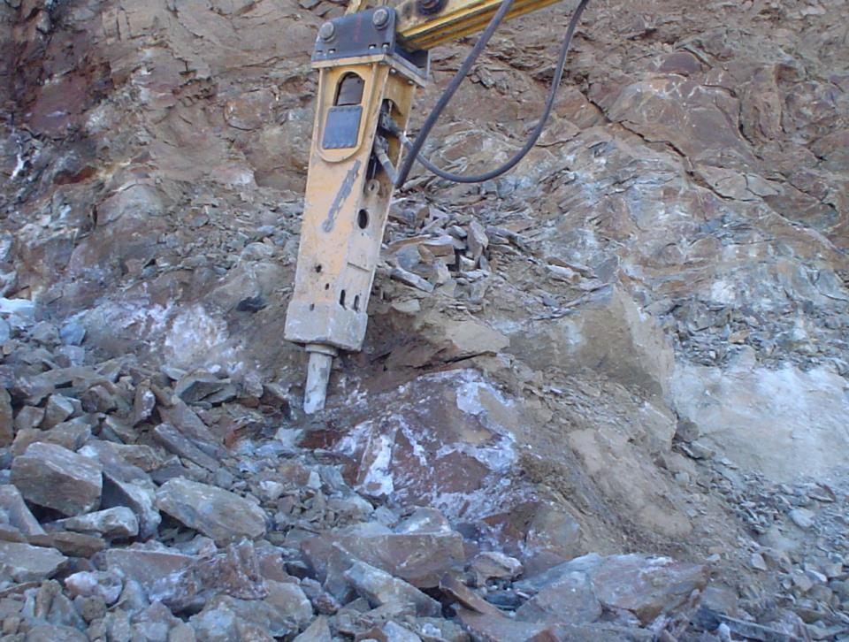
Passo Salati, 2970 m asl

Slide 13
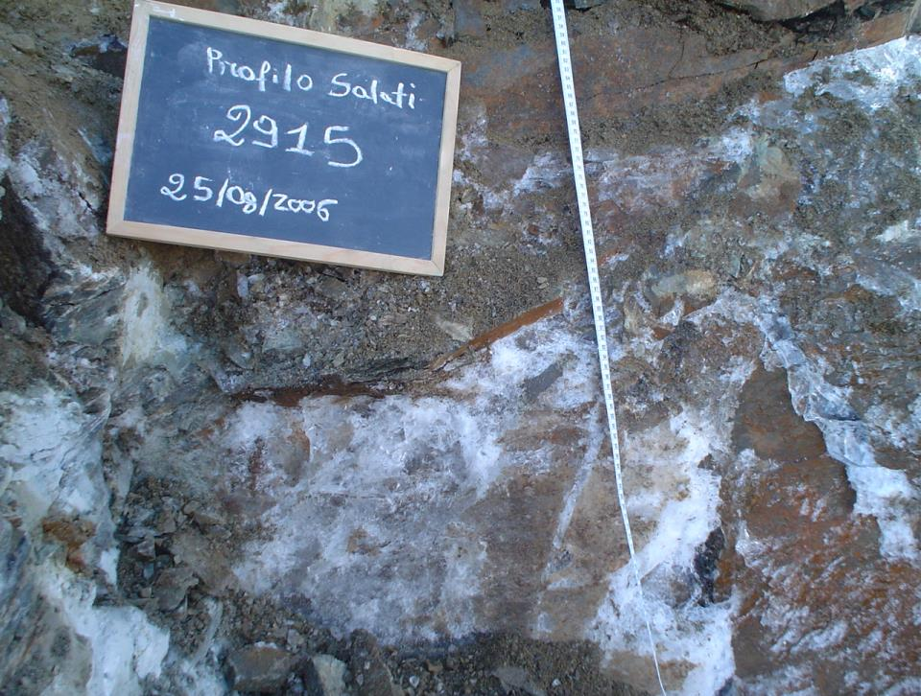
Passo Salati, 2970 m asl

Slide 14
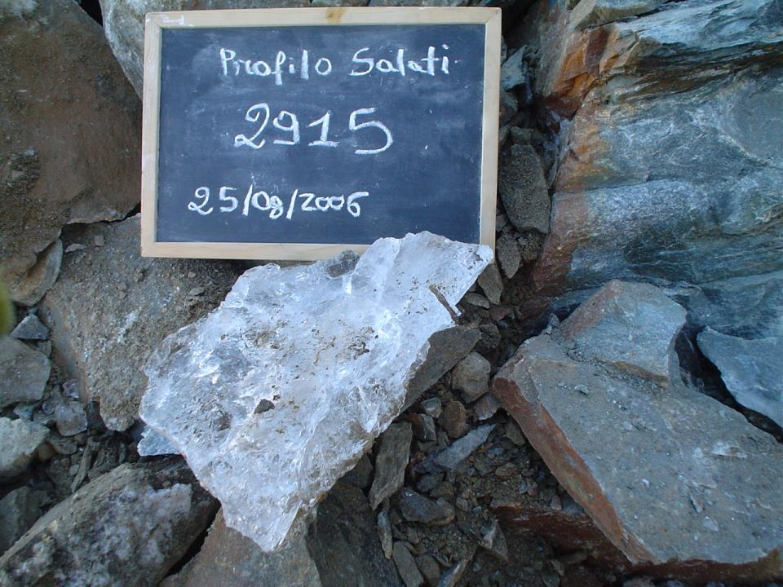
Passo Salati, 2970 m slm

Slide 15
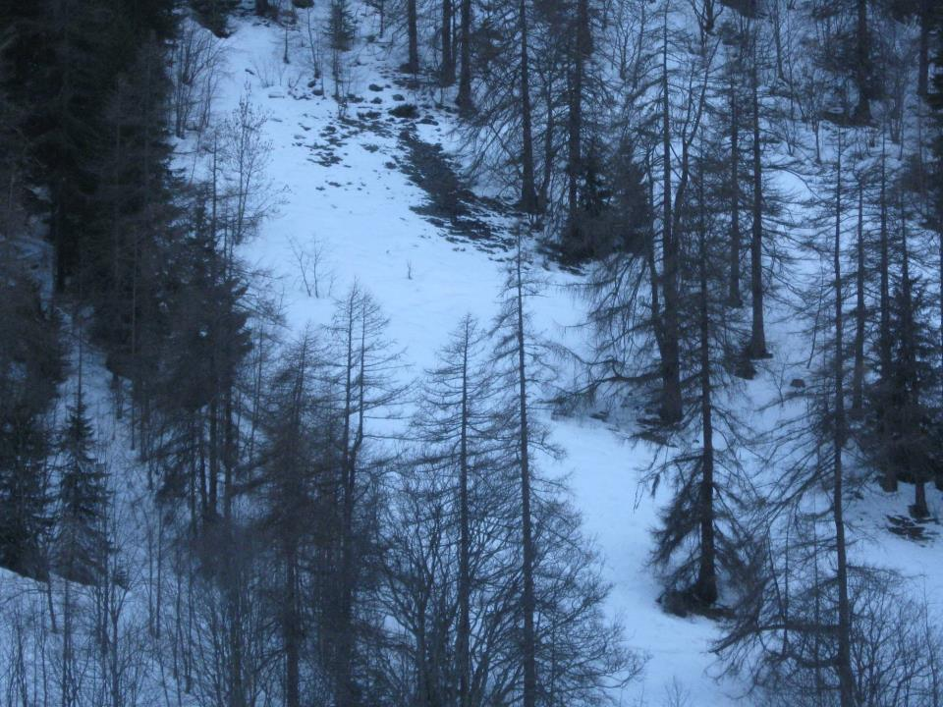
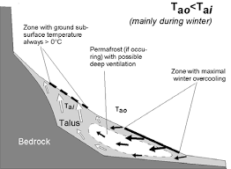
Low-elevation permafrost sites
1350 m ASL
ALTO
Chimney effect
BASSO

Slide 16
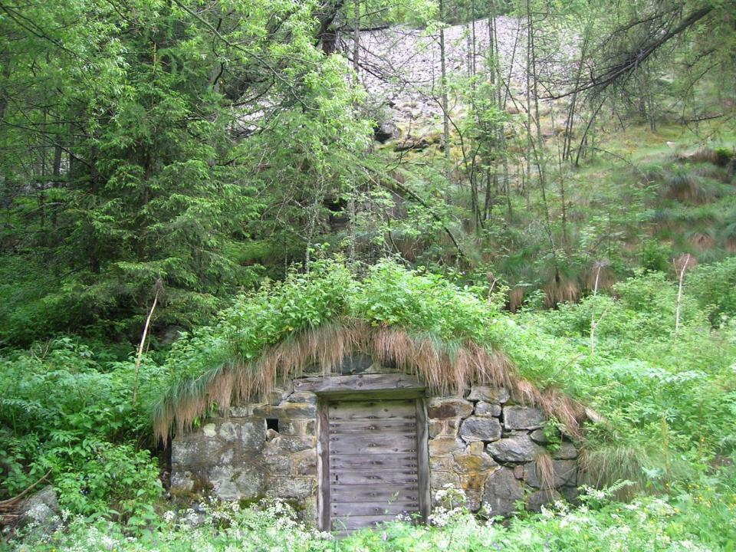
Gressoney Saint Jean, 1350 m slm
Cellars for curing and aging cheese

Slide 17
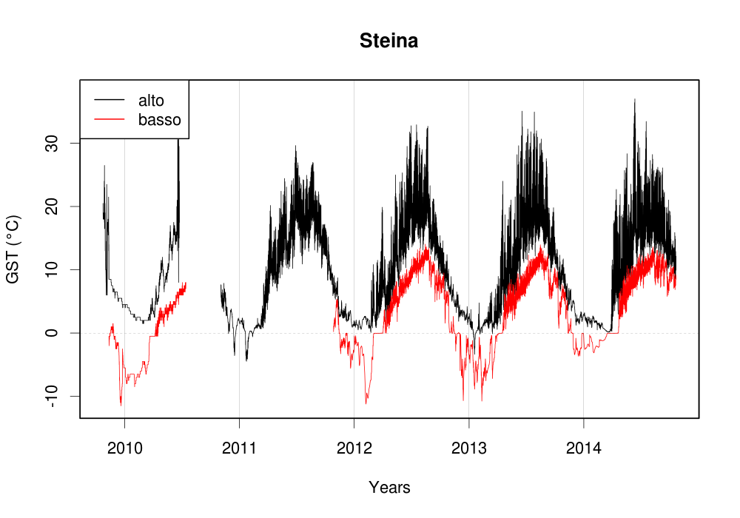
Soil temperature (10 cm depth)
Celi L., Rosso F., Freppaz M., Agnelli A., Zanini E. (2010) Soil Organic Matter Characteristics in Sporadic Permafrost-affected Environment (Creux du Van, Switzerland). Arctic Antarctic and Alpine Research. Vol. 42, n.1: 1-8.

Slide 18
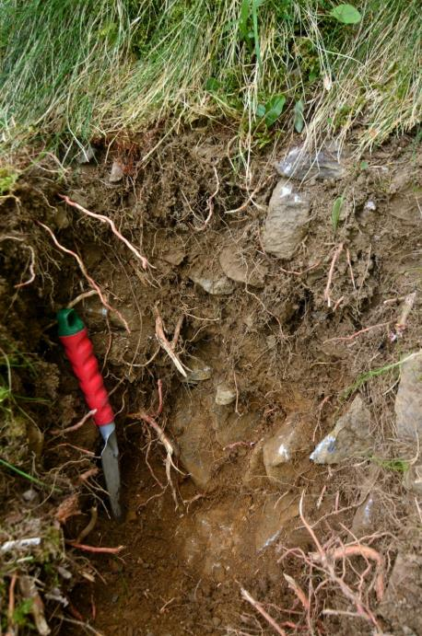
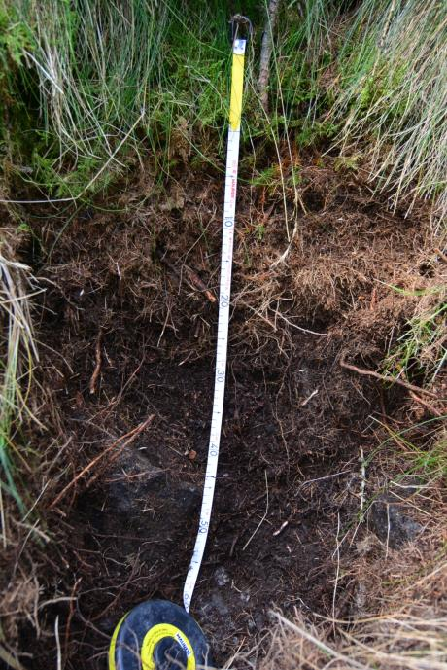
ALTO
BASSO

Slide 19
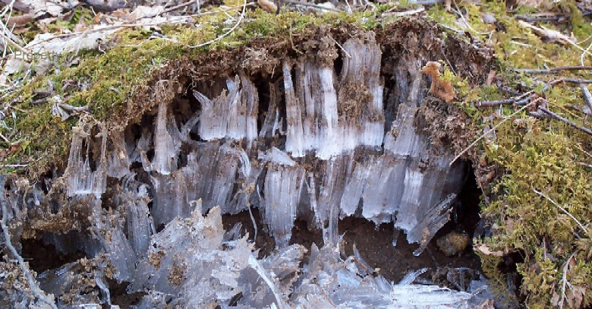
The presence of ice in the soil induces nice phenomena

Slide 20
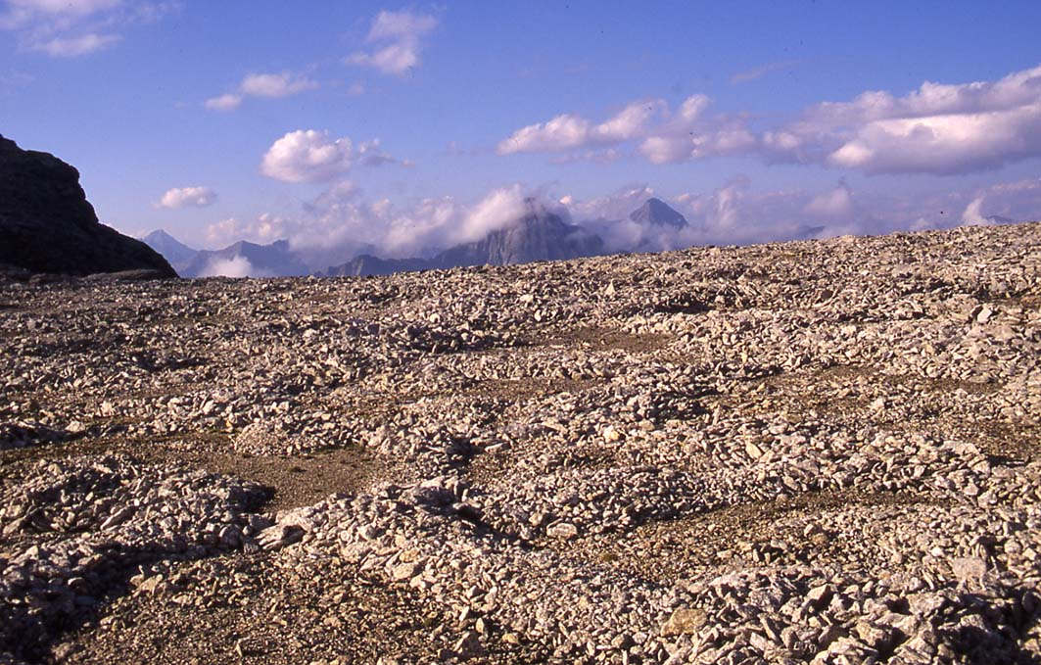

Parco Nazionale del Gran Paradiso, ~ 3000 m slm

Slide 21
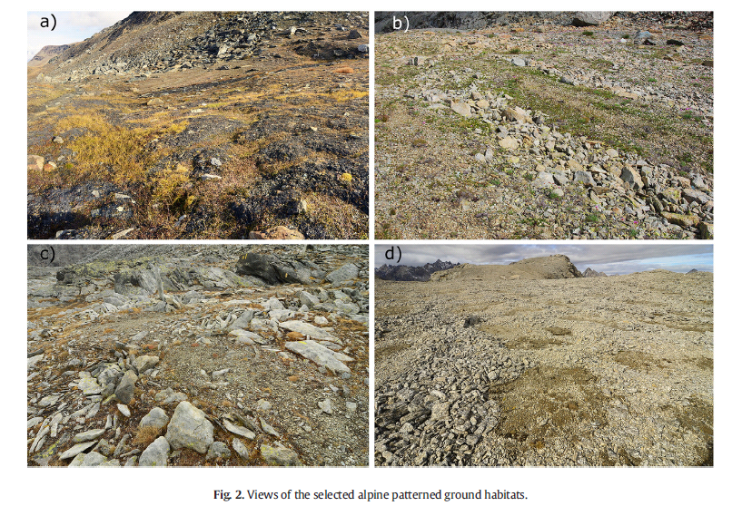
Patterned ground
Calcescisti CS
Gabbri GB
Gneiss GN
D’Amico M., Gorra R., Freppaz M. (2015) Small-scale variability of soil properties and soil–vegetation relationships n patterned ground on different lithologies (NW Italian Alps). Catena 135 (2015) 47–58
Mania I., D’Amico M., Freppaz M., Gorra R. (2016) Driving factors of soil microbial ecology in alpine, mid-latitude patterned grounds (NW Italian Alps). Biology and Fertility of Soils 52: 1135-1148,. doi:10.1007/s00374-016-1147-z.

Slide 22
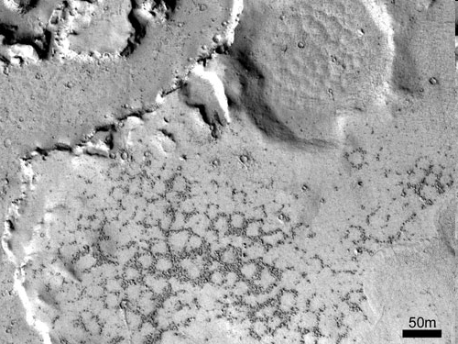

Mars, 05.13.08

Slide 23
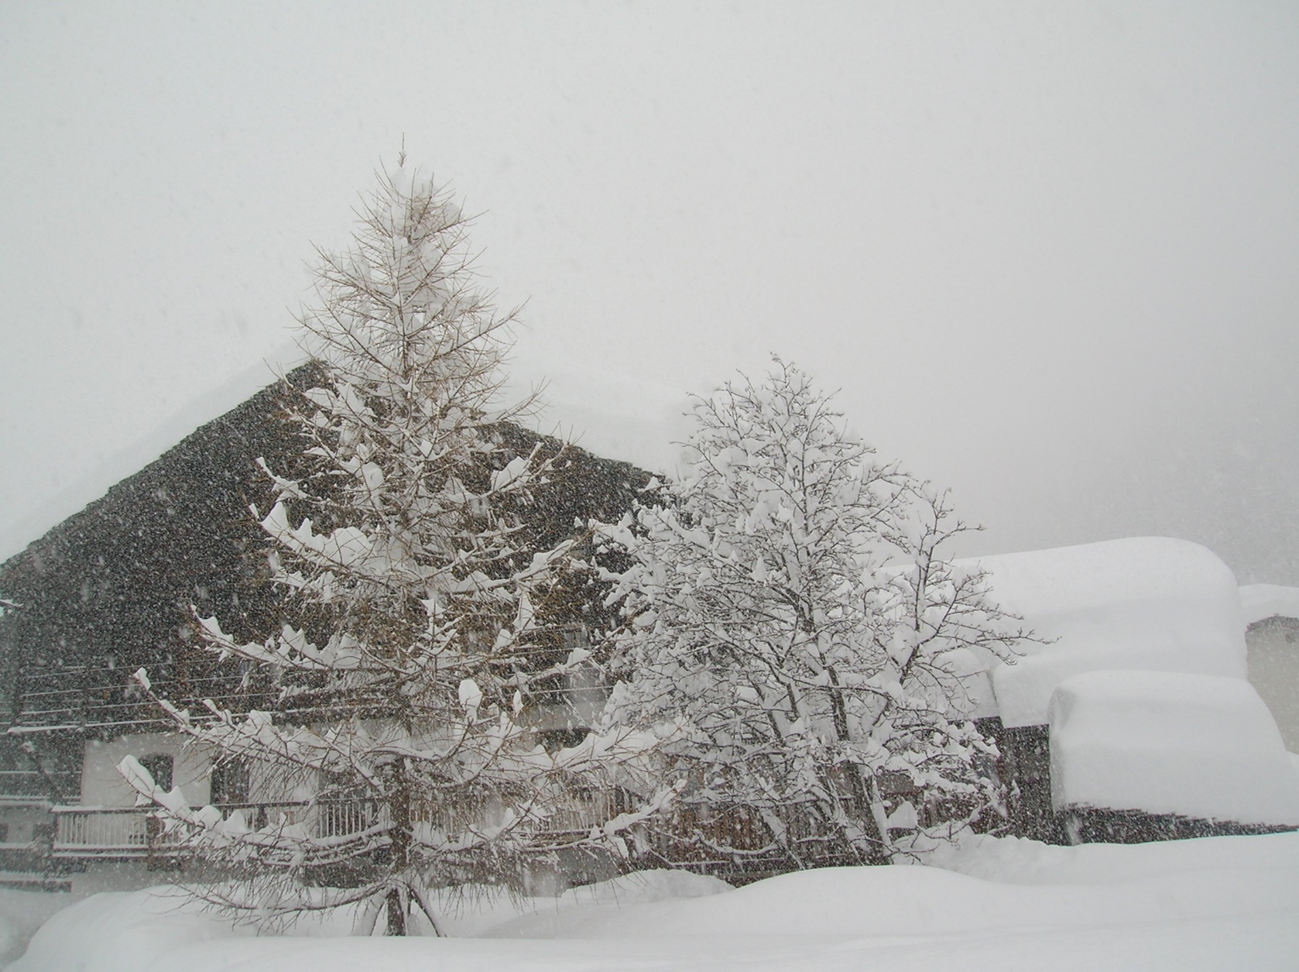
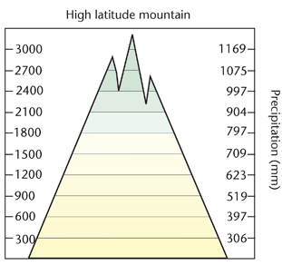

Climate: Seasonal snow cover
Gressoney La Trinité, March 1 2014

Slide 24
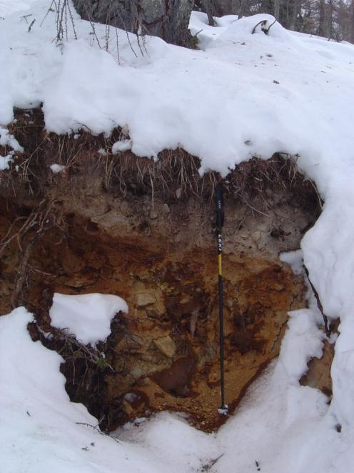
"The two domains, soil and snow, are obviously connected, and perhaps continuous, system" (Guymon GL, 1978).

Slide 25
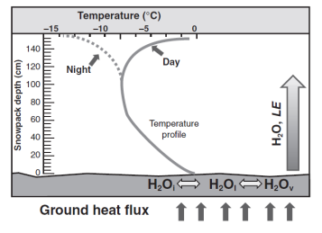
Seasonal snow cover

Slide 26
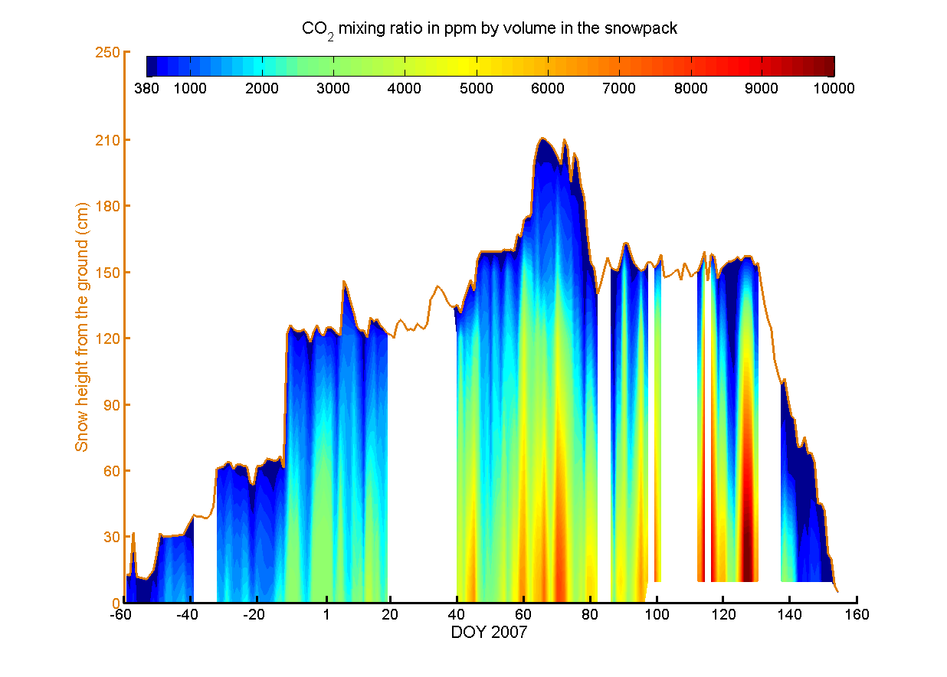
Seasonal snow cover and CO2 emissions
Liptzin et al., 2009

Slide 27
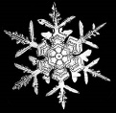

Snow cover under a changing climate

Slide 28
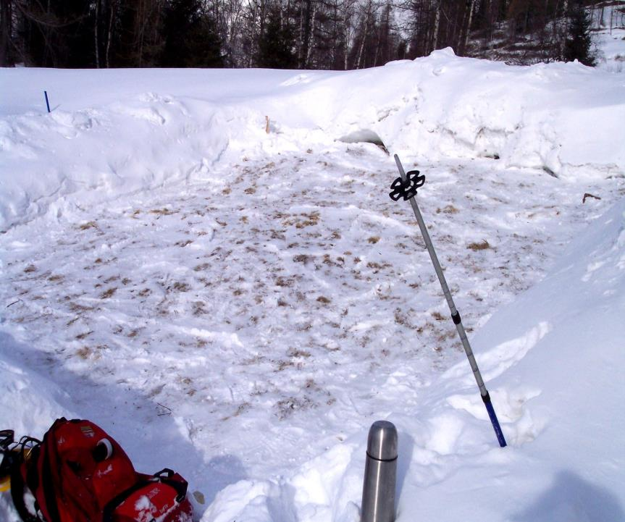
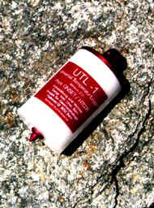
Snow depth manipulation

Slide 29
Soil temperature
1450 m slm
10
8
t with snow
6
t without snow
t air
4
2
°C
0
-2
-4
-6
-8
February 1-9, 2004
Freppaz M., Celi L., Marchelli M., Zanini E. (2008) Snow removal and its influence on temperature and N dynamics in alpine soils (Vallée d'Aoste - NW Italy). Journal of Plant Nutrition and Soil Science 171: 672-680.
Viglietti D., Freppaz M., Filippa G., Zanini E. (2013) Soil C and N response to changes in winter precipitation in a subalpine forest ecosystem, NW Italy. Hydrological Processes. (DOI: 10.1002/hyp.10008).

Slide 30
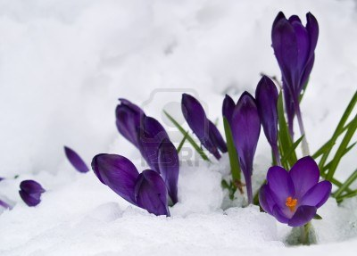
During the winter 2003-2004 our snow removal manipulation produced relatively mild freezing events (soil temperatures seldom decreased below –4°C) but the effects were significant during spring time…..

Slide 31
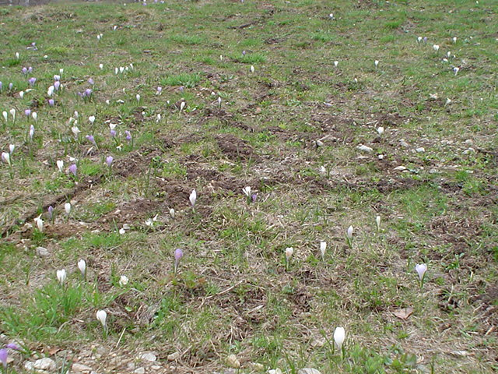
With snow

Slide 32
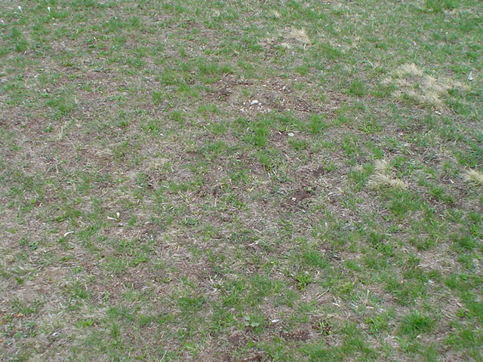
Without snow

Slide 33
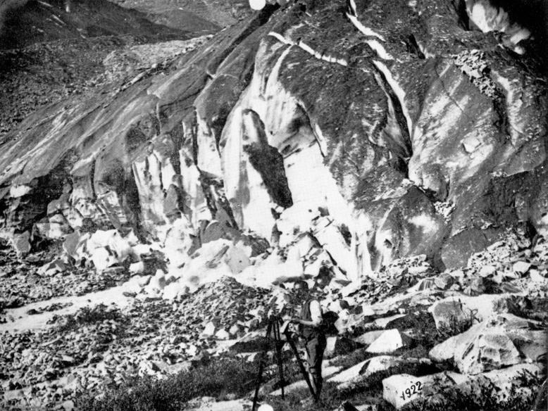
The Disappearing Cryosphere
1922

Slide 34
Lys Glacier
1891

Slide 35
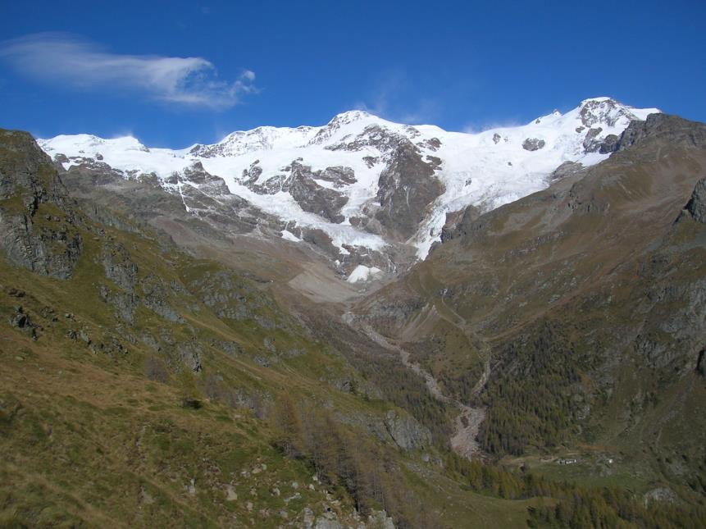
Lys Glacier
2014

Slide 36
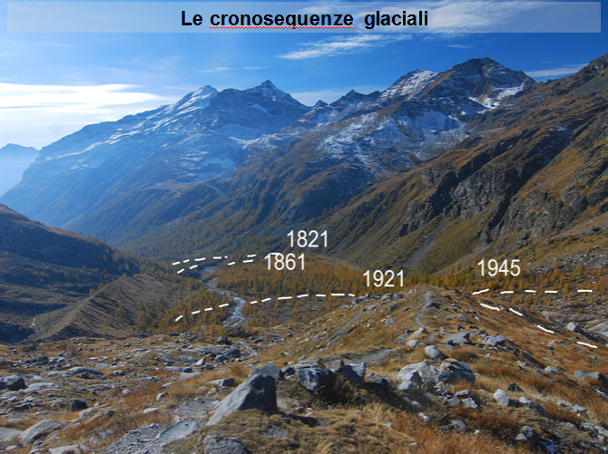
Glacial Chronosequence
D'Amico M. E., Freppaz M., Filippa G., Zanini E. (2014) Vegetation influence on soil formation rate in a proglacial chronosequence (Lys Glacier, NW Italian Alps). Catena 113: 122-137.

Slide 37
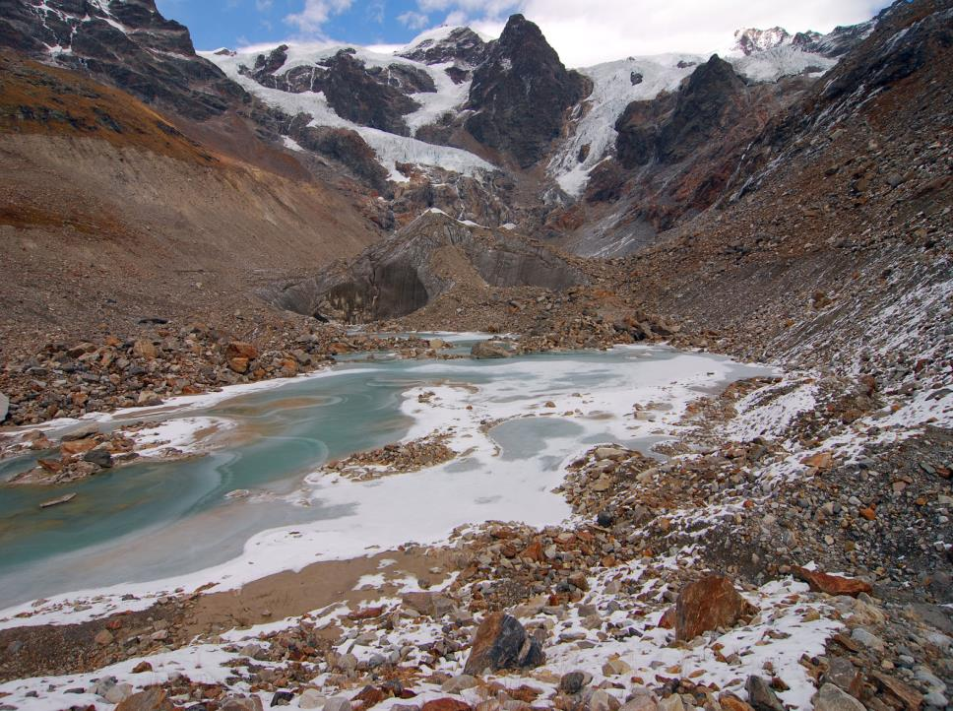
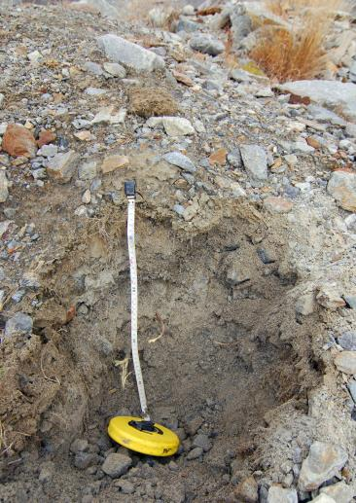
Glacial Chronosequence
2003: Haplic Regosol (Eutric, Skeletic)
Little plant cover (<5%)
Few pioneer species: Epilobietum fleischeri
2003

Slide 38
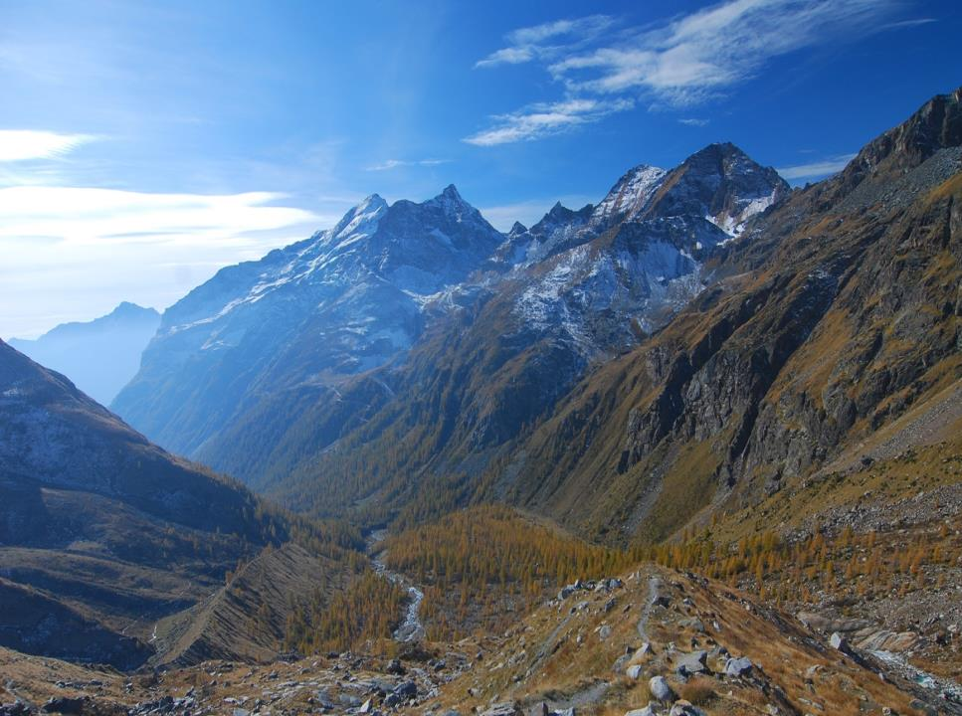
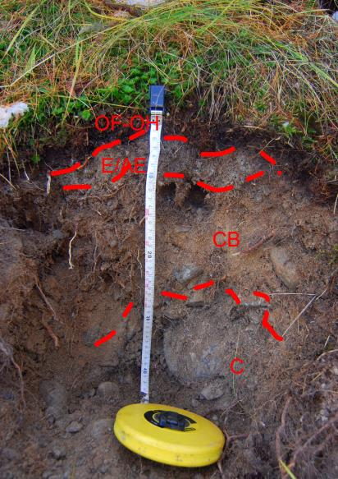
Glacial Chronosequence
1821: Entic Podzol
Starting of podzolization
Enrichment in organic matter

Slide 39
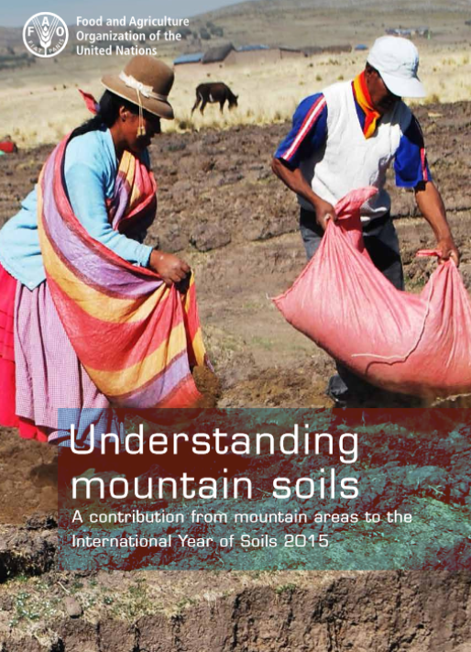
http://www.fao.org/3/a-i4704e.pdf
FAO. 2015.
Understanding Mountain Soils: A contribution from mountain areas to the International Year of
Soils 2015, by Romeo, R., Vita, A., Manuelli, S., Zanini, E., Freppaz, M. & Stanchi.

Slide 40
The soil forming factors
Man as the sixth factor of soil formation

Slide 41


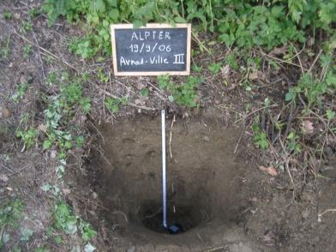
Soils of the terraced areas
Technic Cambisol (Escalic)
Stanchi S., Freppaz M., Agnelli A., Reinsch T., Zanini E. (2012) Properties, best management practices and conservation of terraced soils in Southern Europe (from Mediterranean areas to the Alps); a review. Quaternary International 265: 90-100.

Slide 42


Best practices
http://www.alpter.net/ALPTER-Project-final-publications.html?lang=en

Slide 43





Land reshaping for agricultural mechanization

Slide 44

Land reshaping for agricultural mechanization
Gaby (AO), 1000 m slm

Slide 45

Land reshaping for agricultural mechanization

Slide 46

New land uses: ski runs

Slide 47


Ski runs in Europe

Slide 48


Ski runs building
Archivio Monterosa Ski
Freppaz M., Lunardi S., Bonifacio E., Scalenghe R., Zanini E. (2002). Ski slopes and stability of soil aggregates. Advances in GeoEcology 35: 125-132. Catena Verlag, Germany.

Slide 49

Ski runs building
Archivio Monterosa Ski
Barni E., Freppaz M., Siniscalco C. (2007) Interactions between vegetation, roots and soil stability in restored high altitude ski runs on the Western Alps, Italy. Arctic Antarctic and Alpine Research 39, n.1: 25-33.

Slide 50


Ski runs building
Archivio Monterosa Ski
Barni E., Freppaz M., Siniscalco C. (2007) Interactions between vegetation, roots and soil stability in restored high altitude ski runs on the Western Alps, Italy. Arctic Antarctic and Alpine Research 39, n.1: 25-33.

Slide 51


Ski runs management

Slide 52

Impact of skiing on mountain environments
http://ebooks.benthamscience.com/book/9781608054886/

Slide 53

At the moment, only a few EU Member States have specific legislation on soil protection. Soil is not subject to a comprehensive and coherent set of rules in the Union.
Existing EU policies in areas such as agriculture, water, waste, chemicals, and prevention of industrial pollution do indirectly contribute to the protection of soils. But as these policies have other aims and scope of action, they are not sufficient to ensure an adequate level of protection for all soils in Europe.

Slide 54


The Alpine Space

Slide 55




Slide 56


The diversity of soils, which is typical of the Alpine region, and its characteristic locations shall be preserved and promoted.

Slide 57


http://www.alpine-space.eu/projects/links4soils/en/home

Slide 58

Grazie per l’attenzione
michele.freppaz@unito.it

