Slide 1

Soil erosion in mountain areas: facts, issues, and perspectives

Slide 2
Caring for Soil – Where Our Roots Grow
Outline:
->Definitions (focus on water erosion)
->Facts/examples
->Modelling
->Impact at different scales
->Costs
->Examples and mitigation
IPROMO 2017 – Ormea, 8/7/17

Slide 3
Let’s talk about soil….
https://www.bing.com/videos/search?q=lets+talk+about+soil&qpvt=lets+talk+about+soil&view=detail&mid=2F4B8D8404AD4AE7A4B52F4B8D8404AD4AE7A4B5&FORM=VRDGAR
-> 10 cm of soils are created in 2000 years
->13 000 000 ha forests cut every year
->24 billions tons of fertile soil lost in 2011 alone
-> ca 3 tons per person !
->erosion costs each person 70 USD per year
->Europe : every year a surface as large as the cuty of Berlin is transformed into urban
areas

Slide 4
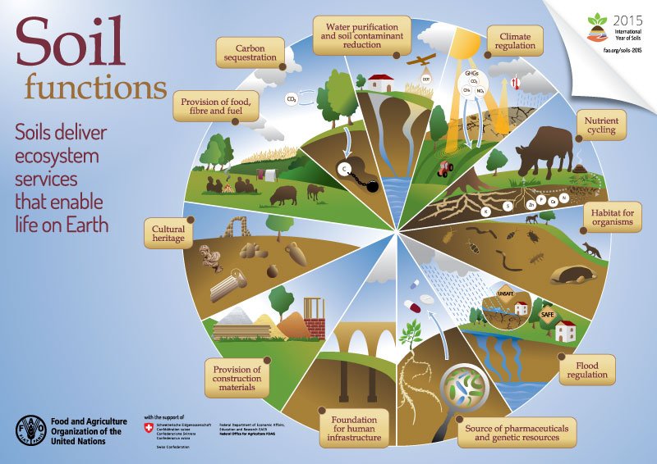
Soils and their functions

Slide 5
Soils and ecosystem services
Supporting
Primary production, nutrients cycling,
soil formation
Provisioning
Timber, raw materials, fuel, water,
habitat & gene pool, surface stability
Water supply and quality, C sink, climate regulation, flood control, erosion control
Regulating
Cultural
Heritage, aesthetic value, recreational

Slide 6
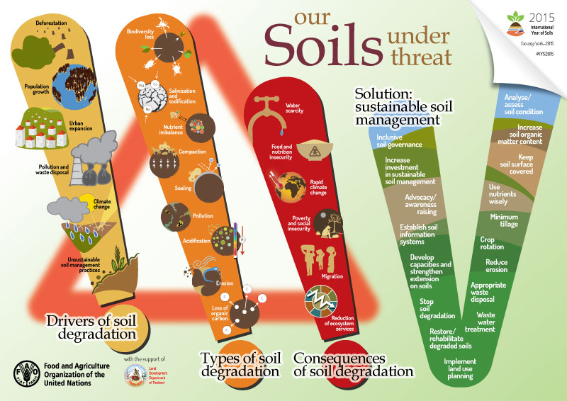
Soil threaths

Slide 7
Defining soil erosion
Water erosion:
->erosion mechanisms: 1) detachment of soil particles by rainfall or runoff abrasion 2) transport by overland water flow 3) deposition
->3 main processes: rainsplash, rainwash, rillwash
->Consequence: soil redistribution
-> Soil erosion is selective process

Slide 8
Erosion types
Splash erosion: raindrop kinetic energy can cause topsoil aggregate breakdown
Related with: vegetation cover, tillage, manuring…
Sheet erosion: water runoff removes a uniform layer of topsoil (difficult to see as water is not channeled)
Rill erosion: channels (rills) a few cm deep (not visible any more after tillage)
Gully erosion: deep channels (dm-m)
Stream bank erosion

Slide 9
FAO’s definition
Soil Erosion is a common term that is often confused with soil degradation as a whole, but in fact refers only to absolute soil losses in terms of topsoil and nutrients. This is indeed the most visible effect of soil degradation, but does not cover all of its aspects. Soil erosion is a natural process in mountainous areas, but is often made much worse by poor management practices.
http://www.fao.org/soils-portal/soil-degradation-restoration/en/

Slide 10
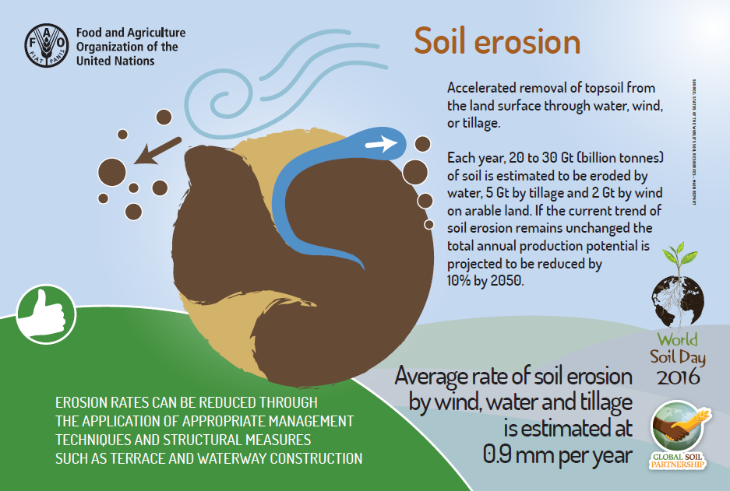
FAO’s perspective

Slide 11
Some facts
-> Soil erosion is a natural process, occurring over geological time, and indeed it is a process that is essential for soil formation in the first place (landscape dynamics, landmarks)
->main concern = accelerated erosion, often induced by human activity
->soil erosion is a widespread problem (in Europe, but not only)
->most dominant effect is topsoil loss, often not conspicuous but still very damaging
Grimm et al., 2002
Grimm et al., 2002 – JRC report

Slide 12
Some facts
->physical factors related to erosion: climate, topography, soil properties (e.g. Mediterranean: steep slope + highly erosive rainfall + fragile soils)
->with a very slow ratio of soil formation, even 1 t ha⁻¹ y⁻¹ soil loss can become irreversible in 50-100 y
->in Europe, losses of 20-40 t ha⁻¹ in individual storms are recorded regularly (every 2-3 y). Extreme events can produce >100 t ha⁻¹ losses
->main causes: inappropriate agricultural management, grazing, deforestation, construction
Grimm et al., 2002 – JRC report

Slide 13
Some facts
->erosion control requires erosion assessment, i.e. identifying vulnerable areas
->runoff control is crucial to mitigate erosion
->erosion estimation models are many
->erosion modelling is fundamental, but requires validation (Grimm et al., 2002 – JRC report)
->Soil protection requires a multi-disciplinary, cross-sectoral approach

Slide 14
Erosion at different scales
Nearing et al, 2017:
Erosion studies span from the raindrop spatial scale to
continental scales
«The erosion topic covers a lot of ground»

Slide 15
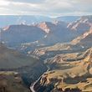
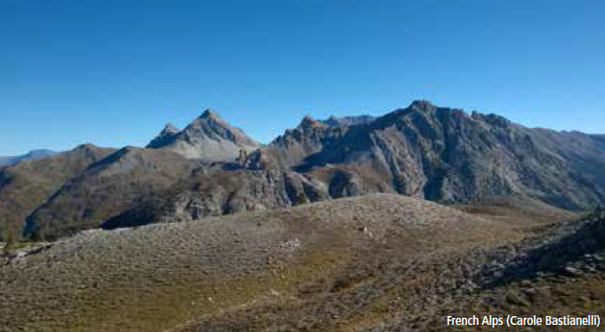
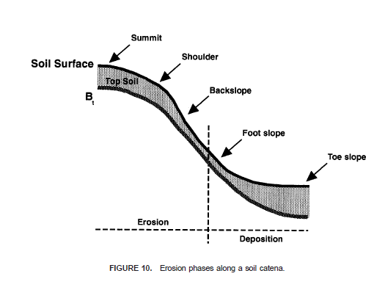
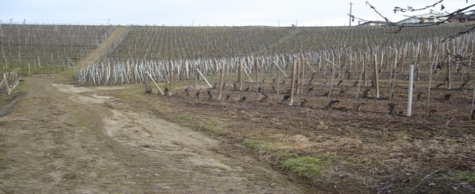
Erosion at different scales
GLOBAL/
CONTINENTAL
WWW.WIKIPEDIA.COM
REGIONAL/
WATERSHED
FAO
FARM/PLOT
pH: Sergio Belmonte

Slide 16
Eroded land in the world
Pimentel (1993) Lal (1994) Speth (1994) stated that at present ~80% of the world’s agricultural land suffers moderate to severe erosion, 10% slight erosion. Worldwide, erosion on cropland averages about 30 t ha⁻¹yr⁻¹ and ranges from 0.5 to 400 t ha⁻¹yr⁻¹ (Pimentel et al., 1995).
Consequence: abandonment of large surfaces of arable land, displacement of farmers, food insecurity

Slide 17
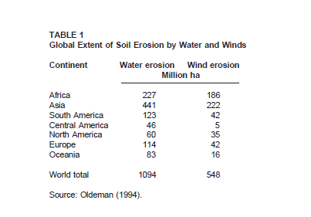
Surfaces affected by soil erosion
Morgan (2005) reported soil erosion rates in agricultural areas -100fold
With respect to natural soils

Slide 18
Erosion in mountain areas
Typical features of mountain environments that make them even more sensitive
to erosion processes (with respect to lowlands):
->limited soil development, shallow soils, scarce organic matter
->harsh climate (e.g. winter erosion processes, freeze-thaw cycles, snow-melting)
->steep slopes, complex topography
-> need for specific modelling techniques
->once erosion has started, it’s very difficult to stop the process
->revegetation takes longer time in mountain area
->erosion mitigation requires more efforts (e.g. terracing)
Potential mitigation aspects:
->very high infiltration (i.e. limited runoff)
->high surface stoniness (mulching effect vs. splash)

Slide 19
Re-defining water erosion in mountain areas
Traditional definition
(sensu-stricto): detachment of soil particles by water followed by transport and deposition
Recent definition for mountain areas (broader meaning): it includes several types of topsoil degradation
A world-wide hazard

Slide 20
Relevance of erosion in mountains
Relevance of soil degradation in mountain environments (JRC, 2010, 2015).
Erosion estimates and assessment in the Alps are priorities, as mountains soils are intrinsically vulnerable. Soil profiles may be truncated and hazards triggered.
Weaknesses and poorly investigated issues:
-models designed for severe slopes with seasonal
snowcower are scarce
-validations are sparse (e.g. Stanchi et al., 2014, Winter Factor, W)
Meusburger, 2010
Meusburger (2010) ->
a broader definition of soil erosion, including all forms of topsoil degradation (debris flows, shallow landslides, rill, interrill, gully erosion)

Slide 21
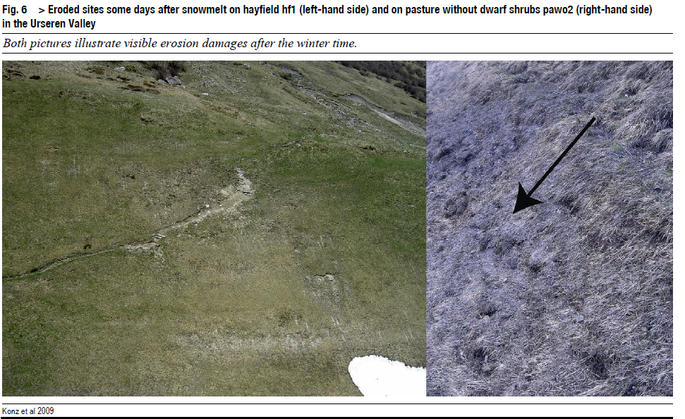
Winter erosion

Slide 22
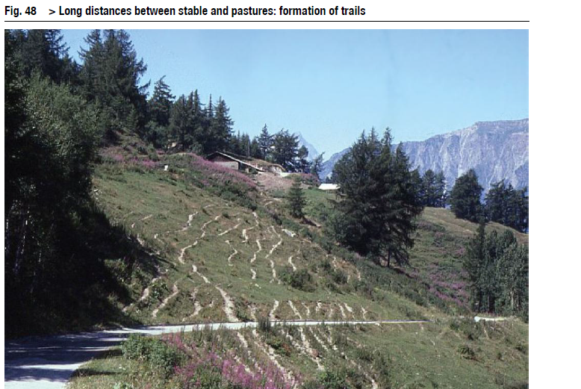
Erosion and grazing

Slide 23
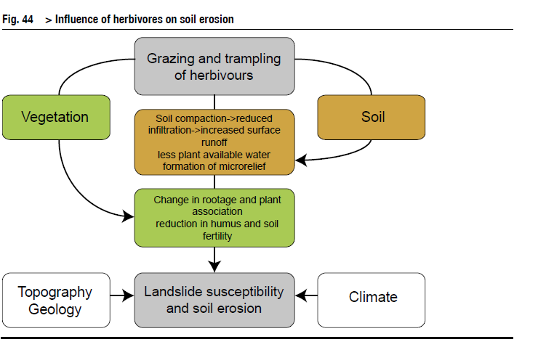
Why do we need a cross-sectoral approach?

Slide 24
The concept of tolerable erosion
-> Erosion is a natural process
->The issue is accelerated erosion…but…
What is the tolerable rate of erosion? Please give examples---
Soil erosion > soil formation rate = hazard = irreversible process
Determining soil formation rate is not easy and the rates may vary greatly in space and time

Slide 25
Soil forming factors
The rate of soil formation is still poorly understood due to its huge variability and to the complex interaction among soil forming factors (e.g. climate, parent material….)
CL
O
R
P
T
SOIL

Slide 26
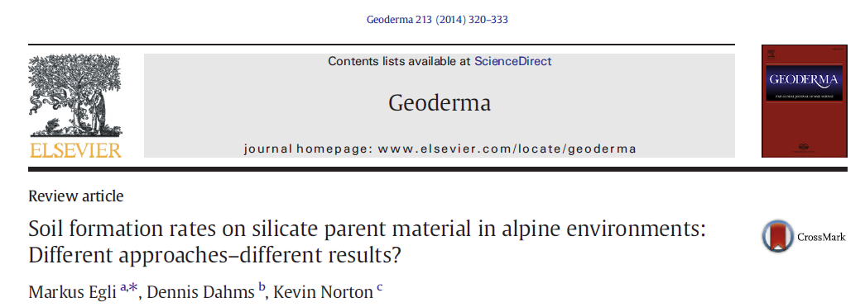
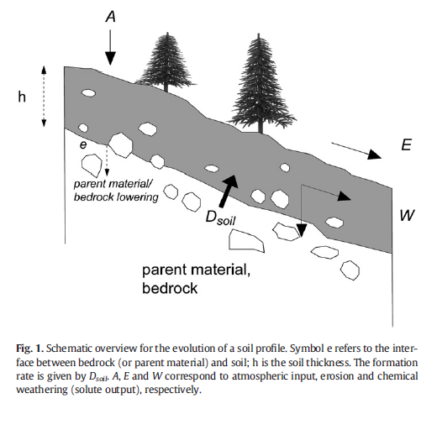
The challenge of soil formation rates
PROGRESSIVE PEDOGENESIS
-promotes differentiation
-horizonization
-leaching
-soil deepening
REGRESSIVE PEDOGENESIS
-rejuvenation
-retardant upbuilding/ burying
-truncation/erosion
vs.

Slide 27
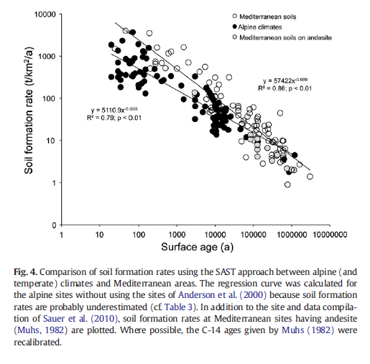
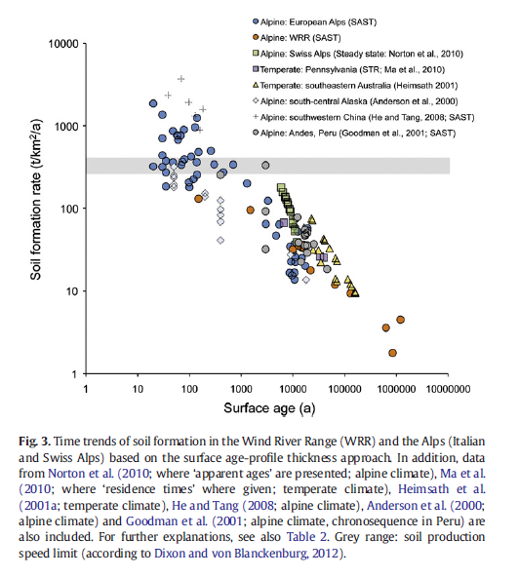

The challenge of soil formation rates

Slide 28
Soil formation rate vs. erosion rate
Literature data
Source | Soil formation rates | Soil erosion rates | Country
Vogel, 1990 | nd | 1-3 cm y⁻¹ | Yemen*
Huang et al., 2013 | 0.95 ± 0.69 t ha⁻ ¹ yr⁻ ¹ 0.066 ± 0.048 mm yr⁻ ¹ | nd | China, granite
Wakatsuki et al., 1993 | 0.66 t ha⁻ ¹ yr⁻ ¹ | nd | World
* Plus terraces collapsing

Slide 29
Accelerated erosion
3 mm soil y⁻¹, in an Entisol, 30 cm deep , may determine a total loss of productivity in 50 y.
1 cm soil y⁻¹ on loess or alluvial deposits, 50 m thick may be negligible for 500 y (Giordano, 2002).

Slide 30
Accelerated erosion

Slide 31
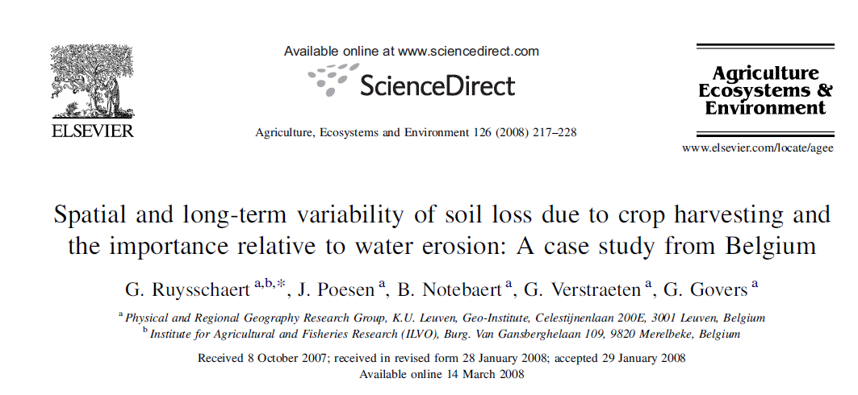
Maybe you didn’t know that…
But also…. SLCH (soil loss due to crop harvesting)
->Sugar beet (Beta Vulgaris L.), leek (Allium porrum L.), potato, carrot
->often neglected BUT relevant
->0.4 t ha⁻¹ y⁻¹ (1846) → 2.4 t ha⁻¹ y⁻¹ (1980’s) estimated for Belgium
->effect of mechanization and increased crop yelds
-> since 1846 more than 163 million tons of soil lost by SLCH in Belgium (estimated), i.e.
an average soil profile truncation of 1.15 cm
->ca 54 % of the sediment export in Flanders was due to water erosion processes
->of this amount, between 38% and 94% came from SLCH

Slide 32
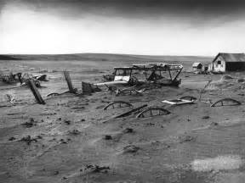
When did erosion awareness started?
www.billdamon.com
Awareness <-> environmental disasters

Slide 33
Awareness on soil erosion
-> China, Mediterranean….not only: local populations have been coping with soil erosion for millennia
->USA: soil conservation movement (1920-30)
->Western Europe: -1970s
- STS (Soil Thematic Strategy - (COM(2006) 231):
soil erosion is one of the SOIL THREATS that can compromise soil functions
(Morgan, 2005)

Slide 34
Awareness on soil erosion
The three components of soil awareness (and thus, also erosion awareness)
-> Knowledge (of soils, the problem, hazards and possible mitigation)
-> Attitude (ethics, feelings…)
-> Behavior (as direct / indirect actors on soils)
(From Miehlich, 2008)

Slide 35
Effects of soil erosion
On-site
EFFECTS
Off-site
IMPACTS
Economic
Environmental

Slide 36
On-site and off-site effects of soil erosion
On-site | Off-site
Organic matter loss | Floods
Degradation of soil structure | Water pollution
Reduced infiltration | Sediment accumulation in rivers and on land
Reduced recharge of the water table | Impacts on fishery resources and river/lake habitats
Nutrients loss | Eutrophication
Plant uprooting | Reduction of land value
Productivity loss | Land abandonment and effects on food security
Drought vulnerability
+ hidden costs: additional fertilizers need ed to compensate the loss of fertility…

Slide 37
Direct effects of soil erosion
Reduced rooting depth
Nutrient/water imbalance
Nutrient deficit in subsoil after topsoil removal
Unfavorable soil temperature regime
Loss of nutrients
Nutrients removal
Unfavorable soil pH and limited rooting depth
Loss of plant available water
Drought stress
Need for more irrigation
Loss of land and production
Permanent soil displacement (e.g. gullies)
Unfavorable conditions in deposition areas
Washing away of seeds and seedlings/burial of seeds/seedlings
From Morgan, 2005

Slide 38
Indirect effects of soil erosion (I)
Costs for fertilizers
Fertilizeers needed due to nutrients loss
Amendants needed for pH correction
Supplemental irrigation
Additional costs for water
Additional costs for irrigation facilities
Loss of agrochemicals
Need for additional agrochemicals/pesticides
Potential yeld reductions due to pests spread
Enhanced soil variability
Uneven soil fertility due to nutrients and fertilizers loss by runoff
Uneven soil esposition and highly variable soil depth
High spatial variability of available water
From Morgan, 2005

Slide 39
Indirect effects of soil erosion (II)
Time of sowing
Late sowing resulting in yeld reduction
Uneven crop maturity due to enhanced soil variability
Replanting
Direct costs of seeds
Additional costs machinaries, work, irrigation, fertilizers etc.
Machinery costs
Extra costs for replanting
Costs due to exposure of gravelly/stoney subsoil
Repair costs
Damages to machineries
Extra maintenance of irrigation, soil conservation and drainage structures
Maintenance of roads, waterways, bridges…
From Morgan, 2005

Slide 40
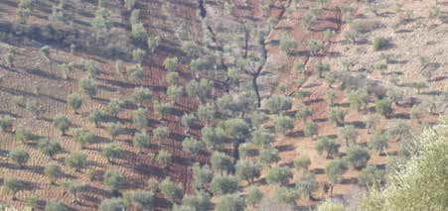
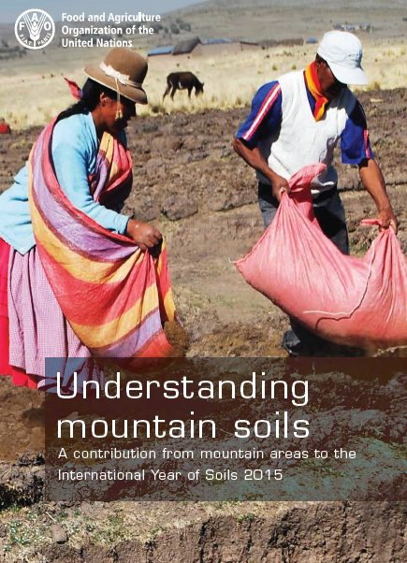
Effects of soil erosion
->Effects of soil erosion
->Relevance of upstream farmers practices
->Long term benefits from soil and water conservation
measures
->Improvement of Ecosystem Services

Slide 41
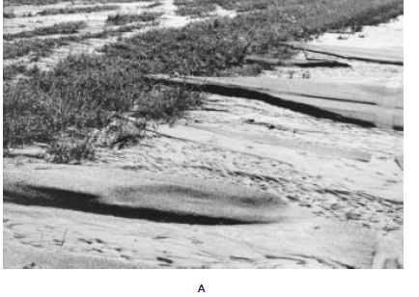
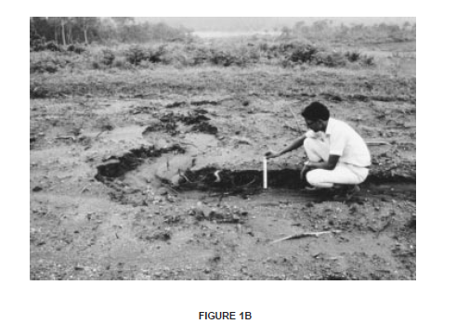
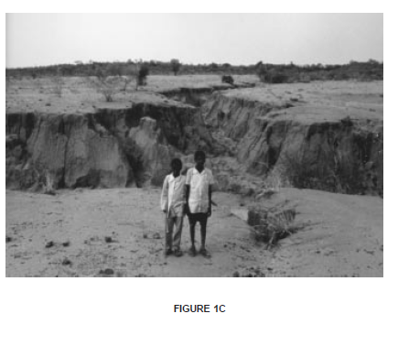
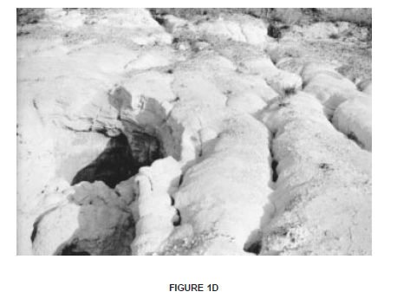
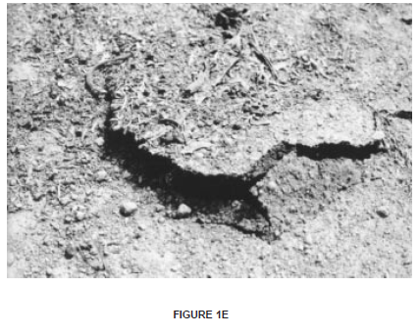

Effects of soil erosion
Lal, 2010

Slide 42
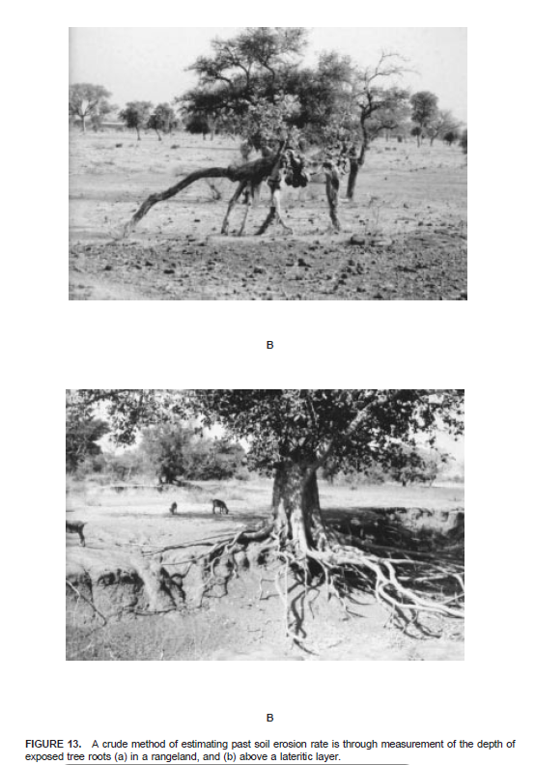
Erosion modelling

Slide 43
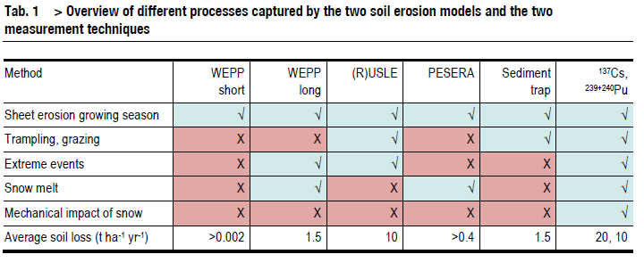
Erosion modelling
Several methods exist, each of them with advantages and limitations

Slide 44
Soil erosion costs
Estimates of soil erosion costs are therefore difficult and complex because the on-site effects are often compensated by the use of increased amounts of fertilizers that mask the productivity losses, and because the cost of environmental goods and services depends very much on the point of view of the different stakeholders (FAO).

Slide 45
Soil erosion costs: some data
USA: total costs are in the range 30-40 billion $/y (Uri & Lewis, 1998; Pimentel et al., 1993)
Indonesia (Java): US$ 400 million/y (Magrath & Arens, 1989)
UK: £ 90 million/y (Env. Agency, 2002).
Data from Morgan, 2005
Mexico (2 scenarios): from US$ 39.7 to US$ 79.4 ha^{–1} (Cotler & Martinez-Trinidad, 2010)
MALI: average annual yield penalties between 2 and 10 percent
(Source: World Bank)
Crosson (Journal of Environmental Economics, 2007) estimated the loss in farm income in the USA per year at 100 million US$. (source: FAO)

Slide 46
Soil erosion costs: some data
Stocking, 1986 (in Morgan, 2005): in Zimbabwe, a cost of US$ 1500 million per year would compensate the decline of soil fertility.
This is an extreme example of hidden cost, affecting food production, food security and
Resulting in a decline in land value on the middle-long term.

Slide 47
Soil erosion and CC
Recent projections of climate scenarios (Schroter et al., 2005) indicated that in Europe, mountains will be the most vulnerable areas to erosion.
IPCC, 2007: increase of intense storms and flash-floods is expected, with potential impacts on runoff, sediment yield, and natural hazard.
Lal (1995): Soil erosion contributes significantly to CC, and CO₂ release into atmosphere enhances the greenhouse effect.

Slide 48
Soil erosion and CC: effects
->Changes in extent, frequency and magnitude
of soil erosion in a number of ways (Pruski and Nearing, 2002; Mullan, 2013).
->Changes in rainfall patterns
->Changes in rainfall erosivity (erosion capacity of rain)
->Land use and land cover changes (may determine increased or decreased erosion depending on soil cover and management)

Slide 49
Soil erosion and CC
Morgan, 2005: “Erosion control is a necessity in almost every country of the world under virtually every type of land use. Further, eroded soils may loose 75–80 per cent of their carbon content, with consequent emission of carbon to the atmosphere. Erosion control has the potential to sequester carbon as well as restoring degraded soils and improving water quality.”

Slide 50
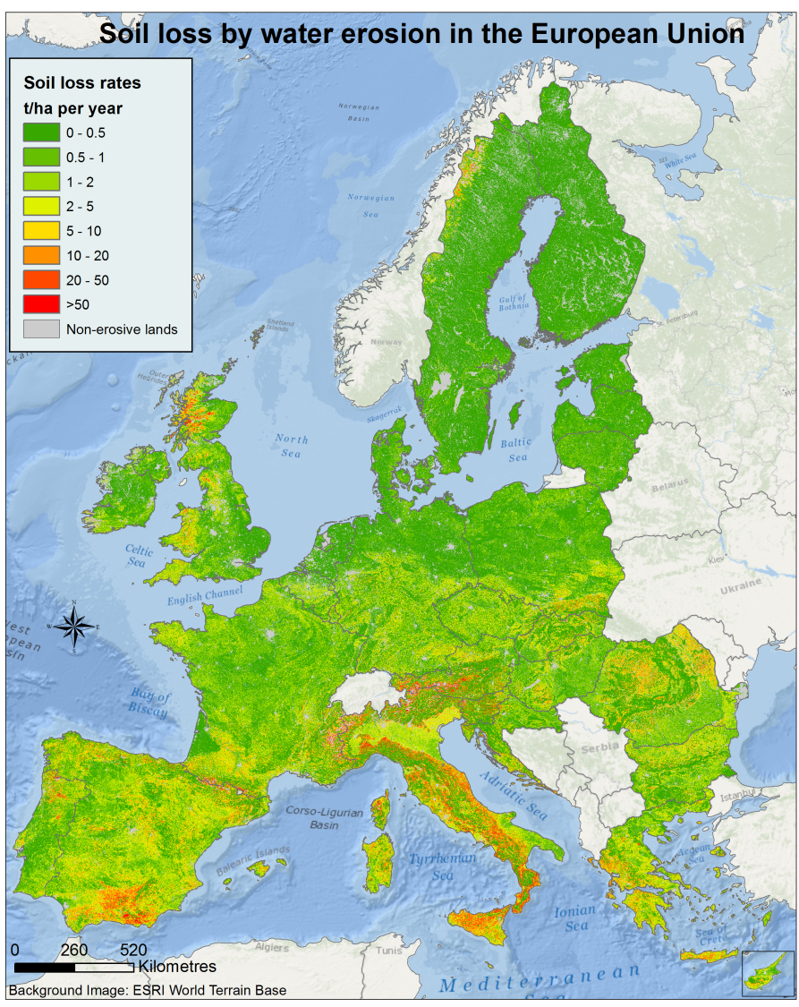
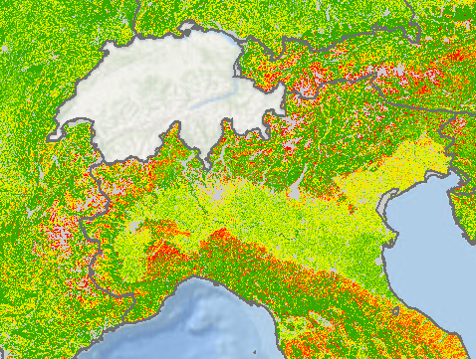
Examples of estimates
http://esdac.jrc.ec.europa.eu/public_path/RUSLE2015_news.png

Slide 51
Erosion estimation in mountain areas - radionuclides
Radionuclides (e.g. ¹³⁷Cs) provides soil redistribution budgets after Chernobyl accident (1986) in the areas affected by radioactive fallout
Cs is strongly associated with fine soil particles, therefore present-day Cs distribution may evidence erosion and deposition processes (i.e. soil redistribution patterns).

Slide 52
Winter factor
Radionuclides estimates provided useful insights on winter erosion
-> a correction factor was proposed (W-winter factor) in order to include winter erosion processes in RUSLE model

Slide 53
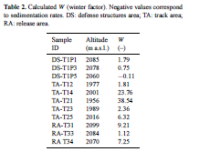
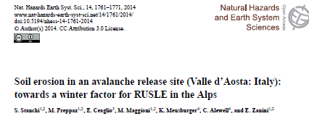
Winter factor

Slide 54
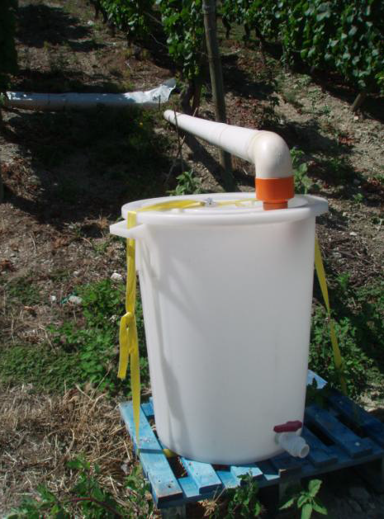
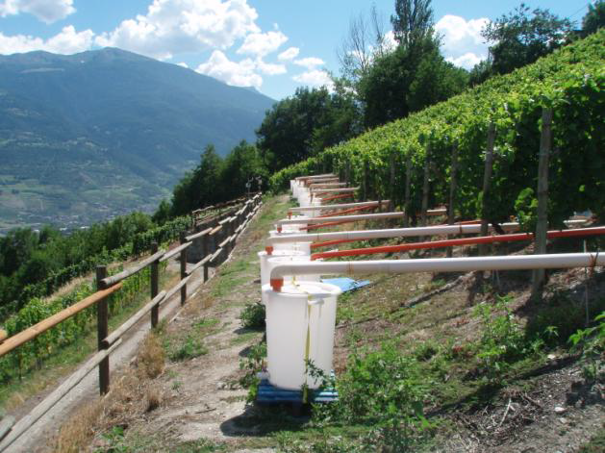
Erosion estimation in mountain areas - field measurements
Sediment collection (traps, cups, other collection systems)
for seasonal, annual or event-based measurements, and model validation

Slide 55
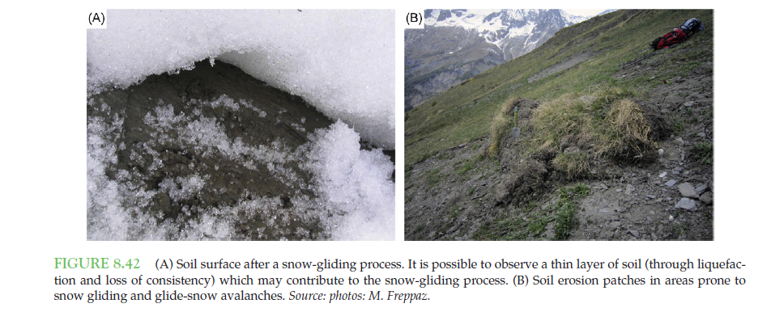
Erosion estimation in mountain areas - field measurements

Slide 56
Measures against erosion
Prevention implies the use of conservation measures that maintain natural resources and their environmental and productive functions (plus ESS)
Mitigation is intervention intended to reduce ongoing degradation. This comes in at a stage when degradation has already begun. The main aim here is to halt further degradation and to start improving resources and their functions. Mitigation impacts tend to be noticeable in the short to medium term: this then provides a strong incentive for further efforts. The word ‘mitigation’ is also sometimes used to describe the reductions of impacts of degradation.
Rehabilitation is required when the land is already degraded to such an extent that the original use is no longer possible and the land has become practically unproductive. Here longer-term and often more costly investments are needed to show any impact.
http://www.fao.org/soils-portal/soil-degradation-restoration/en/

Slide 57
BP for Prevention and mitigation measures
->Terracing
->Contouring
->Planting along contour lines
->Organic matter input (e.g. manuring, organic mixed farming)
->Conservation agriculture (minimum tillage, no tillage)
->Forest conservation
->Sustainable pastoralism
-> CROSS-SECTORAL approach is needed to warrant soil conservation

Slide 58
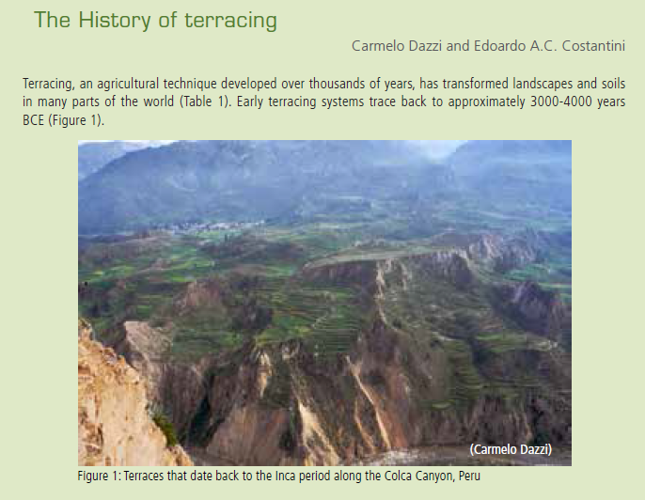
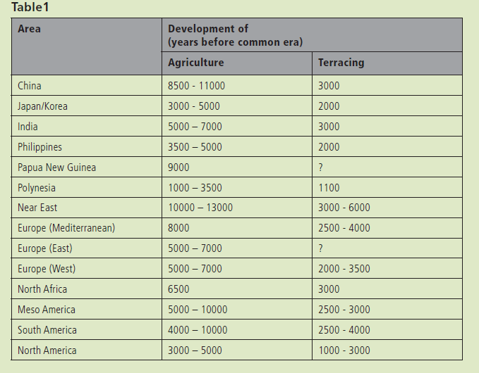
Terracing
GIAHS: Globally Important Agricultural Heritage Systems

Slide 59
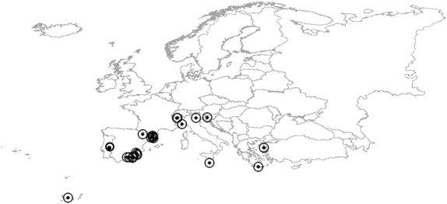
Erosion mitigation – support practices
Fig. 3 Relevant literature on terraced soils in Southern Europe. The map represents the study areas of the papers reported in reviewed literature , i.e. papers with a deeper focus on soils. (Stanchi et al., 2012)

Slide 60
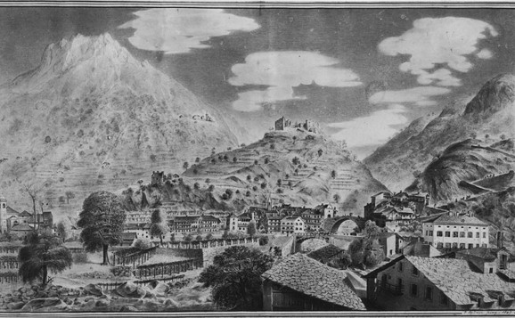
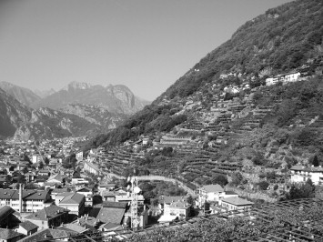
Erosion mitigation – support practices
Fig. 1 Terraced pergola vineyards in Pont-Saint-Martin (Valle d’Aosta, Italy) at present time. A large extension of well maintained pergola vineyards is visible on very steep slopes, often more than 100%, where mechanization is quite impossible.
Fig. 4 The terraced landscape of Pont-Saint-Martin (Valle d’Aosta, Italy) in the XIX Century (G. Ladner, 1847, courtesy Mrs. Ardissone). Pergola vineyards are largely represented with extension comparable to present time

Slide 61
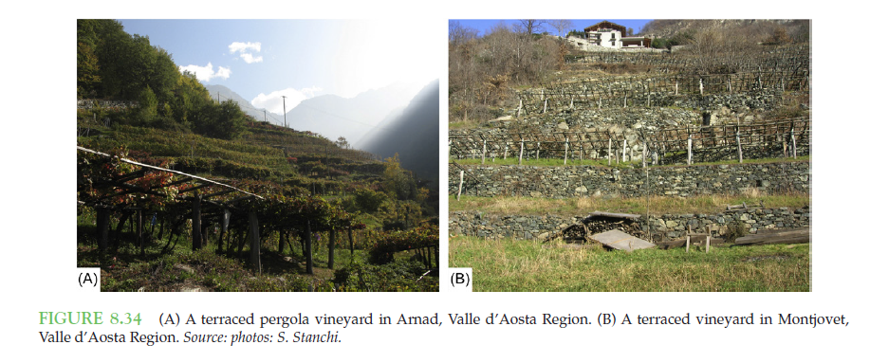
Erosion mitigation – support practices

Slide 62
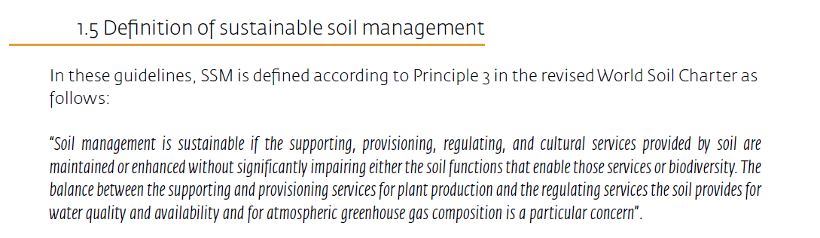
SSM
Among SSM goals -> minimizing water erosion

Slide 63
Suggestions for SSM
->Avoid potentially hazardous LUC (land use change), or carefully plan it
(e.g. pasture to cropland; deforestation)
->improve ground cover, i.e. limit bare soils: mulching, minimum tillage, no-till
->enhance the use of cover crops, reduce use of herbicides, use agro-ecological approach
->control vehicle traffic (tractors, compaction)
->promote continuous plant cover (crop rotation)
->strip cropping, agroforestry, shelter belts, appropriate grazing intensity

Slide 64
Suggestions for SSM on steep slopes
->terracing
->strip cropping, contour planting, intercropping, crop rotation, cross-slope
Barriers (stone lines, grass strips….)
->grassed waterways
->vegetated buffer strips
->when appropriate: riparian buffers and measures for reducing sediment export to rivers
Main links:
-SOM and fertility conservation measures
-grazing and livestock management (e.g. trampling and soil degradation)
-after-fire soil management

Slide 65
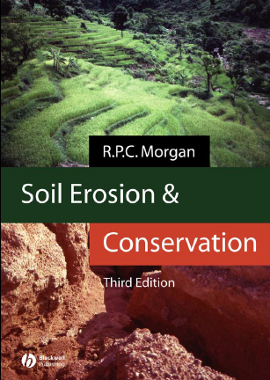
References

Slide 66

silvia.stanchi@unito.it

