Slide 1

Ormea, 28 June 2018
IPROMO 2018 Summer School
Soils and ecosystem services
Silvia Stanchi

Slide 2
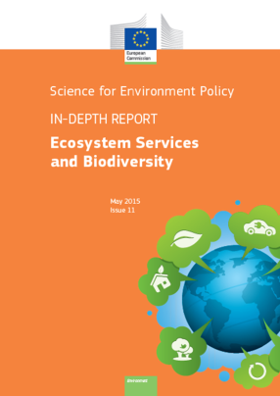
Ecosystem services
Ecosystems deliver a variety of services to human beings
Benefits <-> threats --------conservation
Decision makers need to be aware of ESS

Slide 3
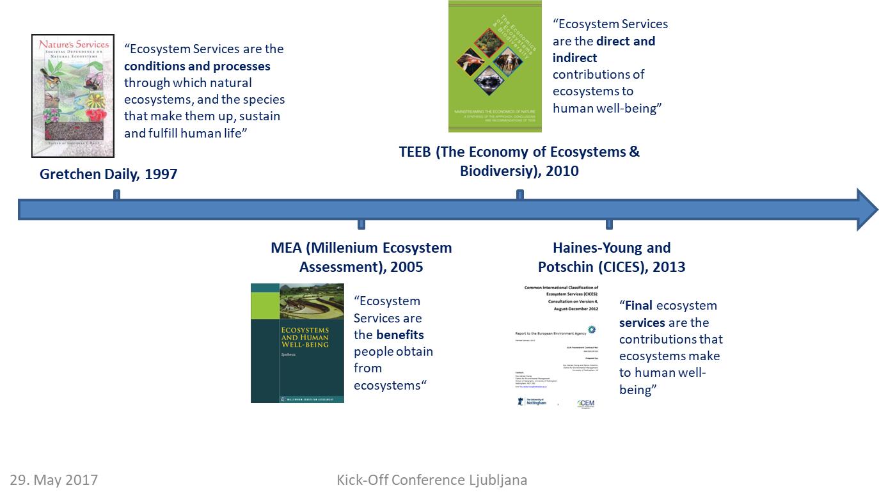
Steps in ESS concepts
ESS are NOT free and infinite
(UIBK, 2017)
Notes:
Common International Classification of ESS

Slide 4
Millennium Ecosystem Assessment (2005) ESS categories
Provisioning:
food, timber, raw materials
Regulating:
climate regulation at the local and global scale, flood control
Cultural: spiritual aspects, reflection, recreation, aesthetics
Supporting: e.g. soil formation, nutrient cycling that are fundamental to the other ESS

Slide 5
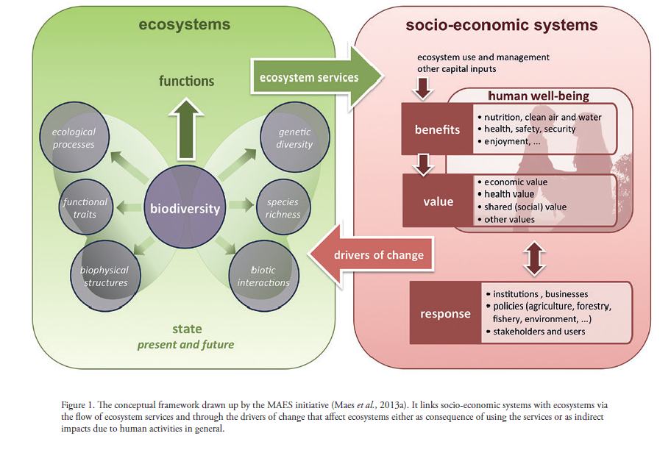
ESS and society
(EU, 2015)

Slide 6
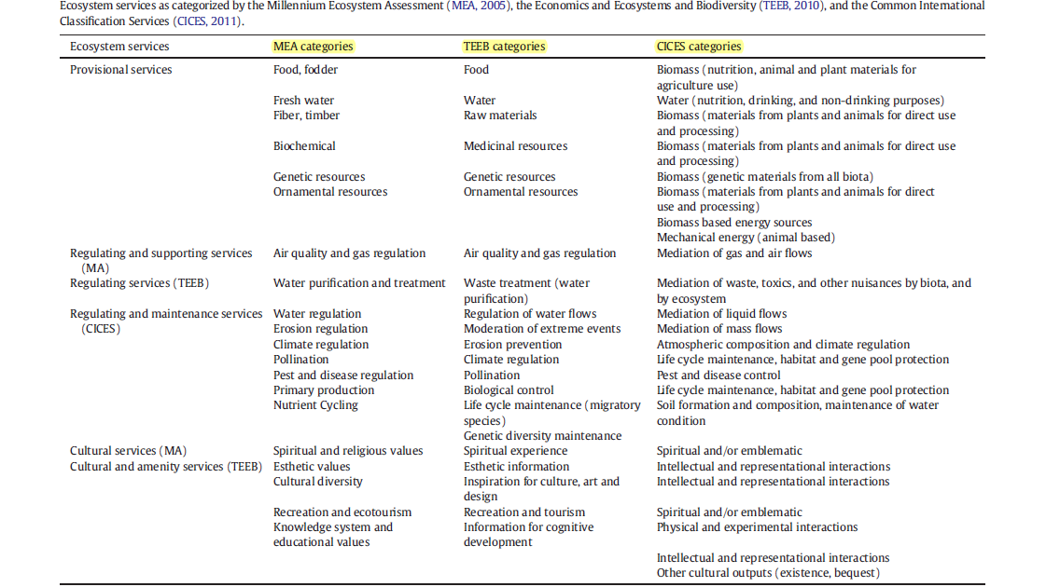
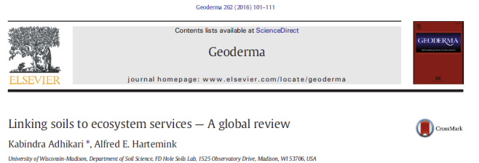
Summarizing
Notes:
Modificare

Slide 7
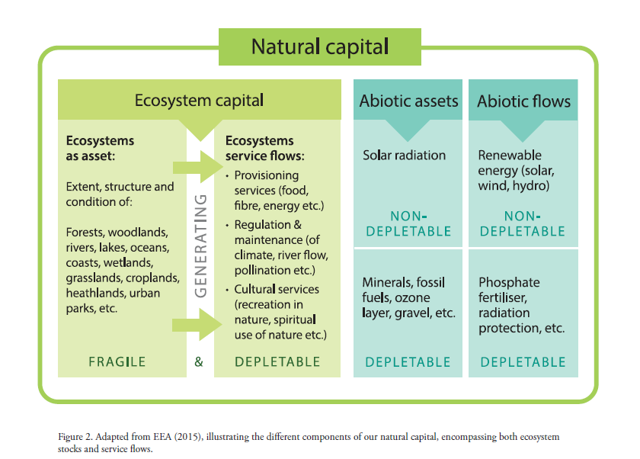
The natural capital (from EU, 2015)
Notes:
Rifare

Slide 8
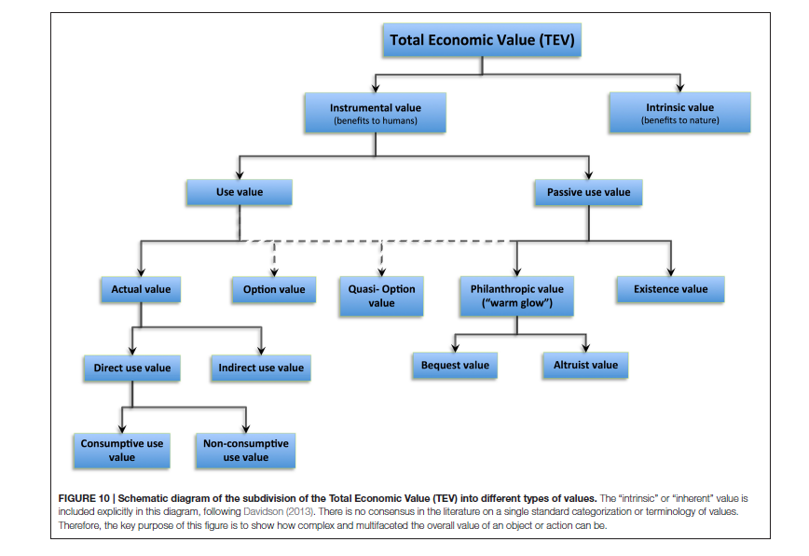
Valuation of ESS
From (Baveye et al., 2016).
Notes:
Da adattare!!!

Slide 9
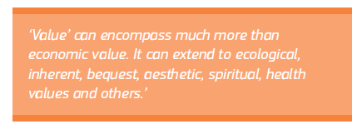
Principles of valuation of ESS
Gomez-Baggethun et al., 2014
Dendoncker et al., 2013
-> ESS valuation is not only an economic/monetary issue
But the «worth..or importance» of ESS
(EU, 2015)

Slide 10
Risks of economic valuation
Non-marketed areas -> trade
Public goods -> private goods
However…..not assigning a $$ value to services can lead policy makers to assigning a 0 value!

Slide 11
In the past…
Many services have been neglected as markets could not assess their value…
-> degradation
-> loss of ESS

Slide 12
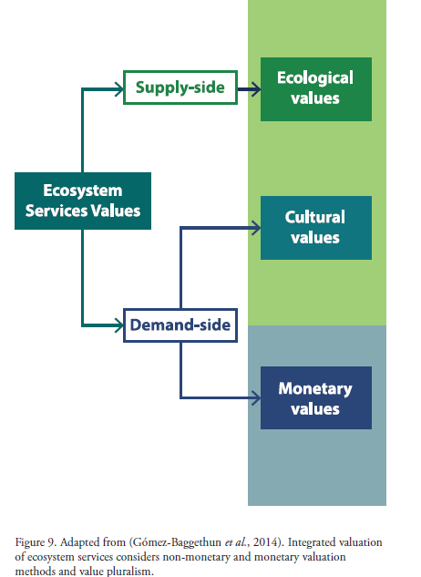
A new paradigm
(EU, 2015)

Slide 13

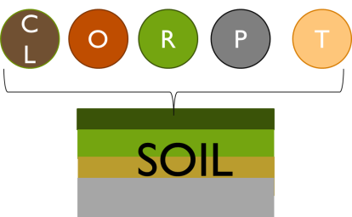
Including Soil-based ESS
Soils as -> ecosystems
Soils as -> a part of the ecosystem

Slide 14
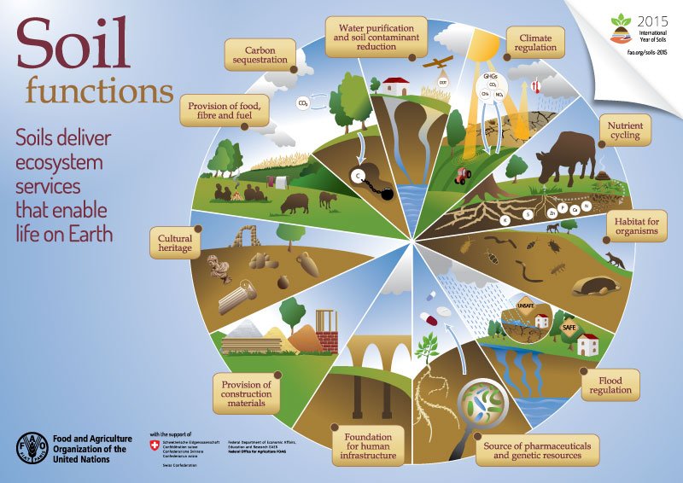
Soil functions

Slide 15
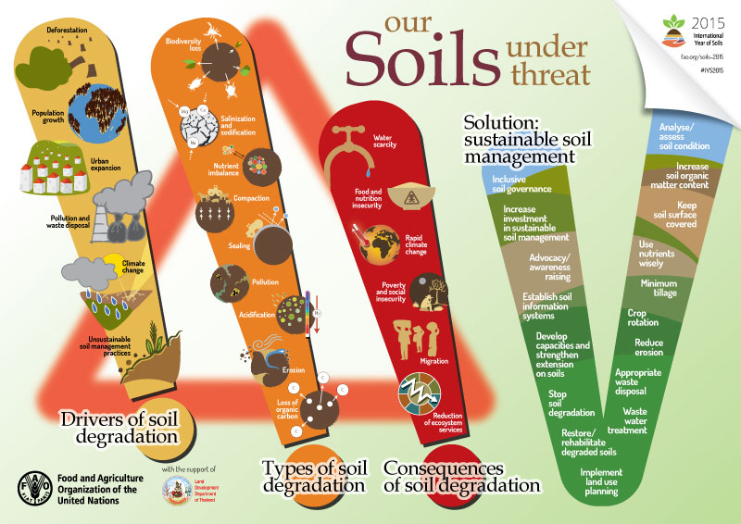
Soil degradation

Slide 16
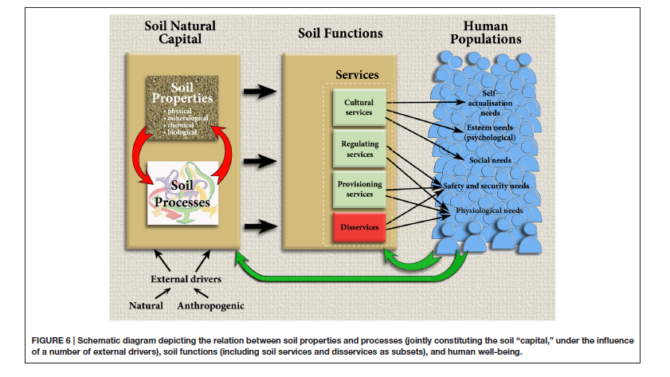
The soil capital (Baveye et al., 2016)

Slide 17
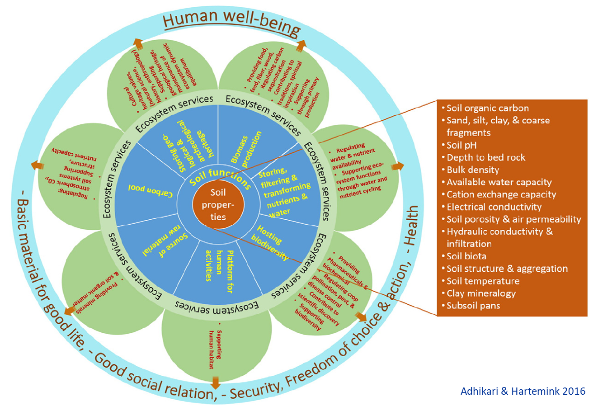
SbES, soil functions and properties

Slide 18
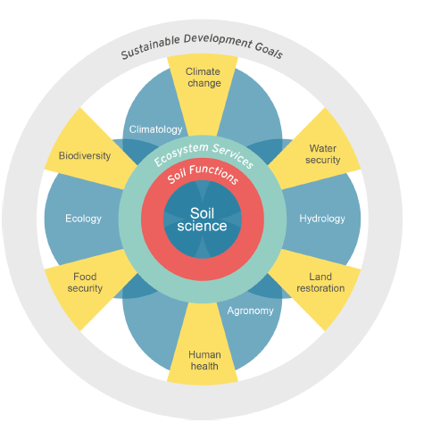
Keestra et al., 2016.
Soil functions according EC (2006)
Biomass production
Storing, filtering, transforming nutrients,
Substances and water
Biodiversity, gene pool
Physical and cultural environment for
people
5) Source of raw materials
6) C sink
7) Archive (geology, archaeology)

Slide 19
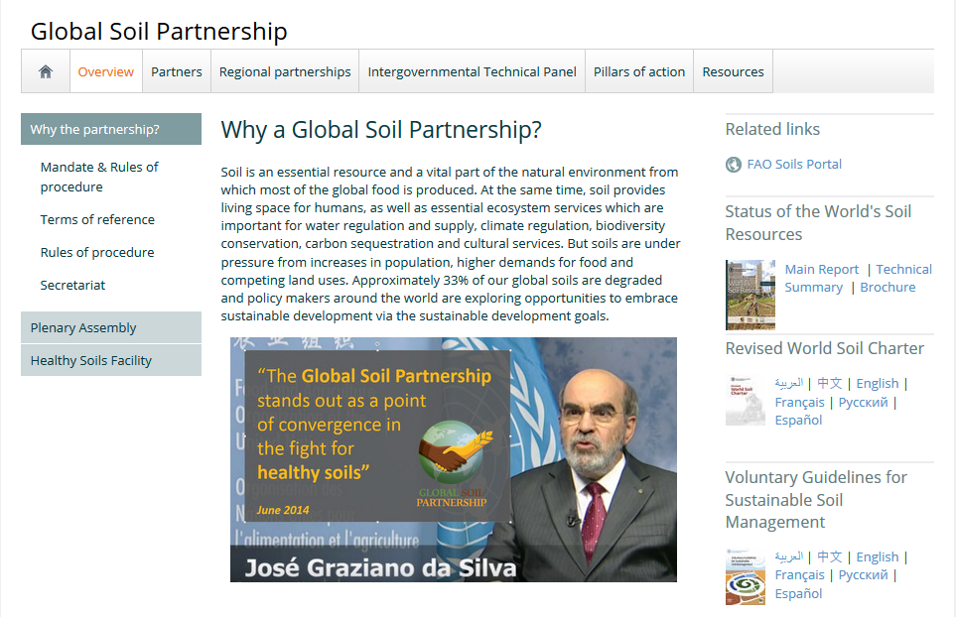
The Global Soil Partnership

Slide 20
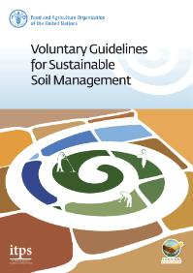
http://www.fao.org/documents/card/en/c/5544358d-f11f-4e9f-90ef-a37c3bf52db7/

Slide 21
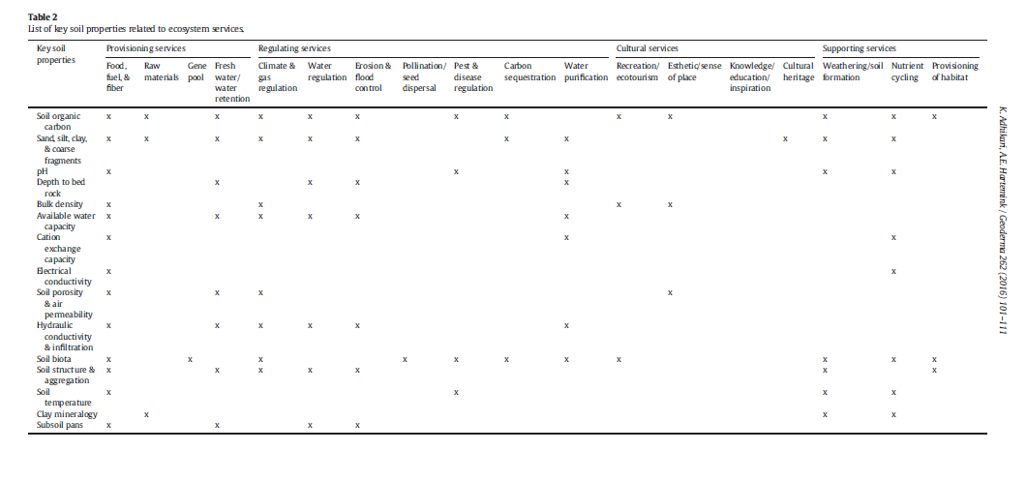
Soil properties related with SbES

Slide 22
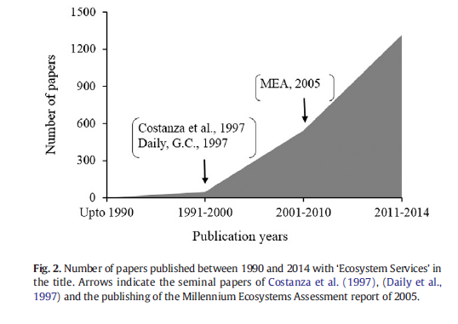
Available literature/1
(Adhikari et al., 2016)

Slide 23
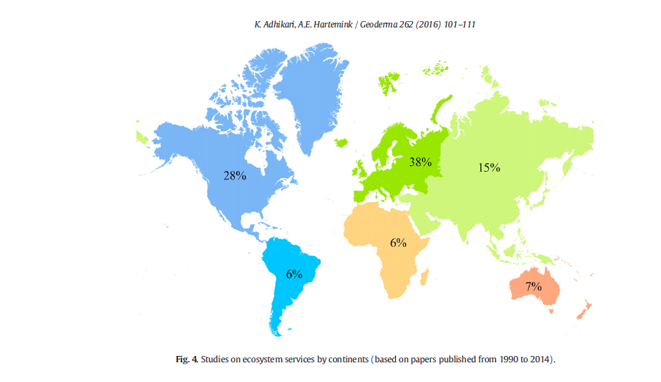
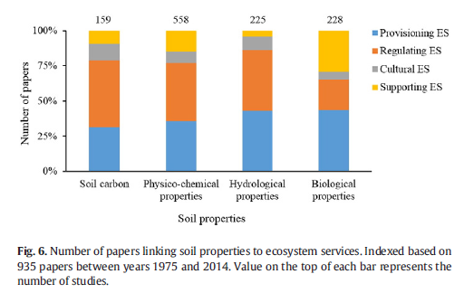
Available literature/2
(Adhikari et al., 2016)

Slide 24
Main issues in SbES assessment
Monetization of SbES is complex and has often been criticized (concept of ESS vs. ES goods)
McBratney et al. (2012)-> attributing soil value and relating soils to ESS is difficult
However, it’s fundamental to include soils in ESS studies (see Daily et al., 1997; Dominati et al., 2014)
Very often, soil has been regarded as a «black box» and more attention has been paid to the «above ground»

Slide 25
Examples of soil valuation
Productivity chain approach (Sparling et al., 2006): how changes in soil fertility can affect primary production (diary products) and contribute to climate regulation
Lal (2011): + 1 t SOC ha⁻¹ y⁻¹ in the root zone ->
significant +++ annual food production in developing countries

Slide 26
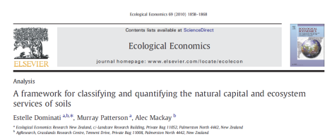
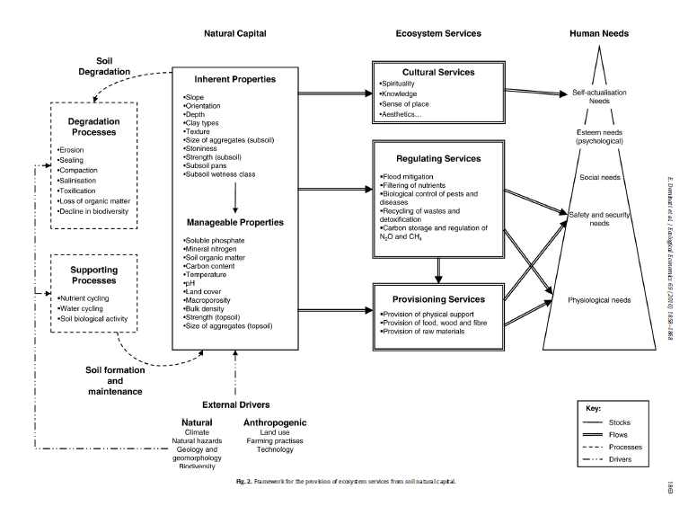
Dominati et al, 2010. A framework proposal for evaluating the ESS of soils

Slide 27
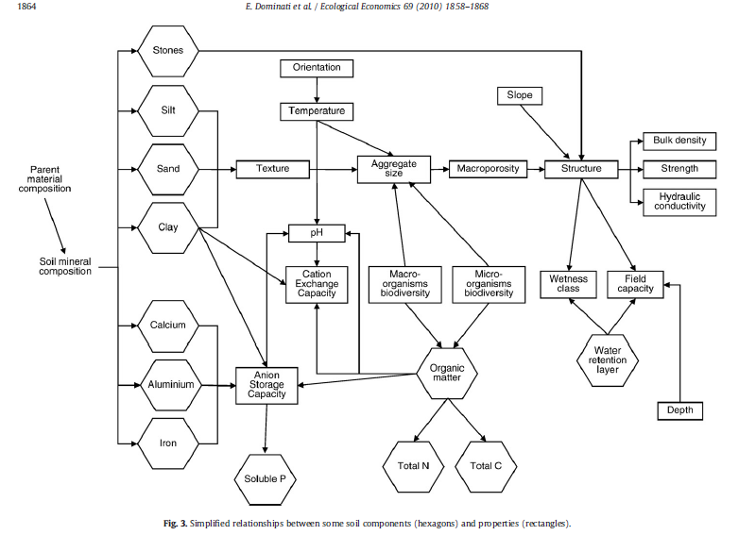
Soil properties <-> soil components

Slide 28
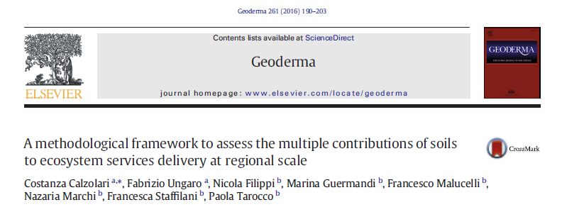
A case study from Italy/1
-> a framework for a regional application, from the theoretical approach to mapping SbES
1. assessment of SbES -> available data and societal needs
2. choosing appropriate indicators
3. assessment and mapping of soil contribution to relevant ESS
-> use of inter and trans-disciplinary approach

Slide 29
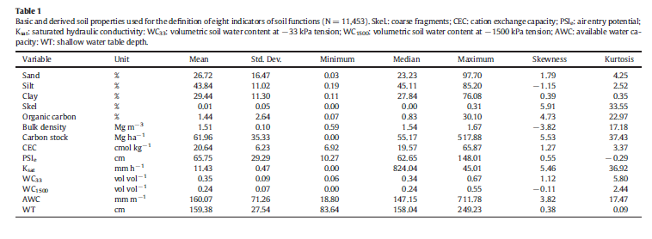
A case study from Italy/2
Indicators -> soil properties -> Soil functions
Example: soil fauna is an indicator for soil quality
Notes:
Conceptual scheme

Slide 30
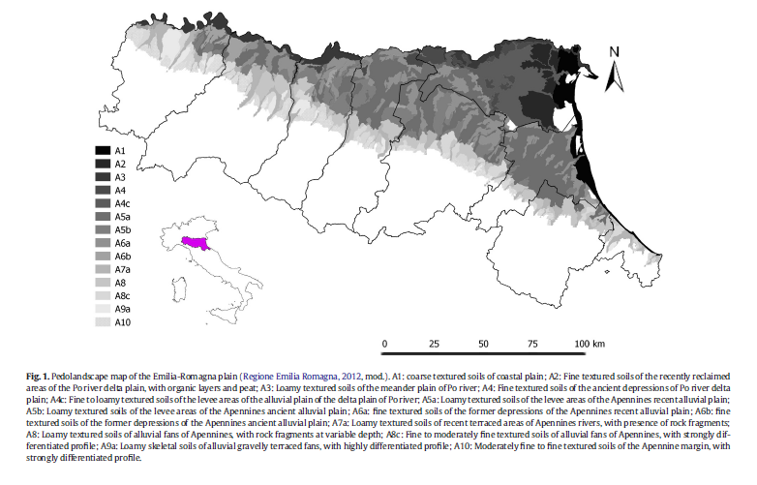
A case study from Italy/3
14 pedolandscape units, 1 km grid

Slide 31
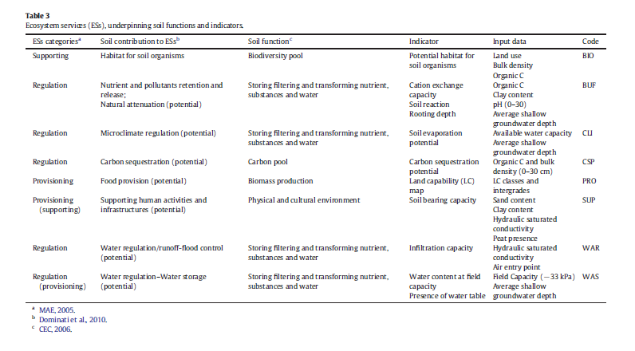
A case study from Italy/4

Slide 32
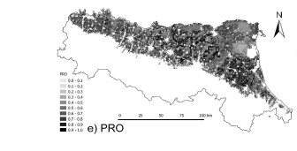
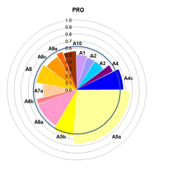
A case study from Italy/5 Focus on food provision
0-1 scores
Scores for 14 pedolandscape units

Slide 33
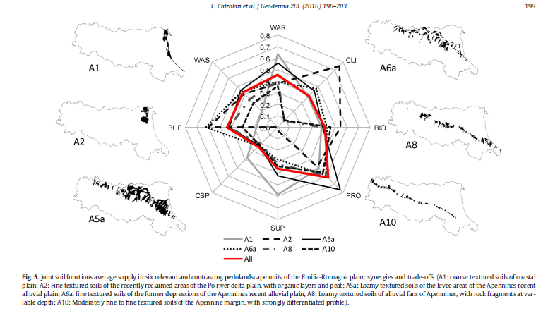
A case study from Italy/6

Slide 34
A case study from Italy/7
Weaknesses
-> no ecomomic valuation
-> difficulties in validation of the proposed framework
Strenghts
-> indicators were discussed with local and regional stakeholders
and authorities (participatory approach)

Slide 35
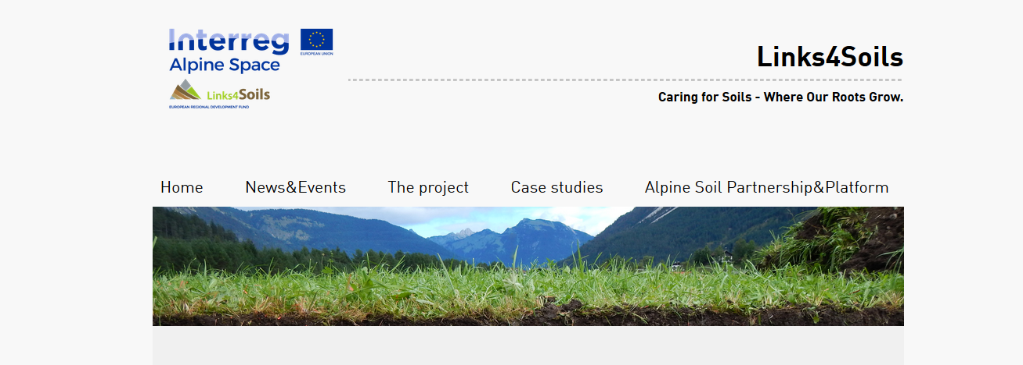
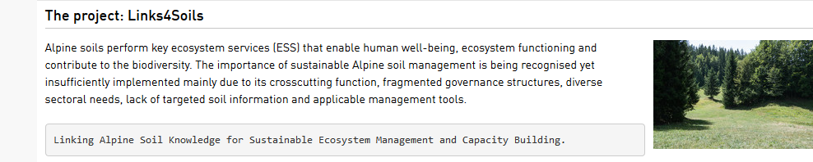
The Links4Soils Project

Slide 36
The Links4Soils Project
Food
production
Education
Recreation
Wood
production
Habitat
Fresh water
Carbon
sequestration
Water flow
regulation
(UIBK, 2017)
Natural potential of Ecosystem Service provision
Current level of Ecosystem
Service provision
Climate
regulation
Erosion
regulation
Notes:
Idee dazu: Bewertung in 5er Schritten: sehr gering, gering, mittel, hoch, sehr hoch / in der Abbildung entsprechend graphisch mit Hilfslinien anzeigen die 5 Klassen

Slide 37
General conclusions
-> ESS assessment and valuation is very complex and requires
a cross-sectoral approach
-> despite this issue, it’s becoming more and more
important for sustainable management of natural resources
-> this is even more true for SbES
-> cross-sectoral and participatory approach should be encouraged

Slide 38

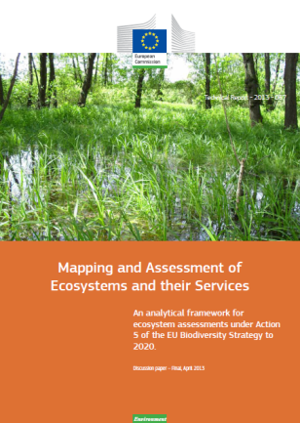
References
Adhikari, Kabindra and Alfred E. Hartemink (2016): Linking soils to ecosystem services — A global review. Geoderma. 262:101-111.
Baveye P., Baveye J., Gowdy J. (2016): Soil “Ecosystem Services and Natural Capital: Critical Appraisal of Research on Uncertain Ground. Frrontiers in Environmental Science, https://doi.org/10.3389/fenvs.2016.00041
Costanza, R. et al. The value of the world's ecosystem services and natural capital. Nature 387, 253-260 (1997).
Daily, G. C. et al. Ecosystem services: Benefits supplied to human societies by natural ecosystems. Issues in Ecology 2, 1-18 (1997).
FAO. Infographics [http://www.fao.org/soils-2015/resources/infographics/en/, access date: 13.04.2017].
FAO. Soil ecosystems services [http://www.fao.org/agriculture/crops/thematic-sitemap/theme/spi/soil-biodiversity/soil-ecosystems-services/en/, access date 13.04.2017]
Maes J., Teller A., Erhard M., Liquete C., Braat L., Berry P., Egoh B., Puydarrieux P., Fiorina C., Santos F., Paracchini M.I., Keune H., Hauk J et al. (2013): Mapping and Assessment of Ecosystems and their Services. An analytical framework for ecosystem assessment under action 5 of the EU biodiversity strategy to 2020.
Millennium Ecosystem Assessment (2005): Ecosystems and Human Well-being: Synthesis. Island Press, Washington, DC.
TEEB (2010): The Economics of Ecosystems and Biodiversity: Mainstreaming the Economics of Nature: A Synthesis of the Approach, Conclusions and Recommendations of TEEB.
Notes:
sistemare

