Slide 1
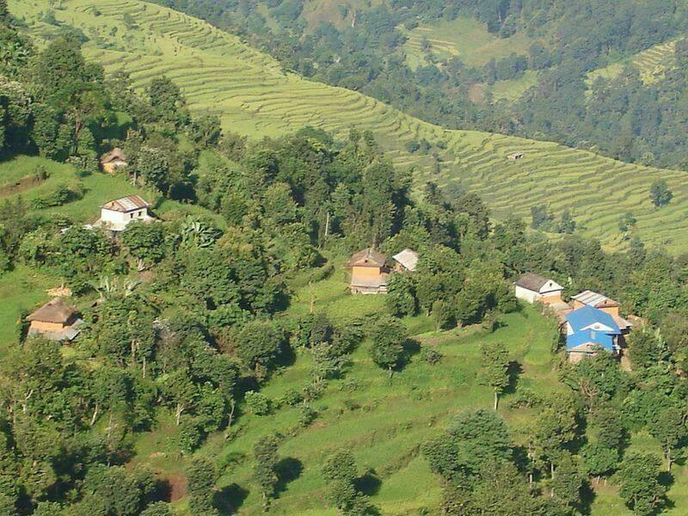
Personal Presentation
Barsha Parajuli
Association of Family Forest Owners Nepal
(AFFON)
barsaparajuli@gmail.com
IPROMO
Bioeconomy in mountain areas – an opportunity for local development
Pieve Tesino /Ormea 18 June -02 July 2018

Slide 2
Education
B.Sc & M.Sc. Environment Science
(spelization in Mountain Environment)
Employment
Worked on youth & environmental issues for a decade.
Currently: National Program Officer, AFFON.
Developing project proposals
Implementing project activities, tacking progress and preparing progress reports.
Coordinating with different stakeholders.

Slide 3
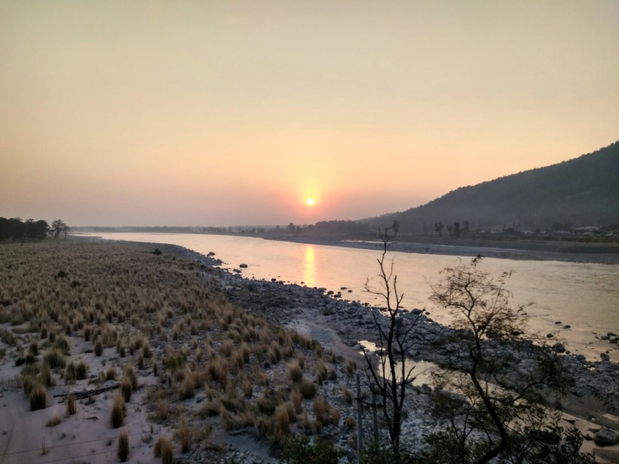
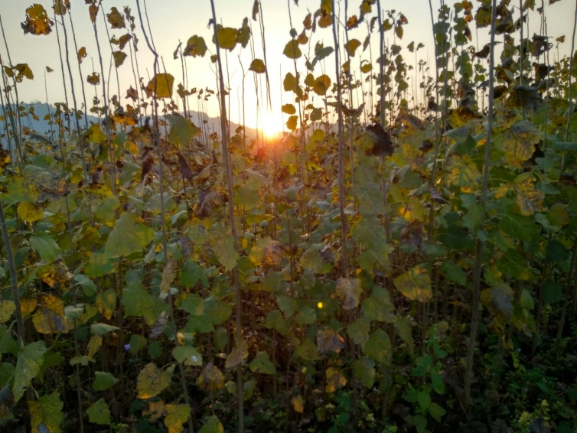
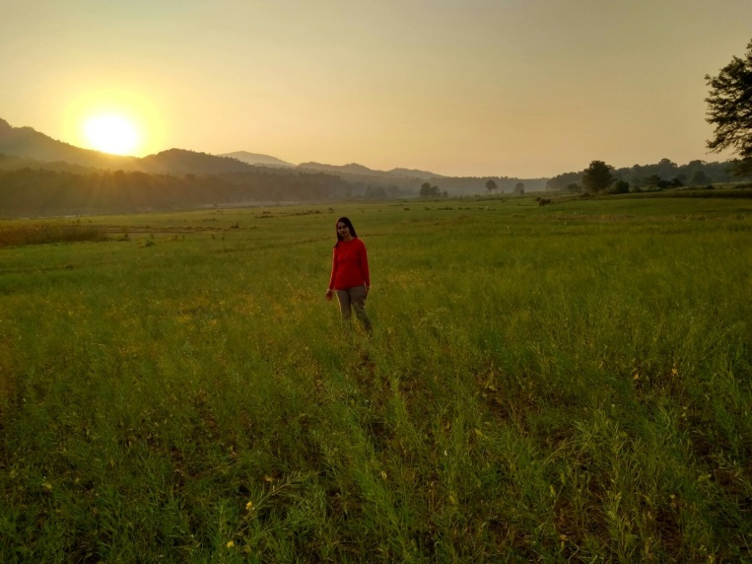
Interests
environmental issues worldwide & how people are overcoming it, fascinates me.
Hobbies: being close to natue, playing around with kids.

Slide 4
Project Involved
Project Title: “Empowerment of Communities through democratic natural resource management”
Funding agency: CISU/DANIDA through Danish Forestry Extension (DFE)
Project Duration: Jan 2016- Dec 2018
Project Components: Capacity building of forest farmers , Association Building.
My involvement: designing the projects (AFFON), Workplans/Operatinal plans: District Chapters, tracking the project activities, regular follow ups & monitor progress.

Slide 5
Project Involved
Scoping study of private family forest: June – Dec 2018
Forestry models and layouts in practice
Production rates and potentials
need analysis of the forest farmers
Market and value chain analyis
Identification of viable best production model

Slide 6
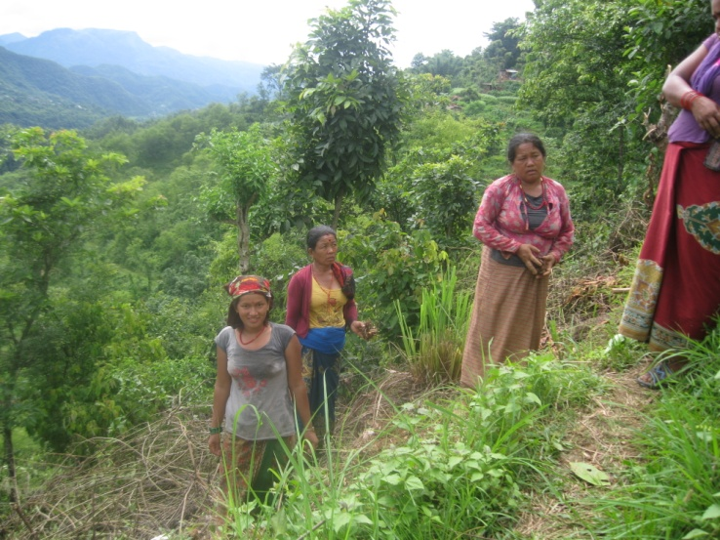
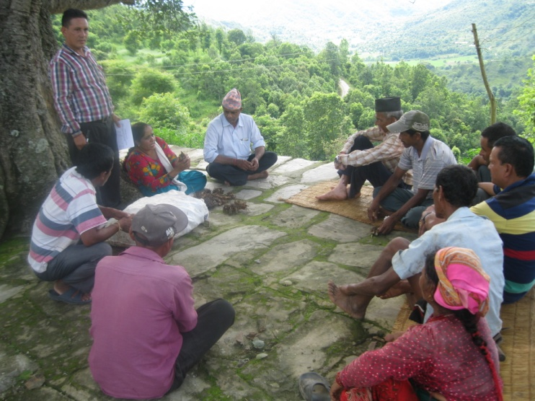
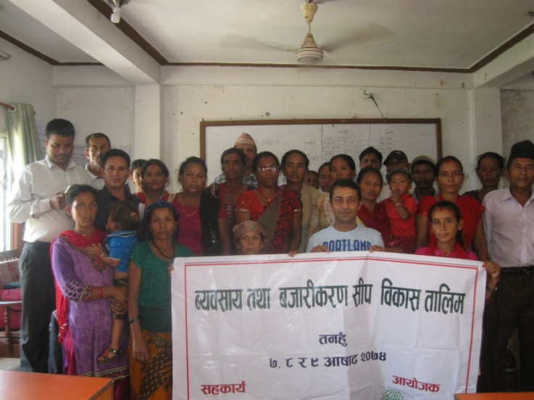
Project Involved
“Livelihood improvement of the family forest owners of Bharbhanjyang and Bhanu VDC of Tanahu district from Agroforestry"
Funding : FAO, FFF program
Duration: 2016/2017
Output
Improved production capacity of forest farm products (Amriso) of the AFFON members
Enhanced entrepreneur knowledge/skill and developed market linkages
Developed capacity of AFFON members and improved communication with the line agencies

Slide 7
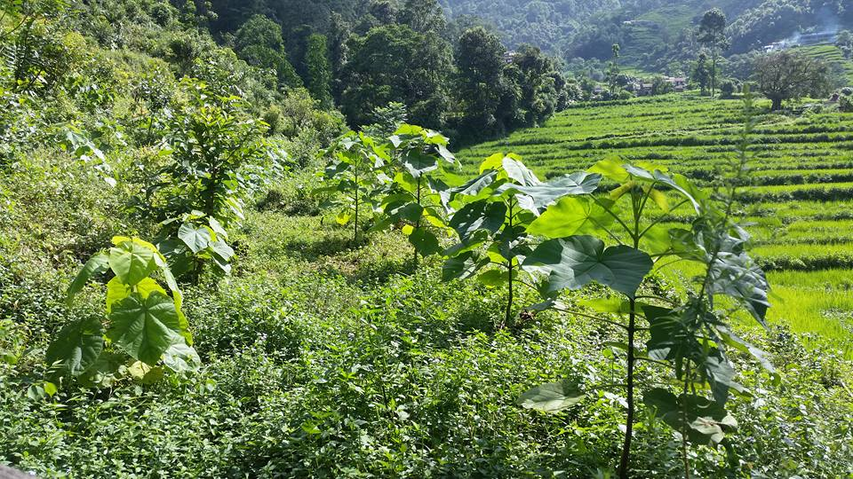
Thank you

