Slide 1
Deepa Basnet
International Centre for Integrated Mountain Development (ICIMOD)
deepa.basnet@icimod.org
IPROMO
Bioeconomy in mountain areas – an opportunity for local development
Pieve Tesino /Ormea 18 June -02 July 2018

Slide 2
Education
Masters in Environmental Science, Tribhuvan University, Nepal
Bachelors in Environmental Science, Tribhuvan University, Nepal
Employment and main activities
ICIMOD: Far Eastern Himalayan Landscape (HI-LIFE)
Himalayan Climate Change Adaptation Programme (HICAP)
Livelihoods theme, Ecosystem Theme
Bird Conservation Nepal: Conservation and awareness of conservation and protection of birds
WWF Nepal: Forest carbon inventory/Payment on Ecosystem Services (PES)
Nepal Development Research Institute: Electoral support, Women development
Ministry of Environment & Forests: Monitoring & evaluation, field verification in Protected areas

Slide 3
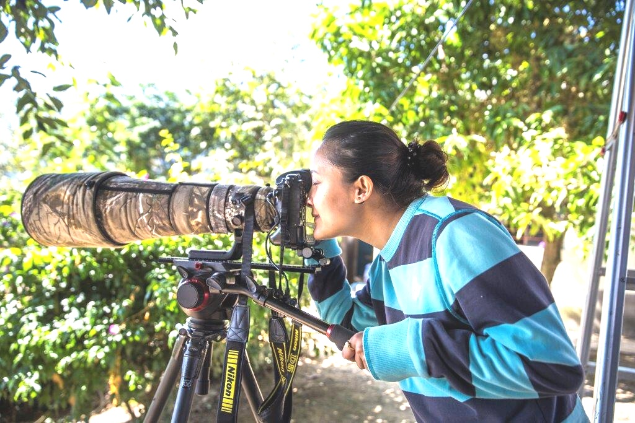
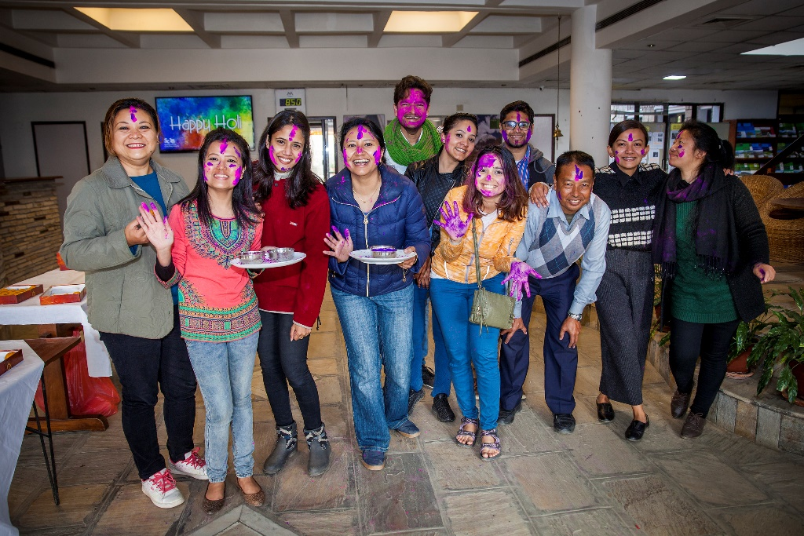
Other interests (volunteer work, hobbies etc.)
Serving orphanage & old age home
Young volunteer for earthquake
victim of Nepal in 2015
Animal lover
Nature lover
Travelling
Badminton, cycling, basketball
Fun-lover

Slide 4
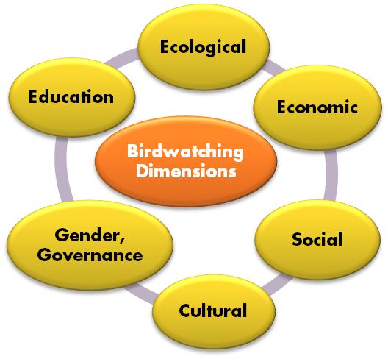
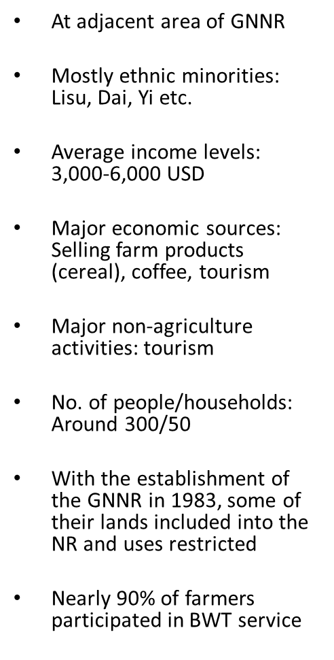
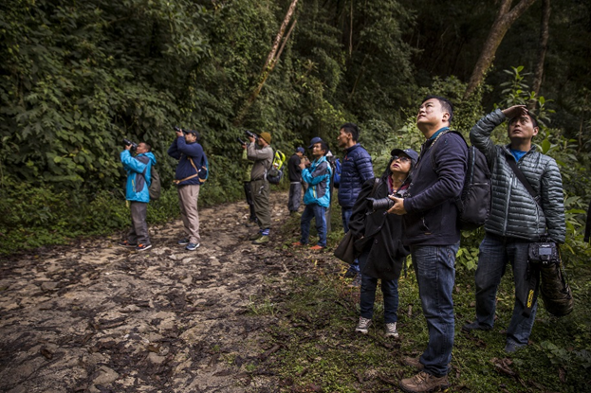
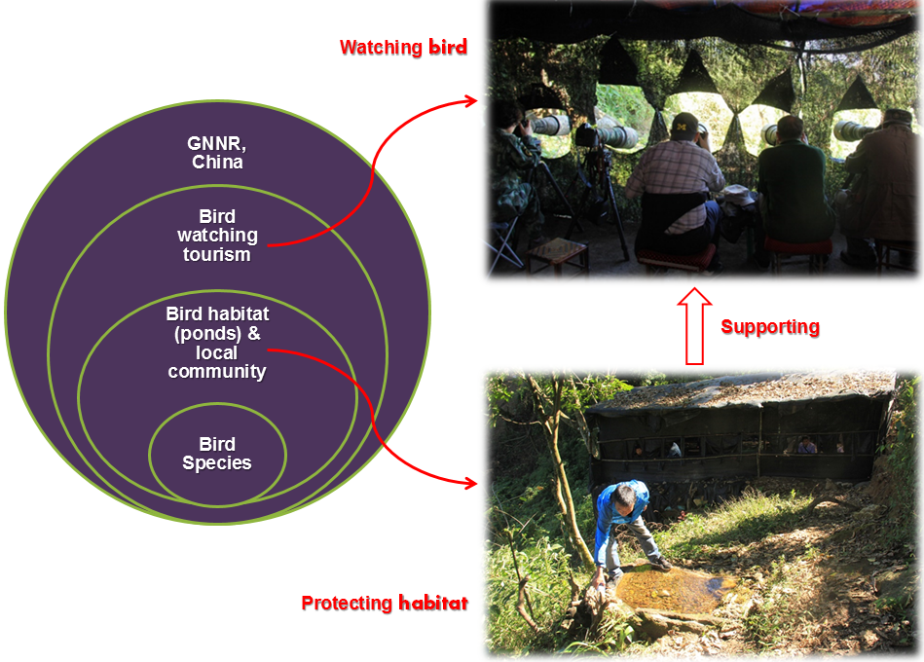
Bird watching & photography tourism in Yunnan, China

Slide 5
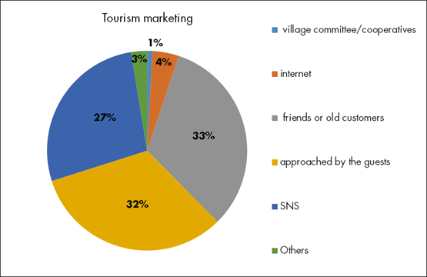

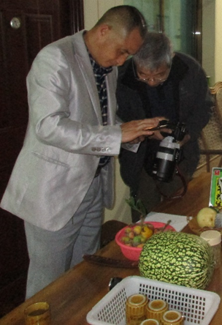
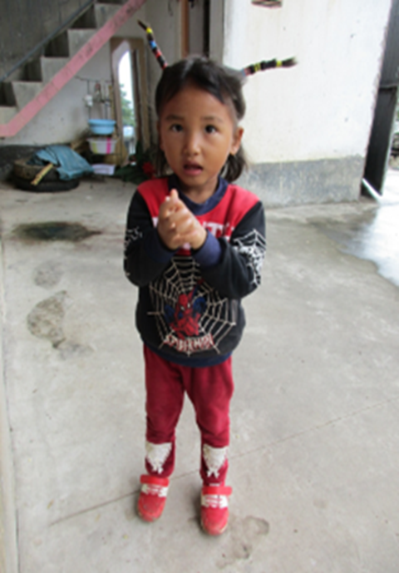
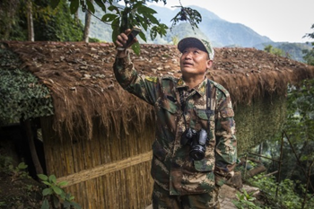
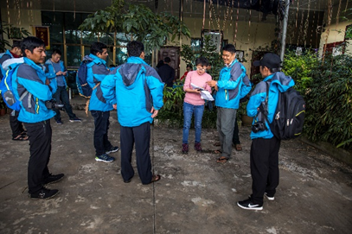
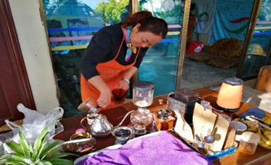
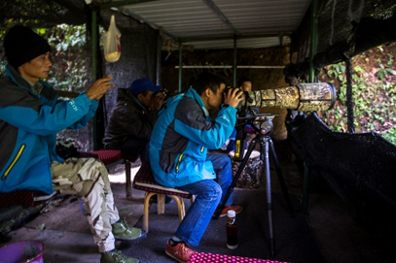
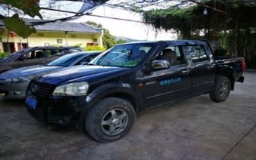
Bird watching & photography tourism
Regional relevance & learning
https://arunachaltimes.in/index.php/2017/12/31/opportunity-of-community-based-bird-watching-ecotourism-in-arunachal/
https://www.thethirdpole.net/en/2018/01/19/developing-birdwatching-as-a-sustainable-programme-in-china/

Slide 6

Transboundary collaboration for monitoring and conservation of biodiversity in HI-LIFE
Biodiversity profiling
Keystone species monitoring
Developing monitoring protocols with CAS-SEABRI
Objectives:
1) Promote conservation of key biodiversity species
2) Foster cooperation, partnerships and network at regional level
3) Local people enagagement in conservation of biodiversity
4) Information sharing at regional level for protection of the species
5 year project

