Slide 1
Personal presentation
Lira Sagynbekova
Research Fellow at Mountain Societies Research Institute, University of Central Asia
lira.sagynbekova@ucentralasia.org
IPROMO
Bioeconomy in mountain areas – an opportunity for local development
Pieve Tesino /Ormea 18 June -02 July 2018

Slide 2
Education
PhD in Human Geography, Free University of Berlin, Centre for Development Studies at the Institute of Geographical Sciences
M.Sc. in Social and Economic Geography, Kyrgyz National University by J. Balasagyn, Faculty of Geography and Ecology
B.Sc. in Geography, Kyrgyz State National University, Faculty of Geography and Ecology
Employment and main activities
Research Fellow at MSRI, UCA
Expert at the Regional Environmental Centre for Central Asia (CAREC)
Consultant at International Organization for Migration
Lecturer at Kyrgyz National University by J. Balasagyn

Slide 3
Other interests (volunteer work, hobbies etc.)
Sitizen science
Interested in different cultural aspects of mountain communities
Sport (Basketball)

Slide 4
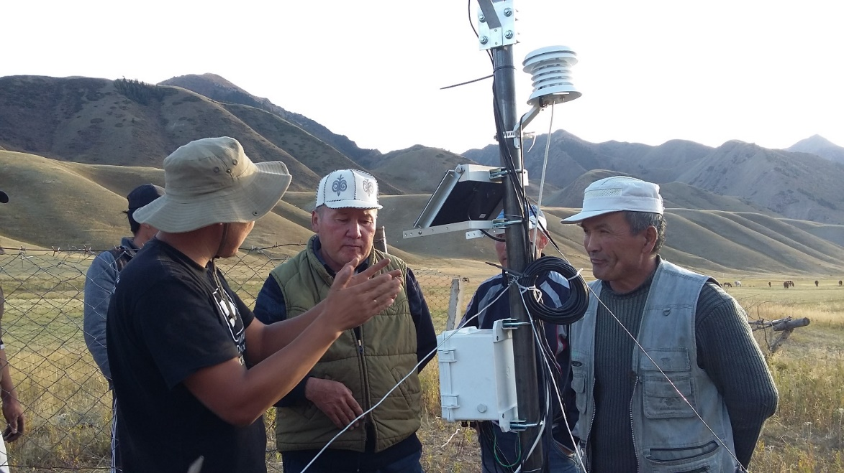
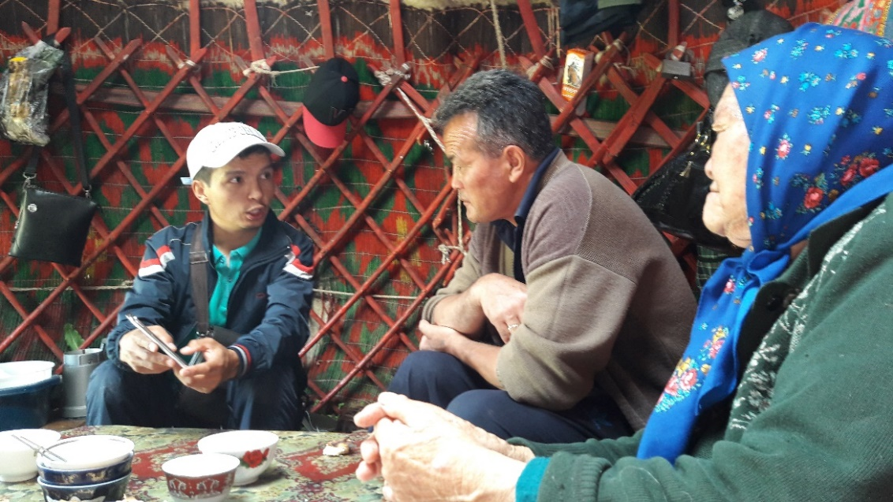
Presentation of a project you are working on 1/3
ESPA (Ecosystem Service for Povery Alleviation)
Participatory monitoring approach
Collecting data on:
Climatic parameters
Pasture conditions
Water resources
Wildlife

Slide 5
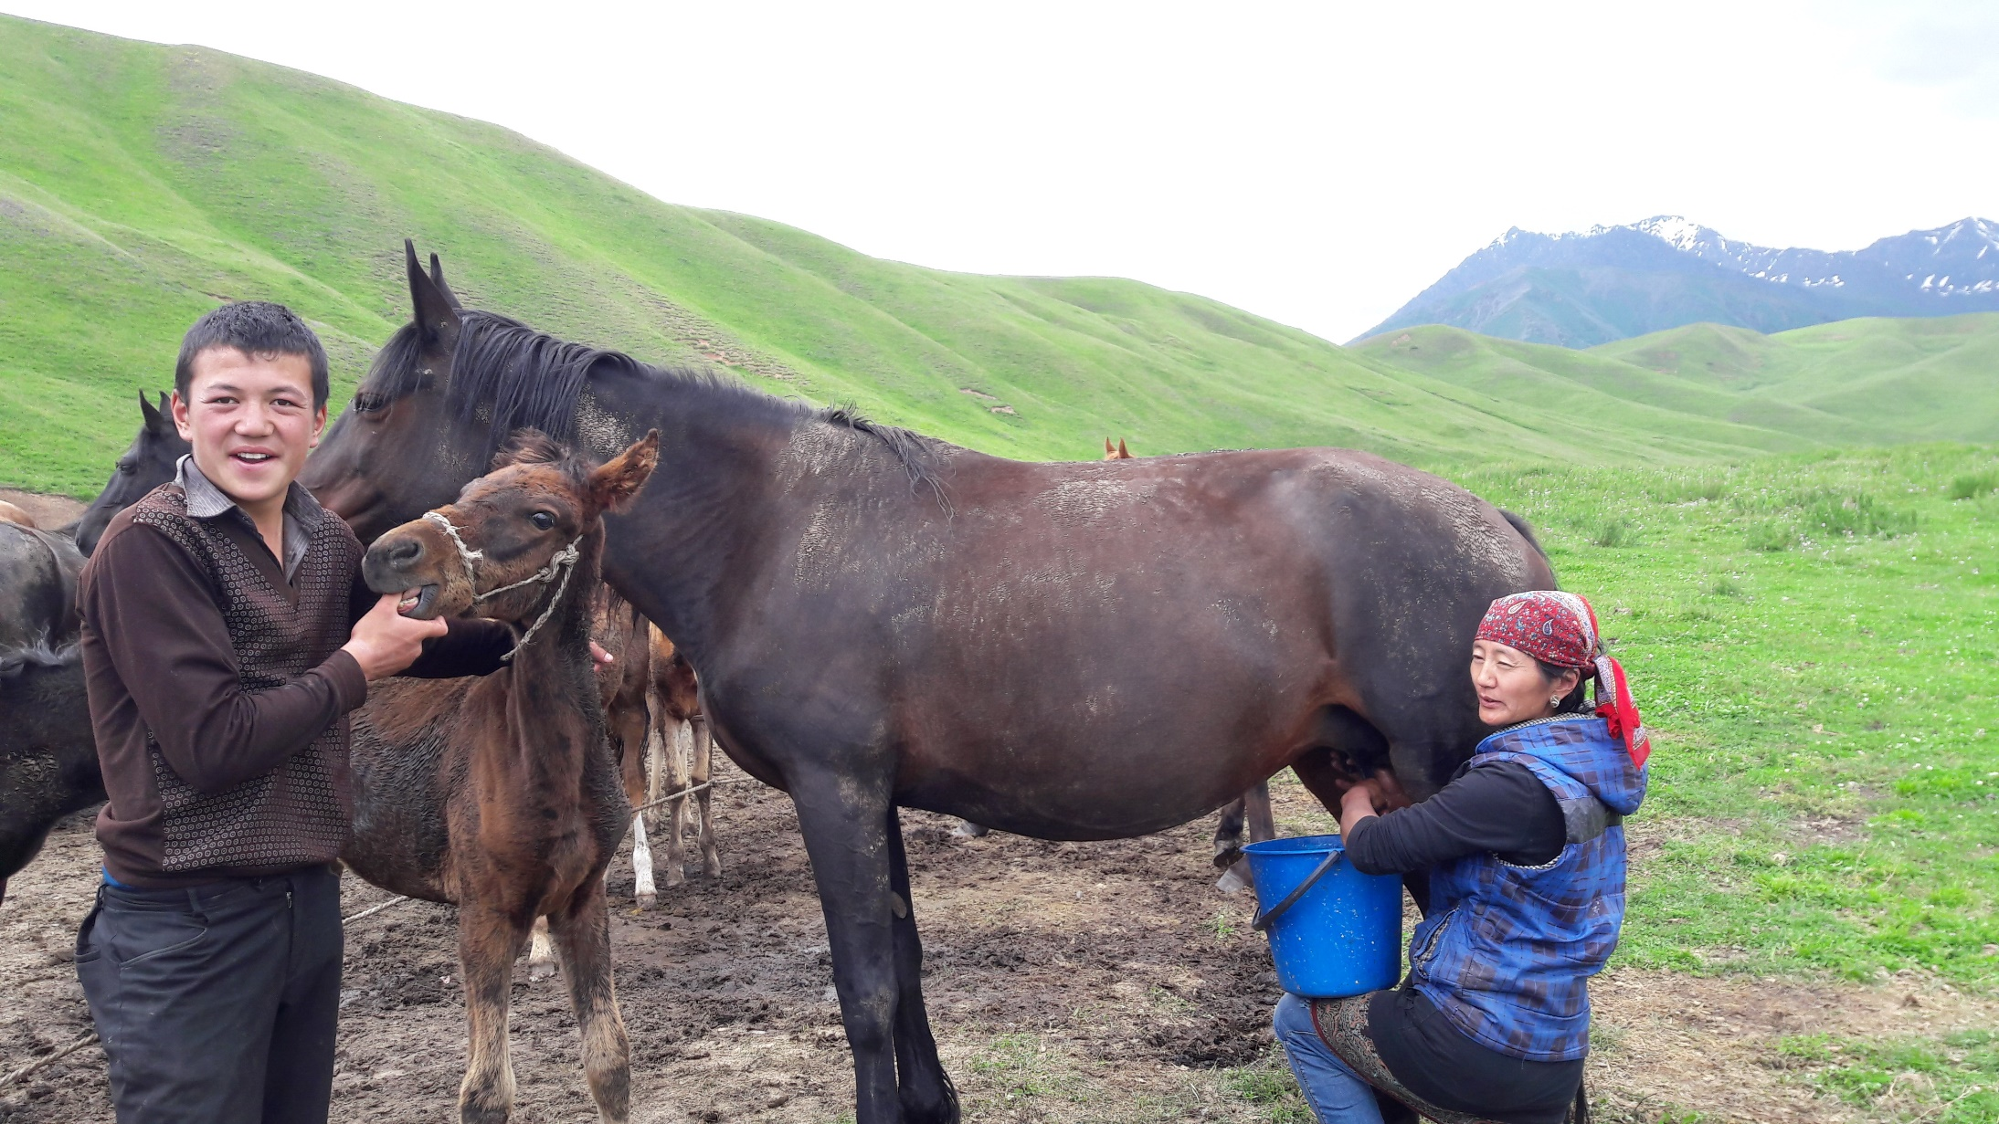
Presentation of a project you are working on 2/3
PRISE (Pathways to Resilience in Semi-Arid Economies)
This project focuses on the resilience of communities in semi-arid regions to climatic and non-climatic (social, economic and environmental) shocks and stressors
Photo: A. Kapalova

Slide 6
Presentation of a project you are working on 3/3
PALESCA (Palaeoclimate, Environmental Change and Social Interaction in Central Asia – connecting Institutional and Citizen Science)
Installation of weather stations and collecting of climatic data
Experiments on soils by using soil test kits and soil moisture sensors
Trainings and experiments on phenology by using smartphones with Phenology Application
Collaboration with nature reserves and national parks
Summer schools

Slide 7


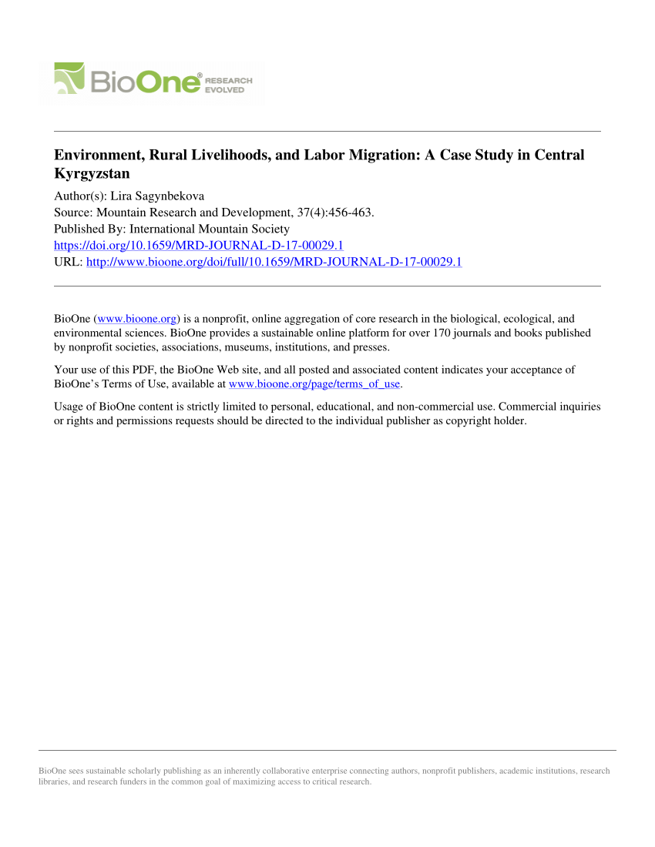
Presentation of a project you are working on 3/4
Migration and Livelihoods

