Slide 1


Personal Presentation
Name: Moselantja Rahlao
Ministry of Forestry, Range and Soil Conservation
Department of Range Resources Management
IPROMO
Bioeconomy in mountain areas – an opportunity for local development,
Pieve Tesino /Ormea, Italy 18th June -02nd July 2018

Slide 2
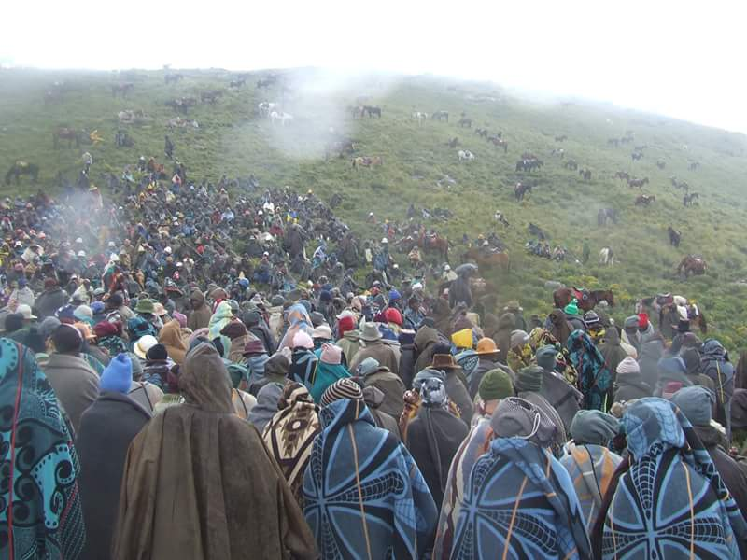
Education
BSc. Biodiversity and Conservation Biology
Diploma in Forestry and Natural Resources Management
Employment and main activities
Range Resources Technical Officer
Duties involve;
Rangeland inventory and planning
Community consultations
Wetland conservation
Reporting (informing policy makers)
Notes:
Conduct plant diversity assessment, Rangeland planning through development of grazing management plans (GIS application). Facilitate presentation and implementation of grazing management plans to rural communities. Supervise demarcation of threatened wetlands and recommend rehabilitation measures. Provide technical advice to policy makers and communities on general range management as well as wetlands conservation for an integrated and sustainable natural resources management.
Photo Credits: Department of Range Resources Management

Slide 3
Other interests (volunteer work, hobbies etc.)
Civic Leadership
Entrepreneurship
Playing netball and aerobic gymnastics
I enjoy reading to learn, travelling and love new exposure
Notes:
I am inspired by volunteering in community based projects and building for improved livelihoods of rural communities. This involves community outreaches such as poverty alleviation projects and donating to scholars/ pupils.

Slide 4
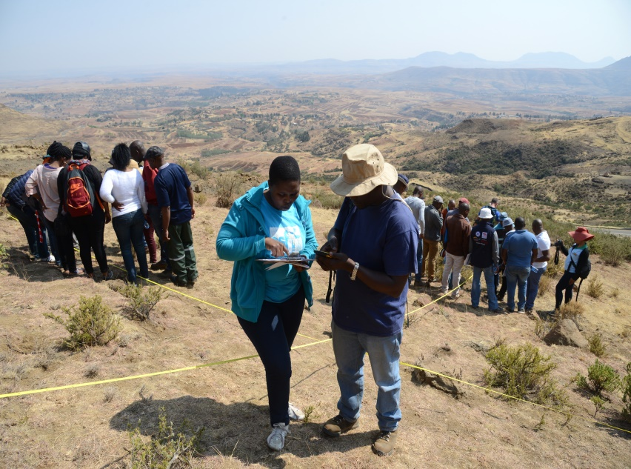
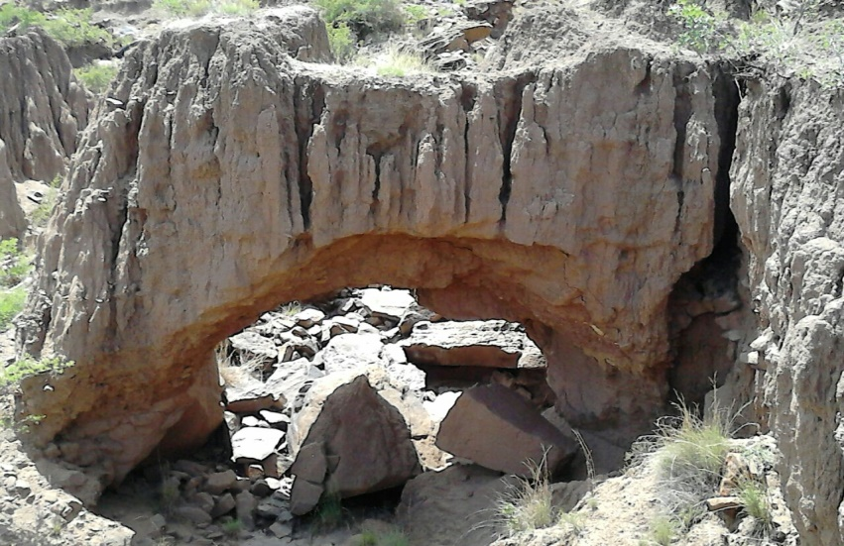
Presentation of a project you are working on 1/3
Wool and Mohair Production Project (WAMPP)
Addresses economy and climate change.
3 Components
A. Climate Smart Rangeland
Management
B. Improved Livestock
Production and Management
C. Wool and Mohair
Processing and Marketing
LDSF (Land Degradation
Surveillance Framework)
Methodology.
Notes:
Aims to boost economic and climate resilience of resource-poor livestock farmers to adverse effects of climate change in the Mountain and Foothill Regions of Lesotho.
My role is to apply community based approach to delineate grazing areas, establish sentinel sites through LDSF methodology and develop grazing management plans, following a participatory rangeland management methodology.
Photo Credits: W. Leigh (a) and M. Rahlao (b)

Slide 5
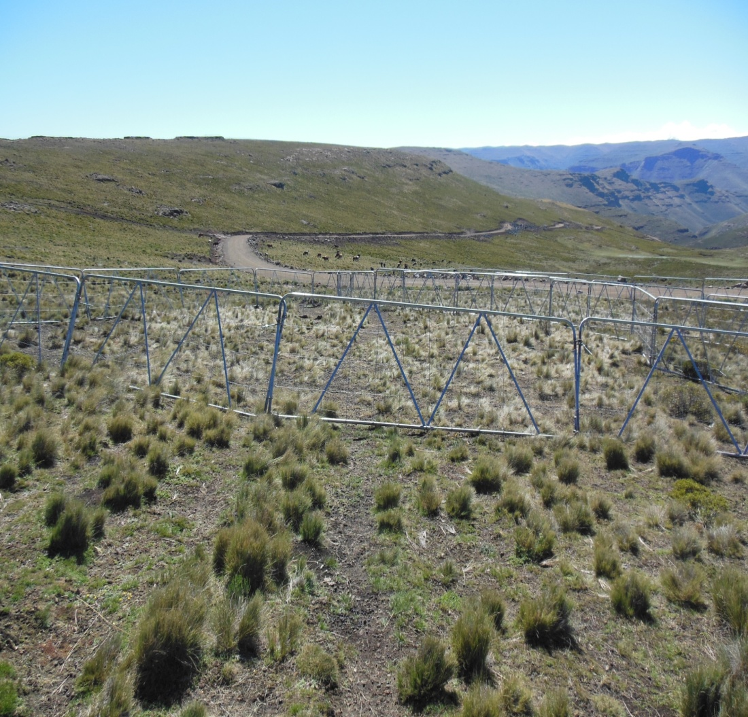
Presentation of a project you are working on 2/3
Khubelu Sponges Project (KSP) / Integrated Catchment Management (ICM)
Addresses Wetland Protection and Conservation.
High Density Grazing
Notes:
Aims to holistically protect and conserve the Sponges in the Khubelu catchment by demonstrating a High Density Grazing approach for sustainable management of the wetlands, benefiting people, the environment and securing long-term availability and quality of water from the Upper Orange-Senqu catchment area.
UPSCALED TO ICM due to maximized foraging, animal performance and soil health benefits.
My role is to implement and monitor range management activities. Also a member of Technical Task Team
Photo Credits: Sauli Ramatla (Mr)

Slide 6
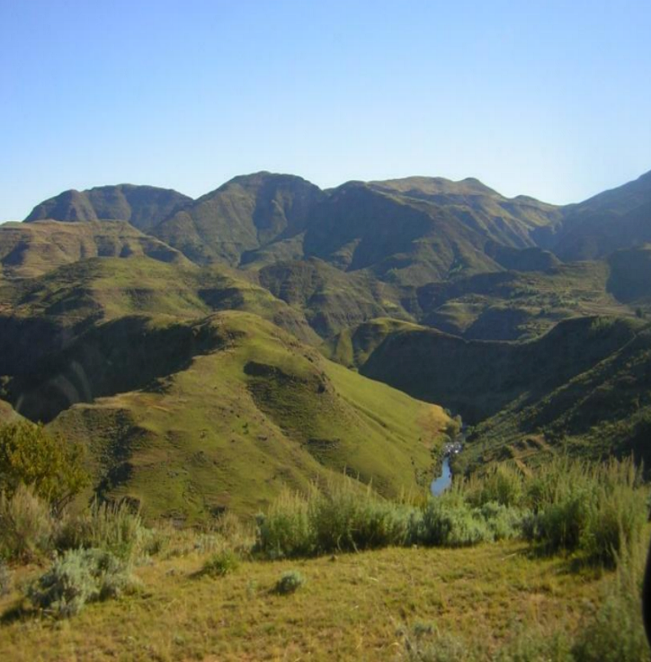
Presentation of a project you are working on 3/3
Sustainable Land Management Project (SLM)
Addresses provision of ecosystem services
Protection of pristine environments
Notes:
Aims to ensure the continued provision of ecosystem services and protection of pristine environment by assisting communities with the powers, knowledge and skills to manage natural resources in a sustainable manner. Also addresses land degradation by providing strong basis for development while sustaining a range of benefits to rural communities. Poverty is mostly concentrated in the rural areas and women are generally poorer than men.
My role is to support implementation of sustainable land management techniques, monitor and evaluate best approaches for upscaling.
Photo Credits: Department of Range Resources Management

