Slide 1
Personal presentation
Rolando Ramirez M.
Manager ProalSUR
Prof. at University for International Cooperation, Costa Rica.
rolandorami2010@gmail.com/rramirez@proalsur.org
IPROMO
Bioeconomy in mountain areas – an opportunity for local development
Pieve Tesino /Ormea 18 June -02 July 2018

Slide 2
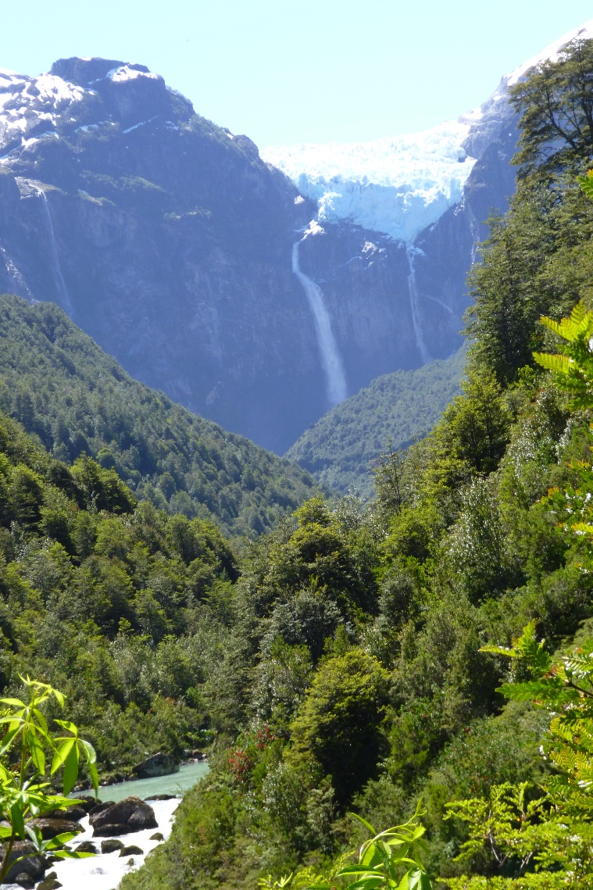
Education
Law Studies at the University of Chile.
M.A. Degre at the University of Regina, Sask. Canada.
Environmental Law diploma, Green Fund, Peru.
Employment and main activities
Until 2011, 20 years as a Senior Manager/Regional Director at a Canadian international development agency for Latin American and the Caribben, based in Costa Rica.
Since 2011 engaged in academic activities at the post graduate level with CATIE.
FAO consultant for the “Andean Mountains, an opportunity for integration and development in South America” project.
2015-2017 Senior Researcher for the “Inclusion of communities in management of reserves and protected areas” project. Patagonia,Chile.
2017 Profesor at University for International Cooperation.

Slide 3
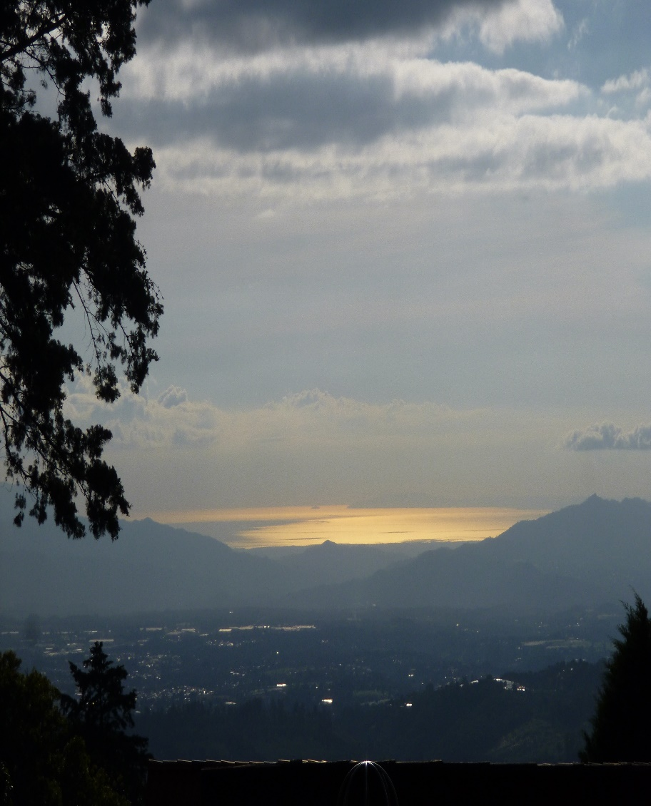
Other interests (volunteer work, hobbies etc.)
Volunteer at the Lankester Botanical Garden, University of Costa Rica.
Volunteer at the Board of the Costa Rica-Canada Rural Housing Foundation, on behalf of the Canadian Ambassador.
Music, poetry, green house, sandsailing.
Particularly interested in exploring new approaches to governance in the field of natural resources and rural communities.

Slide 4
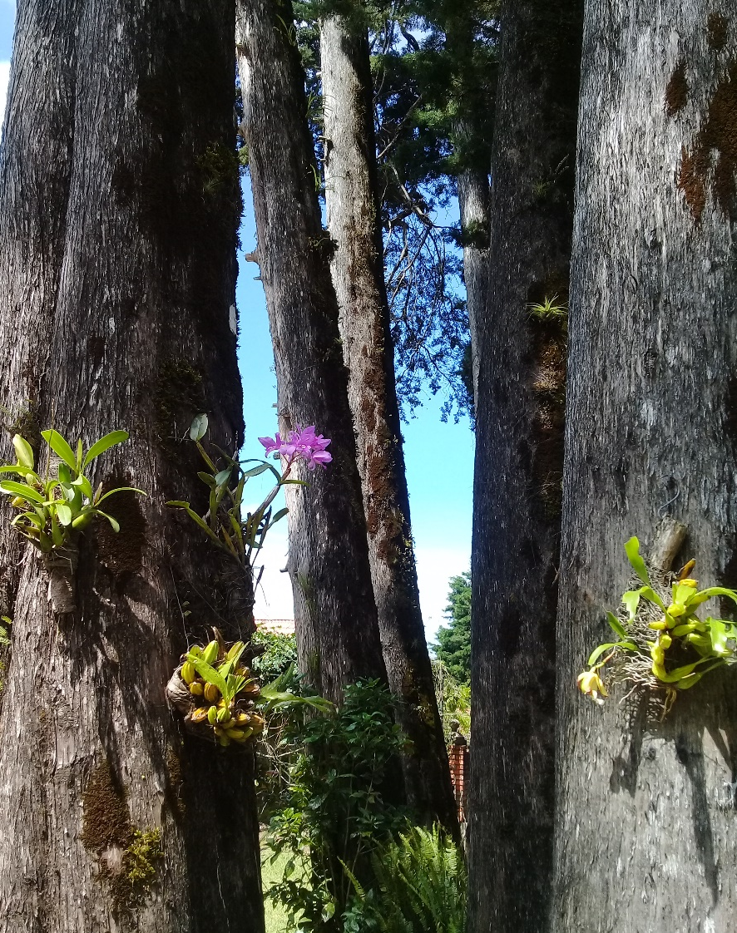
Presentation of a project you are working on 1/3
Research and preparation to give a three month on line course at the University for International Cooperation, Costa Rica. Focus: Governance in Management of Mountain Ecosystems.
Ground work to establish a GIAHS-FAO program in Central America.
Begin consultations with IICA to introduce improved inclusive governance practices in CAIS programs.

Slide 5
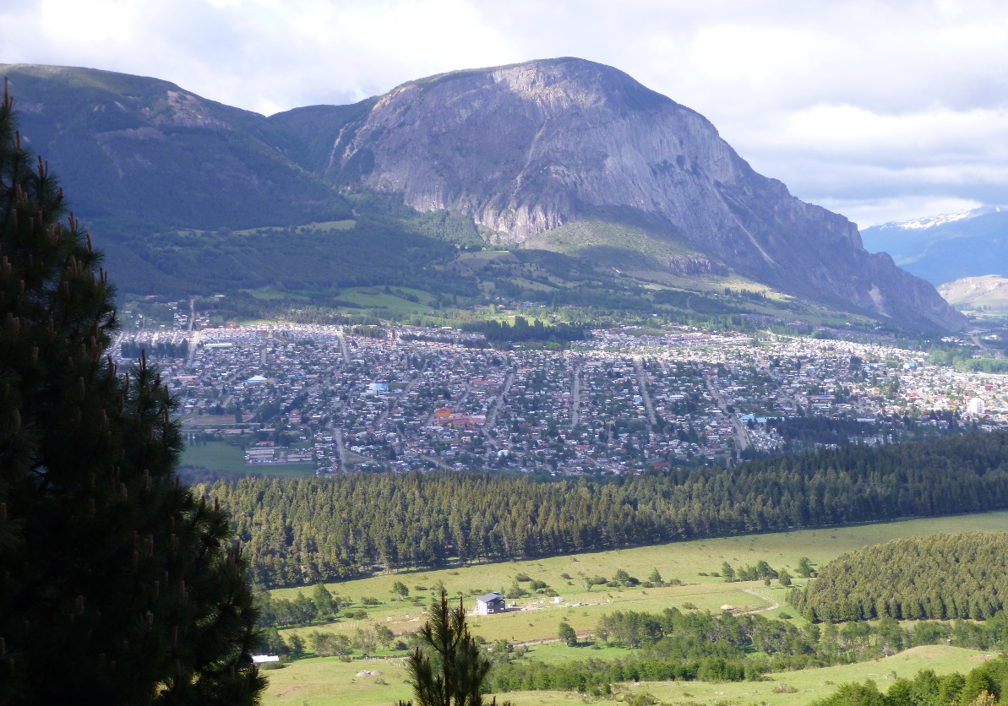
Presentation of a project you are working on 3/3
Findings on recent research project Exploring Inclusive Management practices in Protected Areas and Buffer zone communites. Patagonia,Chile.
Ecosystem sustainability versus protectionist approach.

Slide 6
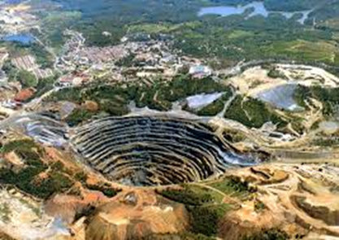
Presentation of a project you are working on 3/3
Absence of community inclusion in managing ecosystem sustainability
Lack of multidisciplinary and multisectorial aproach in ecosytem management

Slide 7
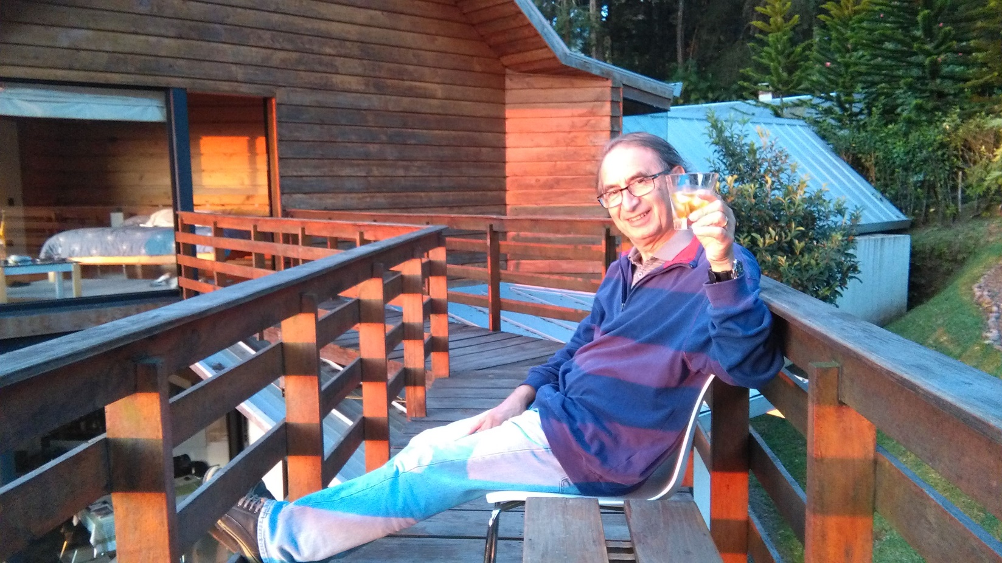
Thank You!

