Slide 1

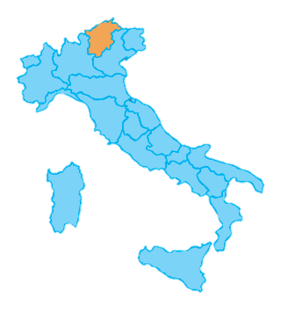
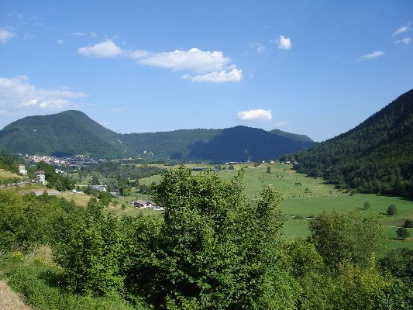
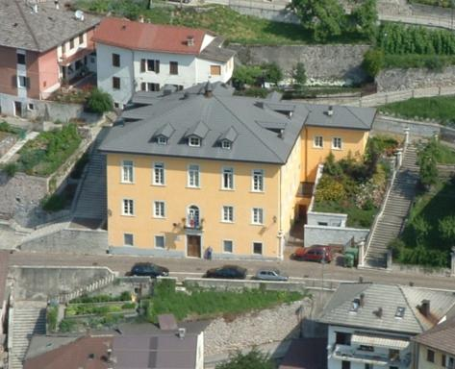
ALPINE RESEARCH CENTRE
of the University of Tuscia
Administrative Unit of the University of Tuscia (Dept. DIBAF), including teaching and research facilities, located in the Tesino plateau (Trento province, Italian Alps-Dolomites)
Viterbo

Slide 2

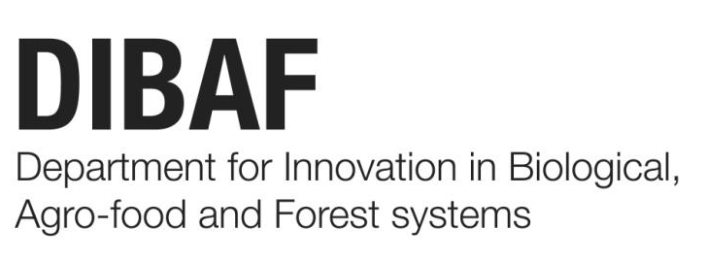
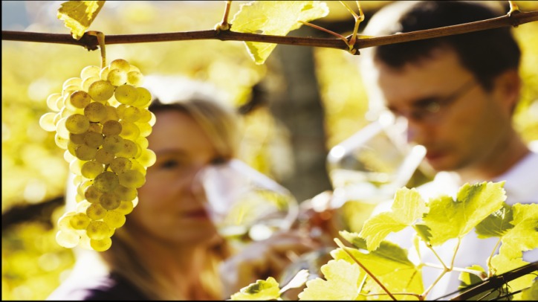

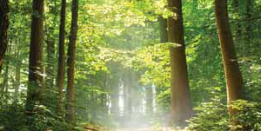
Research for Sustainability

Slide 3
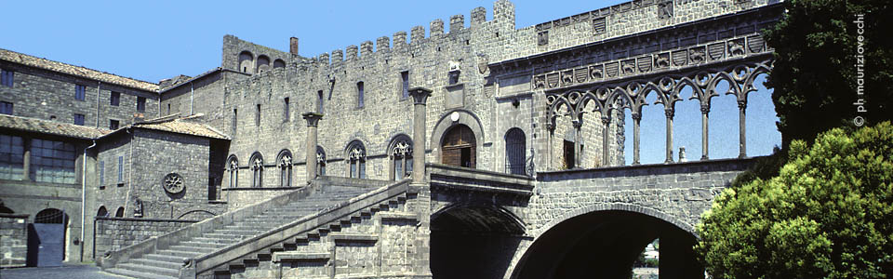
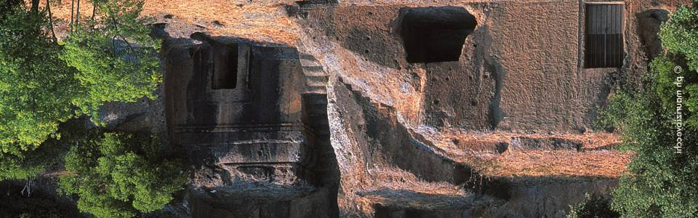
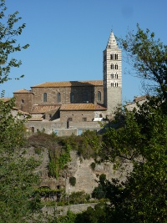
City of Viterbo: from Middle Age with Etruscan-Roman roots

Slide 4
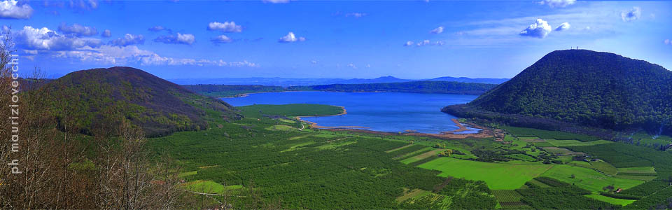
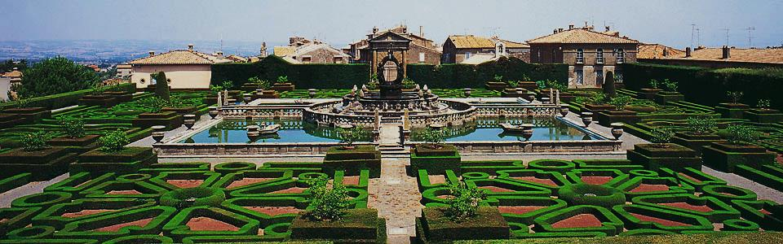
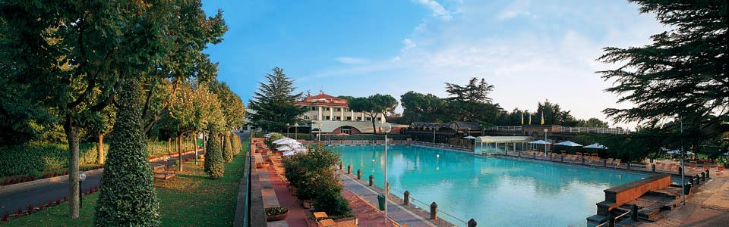
Tuscia: a region of mountains, water, ...

Slide 5
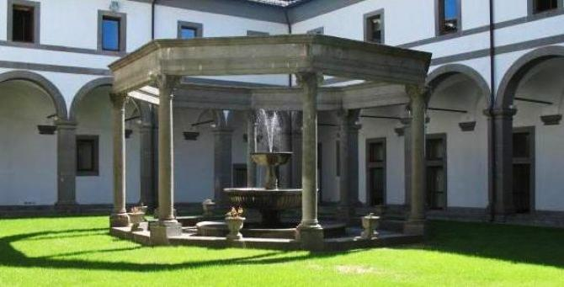
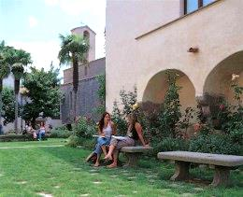
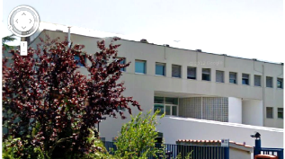
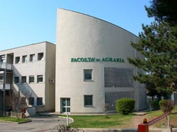
The University: old and new

Slide 6

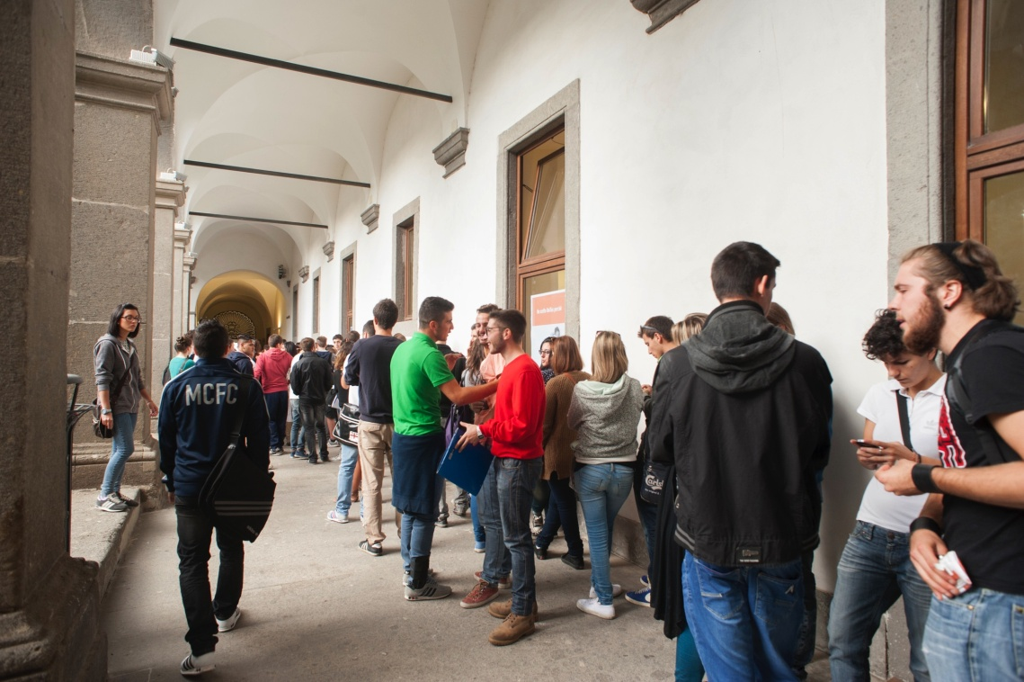
644 members of staff
(82 Full Professors; 101 Associate Professors, 106 Permanent Assistant Professors, 33 Temporary Assistant Professors; 320 Technical and Administrative; )
7000 students
16 Bachelor’ Degree
13 Master’s Degree
6 PhD courses
4 Masters courses
OUR NUMBERS

Slide 7
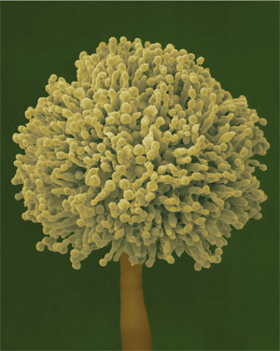
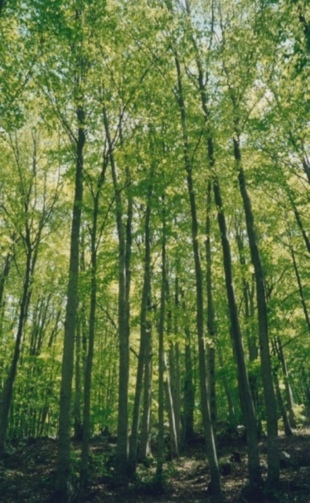
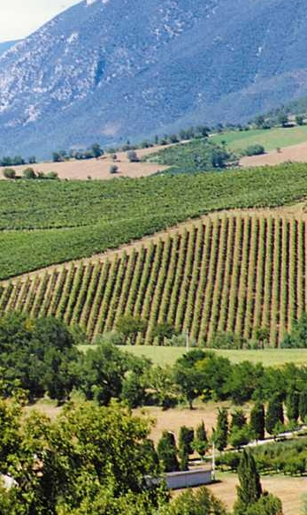
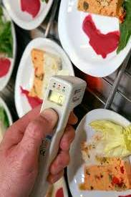
DIBAF
SCIENTIFIC & TECHNOLOGICAL INNOVATION
BIOTECHNOLOGY
AGRO-FOOD SCIENCES
ENVIRONMENT
&
FORESTRY
LANDSCAPE CULTURAL HERITAGE
www.dibaf.unitus.it

Slide 8


The DIBAF staff
20 full professors
29 associate professors
17 assistant professors
21 technical staff
13 administrative staff
31 Post-Doc researchers
63 PhD students
195 people, in total
95 permanent staff

Slide 9
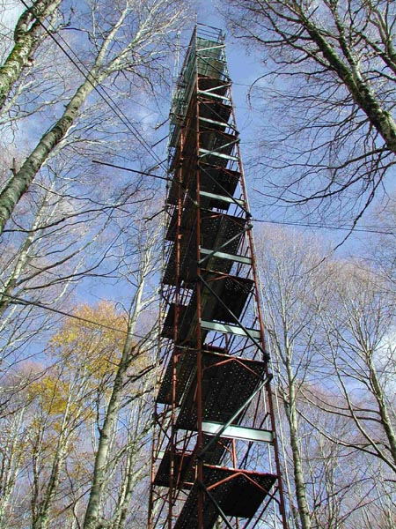

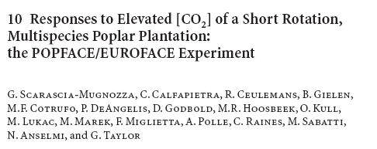
Budget, Projects, Publications
Full budget per year: 12 M€
Nr. research projects : 250
ISI papers per year: 100

Slide 10
ACADEMIC PROGRAMS
DIBAF integrates research and teaching , offering Bachelor of Science (BS) and
Master of Science (MS):
UNDERGRADUATE PROGRAMS
BIOTECHNOLOGY | BS
FOOD & WINE TECHNOLOGY | BS
LANDSCAPE & ENVIRONMENTAL DESIGN AND PLANNING | BS
GRADUATE PROGRAMS
BIOTECHNOLOGY FOR HEALTH & WELLBEING | MS
FOOD SAFETY AND QUALITY | MS
FOREST AND ENVIRONMENTAL SCIENCES | MS
RESTORATION OF CULTURAL HERITAGE | MS
A total of 800 students are enrolled in our courses

Slide 11


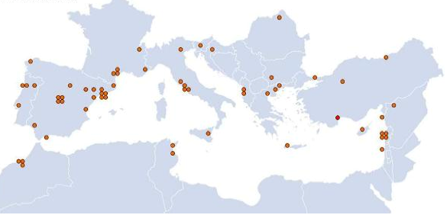
ERASMUS MUNDUS
UNIVERSITY | DEGREE AWARDED
Lisbon | MSc in Mediterranean Forestry and Natural Resources Management
Padova | MSc in Forestry and Environmental Sciences
Lleida | MSc in Mediterranean Forestry and Natural Resources Management
Valladolid | MSc in Mediterranean Forestry and Natural Resources Management
Karadeniz | MSc in Mediterranean Forestry and Natural Resources Management
Tuscia (DIBAF) | MSc in Forestry and Environmental Sciences
Porto | MSc in Mediterranean Forestry and Natural Resources Management
Mediterranean Forestry and Natural Resources Management
A two-year world-class Erasmus Mundus Master Course Program that answers a call for a coordinated approach throughout the Mediterranean basin to develop reliable information and tools - based on sound science and a multidisciplinary approach, in order to improve Mediterranean forestry and natural resources management and policy-making

Slide 12
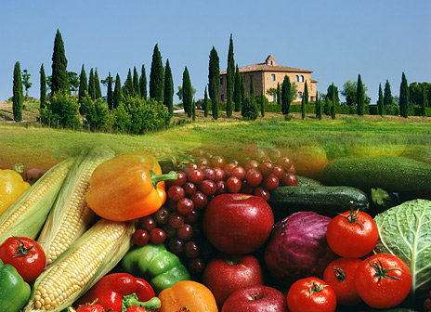

PhD Program: Science of Sustainability
Coordinator: Prof. Mauro Moresi
The DIBAF Doctorate School offers three different curricula
AGRO-FOOD TECHNOLOGIES:
The course was developed to improve the skills of graduates in research areas closely related to environmental topics
BIOTECHNOLOGY:
The course was developed for research on fundamental and applied aspects of conservation, processing and evaluation of food.
FOREST ECOLOGY & ENVIRONMENTAL SCIENCES:
The course was developed to study the forest ecosystems, in the context of high quality research programs.

Slide 13
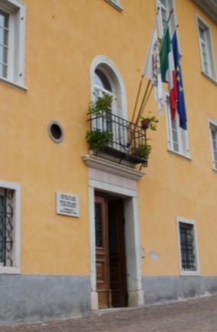
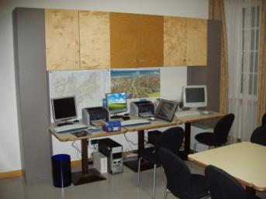
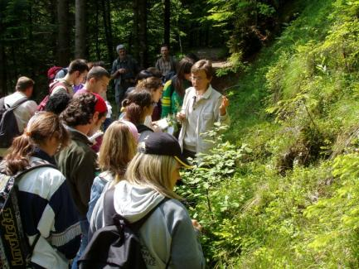
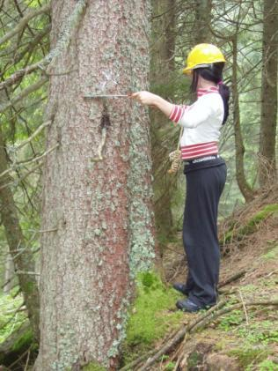
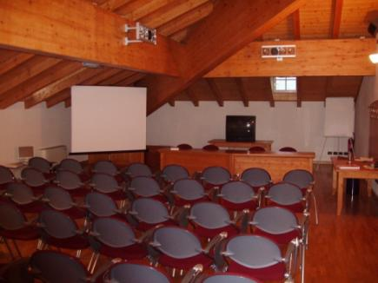
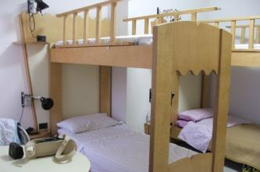
The Alpine Research Centre provides support for:
- practical training of forestry students;
- experimental activity within the preparation of graduate and PhD thesis;
- scientific and technological research;
- summer schools, seminars, workshops and conferences;
- technical, scientific and practical collaboration to the management and development of the Tesino Arboretum.

Slide 14
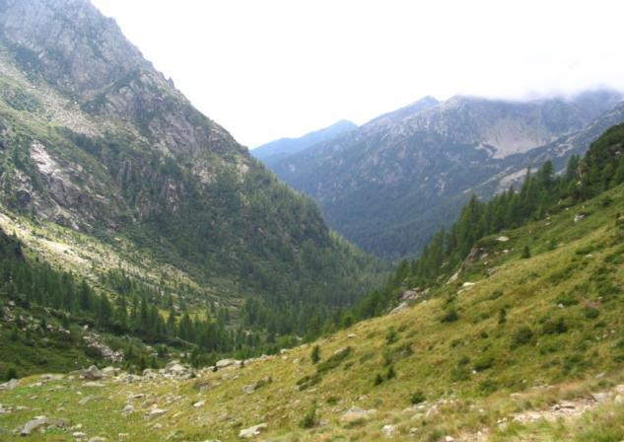
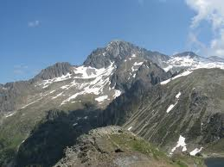
Natural environment in Tesino
The Tesino plateau (900 m a.s.l.) is surrounded by calcareous and granitic mountains.
The highest peak is the Cima d’Asta (2850 m s.lm.).

Slide 15
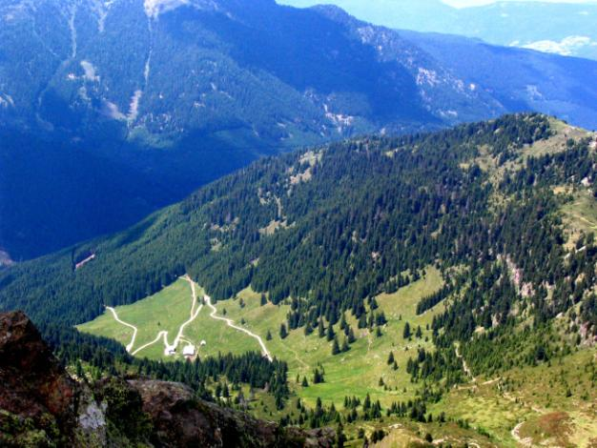
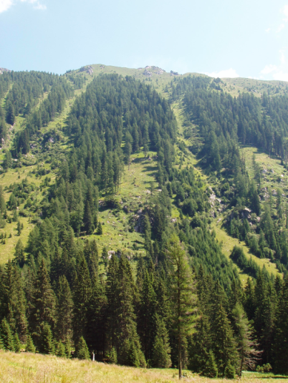
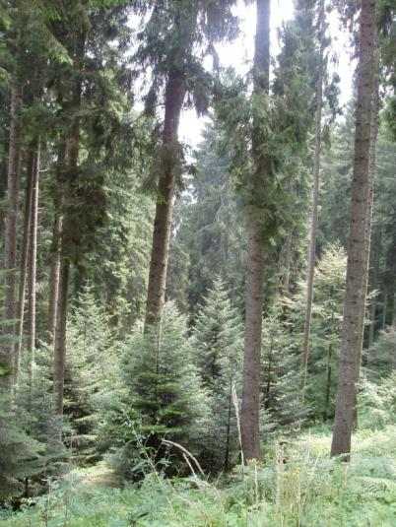
Slopes are covered with typical alpine forest dominated by beech, silver fir, spruce and larch.

Slide 16
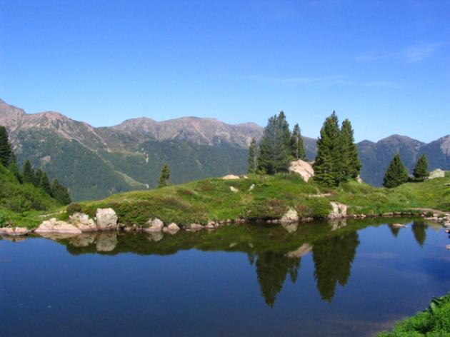
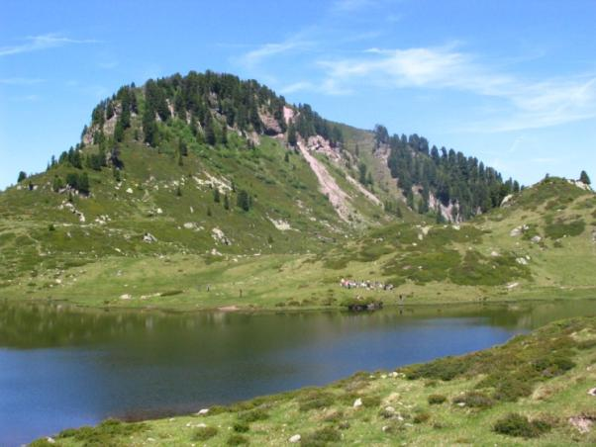
A large area of pastures and meadows extends above the timber line where some small glacial lakes are located. The scarce presence of tourist infrastructures accentuate the wilderness character of the environment

Slide 17
Director: Giuseppe Scarascia-Mugnozza
Admin. Secretary: Alessandra Mancini
Via S. Camillo de Lellis - 01100 Viterbo, Italy
www.dibaf.unitus.it

