Slide 1
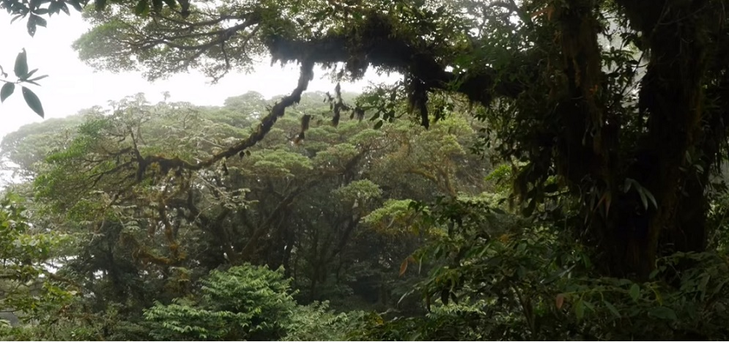

Local Regulatory and Economic Instruments to Encourage Tropical Forestry Conservation:
An Analysis of the Policy Process in
Costa Rica and Mexico
Sarah Cordero
July 7, 2019
Landscape approach for enhancing mountain resilience

Slide 2
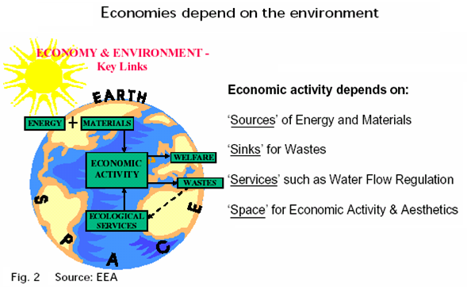
Neoclassical Economics Flaws
Introduction

Slide 3
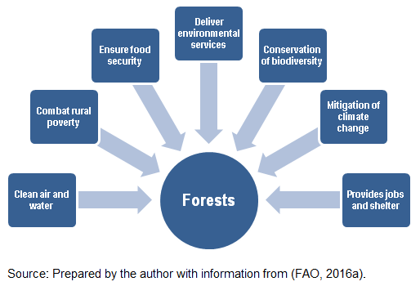
Benefits Provided by Forests
Introduction
Notes:
“Forests play a fundamental role in combating rural poverty,
ensuring food security,
and providing decent livelihoods;
they offer promising mid-term green-growth opportunities;
and they deliver vital long-term environmental services,
such as clean air and water, conservation of biodiversity, and mitigation of climate change”

Slide 4
Global Forest Area Change (1990–2015)
WHA
T
Year | Forest (1000 ha) | Annual change (1000 ha) | Annual growth rate
1990 | 4,128,269
2000 | 4,055,602 | -7,267 | -0.18
2005 | 4,032,743 | -4,572 | -0.11
2010 | 4,015,673 | -3,414 | -0.08
2015 | 3,999,134 | -3,308 | -0.08
Source: FAO. (2016b). State of the World’s Forest 2016. Forests and agriculture: land-use challenges and opportunities.(p.14) Rome: Food and Agriculture Organization of the United Nations.
Introduction
Notes:
Forests cover 1/3 of the world’s landmass
1.6 billion people depend on forests for their livelihoods
Global deforestation continues at an alarming rate
13 million hectares (32 million acres) destroyed annually

Slide 5
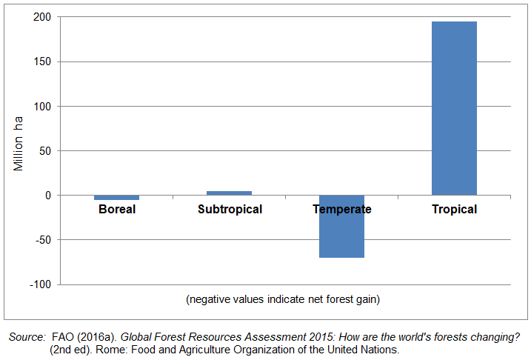
Net Forest Loss 2000—2010 from Country Reports
T
Y
P
E
Introduction

Slide 6
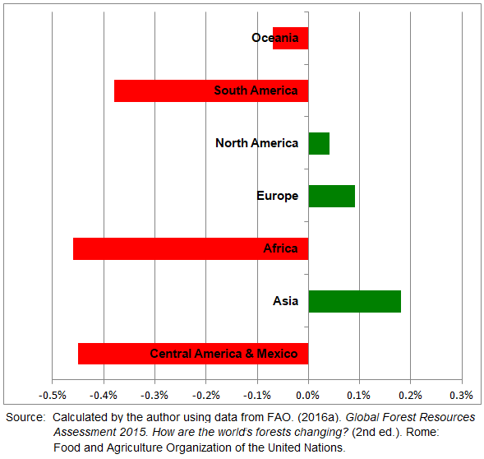
Trend of Net Forest Cover Gains and Losses by geographical sub-region, 1990 - 2015
WH
E
R
E

Slide 7
Research Question
What are the critical variables during a public policy process that increase the probability of policy approval?
How do the results obtained in two countries compare to what the theory says in terms of the dynamics of a forest policy process?
Research Question

Slide 8
Other Policies Related to Forest Policies
Agrarian
Climate change
Land use change
Land Tenure
Research Question
Notes:
Academicians define the policy process as the study of change and development of policy as well as the related actors, events, and contexts. Scholars— in order to analyze a policy process— represent the process of policy creation in a model that delineates the sequence of activities that affect the development of a specific policy (Kraft & Furlong, 2017). In sum, the “policy sequential approach” describes the sequence of activities affecting policy development.
Some scholars of the policy sequential approach describe a process conducted through a sequence of stages (also called cycles): agenda setting, policy formulation, policy adoption, implementation, evaluation, and termination, (Brewer, 1974; Brewer & deLeon, 1983; deLeon, 2007; Lasswell, 1951, 1956). Others also see the policy process as a sequence, but the stages vary, for example they might include agenda setting; policy formulation; policy legitimization; policy implementation; policy and program evaluation; and policy change (Wolf & Robinson Wolf, 2013). In this research, I will focus on agenda setting, policy formulation, and policy adoption, because those stages provide the information that better determines what triggers and generates a change in a policy process (Bray et al., 2006; Kern & Rogge, 2018)

Slide 9
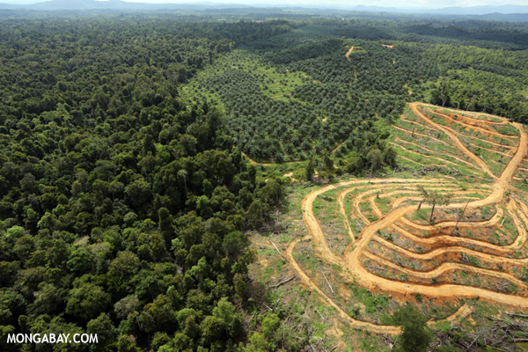
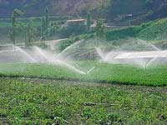
Agrarian
Notes:
Resource Use

Slide 10
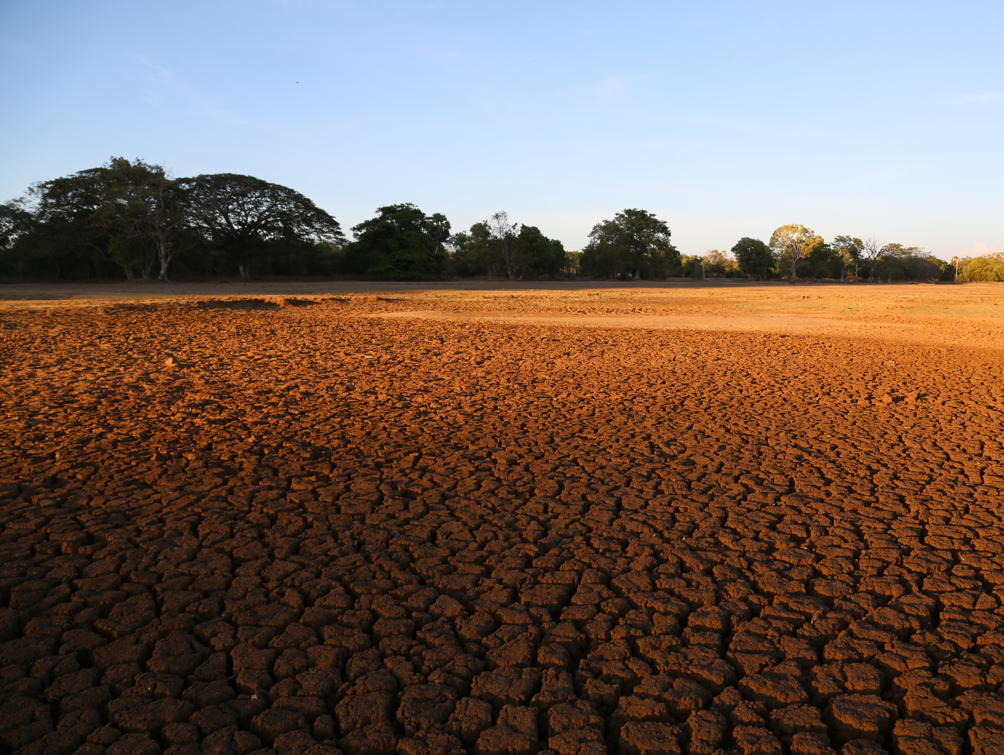
Climate Change

Slide 11
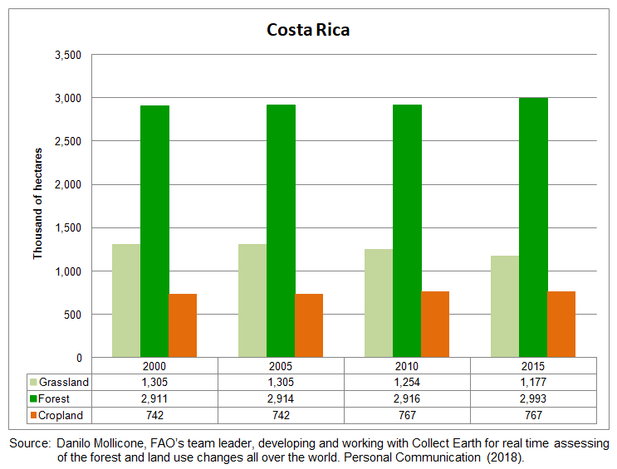
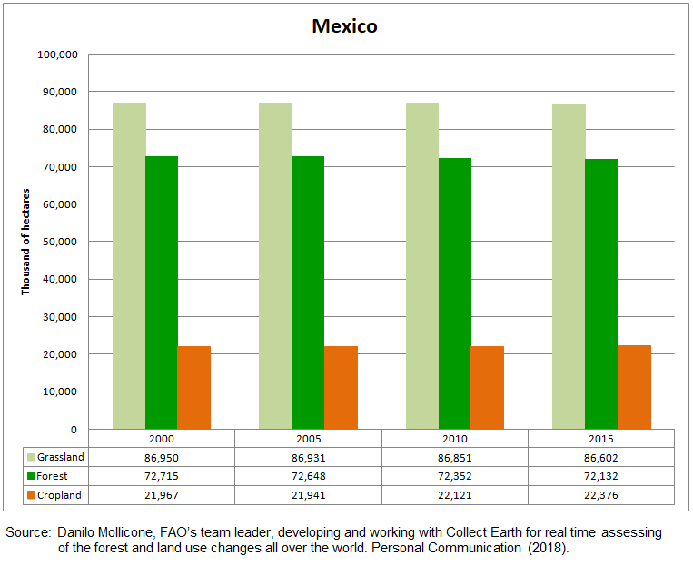
Land Use Change

Slide 12
CASE STUDIES

Slide 13
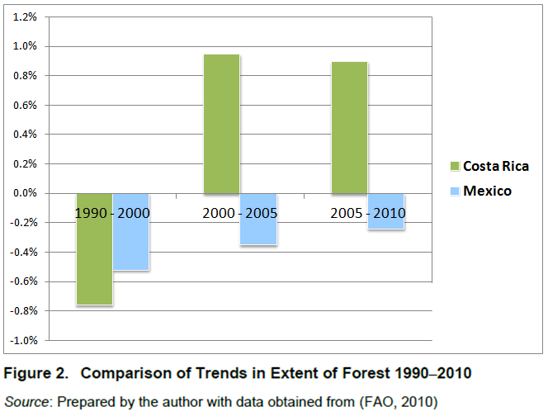
Preliminary Findings from Case Studies

Slide 14
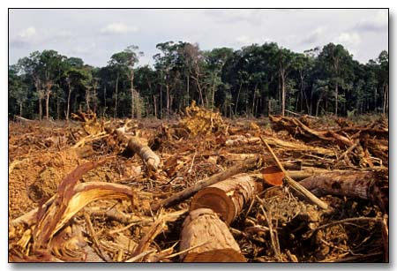
Costa Rica
Cases

Slide 15
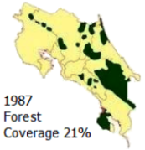
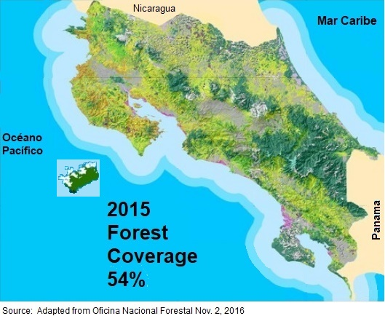
Costa Rica
Cases: Costa Rica

Slide 16
Costa Rica Law 7575 (1996)
CAC | Economic Instruments
veto on land use change on those lands covered by natural forest veto on changing forestlands into forest plantations prison penalties between 3 months and 3 years for those violating the law (i.e. illegal logging) ban on export of wood coming from forests, in logs and squares special permit needed to transport timber around the country police action to remove squatters from areas under PES Forest rangers acquired police authority regarding forest issues | Creation of PES, paid to landowners through the forest conservation certificate real estate tax exemption to those receiving PES forestland accepted as loan warranty (including the value of the forest, not just the land) creation of FONAFIFO establishment of the forestry fund, with the following sources: 1/3 of the proceeds of the tax on fossil fuels 40% of the forest tax (established in this law) income from sale of wood/timber confiscated user fee established on other natural resources (i.e. water)
Source: Prepared by the author based on Forestry Law N. 7575 (Asamblea Legislativa de la República de Costa Rica, 1996).
Cases: Costa Rica

Slide 17
Forest Law No.7575
Recognized four environmental services (ES) provided by forest ecosystems
  mitigation of greenhouse gas emissions;
  hydrological services
    including provision of water for human consumption, irrigation, and energy production
  biodiversity conservation
  provision of scenic beauty
    for recreation and ecotourism
?
2 | PES Legal Context

Slide 18
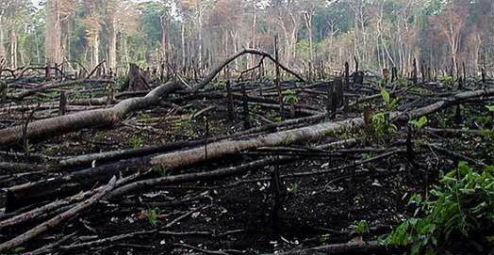
Mexico
Cases

Slide 19
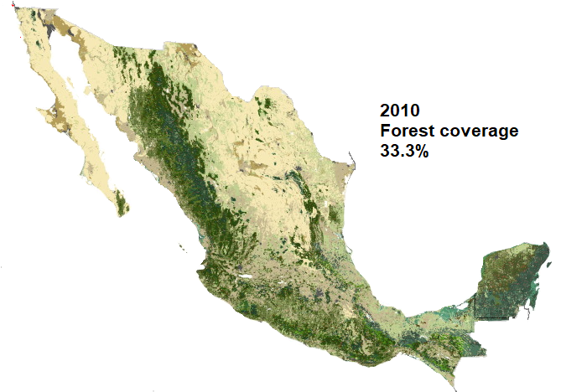
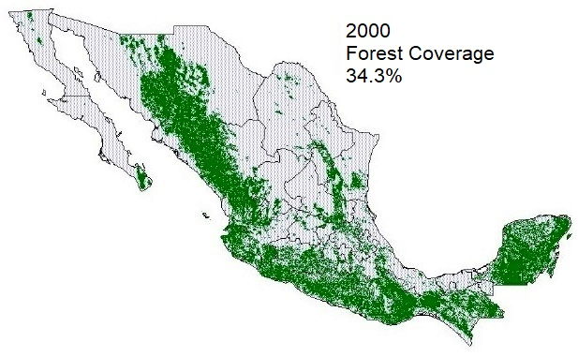
Mexico
Cases: Mexico

Slide 20
Mexico LGDFS (2003).
CAC | Economic Instruments
Zoning in forestry areas, to avoid land use change Land use change requires authorization Sanctions include Admonition A fine Temporary suspension, partial or total, of forest exploitation annulment of the authorization Confiscation of the wood and equipment used Temporary or definitive, partial or total closure of the facilities, | Creation of PES paid to providers of environmental services Tax exception to those contributing to the forestry fund The forest Federation should create: Fiscal incentives Credit mechanisms, preferential interest rates Long term insurance The Federation and other agencies will design, develop and apply other economic instruments A bond for conservation could be created
Creates National Forestry Service to integrate and coordinate efforts Provides clear mandate to CONAFOR Assign responsibilities to the Mexican Forestry Fund Includes a chapter in terminology
Source: Prepared by the author based on (Congreso General de los Estados Unidos Mexicanos, 2003).
Cases: Mexico

Slide 21
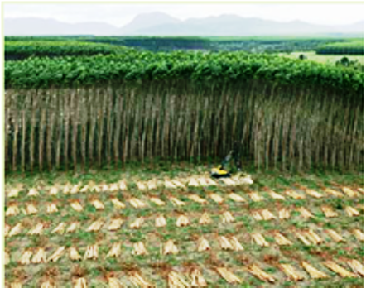
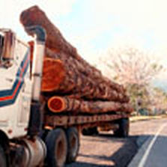
Comparative analysis

Slide 22
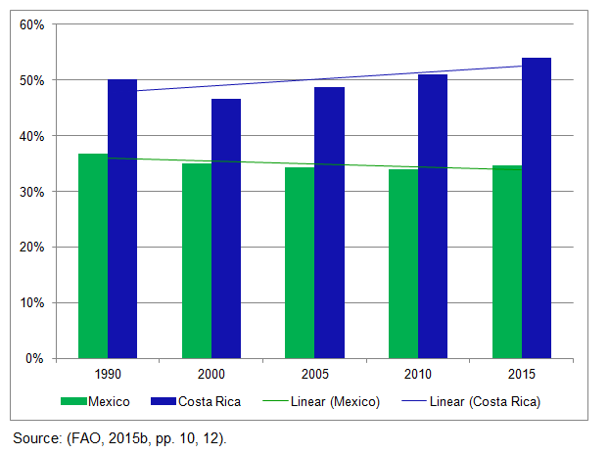
Comparison of Trend in Forest Coverage in Costa Rica and Mexico (%)
Comparative Analysis

Slide 23
Land Tenure
Ownership pattern
 | Public Ownership | Private Ownership | Communal and Other
Costa Rica | 45% | 55% | 0%
Mexico | 4% | 26% | 70%
Source: Prepared by the author with data obtained from (FAO, 2010a).
Comparative Analysis

Slide 24
Land Use
Land Use | Costa Rica | Mexico
 | Area (%) | Area (%)
Forest | 57.35% | 36.74%
Grassland | 22.55% | 44.11%
Cropland | 14.71% | 11.42%
Wetland | 2.45% | 1.96%
Settlement | 2.45% | 1.84%
Other land | 0.49% | 3.93%
Total | 100.00% | 100.00%
Source: Danilo Mollicone, FAO, personal communication (2018). Prepared based on satellite information.
Comparative Analysis

Slide 25
Comparison of Forestry Sub-sector Employment, 1990 - 2011
Comparative Analysis

Slide 26
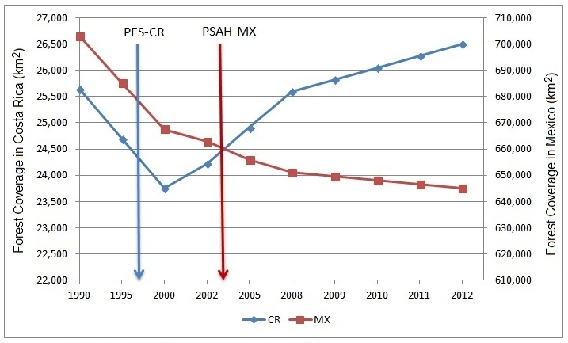
Forest Coverage in Costa Rica and Mexico and the Inclusion of PES (1990–2012)
Source: Prepared by the author with data from the World Bank, World Development Indicators database
. Last updated:11/12/2015. Retrieved from http://databank.worldbank.org/data/home.aspx
Comparative Analysis

Slide 27
From Interviews
Deforestation:
  History of large deforestation
Funds:
  Included in both laws
  Fuel tax and water fees
Instruments:
  Payment for environmental services
International Influence:
  Conventions, treaties and protocols
Opposition:
  Mainly wood industry
Starting point:
  Both countries had previous experiences
Support:
  World Bank experts
Unanimous:
  Congress unanimously approved the forest law
Comparative Analysis

Slide 28
Successful Policy Process
Agenda setting
Policy formulation
Policy
adoption
Conclusion

Slide 29
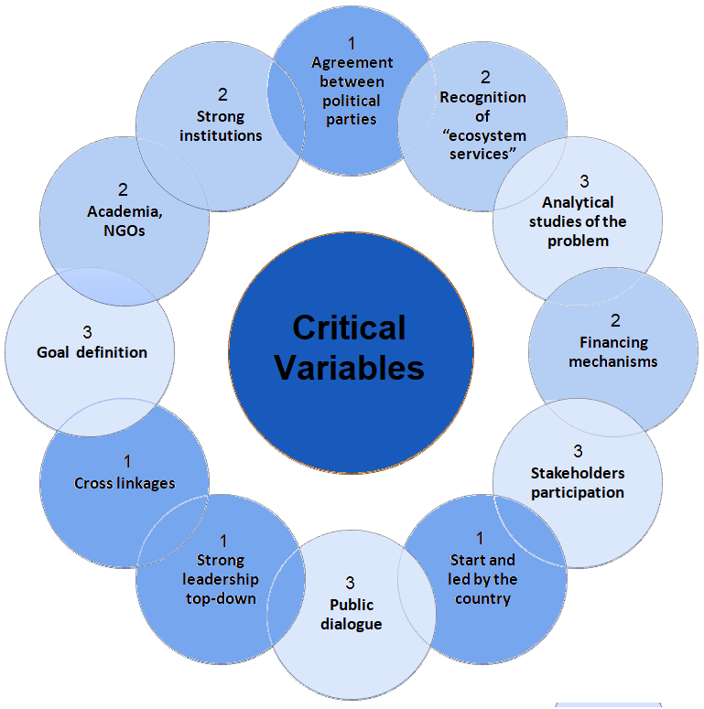

Slide 30
Shift Towards Policy Mix
Policy Mix
Regulation
Institutions
PES
Land use change
Land Tenure
Agrarian/ Climate Change
Conclusion

Slide 31

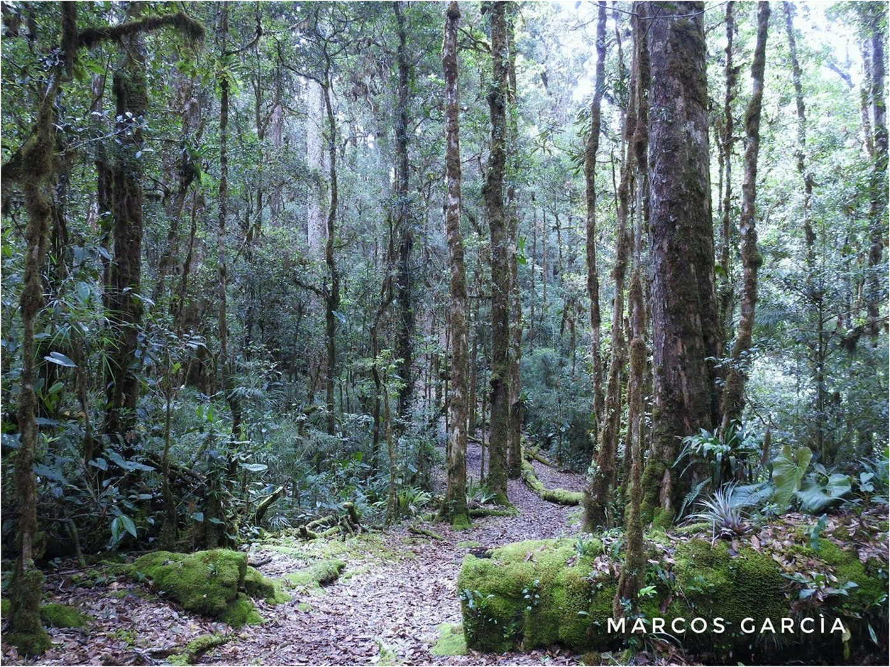

Thank You!
Sarah.cordero.cr@gmail.com
© Sarah Cordero. Ph. D.

