Slide 1
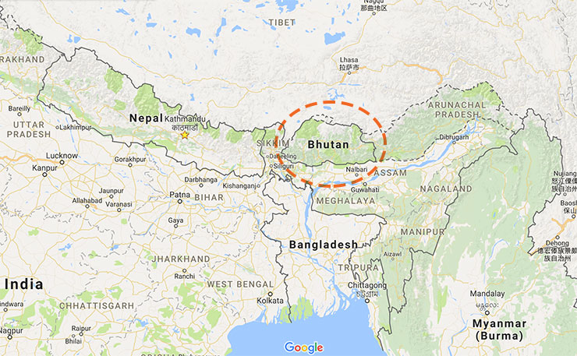
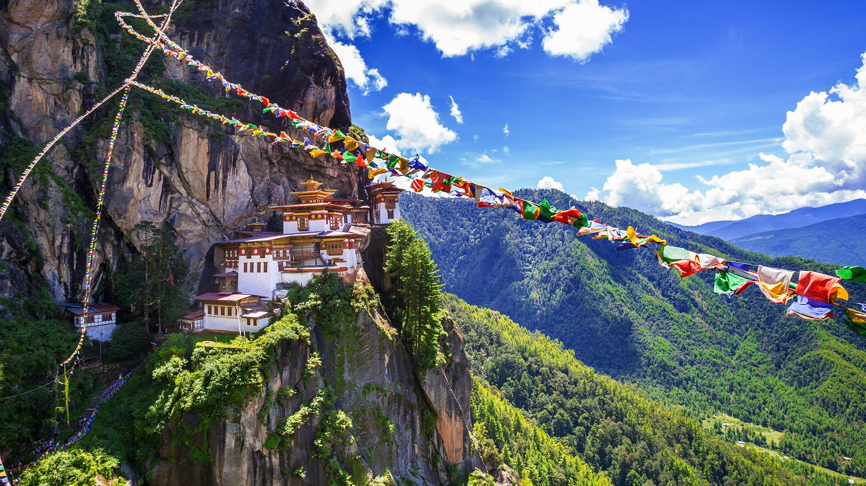
BUTHAN

Slide 2
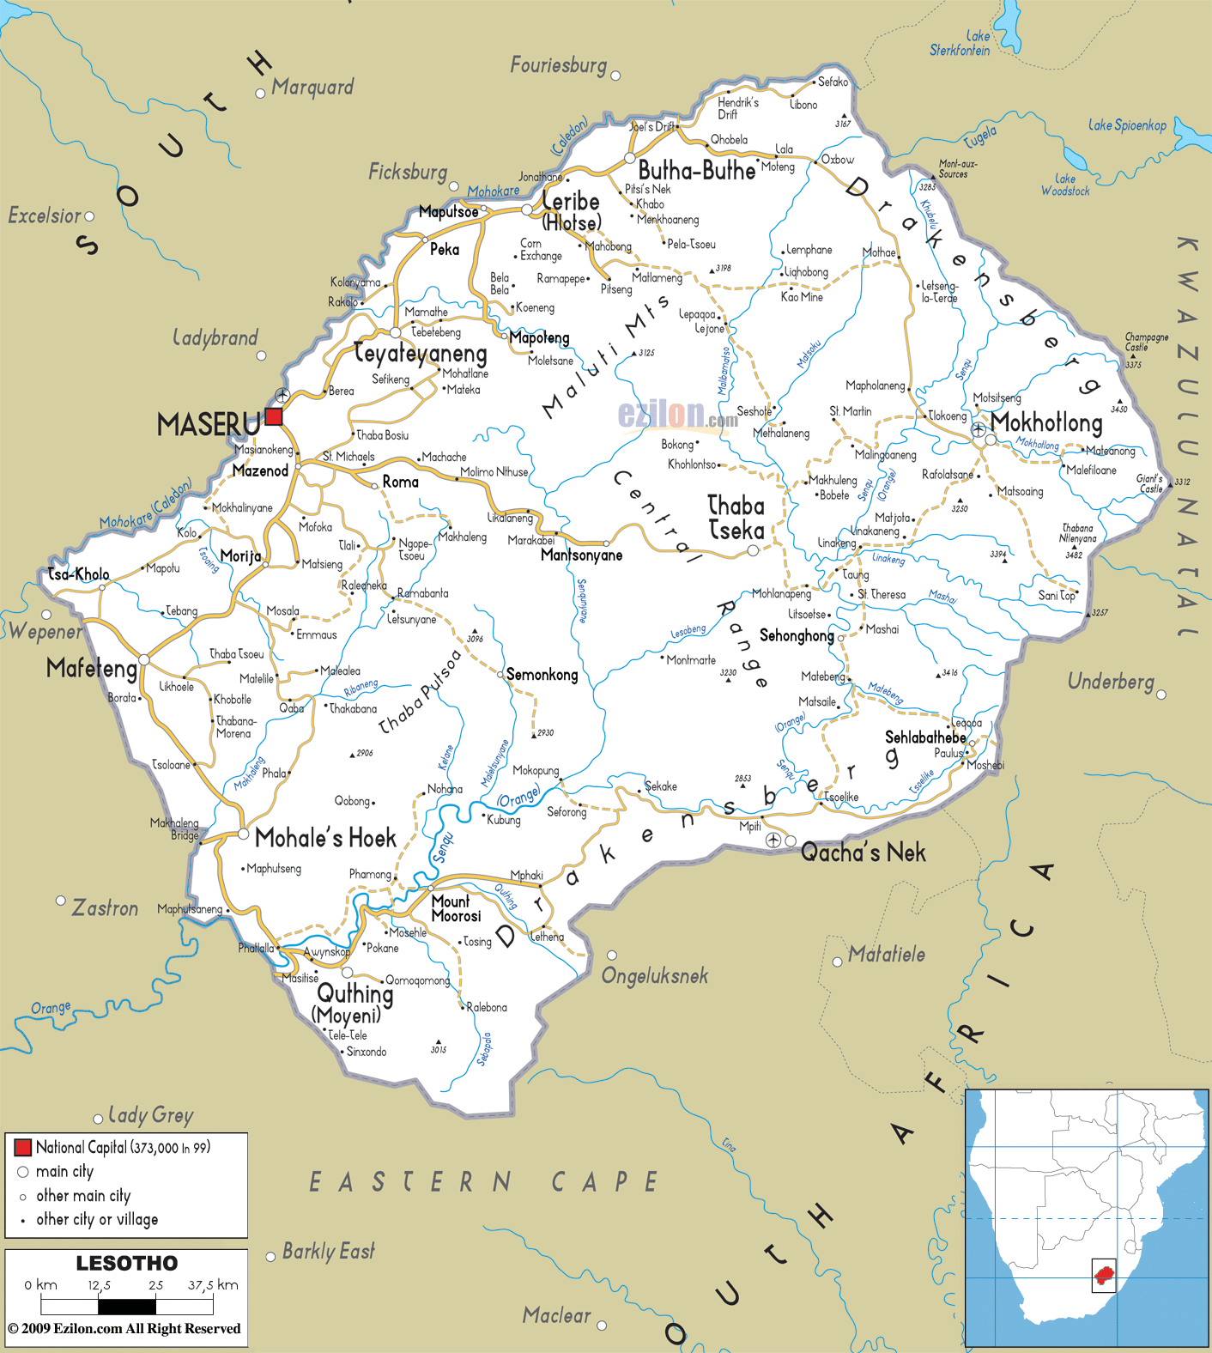
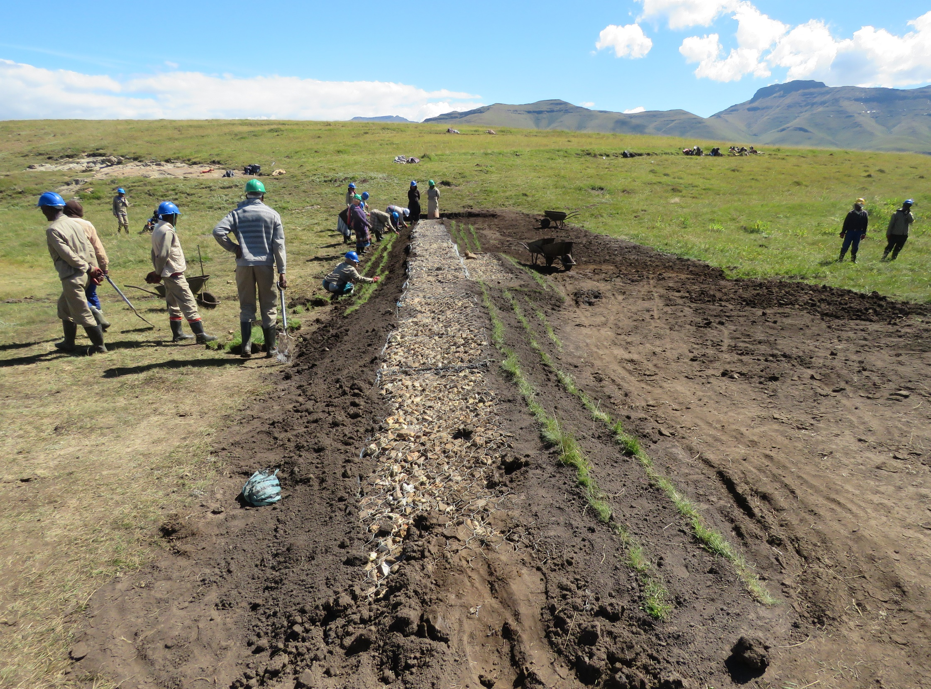
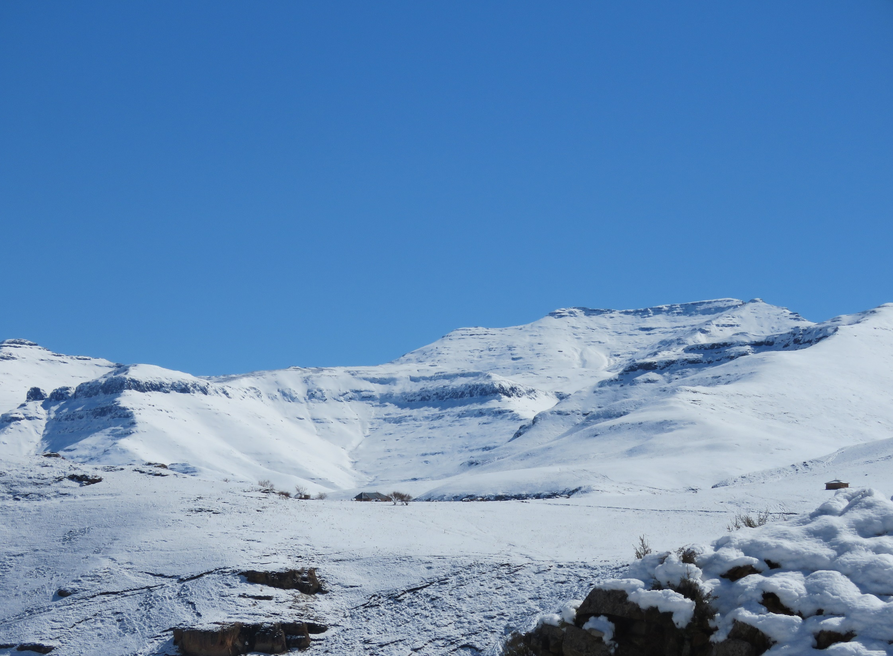
LESOTTHO
Edward Wetland rehabilitation - Lesottho
Somalenje Mountain - Lesottho

Slide 3
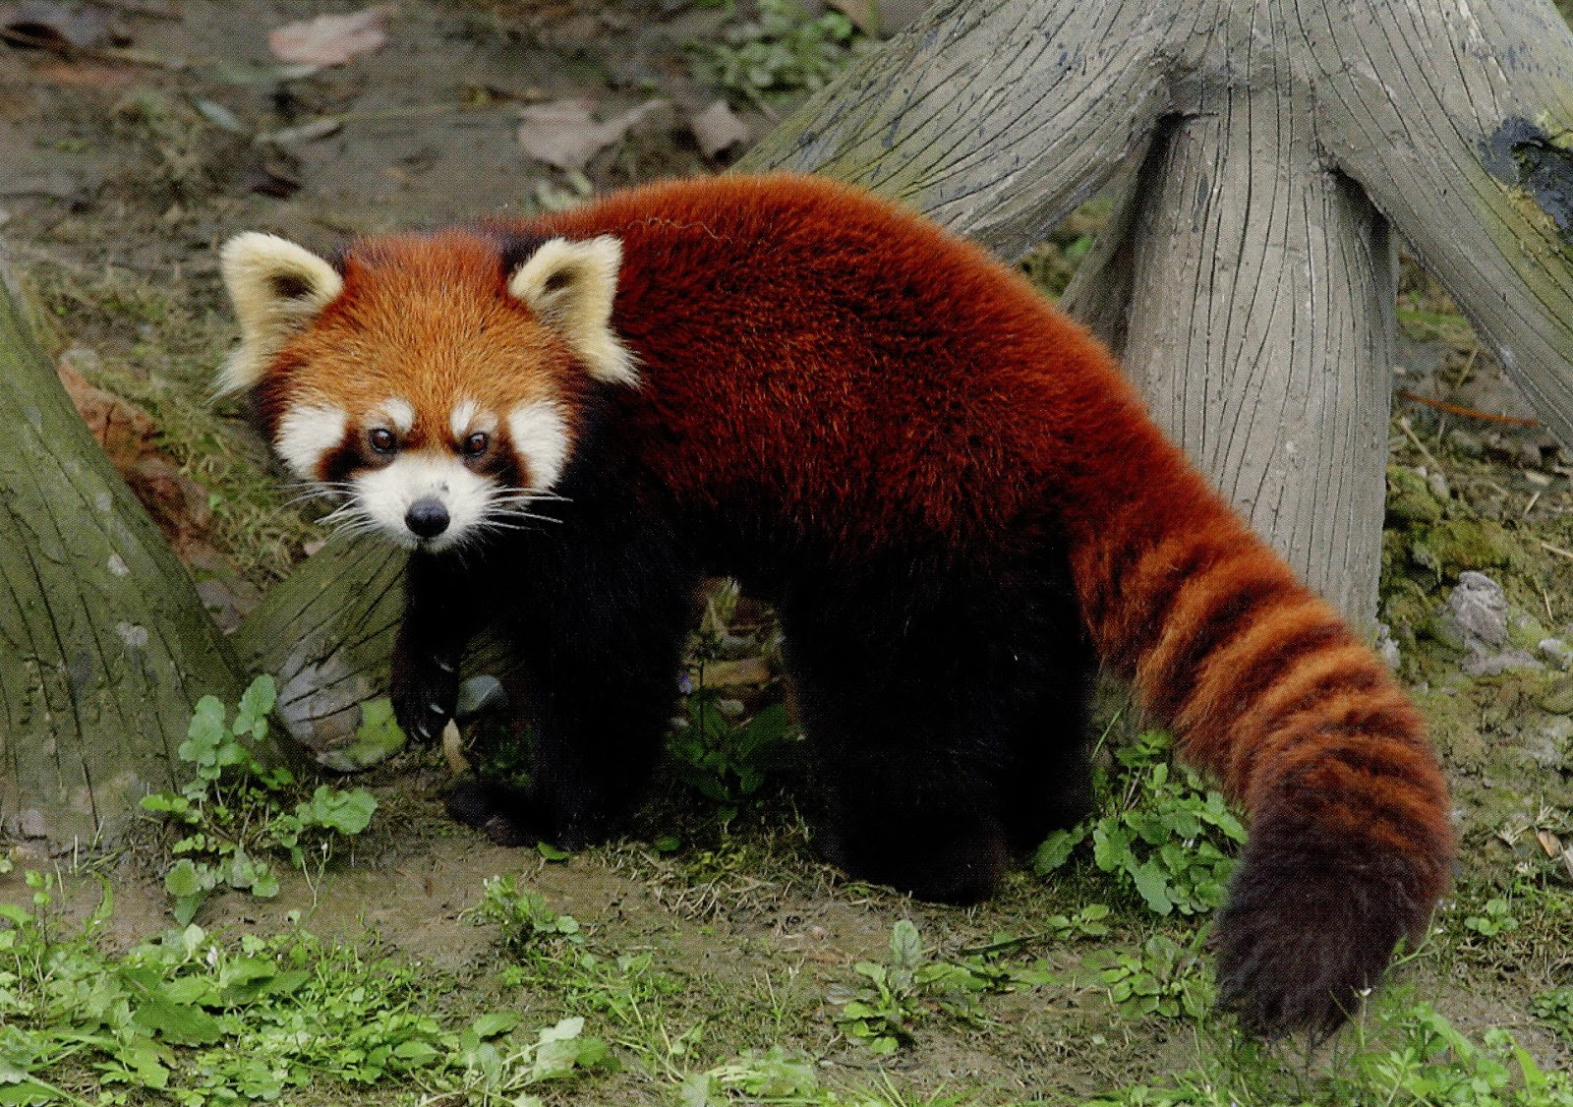
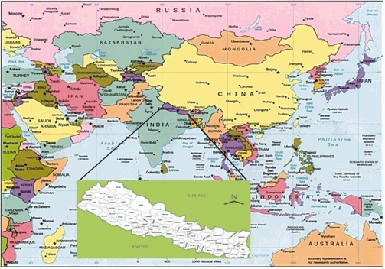
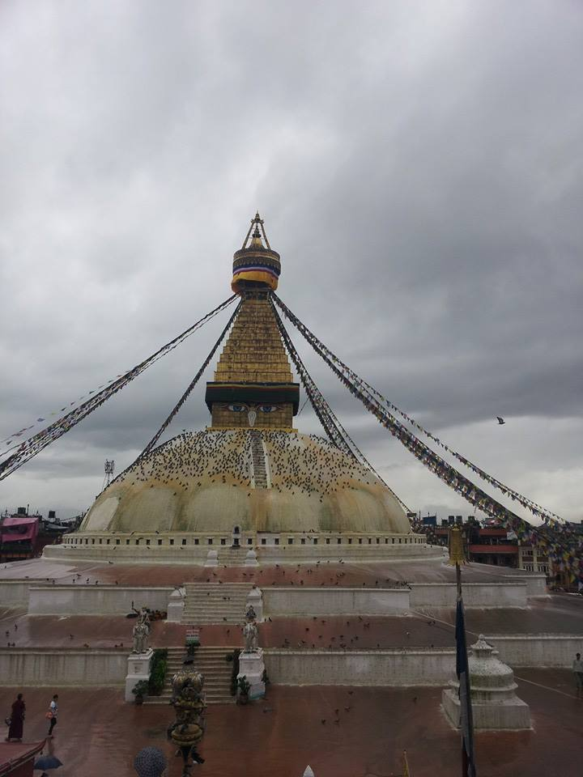
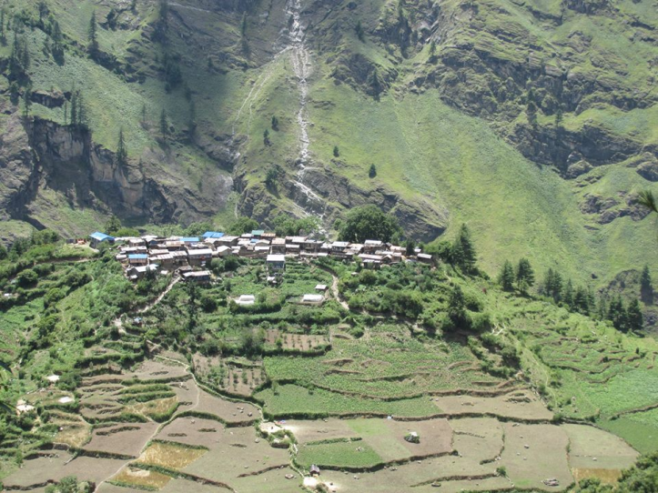
NEPAL
Bouddhanath, UNESCO World Heritage Site – Kathmandu, Nepal
Red Panda – Nepal
Nache Village Manang – Nepal

Slide 4
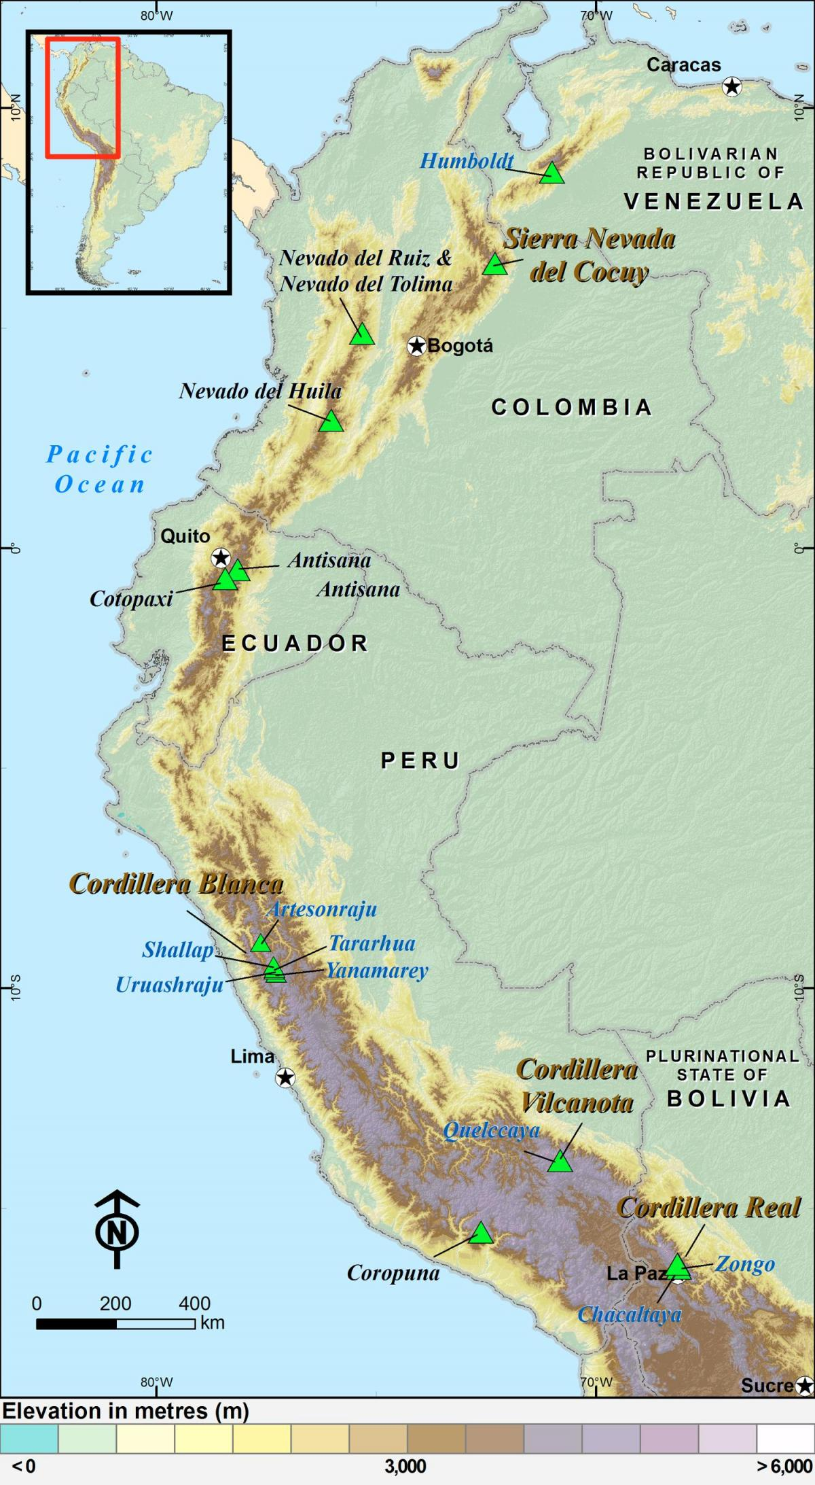
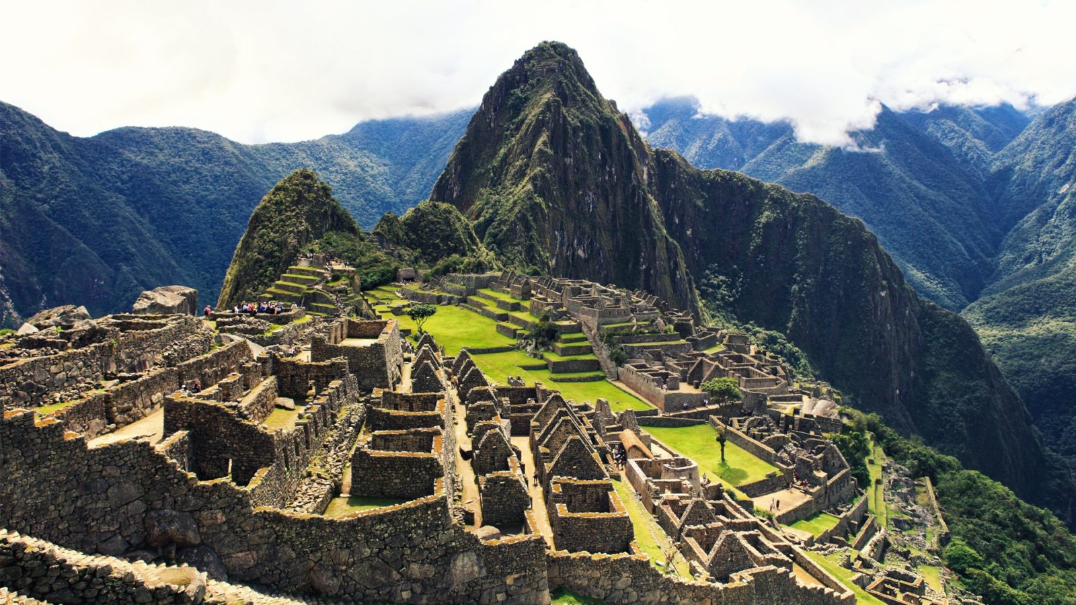
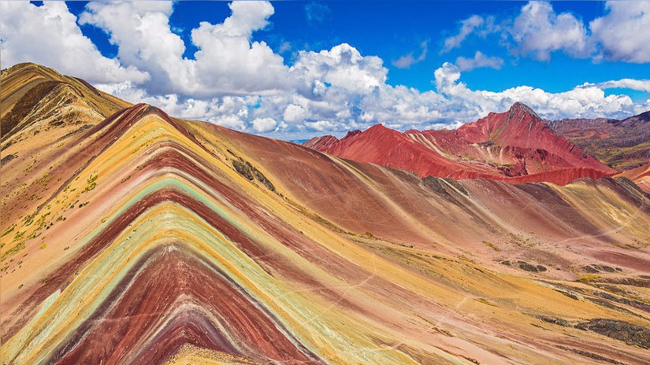
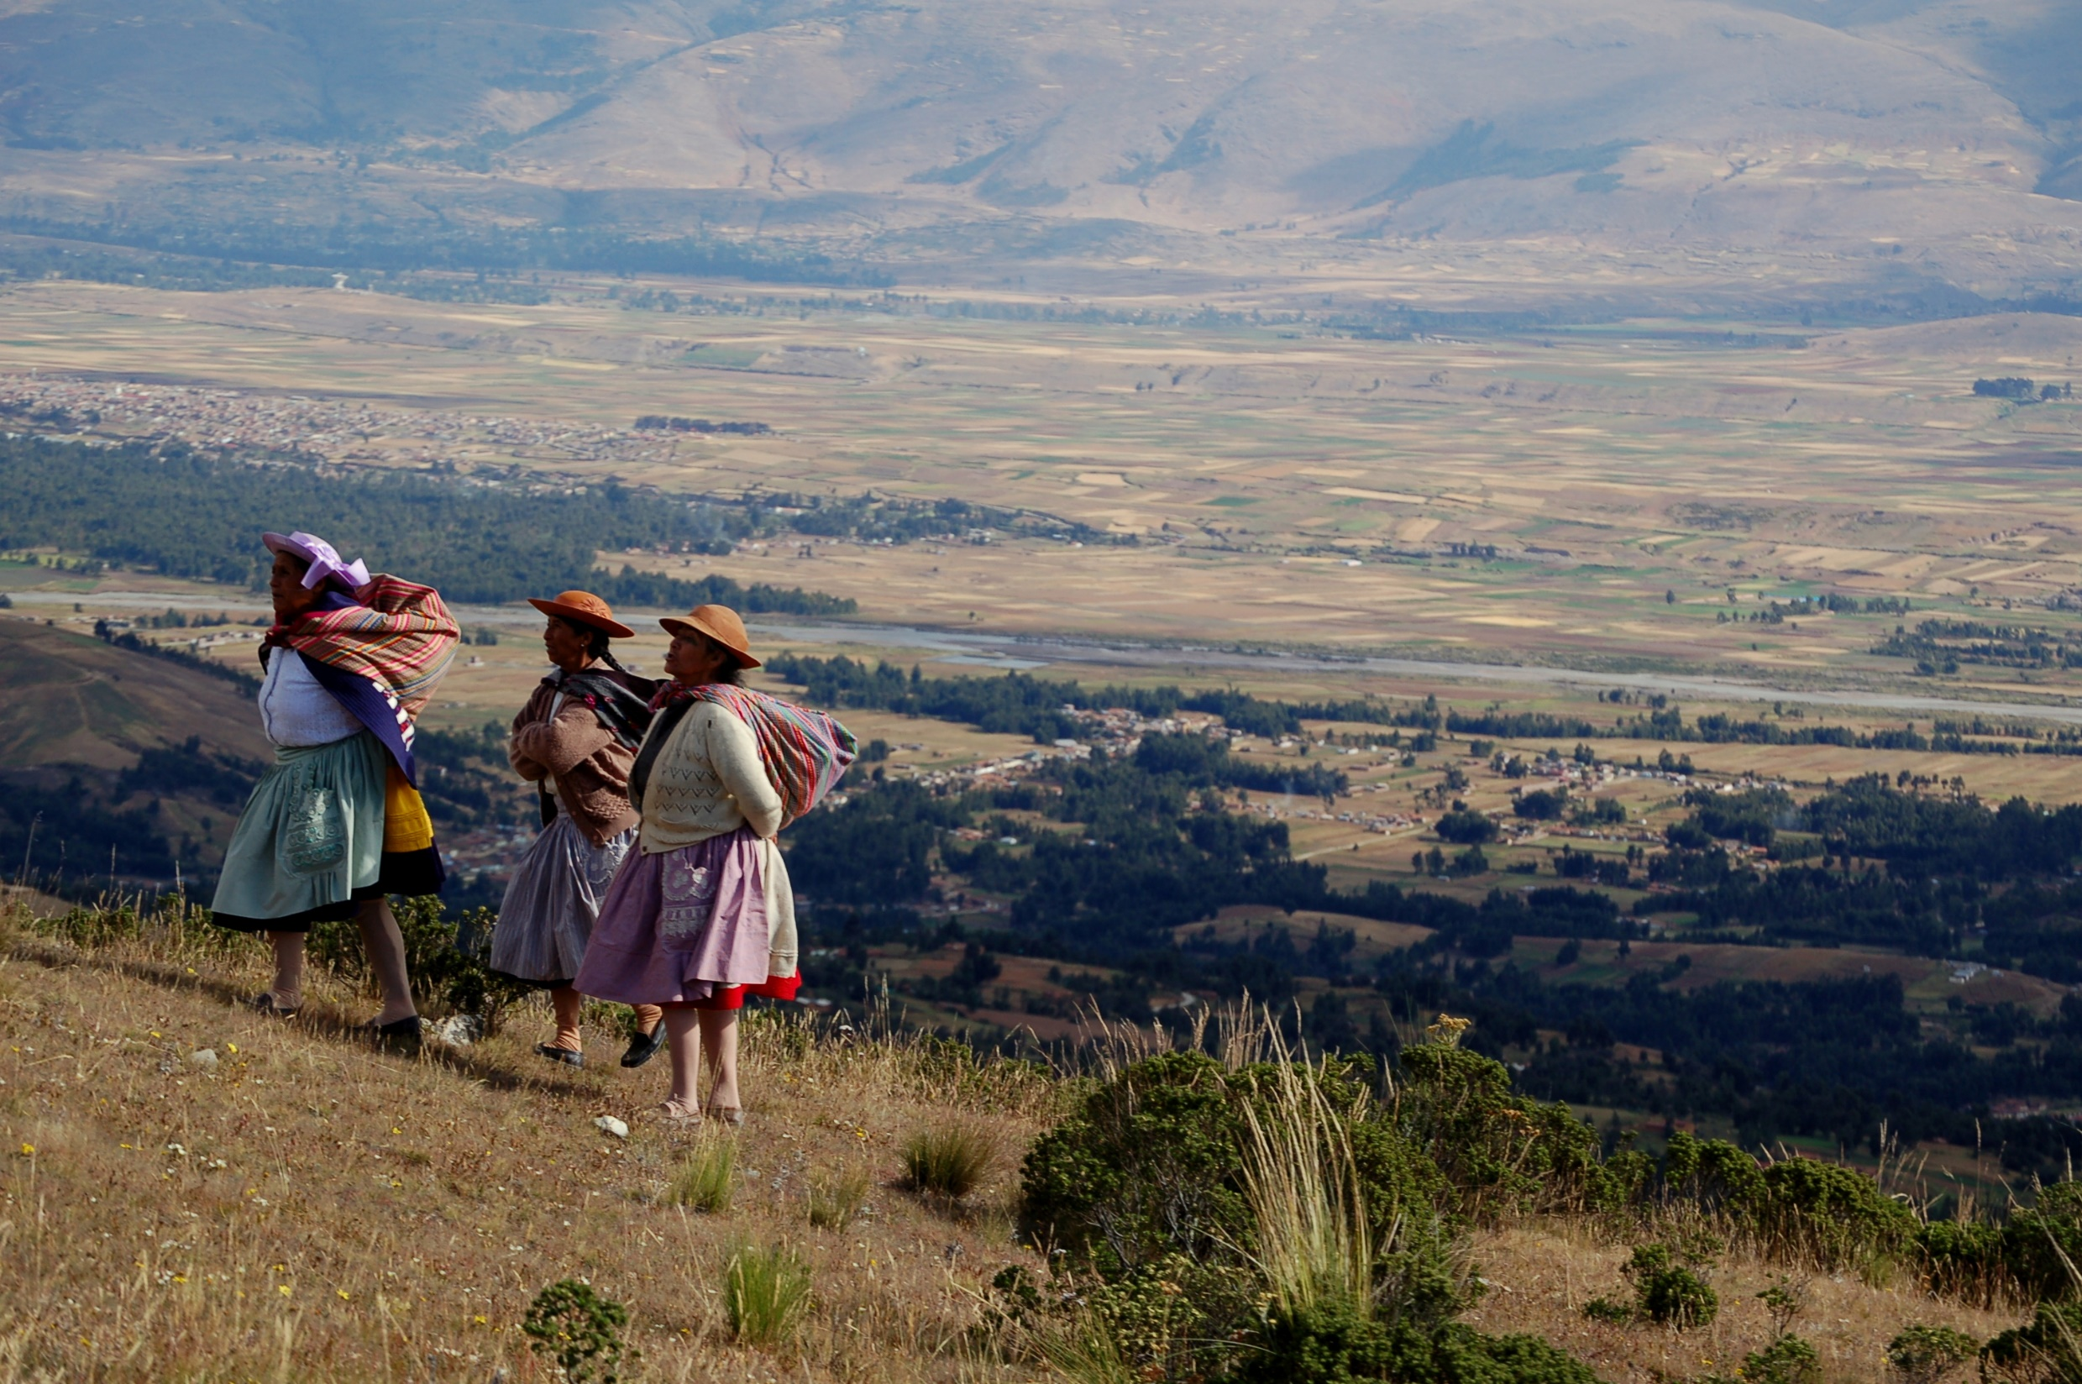
PERU
Machu Picchu- Cuzco, Perú
Seven Colours´ Mountain - Cuzco, Perú
Highlands from Peru

Slide 5
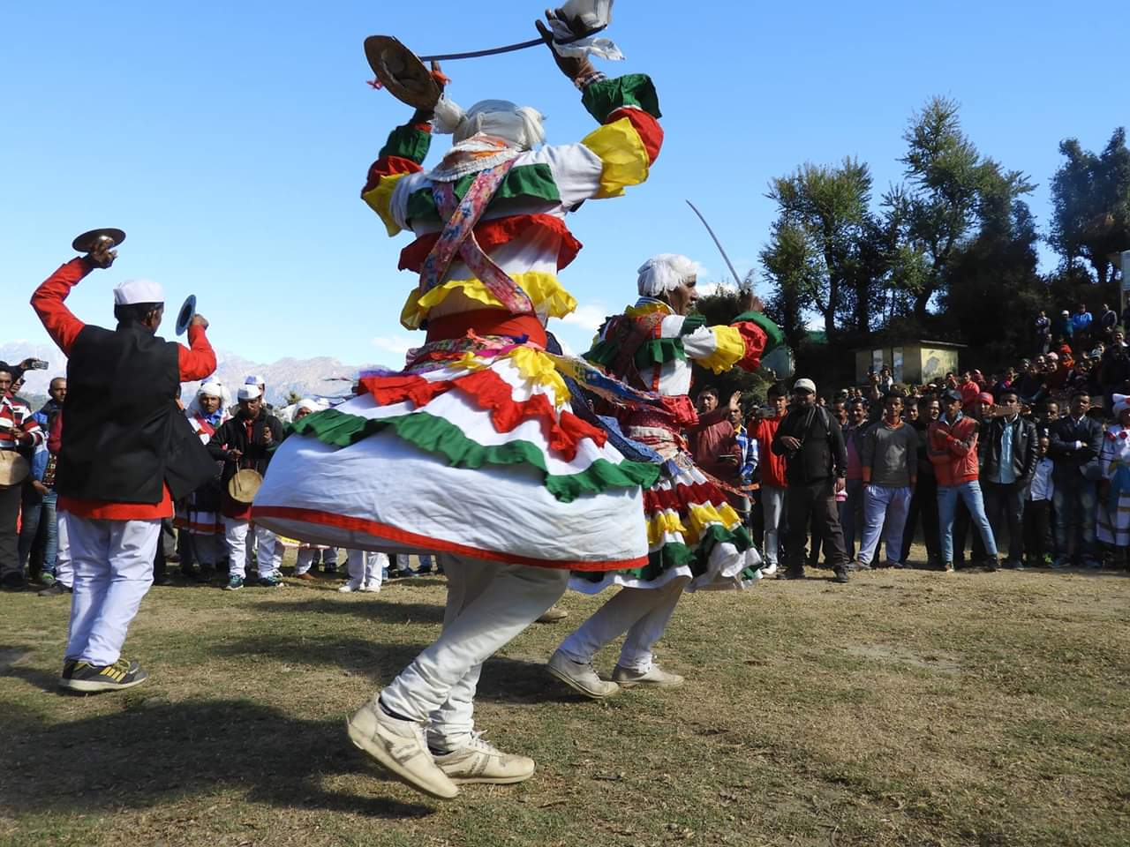
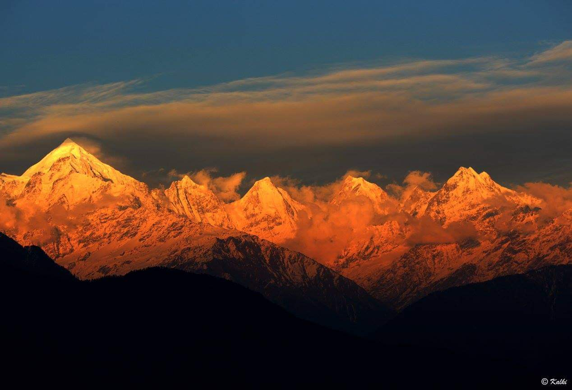
Chholiya Dance - Uttarakhand, India
Panchachuli Massif - Uttarakhand, India

