Slide 1
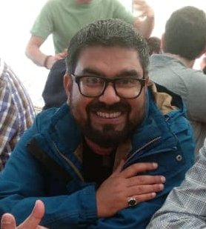





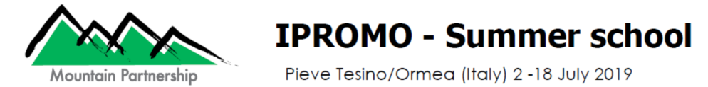
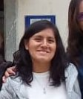

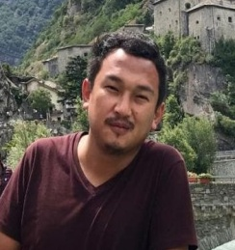

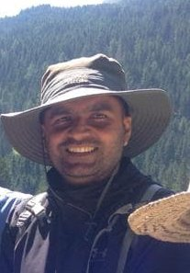

Ghanshyam Pande , India
Mabari Lebamang, Lesotho
Alejandra Huaman, Peru
The stories of Mountains
Yumi Matsuno, Peru
Sonam Tashi, Bhutan
Badri Baral, Nepal

Slide 2
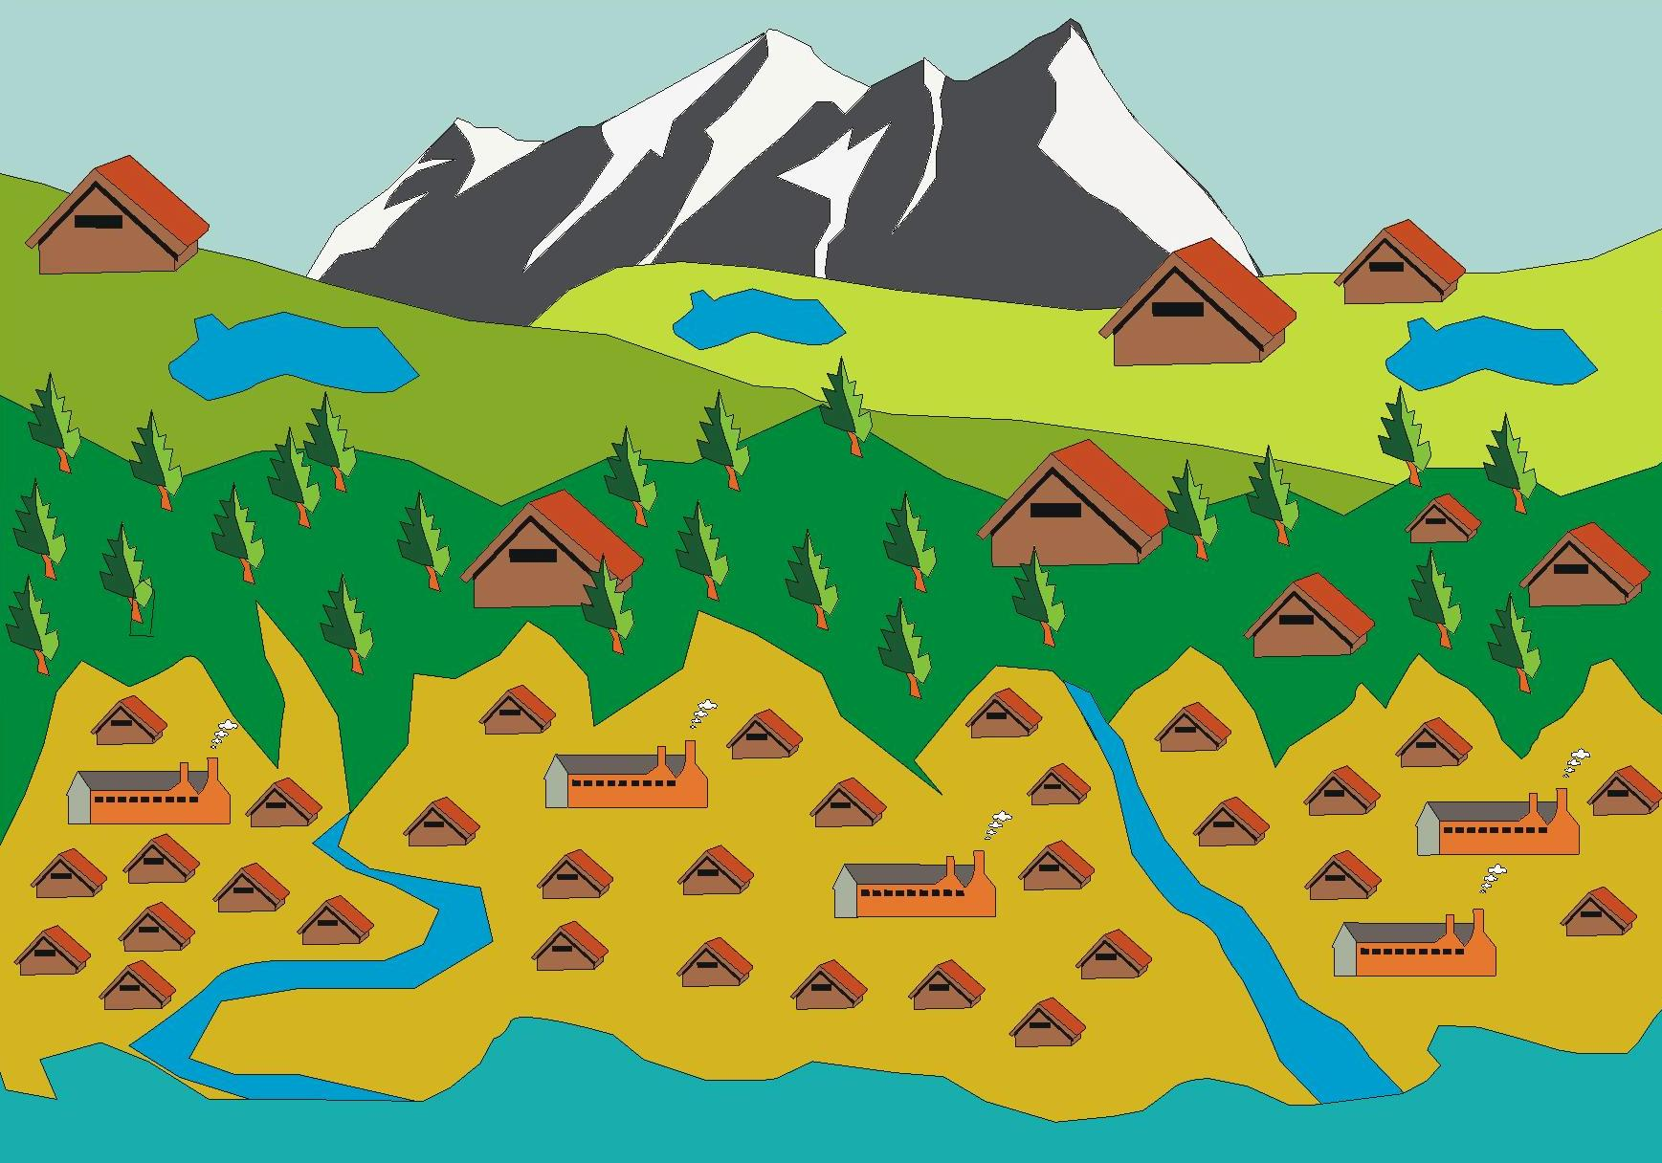
OUTLINE OF PRESENTATION
Ghanshyam Panday
Group Composition
Introduction
Out migration
Natural Hazards
Land fragmentations
Acknowledgement
Alejandra Huaman
Weak Resource Management
Socio-economic and political Exclusion
Long Value Chain
Our Individual learnings

Slide 3
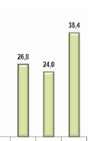
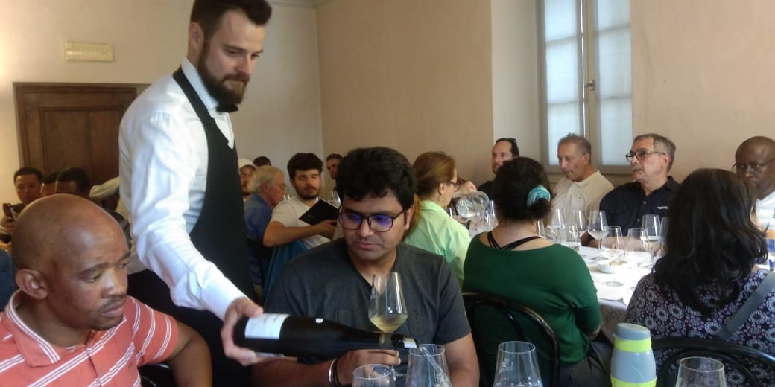
Challenges
Take back solutions
Improve community livelihoods:
  Sustainable Tourism Policy with Low volume, high impact concept as being done in Bhutan
  Create your own niche with high valued product like the wine production in Cembra Valley
Out migration- Younger generations prefer to migrate for better opportunities and public services (jobs, education, health, transportation), while elder generations remain in mountains, specially women.
1. OUT- Migration
% Households lead by elders in rural areas in Peru
Total Men Women
Source: INEI 2018

Slide 4
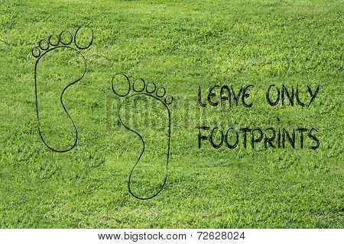
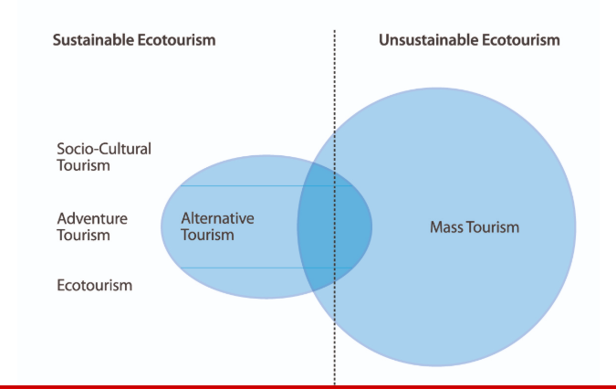
Butanes tourism policy

Slide 5
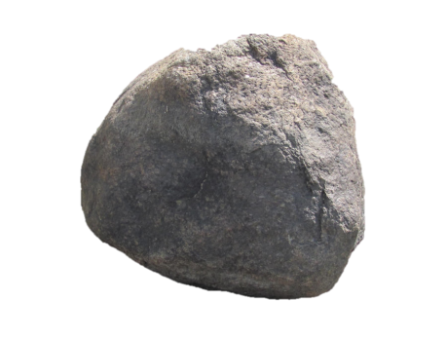
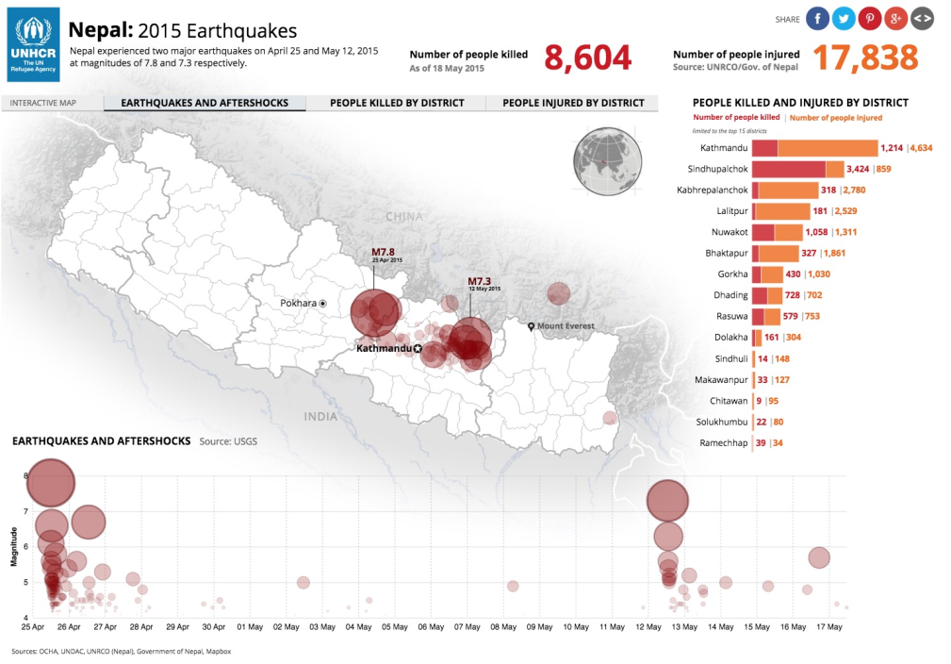
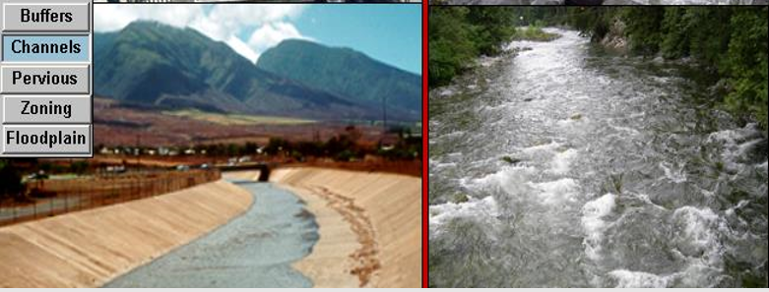
Challenges
Take back solutions
2. Hazards
Natural Hazards- Landslides, GLOF, Droughts and Earthquakes
Natural protection of rivers and lakes with Bio diversity rather then channelizing with concrete infrastructure
Disaster risk= Hazard X Vulnerability X Exposure
Capacity

Slide 6
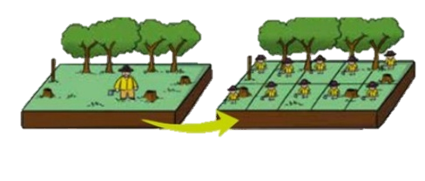
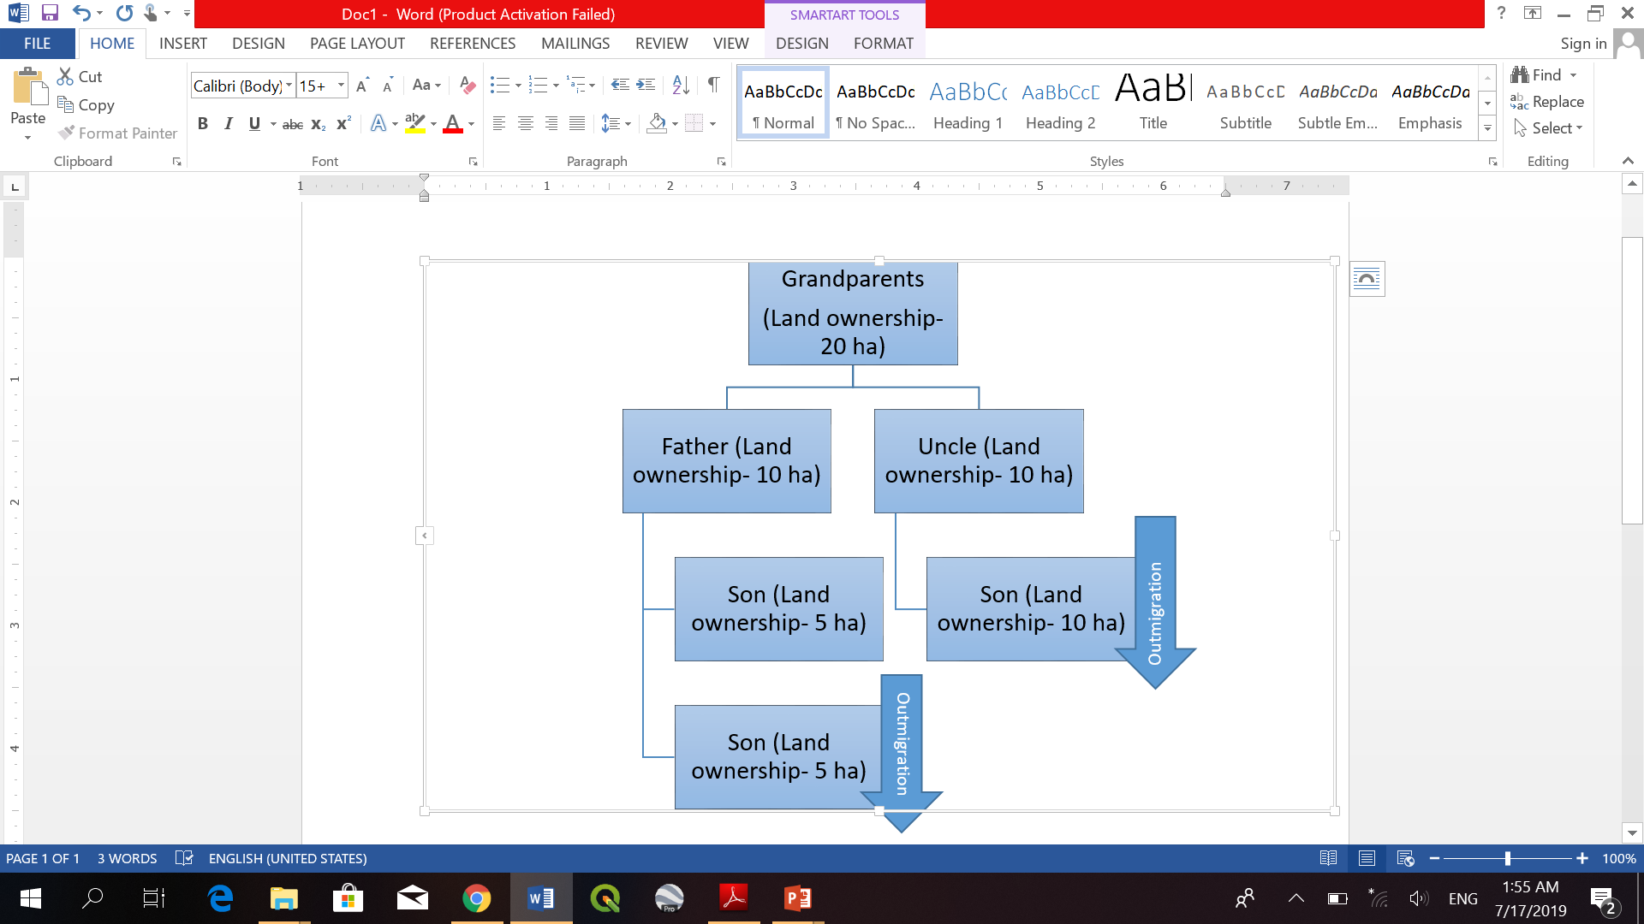
3. Land Fragmentation
Challenges :
Take back solutions
Land fragmentation
Stimulate the formation of small to medium associations to increase the access to more and better quality land (Damonte, Glave & Rodriguez 2016)
Community forest management

Slide 7

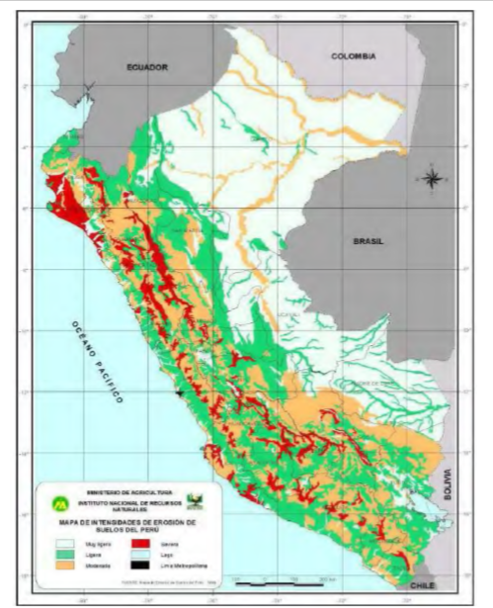
Challenges:
4. Weak Resource Managers
Weak resource management and unsustainable agriculture practices
Take back solutions
Capacity building on sustainable agricultural practices, like:
Temporal grazing and pasture rotation as saw in Monterossa
Terracing
Zero tillage against soil degradation (Peralvo, CONDESAN)
Water management practices, like artificial wetlands and grassland restoration

Slide 8
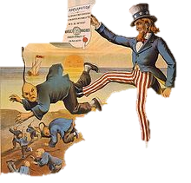
5. Socio-political exclusion
Challenges
Take back solutions
Social, economic and political exclusions suffered by mountain peoples - few mountain specific policies and implementation issues, limited fund allocation from government, inter-generational transmission of poverty
Design and implement mountain-specific policies, plans and interventions
Strengthen women participation and boosting women power.
Recognize and enhance indigenous/traditional people’s knowledge

Slide 9
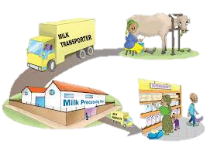

Challenges
Take back solutions
Encourage community cooperatives and associations to shorten the value chain – link the producer to the consumer
Develop specific products based on biodiversity for niche markets
6. Long Value Chain
Long value chains and difficult access to market

Slide 10
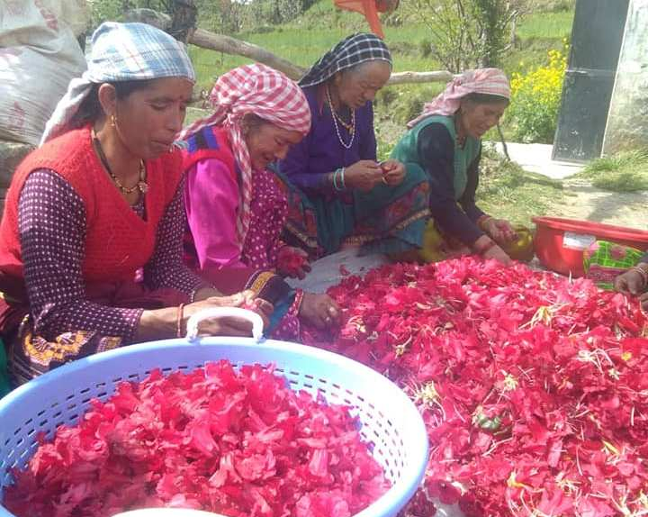

Slide 11
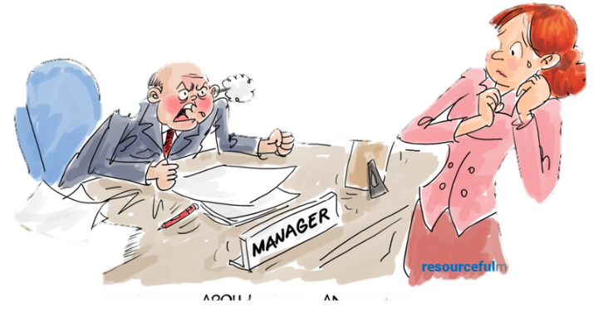
2. Hazards
1. OUT- Migration
5. Socio-political exclusion
4. Weak Resource Managers
6. Long Value Chain
3. Land Fragmentation

Slide 12
Our Individual Learnings
Sustainable management of community landscape (Ecosystem services, community livelihood and well being and biodiversity conservation.-- Ghanshyam Pande
The course has given me exposure on problems around the world and we are all in together. -Sonam Tashi
The course helped us to better understand about all 13 Mountain partner countries- Mabari
Vulnerable global mountain, Impacts of climate change on vulnerable mountain, Adaptation strategies to combat impact of climate change there, Future resilience approaches - Badri Baral
Strengthening community resilience to climate change through different technologies and management systems that are applied differently through-out the world – Alejandra Huaman
Generate more opportunities and involvement for women as mountain-specialists – Yumi Matsuno

Slide 13

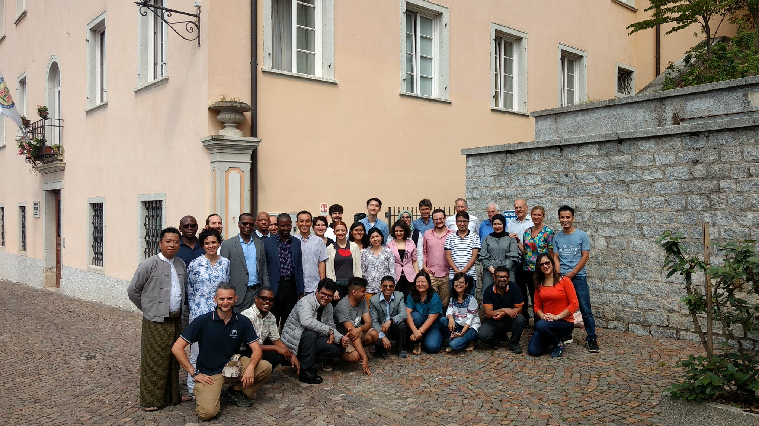
Acknowledgements
University of Turin and the University of Tuscia under the patronage of the Italian Ministry of Foreign Affairs.

