Slide 1

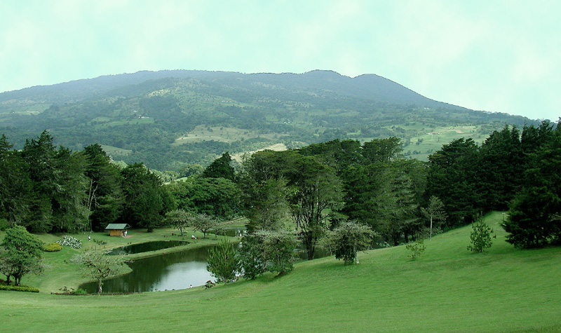






IPROMO 2019
Landscape approach for enhancing mountain resilience
Landscape approach for the local development
Group 3:
Anara Alymkulova
Dang Xuan Truong
Goytom Berhe Hadera
Marilyn Calvo Méndez
Nirajan Bhattarai
Parisa Zhara Najarzadeh

Slide 2
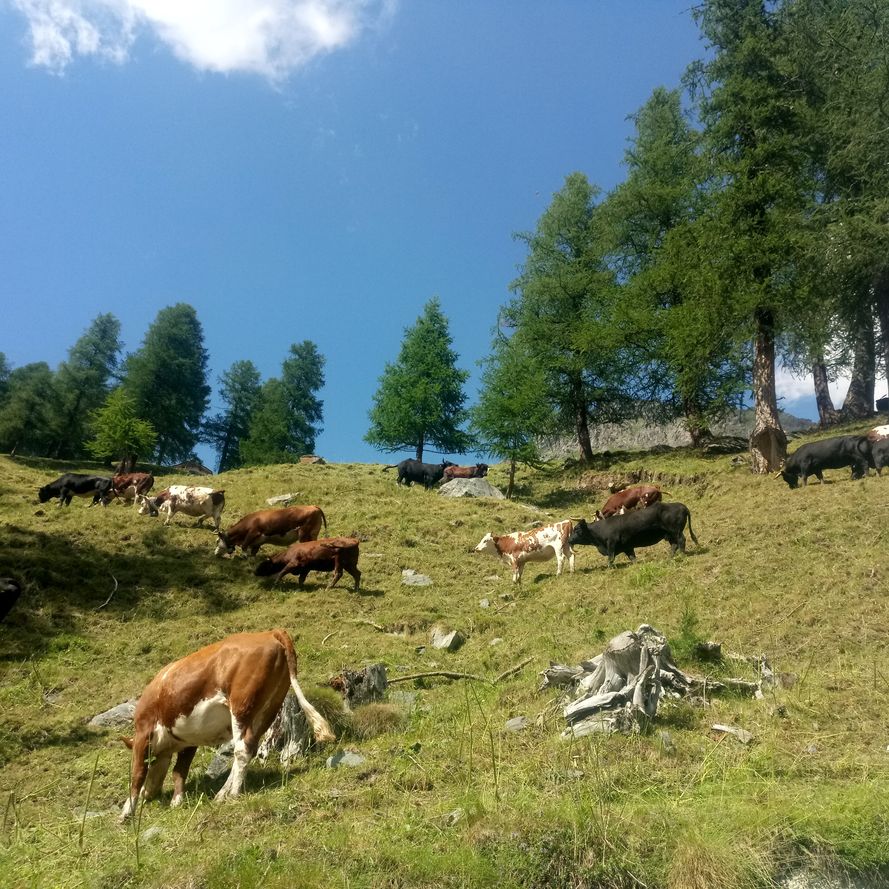
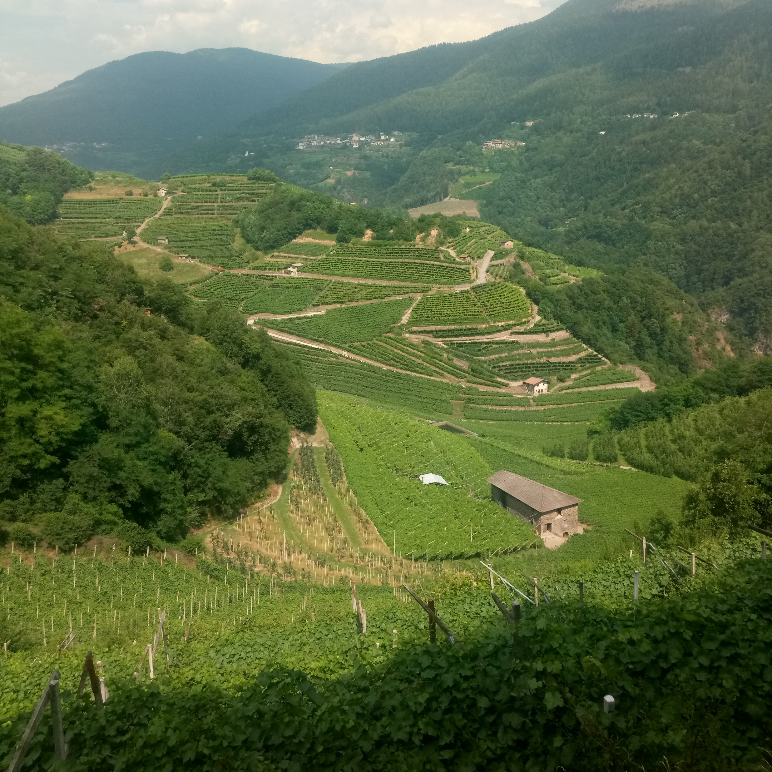
Introduction
Notes:
Conocer el estado actual y los cambios de la cobertura y uso de la tierra, así como de los ecosistemas de Costa Rica
Proporcionar información periódica de alta calidad, que permita evaluar el estado el estado de los recursos del medio ambiente
Toma de decisiones políticas informadas sobre el manejo de la tierra
Mantenimiento de la calidad e integridad de los ecosistemas y el ambiente para las generaciones futuras
Reportes de información a compromisos nacionales e internacionales

Slide 3
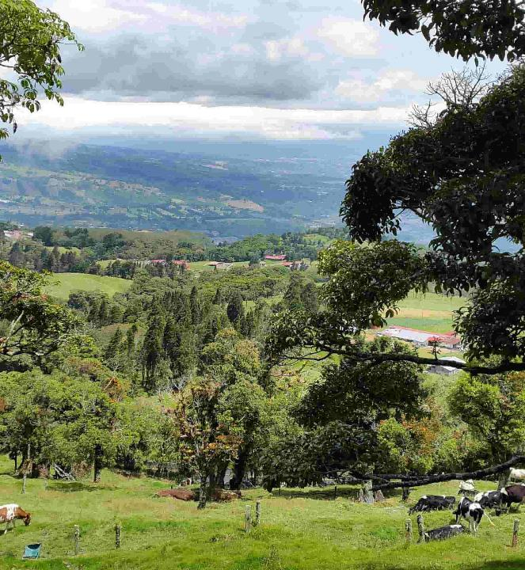
Objectives
Improve the resilience of the mountain communities
Conserve mountain biodiversity
Protect the environment and natural resources

Slide 4
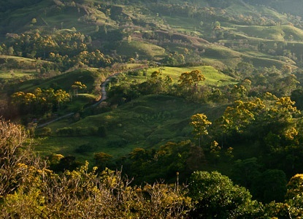
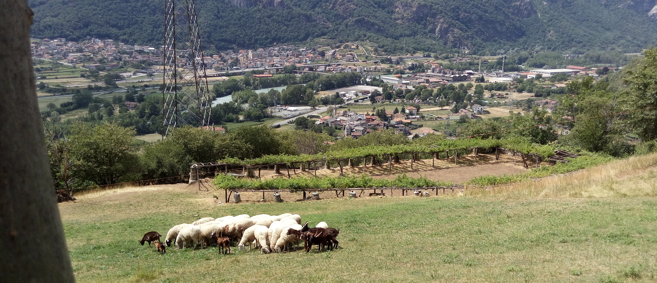
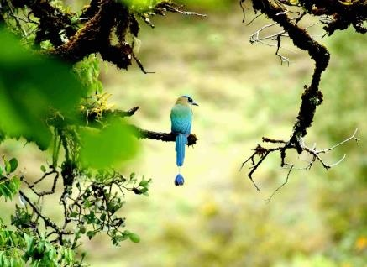
What is landscape approach?

Slide 5
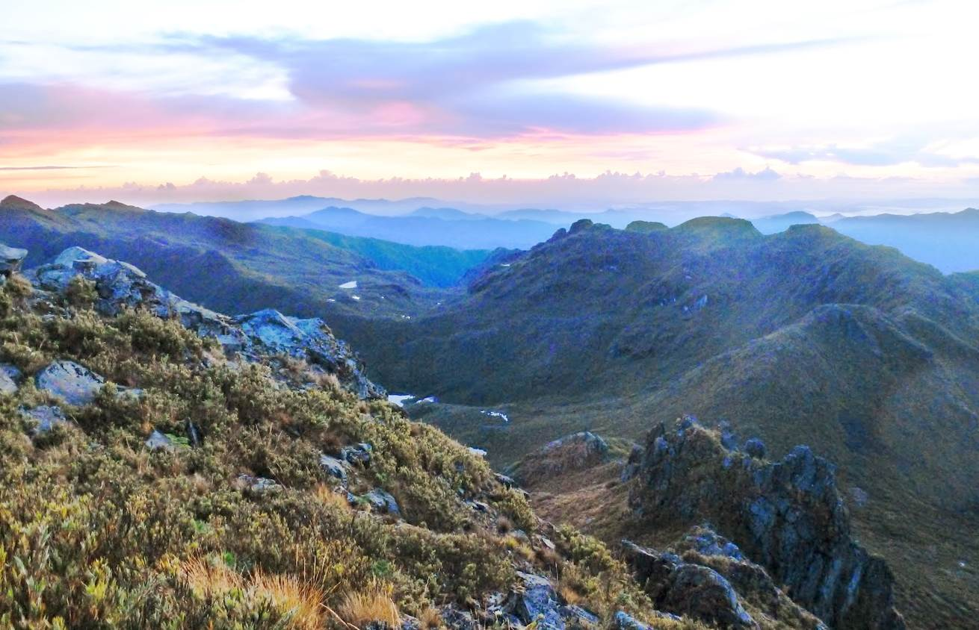
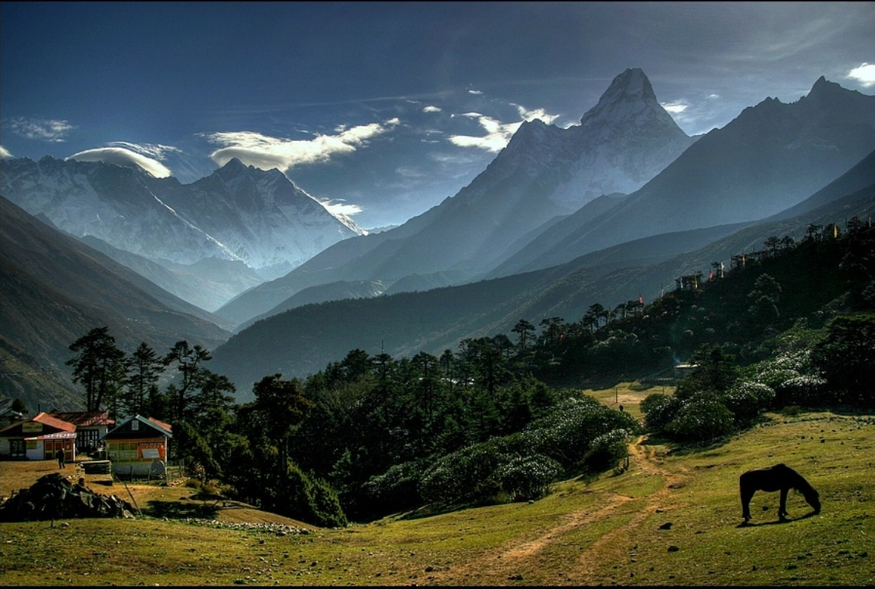
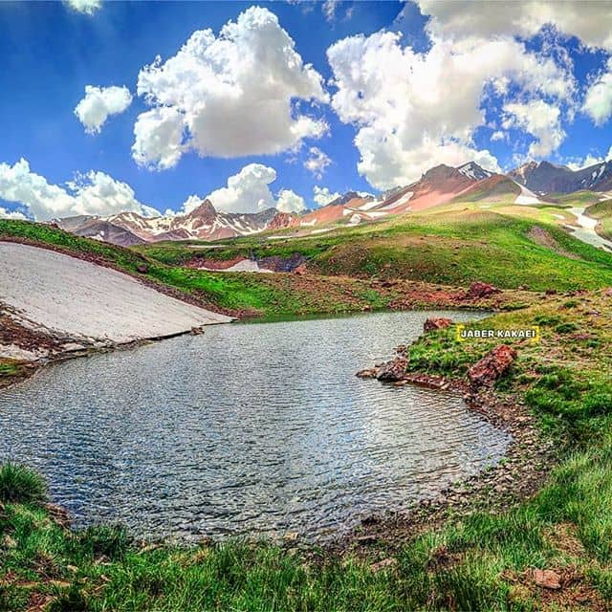
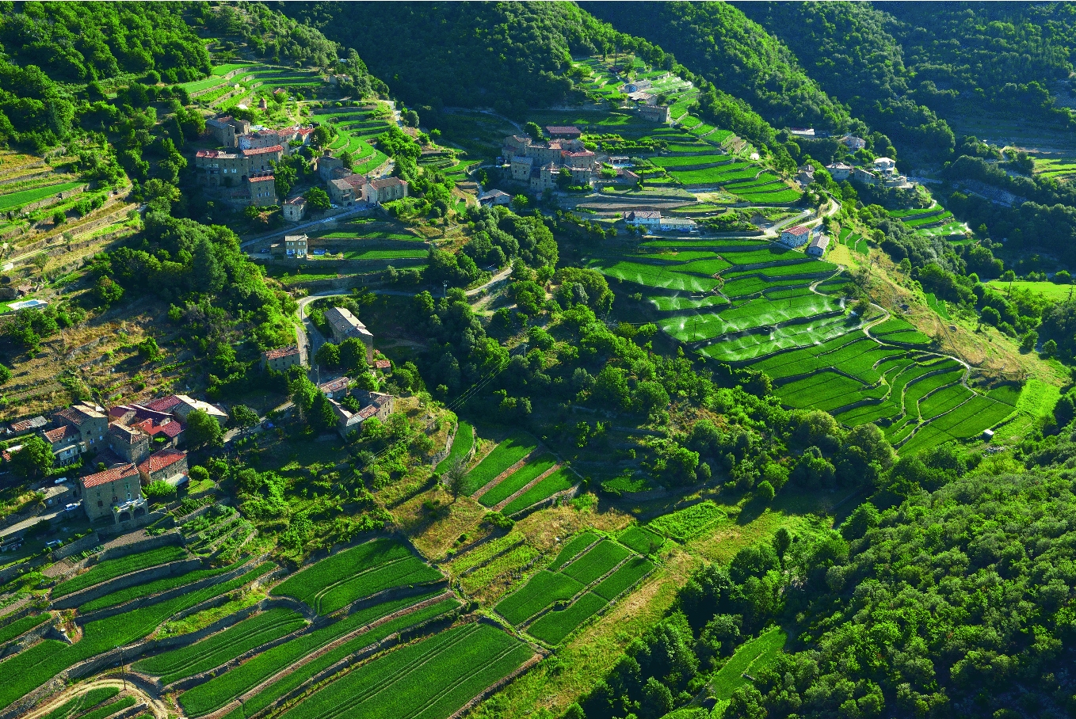
Landscape approach is about balancing the competing land use demands in a way that is best for the people, biodiversity & environment.
The harmony between nature and people.

Slide 6
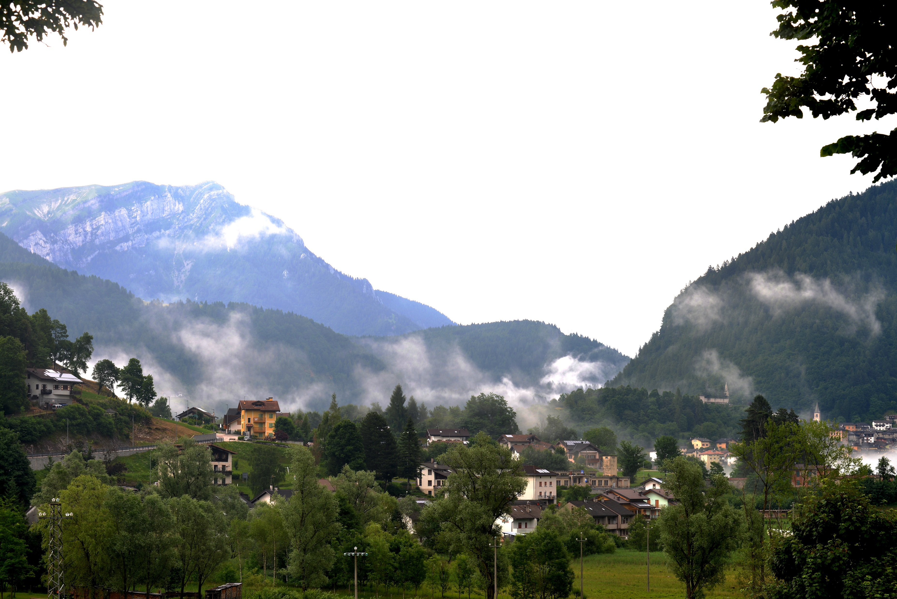
Why landscape approach?
To mitigate the increased impacts of climate change.
To address the problems of food insecurity, poverty.
To protect biodiversity loss.
To promote economic development.
To improve sustainable land management.
To ensure gender equality & women empowerment .
To meet SDGs

Slide 7
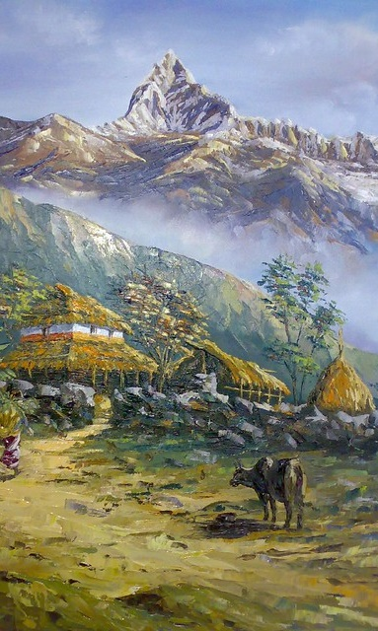
Landscape approach considers:
Effective policy (land use planning)
Participatory approach
Multi stakeholder integration
Multidimensional / Holistic approach
Gender equity
Capacity building

Slide 8
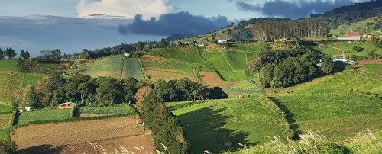
Conventional vs Landscape approach
Conventional
Landscape
Top down approach
Exclusive / women are excluded from the decision-making process
Short term
Sector-specific
People is seen as enemy of nature
Dependent
Bottom up/Participatory process
Inclusive - capacities of women & vulnerable groups are recognized
Long-term/Sustainable
Holistic
People is the center
Resilient community

Slide 9
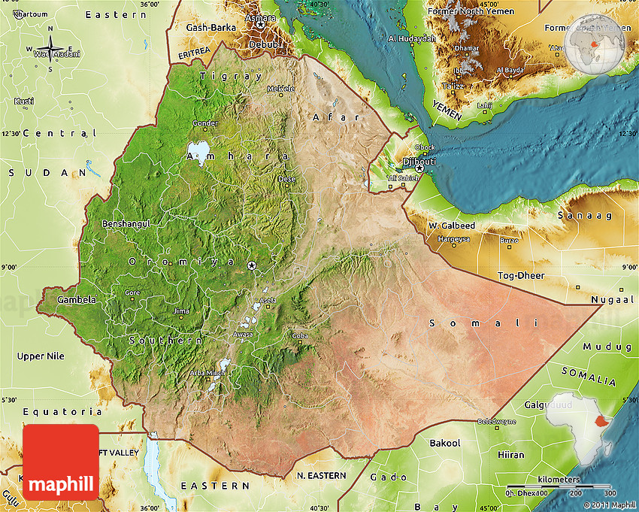
Ethiopia Map
Notes:
Conocer el estado actual y los cambios de la cobertura y uso de la tierra, así como de los ecosistemas de Costa Rica
Proporcionar información periódica de alta calidad, que permita evaluar el estado el estado de los recursos del medio ambiente
Toma de decisiones políticas informadas sobre el manejo de la tierra
Mantenimiento de la calidad e integridad de los ecosistemas y el ambiente para las generaciones futuras
Reportes de información a compromisos nacionales e internacionales

Slide 10
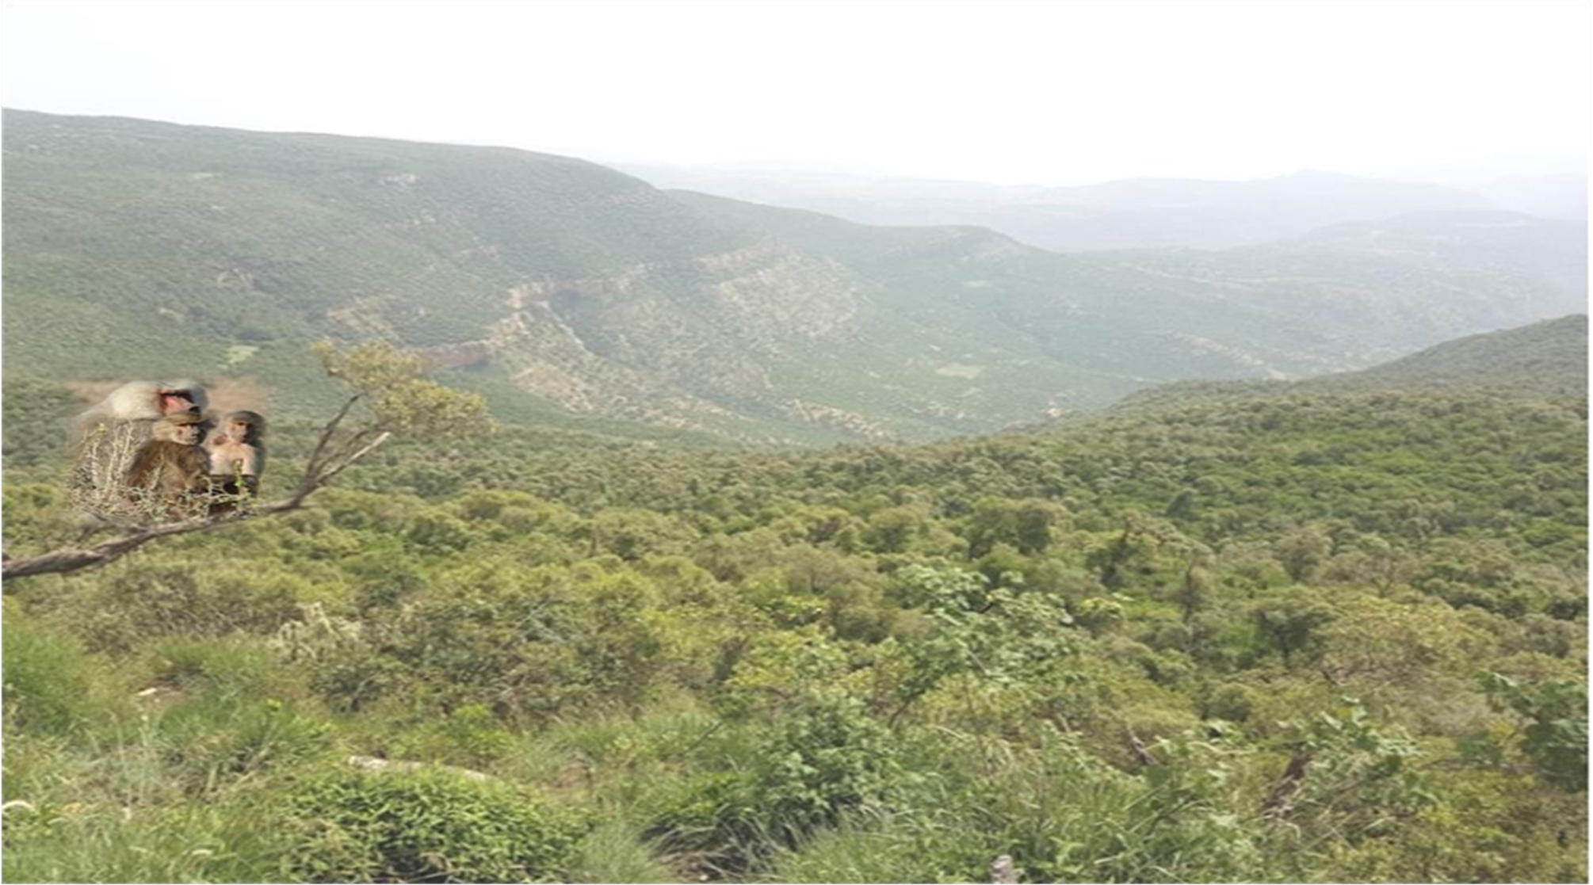
Dessa´a Transboundary Landscape

Slide 11
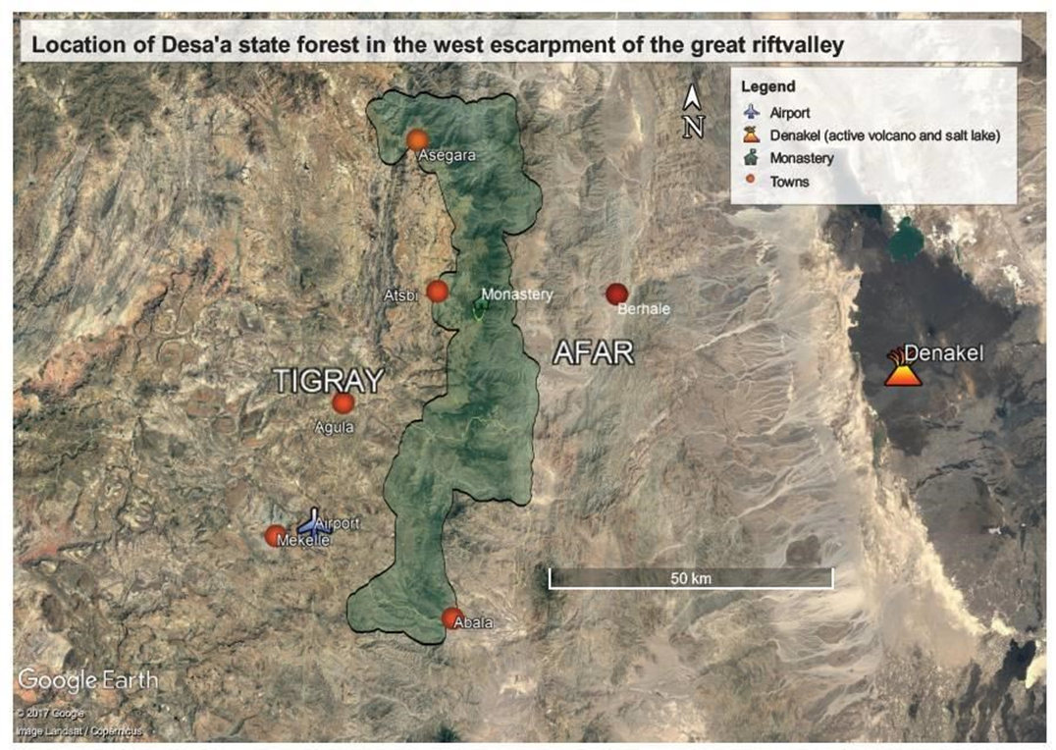
Dessa´a Transboundary Landscape
Notes:
Conocer el estado actual y los cambios de la cobertura y uso de la tierra, así como de los ecosistemas de Costa Rica
Proporcionar información periódica de alta calidad, que permita evaluar el estado el estado de los recursos del medio ambiente
Toma de decisiones políticas informadas sobre el manejo de la tierra
Mantenimiento de la calidad e integridad de los ecosistemas y el ambiente para las generaciones futuras
Reportes de información a compromisos nacionales e internacionales

Slide 12
General information
Dessa’a transboundary landscape is found in Ethiopia, northern Ethiopia between the two regions of Tigray & Afar (8 districts)
Dominated by natural forest-Juniperus procera & Olea europia and endangered global species like Dragon (locally known as “Dracena”) tree
Total size of the landscape is 154,071 Ha
Elevation of the landscape is between 900 -3,100 Meter above sea level
A potential biodiversity hotspot area and strong effort to register Dessa'a forest to UNESCO's heritage list, as one of the old ecosystem heritage
2

Slide 13
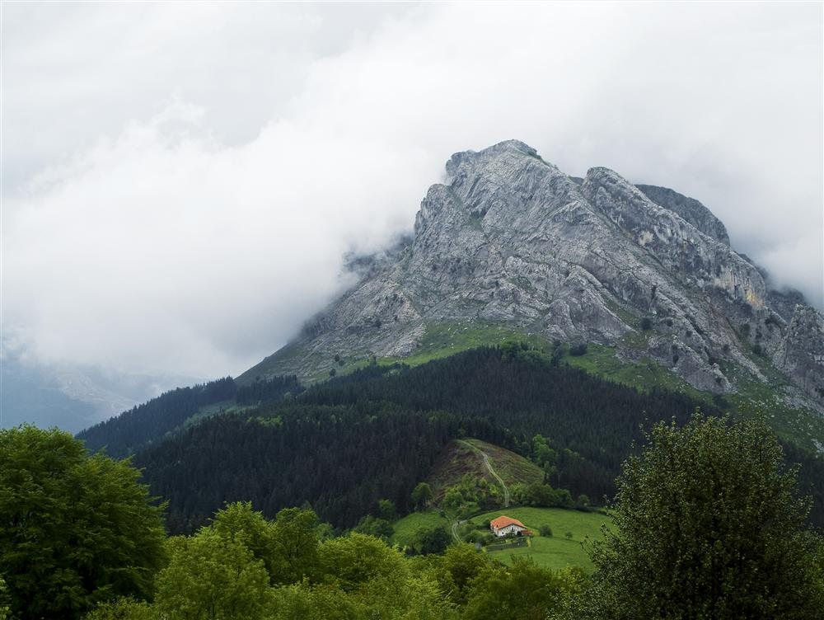
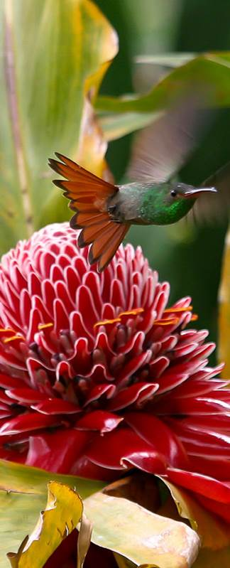
Main Stakeholders
Ministry of Environment, Forest & Climate Change
Regional bureaus of Natural resources & Agriculture development.
District Offices of Natural resources & Agriculture development of both regions
Local communities (Farmers & Pastoralists)

Slide 14
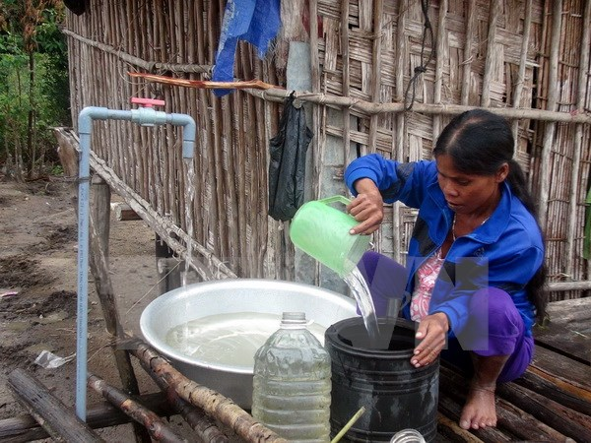
Challenges

Slide 15
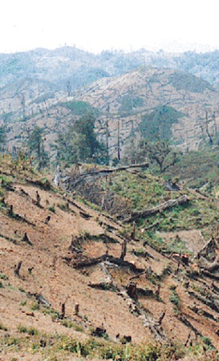
Policy / National Level
Absence of boundary demarcation
Landscape/Land Use planning
Lack of Partnership/Coordination
Low capacity of partners in MD

Slide 16
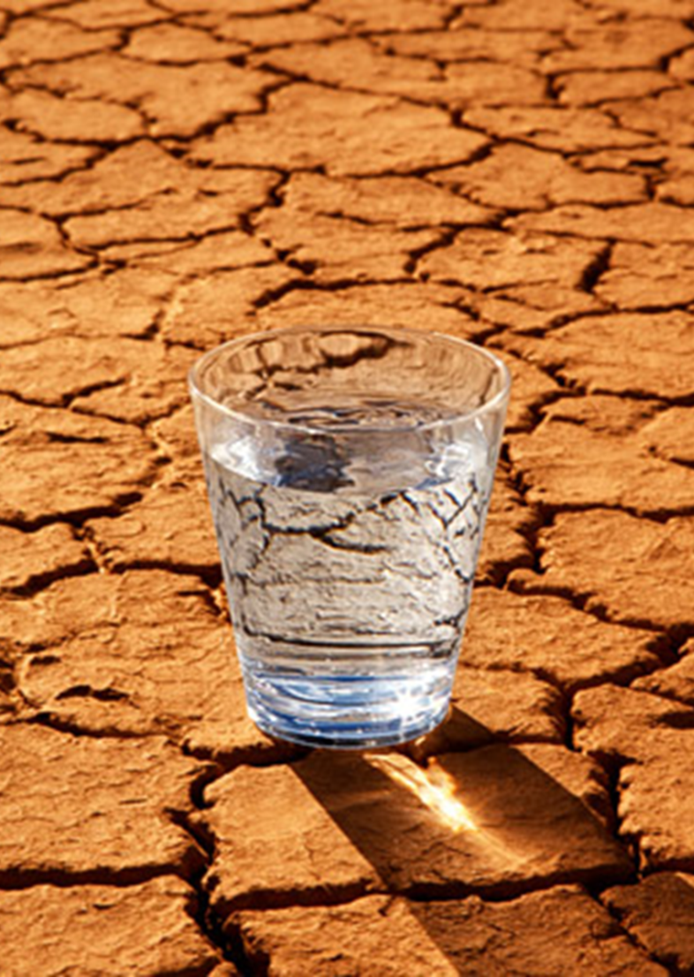
Community / Local Level
High poverty/poor livelihood
Deforestation
Overgrazing (affect the natural regeneration)
Soil degradation
Loss of biodiversity
Water scarcity
Settlement expansion
Problems of value chains/marketing

Slide 17
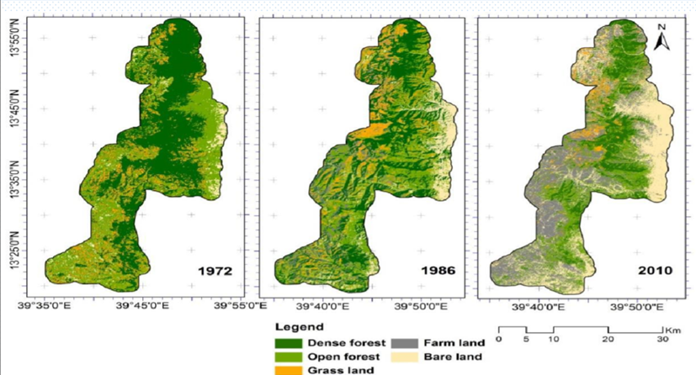
Degradation Status of the Landscape
Notes:
Conocer el estado actual y los cambios de la cobertura y uso de la tierra, así como de los ecosistemas de Costa Rica
Proporcionar información periódica de alta calidad, que permita evaluar el estado el estado de los recursos del medio ambiente
Toma de decisiones políticas informadas sobre el manejo de la tierra
Mantenimiento de la calidad e integridad de los ecosistemas y el ambiente para las generaciones futuras
Reportes de información a compromisos nacionales e internacionales

Slide 18
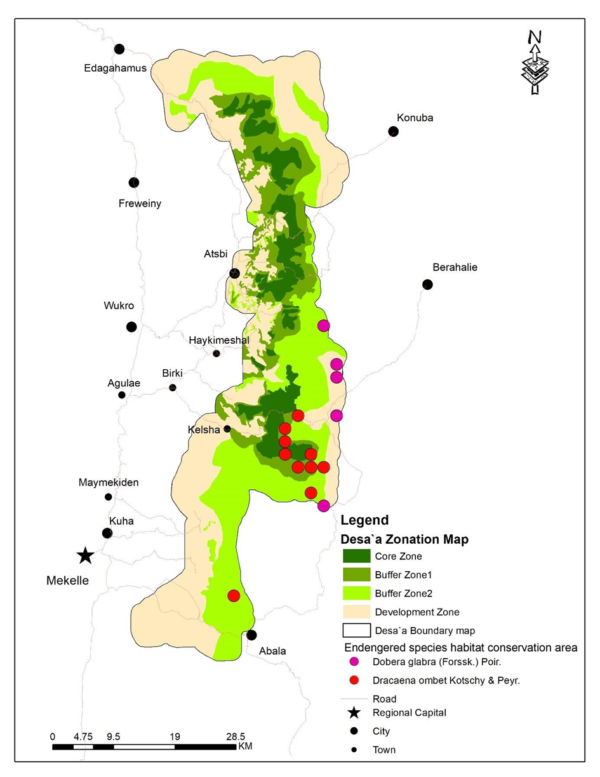
Landscape management approach or Biosphere reserve management approach

Slide 19
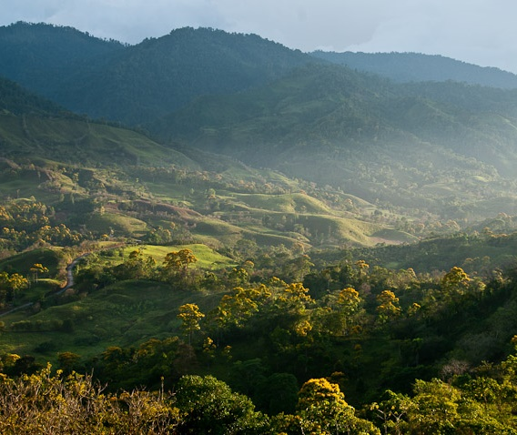
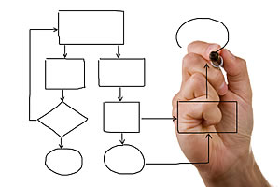
Actions:

Slide 20
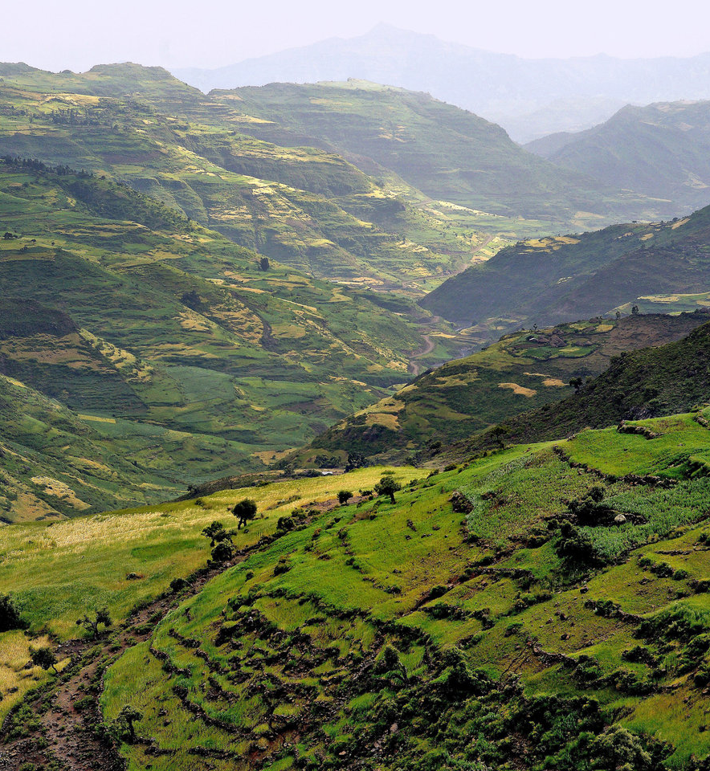
A. National level
Policy formulation to allow a clear demarcation of the forest: based on the community needs and government goals to preserve biodiversity
Coordination and partnership.
Networking with research and higher institutions, local government and communities.

Slide 21

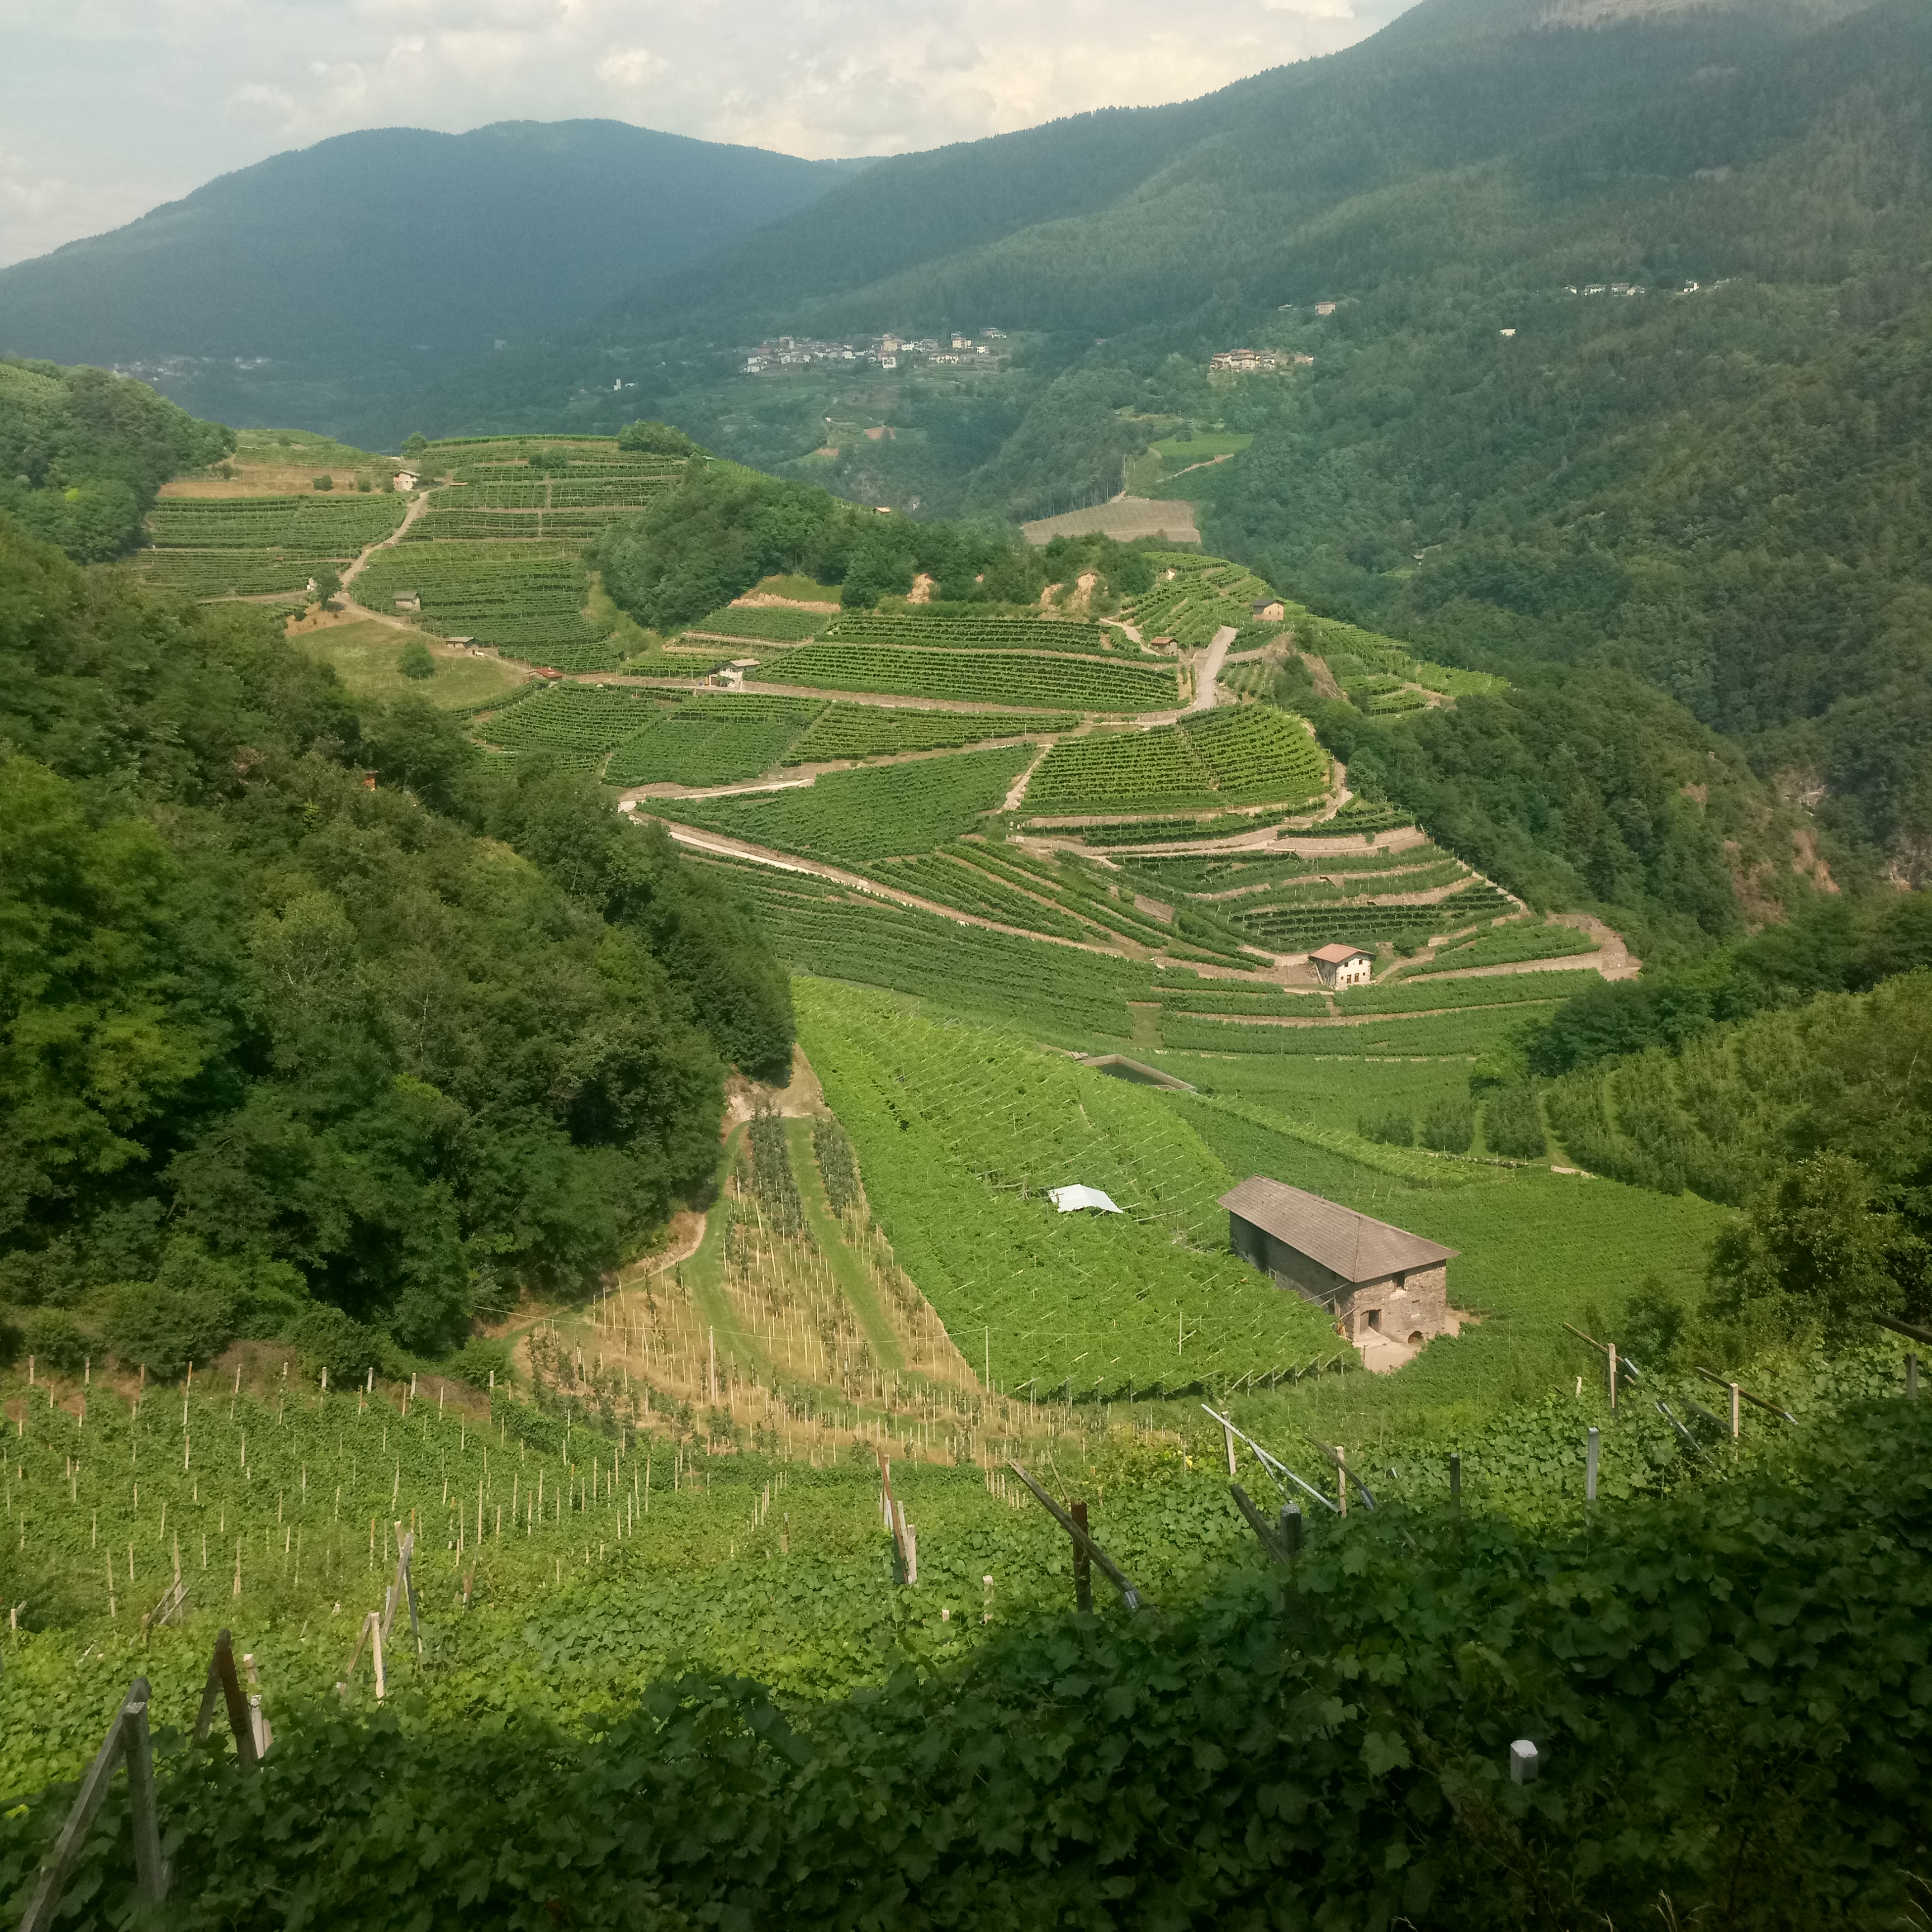
A. National level
Land use planning and implementation
Policy dialogue, review and advocacy.
Formulation of a policy to restore and protect the endangerous species.

Slide 22
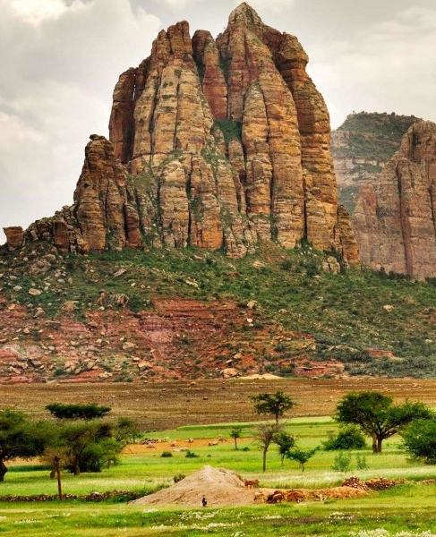
B. Local level
Capacity building/ education and public awareness about sustainable landscape management, based on local needs.
Promotion of ecotourism.
Income generation activities:
Bee keeping.
Livestock farming
Agriculture production.
Improvement agricultural practices (research based solutions to increase productivity and protect the resourses at the time).

Slide 23
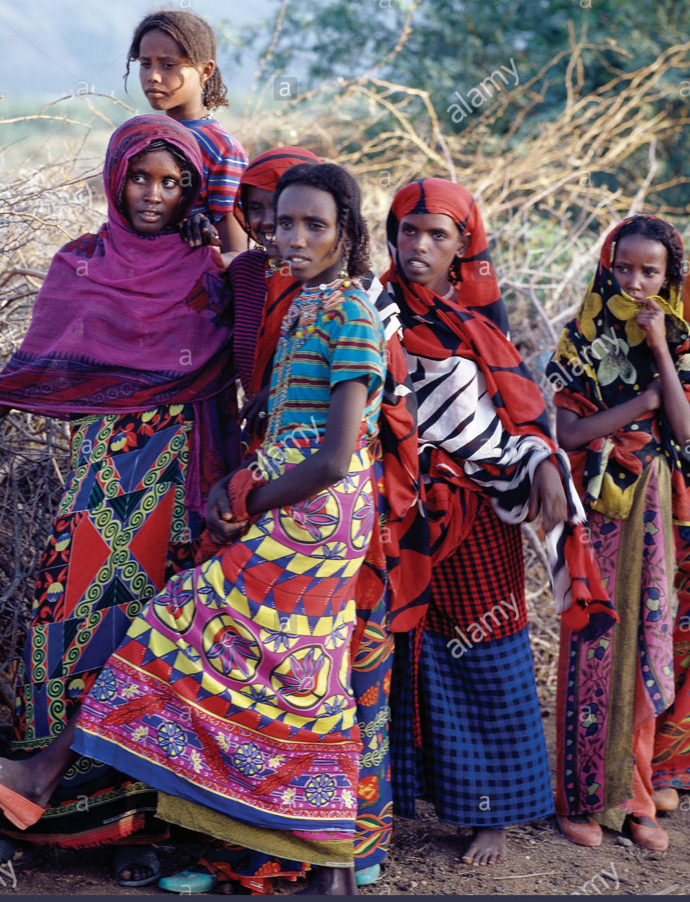
Improvement livestock farming.
Promotion of the traditional communication system: “DAGU”.
Learning or experience sharing visits (Landscape process and impacts).
Reforestation campaing.
Value chain development for the produced/ selected businesses.
Participatory forest and grazing management.
Forage production at household level.
Soil and water conservation – terracing
Provision and promotion of alternative energy sources (Solar Powers, biogas, etc.).
Building linkage between public and private companies.

Slide 24
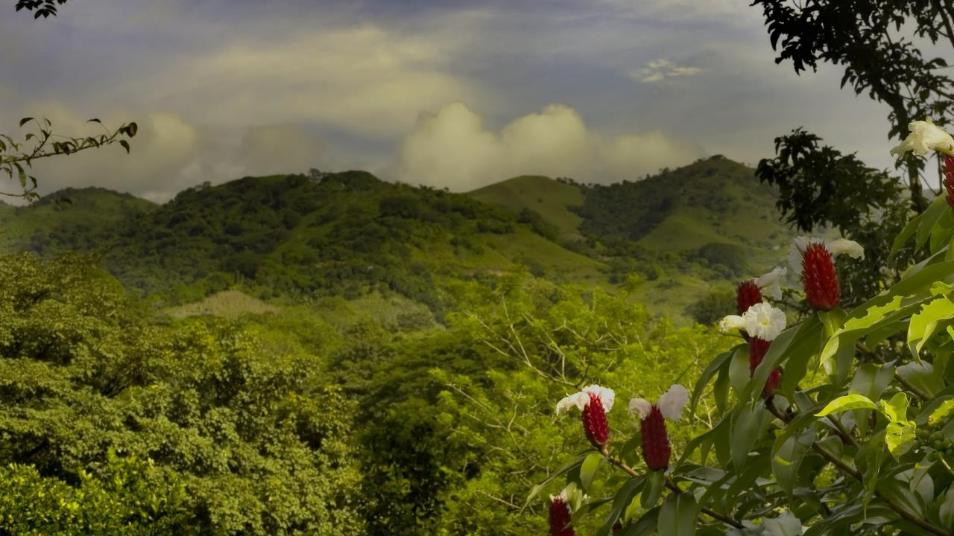

Chon rakhmat!
Cam on!
Amesegenalehu!
Muchas gracias!
Dhanyabaad!
Mamnoon!
Thank you!

