Slide 1
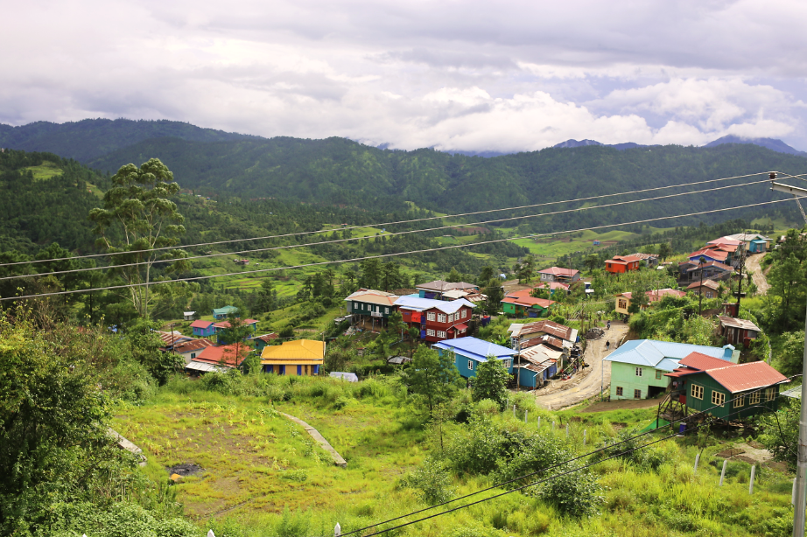
Assessing vulnerabilities to Climate Change in Chin State, Myanmar and Planning Adaptation Measures
Group 5 [Angela Mendoza Ato, Apurva Rai, Fabio Parisi, Hung Ling, Mirlan Zholdoshbaev, Mokitinyane Nthimo]

Slide 2
Presentation Outline
Introduction
Objectives of the assessment
Methodology
Census 2014 and disaggregated data
Vulnerability Index and Participatory Natural Hazard Mapping
Current vulnerabilities
Climate change future scenarios
Defining Objectives
Adaptation action planning and recommendations

Slide 3

Introduction – the global context
Warmer temperature
Uncertain precipitation
Earlier snowmelt
Accelerated glacier melt
Extreme snow & rain events
Change in streamflow pattern
Greater climatic variability

Slide 4
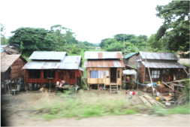
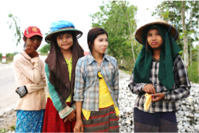
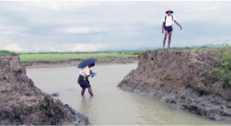
Why is Myanmar vulnerable
2nd most vulnerable: why?
Exposure: Large number of people in Myanmar living in mountainous remote terrains (53.4 M Census 2014)
High sensitivity
Adaptive capacity very low
Climatic changes observed in last 6 decades (+0.8°C, Monsoon etc.)
Increase of rapid and slow on-set disasters…
social & economic consequences e.g 34.7% GDP from climate sensitive agriculture

Slide 5
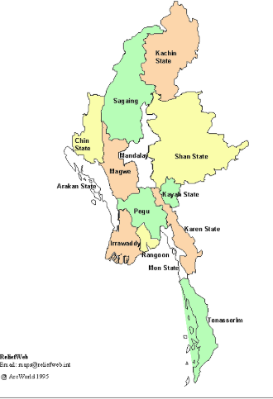


Chin State
3. Chin State
Chin State spans over 36,019 km2 of mountains
The capital of the state is Hakha
Total population is approximately 478,801 as per the 2014 Census (0.93% of total population).
2. Pakoku
1. Laputta
MCCA Program funded by EU
Project Period : July 2013-2017

Slide 6
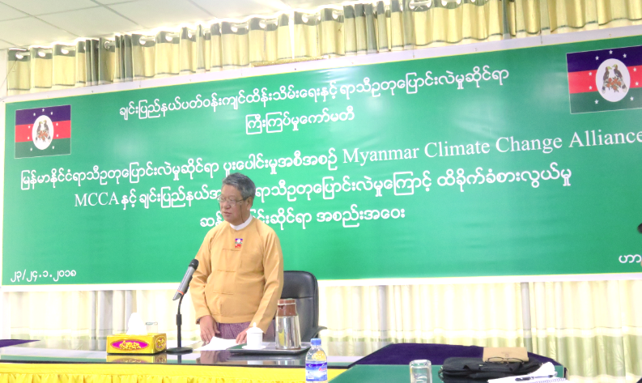
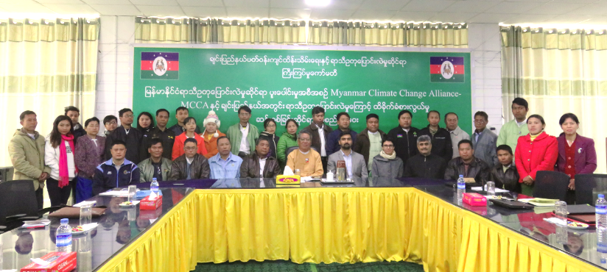
Objectives of the assessment
To provide communities, township, regional and national authorities with evidence of vulnerabilities
To inform township, regional and national authorities on the expected consequences of climate change
To plan for adaptation to the expected changes in climate in the township
To test a methodology that can be replicated at national level to support township development planning

Slide 7
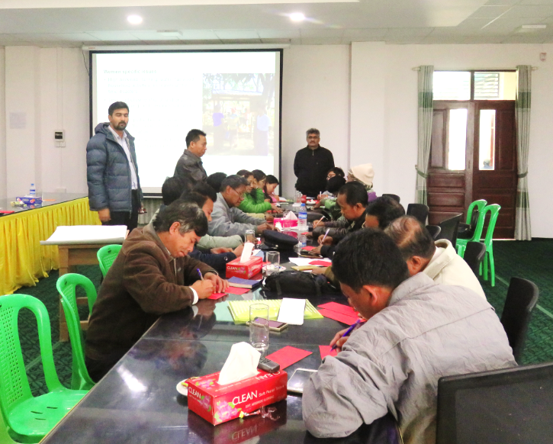
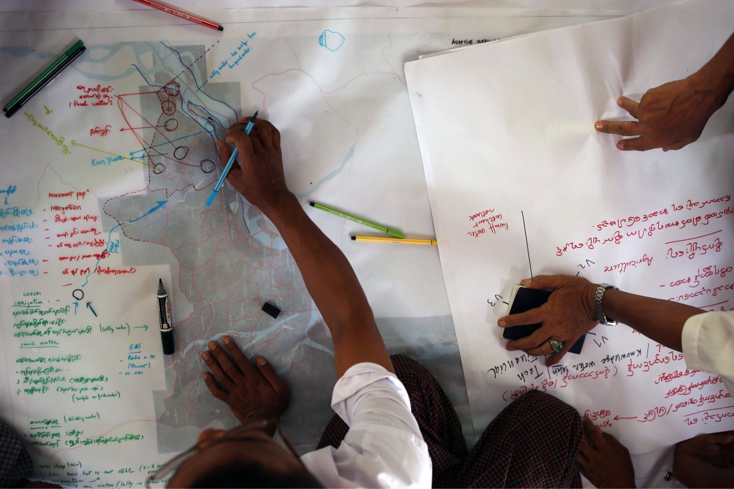
Methodology
Census 2014 and disaggregated data
Vulnerability Index and Participatory Natural Hazard Mapping
Current vulnerabilities
Climate change future scenarios
Defining Objectives
Adaptation action planning and recommendations

Slide 8
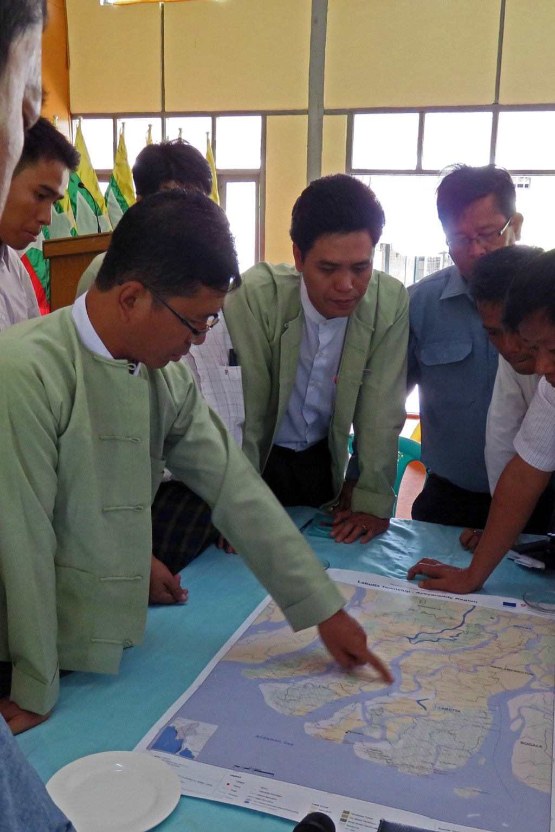
Census 2014 and disaggregated data
Studies the demographic characteristics:
Population by household, sex and sex ratio in urban/rural areas
Households by sex of the head, population by type of household and mean household size
Population by 5-year age group
Notes:
Why do we do this assessment:
- It is essential to understand the township demographics
Because it may indicates vulnerabilities effectively
It helps to forecast future causes of stress

Slide 9
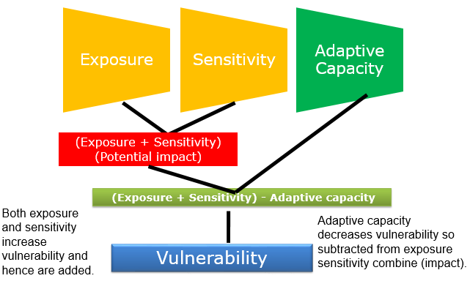
Vulnerability Index and Participatory Natural Hazard Mapping
The sensitivity index is calculated by looking at three main components: infrastructure, socio-economic and eco-systems
The potential impact is defined by looking at the hazard intensity (frequency/magnitude) and it is classified accordingly (high, medium, low)

Slide 10
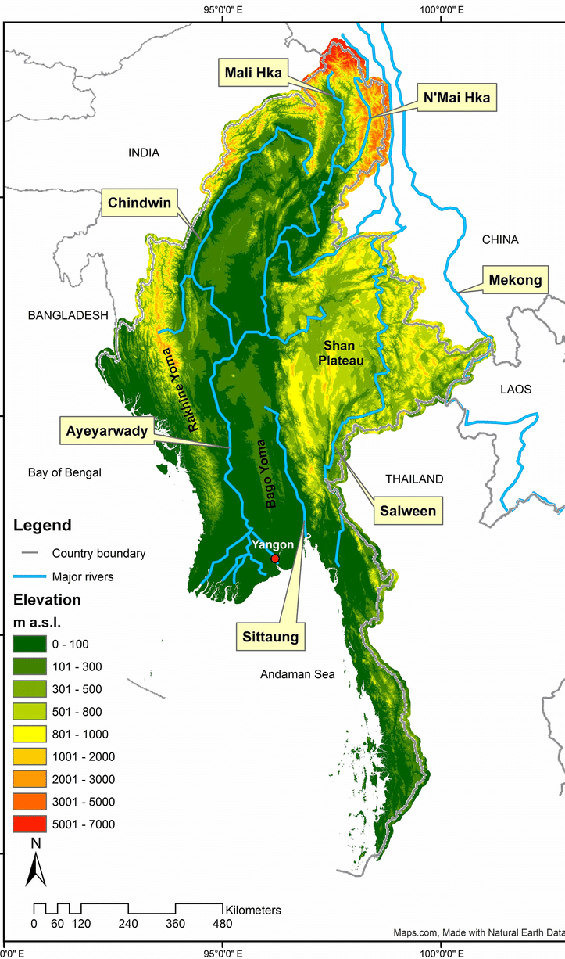
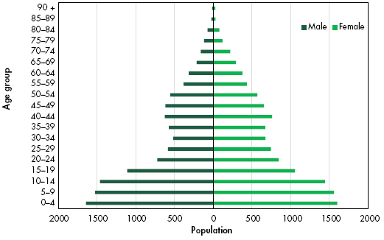
Township assessment: geography and population
Notes:
Mountainous Hakha township in northern Chin state is more prone to disasters
The highest percentage comprises age groups 0–4, 5–9 and 10–14, which indicates that children make up the largest portion of the population.
The population of young people in rural areas has declined significantly as they migrate for job and business opportunities.
In both rural and urban areas, older adult populations make up the lowest percentage of the total.

Slide 11
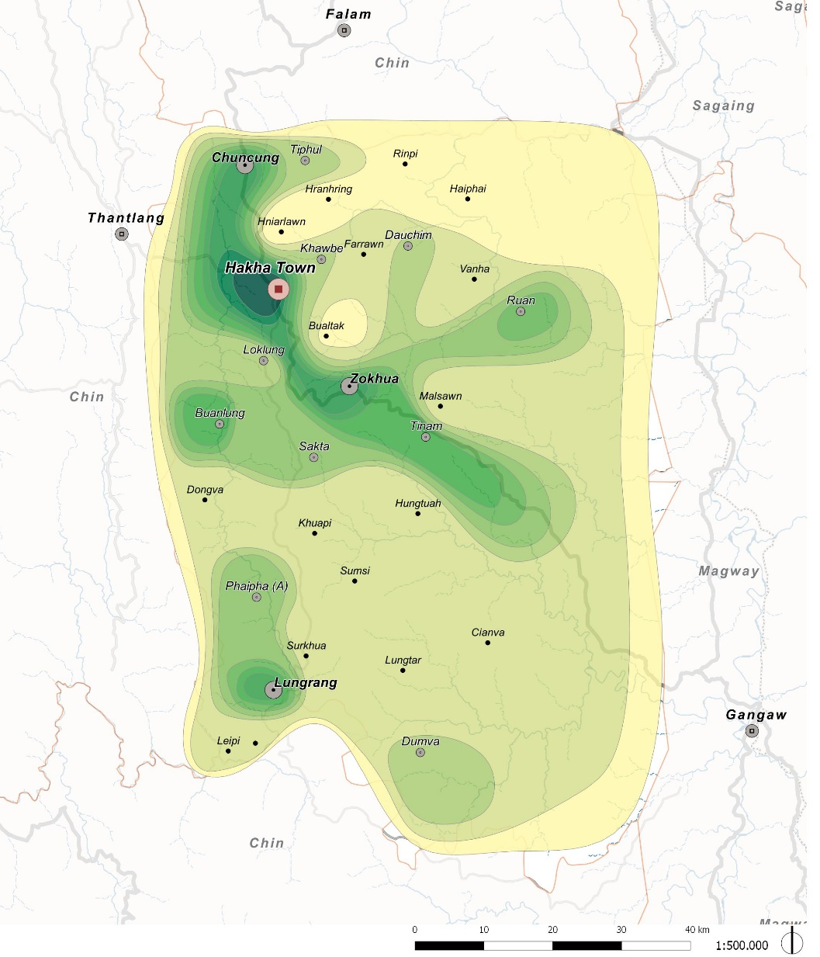
Spatial analysis of Hakha township
A matrix of functions that identifies townships and services was developed to assess the level of development of a given area.
It is used to determine exposure and potential impact of natural hazards and to gather information concerning the need for new infrastructures and services
Notes:
- A lack of infrastructures and services may result in exacerbating existing vulnerabilites

Slide 12
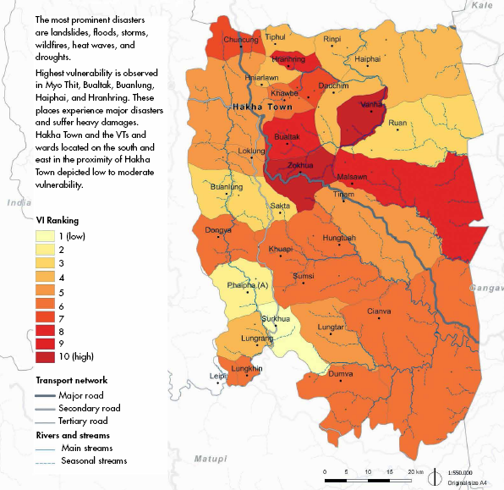
Vulnerability Index Map of Hakha Township

Slide 13
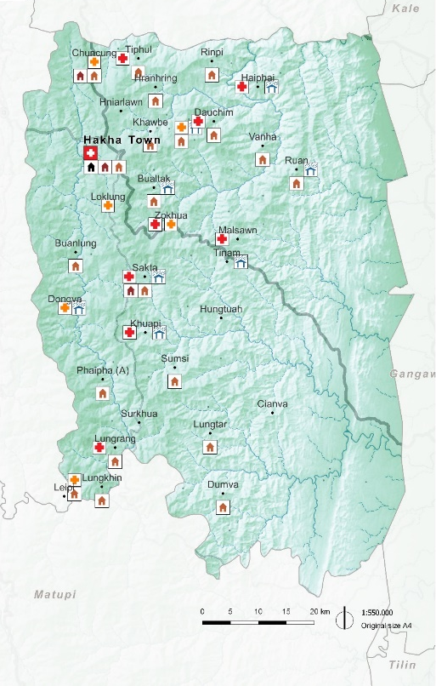

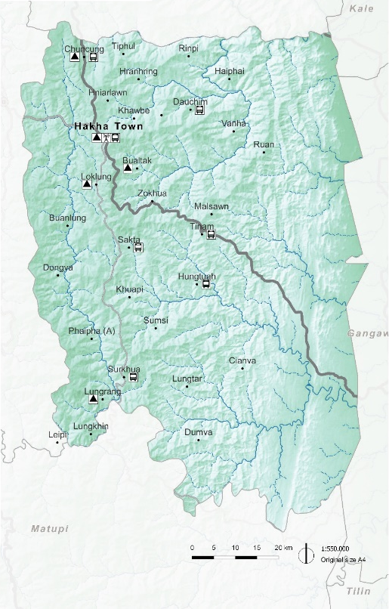

Current vulnerabilities: infrastructure
The transport network mainly relies on the primary paved road
Health and education coverage is very weak across the township
95% of the population relies on underground water sources
70% of the local community recognized a reduction in water availability as the main impact of an increase in temperature
Over the last 30 years 50% of the local community reported an increase in floods and landslides

Slide 14
Current vulnerabilities: socio-economic
High socio-economic dependence (employment, income, food security) on climate-sensitive sectors like rainfed agriculture
High poverty, unemployment and migration rates
Factors for vulnerability to climate change
Low access to education, health, information, market, finance services
Low institutional capacities and unsustainable utilisation of natural resources socio-economic purpose

Slide 15
Current vulnerabilities: socio-economic
Lack of diversification
Livelihoods depend mainly on agriculture (mainly rain fed shifting cultivation), including animal husbandry. Rainfed agriculture is highly sensitive to climate change.

Slide 16
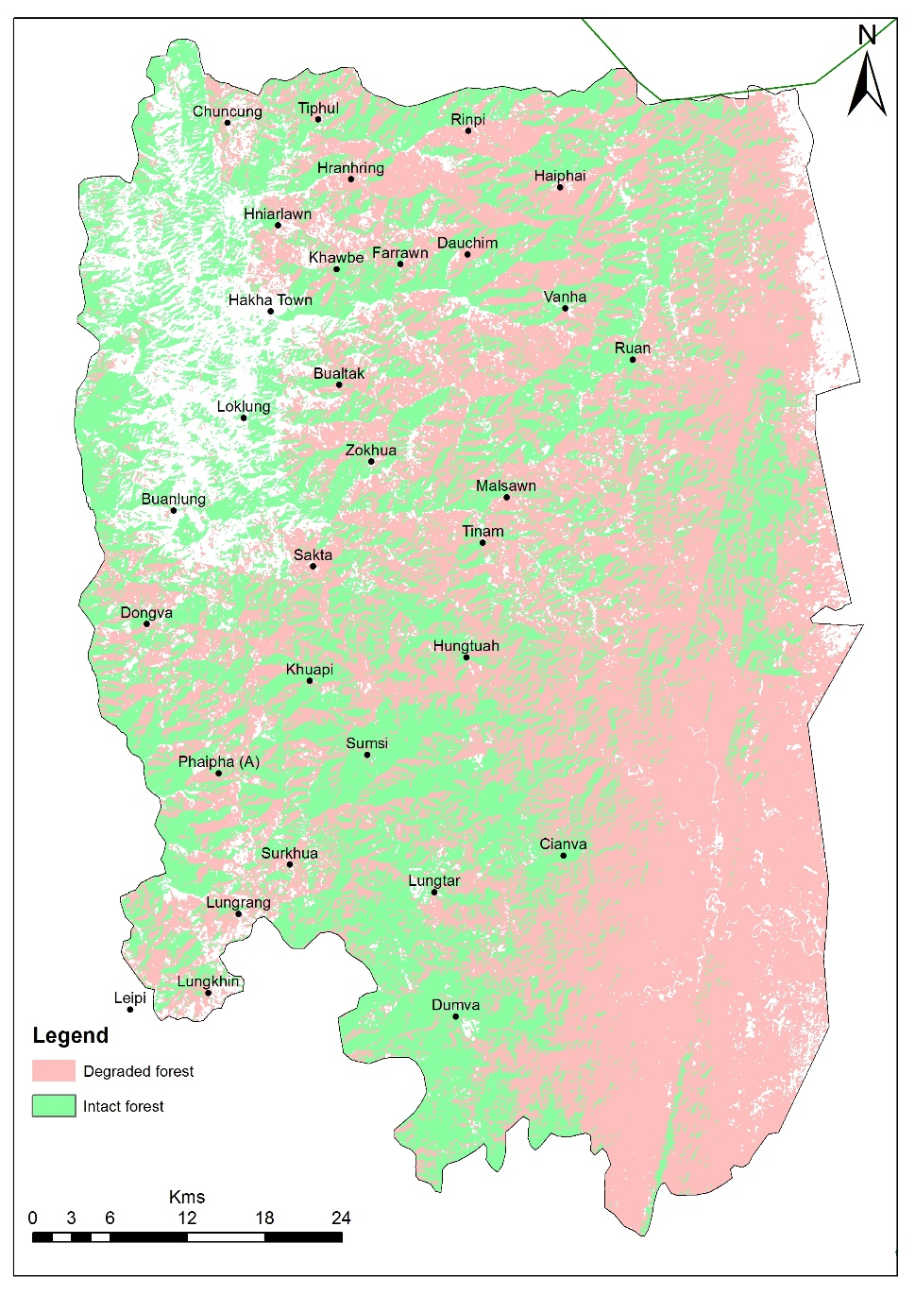
Current vulnerabilities: eco-systems

Slide 17
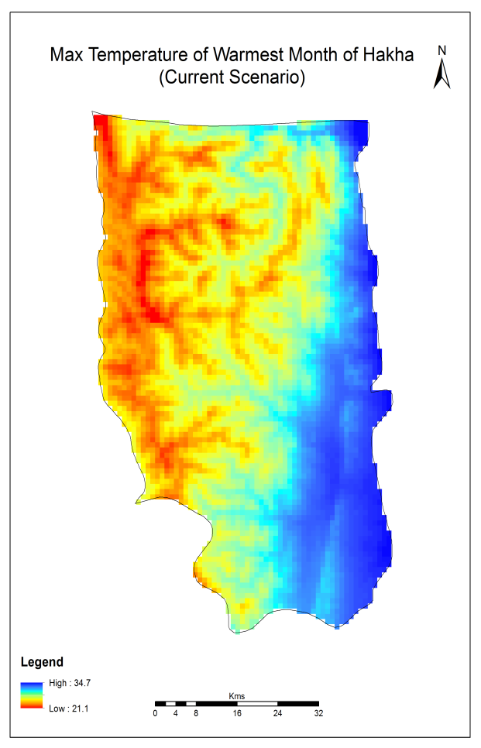
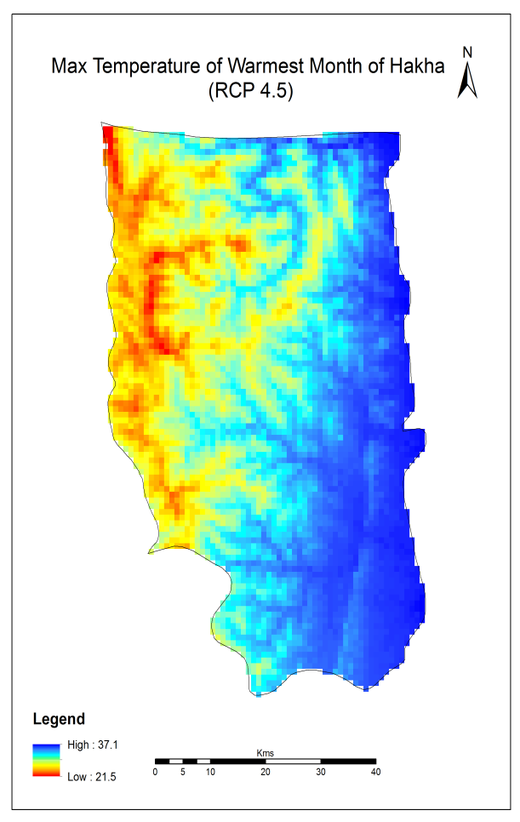
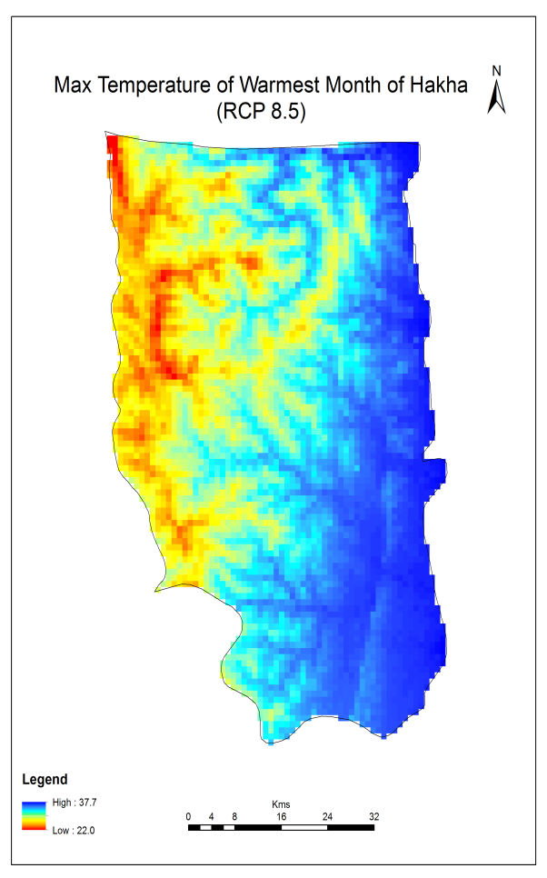
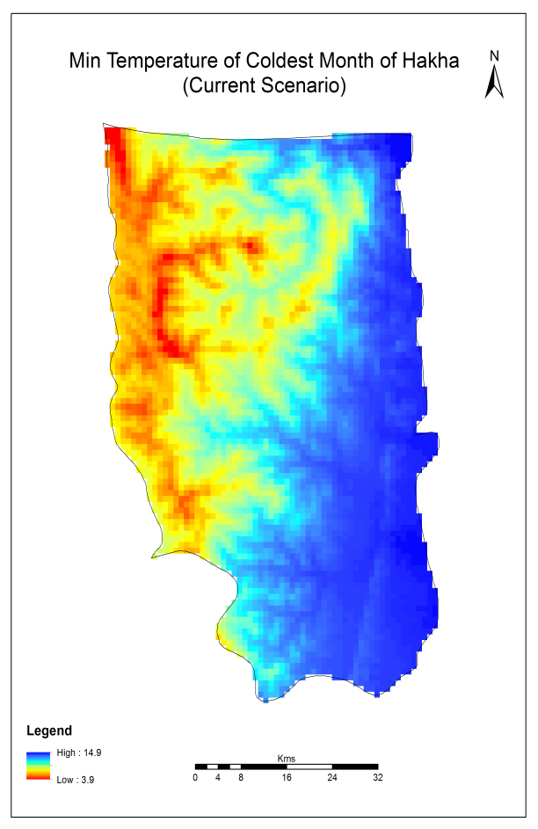
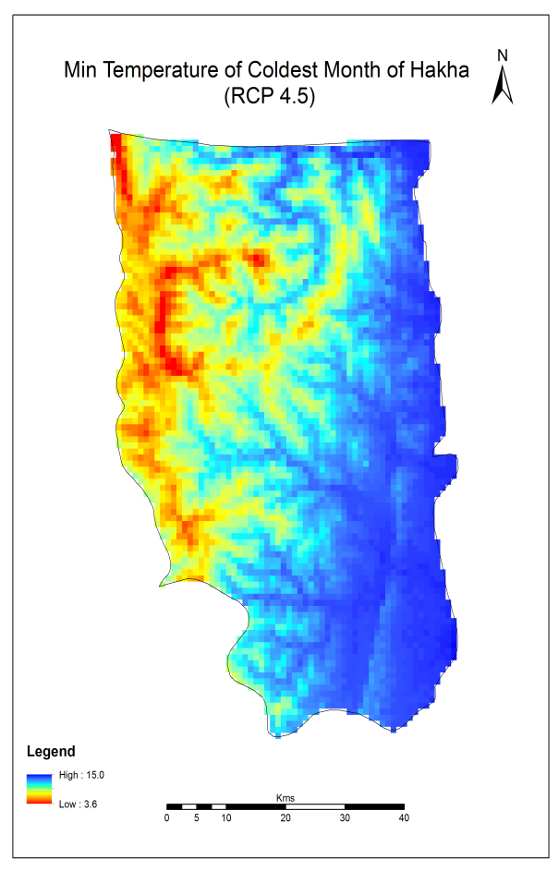
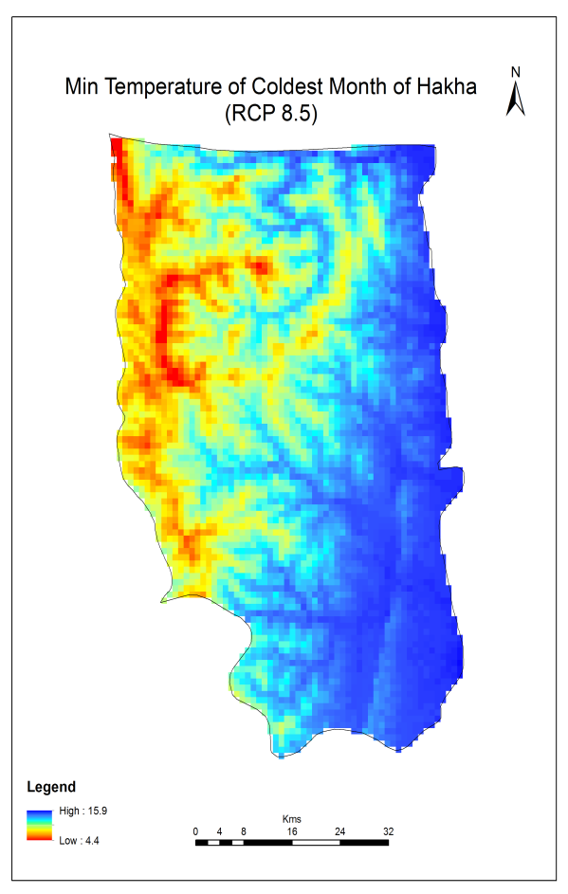
Climate change scenarios: temperature
Increase from 34.7 to 37.7 (+3 Deg. C)
Increase from 21.1 to 22.0 (+0.9 Deg. C)
Increase from 14.5 to 15.5 (+1 Deg. C)
Increase from 3.9 to 4.4 (+0.5 Deg. C)
Hotter summer!
Not so cold winters!

Slide 18
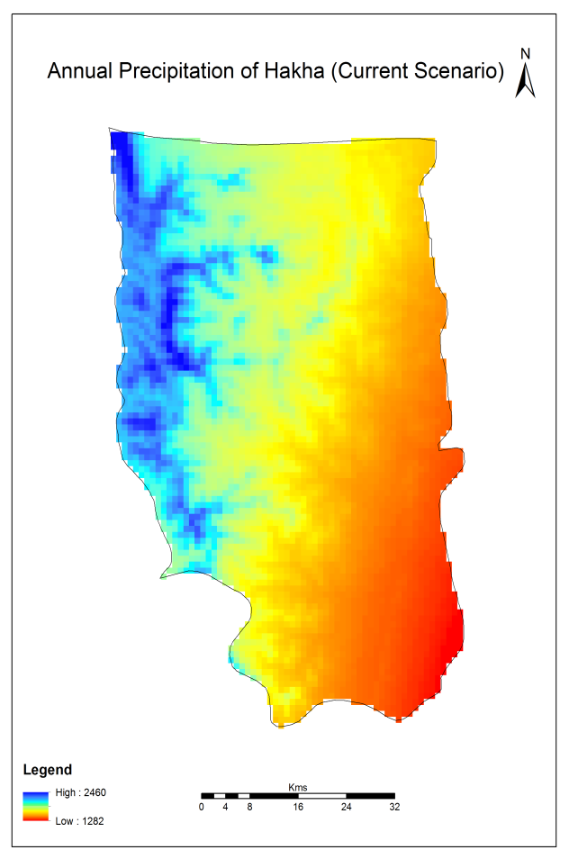
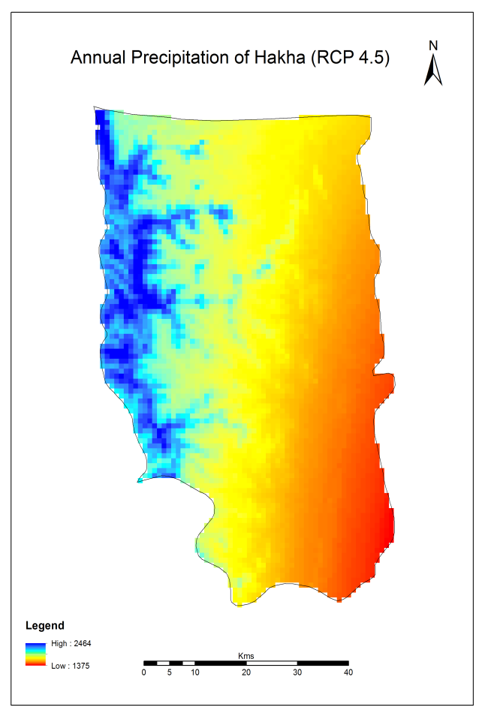
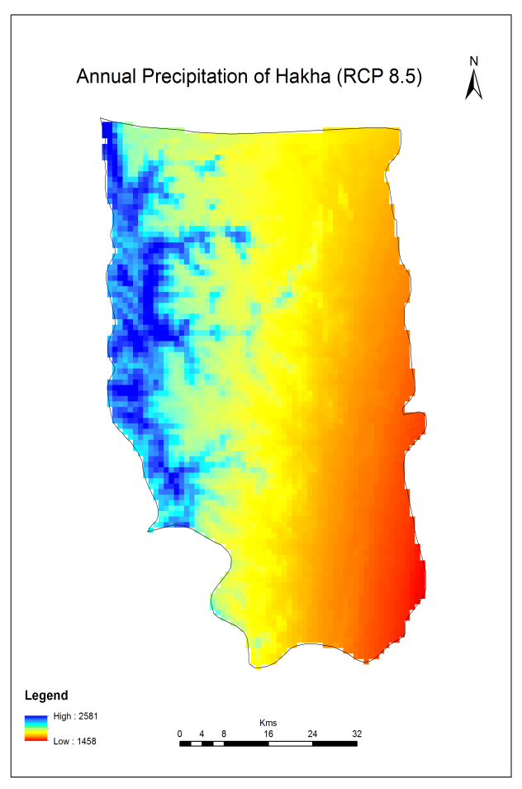
Climate change scenarios: precipitation (I)
Its getting wetter and wetter!
Higher values will increase from 2460 to 2581 mm (~100 mm)
Lower values will increase from 1282 to 1458 mm (~170 mm)

Slide 19
Climate change scenarios: precipitation (II)
Large increase in monthly rainfall during June, July, August, September
More rainfall in short duration – more flash floods and landslides
Changes in rainfall pattern need to be considered in agriculture as well as other activities

Slide 20
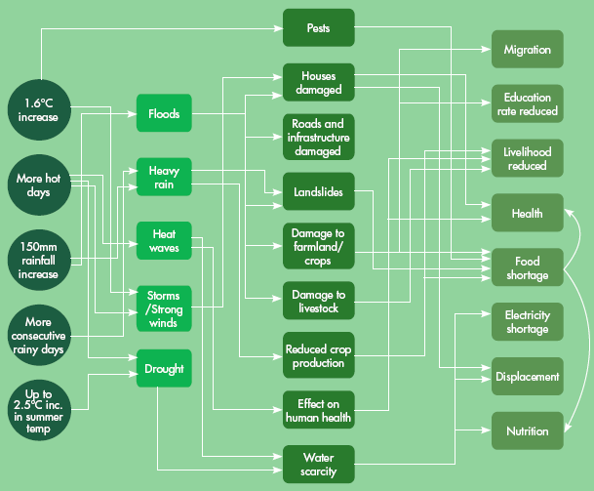
Pathway depicting climatic features, hazards, and impacts by 2050
CC Scenarios
Hazards
Primary impact
Secondary impact
Government provided local communities with future climate scenarios
Local communities defined which kind of hazard it might cause
Local communities defined primary and secondary impacts
Local communities came up with adaptation plans

Slide 21
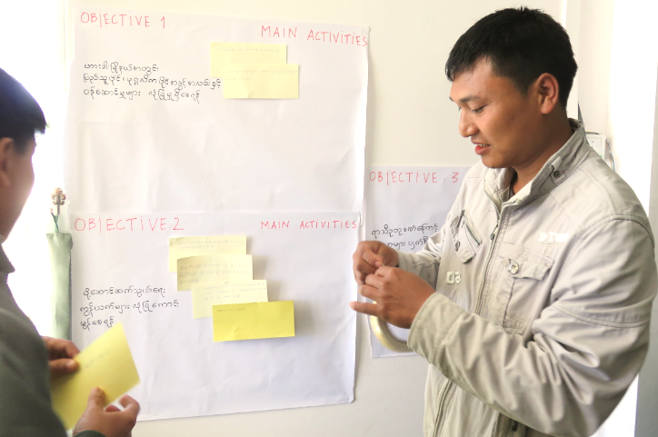
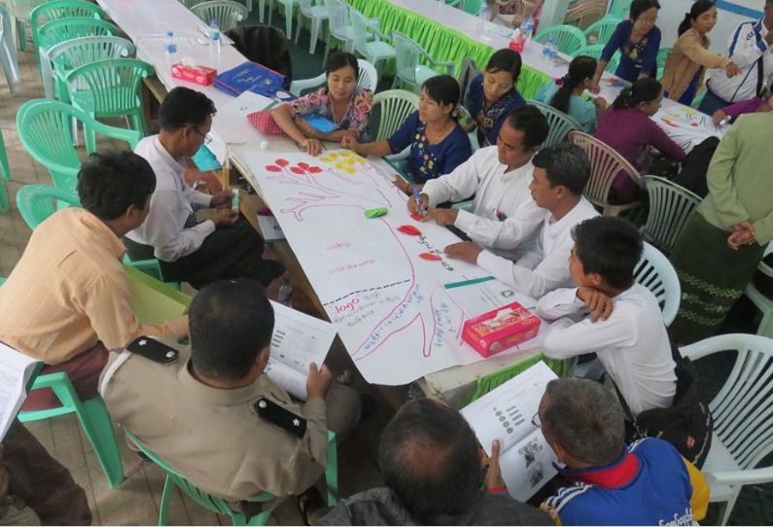
Defining objectives
OBJECTIVE 1:
All Public/Private facilities and services are protected against climate hazards in Hakha township
OBJECTIVE 2:
The Network of communication and transport is ensured across the township
OBJECTIVE 3:
Land and people is protected and prepared against climate hazards in Hakha township

Slide 22
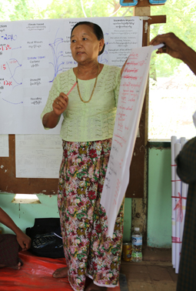
Develop adaptation action planning
 | CATEGORIZATION |  | PRIORITIZATION
Strategic Outcome/ Expected Result | Activity | Category | Cost | Feasibility | Acceptance | Adaptation effectiveness | No regret | Speed | Score
Local communities compile the matrix
Adaptation plans are ranked accordingly
Government implements measure prioritizing the plans considered most important by the community

Slide 23
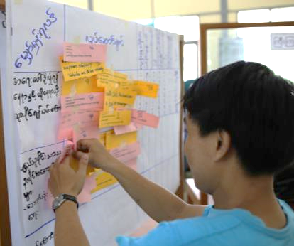
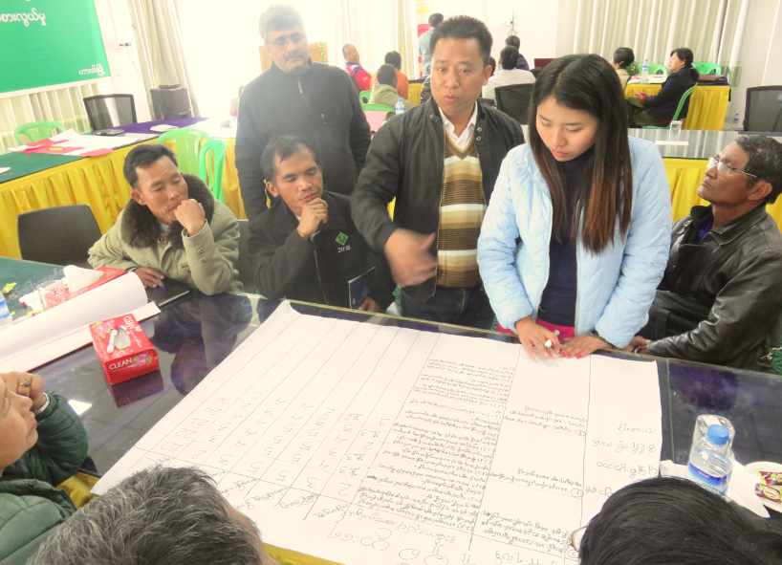
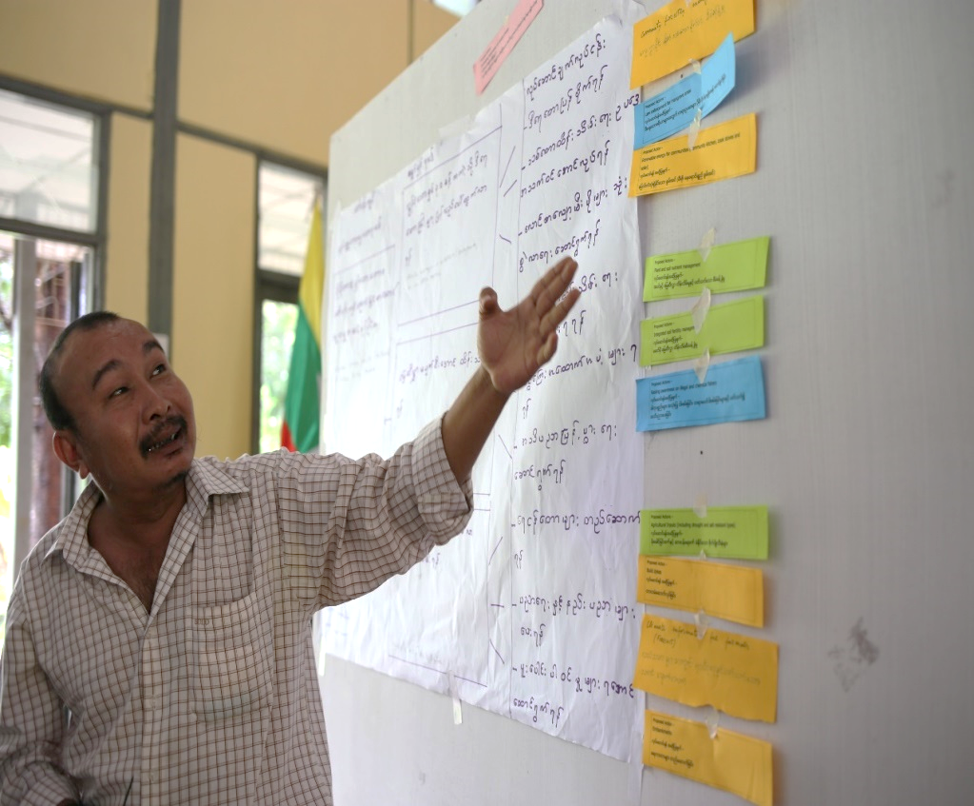
Prioritizing & ranging for adaptation planning

Slide 24
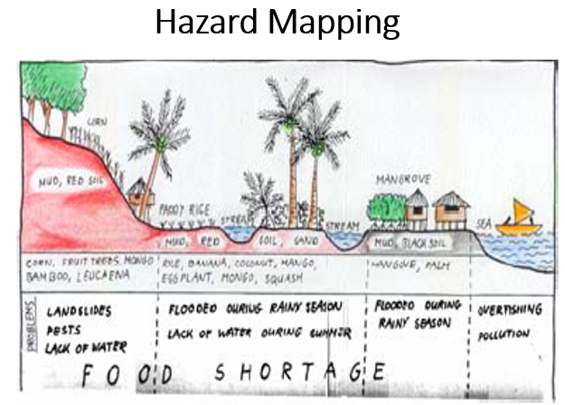
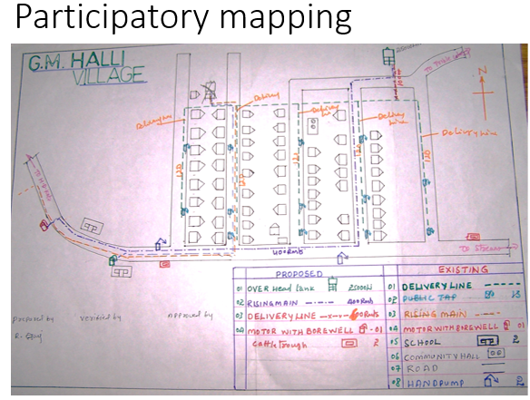
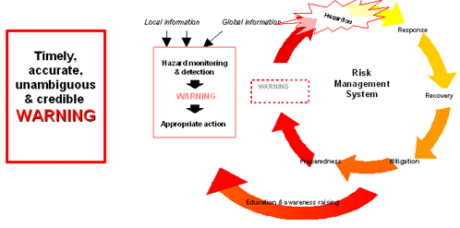
Adaptation and Implementation: infrastructure
Problem:
Poor infrastructures and access to basic services and Housing construction is vulnerable to strong winds and storms
Coverage of disaster and climate resilient basic services is limited
Increase in short duration rainfall, flash flood and changes in rainfall patter
Adaptation:
Studies to identify risk areas (prone to landslides, floods, erosions), improve early warning systems and emergency preparedness
Implementation:
Participatory tools in community based in disaster risk management (CBDRM): hazard mapping; seasonal calendar; focus group interview; community walk; disaster timeline
Community mapping: list of household number and heads with corresponding color; Hakha household mapping with corresponding house number and color-coded hazard (orange = landslide; red = fire; green = flood; brown = erosion)
Reference: Zenaida Delica-Willison

Slide 25
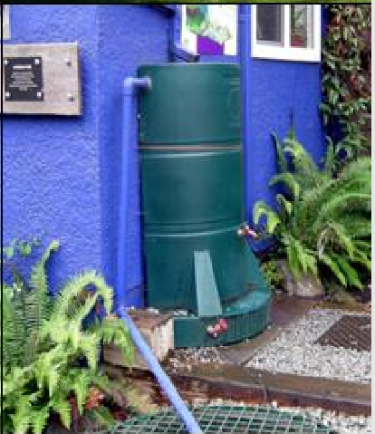
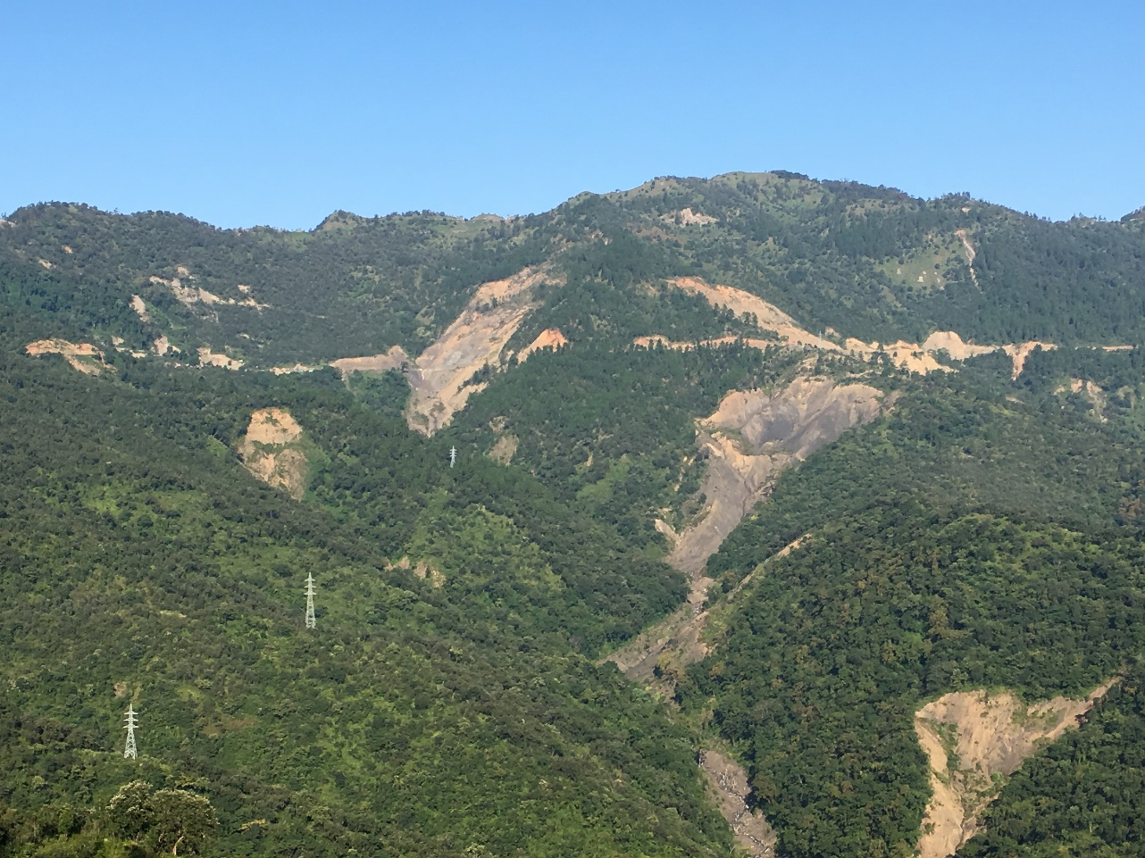
Adaptation and Implementation: eco-systems
Problem:
High dependency on underground water resources (Water Scarcity);
Reduction in water availability due to rising temperature.
Communities heavily depend on fuelwood, which causes degradation and deforestation.
Adaptation:
To protect water sources, and have effective water storage and distribution systems.
Implementation:
Develop an inventory of water sources and possible sources of pollution (protect water source)
Promote roof water harvesting and re-use (water storage - household level)
Establish swales and other water retention structures (water storage - community level)
Contain and reverse deforestation and other unsustainable land management practices (water storage - watershed level)
Improve efficiency of distribution system by fixing leakages (distribution system)
Reference: Hans Schreier

Slide 26
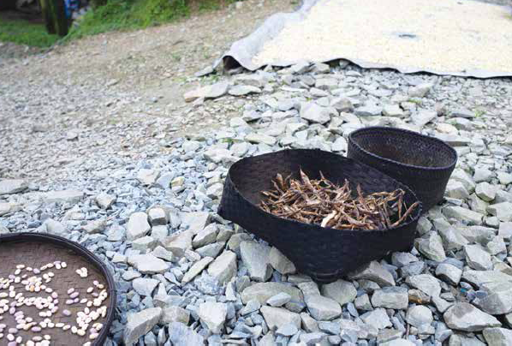
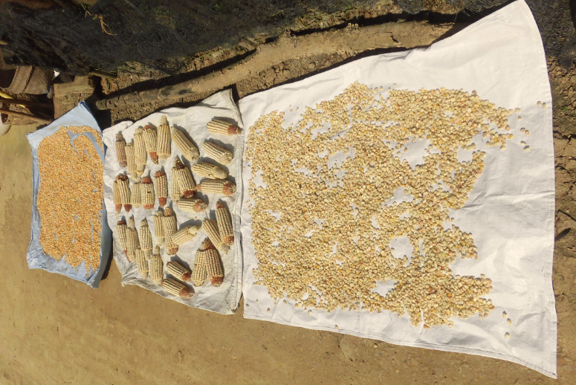
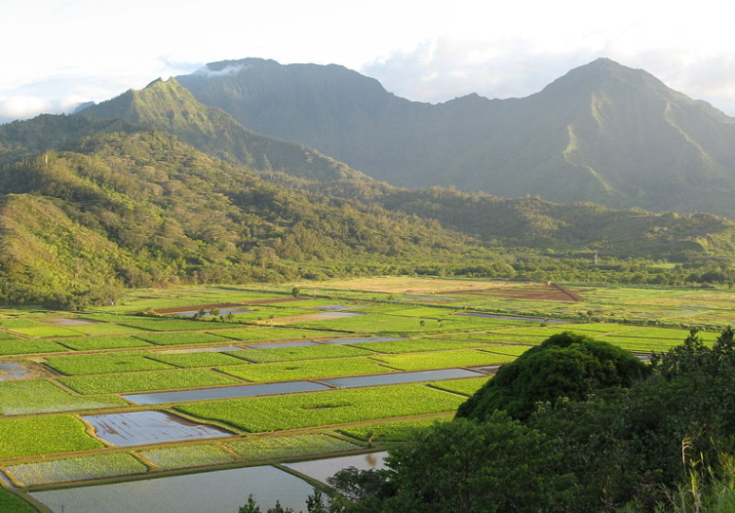
Adaptation and Implementation: socio-economic
Problem:
High rate of economic inactive people (especially female)
Production systems are not diverse. They are highly dependent on paddy and maize cultivation and livestock.
High dependency on rainfed agriculture and lack of diversification.
Adaptation:
Credits/loans for on-farm and off-farm activities to increase production and increase income
Implementation:
Establish a microcredit system which enables local women to access funds that can be invested in climate smart agricultural techniques, climate resident seeds etc..
Kick start a virtuous system in which women employment increases and brings in another income to the household (livelihood diversification)
Reference: Yuka Makino; Manuel Peralvo

Slide 27
Thank you for your attention

