Slide 1
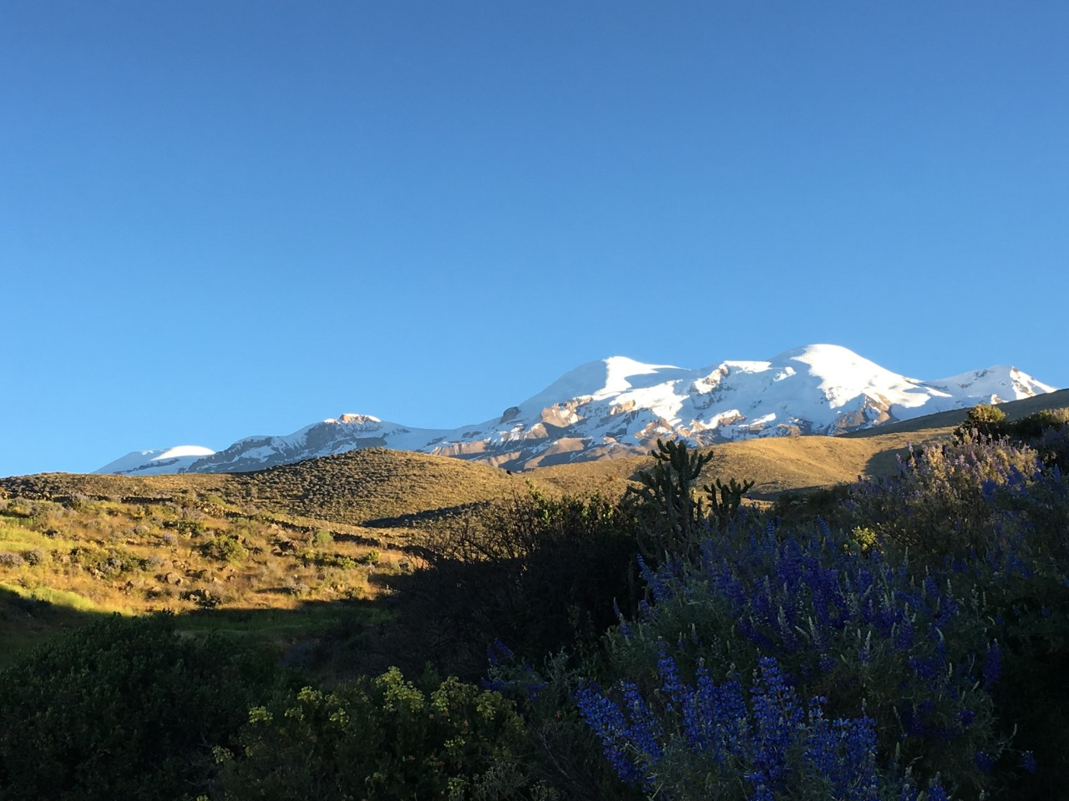
Personal presentation
Angela Mendoza Ato
National Institute of Research on Glaciers and Mountain Ecosystems (INAIGEM-PERU)
E-mail: amendoza@inaigem.gob.pe
Coropuna glacier - Arequipa
IPROMO
Landscape approach for enhancing mountain resilience
Pieve Tesino /Ormea 02-18 July 2019

Slide 2
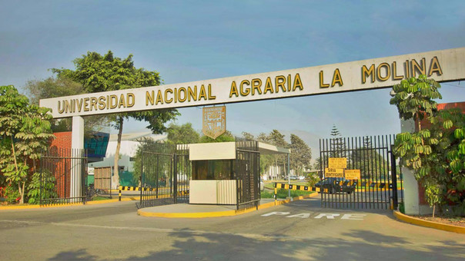


Education
Biology at La Molina National Agrarian University
Employment and main activities
Biology specialist at INAIGEM
Research about glacier and climate risk on livelihood related to mountain ecosystems: Adaptation.
Research in conservation of fragile ecosystems.
Research in restoration of degraded ecosystems.

Slide 3
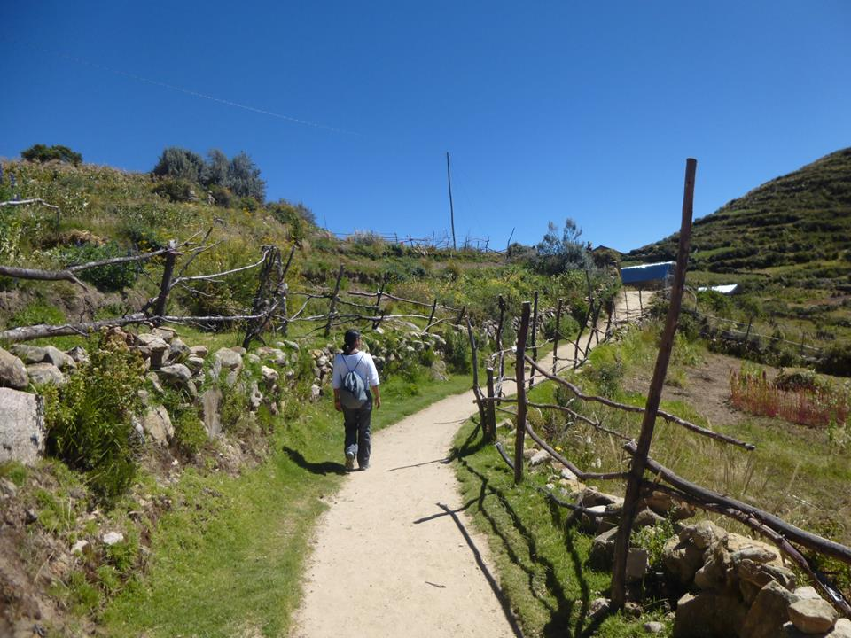
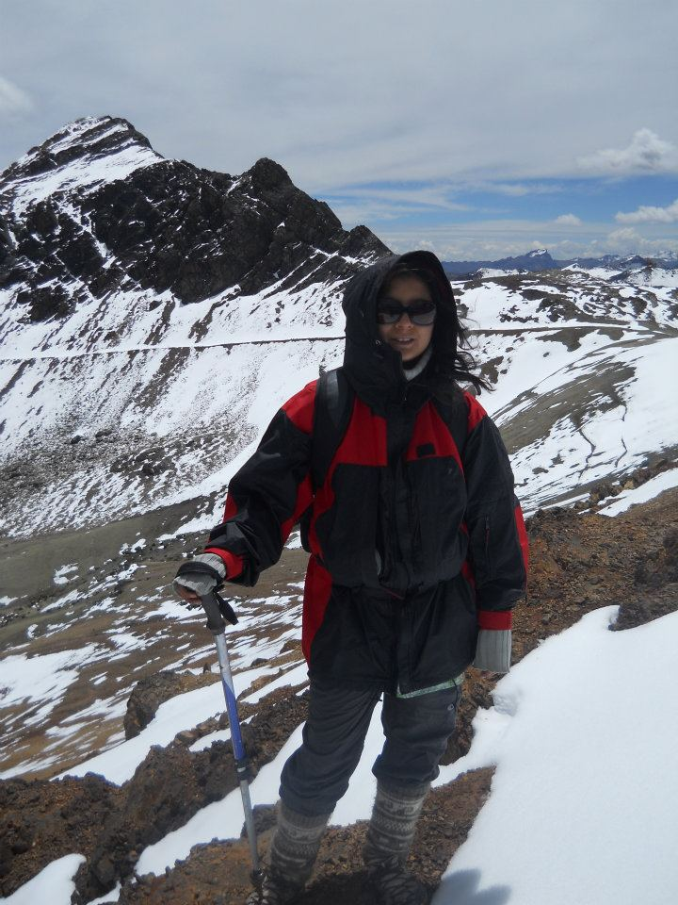
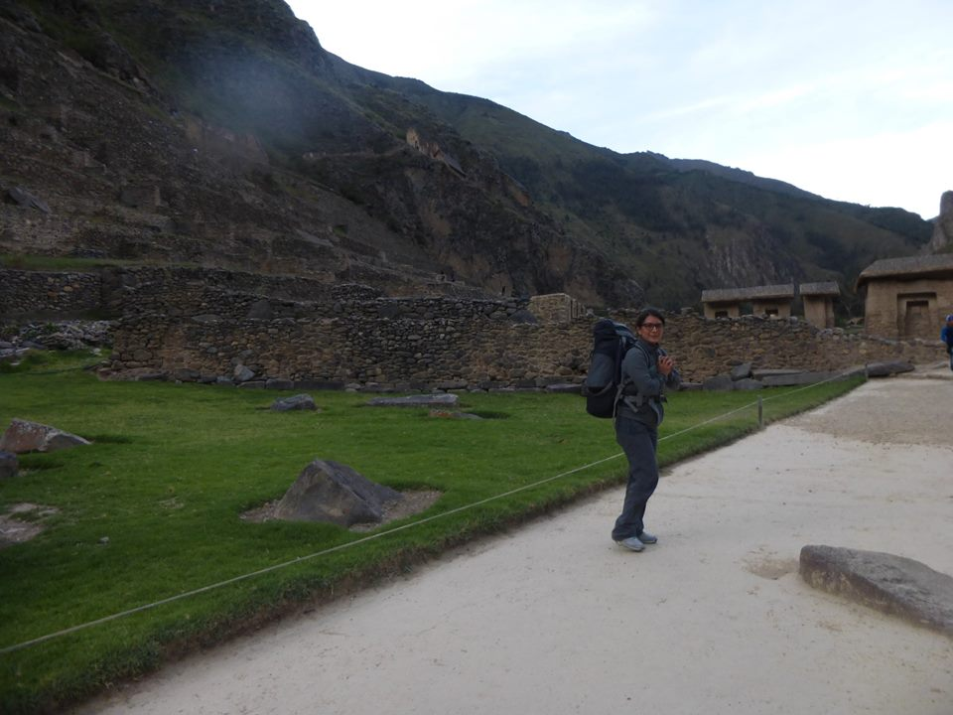
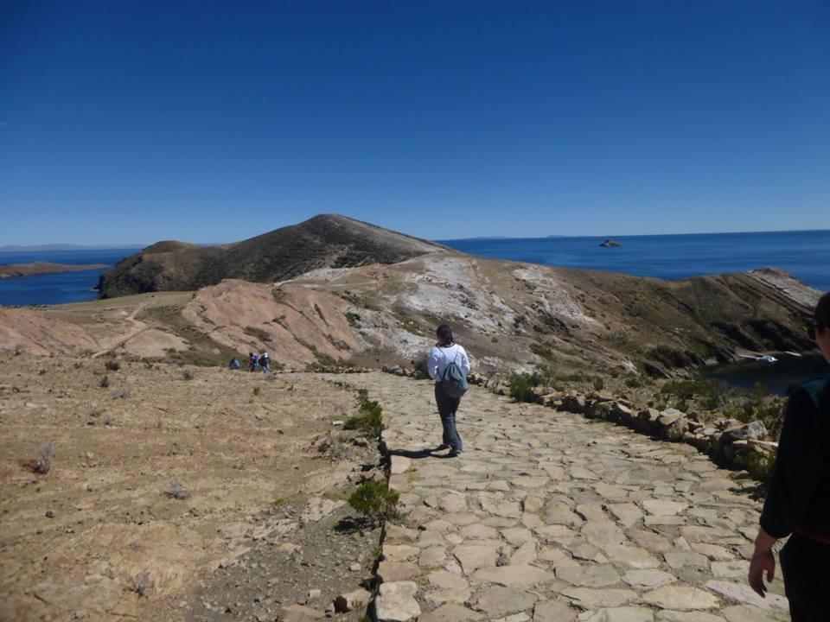
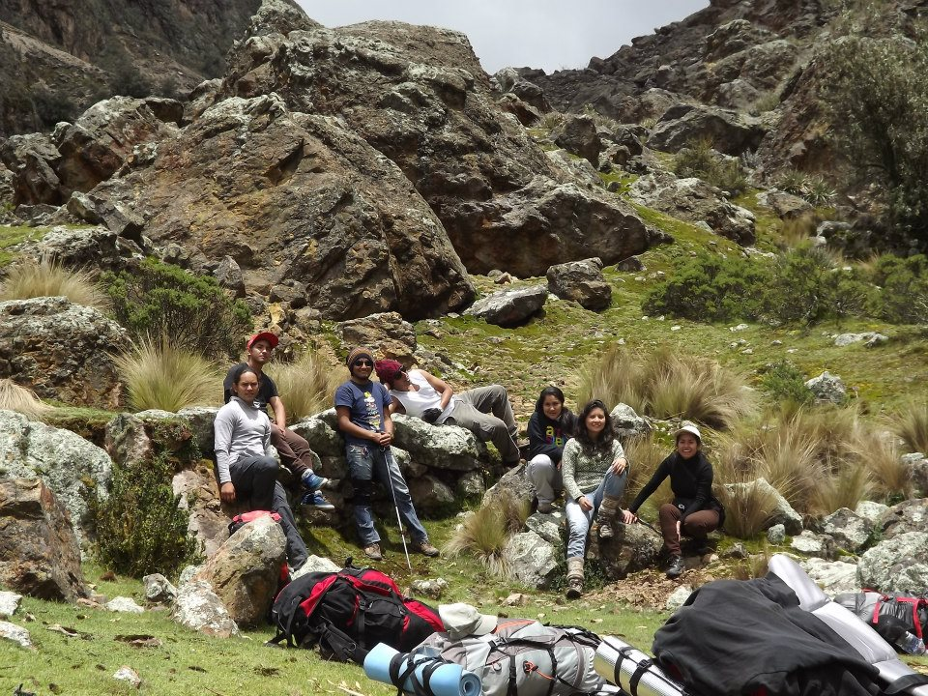
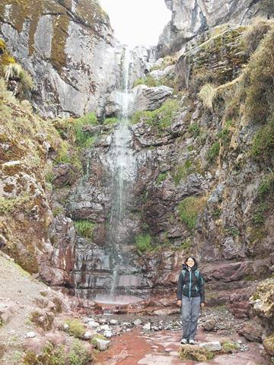
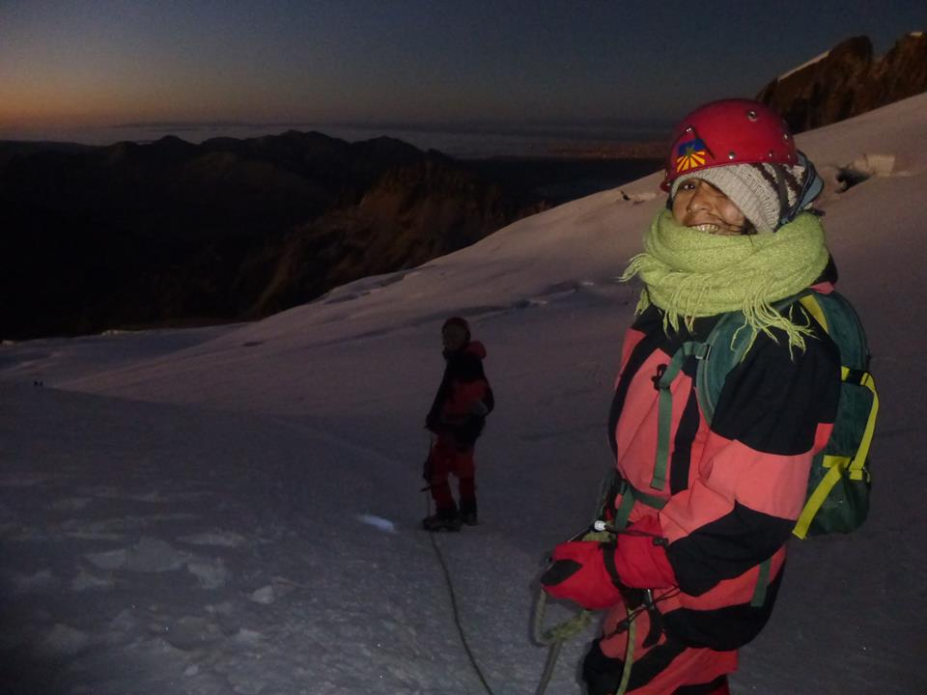
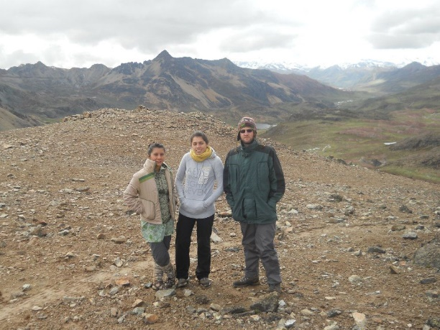
I love the mountains!

Slide 4
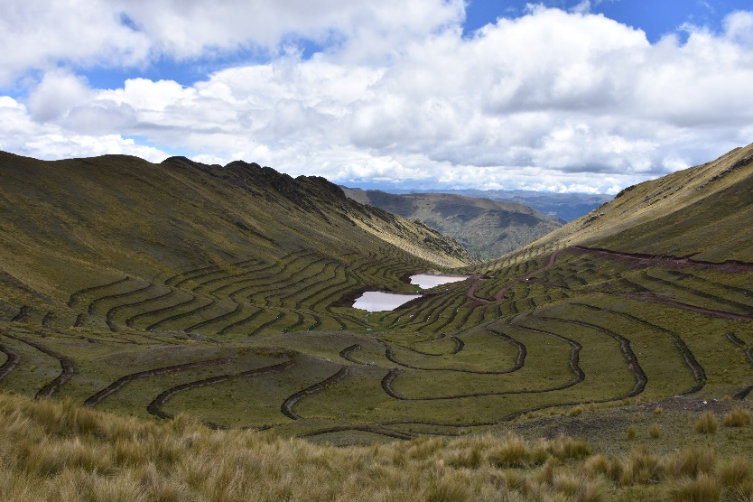
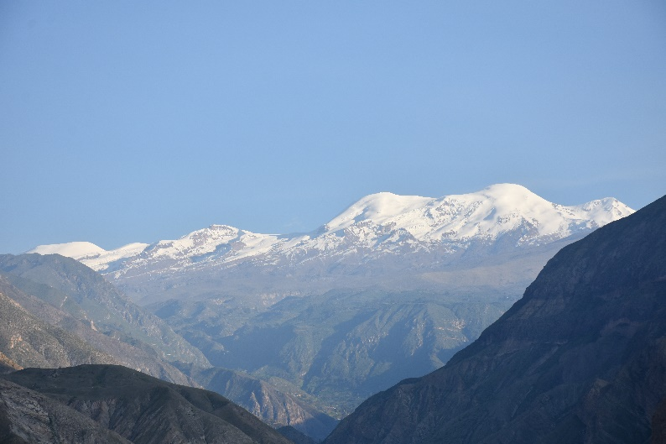
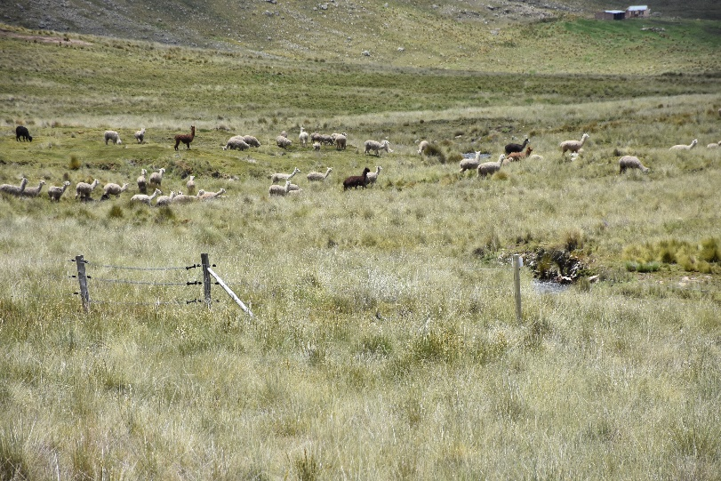
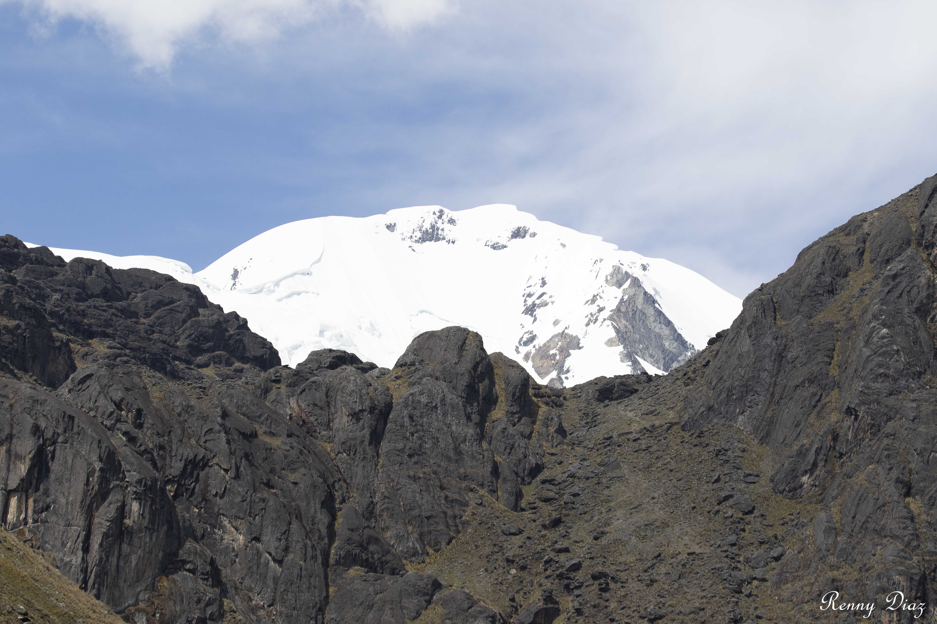
We work in three regions of Perú
And in 4 watershed
CUSCO
Arequipa
Piuray watershed
Llajllajo watershed
Puno
Huari huari watershed – Apolobamba mountain range
La Raya watershed

Slide 5



Restoration practice in Piuray Watershed in the frame of Reward Mechanisms for Ecosystem Services
Agreement
Implement the restoration mechanism
Research in restoration of degraded ecosystems.
Researcher
Infiltration ditch
2 dikes
5 sp Poaceae
2 sp of trees
1 sp of shrub

Slide 6
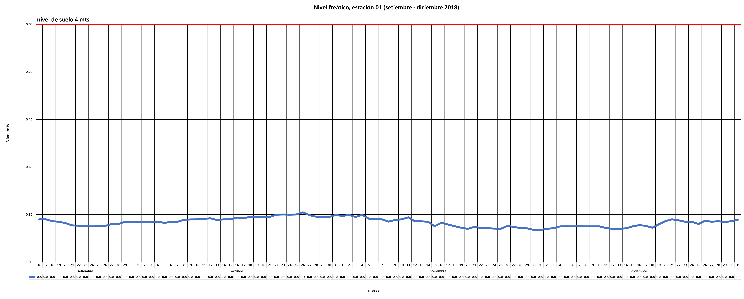
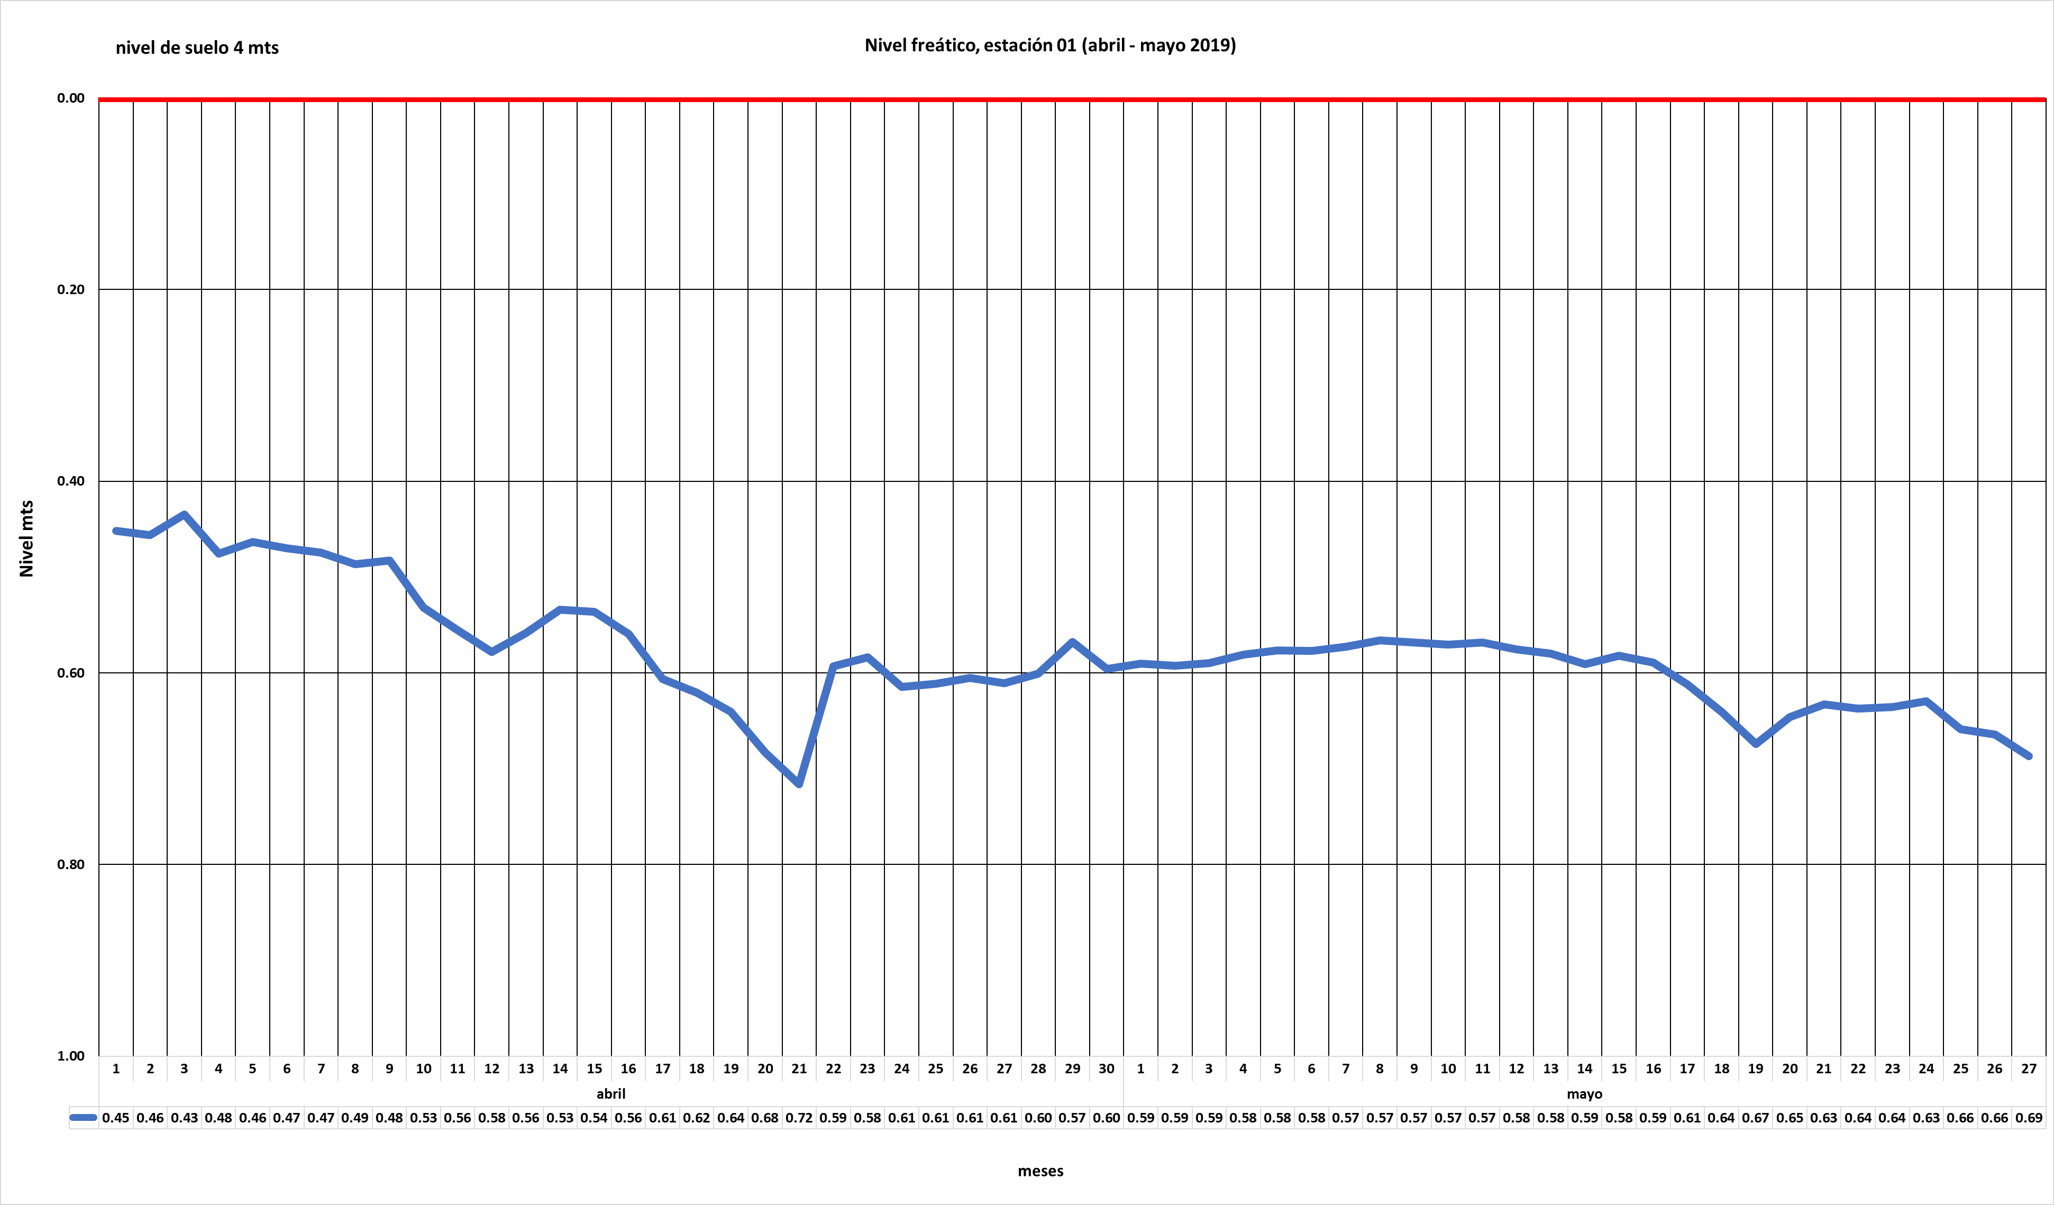
Hidrometeorological monitoring – Piuray watershed
Water table level (september – december 2018)
0.0
0.2
Level (m.)
0.4
0.6
0.8
september
october
november
december
Water table level (april – may 2019)
0.0
0.2
0.4
Level (m.)
0.6
0.8
1.0
Abril
Mayo

Slide 7
Thank you all for your attention!

