Slide 1
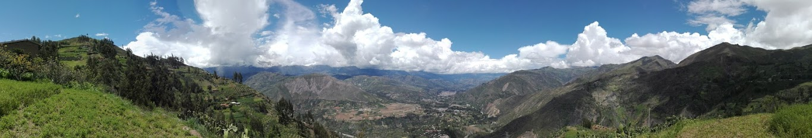
Personal presentation
Alejandra Huamán Tejo
Ministry of Development and Social Inclusion, Peru
ahuamant@midis.gob.pe / alejandra.huaman@pucp.edu.pe
IPROMO
Landscape approach for enhancing mountain resilience
Pieve Tesino /Ormea 02-18 July 2019
Notes:
<número>

Slide 2
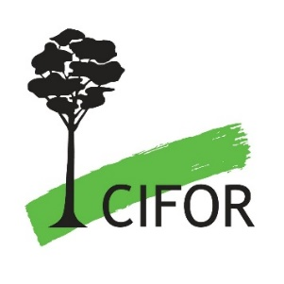


Education
BA in Social Sciences, Anthropology major
Diploma in Food Security for Agricultural Development
Employment and main activities
Public sector
Ministry of Development and Social Inclusion – Policy Design and Articulation
Research
Subjects: Land tenure, household economics, political participation and natural resource management amongst peasant communities and indigenous peoples
Methods: qualitative (ethnography), quantative and spatial

Slide 3
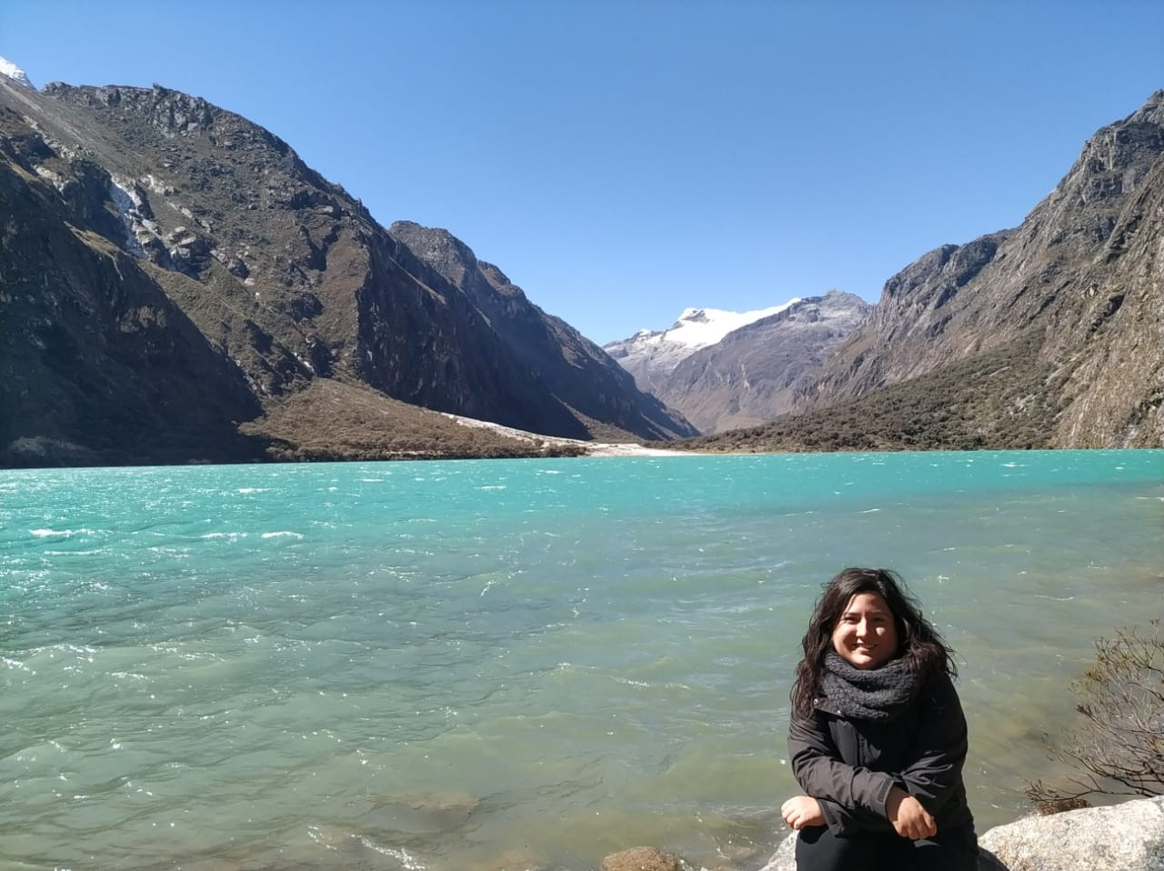
Other interests
I enjoy:
  Learning new languages and travelling
  Meeting new people
  Computing and technology
  Playing boardgames
  Cooking
  Taking care of pets!
Volunteer in the university mentoring students and organizing book clubs
(current topic: 50 Years of the Agrarian Reform in Peru)

Slide 4
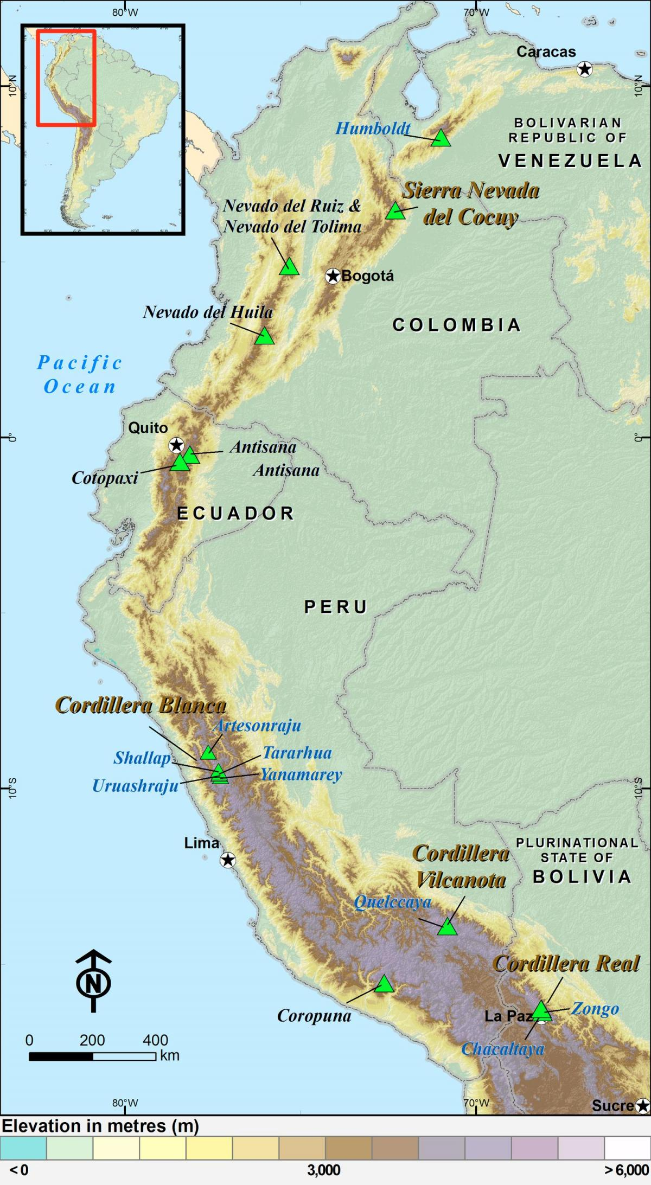
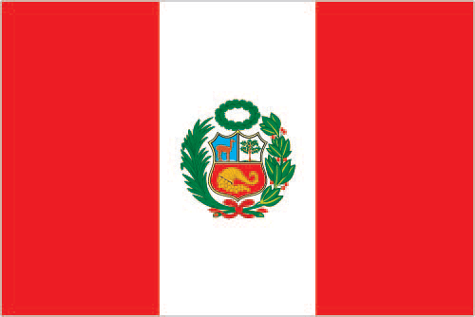
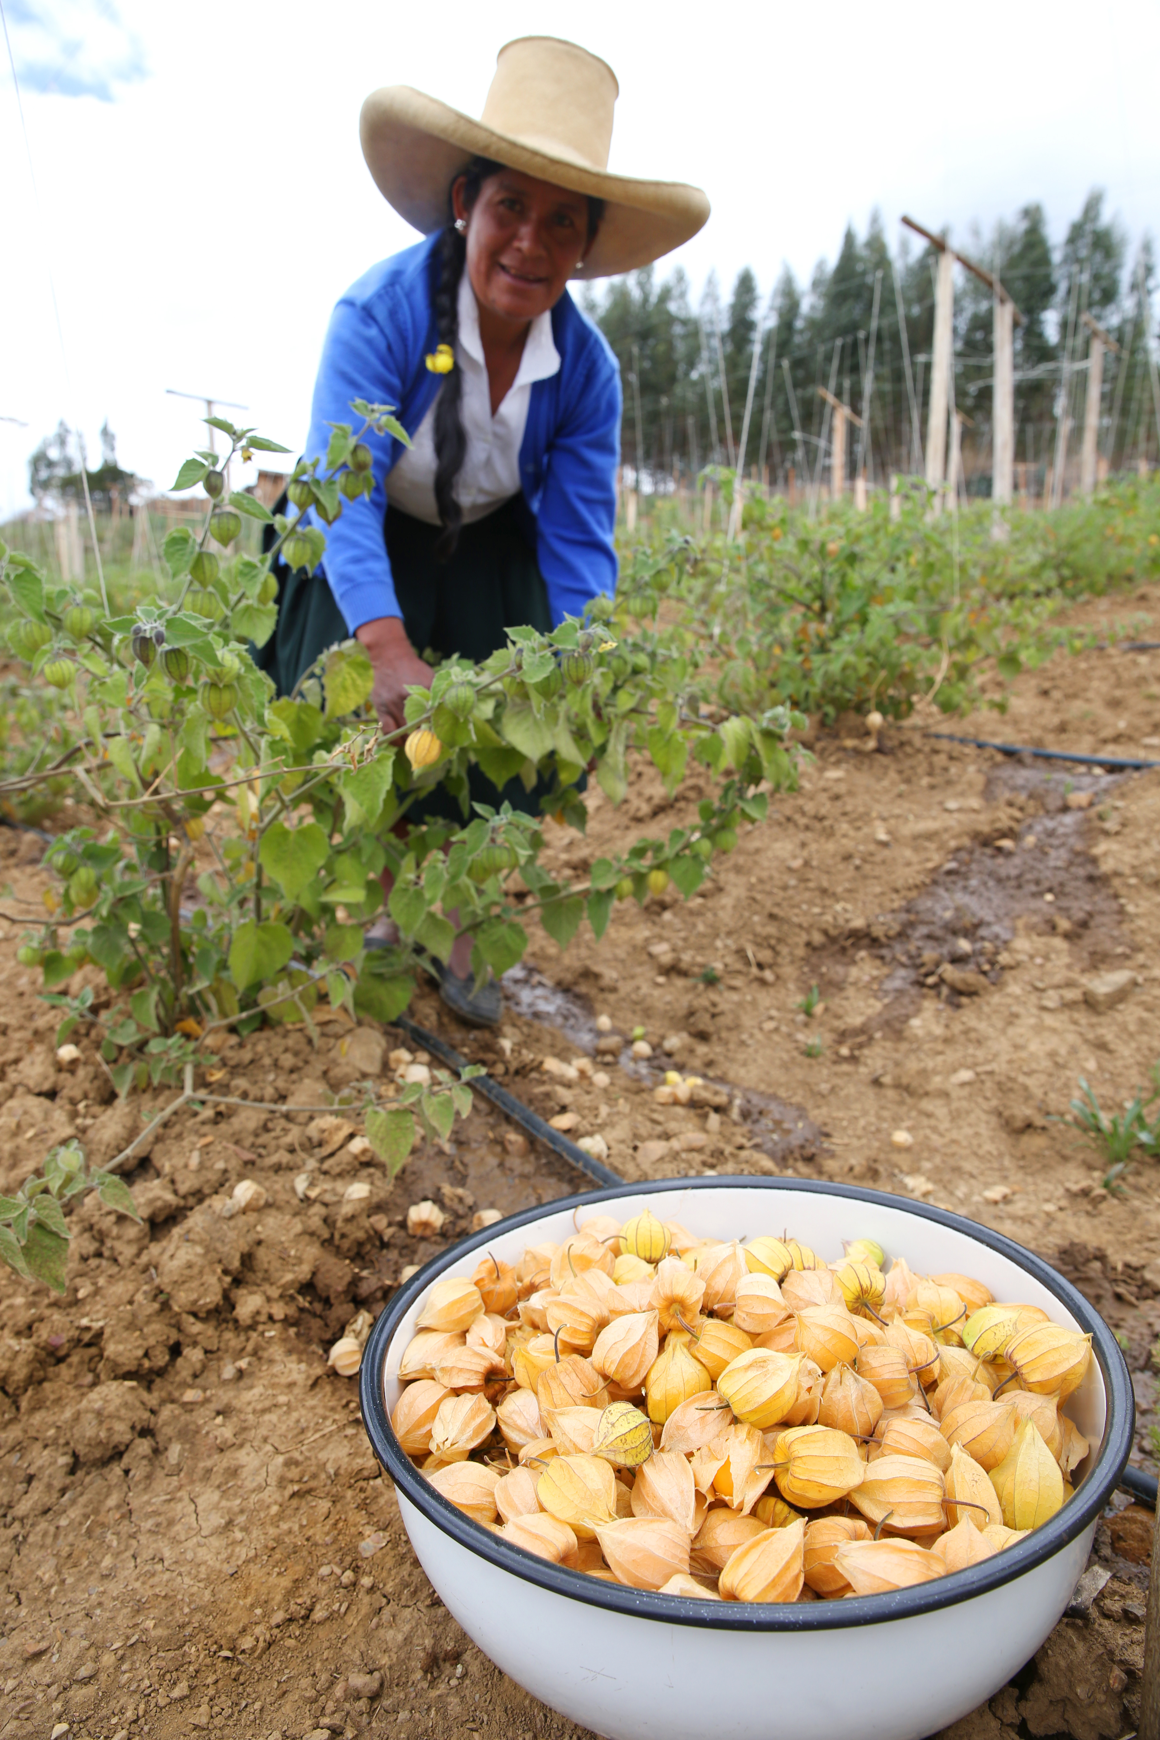
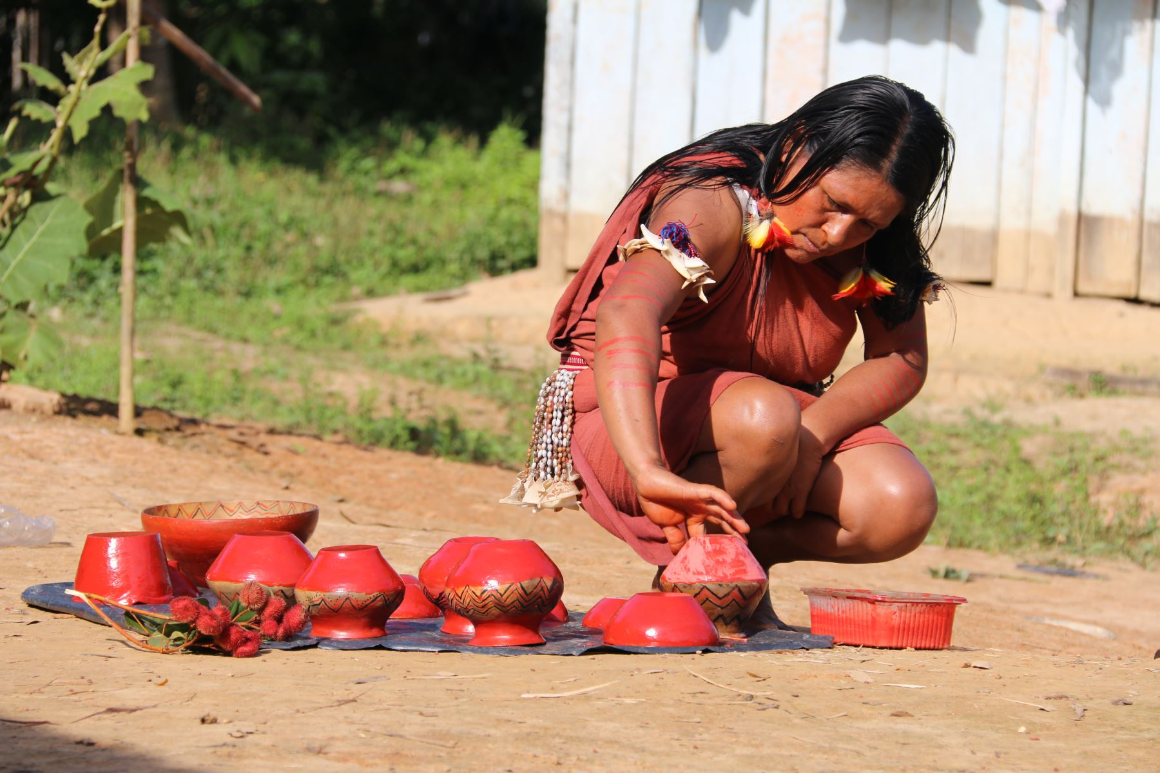
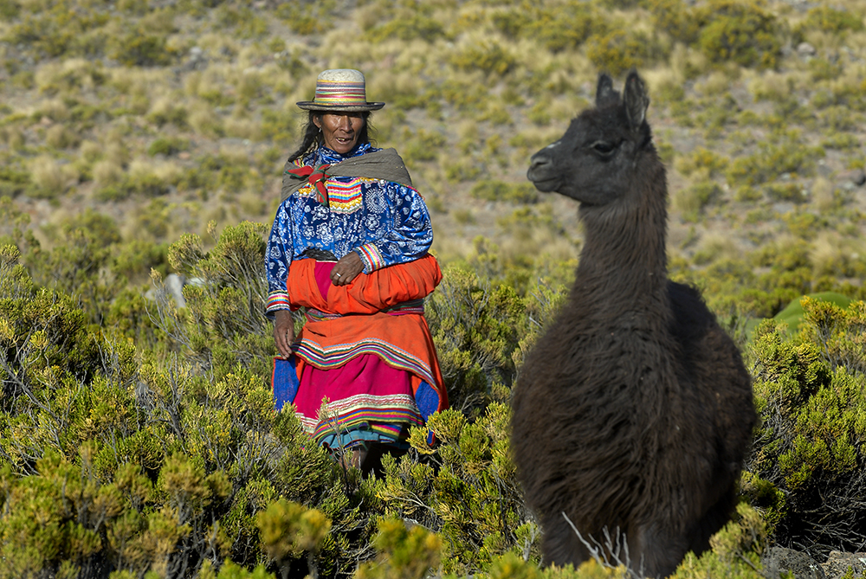
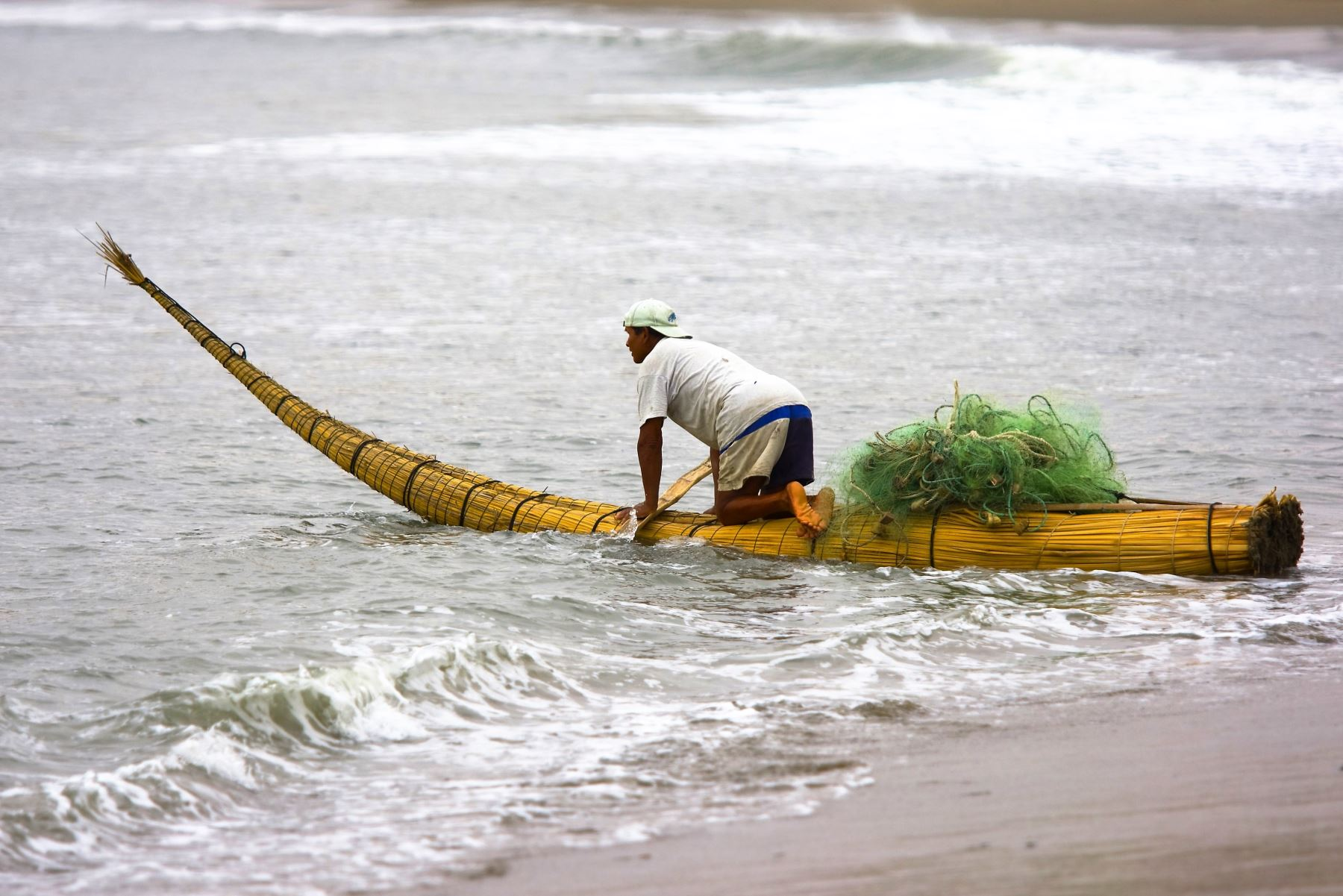
Perú
Languages: Spanish,Quechua, Aimara, and many amazonian indigenous languages (+40)
Area: 1,285,216 sq km
Population: 31 million people, over 4 million live in the mountain areas
Highest point: Huascaran mountain (6746 m)
Mega-diverse country: biologically, ecologically and culturally

Slide 5
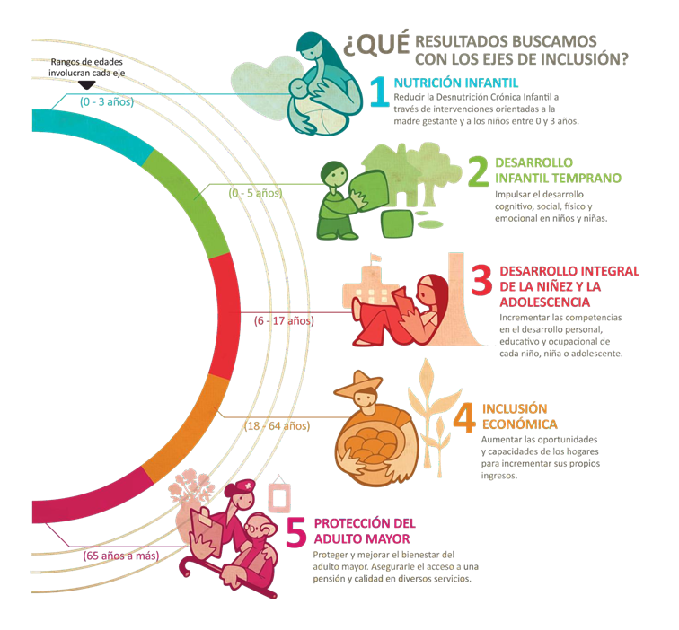
Work project: Integrated action for attacking poverty
The Ministry of Development and Social Inclusion works with the Life cycle approach, directing initiatives for each life stage, “from cradle to grave”, looking to stop the intergenerational transmission of poverty.

Slide 6
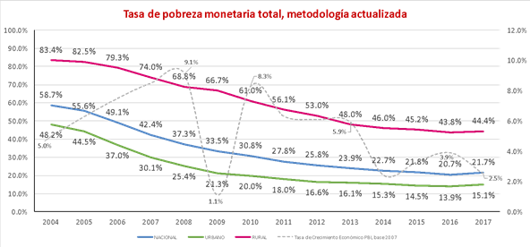
Work project: Integrated action for attacking poverty
Poverty rate 2004-2017
Although we have achieved great results, social gaps persist amongst rural populations, particularly with scattered population and indigenous peoples (like forest and mountain dwellers).

Slide 7
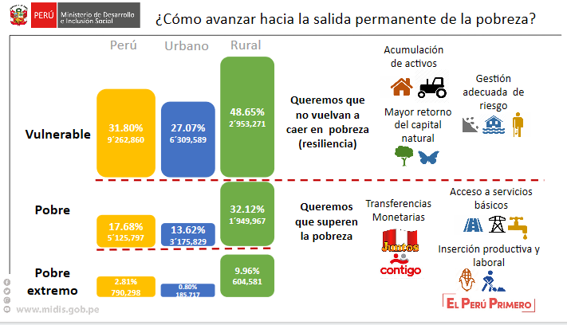
Work project: Integrated action for attacking poverty
Notes:
We need an integrated approach to tackle poverty, so we are ellaborating a Rural Devlopment Strategy to adress extreme poverty, poverty and vulnerability.

Slide 8



Work project: Integrated action for attacking poverty
1. Increasing assets and improving food security
2. Articulating to markets and escaping poverty
3. Consolidating economic and productive activities
Participatory approach that strengthens communities and local governments.

Slide 9
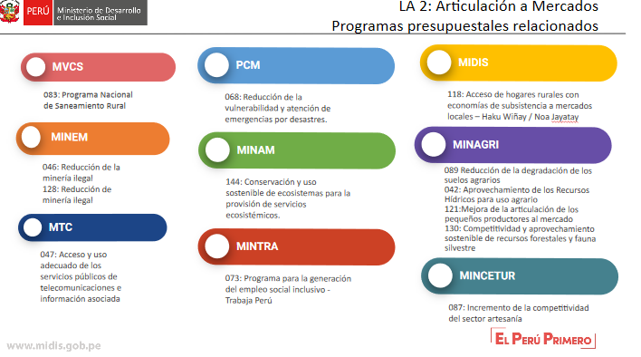
Integrating different government sectors and objectives
Notes:
There are many ministries with different programs directed to the extreme poor and poor, but they do not speak to each other.

Slide 10

Design of a project pilot in the Amazon
Goals:
Improving the management of the commons and resource governance
Improving productive and natural actives through culturally and ecologically appropriate technologies
Strengthening capacities for sustainable economic activities in the local systems of production
Increasing the resilience of agri-food systems
Strengthening the active participation of women in indigenous economies
Notes:
We will develop several pilots in rural areas. We have started with a project pilot for articulating different government sectors in the Amazon, but we will do the same with the Andean region. IPROMO is an opportunity to develop a pilot specific for mountain dwellers.
In the Amazon, we will work with the Ministry of Development’s program HAKU WIÑAY / NOA JAYATAI, which meand Let’s grow together in quechua (HAKU WIÑAY) and shipibo (NOA JAYATAI). The program’s objective is to increase productive assets and reduce economic vulnerability. The second program is PROGRAMA BOSQUES (PNCB) a program from the Ministry of the Environment that aims to reduce deforestation through sustainable activities with indigenous communities.

Slide 11


Design of a project pilot in the Amazon
Interventions and results that converge
Incrementar activos críticos con tecnologías apropiadas
Producto 1:
Hogares con AT y capacitación para el desarrollo de capacidades productivas
Contribuir con la atención de necesidades básicas de la comunidad
Brindar tecnologías apropiadas para mejorar el proceso de producción
Noa Jayatai
Desarrollar actividades productivas sostenibles
PNCBMCC - TDC
Producto 2:
Hogares con AT, capacitación y portafolio de activos para la gestión de emprendimientos rurales
Desarrollar capacidades para operar los sistemas de información comercial / de mercado
Mejorar la capacidad de gestión comunal
Conformar pequeñas organizaciones
Año 1
Año 2
Año 3
Año 1
Año 2
Año 3
Año 4
Año 5
Notes:
Objectives, activities and results of both programs coincide. They could work together to provide sustainability and an integrated approach to tackle the project’s objectives.

Slide 12
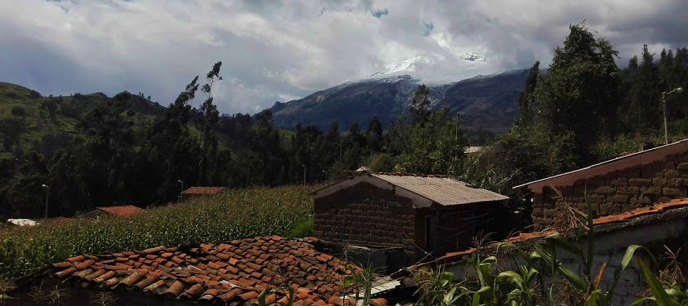
Thank you! Gracias!
Notes:
Ancash, Peru (near the highest peak)

