Slide 1
Personal presentation
Name: Alexey Kim
Affiliation: The Regional Environmental Centre for Central Asia (CAREC)
E-mail: akim@carececo.org
IPROMO
Landscape approach for enhancing mountain resilience
Pieve Tesino /Ormea 02-18 July 2019

Slide 2

Education
Master of Public and Municipal Administration (MPMA), present;
BA in International Relations.
Employment and main activities
Climate Change and Sustainable Energy (CCSE) Program Specialist / Administrative Specialist of the CAMP4ASB project at the Regional Environmental Centre for Central Asia (CAREC).
M&E; communication; management of SSFAs; administrative tasks.

Slide 3


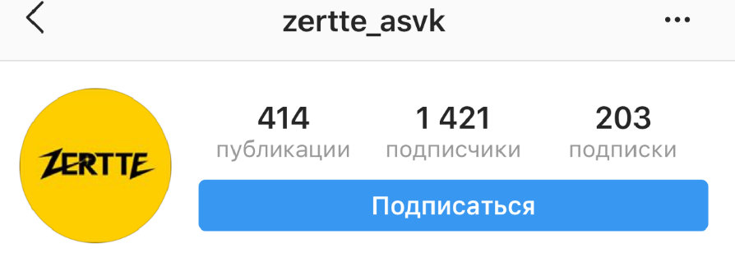
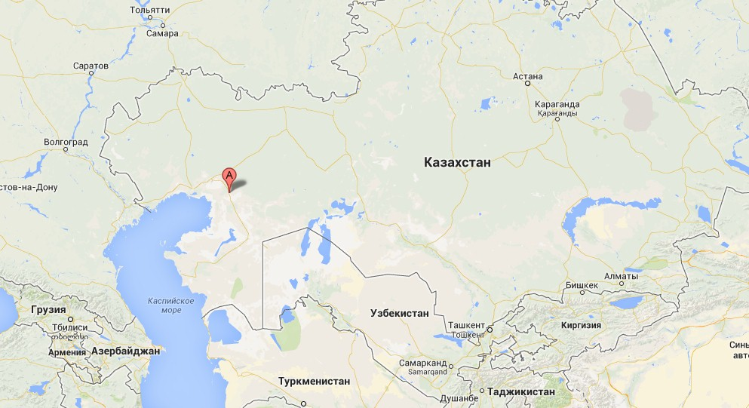
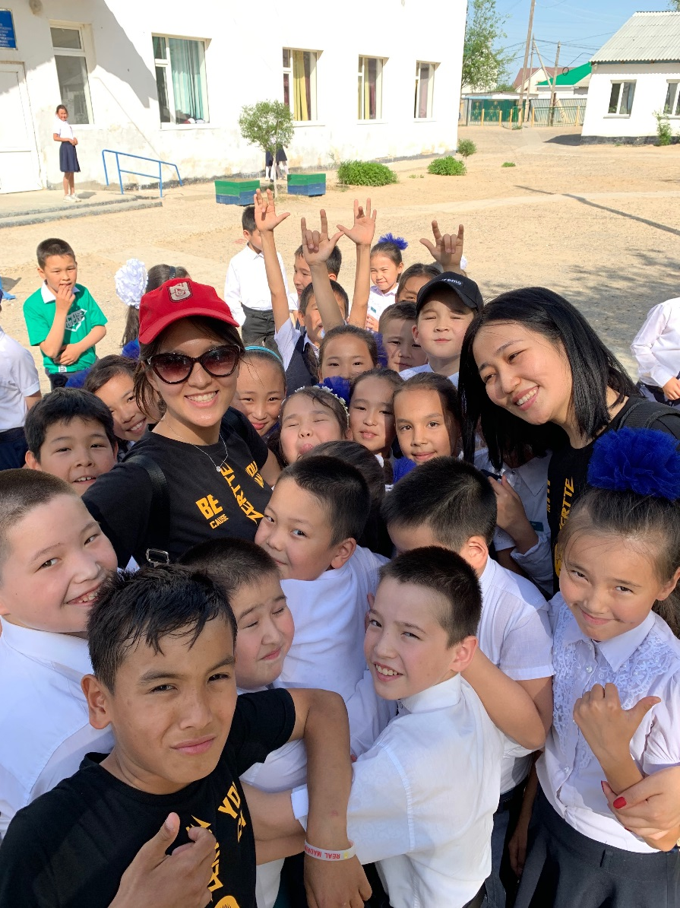
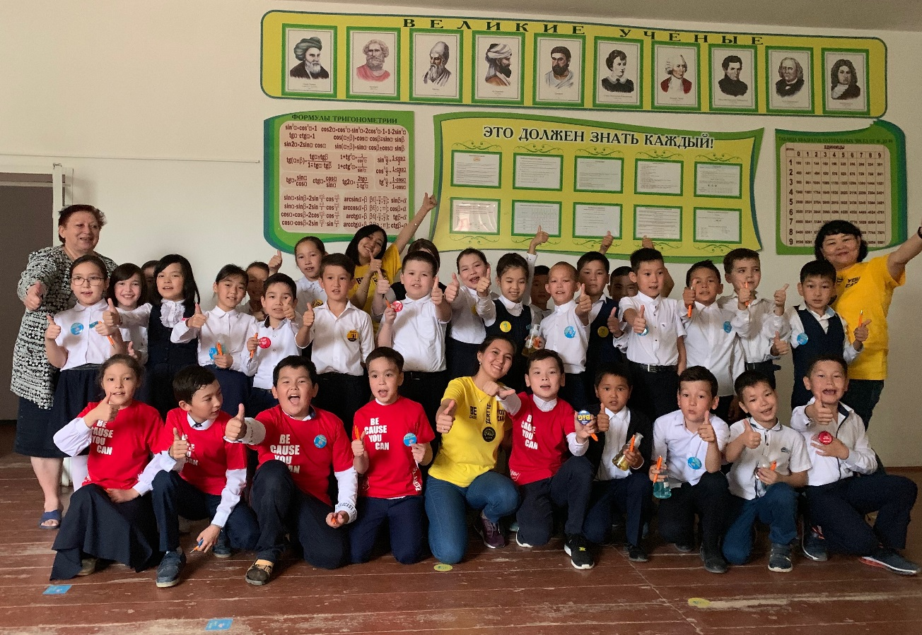
Other interests (volunteer work, hobbies etc.)
project
Notes:
Zertte is a project of the Kazakhstan Association of Family Physicians.
Location of realization: Qulsary city (Atyraū Oblysy).
Zertte from Kazakh language is translated as: “to discover, to explore”. The mission of Zertte is to inspire youth to actively explore themselves and the world around them.
Through interactive way and gaming we are engaging with Primary and High School pupils and telling about the 5 basic Zertte princiles:
To wash hands properly (showing the correct technique);
To drink more water;
To eat more fruits and vegetables;
To care about environment;
To dream big.

Slide 4
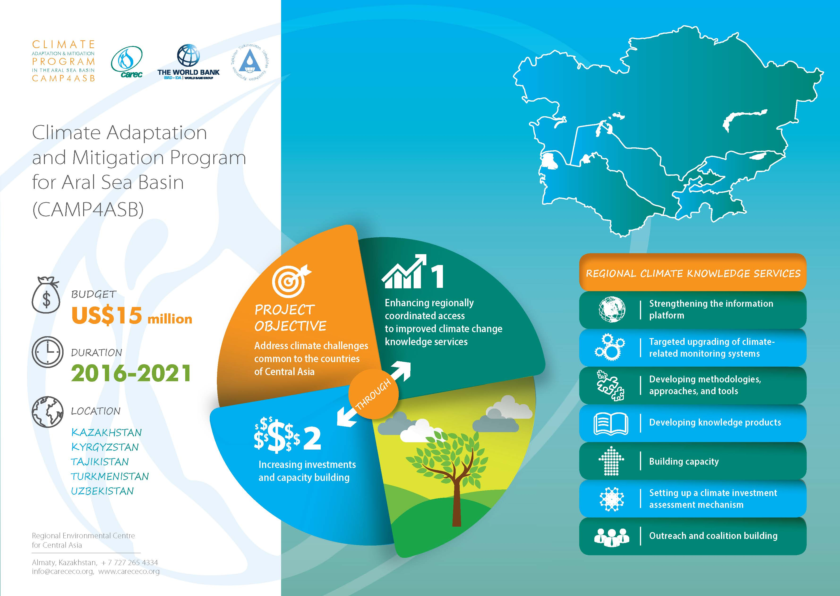
Presentation of a project you are working on 1/3

Slide 5
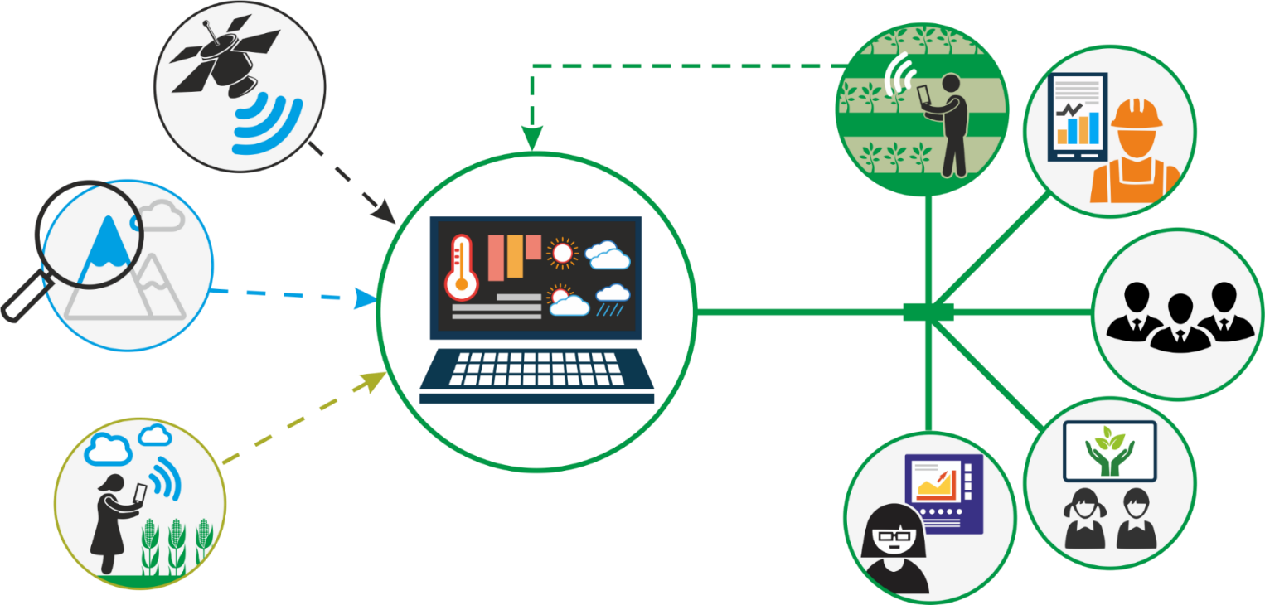
2/3
1.1. Regional Climate Information Platform
Development and content of the regional information platform will be carried out in cooperation with suppliers and users of climate information in 2019.
The functionality of the system will allow to work with primary sources of information (data from HydroMets, scientists, field examples), to carry out data synthesis and distribution to farmers’ mobile devices, to use it in planning, etc.
Notes:
The system will be developed during 2019, taking into account the needs of different users, the characteristics of the information sources and applying international experience and recommendations

Slide 6



3/3
1.3 Development of methodologies approaches and tools for climate change assessment
1.4 Human Resources Development - trainings, exchange of experience, courses
1.5 Development of information products and dissemination of climate knowledge and solutions
Study on climate change projections, hydrological impacts and associated risks for agriculture in pilot river areas (in cooperation with PIK): Kazakhstan: Bukhtarma, Yessil and Zhabay; Kyrgyzstan: Aspara and Isfara; Tajikistan: Kafirnigan; Turkmenistan: Murghab; Uzbekistan: Zeravshan;
4 Technical trainings on hydrological forecasts with the use of MODSNOW (in collaboration with GFZ Potsdam under the CAWa Project); 2 Regional trainings on climate and hydrological modeling; A total of 122 specialists were trained; Student research competition, work with Universities of CA region on curriculum update and summer educational programs;
Notes:
The MODSNOW Tool allows to combine MODIS data from satellite monitoring of snow cover in mountains with additional modules, as well as to estimate seasonal, monthly or decadal availability (and forecast) of water for selected river basins.
30 experts have already been trained in hydrological forecasting using MODIS data on snow cover > 30 experts).
Hydrological forecasting for 18 river basins, with use of the MODSNOW tool, is planned in 2019, as well as assessment of accuracy of forecasts at the end of the vegetative period.
It is also planned to continue training seminars in hydro meteorological services in order to improve knowledge of hydrological forecasting.

Slide 7
Thank for your attention!
www.ca-climate.org

