Slide 1
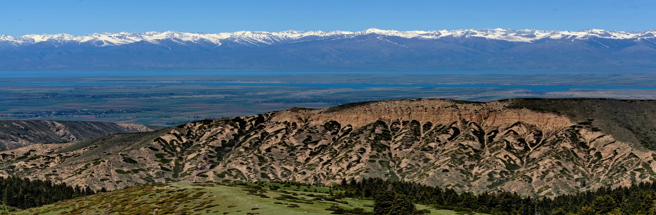
Personal presentation
Anara Alymkulova
Affiliation: «Institute for Sustainable Development Strategy» Public Fund
Kyrgyz Republic
E-mail: anaraal@gmail.com
IPROMO
Landscape approach for enhancing mountain resilience
Pieve Tesino /Ormea 02-18 July 2019

Slide 2











Education
MSW, Concentration on Community & Organization Development Fulbright Fellowship, USA
MBA, Academy of Management, Kyrgyzstan
BA in Economics
School of Social Work
Organization & Community Leadership
Academy of Management under the KR President
Employment and main activities
Co-Founder & Executive director of ISDS
Community Development Practitioner
Consultant, International Programmes Evaluation
Manager, ‘UN as One’ Project
Researcher

Slide 3
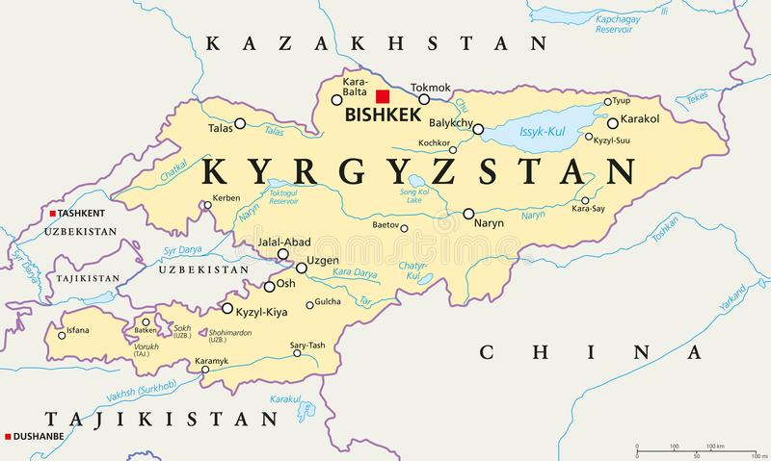

Slide 4
Other personal interests
Volunteer activities:
Fulbright Association
Serve on the boards of directors for several NGOs
Member of Mountain Partnership Global Steering Committeee representing Central Asia region
Hobbies – travelling, writing short stories

Slide 5

Presentation of a project you are working on 1/3
“Promotion of Biocultural diversity in the Northern and Inner Tien Shan” Program (2012-2020)
Local Initiatives Support Program
Supported over 120 local initiatives
Community–based pasture conservation approach based on traditional knowledge and practice has been developed and piloted in Cholpon rural municipality (Cholpon pasture users association) in Kochkor district of Naryn province. Currently this experience is being multiplied in 3 other municipalities in Naryn and Chuy provinces.
https://satoyama-initiative.org/traditional-knowledge-for-climate-resilience-collaborative-strategies-to-mitigate-vulnerability-and-enhance-adaptation-of-pastoralism-to-climate-change/?fbclid=IwAR0Z4H7kt3xv1xjsKWB8G8mYIbVx2RbmxcUPYqbsYBbB-_o_oSW-HxRLRpM
Place-based Education - 20 preschool orchards, ethnobotanical gardens and micro-reserves created to conserve and protect local agrobiodiversity (local apple and apricot trees) and seed banks (local varieties of potato, tomatoes and pepper).

Slide 6
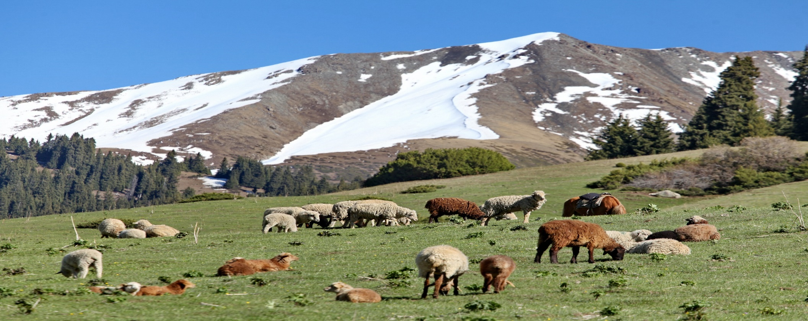
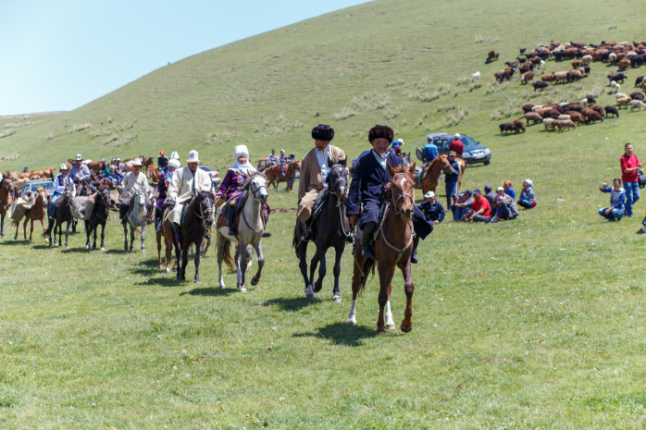

Slide 7
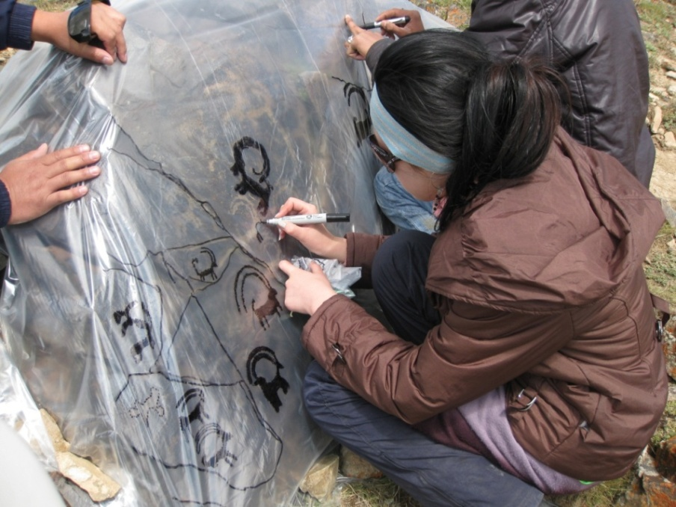
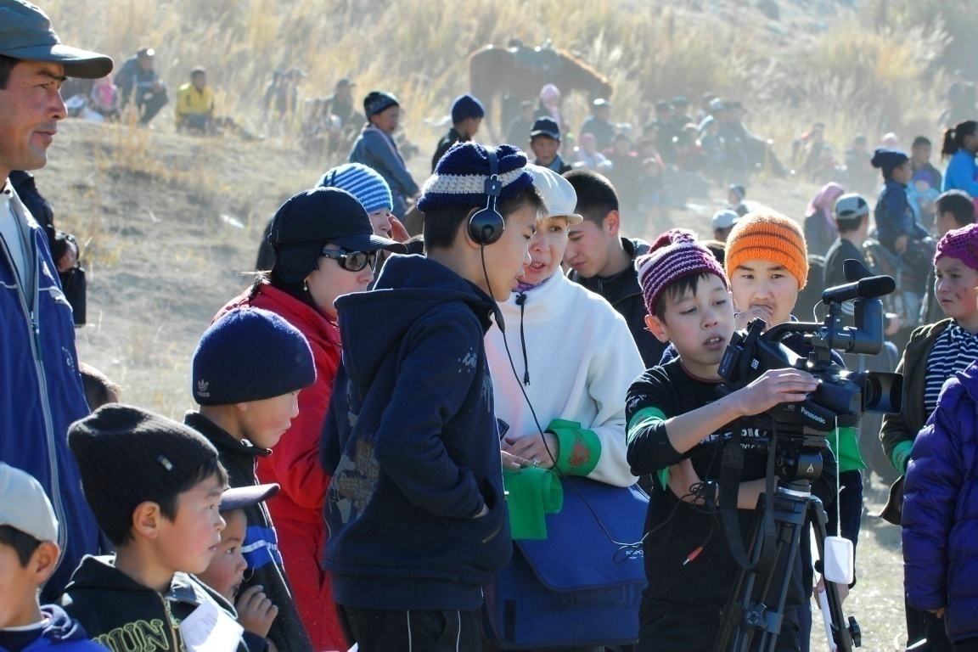
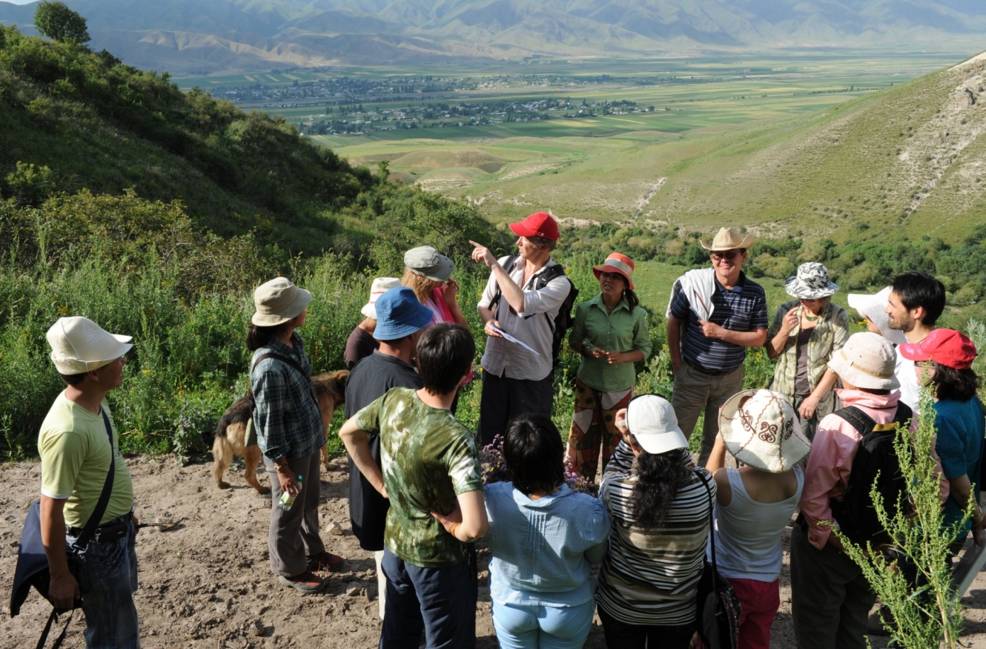
Work with local schools (Place-based Education)

Slide 8
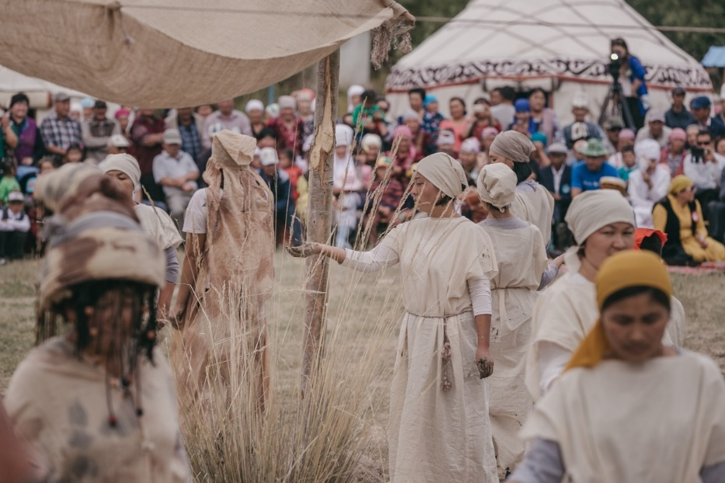
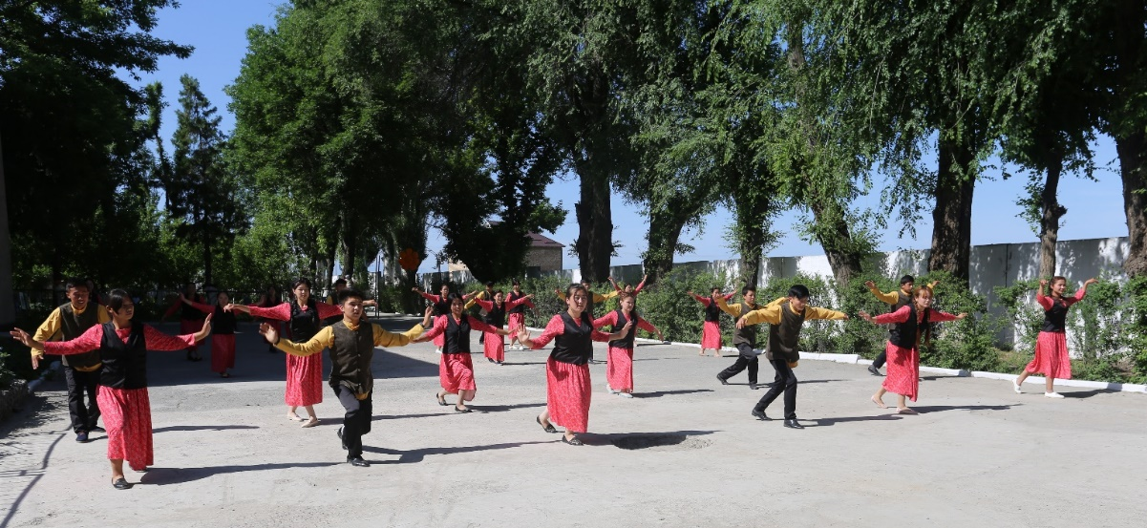
Festivals, theatres, actions, etc.

Slide 9
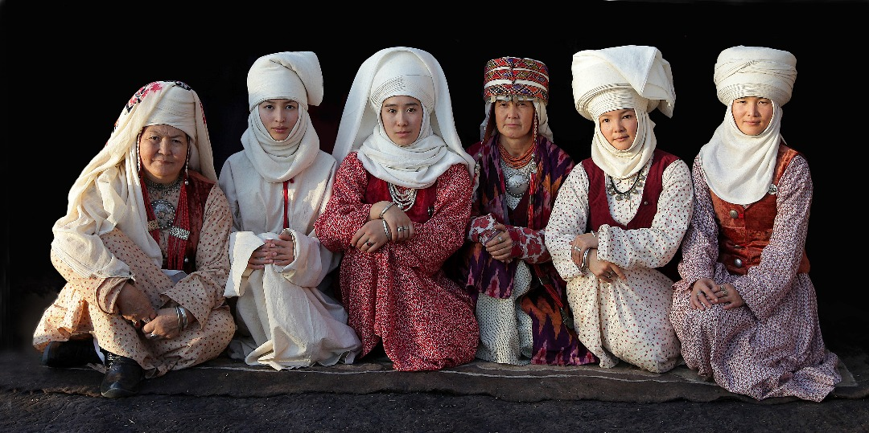

Slide 10
Presentation of a project you are working on 2/3
“Central Asia Regional Travel Fund” Program
The Program provides local NGOs from Kyrgyzstan and Tajikistan, especially on a grass root level, to have the first person voices, experiences and insights of local communities in the policies and forums that concern biocultural diversity at a global level.
Notes:
Thanks to the TCF support within the Regional Travel Fund Program from 2014 to 2018, over 312 delegates from Tajikistan and Kyrgyzstan were provided with unique learning opportunities to gain and share the best practices and knowledge through participation at 53 global/international and 13 regional events/study tours/peer-to-peer learning exchanges.

Slide 11
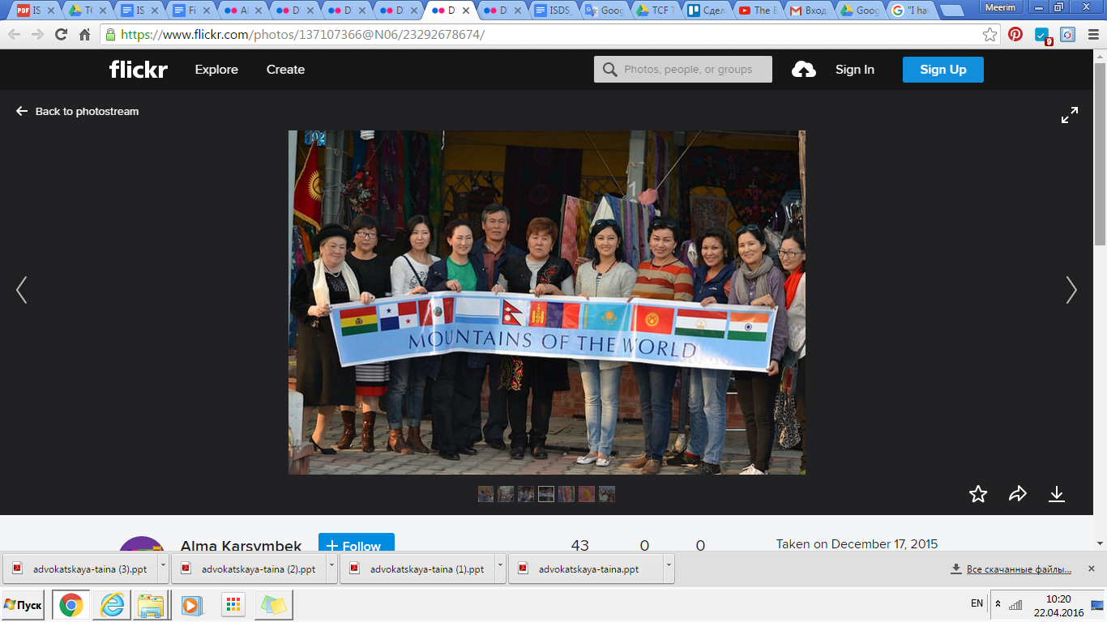
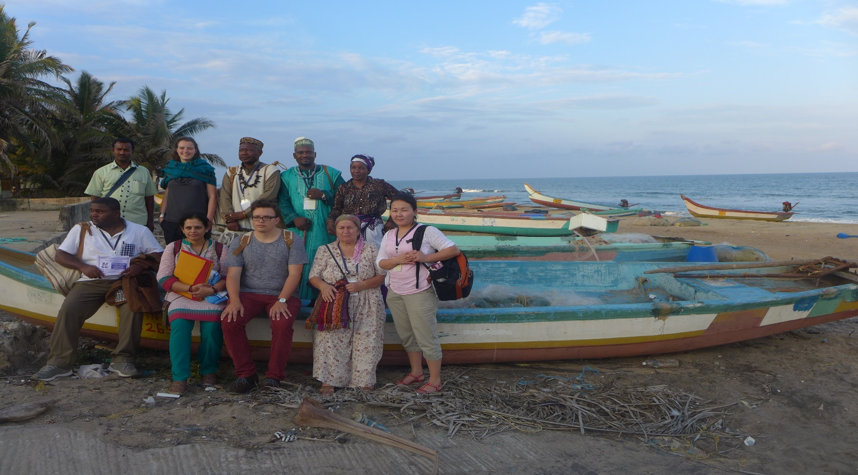

Slide 12
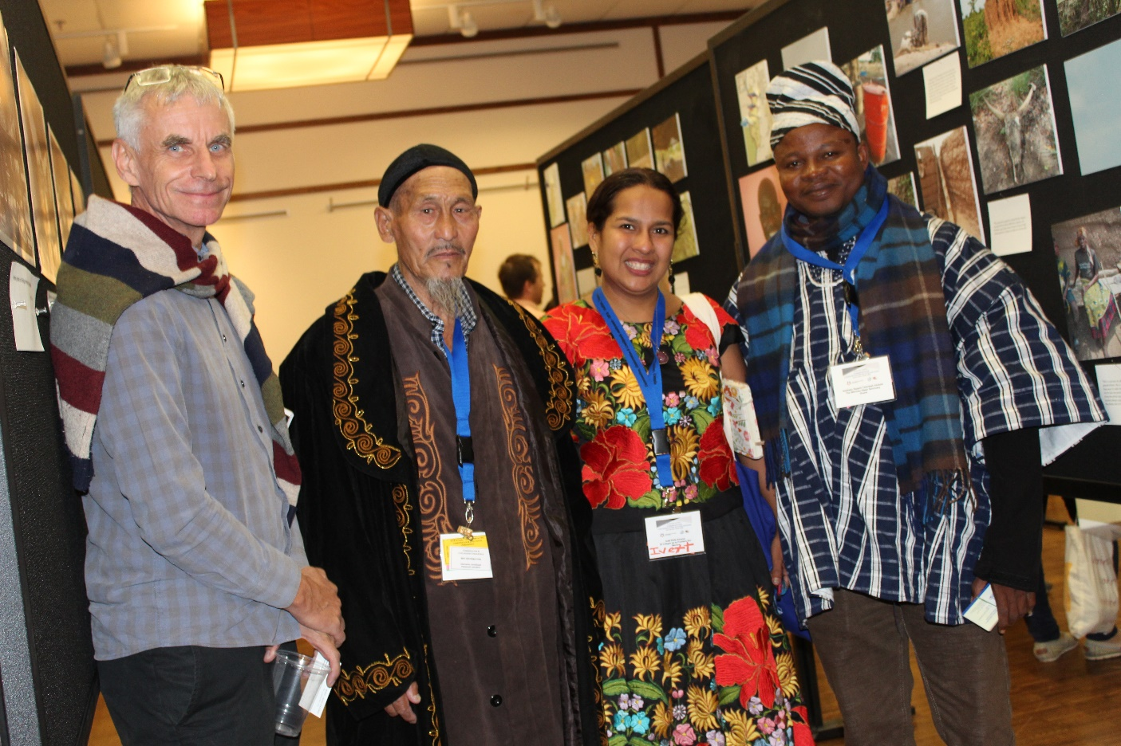
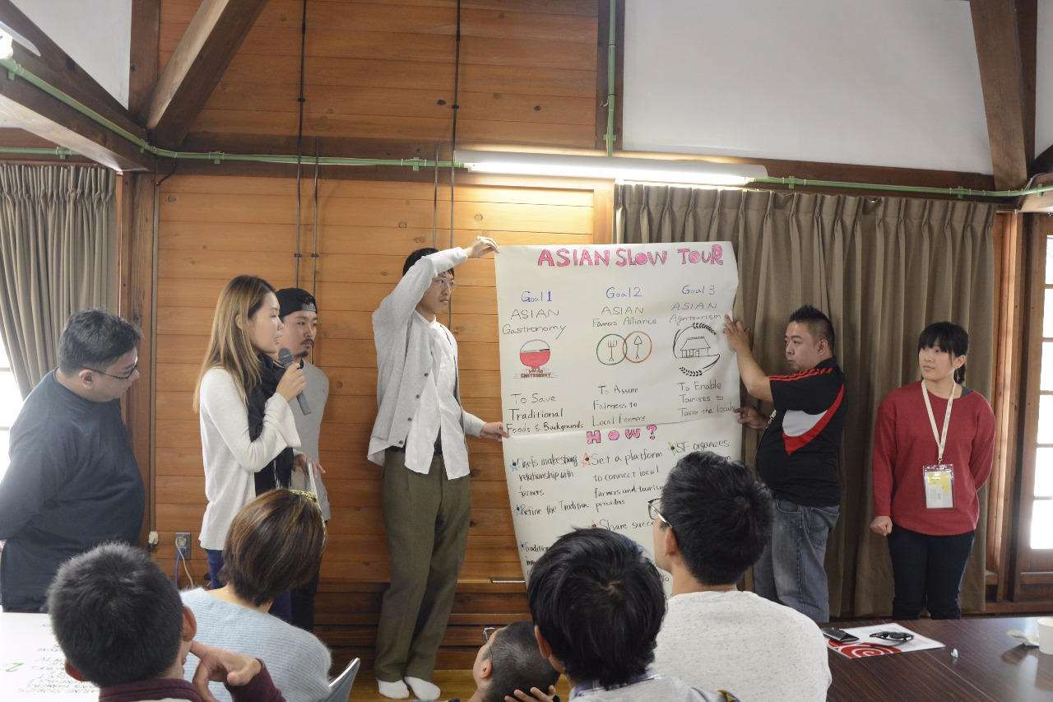
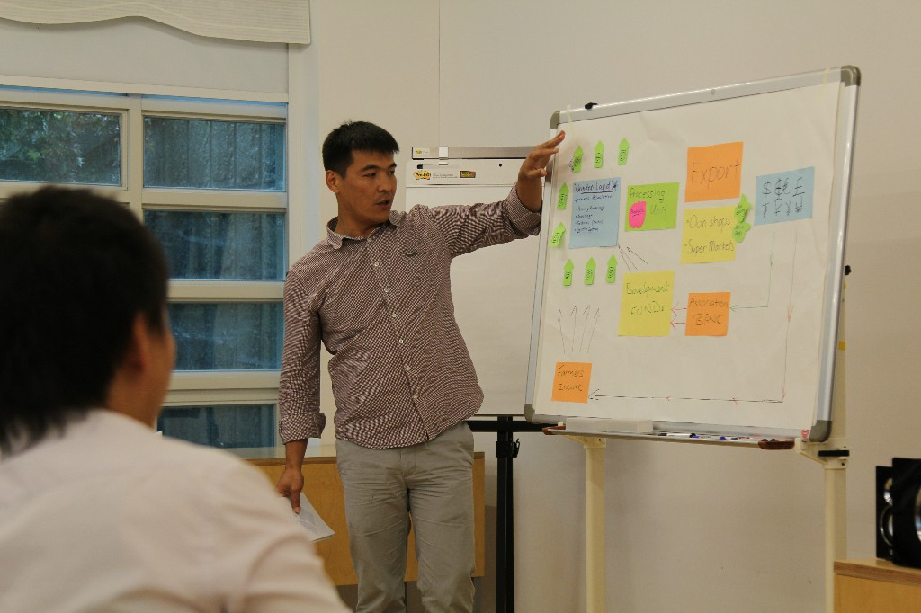
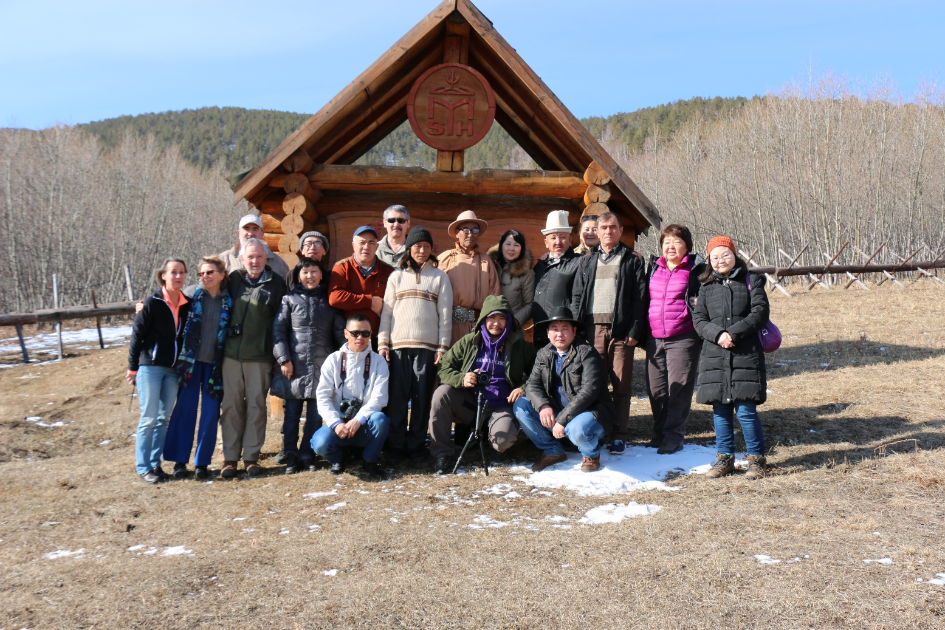

Slide 13
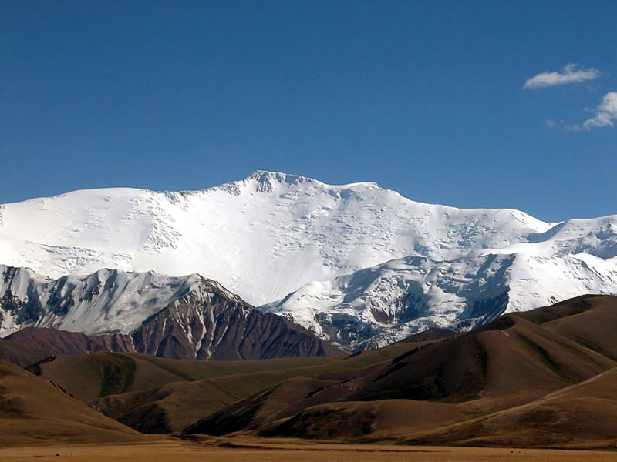
Presentation of a project you are working on 3/3
“Improvement of the economic well-being and empowerment of women and youth in Chon-Alai district” Project funded by SDC/Helvetas Swiss Intercooperation in Kyrgyzstan
Location – the highest Peak in Central Asia
Elevation 7,134 m
ISDS Social Venture – T.E.R.M.E. ART
T.E.R.M.E. ART – Traditional Ethnic Rural Modern Excellence Art
Finanilst of British Council Creative Industries Program

Slide 14
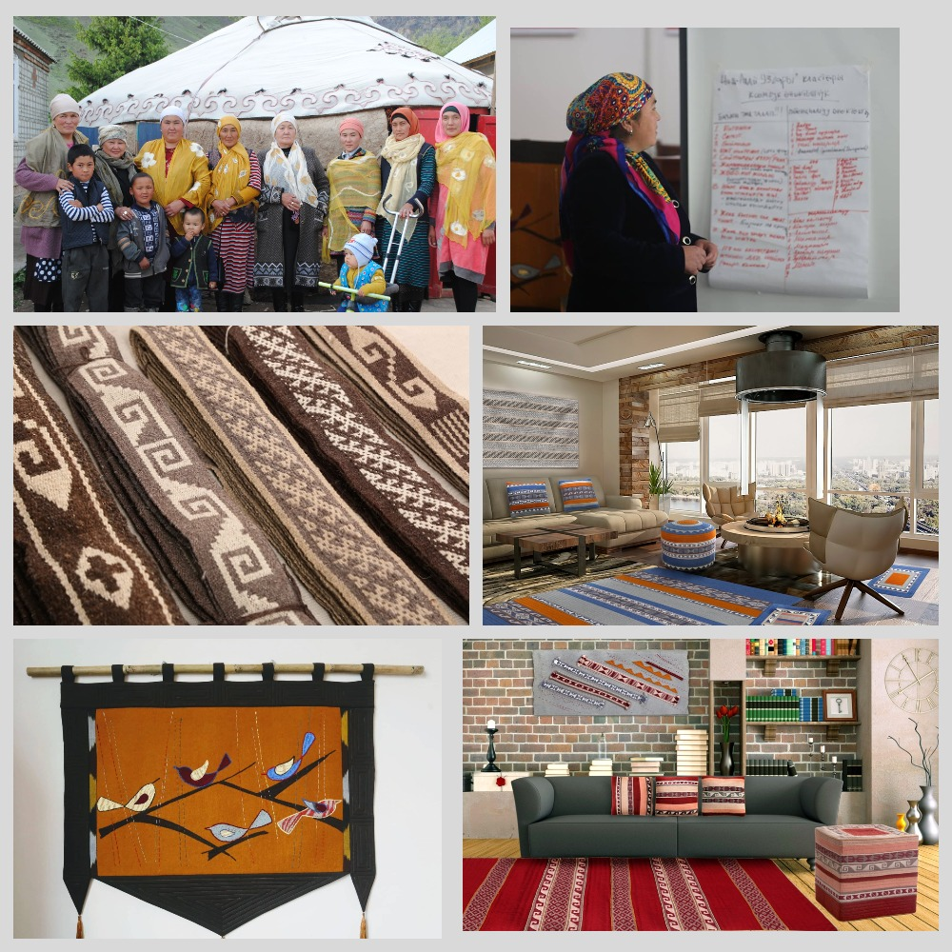


Slide 15
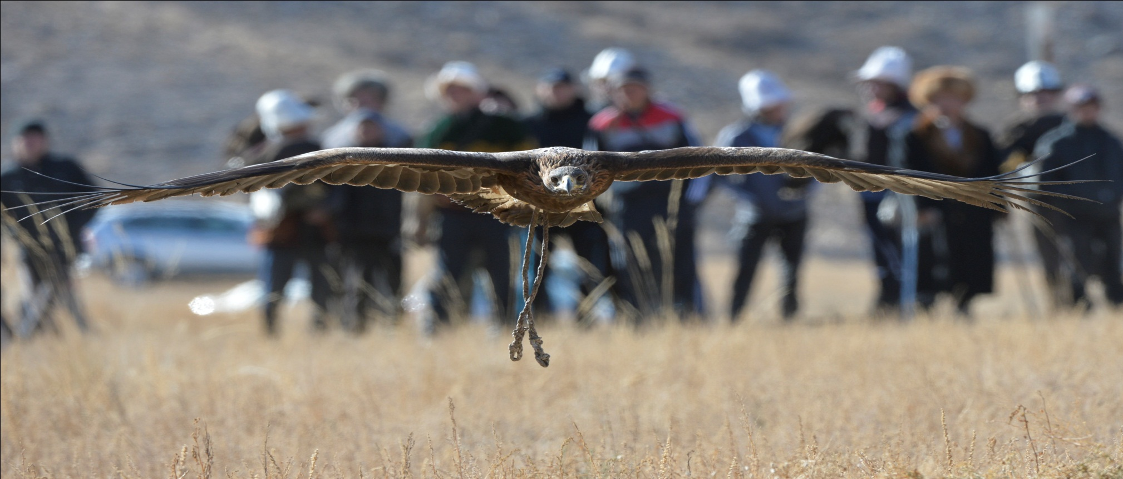
Thank for your attention!

