Slide 1
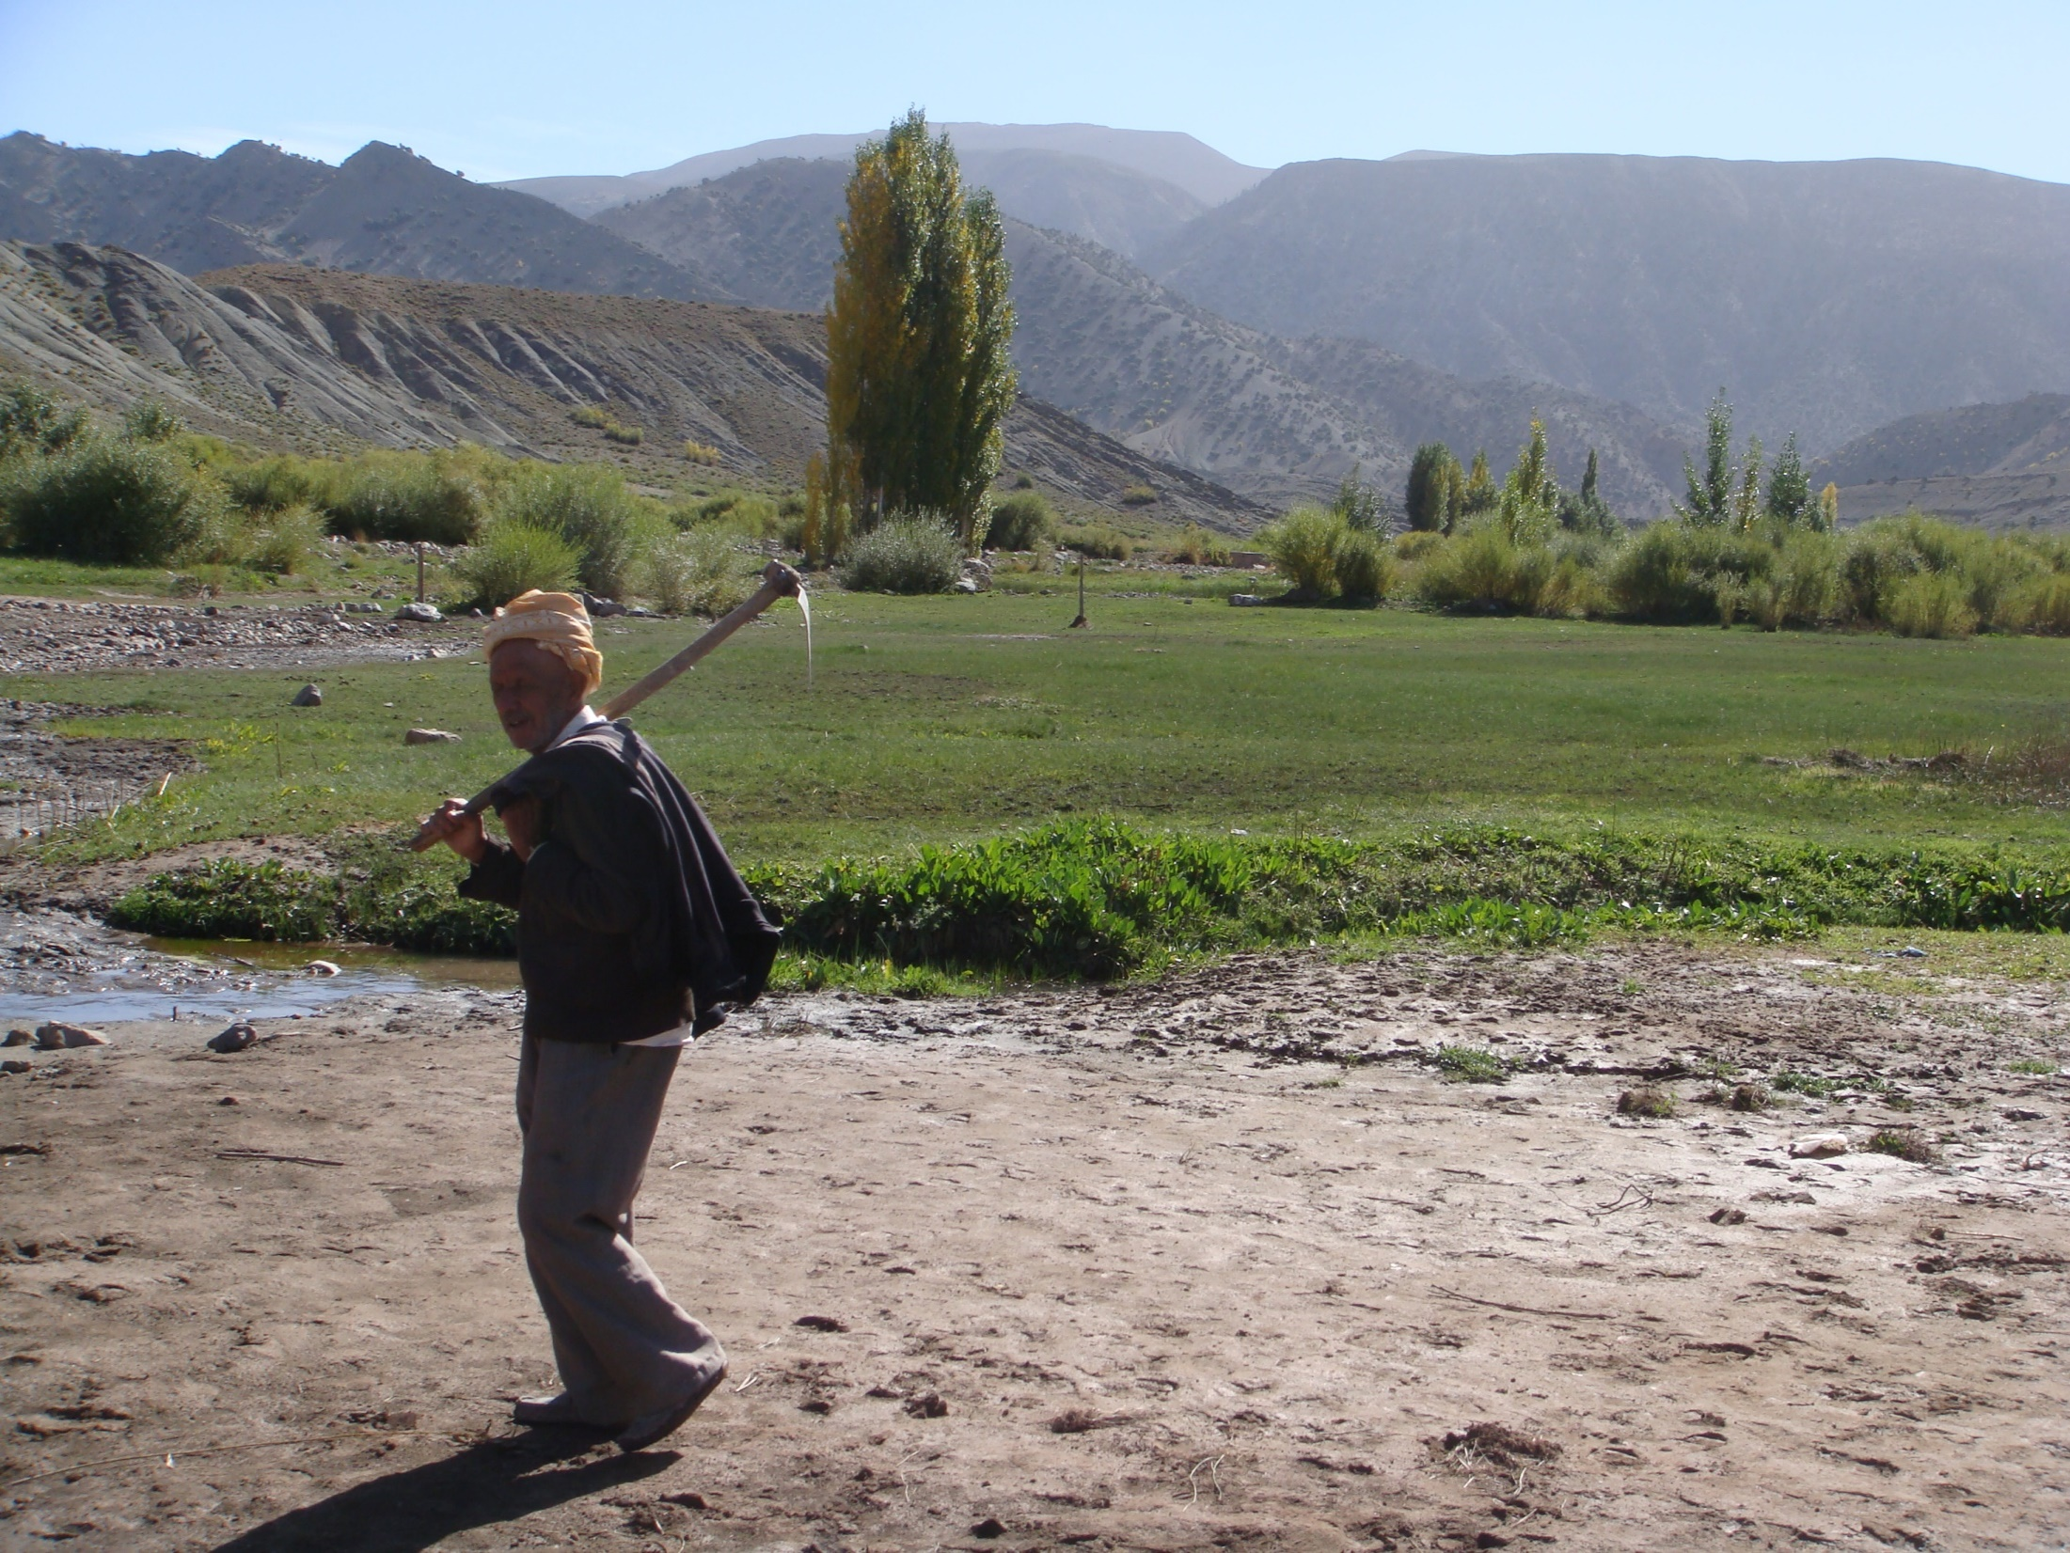
Personal Presentation
Consultant extensionist and community development to the
FAO/GCP/MOR/050/SWI Project-FAO-Morocco
E-mail: chkirnifao@gmail,com
Chkirni Malika
IPROMO
Landscape approach for enhancing mountain resilience
Pieve Tesino /Ormea 02-18 July 2019

Slide 2
Education
I have a diploma in Geography
Employment and main activities
I work since 9 years with the Food and Agriculture Organization of the United Nations (FAO) Morocco:
Support in project against poverty and erosion
Knowledge of the watershed management approach on the new generation
Knowledge of participatory rural diagnostic techniques, participatory approach tools and, gender, participatory planning and concerted
Participation in the execution and field monitoring of the programme of the matrix of the Watershed Management Project for the Control of Erosion Support communities in the identification, planning and implementation of interventions
Assistance in the administrative and logistical management of projects

Slide 3
What I experienced
Collaborate with foreign experts
Collaboration of different actors of civil society (traditional institutions, associations, cooperatives, forestry services, agricultural services…)
Documentation with wocat

Slide 4
Other interests (volunteer work, hobbies etc.)
it was mainly because I enjoy helping people,
I am very passionate about development issues, such as helping to improve and conserve the natural resources, environmental protection and many others

Slide 5

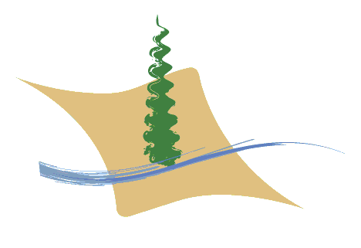
Kingdom of Morocco
HIGH COMMISSIONER FOR
WATERS AND FORESTS AND
FIGHT AGAINST DESERTIFICATION
Project supporting the development of Oued Outat and Oued Ansguemir watersheds
(2010/2019)
(Midelt province)
Morocco

Slide 6
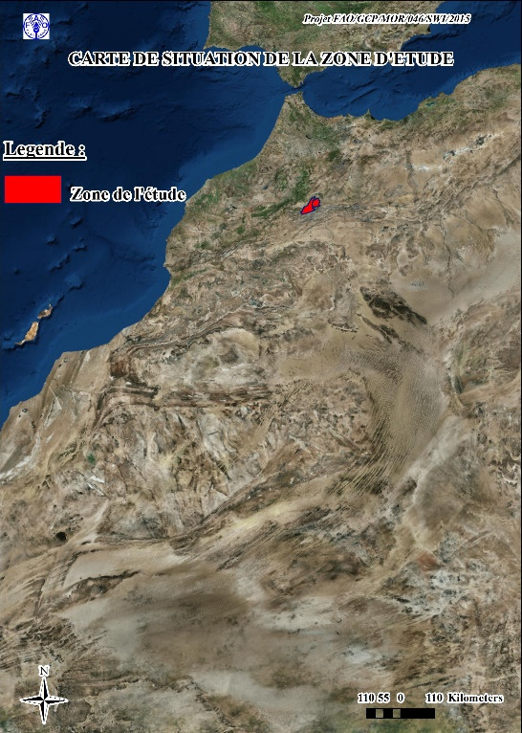
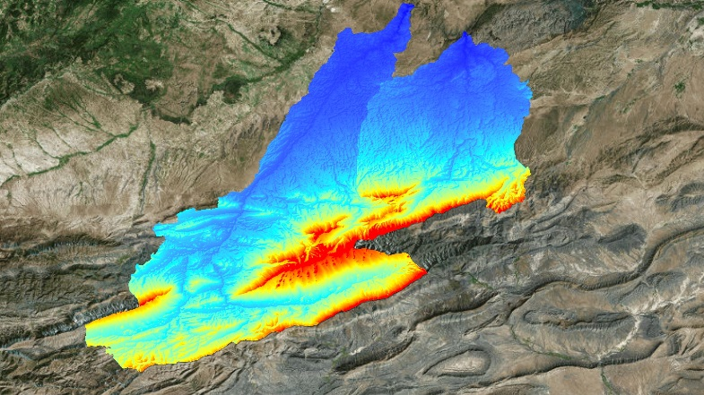
GENERAL PRESENTATION OF THE PROJECTS AREA
The concerned area of action is part of the Upper Moulouya basin (157 900ha) in the Province of Midelt:
Oued Outat Watershed: Rural Commune (RC) of Ait Izdeg, Ait Ayach, Mibladen and Amerside
Anseguemir watershed: RC of Ait Ayache, Tounfit, Agoudim.
Oued Outat watershed : 51 900 ha 33%
Anseguemir watershed: 106 000 ha 67%
Rural population: approximately 23 600 inhabitants divided in 3200 households with an average of 7.4 inhabitants / household:
Oued Outat watershed: 5,800 inhabitants and 1,020 households, i.e. 5.7 inhabitants / household;
Oued Anseguemir watershed: 17,800 inhabitants and 2,170 households, i.e. 8.2 inhabitants / household.
Land use:
Forests, steppe & matorral: 145,000 ha (92% of the total). The 2/3 clear and degraded;
Cropland: 13,000 ha (8% of the total). The 40% of irrigated crops.

Slide 7
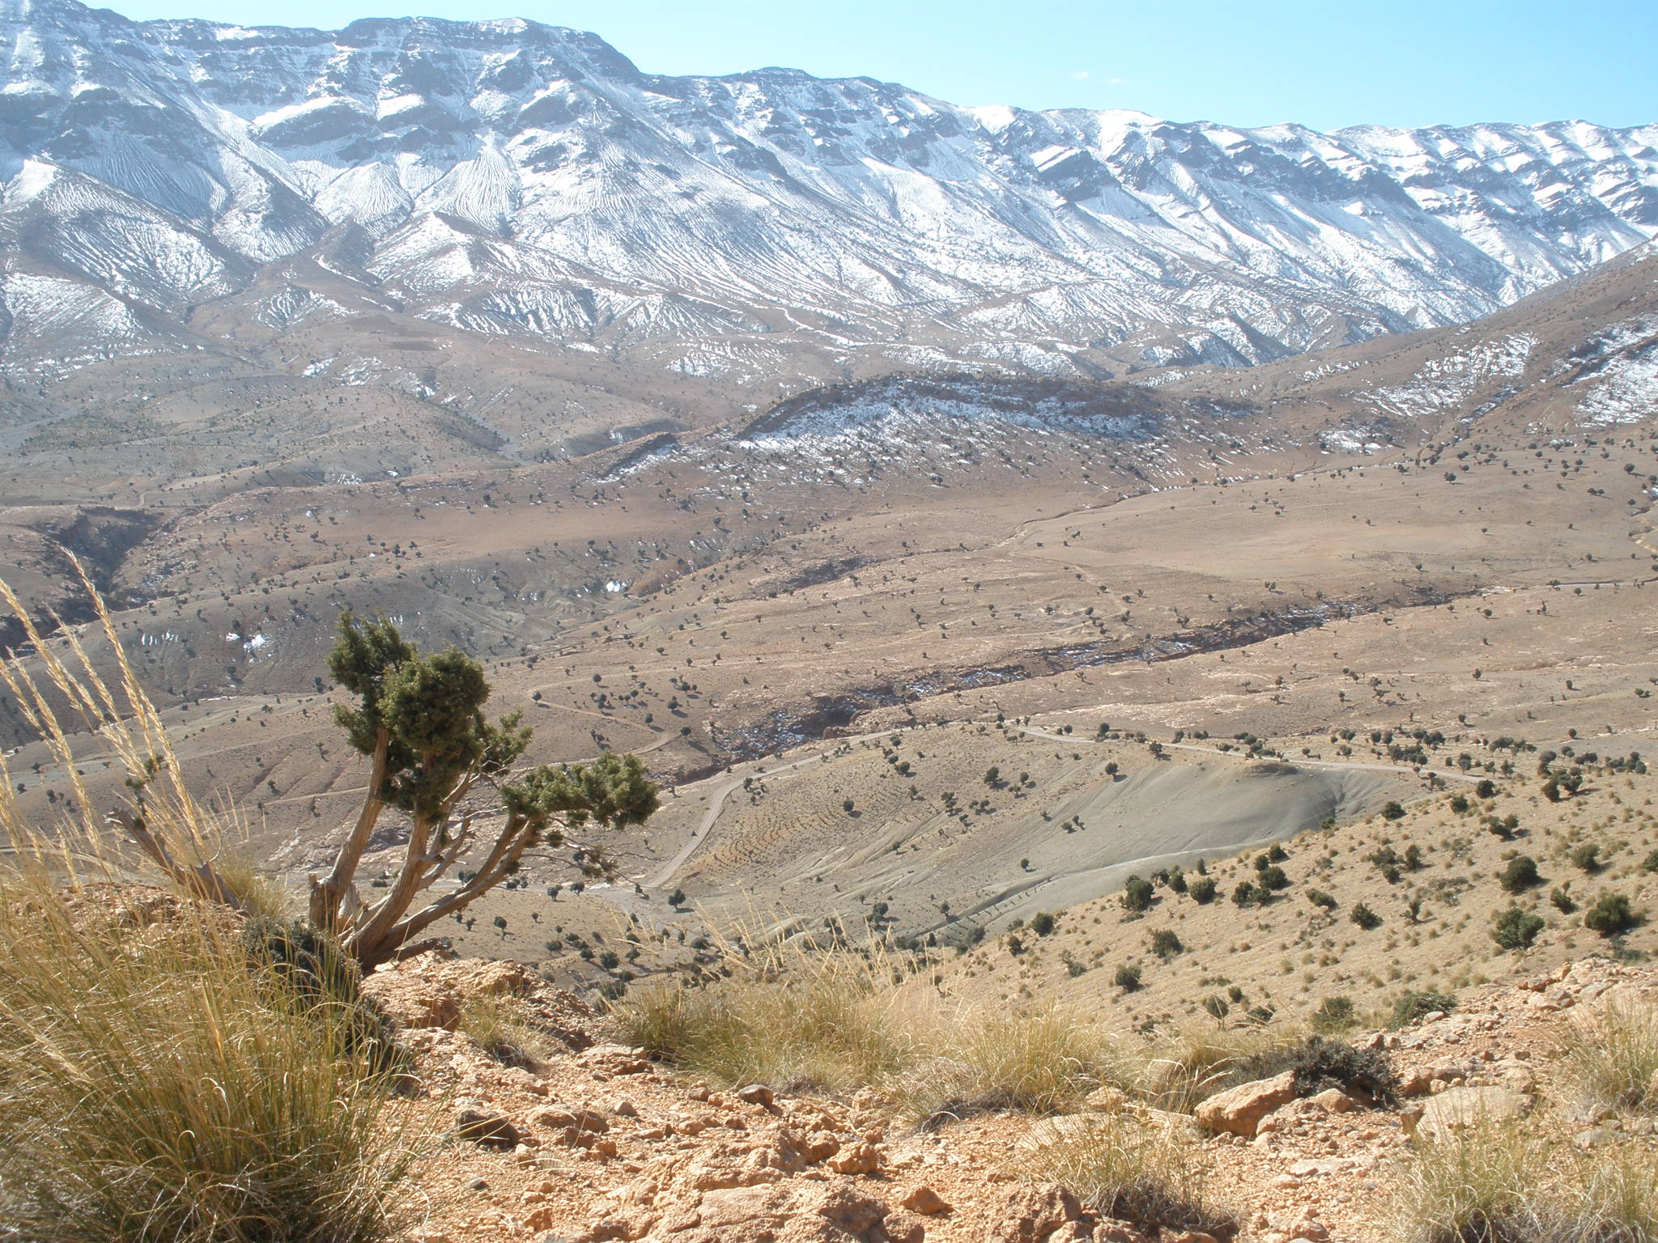

Slide 8
The strategy and the approach adopted in the project
Analysis of the problems, identification of the solutions and implementation of the taken actions jointly and multidisciplinary (technical services, populations, project team);
Combination of biophysical actions (protection of natural resources) and socio-economic actions (development of sectors);
Integration of actions in space: micro-watersheds as a concentration place for actions;
Integration of actions over time: short, medium and long-term actions;
Action research to test and demonstrate new ideas, combining traditional know-how and innovative technical solutions from outside;
Negotiation process and joint planning leading to the formulation of the watershed co-management plan.

Slide 9
Example of one activity: Sylvopastoralism in Tatiouine
The "small action" approach adopted in the Midelt FAO-Projects is a fundamental bottom-up approach that focuses on small equity securities and combines human and environmental value characteristics. It is based on good practices derived from the empirical kno of the rural populations concerned. These actions, although small, find their strength through their duplication capabilities (oil stain). The identification of these actions was based on the principle of Research-Action.

Slide 10
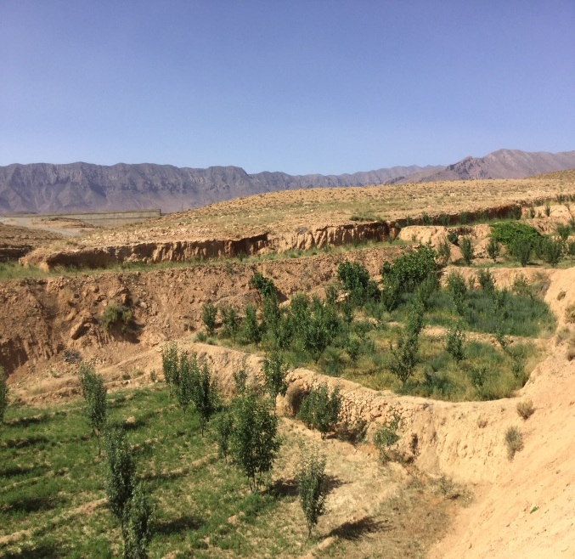
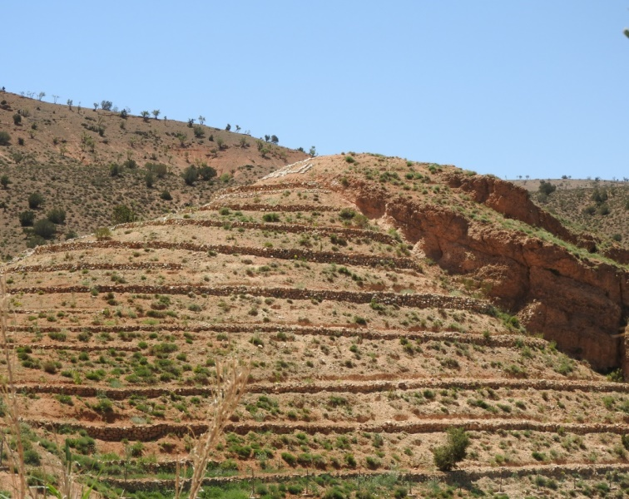
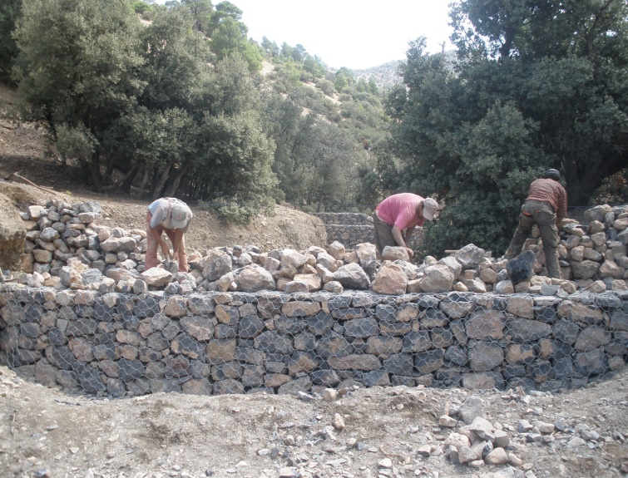
Ago-Forestory Development and Banks protection
Much of the Project's time was patiently devoted to sensitizing the communities concerned through continuous contacts in the field, interactions through participatory workshops and information exchange trips to other parts of the country. In addition, there are also the Income Generating Activities which have been promoted and applauded and which generated a very tangible impact, motivating and stimulating the targeted population to build trust, appreciate the credibility of the team, cooperate and collaborate in the implementation of conservation and protection actions on of the soil through the reconstitution vegetation and the Treatment of ravines. Their confidence increased when they perceived the results well in practice
treatment of ravines against water erosion in the framework of the project

Slide 11
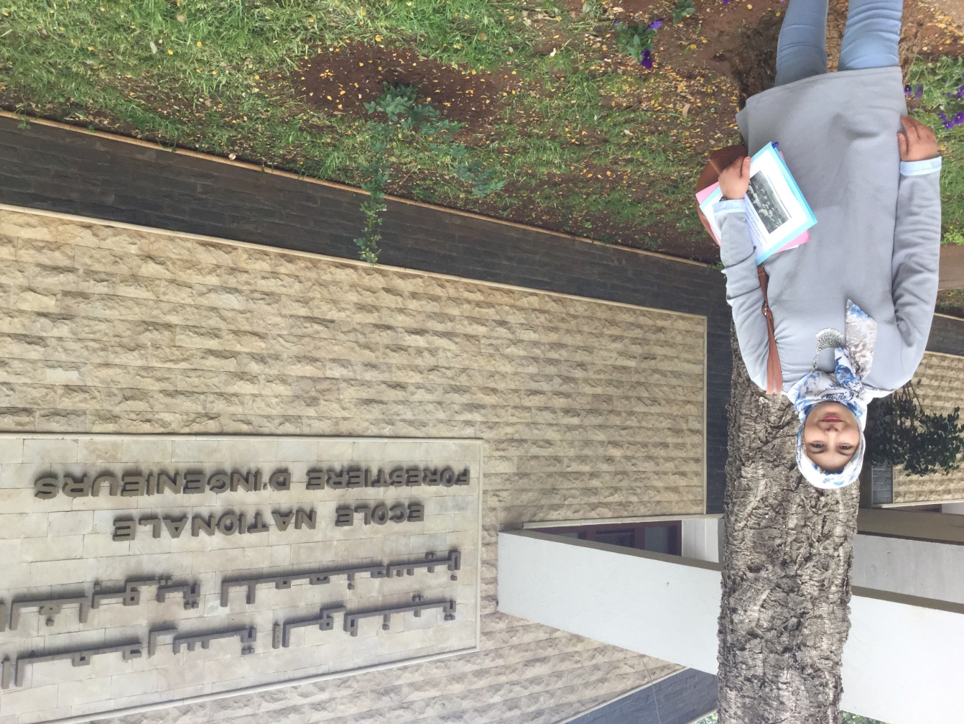
Thank for your attention!
Merci
شكرا

