Slide 1
Personal presentation
Dang Xuan Truong
Vietnam
truongdx@nature.org.vn
IPROMO
Landscape approach for enhancing mountain resilience
Pieve Tesino /Ormea 02-18 July 2019

Slide 2
Education
B.Sc. in Agriculture. Major: Crop Sience, Vietnam National University of Agriculture.
Sept 2009: Completed modules “Participation irrigation management” by JICA and Vietnam Academy for Water resources.
May 2014: Completed course “Grassroots equity” by RECOFTC in Bangkok, Thailand.
July 2017: Completed course “Skills training for Trainer” by MDF Asia
2015 -2018: Completed Gender Action Learning program organized by Oxfam
Employment and main activities
Project Coordinator – Center for People and Nature reconciliation (PanNature).
Main responsible:
Coordinate projects related to forest governance and and climate-friendly agriculture.
Conducting policy research and advocacy activities at local level.
Training for trainers on some soft skills

Slide 3
Other interests (volunteer work, hobbies etc.)
Volunteer work: Environtment and trees protect activities in Hanoi
Hobbies: Motobike trip and take photos; football and tennis.

Slide 4
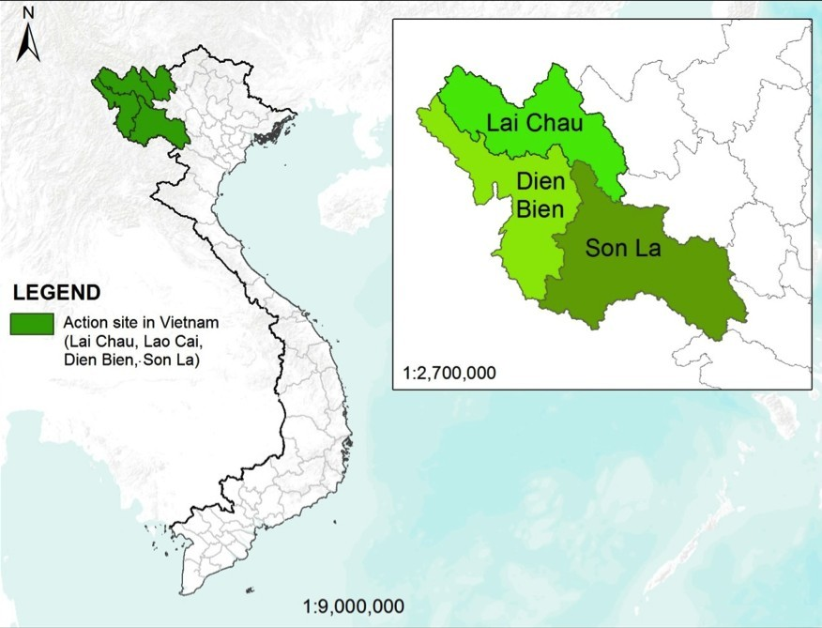



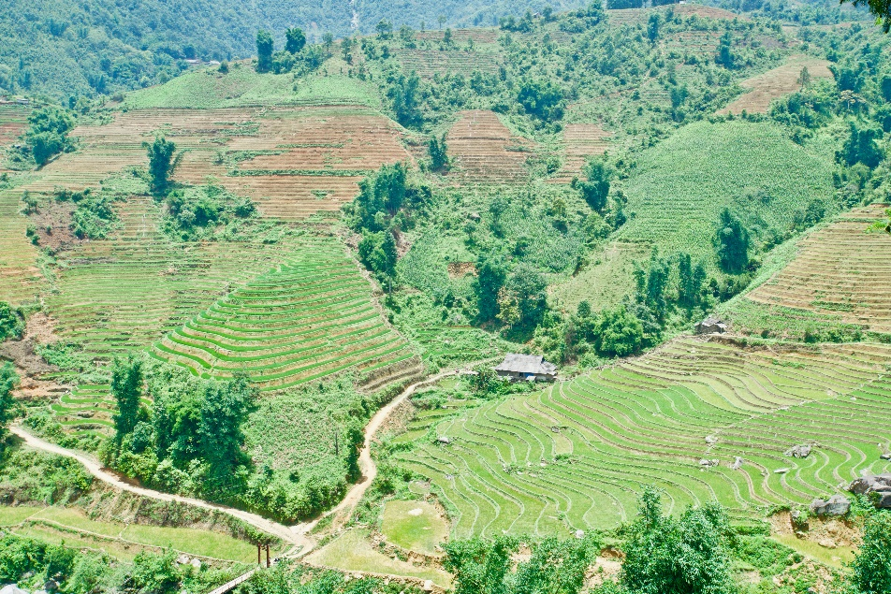


Presentation of a project you are working on 1/3
Project name: «Climate change and Ethnic Minorities in Northwestern Vietnam» (2015 – 2018)
Main Goal: strengthening the capacity to respon to CC of local EMs through increasing their role in policy processes and promoting CSA practices. Role: Policy officer
Donnor: CISU (Denmark)
Implementing organizations:
- PanNature, ADDA Vietnam
- Local Partners: Province Farmer’s Union (Son La, Lai Chau), Women Development Fund (Dien Bien)
- Project sites: 25 communes, 9 dicstrict, 3 prvinces

Slide 5
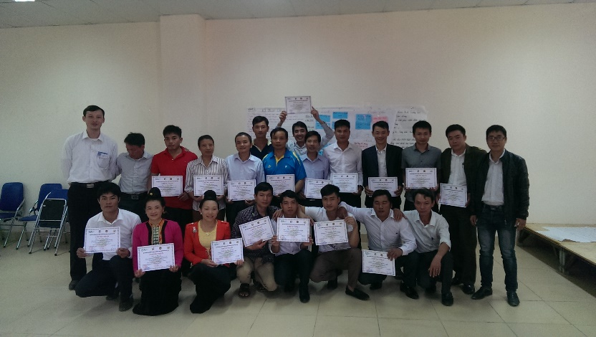
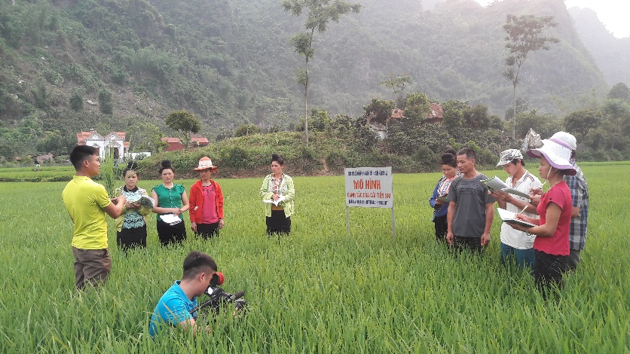
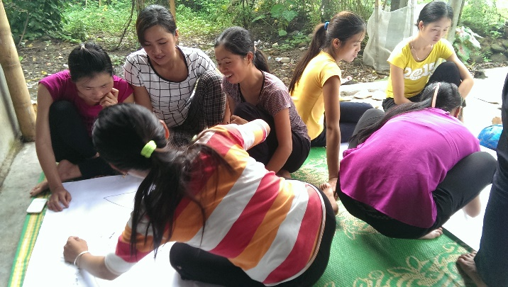
Presentation of a project you are working on 2/3
Activities
Establish FIG group and demonstration model
FIGs was established by local farmers (10-15 households) base on voluntary
Trainners/ Local Facilitators was selected from good and experienced farmers. Trainner
Experts
TOT
LFs
FFS
FIGs
Practices
Demonstration models
Technic and skills

Slide 6
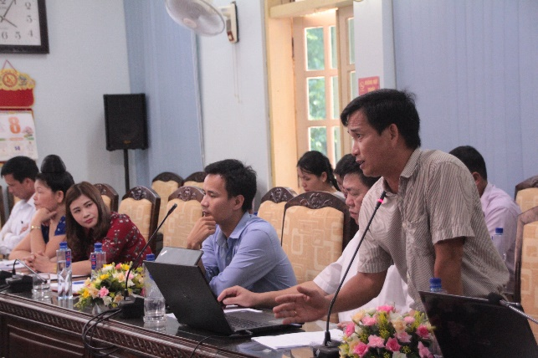
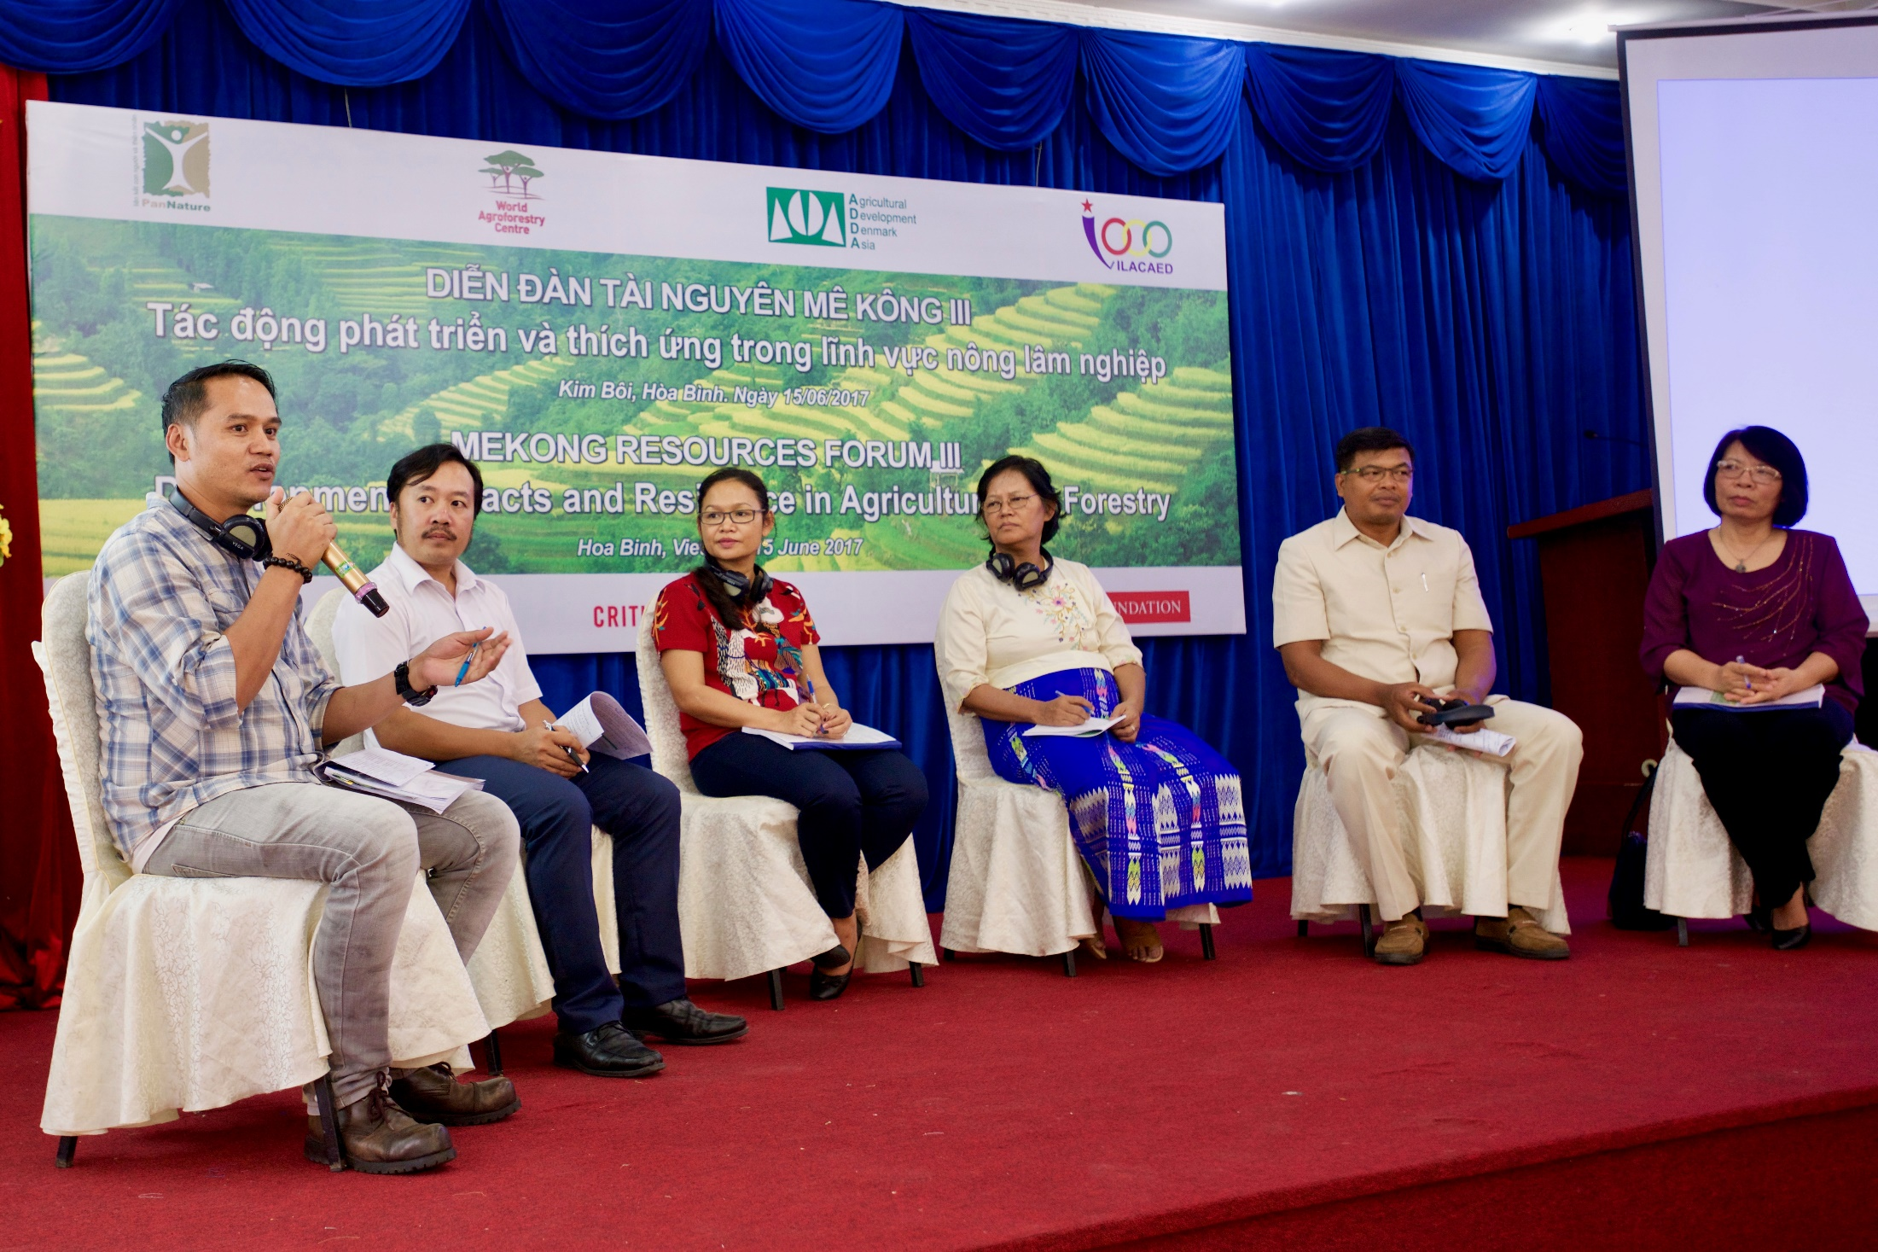
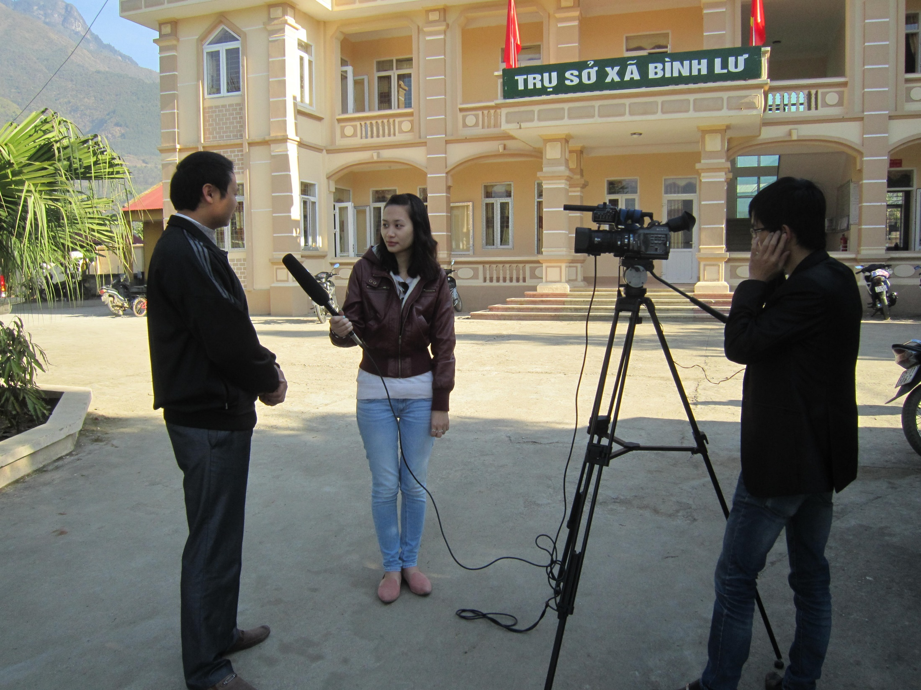
Presentation of a project you are working on 3/3
II. Policy advocacy
Research on impact of climate change to agriculture production
Develop CRAI (Climate Change Responded Agricultural Indexs)
Research on anual and five-year development planning process aim to identify opportunities for promoting mainstreaming CC in policy
Dialogues between all stakeholders: FIGs, Expert and Policy makers.
Training for local Social organiaztion on policy analysis and advocacy
Mekong Resources Forum III
III. Communications
Video, publications, Policy recommendations

Slide 7
Thank for your attention!

