Slide 1
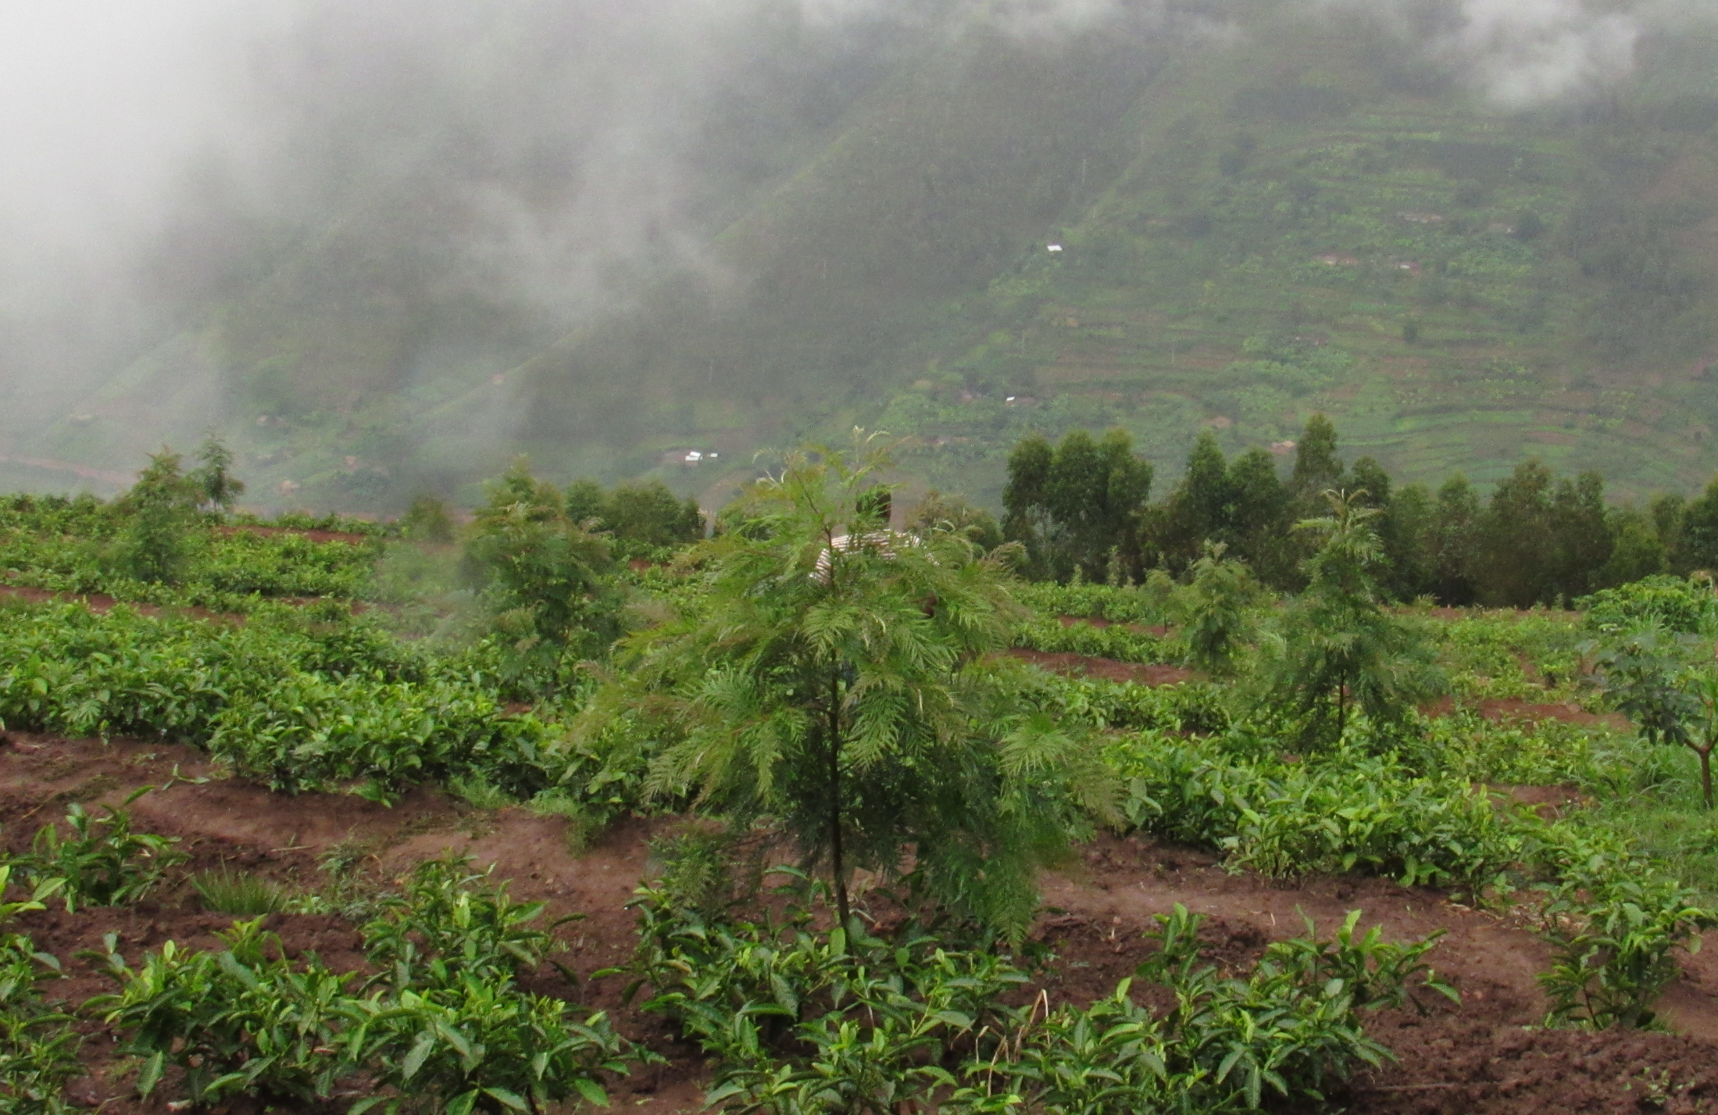
Personal presentation
Name: Gilbert Muvunankiko
Affiliation: Albertine Rift Conservation Society (ARCOS Network)
E-mail: gmuvunankiko@arcosnetwork.org
IPROMO
Landscape approach for enhancing mountain resilience
Pieve Tesino /Ormea 02-18 July 2019

Slide 2
Education
Bachelor of Biology
Other trainings and courses: Science Communication for journalists, graphic design & video editing, Biodiversity Data Mobilization and Management, Integrated Freshwater Ecosystem Management
Employment and main activities
2014-Now: Head, Communications Department at The Albertine Rift Conservation Society (ARCOS Network)-
Main activity: to provide leadership, coordination, management and support ARCOS information systems, communication and outreach activities and GIS resources, working closely with ARCOS staff and partners.
Other tasks: Apart from leading IS and Communications Department, also Manage Forest Landscape Restoration Initiative with responsibility to develop projects, mobilise resources and oversee the implementation and scaling up.

Slide 3
Other interests (volunteer work, hobbies etc.)
Interests
Environment and sustainbale development
Forest Landscape Restoration
Education for Sustainable Development
Science Journalism
Hobbies
Listening to music, swimming and outing

Slide 4
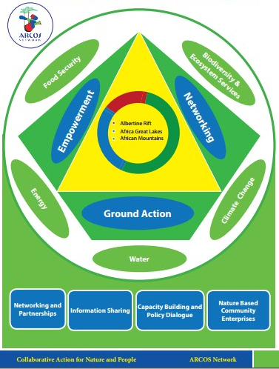
About ARCOS Network

Slide 5
Building Resilience through Nature-Based Community Solutions
Goals
The overall goal of this initiative is to ensure sustainable community development through supporting their engagement in sustainable environment management, strengthening their nature-based enterprises and building networks with other communities to exchange knowledge and experiences.

Slide 6
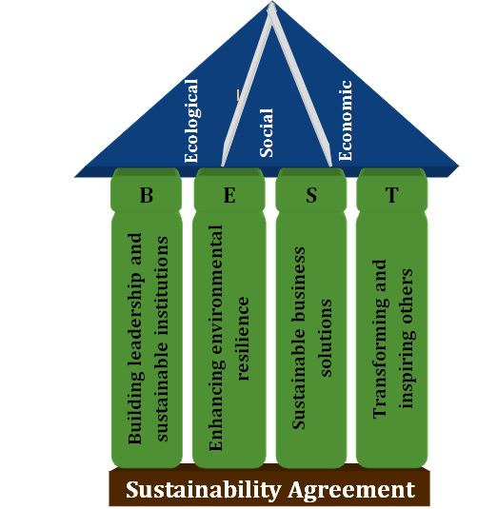
Implementation: BEST Approach

Slide 7
Implementation Models
Collaboration between and within models is the key
All models adapt and apply BEST Approach
NBV is the transformation unit where, building on well trained communities in other models, sustainable transformation is driven to serve as a model
NBCD Programme
Nature-Based Community Enterprises (NBCE)
(32 NBCE)
Nature-Based Community Village (NBV)
(7 NBV)
Nature-Based Schools (NBS)
(23 NBS)

Slide 8
Key Areas of intervention
Sustainable agriculture
Landscape restoration and resilience to climate change
Nature-based off-farm enterprises (sustainable fishing, beekeeping, ecotourism, handcraft, etc.)
Transformational and home-grown solutions to promote environment, livelihoods & financial sustainability
Sustainable Community

Slide 9
Challenges and Opportunities
Transformational process takes long time
Limited resources to scale up the initiative
Remote access for some NBCEs
Government interest and appreciation of the initiative as well as willingness to support
Community willingness to develop and contribute to implementing identified sustainable actions
Challenges
Opportunities

Slide 10
Grazie per la vostra attenzione!
Thank for your attention!

