Slide 1
Personal presentation
Goytom Berhe
GIZ Biodiversity & Forestry (GIZ–BFP) Programme
goytomberhe1979@yahoo.com
IPROMO
Landscape approach for enhancing mountain resilience
Pieve Tesino /Ormea 02-18 July 2019

Slide 2
Education
BA degree in Development & Environmental Management Studies
MA in Rural Development
Employment and main activities
GIZ Biodiversity & Forestry Programme and working as a Forestry Advisor in Dessa’a transboundary forest since the end of 2016
Main Activities: Forest management plan, Forest landscape restoration (FLR), livelihood improvement programme, incentive based tree planting business at private HH level (targeted indigenous people living around buffer part of the Dessa’a forest), tree seed and nursery business, Sylvicultue management

Slide 3
Other interests (volunteer work, hobbies etc.)
Actively engaged and led awareness creation campaign for protection of native species against deforestation and charcoal making together with Awash-Arba municipality in Afar region of Ethiopia
A member of Ethiopia ForWater interest group: which will focus on strengthening this new network of forest-water stakeholders to facilitate and scale-up forests and water interventions in FLR and Integrated Watershed Management (IWM)

Slide 4
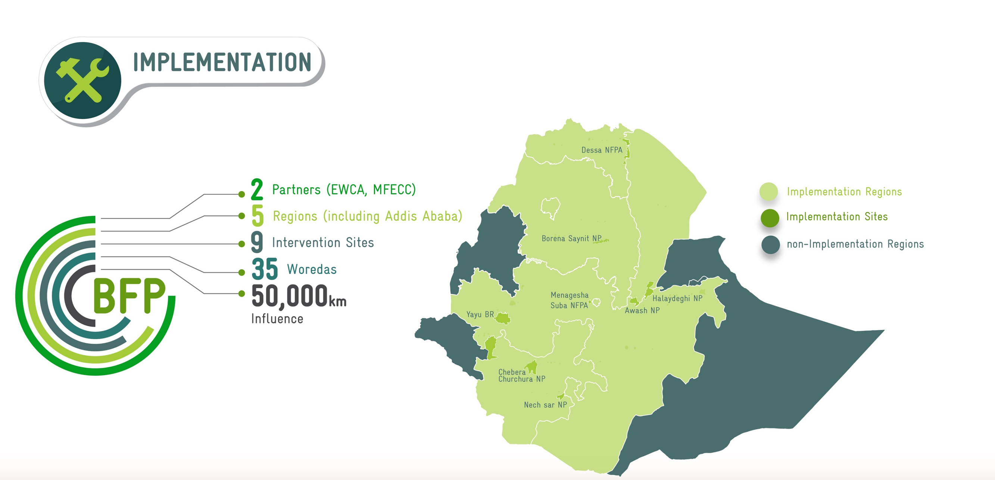
Brief presentation of GIZ-BFP intervention sites

Slide 5

Mission of the programme

Slide 6
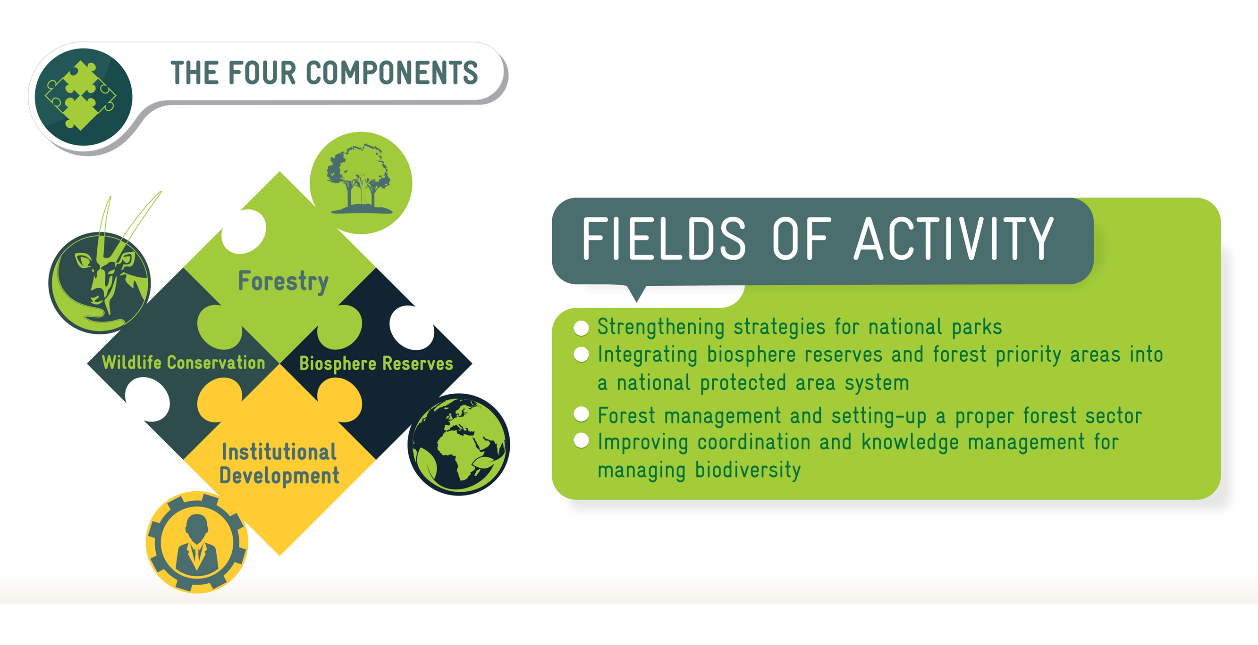
The 4 Programme component areas

Slide 7
Instruments for the implementation
Advisory services
Provision of equipment/materials
Consultants
Local subsidies

Slide 8
“Dessa’a” transboundary forest
154,071 Ha of area in size
Located between two regions of Tigray & Afar
Dominated by indigenous tree species mainly Olea and Juniperus in the highland and acacia in the lowland
Elevation up to 3,200 M
Deforestation for fuel wood and charcoal is a key challenge

Slide 9
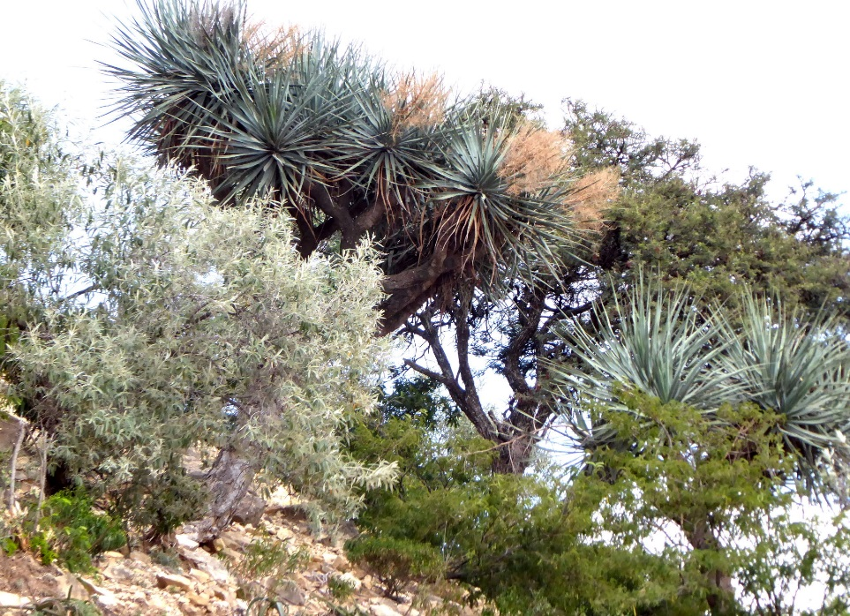
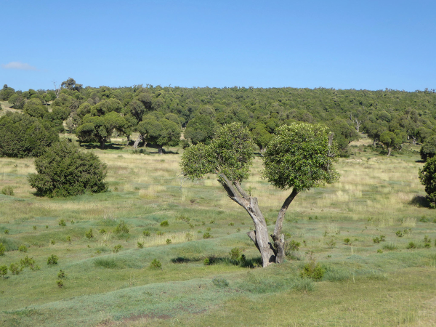
Trees in lowland vs highland in Dessa’a
Dragon tree (Endangered tree at global level)
Olea and Juniperus trees

Slide 10
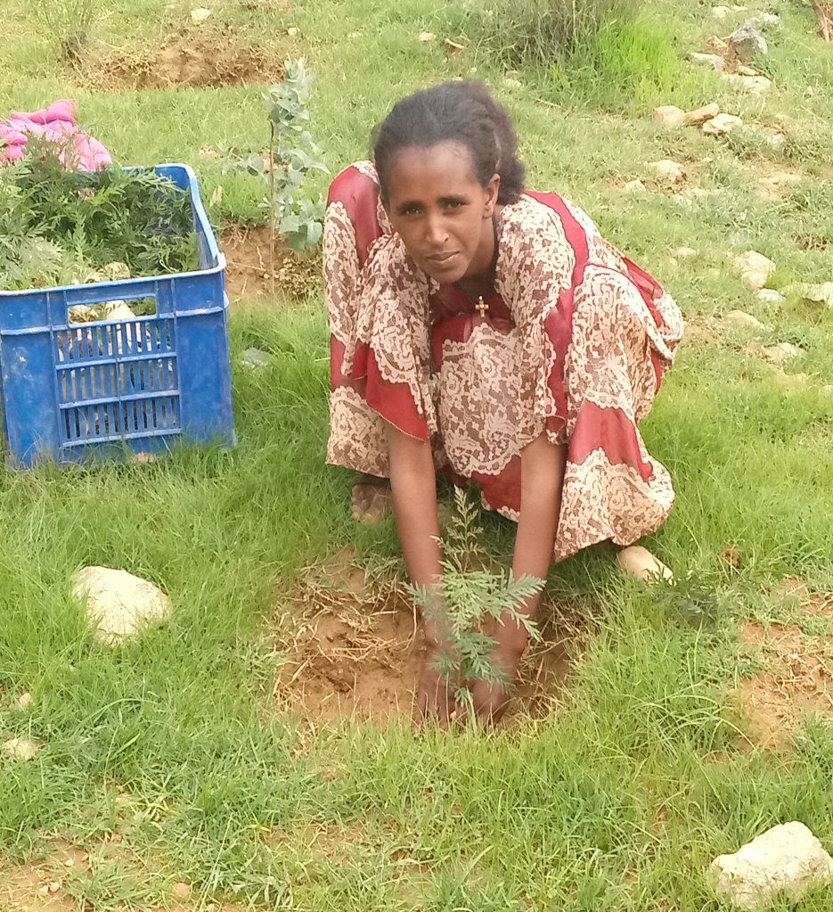
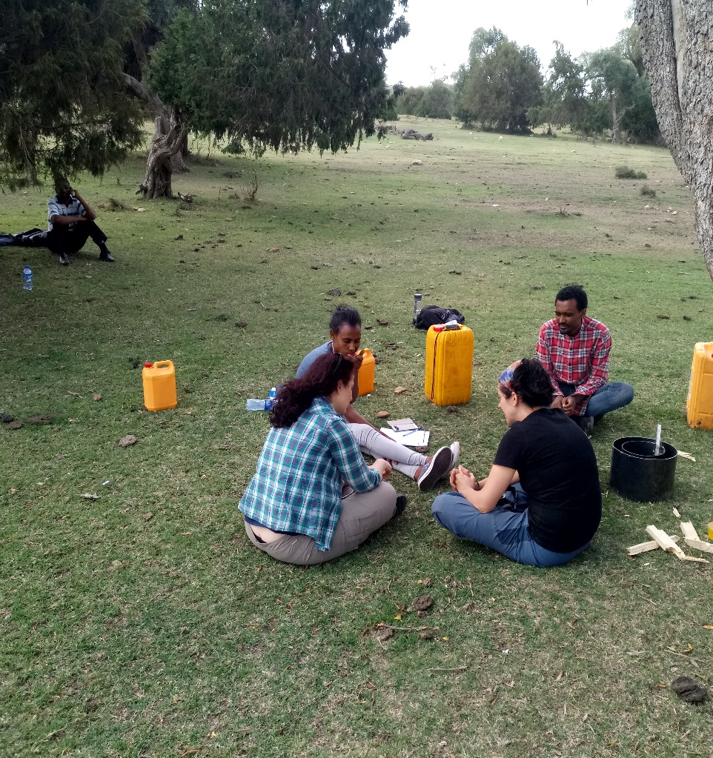
Field level activities

Slide 11


