Slide 1
Martine Btaich
Rural and Responsible Tourism Professional
Lebanon Mountain Trail Association
martinebtaich@gmail.com
martineb@lebanontrail.org
«The Land is the Source» F.B
IPROMO
Landscape approach for enhancing mountain resilience
Pieve Tesino /Ormea 02-18 July 2019

Slide 2
Education
Executive MBA- Ecole Supérieure des Affaires (ESA)- ESCP EAP, Lebanon, 2007
BA – Sales and Advertising- Saint Joseph University, Lebanon, 1996
Employment and main activities
Currently: Executive Director of the Lebanon Mountain Trail Association
Independent professional with NGOs on Community Development, Community Based Tourism, Tourism Policies

Slide 3
Other interests (volunteer work, hobbies etc.)
Hiking/ trekking
Sustainable travel, culture, mountain, conservation and environmental issues
Contributor to the Lebanon Traveler magazine

Slide 4
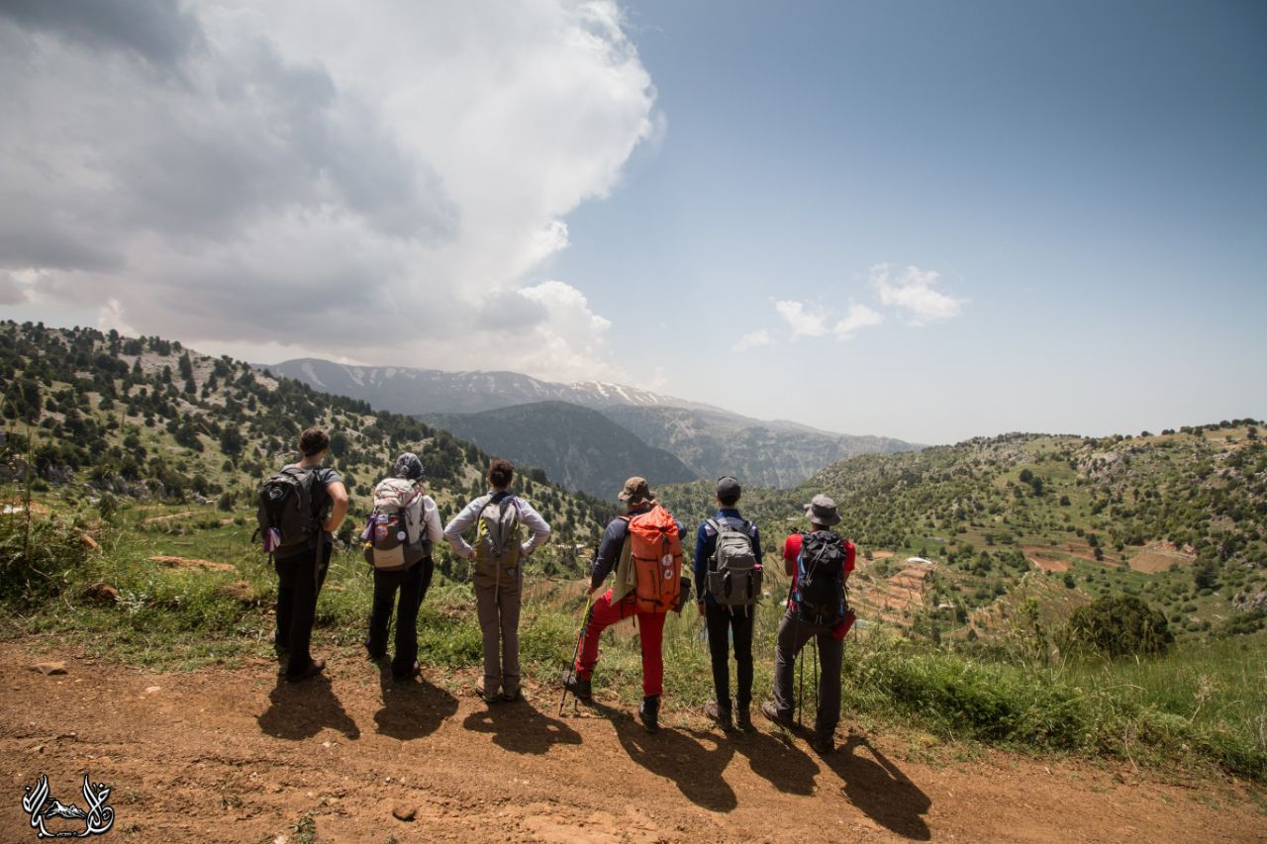

Celebrating a Shared Heritage
Bringing Communities Closer Together

Slide 5
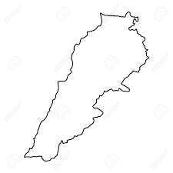


Lebanon
لبنان
33 ° North
10,452 km2
4Million people
66% mountainous
Minority groups (18 different religious groups)

Slide 6
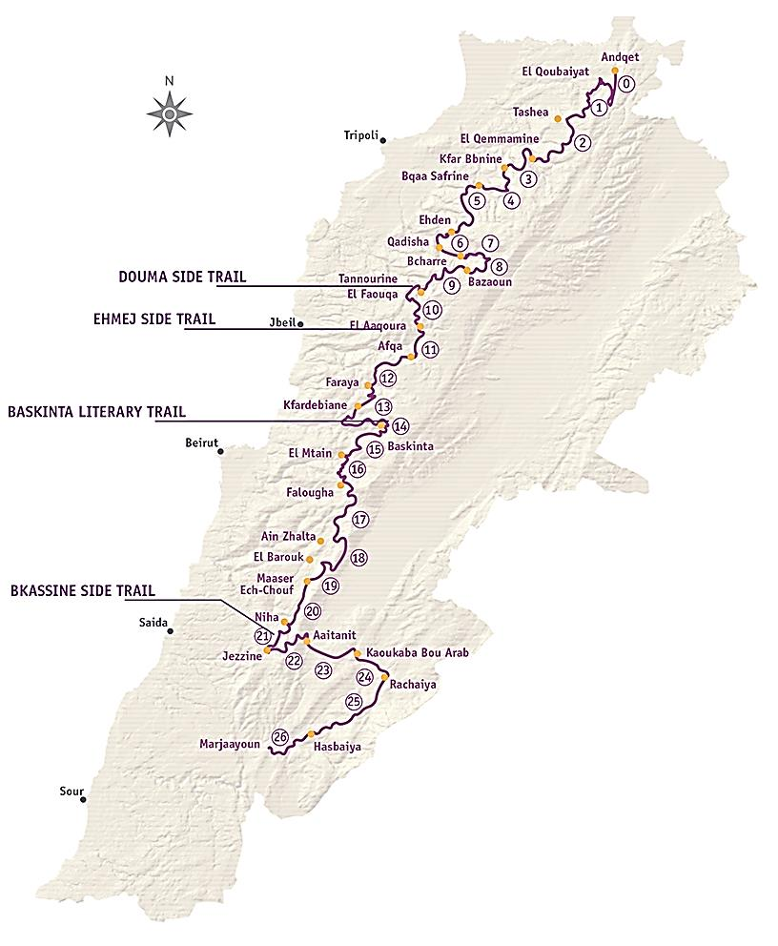



Lebanon Mountain Trail
Celebrating a Shared Heritage!
470 km (293 mi.)
570-2,011 m (1,870-6.600ft)
27 sections (27 days)
4 side trails
75 towns and villages
50 municipalities
1 World Heritage Site
3 Nature Reserves
2 Biosphere Reserves
Protected Areas and Sites
Important Bird Areas
50% foot/ historic paths
40% dirt/ agricultural roads
10% paved

Slide 7
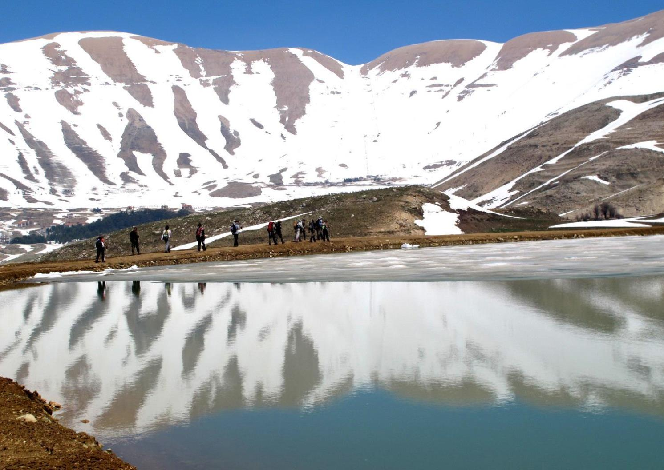
Notes:
Identity/ Heart of the country

Slide 8
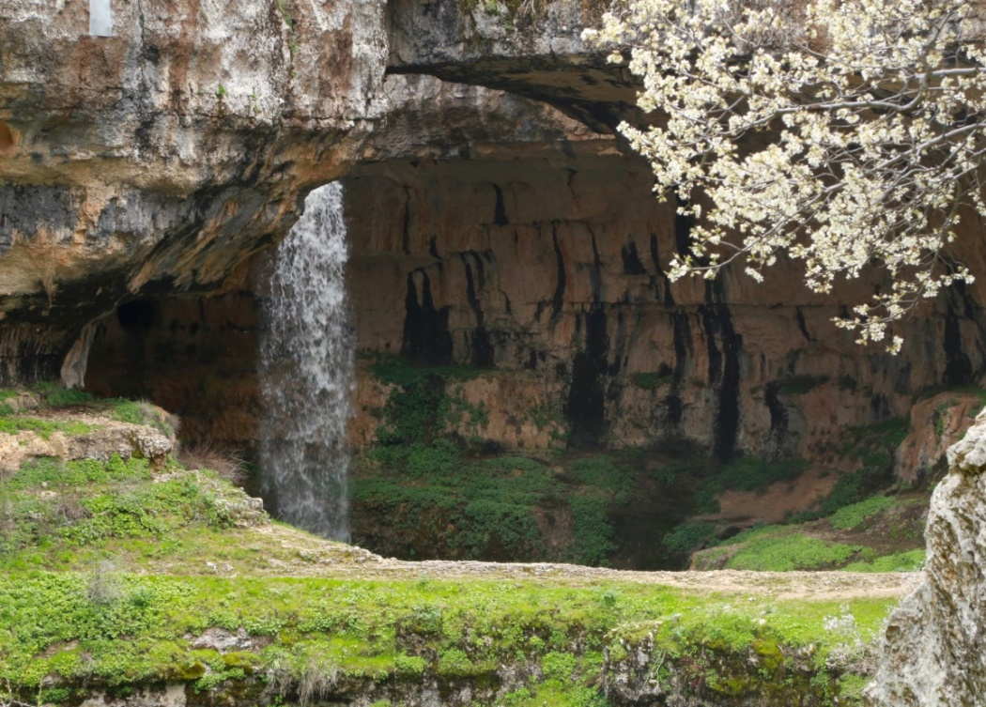
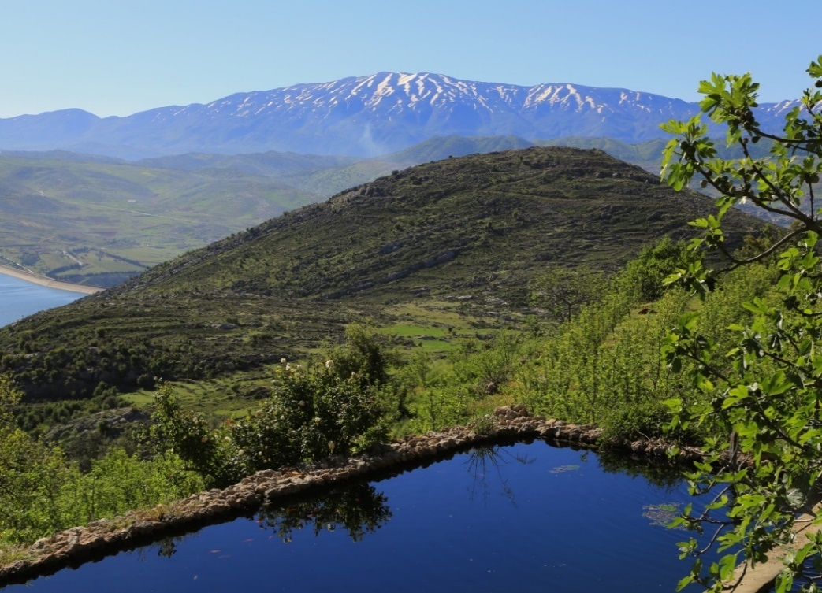
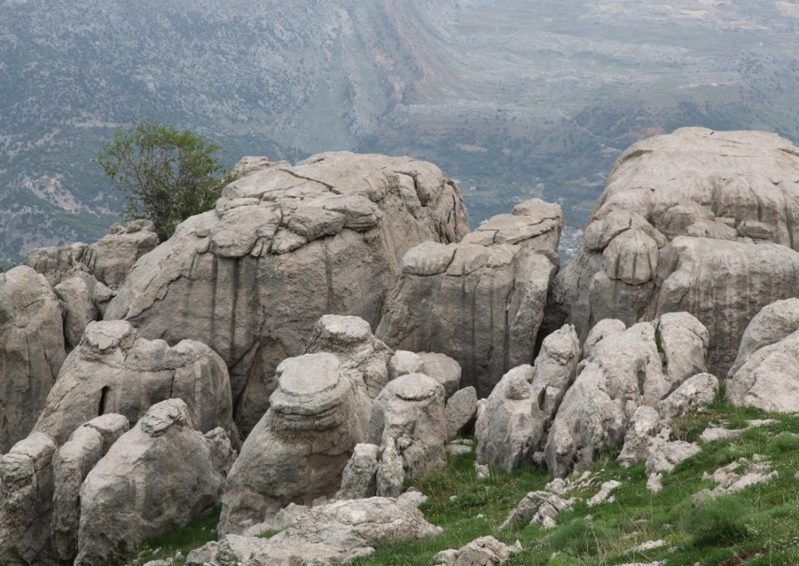
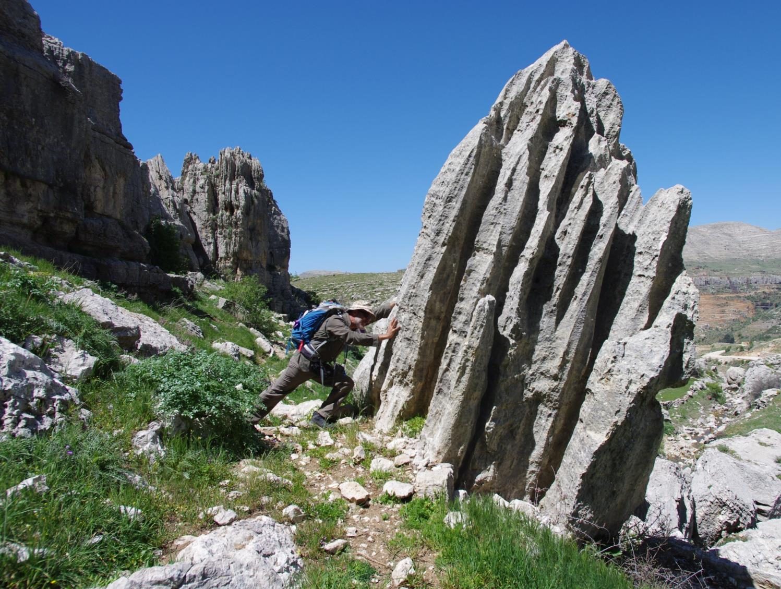

Slide 9
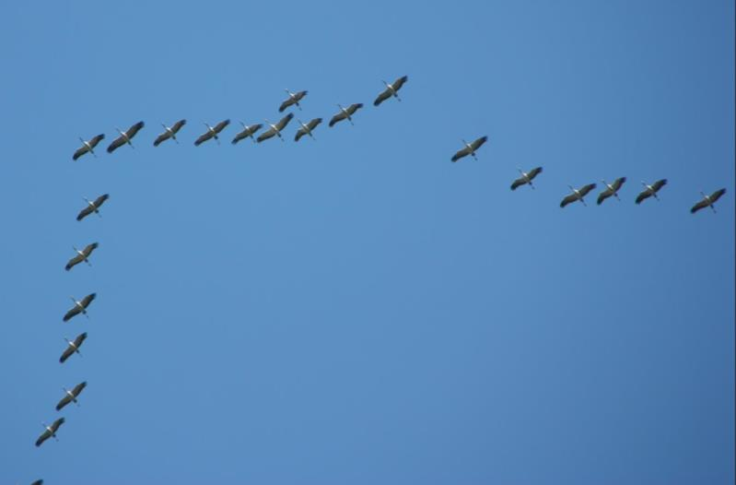
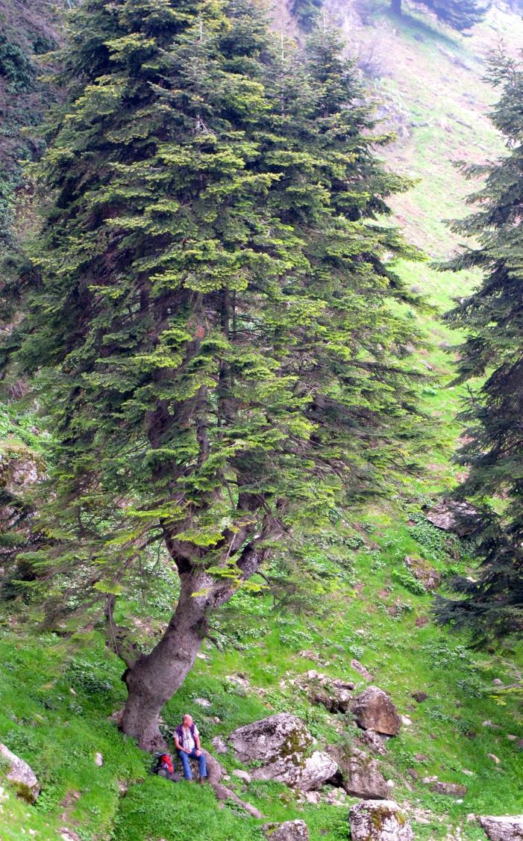
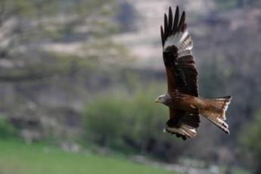
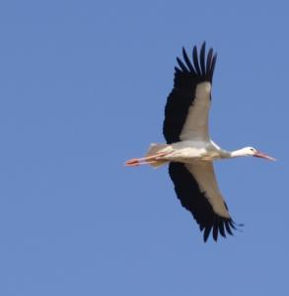
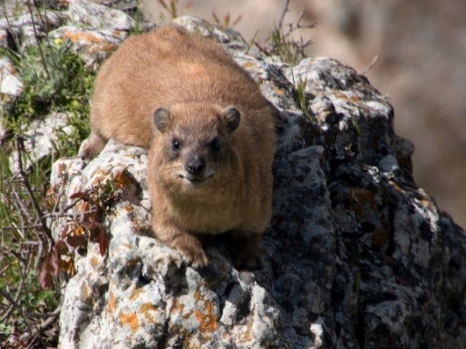

Slide 10
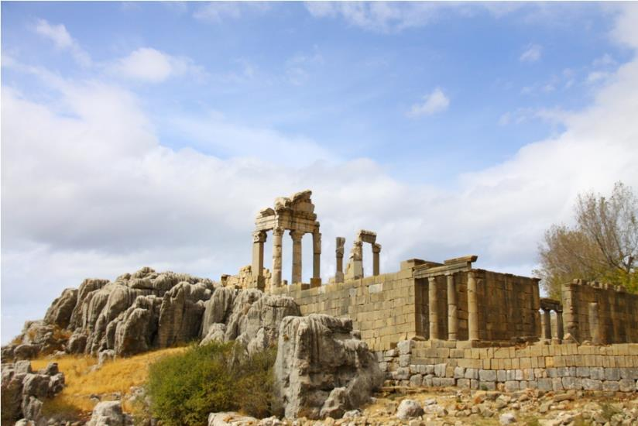
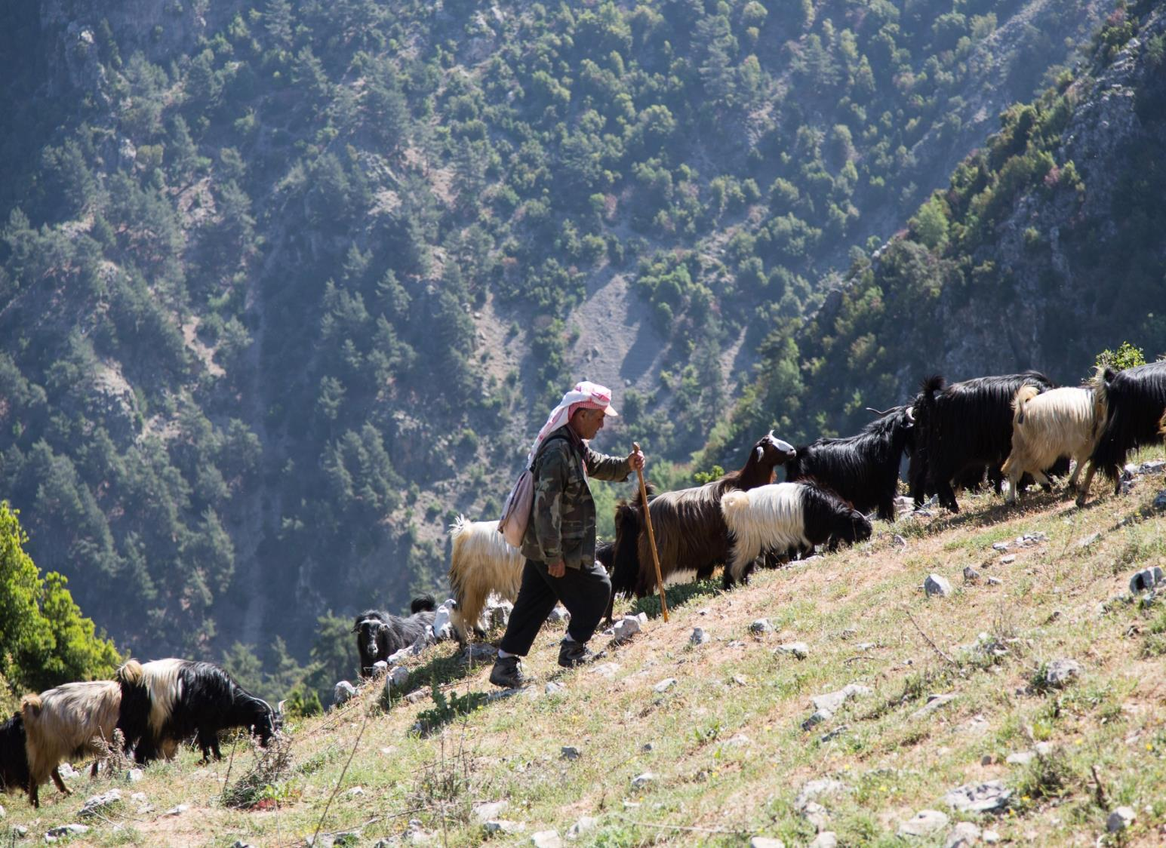
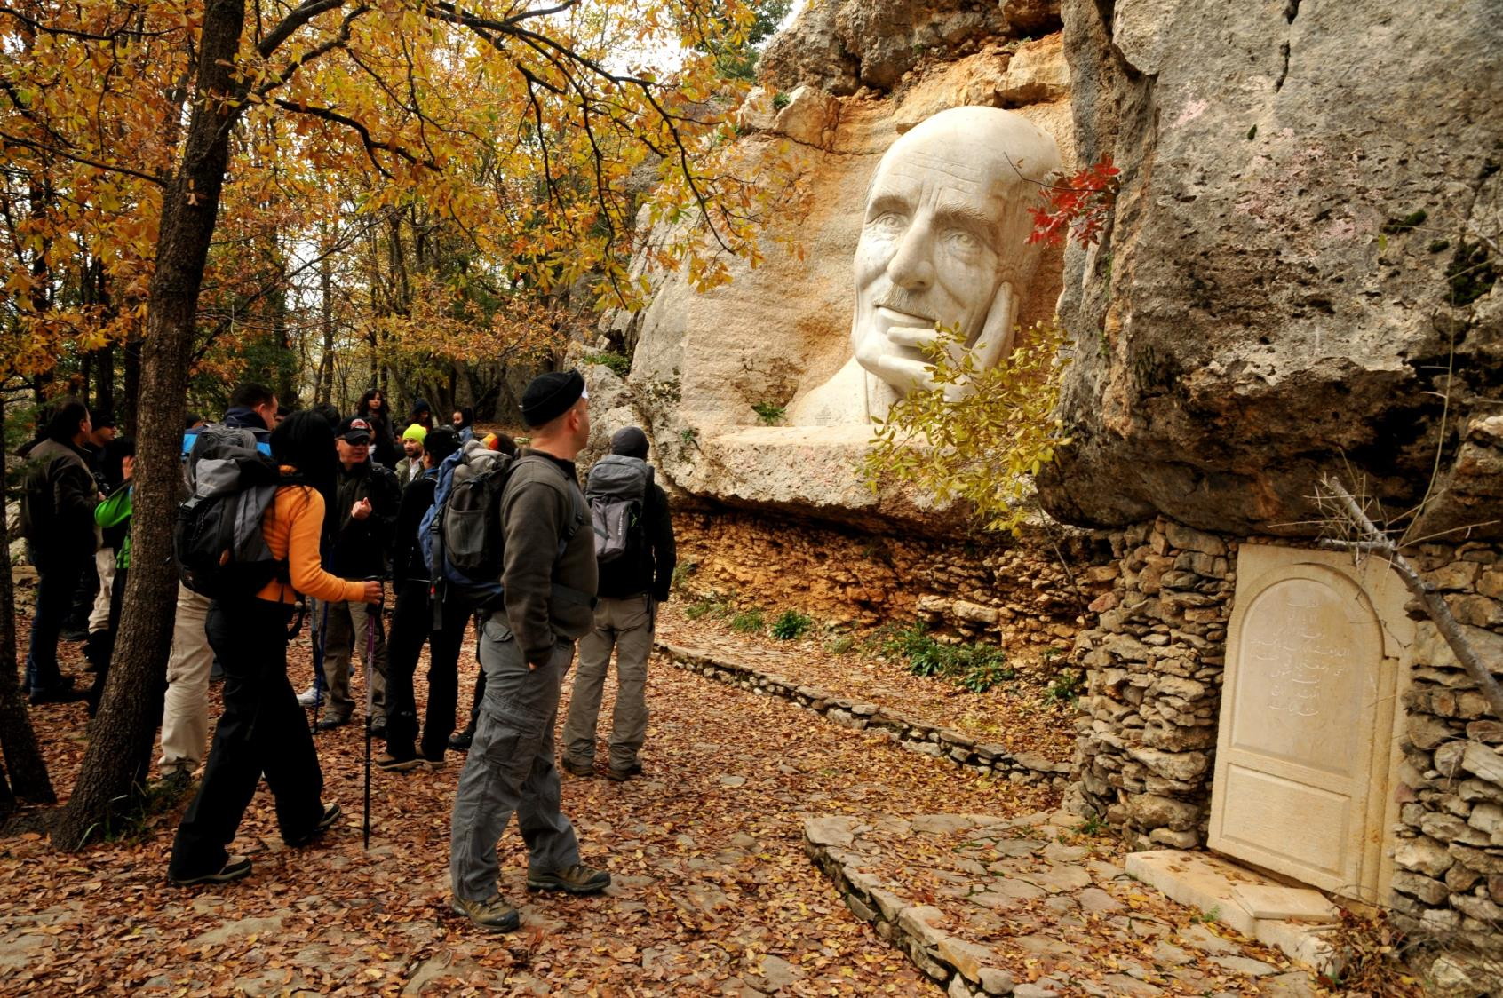
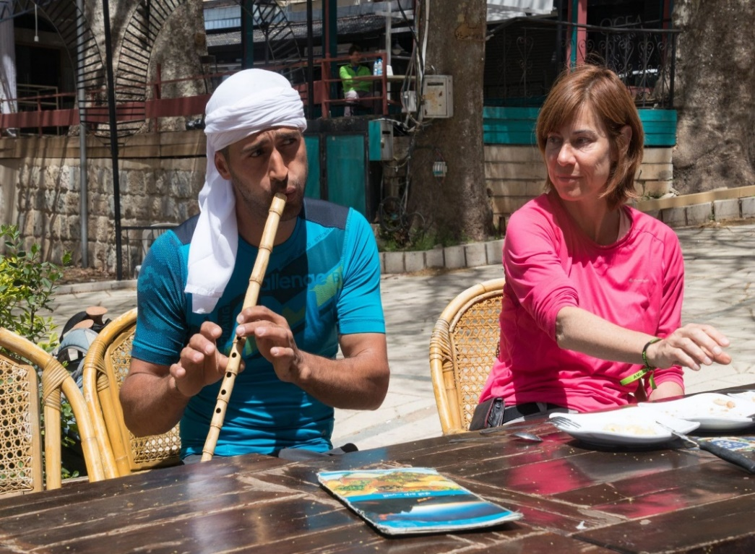

Slide 11
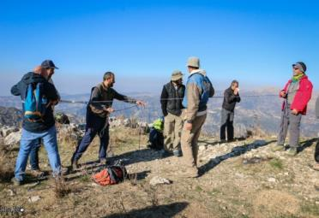
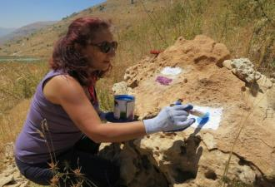
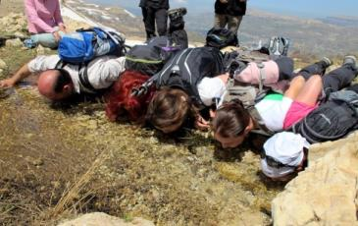
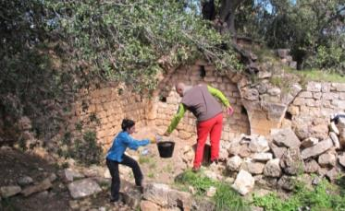
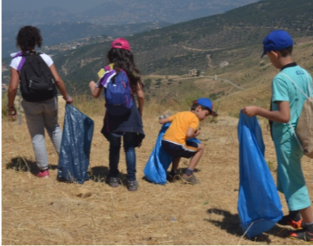
The LMT Association (LMTA)
Develop, maintain and conserve the trail
Promote the trail as a responsible tourism destination
Develop economic opportunities
Protect the natural, cultural and architectural heritage and landmarks near the trail
Community development and educational activities

Slide 12
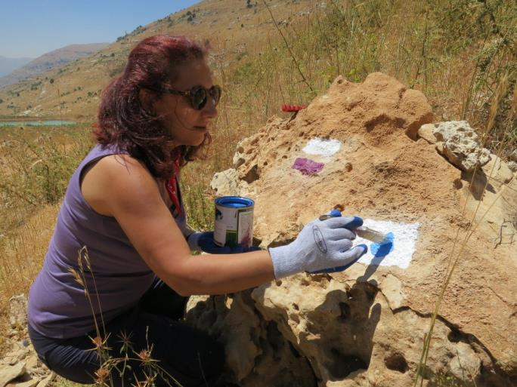
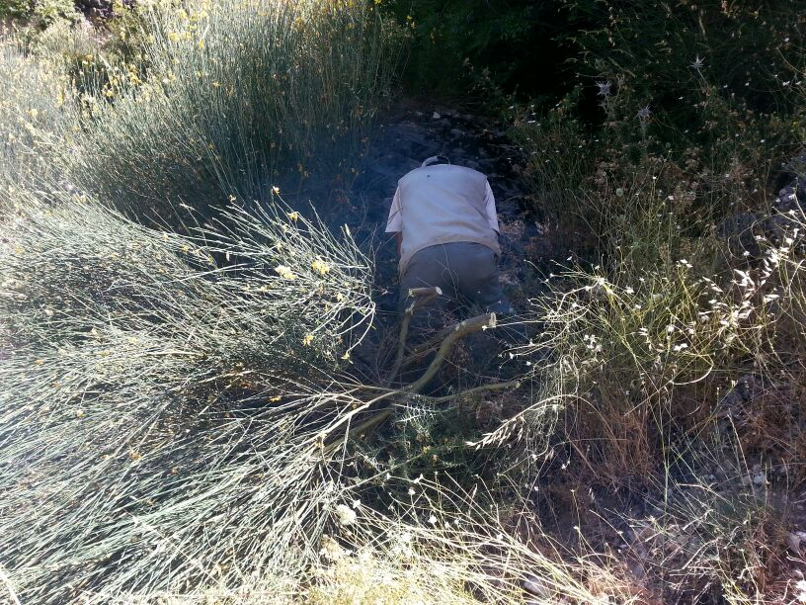
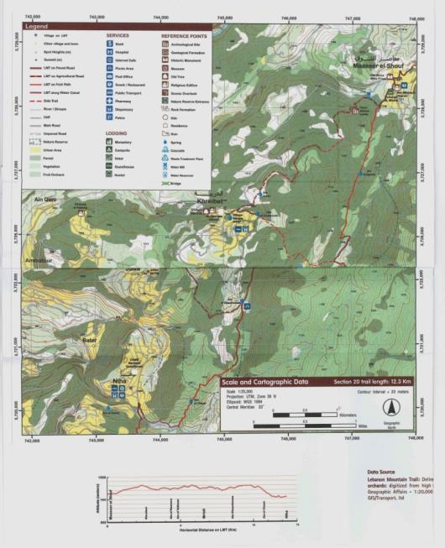
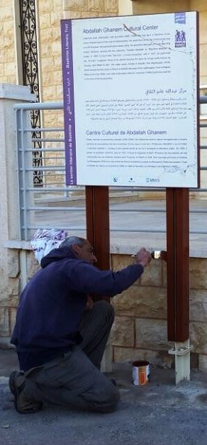
Trail Development

Slide 13
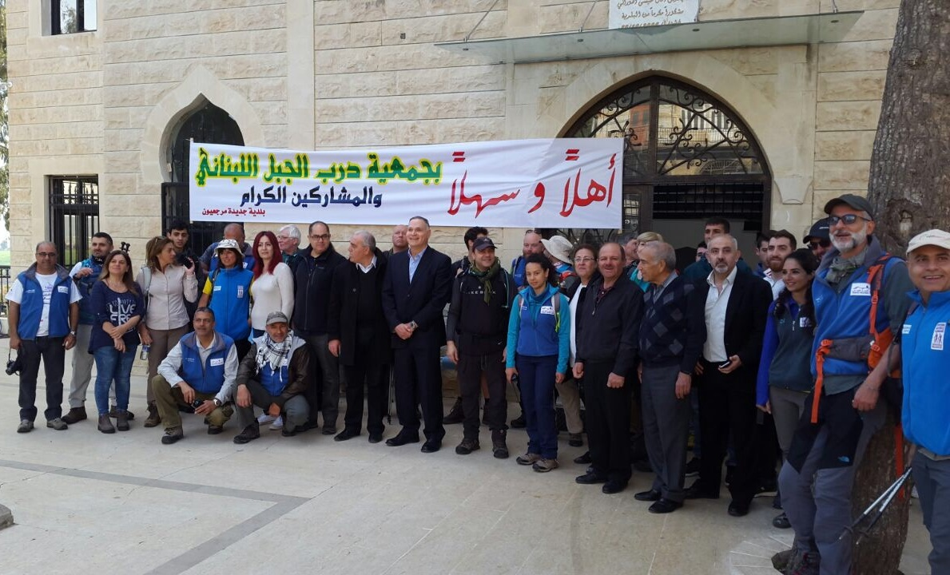
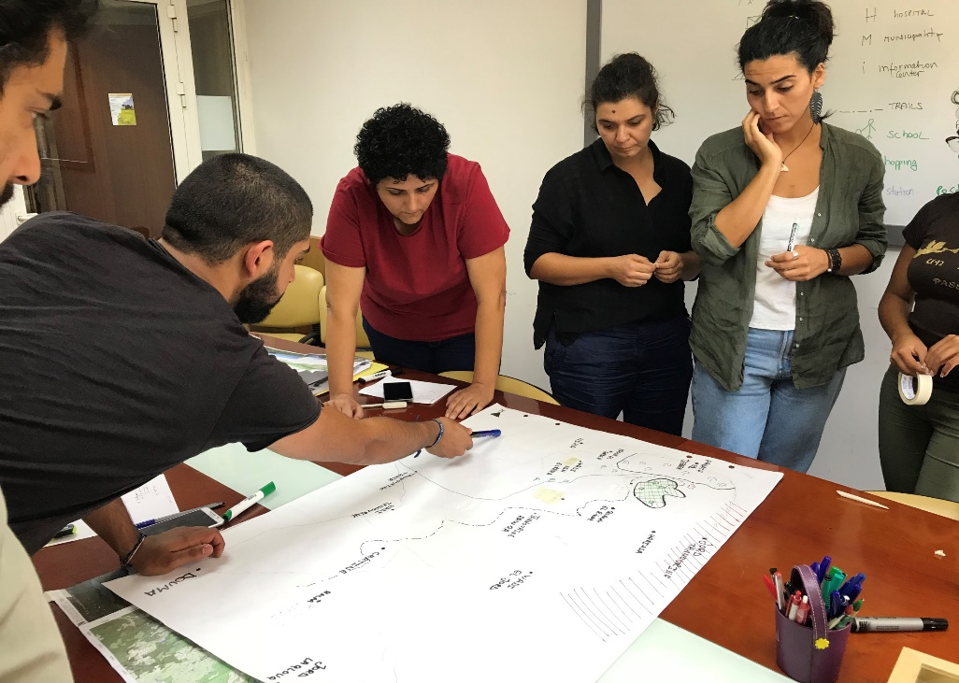
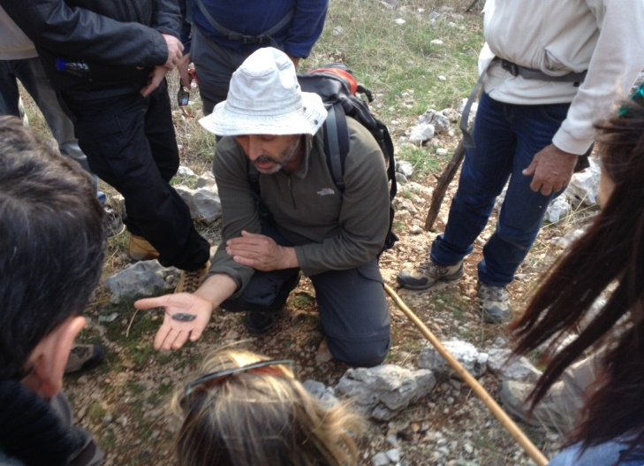
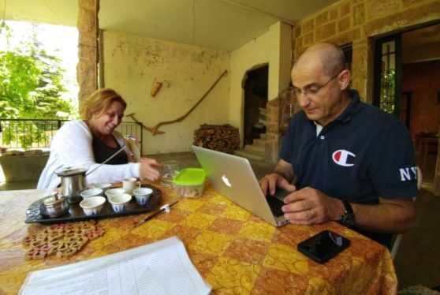
Community Development

Slide 14
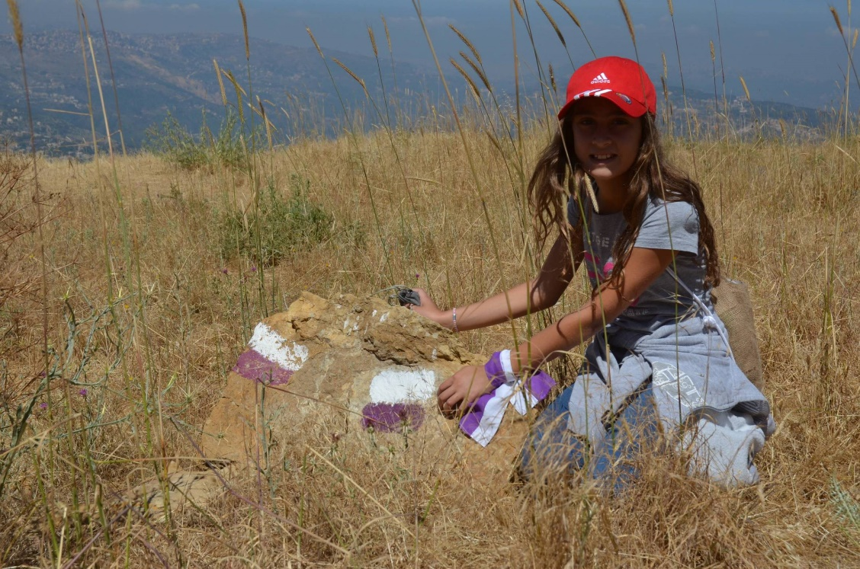
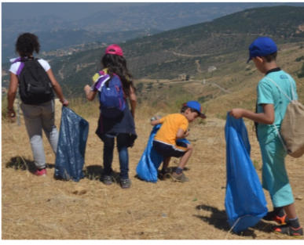
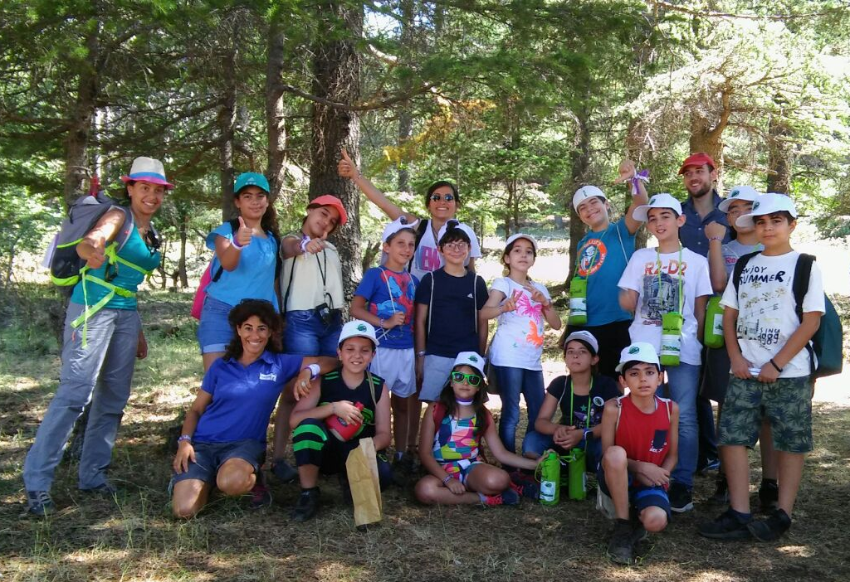
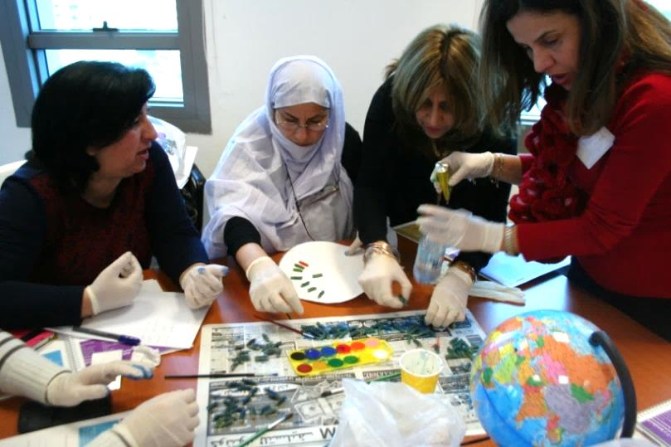
Education

Slide 15
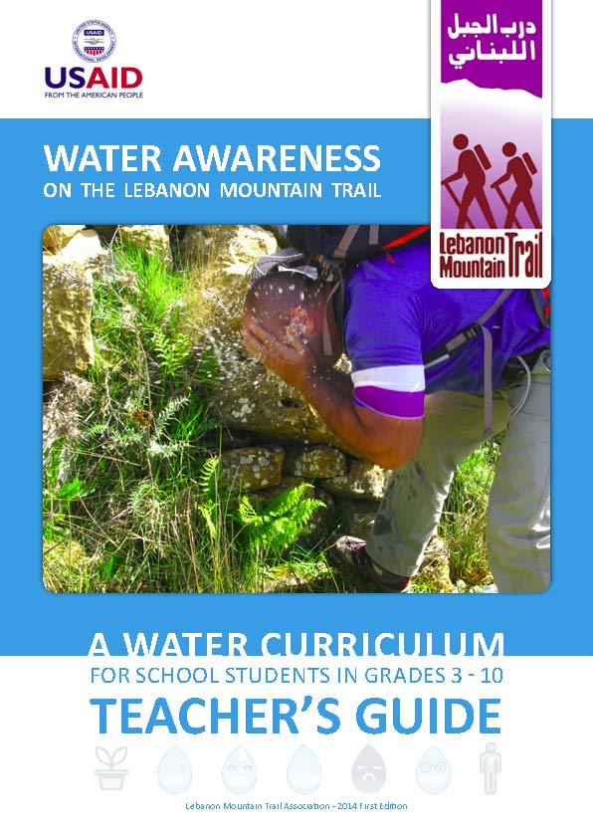
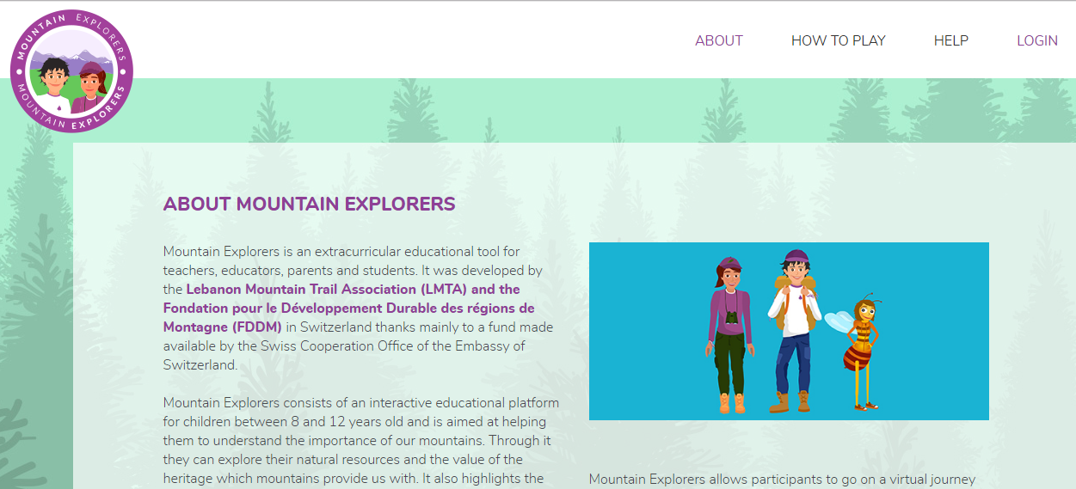
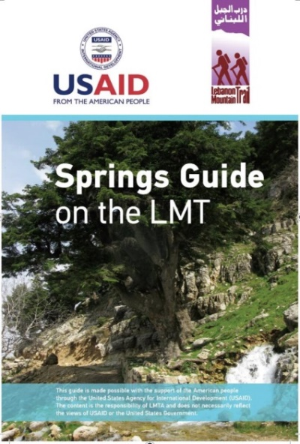

Slide 16

The Trail and the Mountains are in Danger

Slide 17
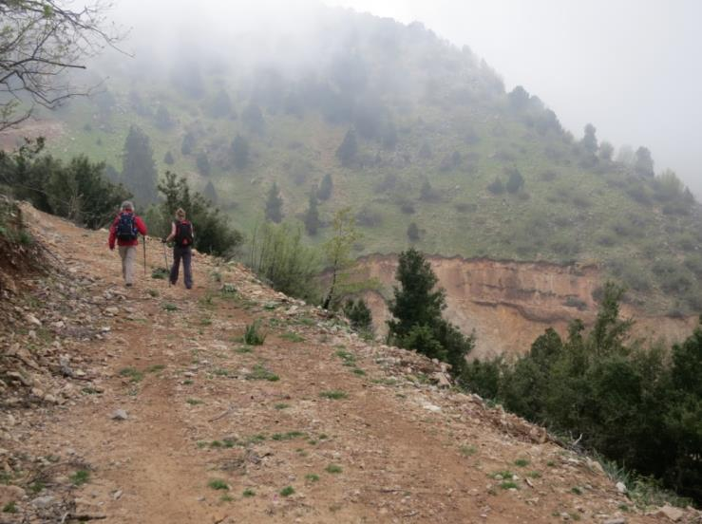
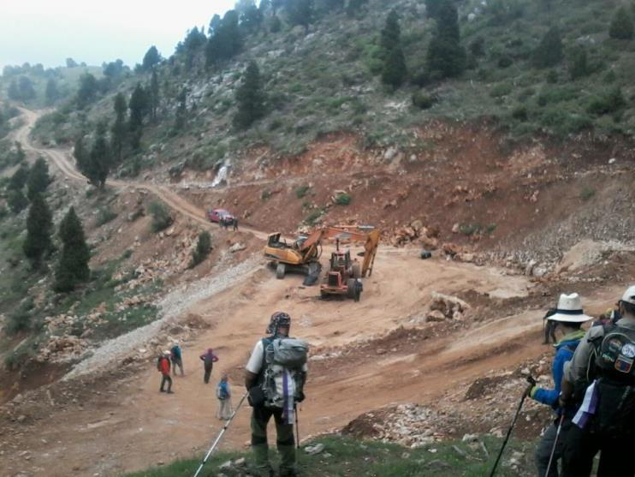
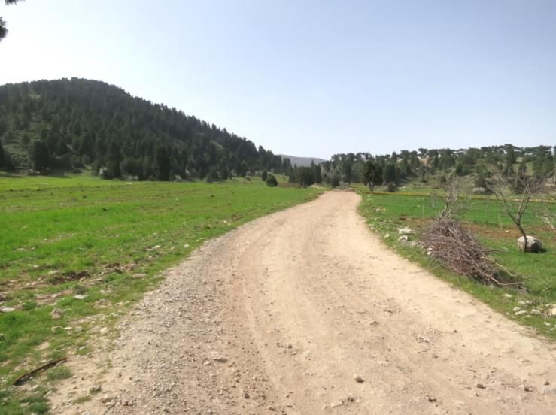
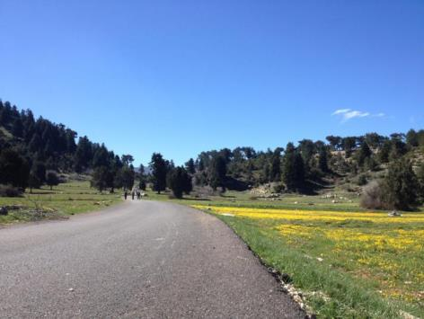

Slide 18
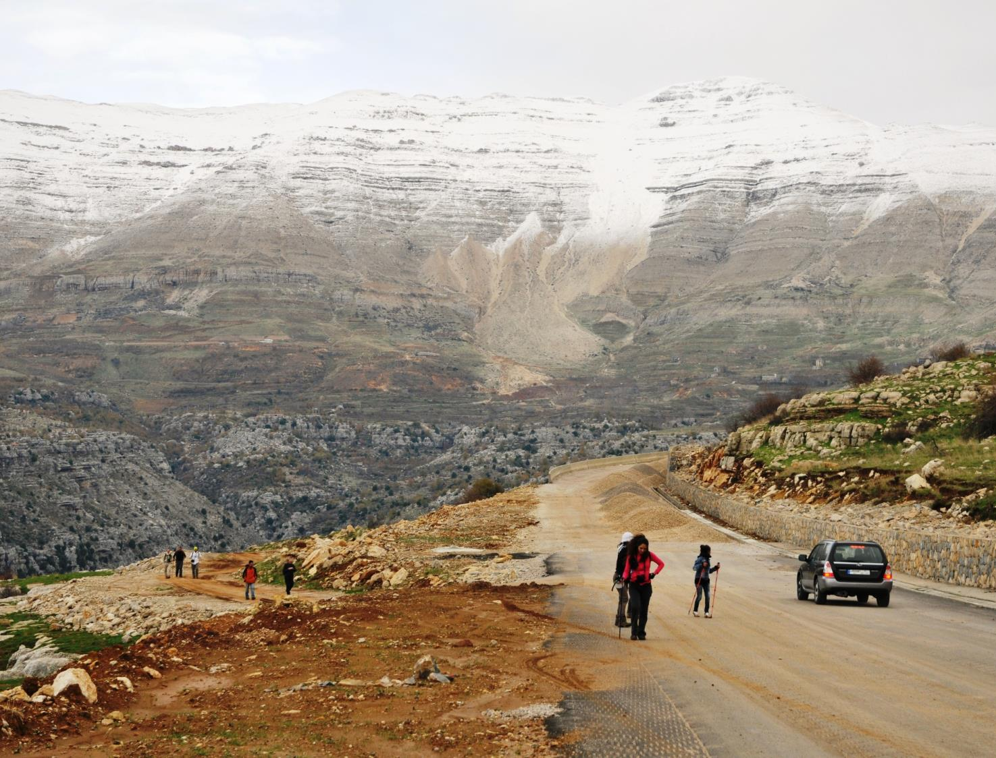
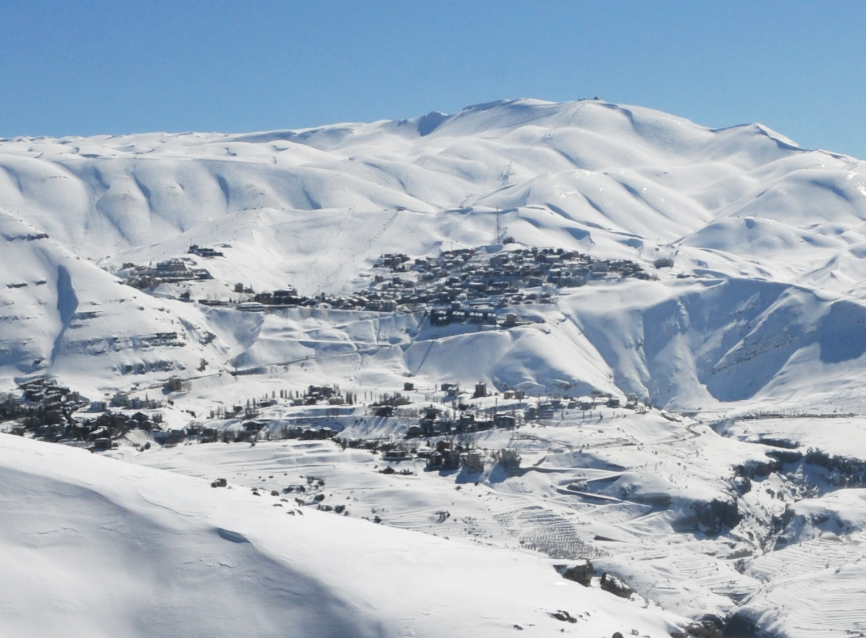
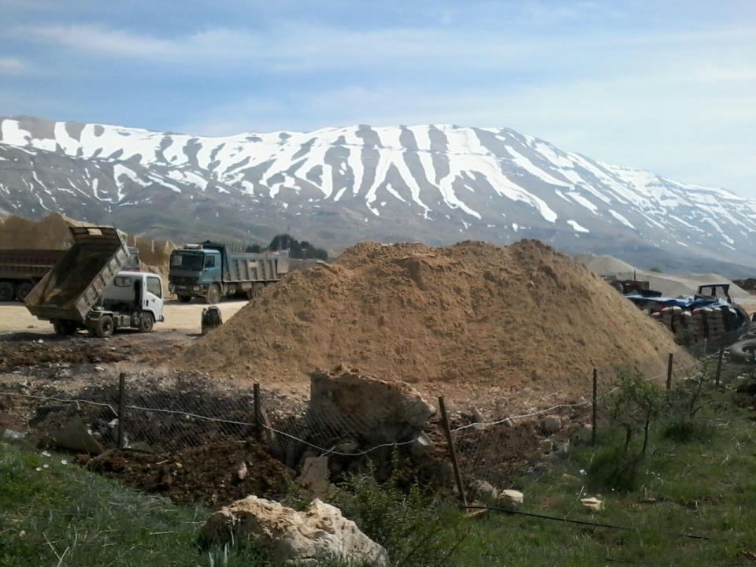
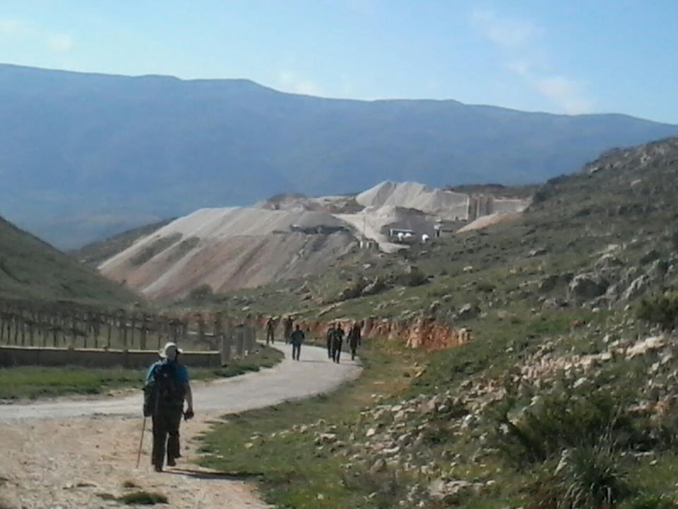

Slide 19
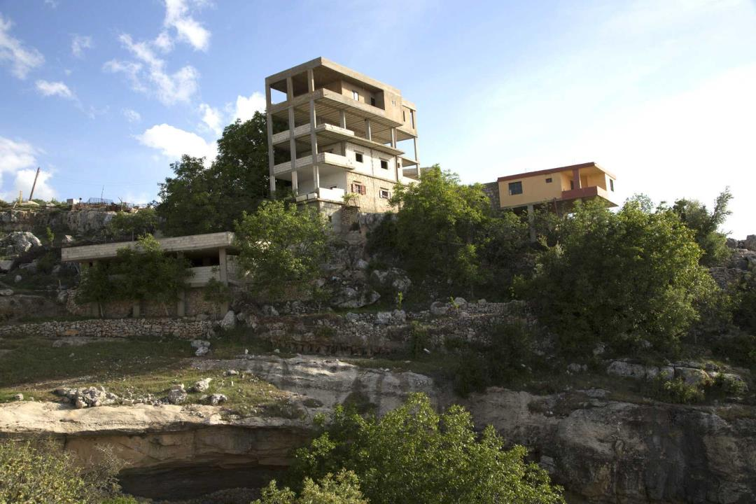
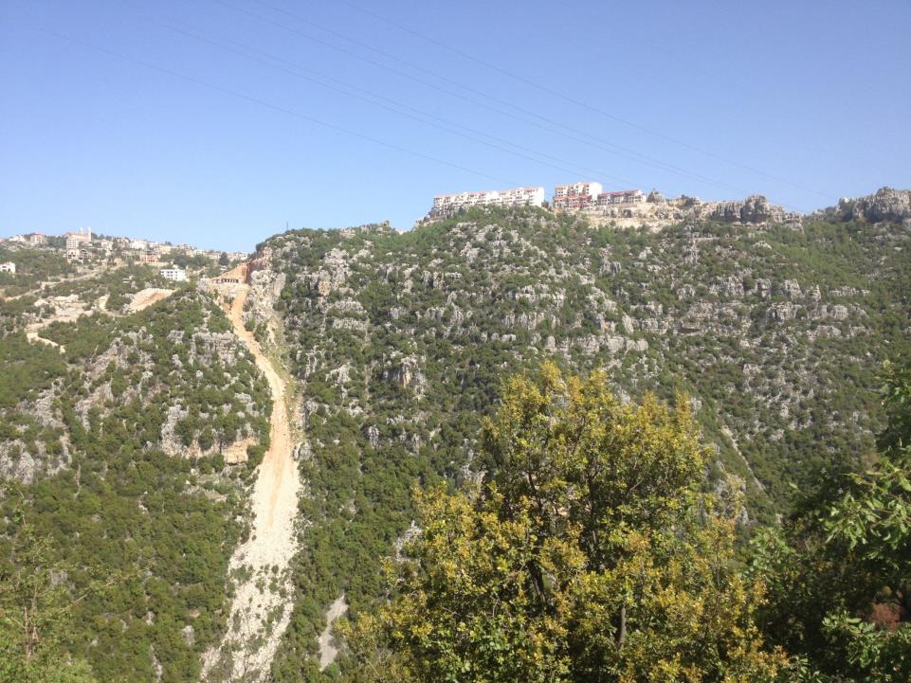
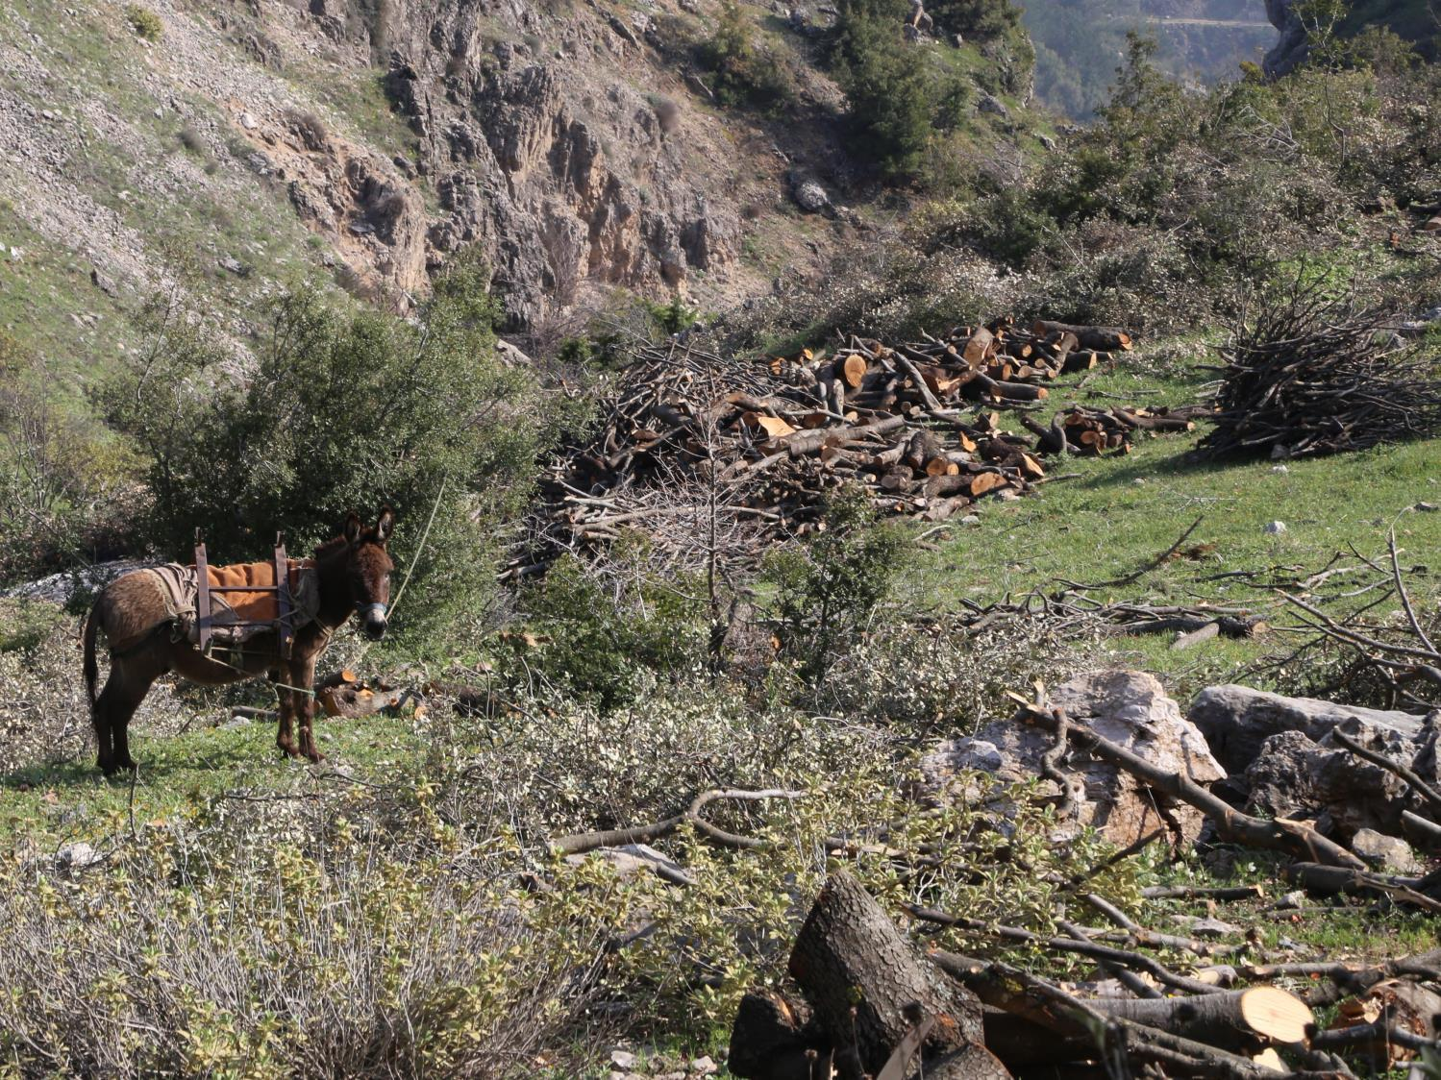
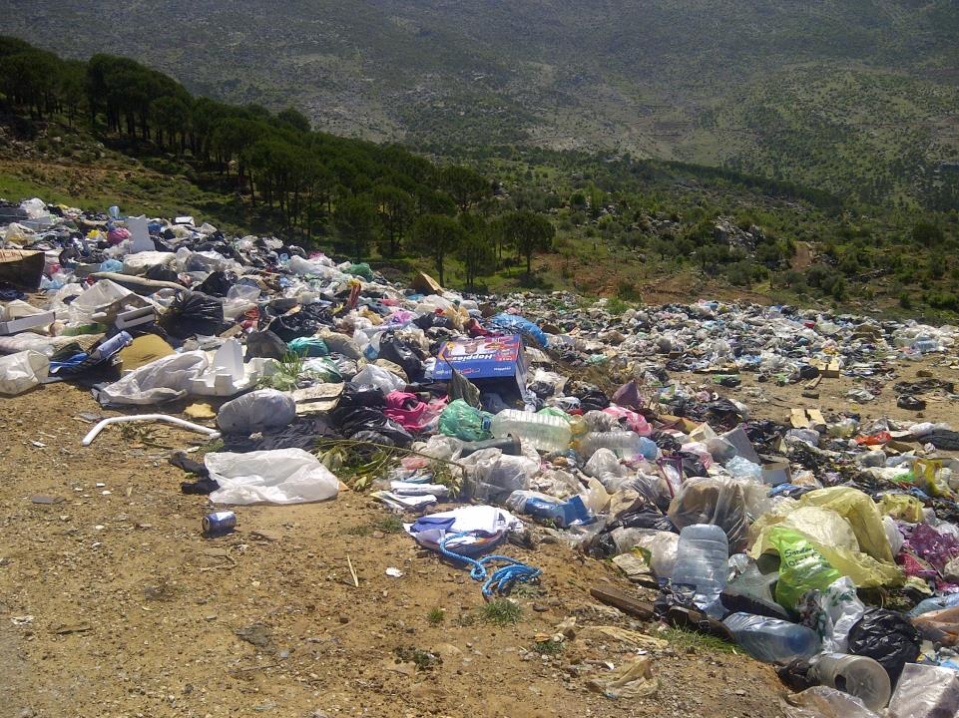

Slide 20
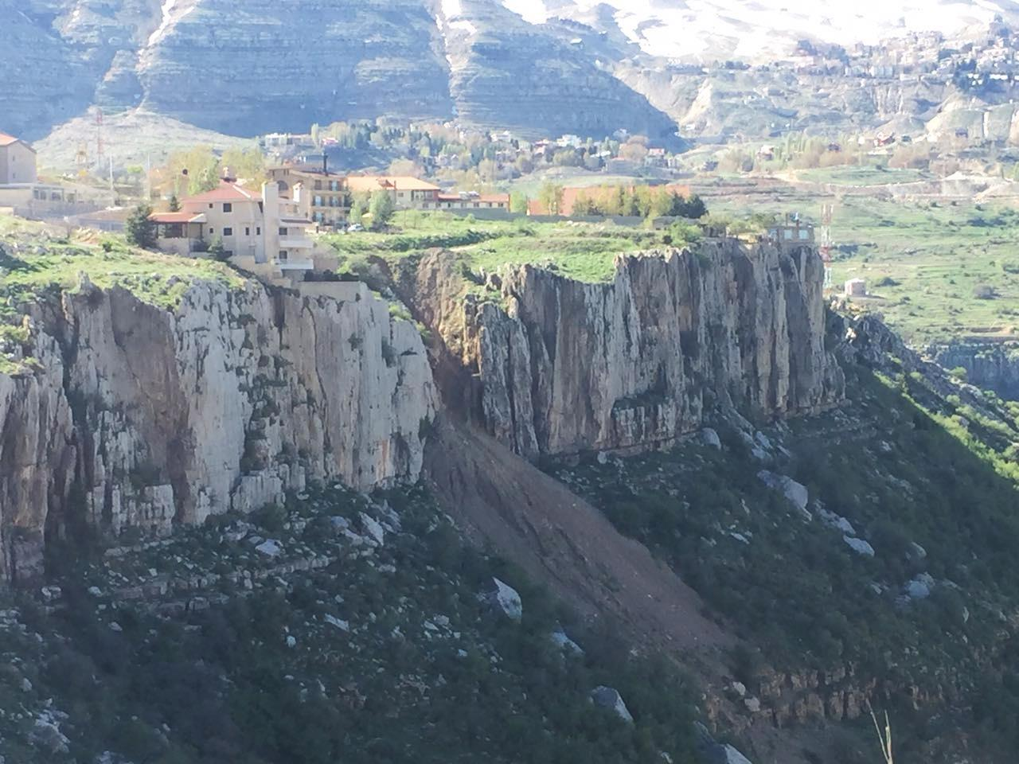
Lack of legal frameworks
Lack of enforcement of laws
Infrastructural gaps
Socio economic challenges
Political instability
Cultural challenges
…

Slide 21



Reporting Abuses
+
Lobbying with the Government and advocating for legislation for conservation
+
Discouraging Unwanted Behavior
Notes:
Many uninitiated hunters shoot all types of birds including migrating soaring birds (storks, pelicans, cranes, etc.) which are specifically protected by international conventions.
Pursuing a bird case in court since 2012.

Slide 22

Create Harmony
Between
Those who serve the trail
Those who walk it
Those who host visitors
With officials and authorities
And of course with Nature

Slide 23




Lebanontrail.org

