Slide 1
Personal presentation
Maher MELAOUHIA
Senior engeneer
Regional Commissionership of Agricultural Development
Ministry of Agriculture
mmeher@hotmail.com
IPROMO
Landscape approach for enhancing mountain resilience
Pieve Tesino /Ormea 02-18 July 2019

Slide 2
Education
Agricultural engeneer since 2002
Many additional diploma (food safety, quaranteen deseases, sustainable agriculture, agricultural innovation, development of marginal areas, plant protection, food waste ....)
Employment and main activities
Head of organic agriculture department in regional commissionnary of Zaghouan (ministry of agriculture) 34800 ha certified organic of which 20000 ha of forests and mountain
Extension services for mounatin productions
Involved in development projects
Ecotourism and mountain development

Slide 3
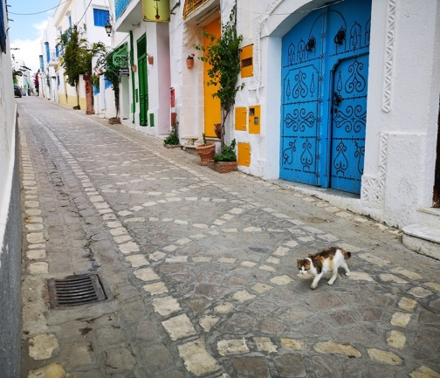
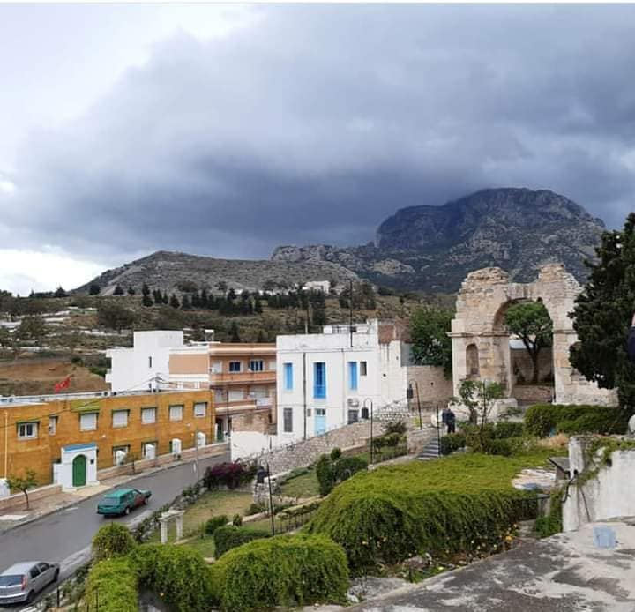
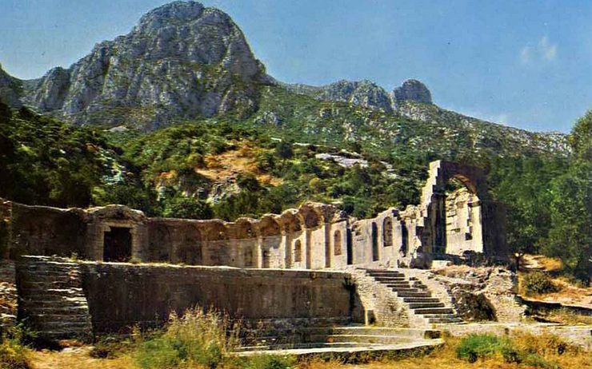
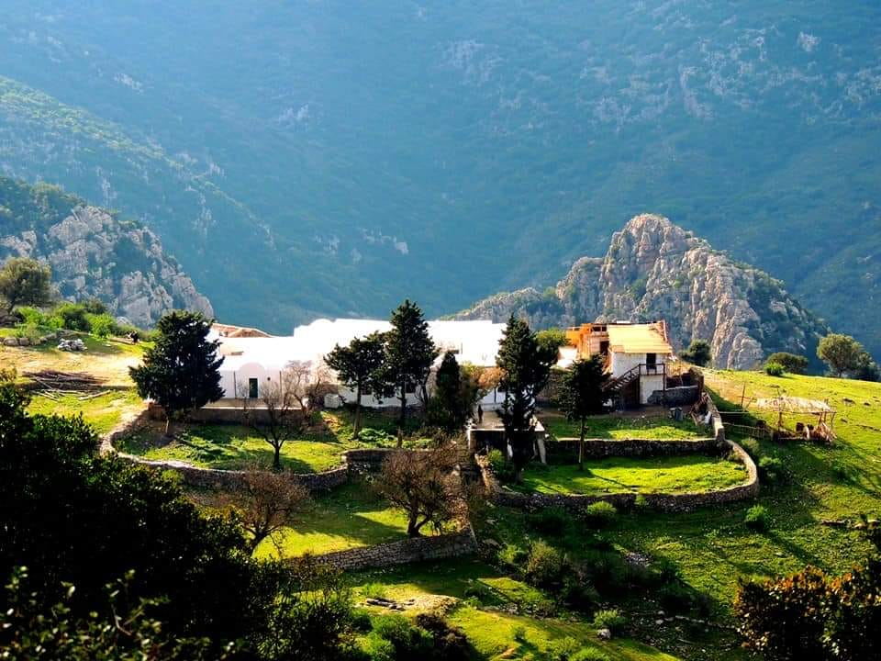
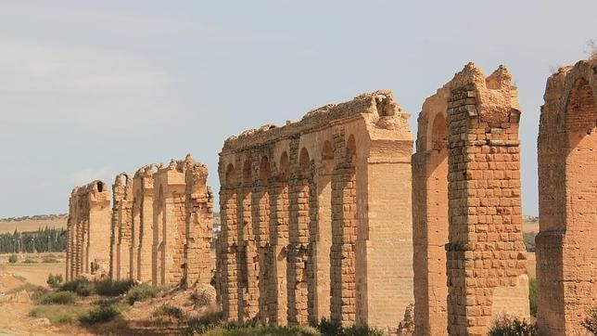
My region
Zaghouan
Old romain city (Ziqua)
Mountain area
3 rd highest mountain in Tunisia : Mountain Zaghouan
187.000 habitants (45.000 living in mountain)
70 .000 Ha forest and mountains = 25% of all the region area

Slide 4
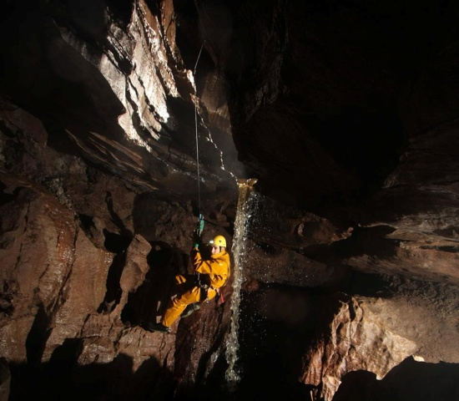
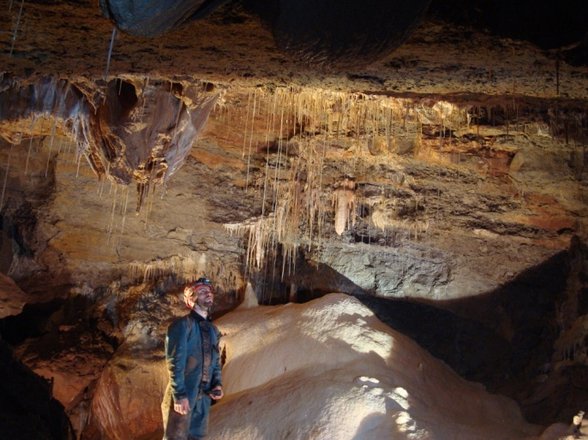
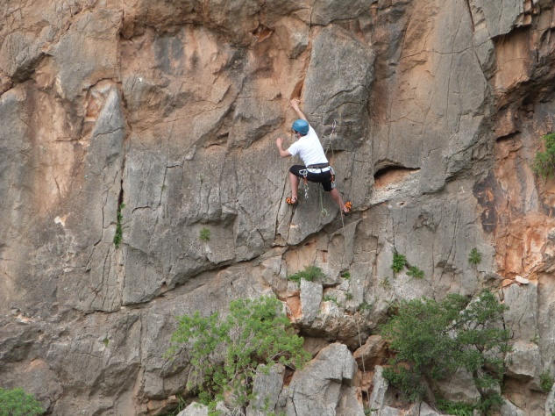
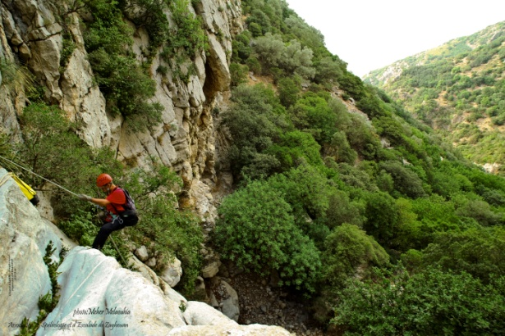
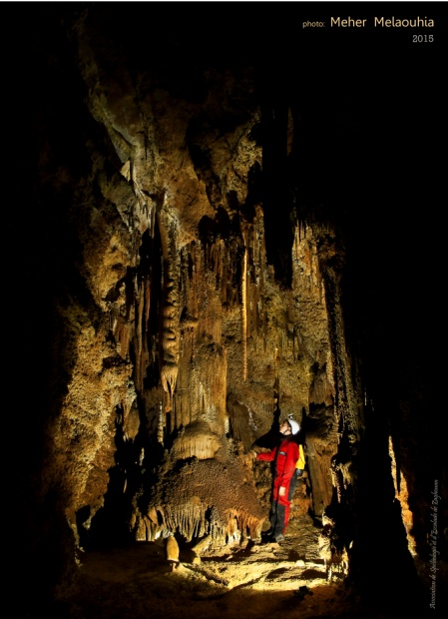
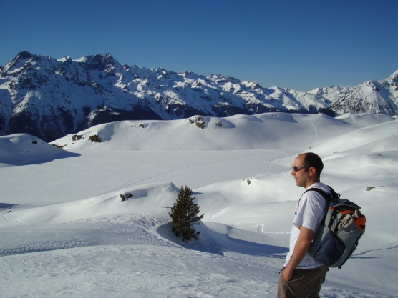
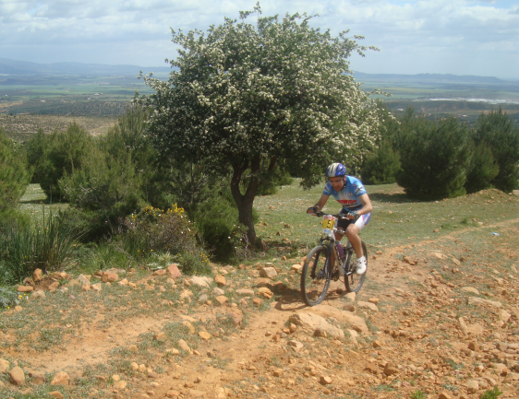
Hobbies
Caving
Caving photographer
Rock Climbing
Climbing monitor
Mountain rescue
Mounatin biking
Canyoning
Hiking

Slide 5
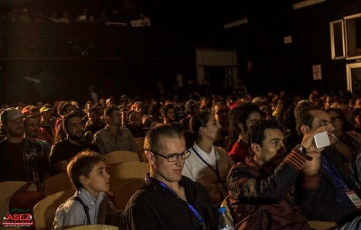
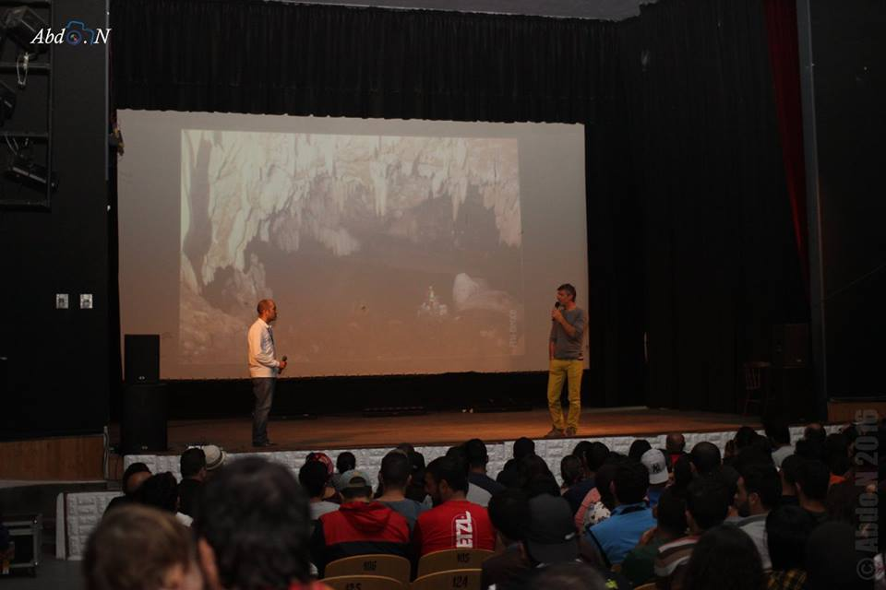
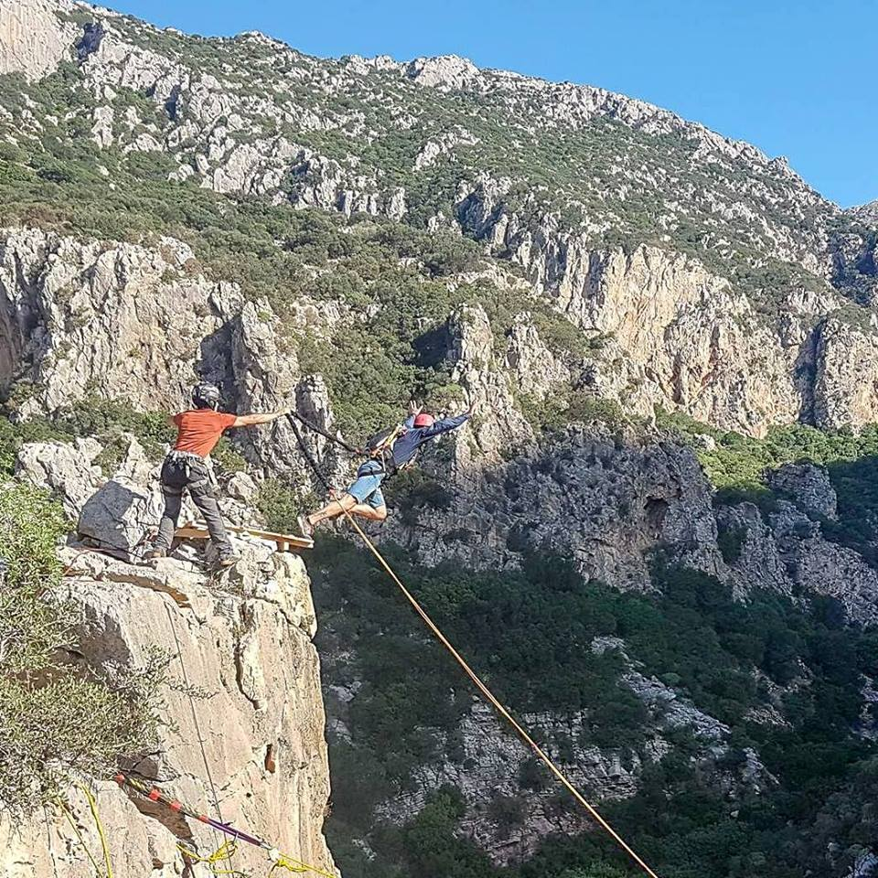
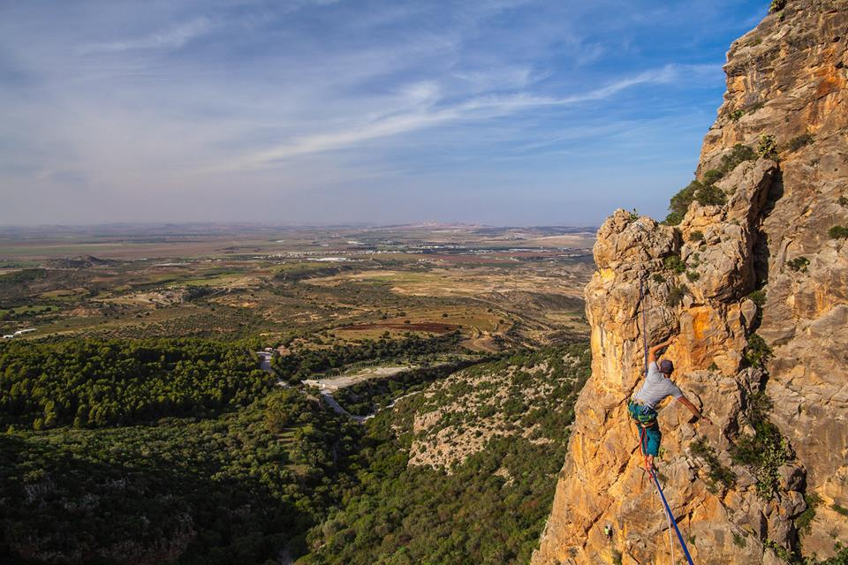

Other interests
Co founder and artistic director of Zaghouan mountain film festival (6th edition)
Promotion of mountain areas
2 evenings of film screening and speakers
2 days of moutain activities

Slide 6

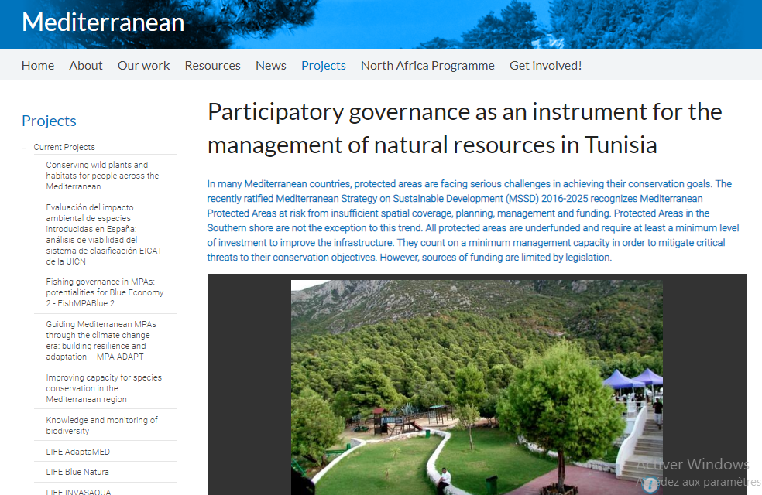
Presentation of a project you are working on 1/3
Integrated agricultural development project (African Bank of Development)
Provinding extension services and equipement for forest plant distillation, organic certification of forests, goat farming and honey production.
Improvement of the protection and conservation status of Tunisian Protected Areas through the implementation of innovative models of participatory governance;
Improvement of the local livelihoods and diversification of the income opportunities for the populations living in the surroundings of the protected area.

Slide 7
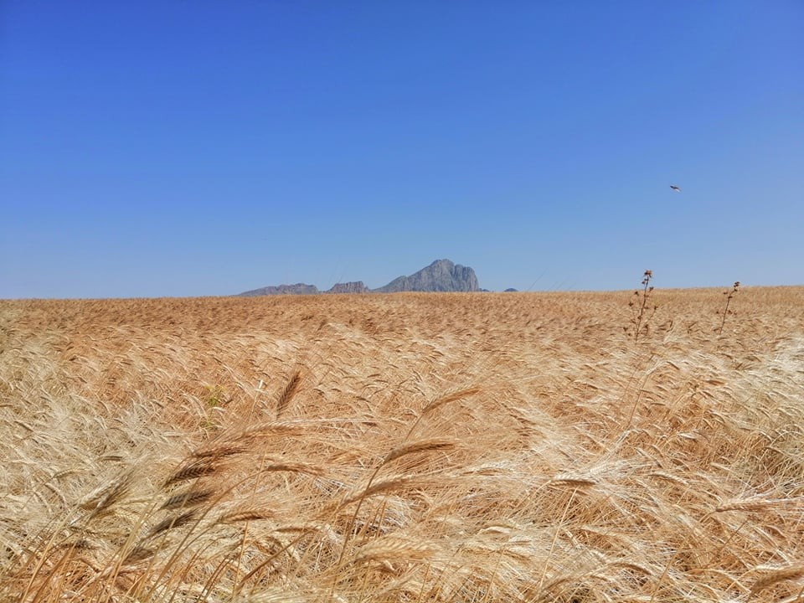
Presentation of a project you are working on 2/3
Old cereal varieties valorisation in mountain aereas in collaboration with the National Bank of Genes
Selection of the most suitable varieties
Field trials
Seed production
The “Dog Rose” petals tour project to develop mountain tourism
Creation of ecotourism tours
Contacts with tourism agencies
Creation of tourist themes
Creation of a network between actors and stakholders

Slide 8
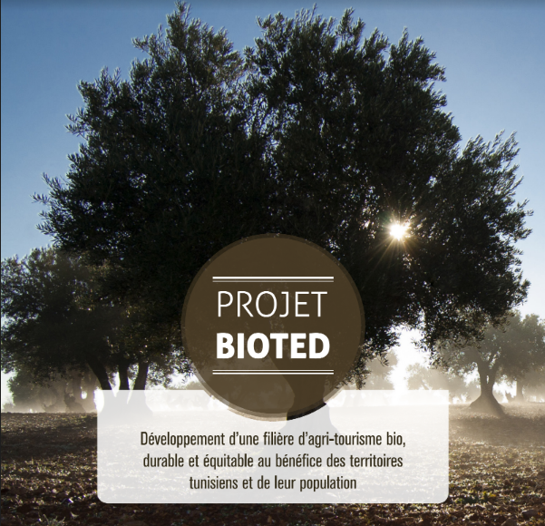
Presentation of a project you are working on 3/3
Bioted :Development of a sustainable and equitable Ecotourism for the benefit of Tunisian populations
The creation of a new private-public governance structure that will have
aim to bring toghether 700 actors in the agri-tourism and eco-tourism sector in mountains by 2023;
Training of trainers of rural eco-advisers and coaching of project makers, to raise the capacity of the sector;
The financing of pilot projects to be engines of inspiration to others.

Slide 9
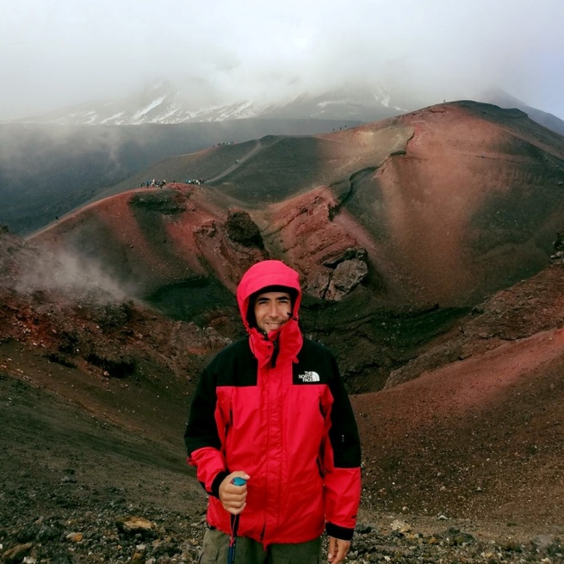
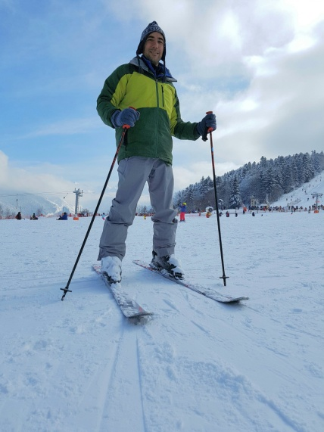
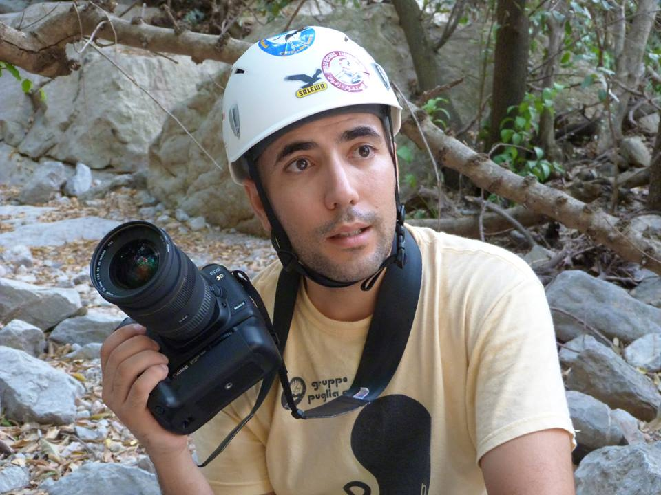
Thank you for your attention!

