Slide 1

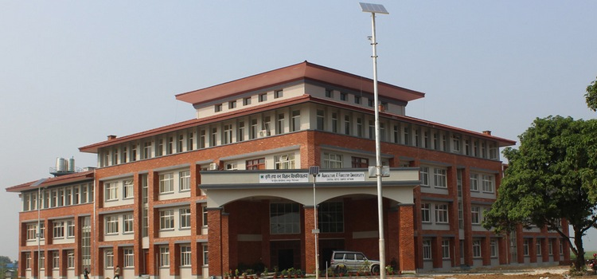
Nirajan Bhattarai, PhD
Associate Professor and Chairman
Department of Animal Breeding and Biotechnology
Faculty of Animal Science Veterinary Science and Fisheries
Agriculture and Forestry University
Bharatpur Metropolitan City- 15, Rampur, Chitwan, Nepal
E-mail: nbhattarai@afu.edu.np
IPROMO: Landscape approach for enhancing mountain resilience
Pieve Tesino /Ormea 02-18 July 2019

Slide 2
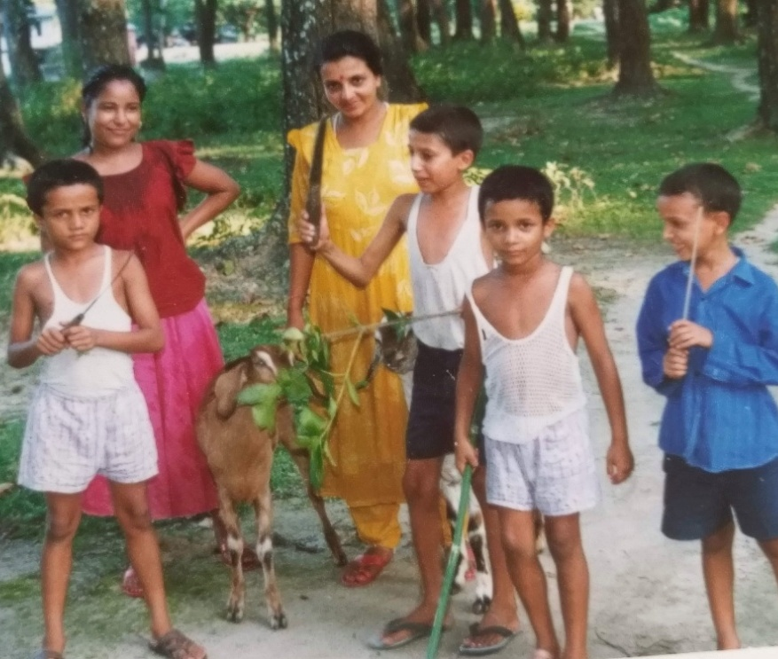
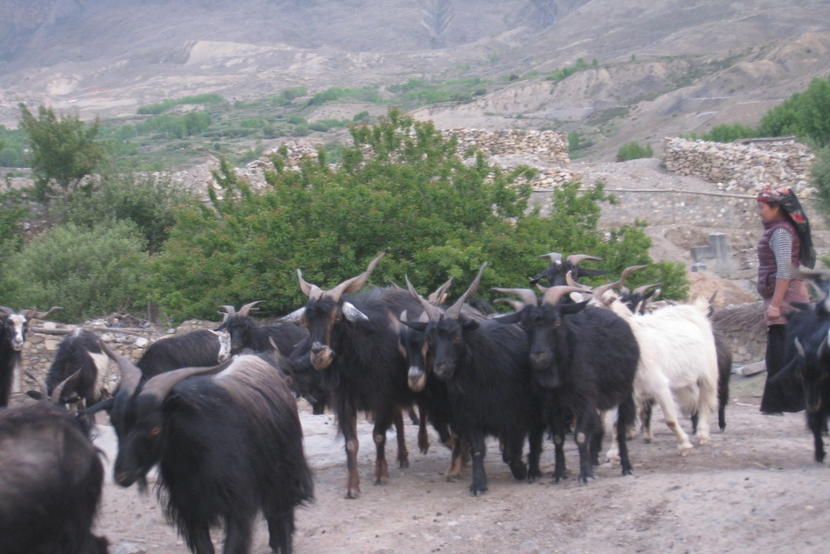
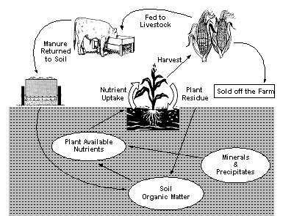
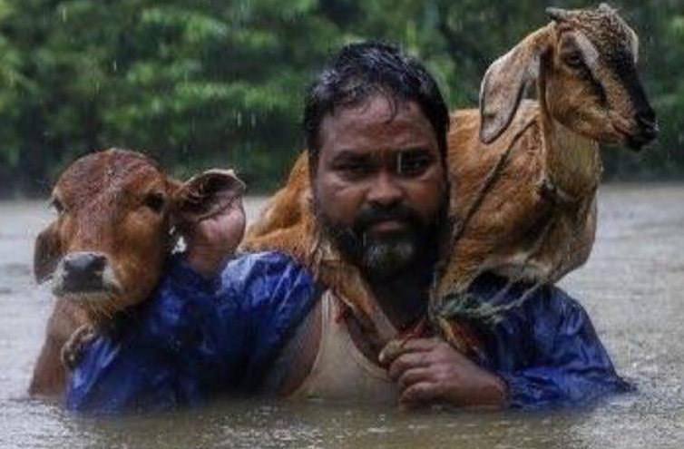


Slide 3
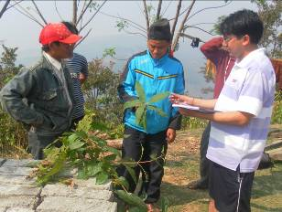
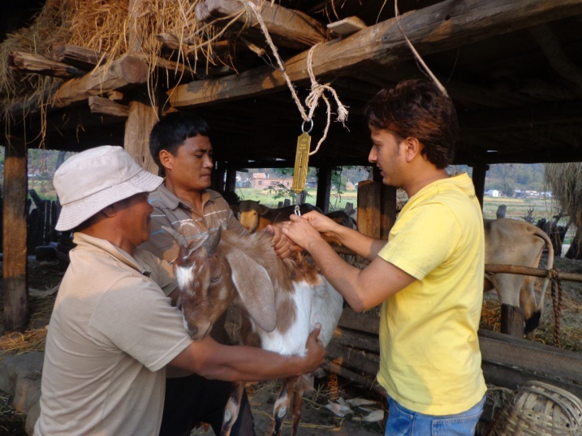
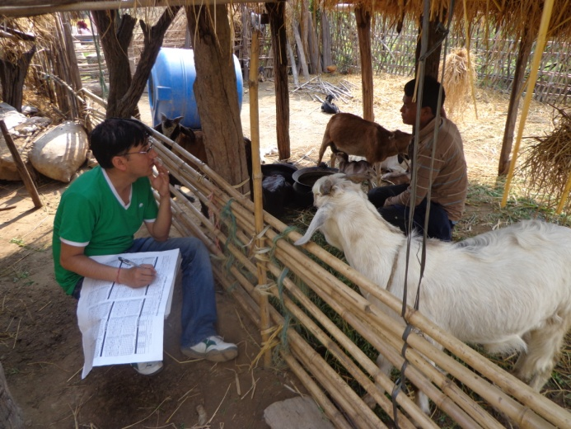
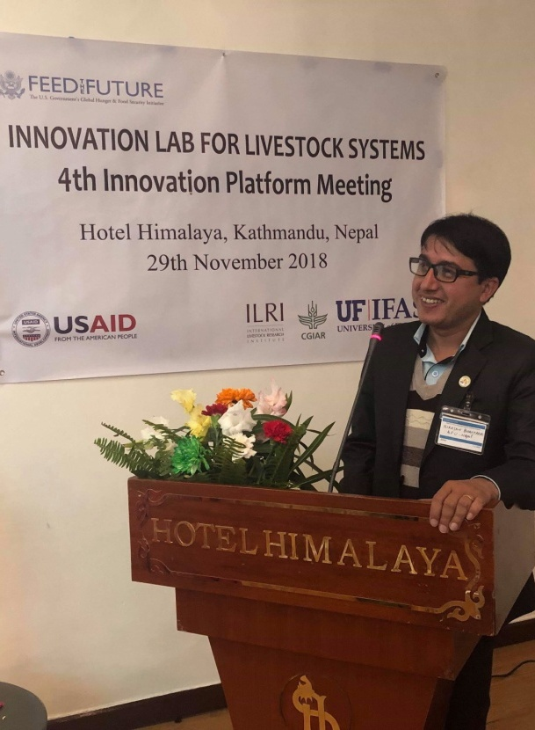
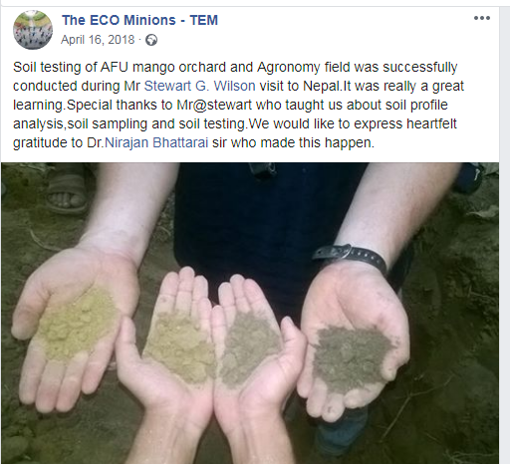
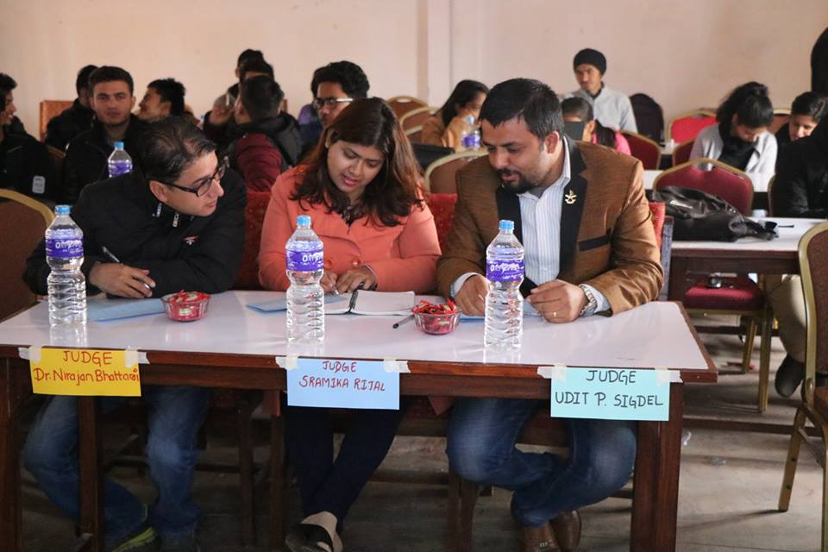
Education
PhD (Animal Breeding): 2017 [Tribhuvan University-TU, Nepal]
Employment and main activities

Slide 4


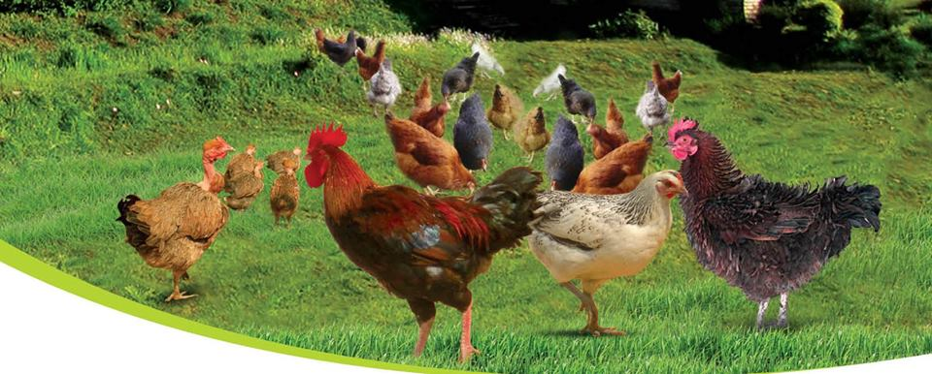
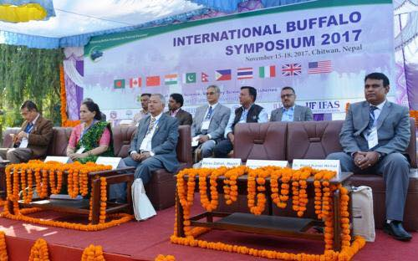
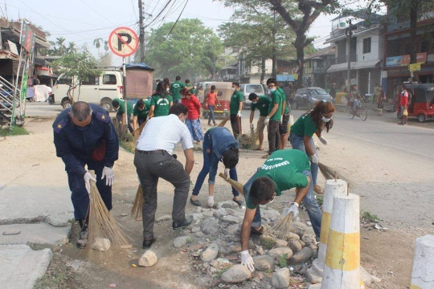
Other interests (Volunteer work, hobbies etc.)
Co-Secretary
Organizing committee member
Organizing Secretary

Slide 5
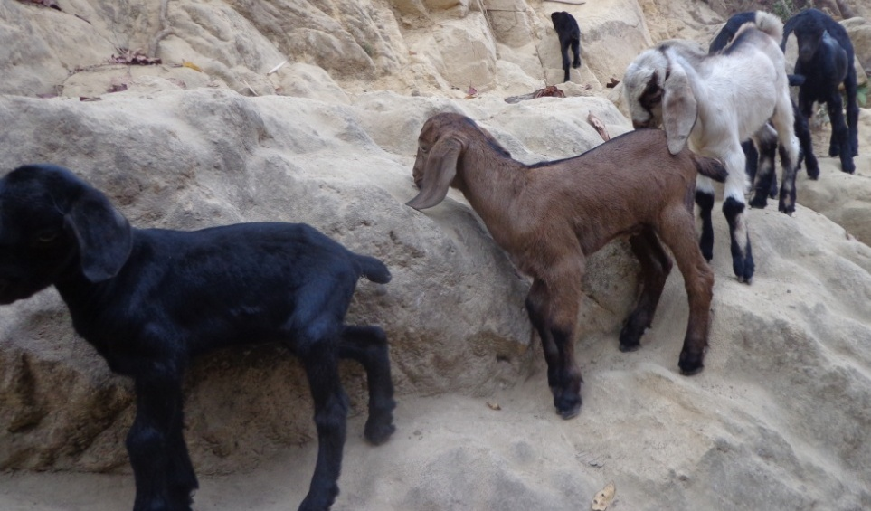
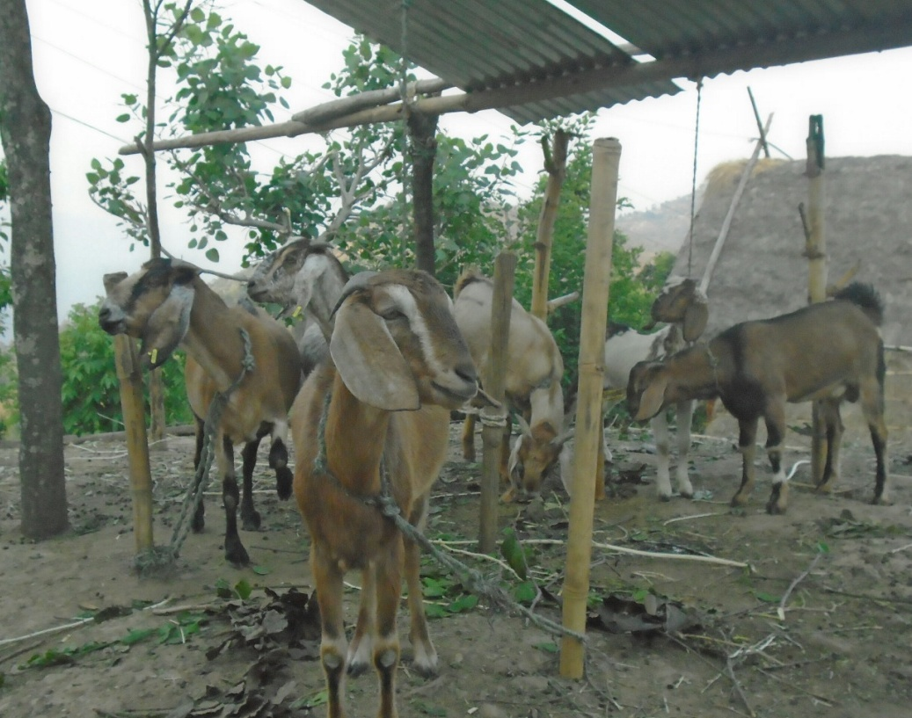
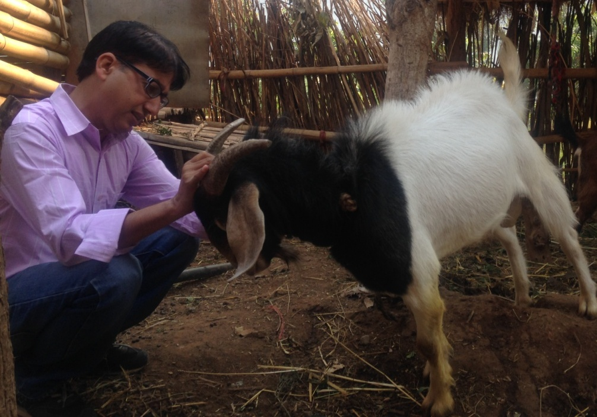
PHENOGENETIC EVALUATION OF CHITWAN LOCAL GOATS AND DEVELOPING A HIGH PERFORMING GOAT BREED AT AGRICULTURE AND FORESTRY UNIVERSITY, RAMPUR
Objectives:
The general objective of this study is to evaluate the Chitwan local goats phenologically and establish a high performing goat breed at AFU, Rampur.

Slide 6
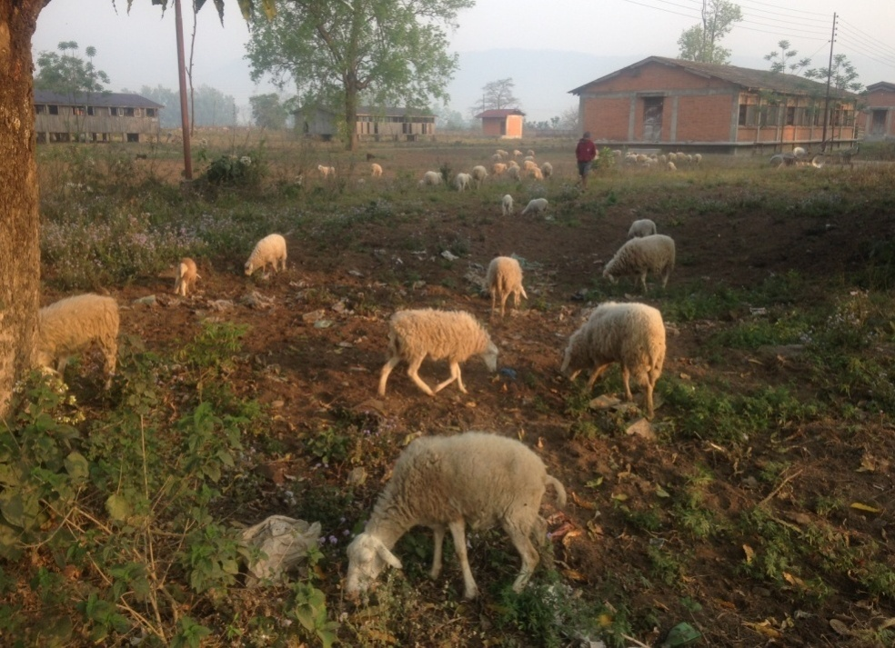
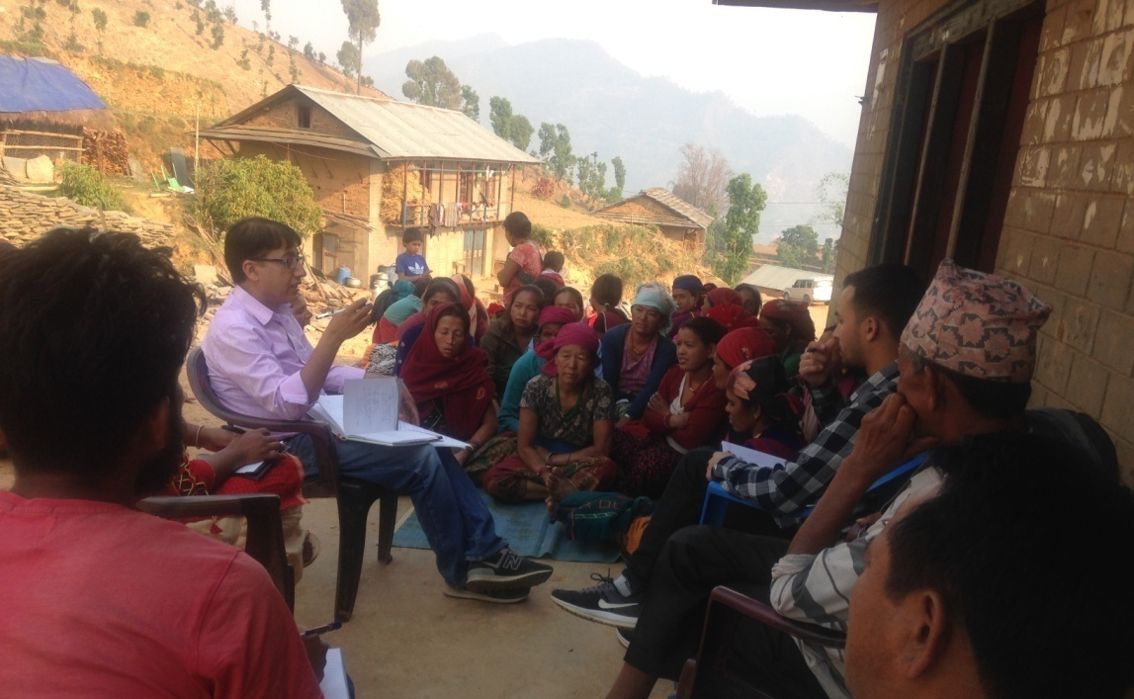
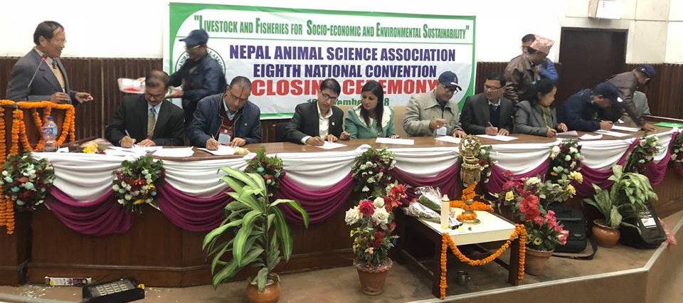

Slide 7
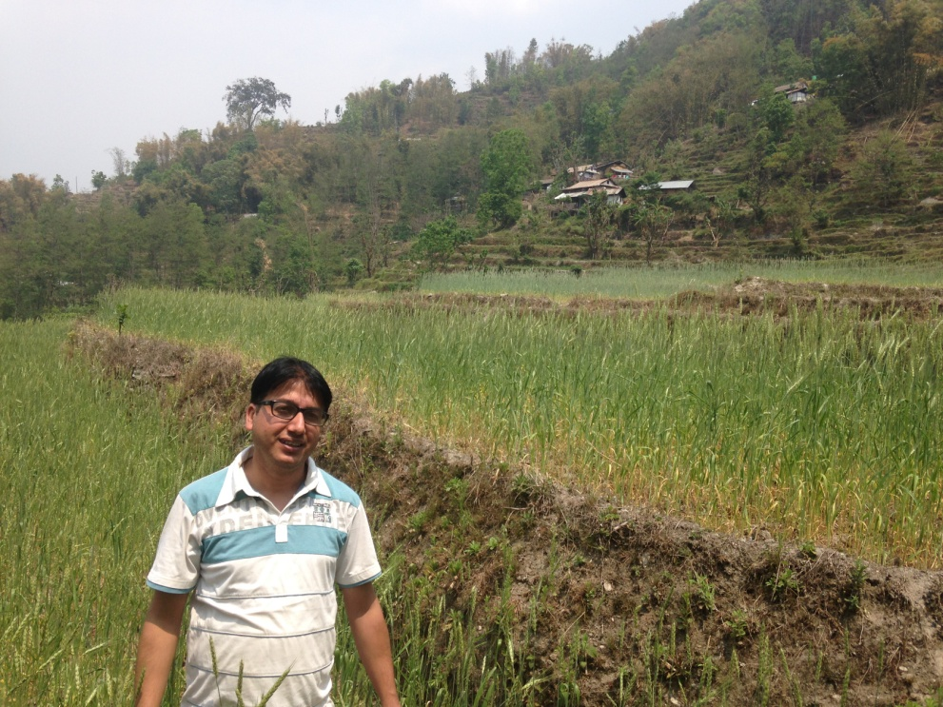
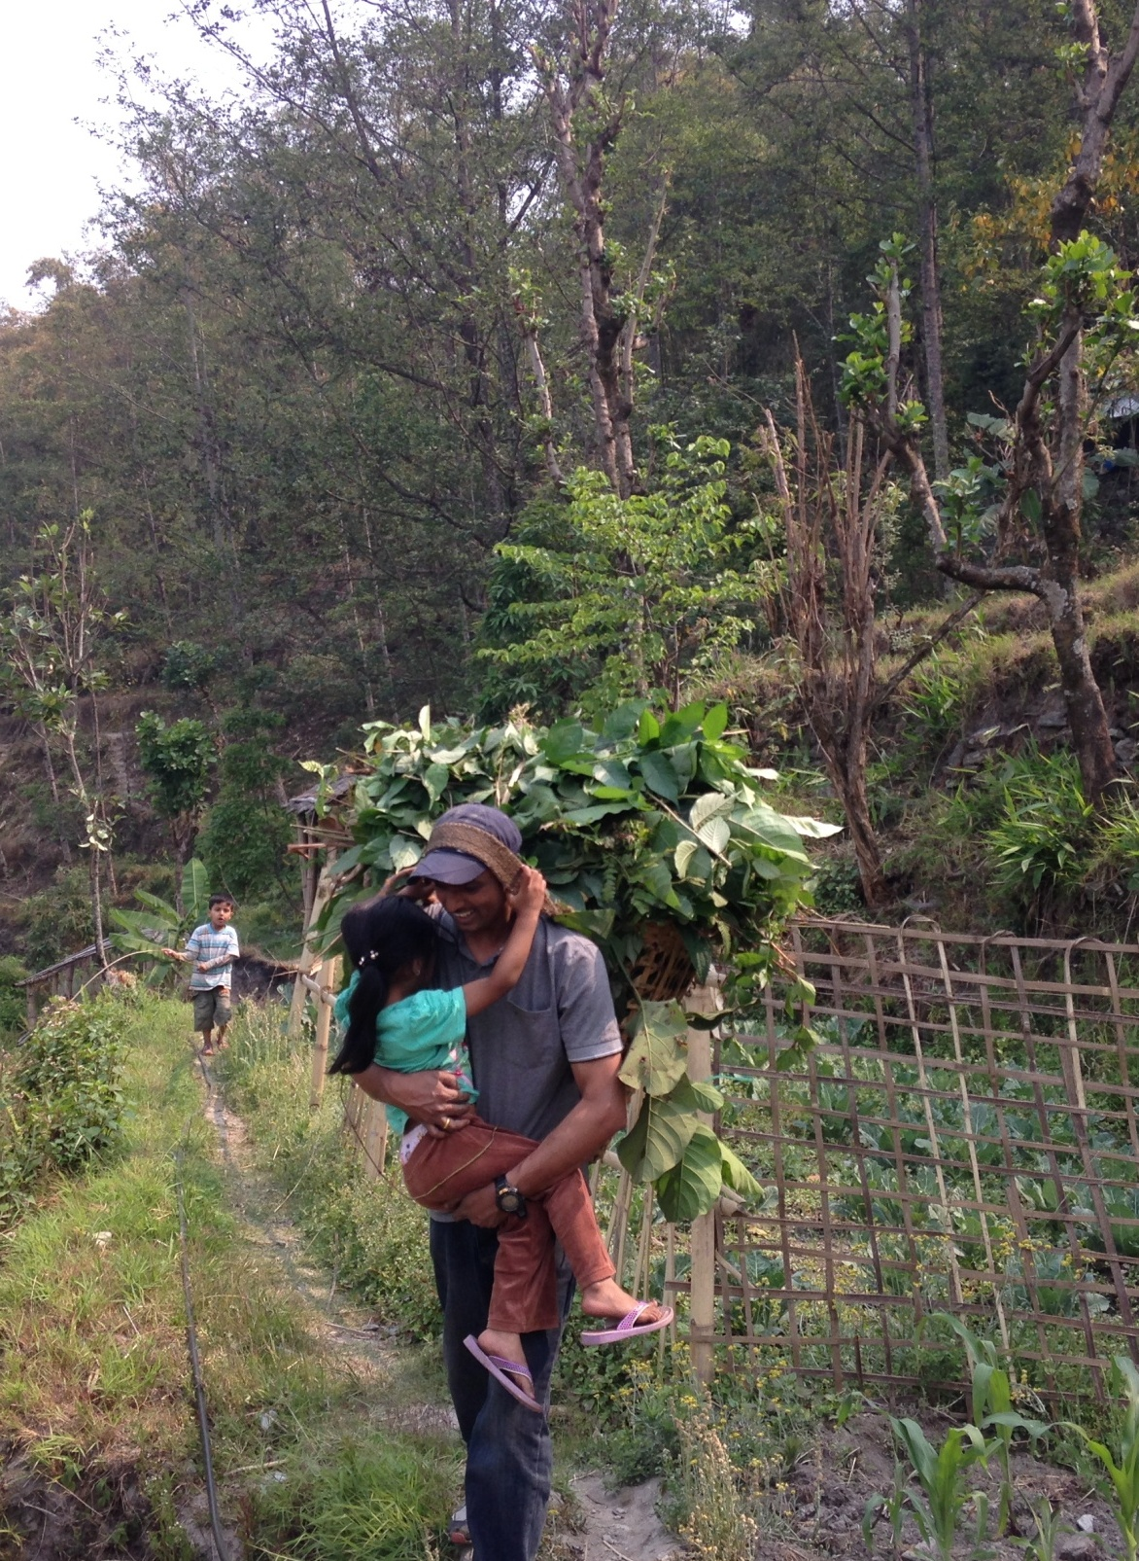
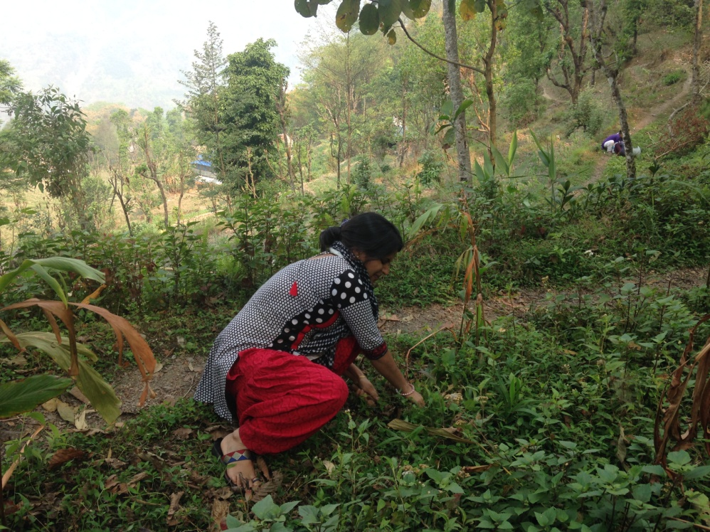
Thank for your attention !

