Slide 1
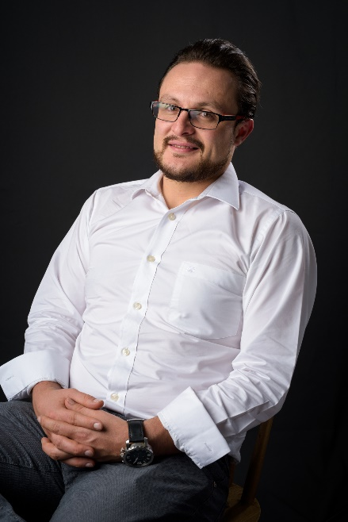
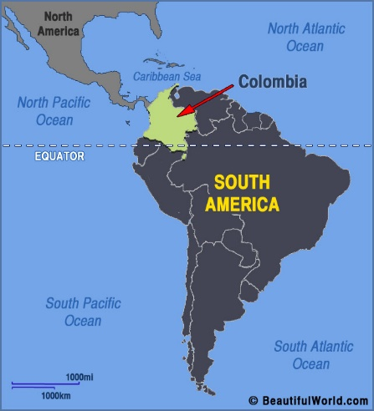

Personal presentation
OSCAR IVÁN GALVIS MORA - COLOMBIA
Climate Change Adaptation Specialist – Colombian Ministry of Mines and Energy
oigalvis@minenergia.gov.co
IPROMO
Landscape approach for enhancing mountain resilience
Pieve Tesino /Ormea 02-18 July 2019

Slide 2
Education
Bachelor: Civil Engineering – National University of Colombia
Master Degree: Civil Engineering for Risk Mitigation – Politecnico di Milano
Employment and main activities
Climate Change Adaptation Specialist of the Colombian Ministry of Mines and Energy: Support the implementation of the adaptation guidelines and strategies defined in the Integral Climate Change Management Plan of the mines and energy sector.
Coordinator of the «US in-Country» Program in Colombia of the NAP Global Network: Coordinator of all activities and strategies developed by the NAP Global Network in Colombia, related to the formulation and implementation of Integral Climate Change Management Plans.

Slide 3
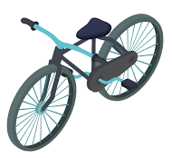


Other interests (volunteer work, hobbies etc.)
VOLUNTEER WORK:
Solid Waste Management: Active member of young communities that look for an innovative strategies to manage solid wastes on Bogotá-Colombia
Capacity building on local schools: Speaker on a series of conferences in local schools, where the main topic are the activities the children can make on their homes to help the environment.
HOBBIES:
As a transportation mode
When I have time
Just like a fan

Slide 4
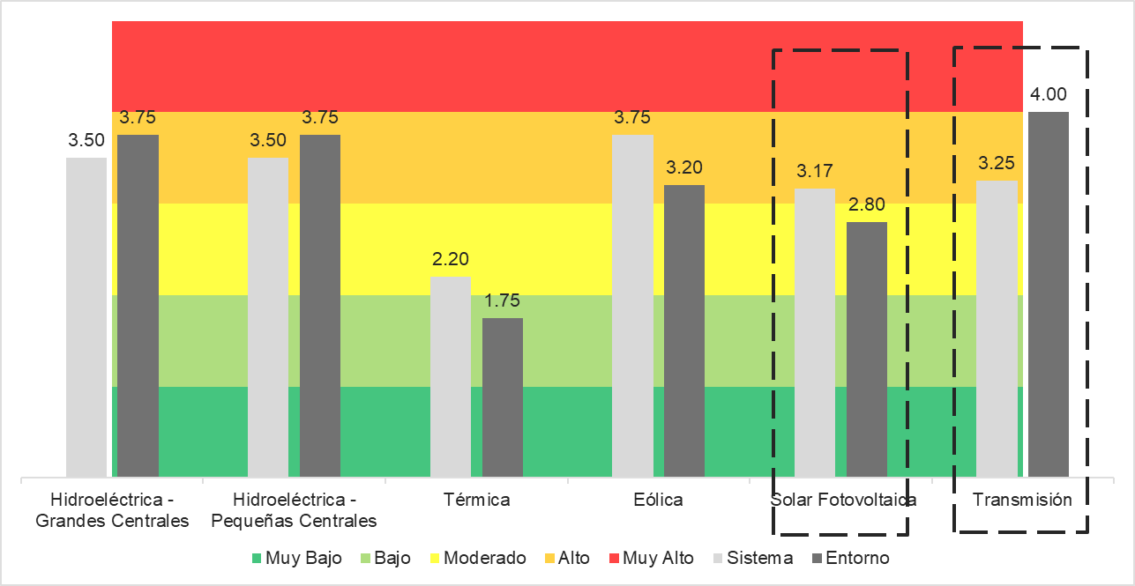


Presentation of a project you are working on 1/3
Development of a Climate Risk Assessment Methodology
Very High
High
Moderate
Climate Risk Assessment for the three sectors: Power, Oil & Gas, Mining
Low
Very Low
Hydropower plants
Small Hydropower plants
Thermal plants
Eolic plants
Solar plants
Transmission
System
As main result
Environment
Even that the sector infrastructure is vulnerable to the changing climate patterns, the indirect impacts due to the possible affectations on the surrounding environment, pointed out the necessity to improve the environment resilience in order to reduce the sector’s vulnerability

Slide 5
Presentation of a project you are working on 2/3
ECOSYSTEM BASED ADAPTATION
Dependency on Natural Reources
Bioengineering: Green structures to reduce the sediment production on the hydropower plant’s catchments.
Measures to improve the manage the produced water within an oil and gas exploration process.
Measures to improve the environment response during a drought, in order to assure the water availabiluty for the energetics generation.
Physical and Economic Vulnerability
Sector Climate Resilience
Impacts on bioduversity
TECHNOLOGY BASED ADAPTATION: Early warning System to face climate risk. It is the base of the M&E system for the mines and energy sector

Slide 6





Presentation of a project you are working on 3/3
Support on the formulation of the Adaptation component of the Integral Climate Change Management Plan
Housing Sector
Design and implementation of an Early Warning System for the Water and Sanitation sector to face climate change
Water and Sanitation Sector
Industry Sector
Health Sector
Transportation Sector
Defiition of the climate change related needs
Definitipn of the Problem and Solution tres
Definition of Adaptation Goals (mid and long term)
Definition of Adaptation Indicators
Baseline
Definition of Adaptation measures portfolio
Measures’ Technical and Financial structuring

Slide 7
Thank for your attention!
Hope to be a great colleage for this course and all your work back in home.

