Slide 1
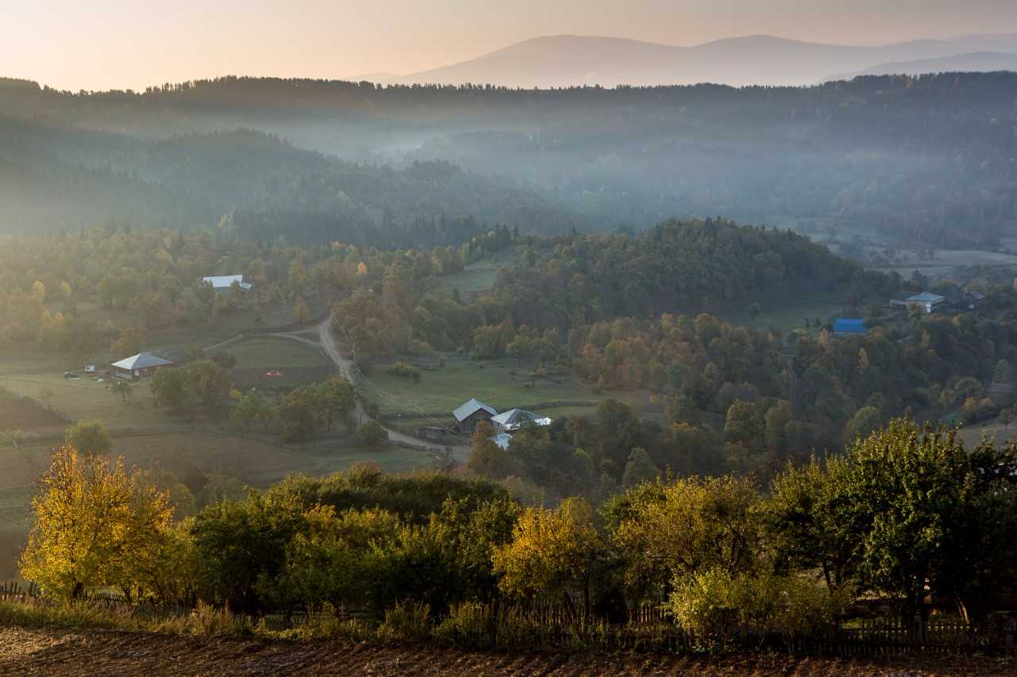
Rusudan-Tata Chochua
Eco-Corridors Programme in the Southern Caucasus
Partnership for Living Landscapes
tatachochua@yahoo.com; rusudan.chochua@gopa.de
IPROMO
Landscape approach for enhancing mountain resilience
Pieve Tesino /Ormea 02-18 July 2019

Slide 2
Education
PHD Study
2009 – MSc, Ivane Javakhishvili Tbilisi State University, Faculty of Exact and Natural Sciences, Department of Regional Geography and Landscape Planning, Geography
2006 - BSc, Ivane Javakhishvili Tbilisi State University, Faculty of Exact and Natural Sciences, Biology
Different international Seminars and Training
Employment and main activities
National Coordinator, Eco Corridors Programme in the Southern Caucasus (BMZ/KfW/WWF/GOPA GERMANY/DFS,HessenForst)
Advisor to Executive Director in Environmental issues/leading of Environmental and Social Safeguards Unit, Municipal Development Fund/Ministry of Regional Development and Infrastructure of Georgia
National Coordinator, Transboundary Joint Secretariat for Nature Conservation in the Southern Caucasus (BMZ/KfW/AHT Group AG/REC Caucasus)
Landscape Planning and Infrastructure Specialist, Planning Unit of the Agency of Protected Areas Georgia/Ministry of Environment Protection
Department of Landscape Planning, Natural Resources and Expertise, Vakhushti Bagrationi Institute of Geography
Different Projects and assignments

Slide 3

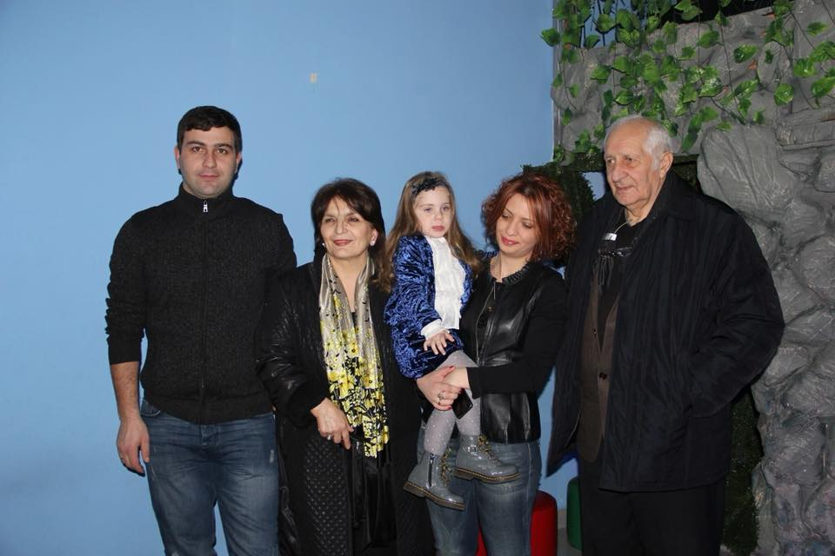
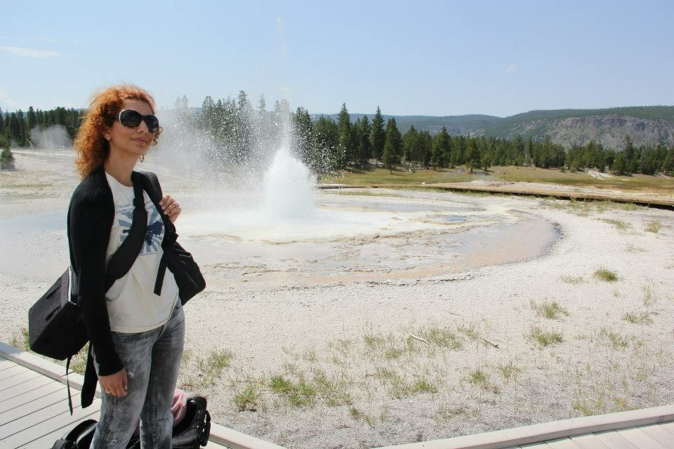
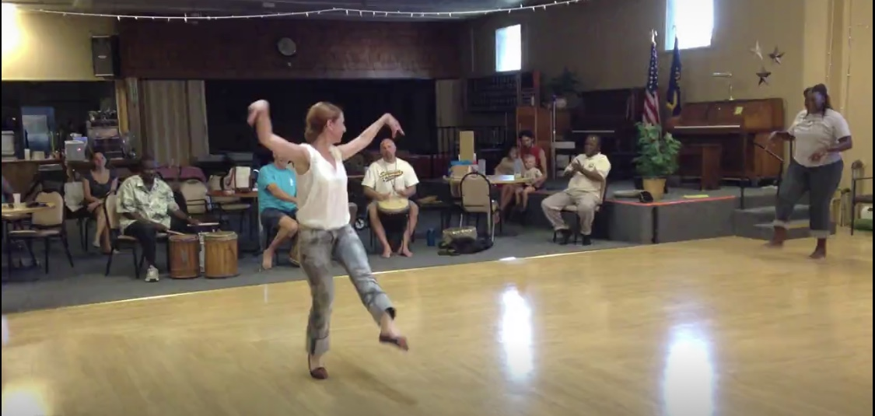
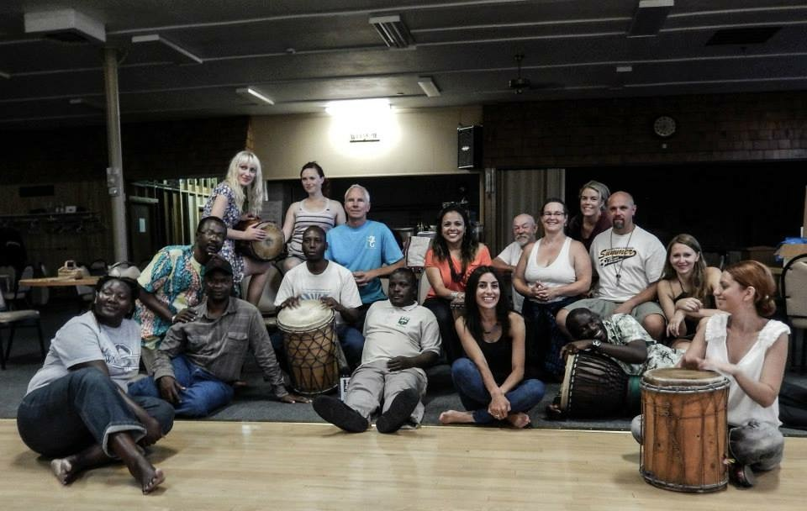
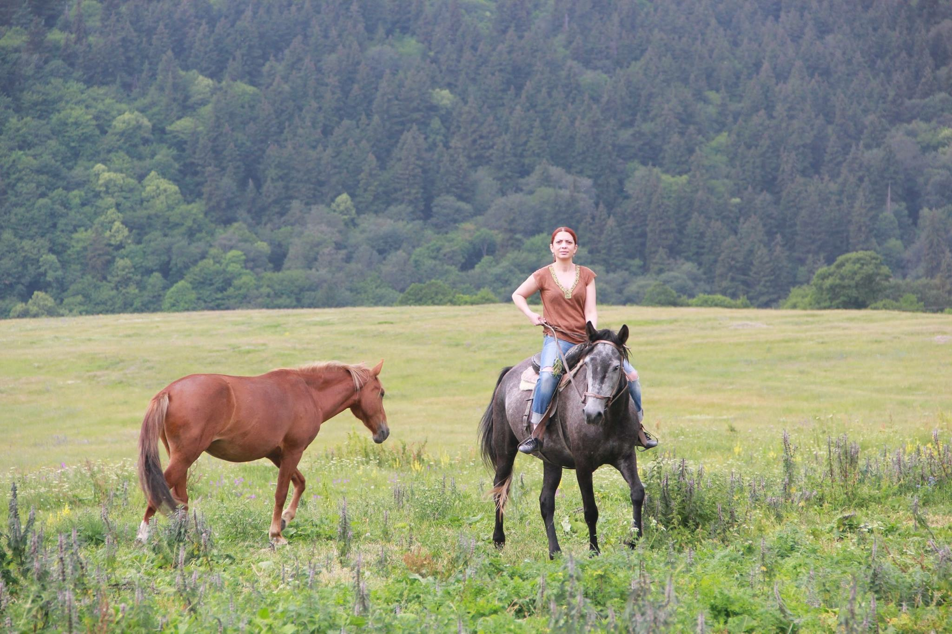

Other Activities and Interests

Slide 4
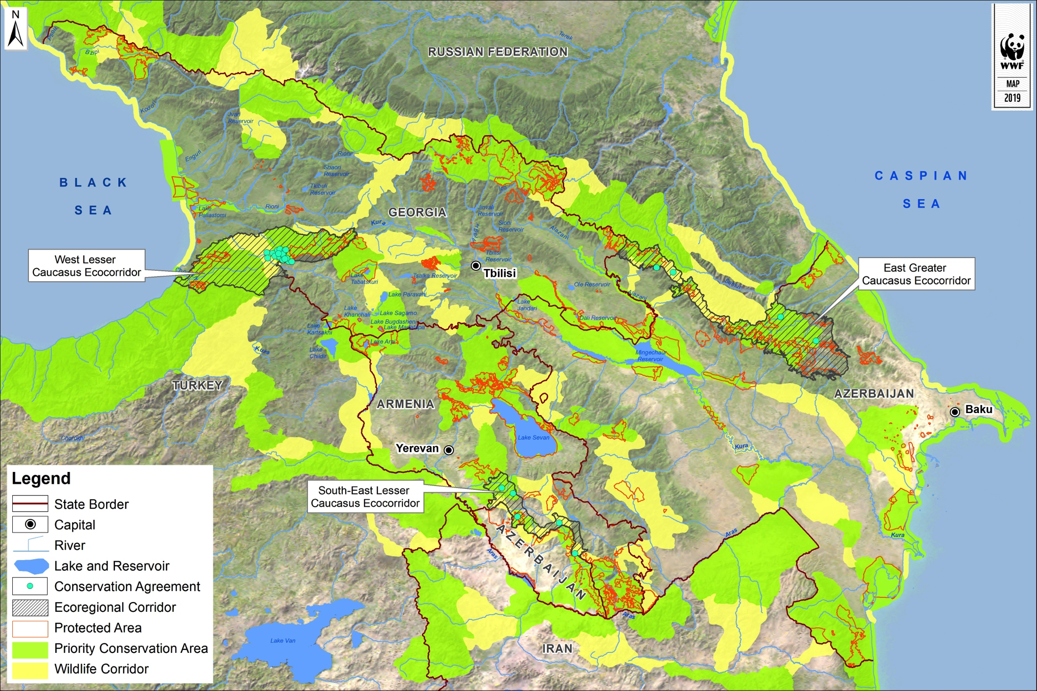
Eco-Corridor Programme in the Caucasus
Secure conservation and sustainable use of biodiversity in the ecological corridors in Armenia, Azerbaijan and Georgia
Secure at least equal income to the local rural population
Help the local rural population (beneficiaries) of selected eco-corridors to manage their land in an ecologically sound way
Establishing an “Ecoregional Corridor Fund” (ECF) as an instrument for promoting sustainable land use practices in ecological corridors

Slide 5




Living Landscape
Ecologically sound
(sustainable) land use
People
Common ground
ECF
Win-win solution

Slide 6
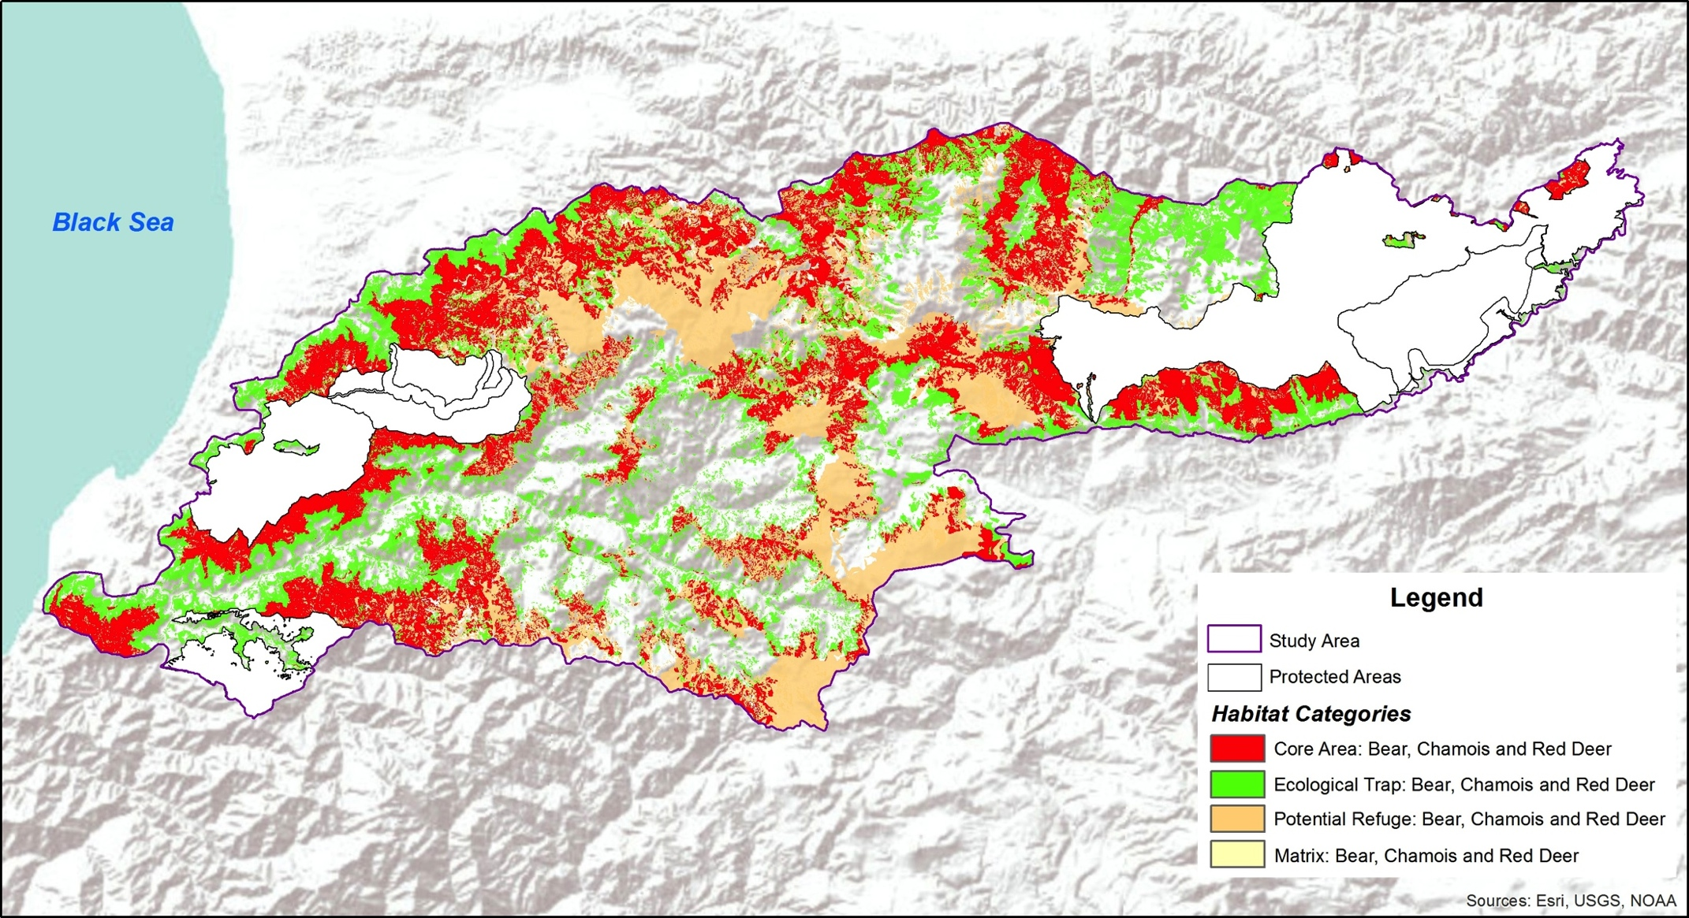
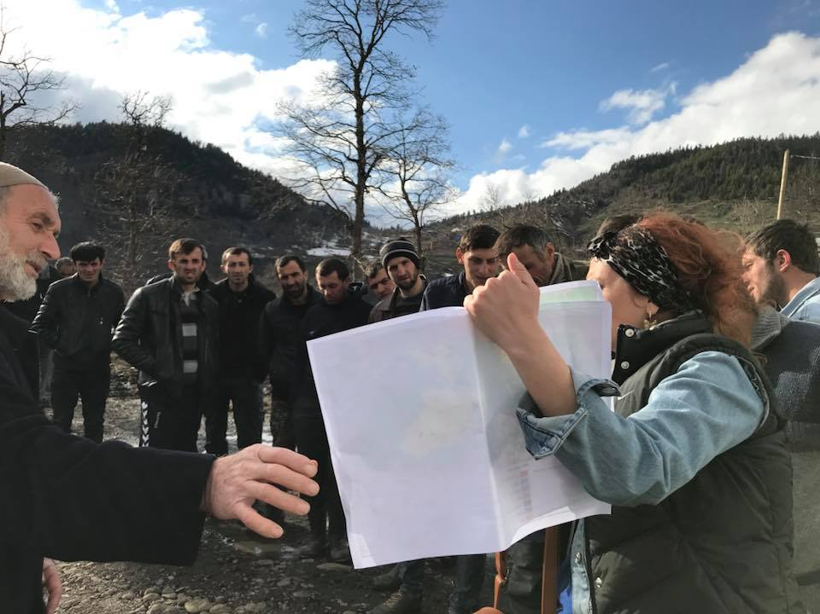
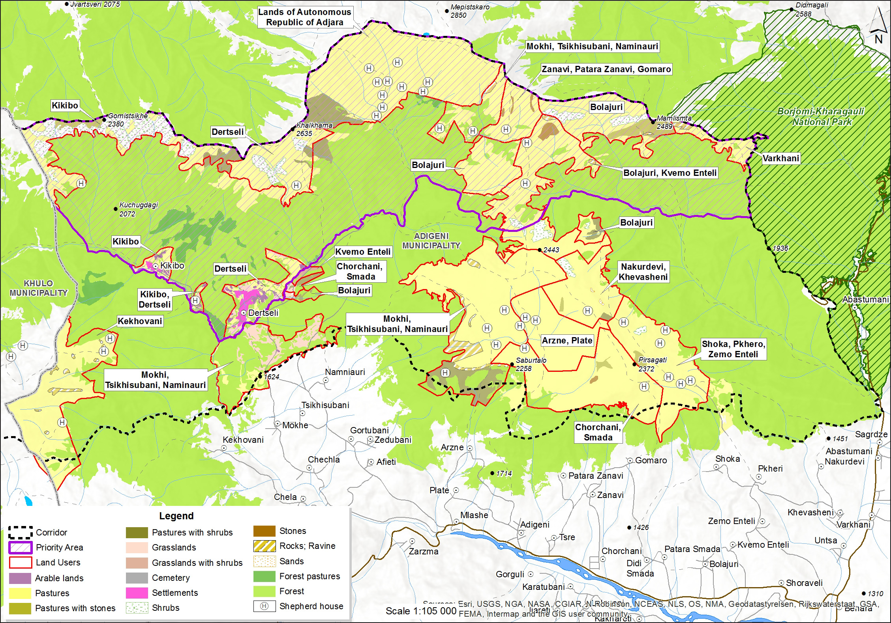
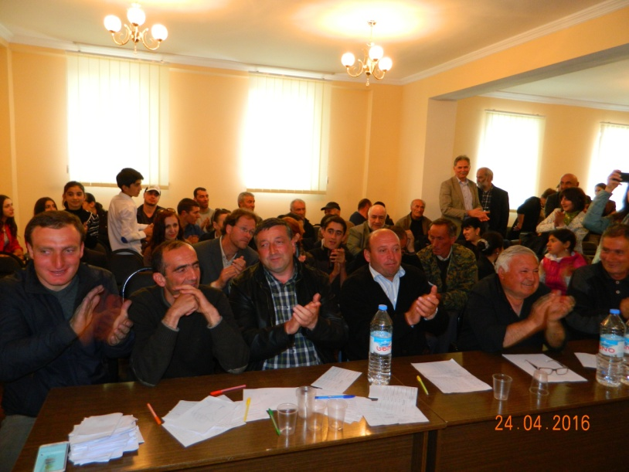
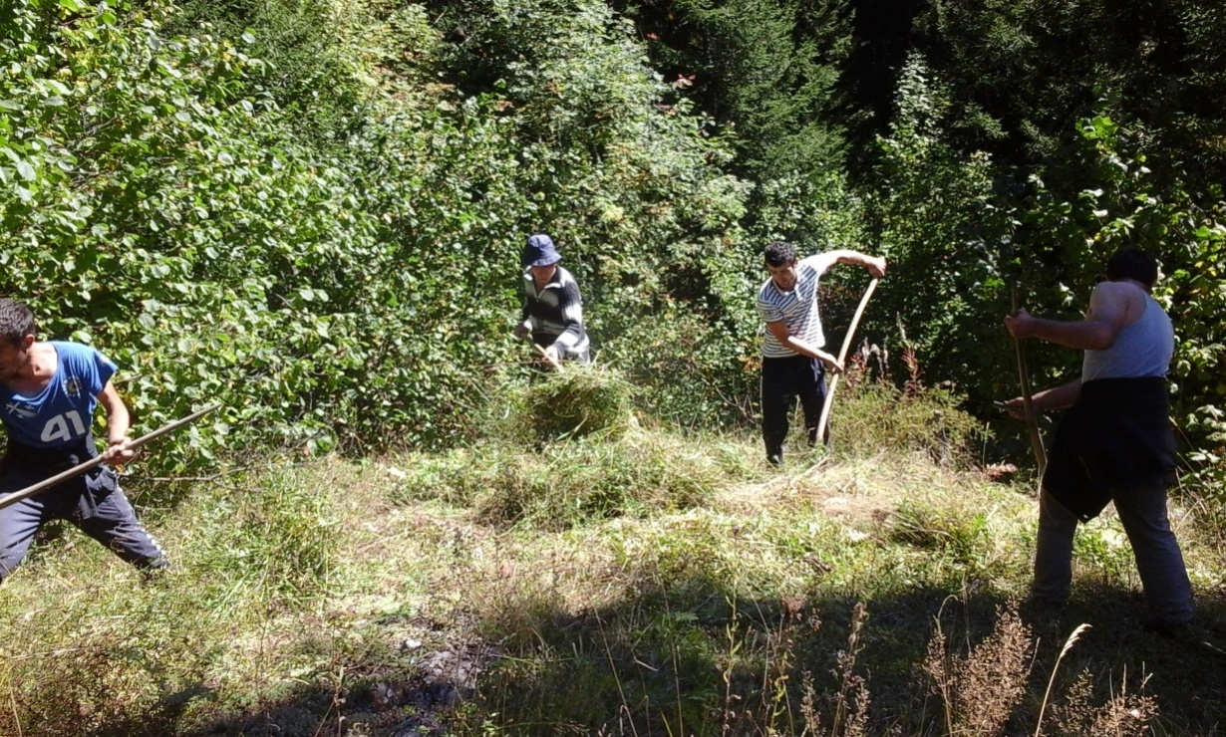
Delineation of habitats of key species and key biodiversity areas
Delineation and empower communities (trust-building measures, build the capacity to enter into conservation agreements)
Small Projects – Conservation of habitats of the target species and improving livelihood conditions (family, village, community level)

Slide 7
Menu of Conservation Measures
Win-Win Solutions for people and nature
I Habitat management
Core wildlife habitat zone with no use and restricted access
Pasture Management
High plant diversity meadows
Arable Land Production
Forest Management
Non-timber forest products regulation
Rehabilitation of habitat
Planting
High Value Landscape Element Conservation
Removing bottlenecks
II Conservation management
Caretakers (Community Rangers)
Land Tenure Rights
Compensation of damages by wild predators
Community Based Organisation
Community Conserved Area
Forest management plans
Pasture management plans
Wildlife management area (including hunting area)
Land use plans
III Socio and economic activities ( compensation)
Support social and economic activities of the local communities, directly not linked to habitat conservation that will generate new income and/or other benefits, equal or larger then the income and/or benefits arising from the land use to be discontinued to conservation agreement
Introduction of livestock solidarity fund

Slide 8
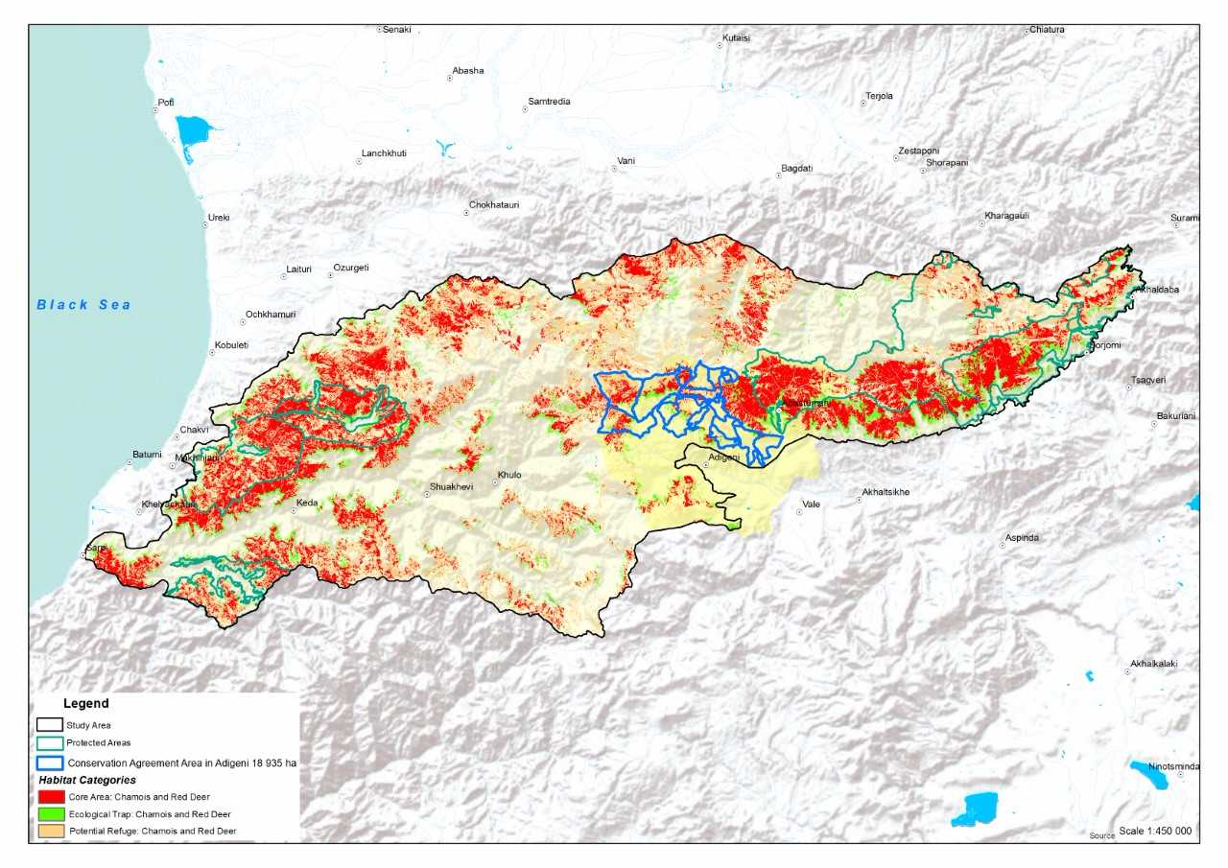
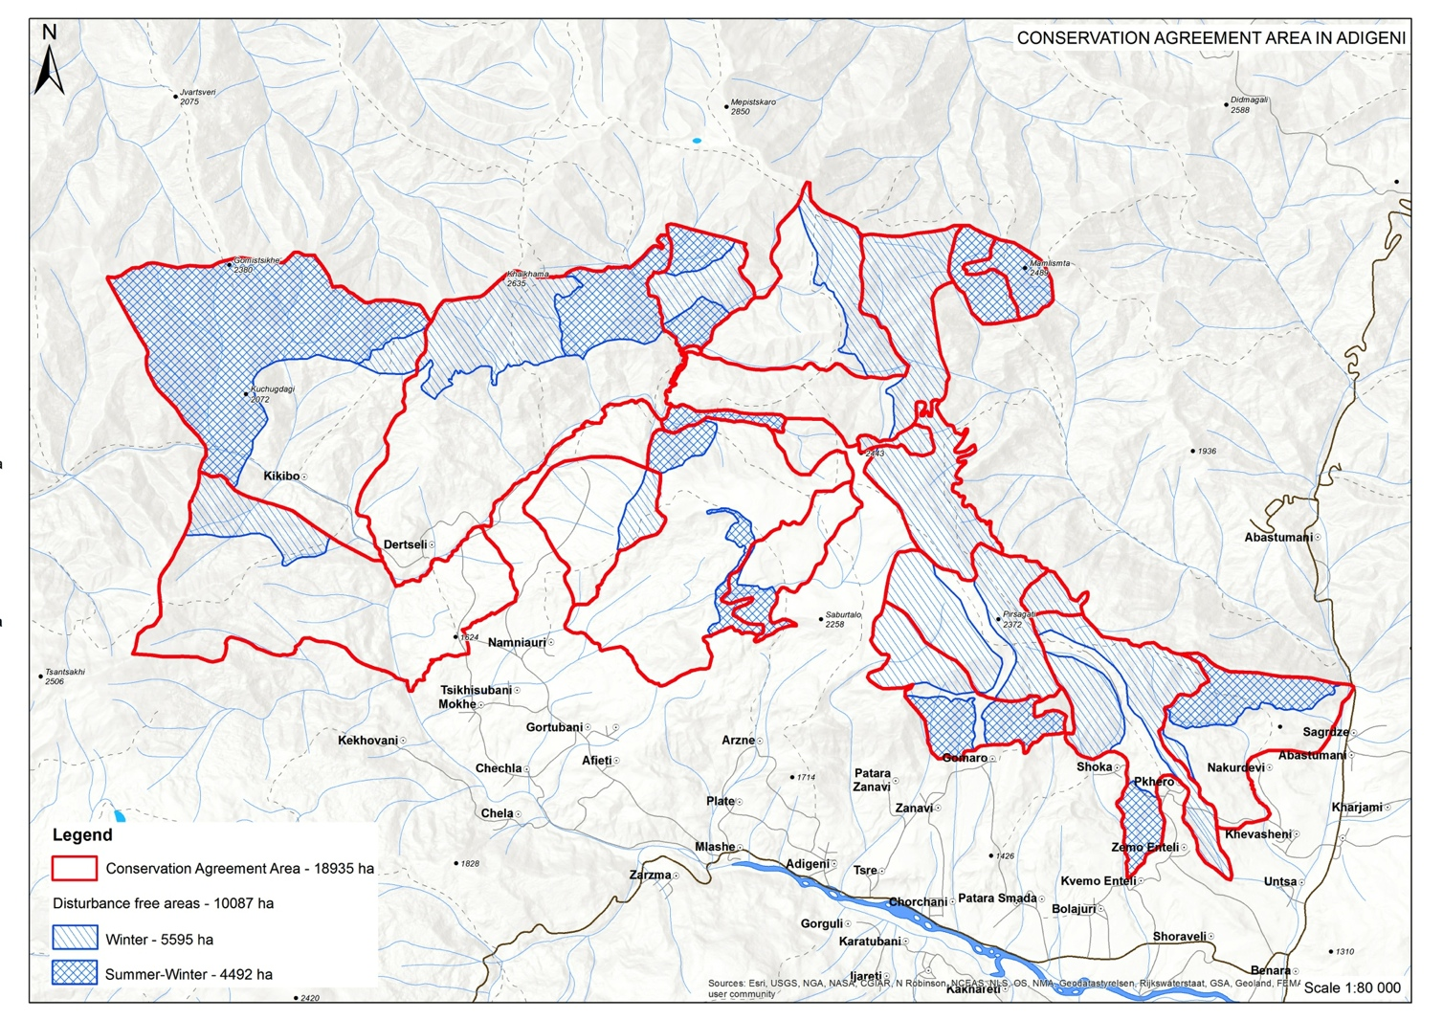
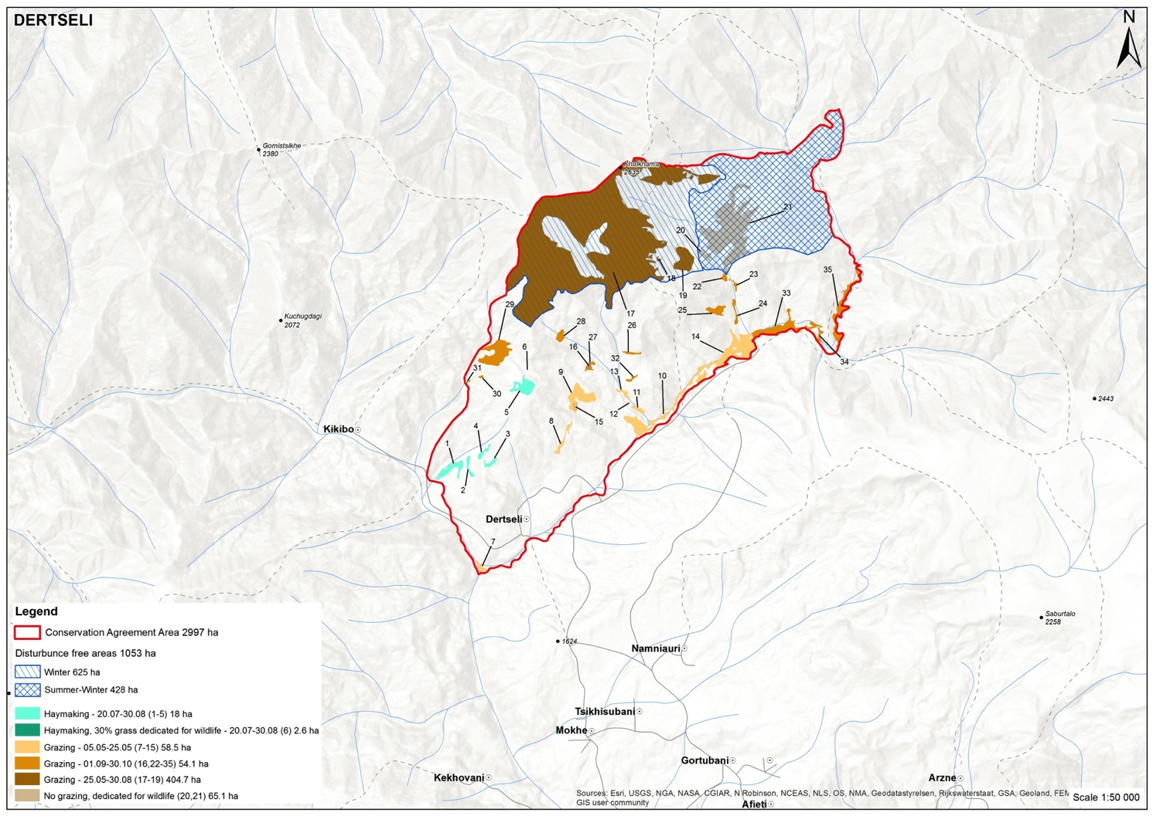
Long-term Conservation Agreements
Conservation Agreement Area – 20 297 ha
Core zone – 9 164 ha
Total budget for 10 years – around 1,150,900 EUR

Slide 9
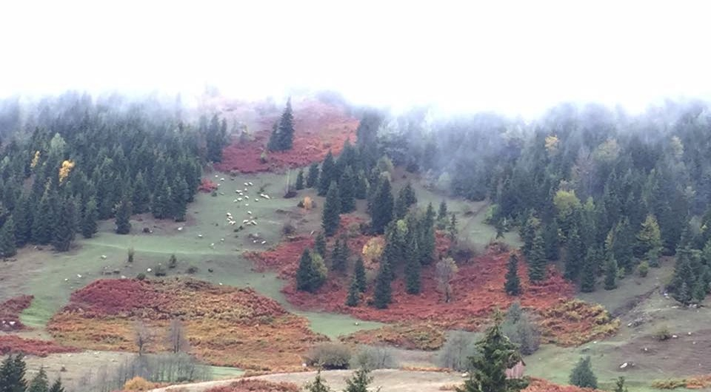
Thank for your attention!

