Slide 1
Personal presentation
Sebastián Seisdedos Morales
Head of Territorial and Heritage Management Unit
Ministry of National Assets | Goverment of Chile
sseisdedos@mbienes.cl / sseisded@uc.cl
IPROMO
Landscape approach for enhancing mountain resilience
Pieve Tesino /Ormea 02-18 July 2019

Slide 2
Education
Architect and Master of Architecture; Pontificia Universidad Católica de Chile (2007)
Postgraduate Diploma in «Cultural Landscapes, Heritage and Territorial Project, Universitat Politecnica de Catalunya» (2005)
PhD (c) in Urban Planning and Land Management (research phase), Universitat Politecnica de Catalunya (2009)
International course in «Territorial planning of sustainable development and the 2030 agenda» (2017), ILPES-ECLAC, United Nations.
Employment and main activities
Since 2012 public server and advisor in landuse planning and territorial management in Chile. Now working as head of territorial and heritage managment unit for Ministry of National Assets, managing 54% of Chile’s territory, majority mountain according to FAO. Former architect at Ministry of Energy, at Sustainable Development Division, leading regional energy plans. From 2004 consultant in landuse management, urban planning, urban design and heritage projects in Spain and Chile.
Researcher and proffessor at Pontificia Universidad Católica de Chile, Universidad Diego Portales, Universidad Autónoma de Chile and Universitad Católica de Temuco. Speaker and lecturer in Chile, Ecuador and Argentina.

Slide 3
Other interests (volunteer work, hobbies etc.)
My Family
Travel
Member of The International Commitee for Conservation of Industrial Heritage – TICCIH Chile
Member of College of Architects of Chile

Slide 4
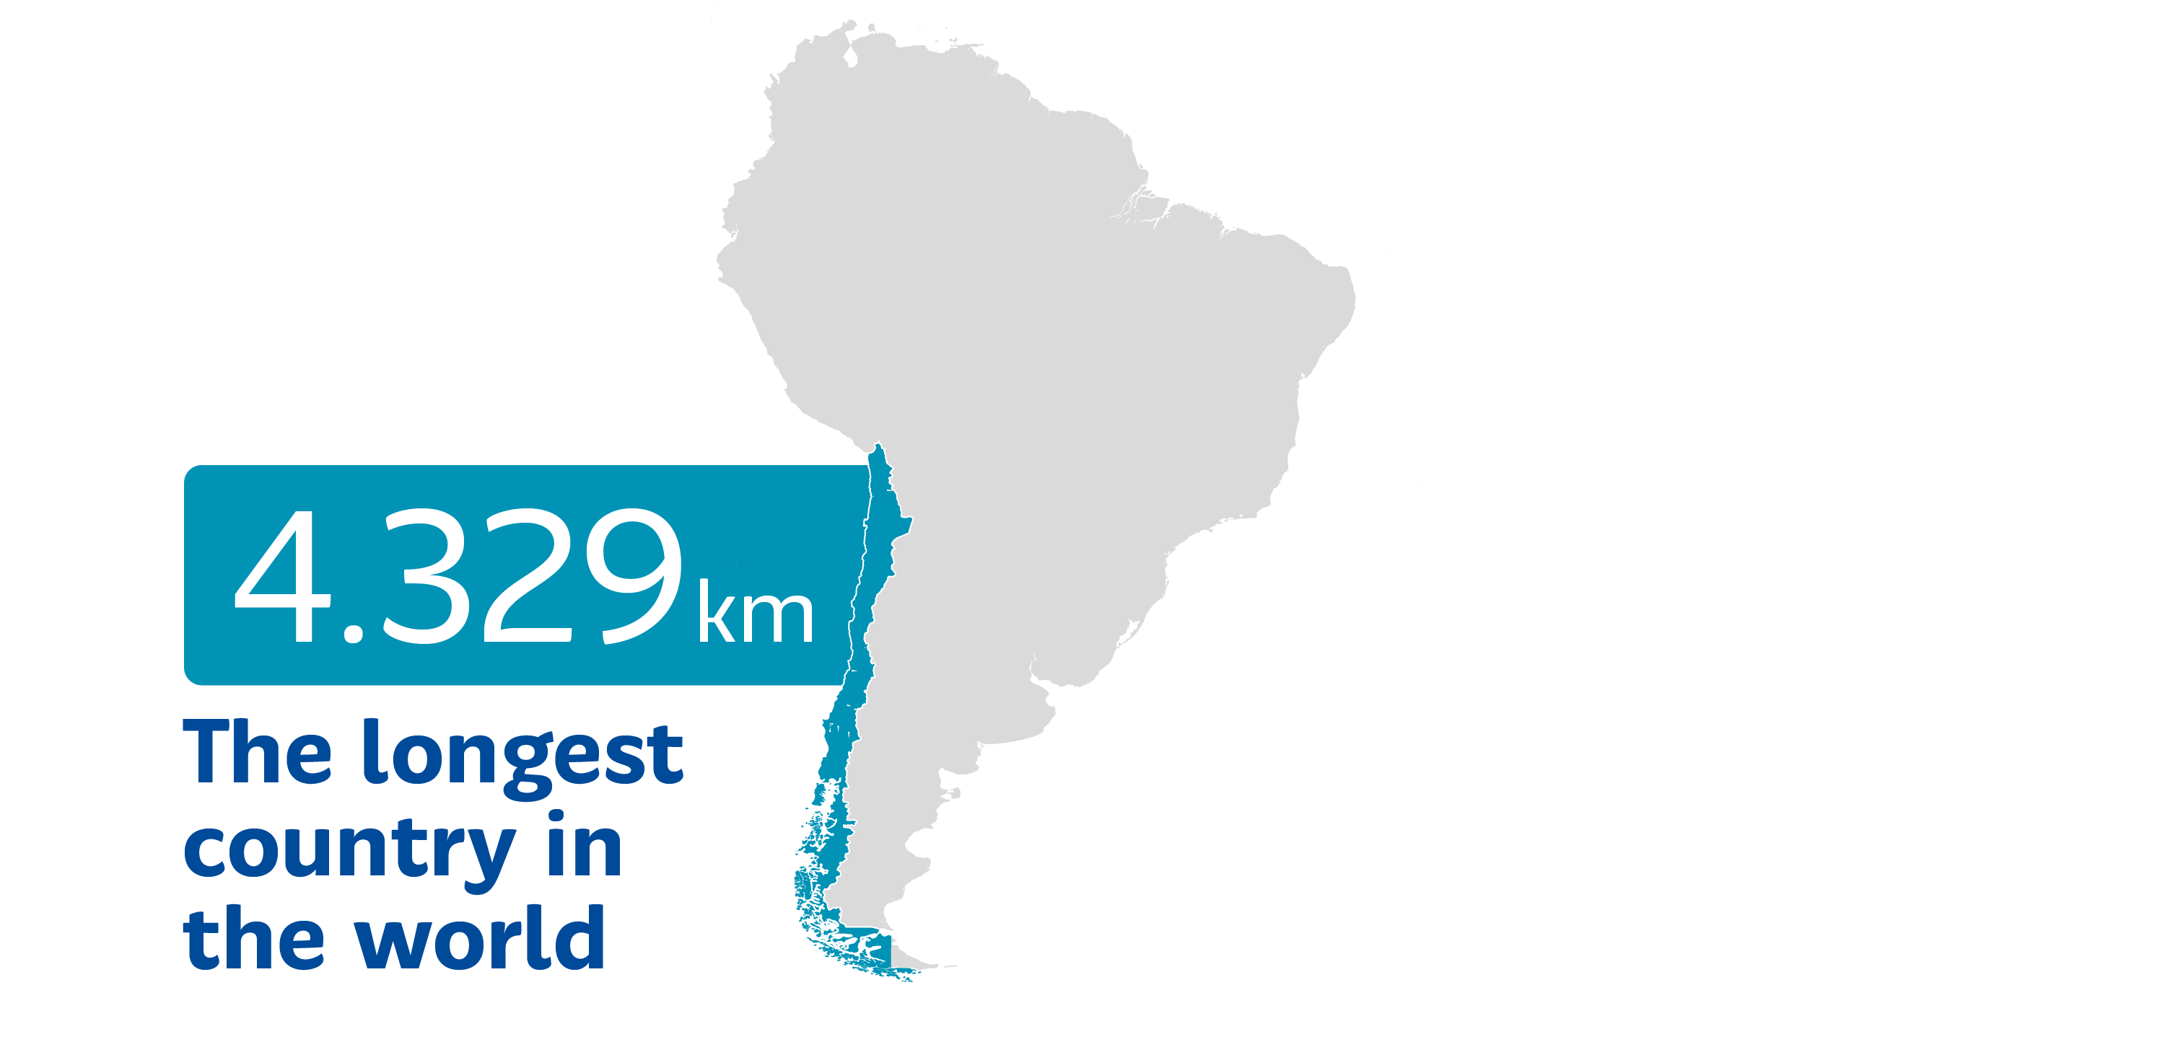
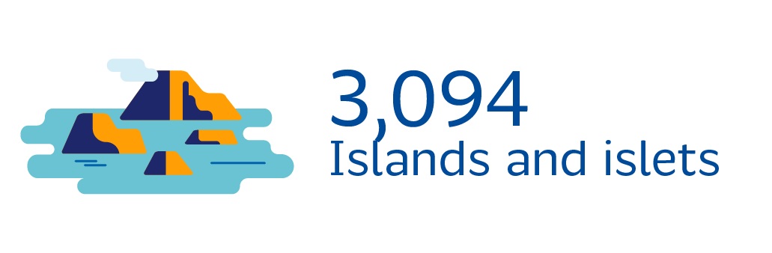
Chile
83.000 km
coastline including islands

Slide 5
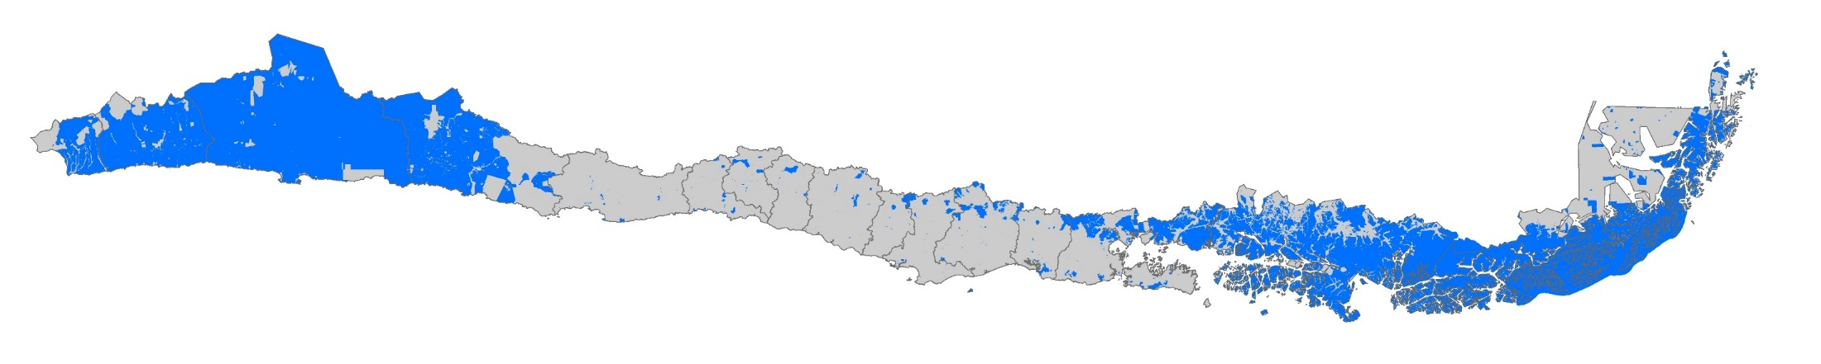
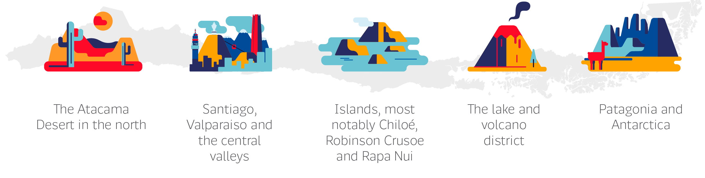
Chile, state owned territory
53,73% of the Chilean territory is state-owned
(40.621.285 hectares)
26,7 %
(20.205.976 hectares)
1,2 %
(933.049 hectares)
25,8 %
(19.482.260 hectares)
75.609.630 hectares (756.096,3 km2)

Slide 6
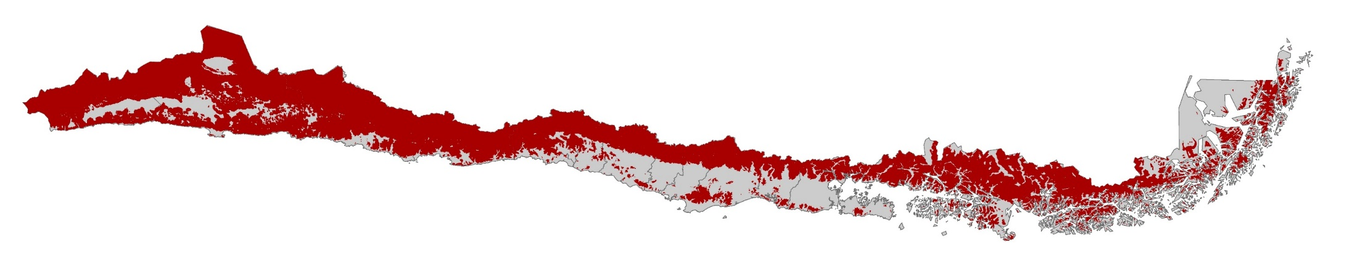
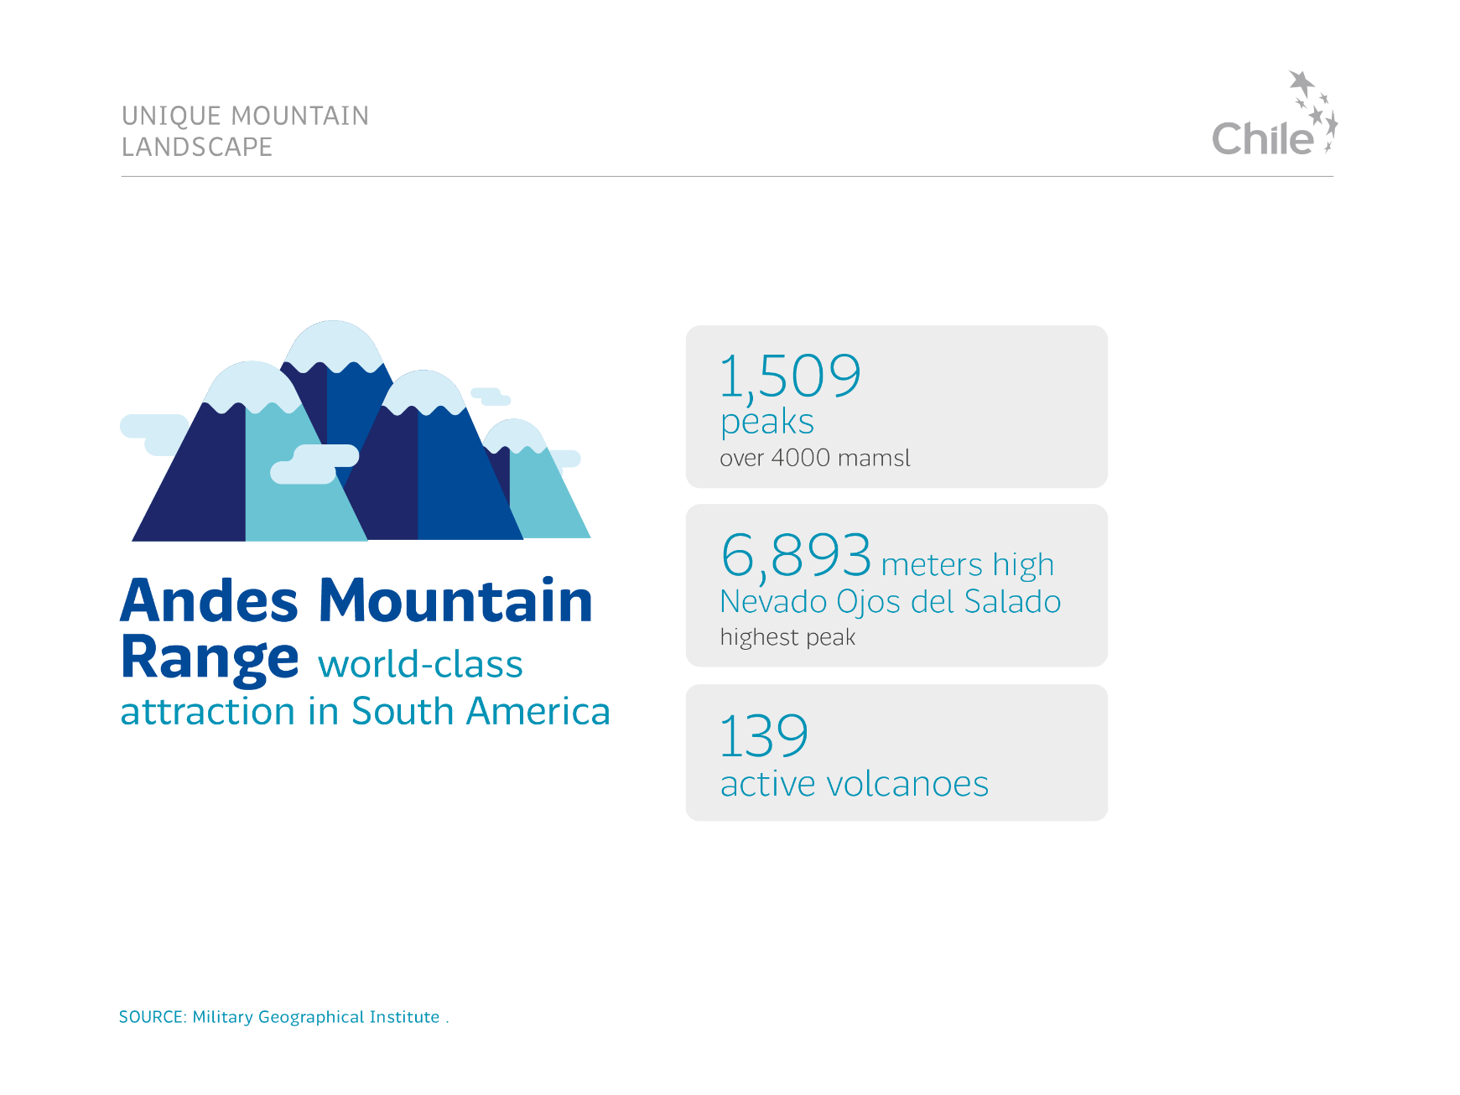
Chile, mountains country
63,2 % are mountains
(47.767.300 hectares)
37,9 % are state owned
(28.660.120 hercates)

Slide 7
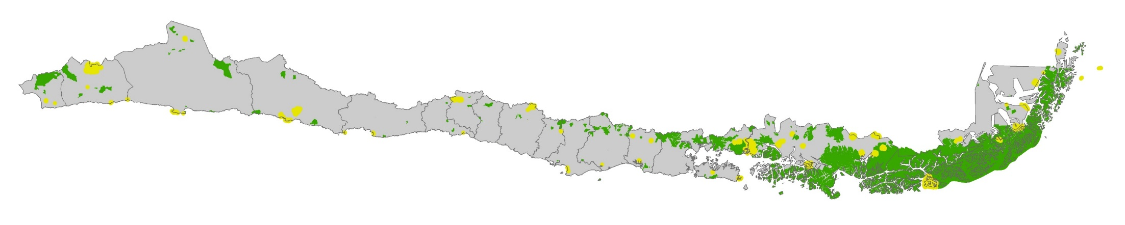
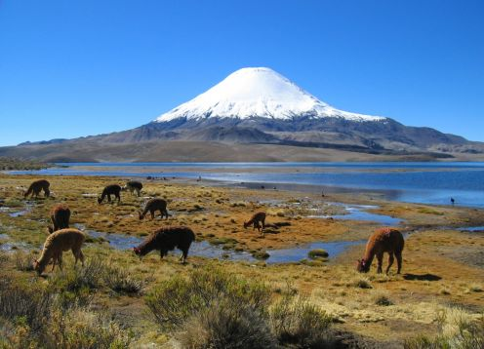
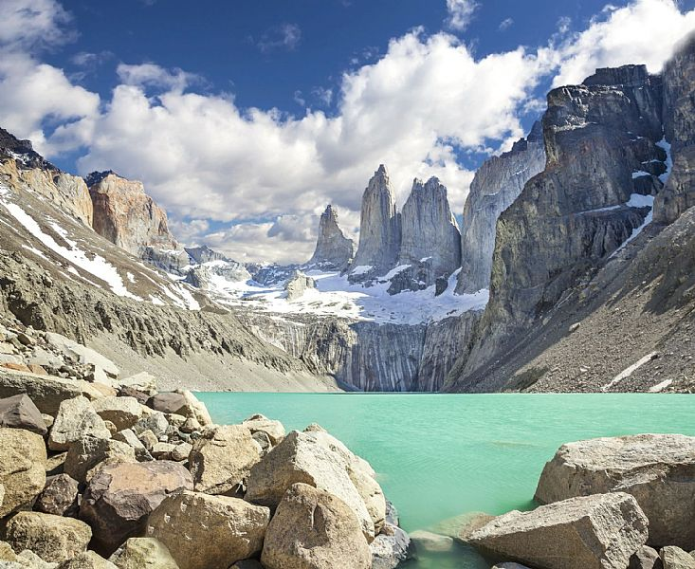
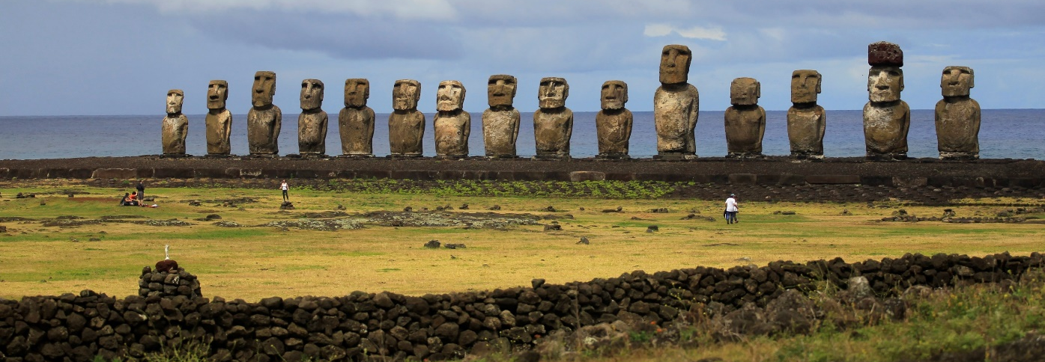
Chile, state protected areas
104 SNASPE
59 BNP
SNASPE
1,5 %
(1.170.480 hectares)
SNASPE
0,8 %
(578.970 hectares)
SNASPE
0,244 %
(184.783 hectares)
18,4 %
(13.923.380 hectares)
BNP
0,005 %
(38.393 hectares)
0,517 %
(390.768 hectares)
BNP
21,46 % of Chilean territory is protected
(15.672.830 hectares SNASPE + 613.944 hectares BNP)
BNP

Slide 8
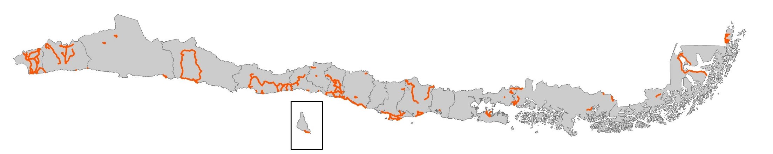


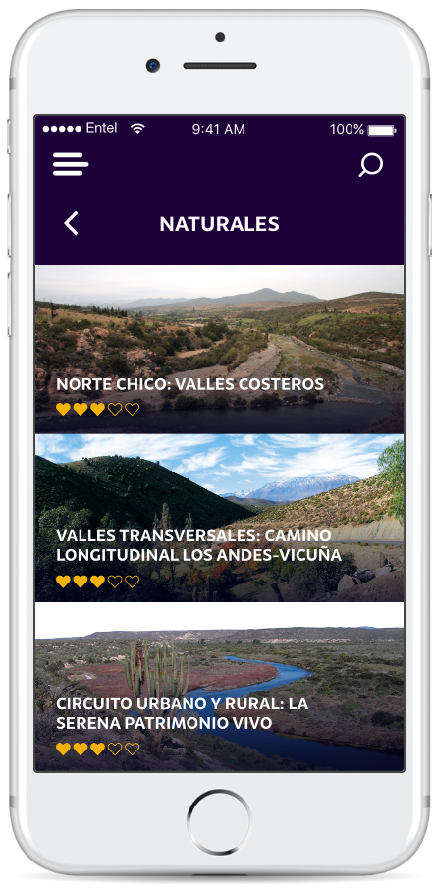
Chile, heritage routes
74 heritage routes
7.800 kilometers
1.600 heritage landmarks
205 municipalities
15 regions
Visit: rutas.bienes.cl
Notes:
Link a WEB en imágenes.
El programa de Rutas Patrimoniales del Ministerio de Bienes Nacionales busca poner en valor el patrimonio natural y cultural de Chile a través de recorridos gratuitos y autoguiados.
Este programa cumple este año 18 años desde su creación en el año 2001 cuando se creó la Ruta Patrimonial Dientes de Navarino, la ruta de treking más austral del Mundo.
Durante el año 2019 se relanzará la APP RutasPatrimoniales, donde se podrá encontrar información sobre las Rutas Patrimoniales, sus hitos naturales y cultuales y los servicios turísticos asociados a ellas.

Slide 9
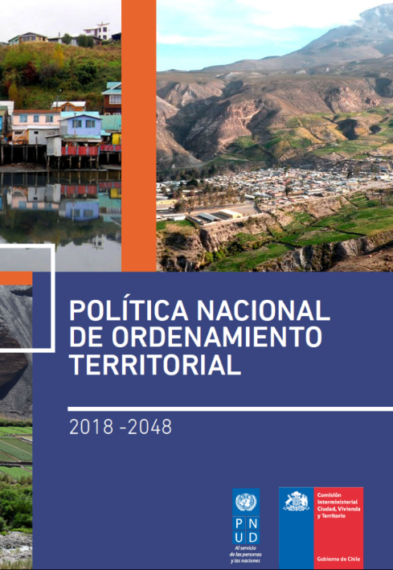
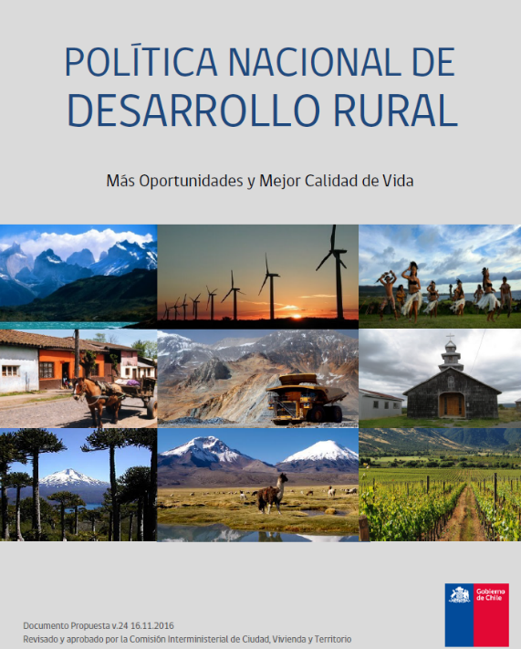
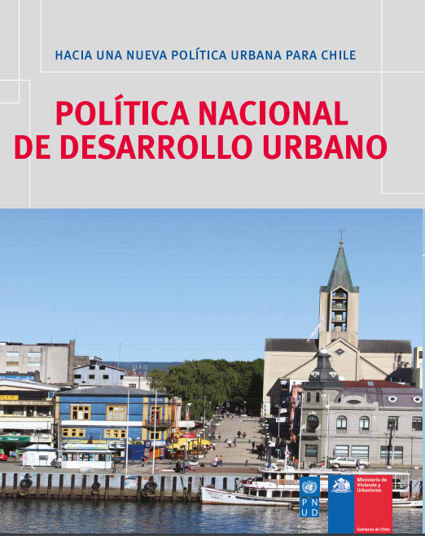

Chile’s first territorial policies for landmanagment, urban development and rural development in only last five years.
Las políticas territoriales (PNOT, PNDR y PNDU) y algunas políticas sectoriales (PEN) consideran con especial énfasis rol del Ministerio de Bienes Nacionales y el uso del territorio fiscal para su implementación.
also working on the first Sustainable management for mountains policy

Slide 10
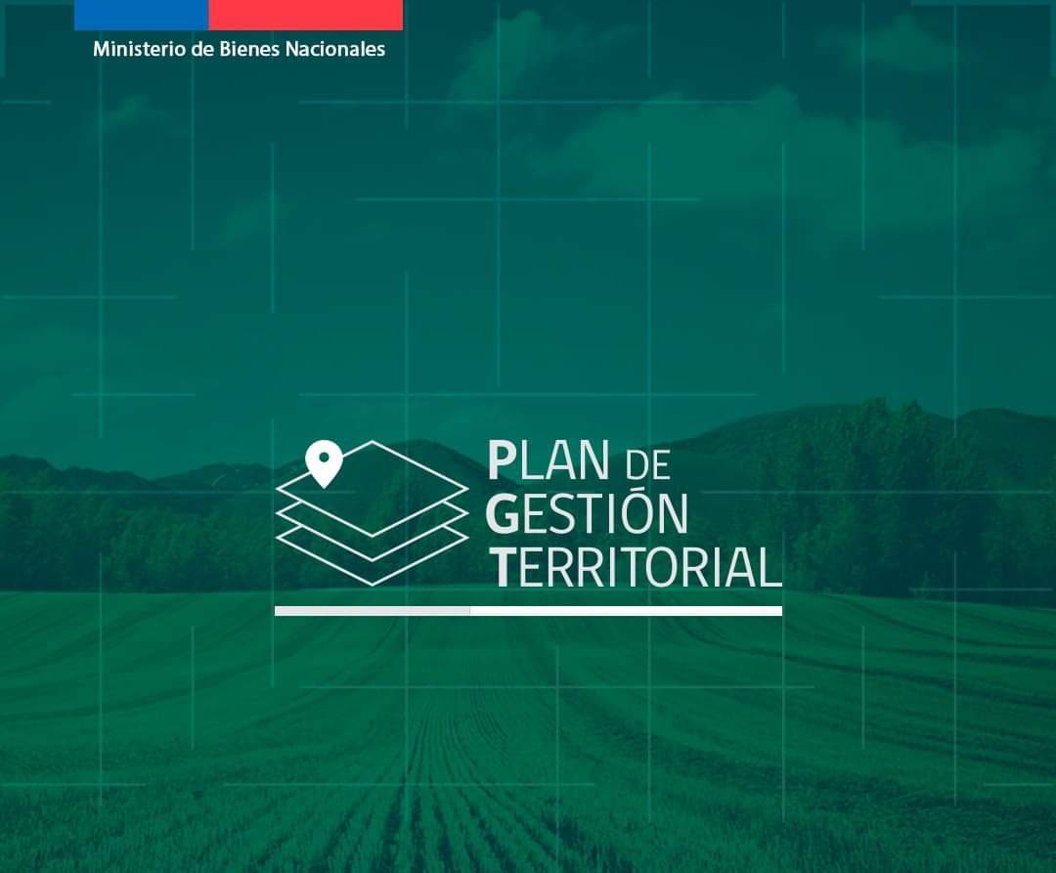
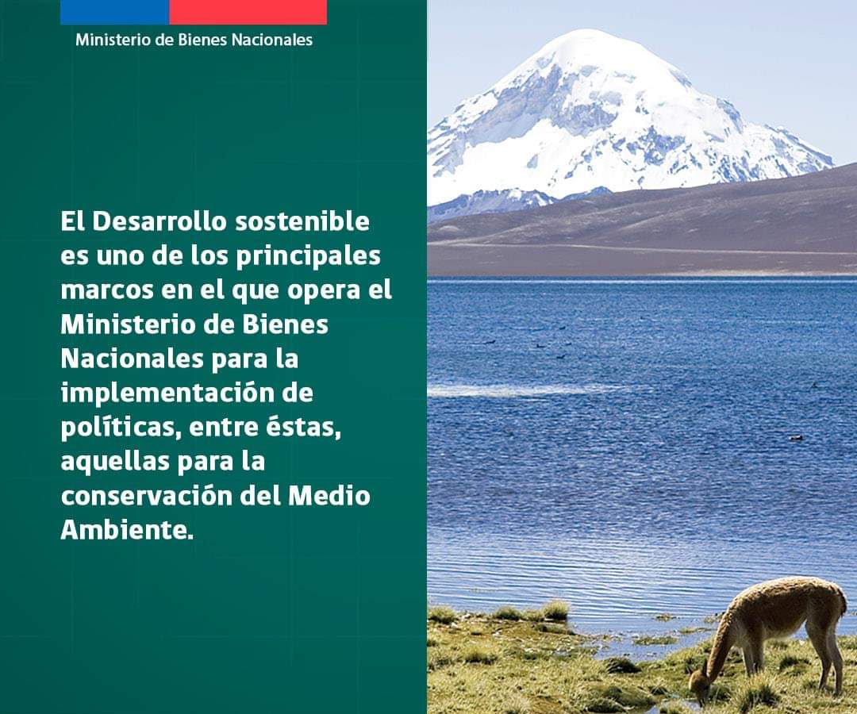

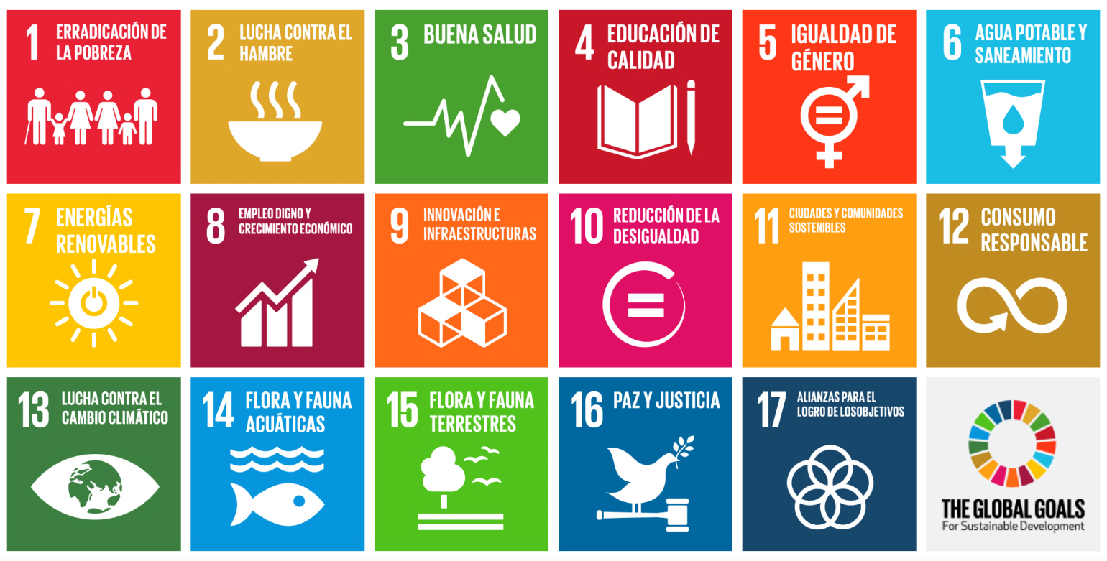


Territorial Management Plan
managing territory for sustainable development

Slide 11
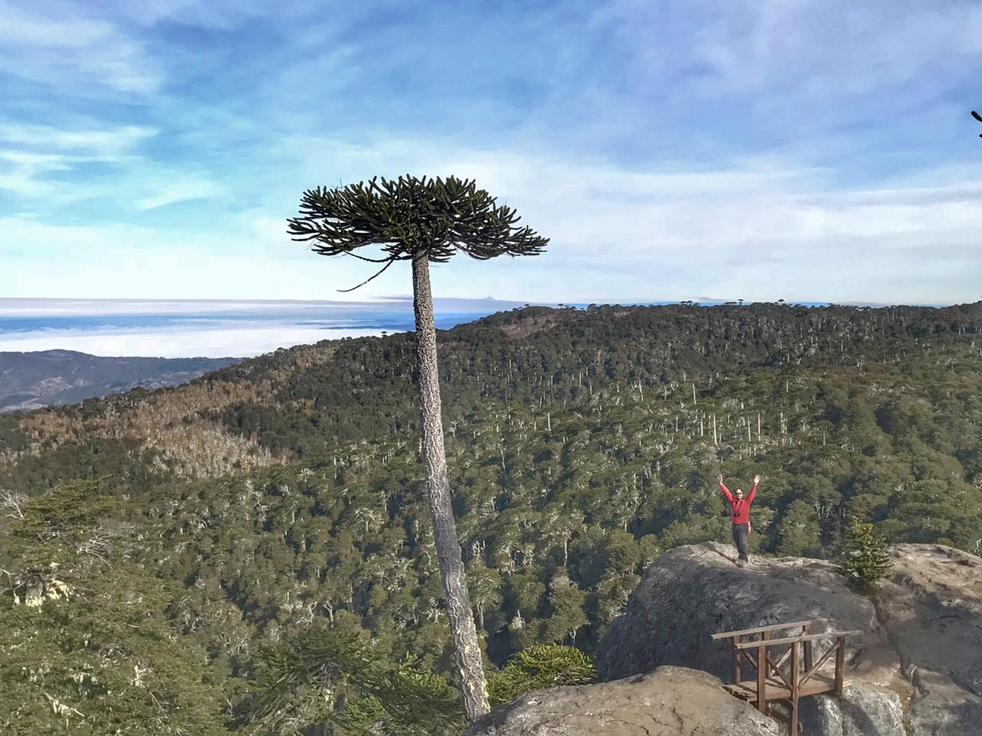
This is me!

