Slide 1
Personal presentation
WU XUEMEI
Institute of Mountain Hazards and Envirornment,
Chinese academy of Sciences
E-mail: wuxuemei@imde.ac.cn
IPROMO
Landscape approach for enhancing mountain resilience
Pieve Tesino /Ormea 02-18 July 2019

Slide 2
Education
Sep 2001 ‐ Jul 2004 Sichuan Agricultural University,
MA, Pomology
Sep 1997 ‐ Jul 2001 Sichuan Agricultural University,
BS, Horticulture
Employment and main activities
Institute of Mountain Hazards and Environment, Chinese Academy of Sciences, China
Editor of JOURNAL OF MOUNTAIN SCIENCE. My main job is to contact with the reviewers and the authors, chose the good papers, and help the authors modify and improve these papers and publish them in our journal.

Slide 3
Other interests (volunteer work, hobbies etc.)
No volunteer work. Now I am spending a lot of time on Journal of Mountain Science. But I'm willing to do some volunteer work If there is ever an opportunity.
Hobbies. Reading, Yoga, drawing ... I like a lot of things. Maybe I am not good at it, but I would like to try it.

Slide 4
Institute of Mountain Hazards and Environment 1/3
No project
Institute of Mountain Hazards and Environment (IMHE), Chinese Academy of Sciences.
Address: Chengdu, China
http://www.imde.cas.cn/
A state non-profit academic institution, major in the following subjects:
Formation and mitigation of mountain hazards
Degradation and reconstruction of mountain environment
Evaluation, planning and sustainable development of eco-environment,
Remote-sensing, mapping, GIS, and Agroecology

Slide 5
Journal of Mountain Science (JMS) 2/3
Founded in 2004. It is an International english journal (published monthly).
http://jms.imde.ac.cn/
Sponsored by the Institute of Mountain Hazards and Environment, Chinese Academy of Sciences, distributed by Springer.
Fulltexts at SpringerLink, https://link.springer.com/journal/11629
JMS is one of the four SCI‐indexed journals on mountain science in the world.

Slide 6
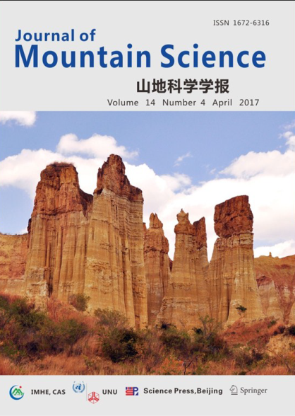

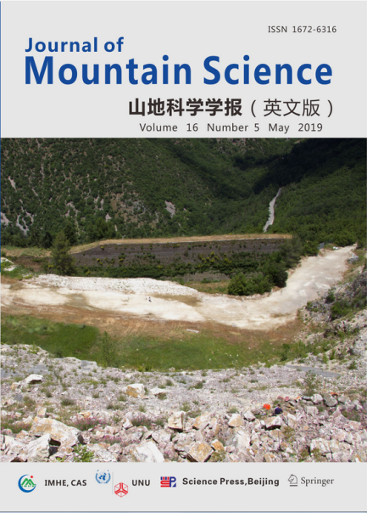
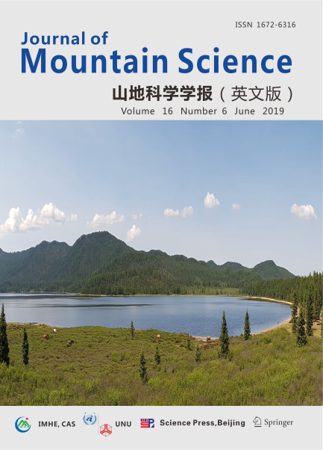
Journal of Mountain Science (JMS) 3/3
The subjects are about manly aspects of mountains, including Geo‐surface process, climate change, glaciers, hydrology, ecology, livelihood, etc.
Contact us
Tel: 86-28-85252044; Email: jms@imde.ac.cn
http://www.springer.com/earth+sciences+and+geography/journal/11629
Submission on: https://mc03.manuscriptcentral.com/jmsjournal

Slide 7
Thank for your attention!
(Optional)

