Slide 1


Solar energy for water desalination and purification
Matteo Morciano
matteo.morciano@polito.it
Multi-Scale Modeling Laboratory (http://www.polito.it/small), Energy Department, Politecnico di Torino, Torino, Italy.

Slide 2
TOPICS
Introduction
Our contribution (making desalination more sustainable)
  Solar Steam Generator (evaporation – concentrated solar power)
  Distiller (complete desalination – under 1 sun)
  Follow-up Distiller
      Waste heat driven Distiller
      Scale-up of the Distiller
Conclusions

Slide 3
TOPICS
Introduction
Our contribution (making desalination more sustainable)
  Solar Steam Generator (evaporation – concentrated solar power)
  Distiller (complete desalination – under 1 sun)
  Follow-up Distiller
      Waste heat driven Distiller
      Scale-up of the Distiller
Conclusions

Slide 4
INTRODUCTION
Conventional desalination plants:
    large plants which operate in developed countries;
    mainly fossil fuel driven;
    based on active components (pumps).
What we need? → Enhancing the sustainability of desalination using alternative energy sources:
    Small plants able to operate in locations where lack of primary energy resources and/or power generation infrastructure exists;
    low cost and low carbon;
    based on self operating systems (no mechanical moving parts).
Innovative solutions

Slide 5
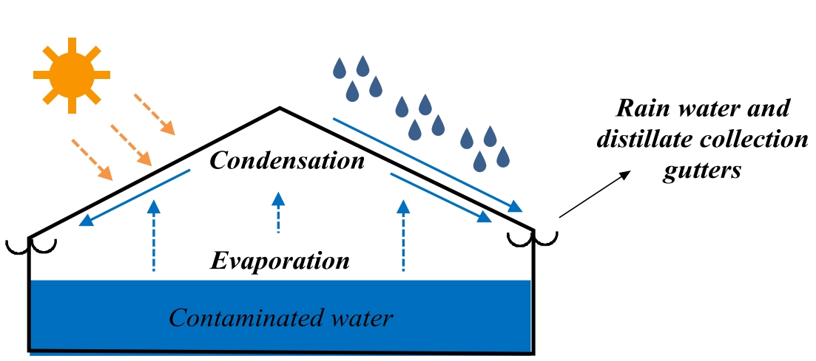
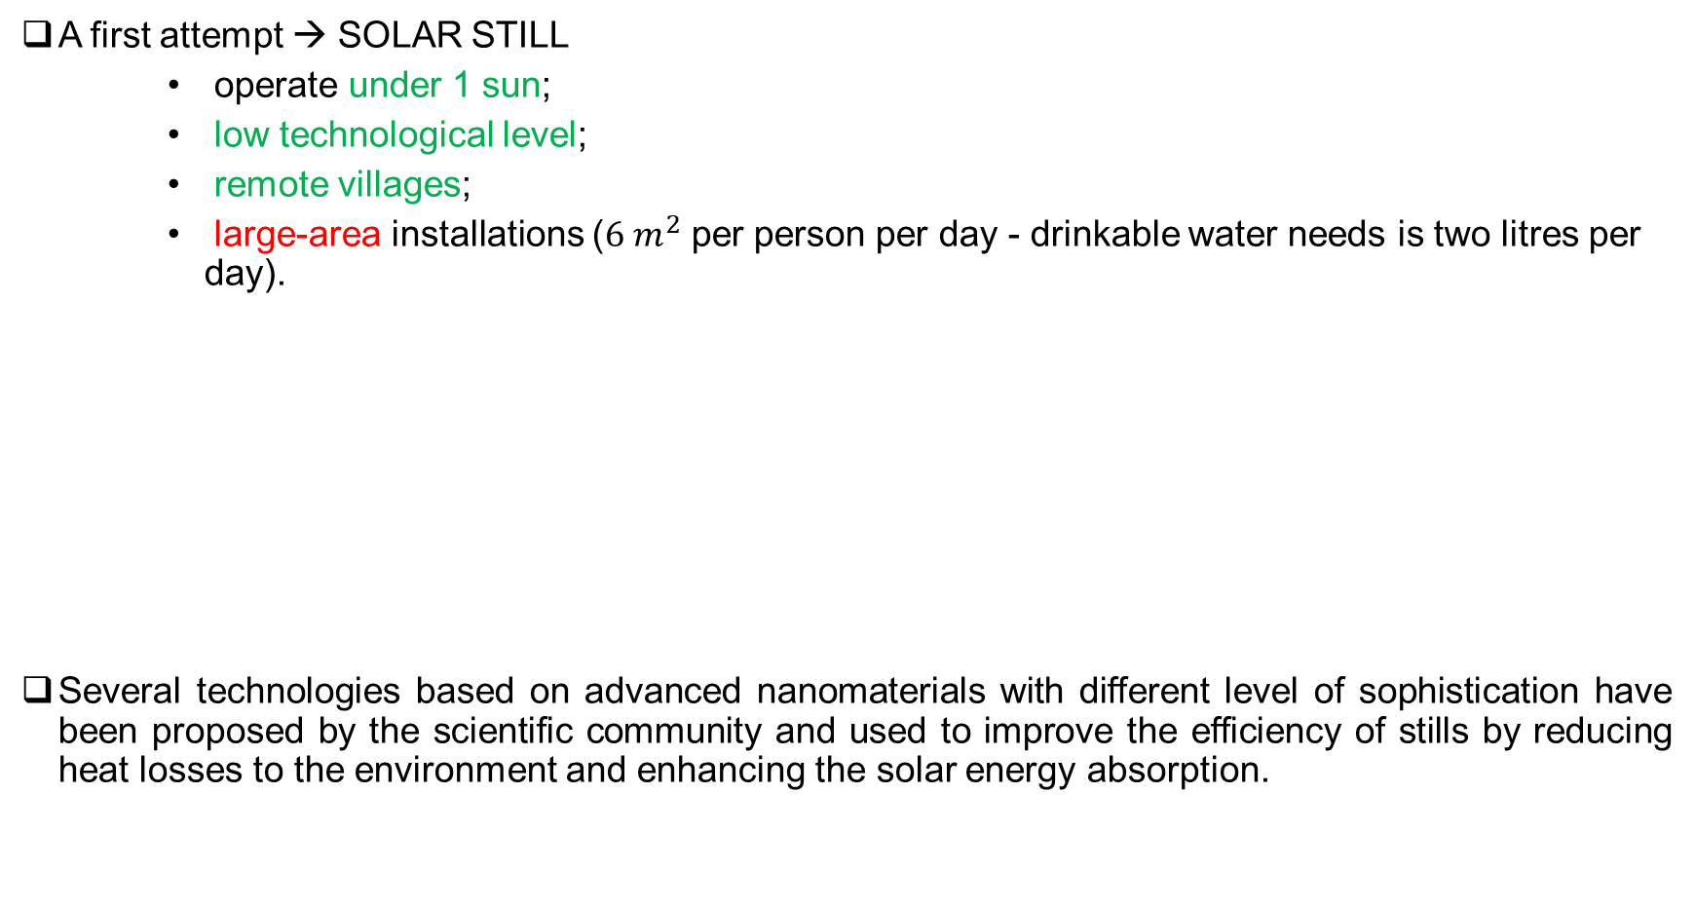
OVERVIEW ON APPROACHES
A first attempt → SOLAR STILL
    operate under 1 sun;
    low technological level;
    remote villages;
    large-area installations ($6 m^{2}$ per person per day - drinkable water needs is two litres per day).
Several technologies based on advanced nanomaterials with different level of sophistication have been proposed by the scientific community and used to improve the efficiency of stills by reducing heat losses to the environment and enhancing the solar energy absorption.

Slide 6
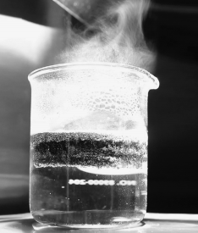
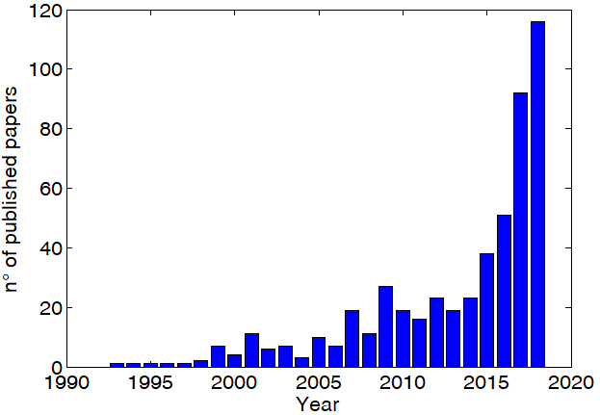
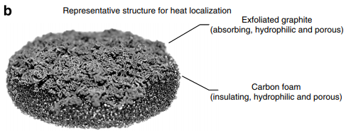
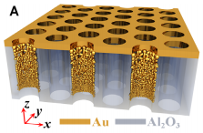
HOW THE COMMUNITY FACED THE PROBLEM?
BIG CHALLENGE
Double-layer structure for heat localization
- High-tech solutions
- Expensive materials
Ghasemi et al, Nature communications 2014
Gold nanoparticles with random sizes and distributions enabling broadband absorption,
Nanoporous template for reflection reduction
Data taken from Web of Science.
Solar-driven evaporation and desalination (characterized by minimum environmental impacts) has recently attracted tremendous research attention.
Zhou et al, Science Advances 2016

Slide 7
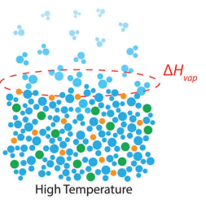
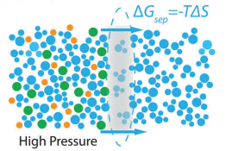

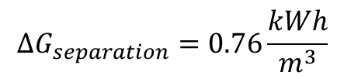
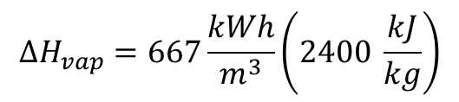
CONSIDERATIONS
DRAWBACKS
PRACTICAL
  Very high costs
  Difficult to prototype
  Difficult scale up of the device
  Low applicability
THEORETICHAL
  High pain low gain (high cost increase for low efficiency increase)
$$∆H_{vap}=667\frac{kWh}{m^{3}}\left(2400 \frac{kJ}{kg}\right)$$
$$ΔG_{separation}=0.76\frac{kWh}{m^{3}}$$
  $$≫$$
IDEAL MINIMUM WORK OF DESALINATION
Deshmukh, Akshay, et al. "Membrane distillation at the water-energy nexus: limits, opportunities, and challenges." Energy & Environmental Science 11.5 (2018): 1177-1196.

Slide 8
FUNDAMENTAL QUESTIONS
Do we really need advanced materials?
Can we do the same (or even better) with common materials?
More focus on the process (IDEA) rather than the material (TECHNOLOGY)
We experience the importance of frugality:
DO MORE WITH LESS
(extremely challenging)
PECULIARITIES OF (OUR) FRUGAL APPROACH
Off-grid (renewable or waste-heat driven)
Low-cost
Robust (low-maintenance)

Slide 9
TOPICS
Introduction
Our contribution (making desalination more sustainable)
  Solar Steam Generator (evaporation – concentrated solar power)
  Distiller (complete desalination – under 1 sun)
  Follow-up Distiller
      Waste heat driven Distiller
      Scale-up of the Distiller
Conclusions

Slide 10
DIRECT SOLAR STEAM GENERATOR
CONVENTIONAL APPROACH
BULK HEATING
INSPIRING WORK
HEAT LOCALIZATION
INSULATING AND POROUS MATERIAL
REDUCED LOSSES
Ghasemi et al, Nature communications 2014
time
OUR APPROACH
The concurrent action of three phenomena is exploited to increase solar light harvesting:
heat confinement in the evaporative region,
capillary action to distribute water in a narrow gap,
effective thermal insulation around the evaporative region.

Slide 11
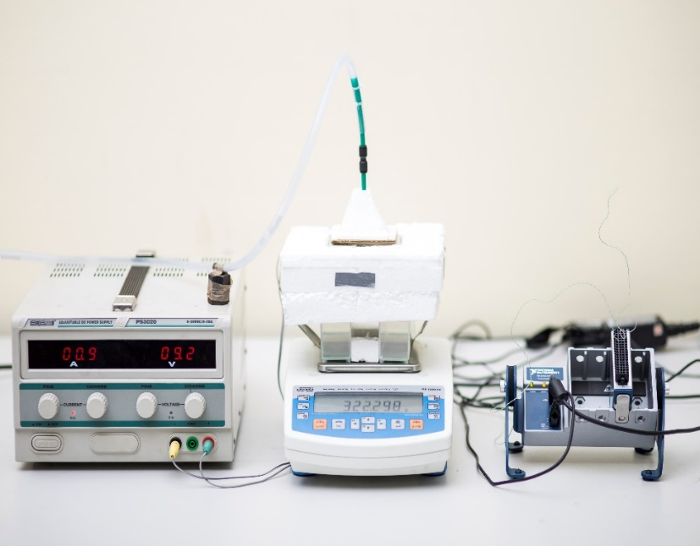
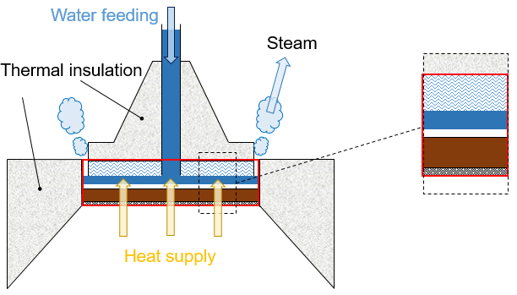
DIRECT SOLAR STEAM GENERATOR
THIN FILM EVAPORATION
Glass, thermal insulation
Water feeding
Steam generator
Heat supply
Data acquisition
Scale
Water thin film
Hydrophilic material (capillary action)
Absorber
Morciano Matteo, et al. "Efficient steam generation by inexpensive narrow gap evaporation device for solar applications." Scientific reports 7.1 (2017): 11970.

Slide 12
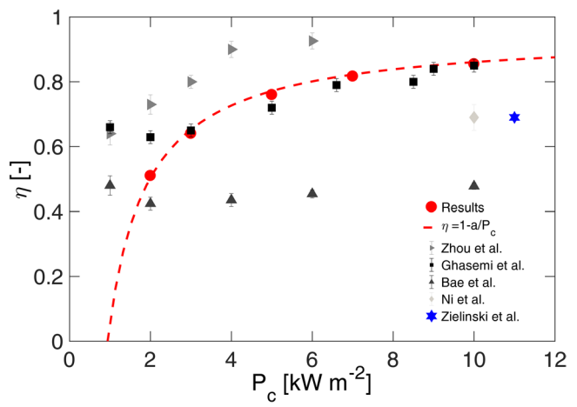

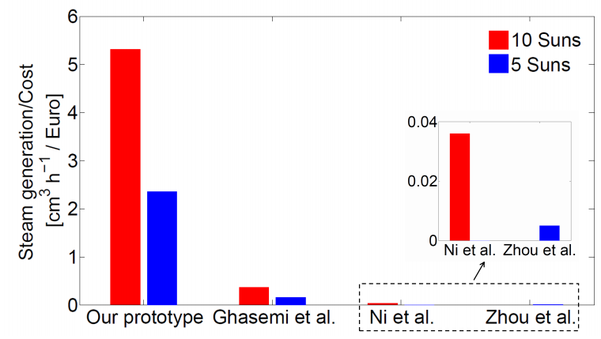
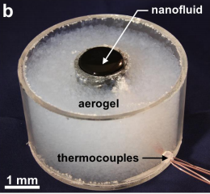
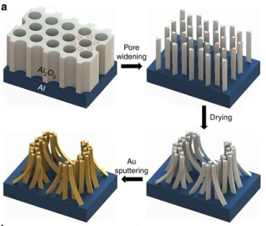
DIRECT SOLAR STEAM GENERATOR
In this work, we achieved an efficient (87%) steam generation by inexpensive (no advanced nano-structured materials) narrow gap evaporation device for solar applications.

Slide 13
WHAT ABOUT CONDENSATION PROCESS?
We made a step forward…

Slide 14
TOPICS
Introduction
Our contribution (making desalination more sustainable)
  Solar Steam Generator (evaporation – concentrated solar power)
  Distiller (complete desalination – under 1 sun)
  Follow-up Distiller
      Waste heat driven Distiller
      Scale-up of the Distiller
Conclusions

Slide 15
DISTILLER
PASSIVE
sun provides energy and capillary forces drive water feeding (no pumps or valves)
LOW-COST
smart combination of inexpensive materials
MODULARITY
latent heat of vaporization given off by the condensing vapour is re-used: go beyond the thermodynamic limit of single-stage
NOVELTY

Slide 16
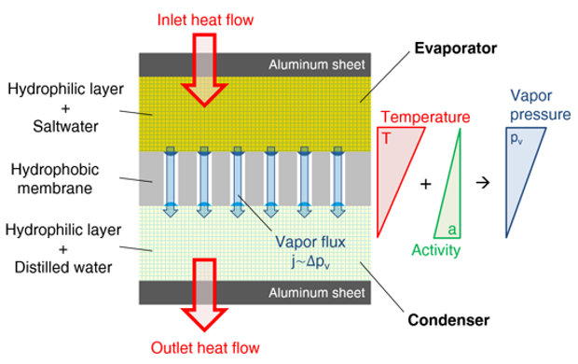
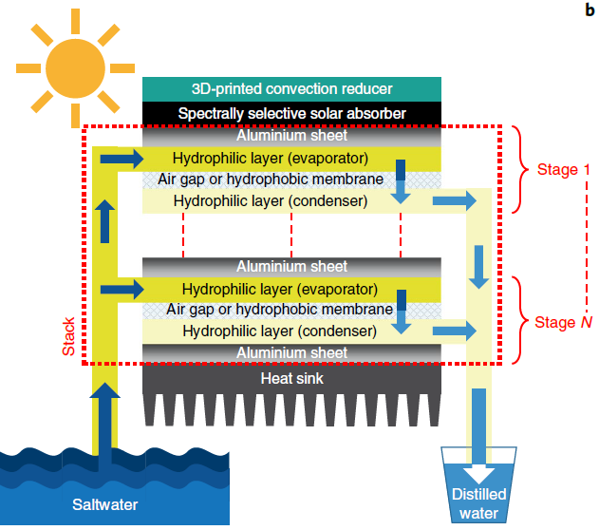
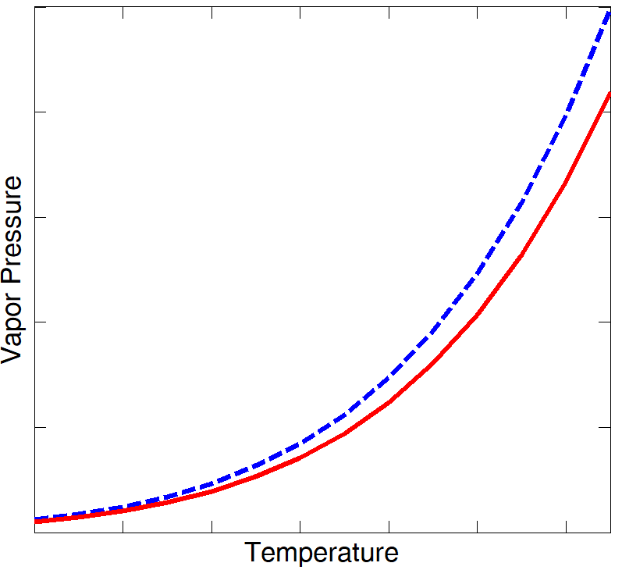

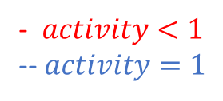


HOW DOES IT WORK?
MODULARITY
- $activity<1$
-- $activity=1$
$${Δp}_{w}$$
$$T_{EVA}$$
$$T_{COND}$$

Slide 17

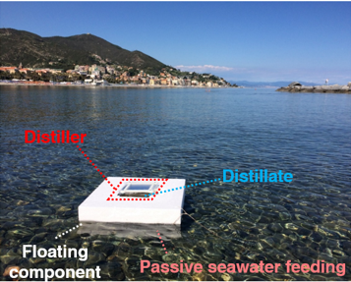
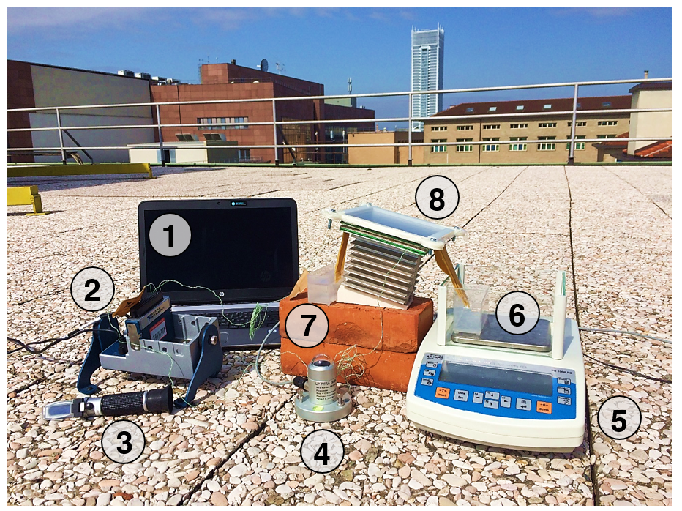
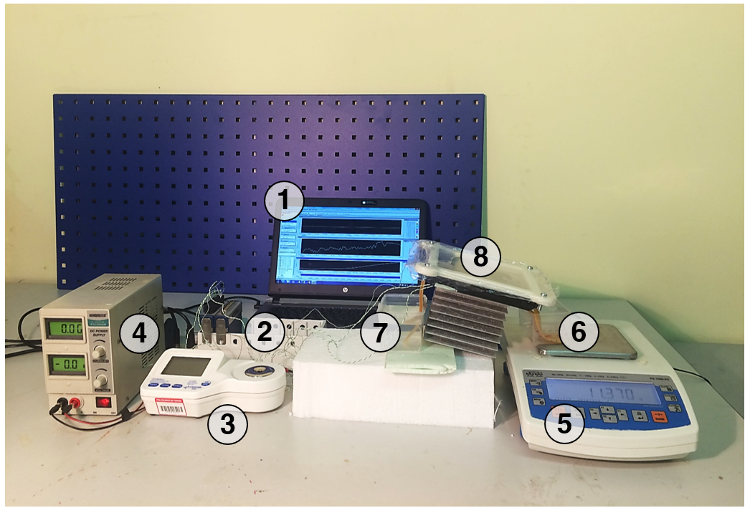
METHODOLOGY
REAL WORLD
APPROACHING REAL WORLD
LABORATORY ACTIVITIES
Step 1
Step 2
Step 3

Slide 18
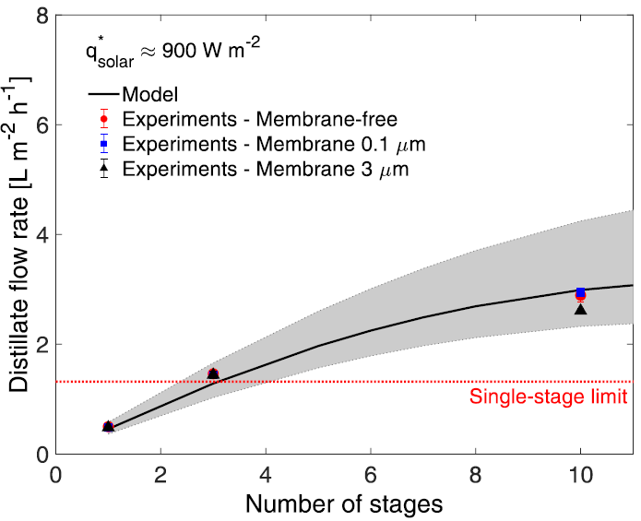
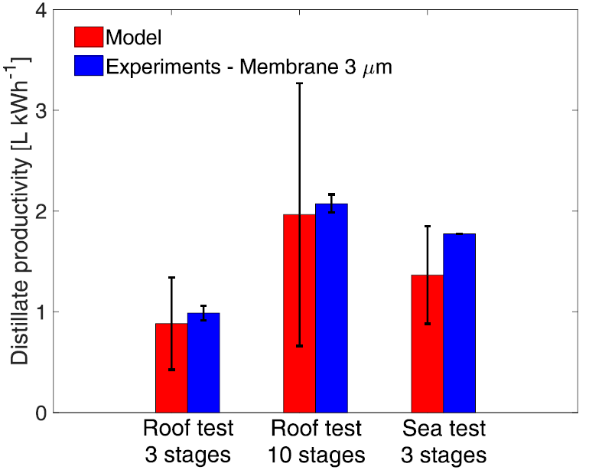


MAIN RESULTS
Laboratory conditions
In-field conditions
$$850 W m^{−2}$$
$$600 W m^{−2}$$

Slide 19
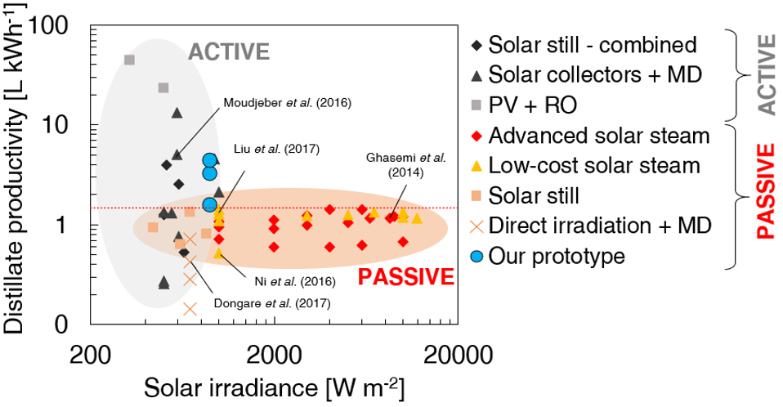
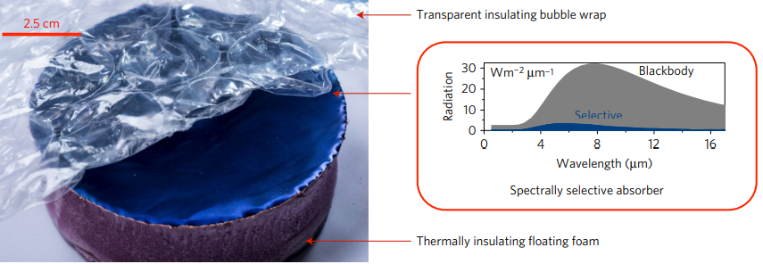
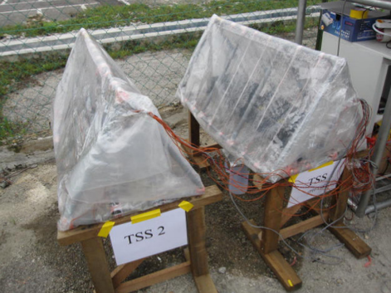
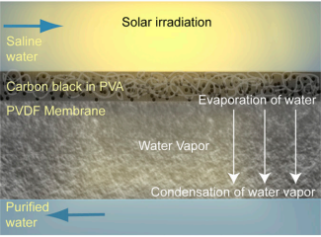
COMPARISON BETWEEN SOLAR-DRIVEN DESALINATION PERFORMANCES
Advanced solar steam
Low-cost solar steam
Solar still
Direct irradiation + MD

Slide 20
TOPICS
Introduction
Our contribution (making desalination more sustainable)
  Solar Steam Generator (evaporation – concentrated solar power)
  Distiller (complete desalination – under 1 sun)
  Follow-up Distiller
      Waste heat driven Distiller
      Scale-up of the Distiller
Conclusions

Slide 21
WASTE HEAT DRIVEN DISTILLER
Low-grade heat is particularly suitable for its utilization for membrane distillation systems such as the proposed compact distiller, which has the peculiarity to work at low temperatures.
Low-grade heat sources are underutilized considering that the average efficiency of a power plant is ≈ 30%.
In detail, waste heat is recovered from the cooling circuit of an electric power generator
This heat is continuously available when the generator is used in constant operation.
A strategy for electricity-freshwater co-production in remote or impoverished areas (where electric power generators are needed - e.g. field hospitals, emergency situations) is proposed.

Slide 22
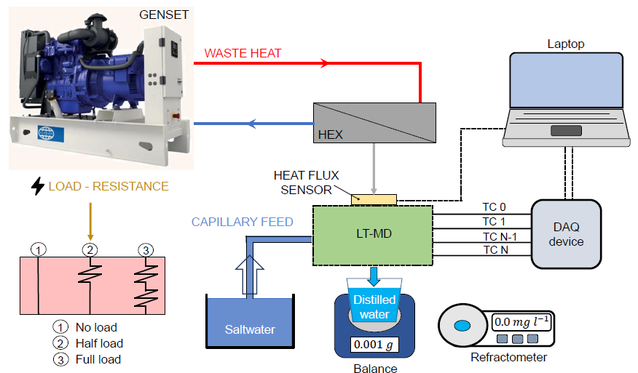
EXPERIMENTAL SETUP
7.6 kW

Slide 23
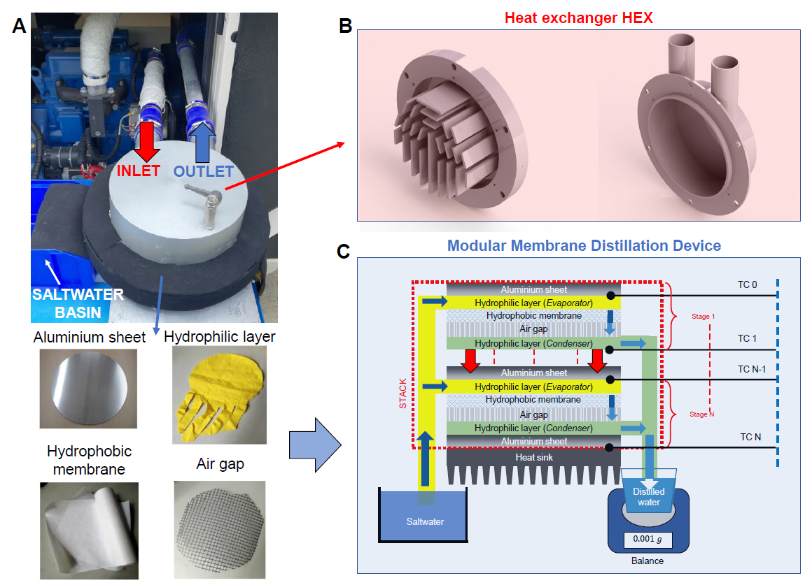
DETAILS ON HEX & MD DEVICE

Slide 24

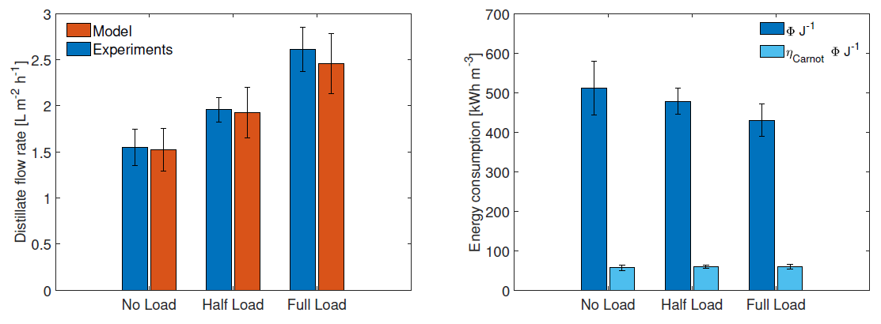
RESULTS - PRODUCTIVITY
${1 m}^{2}$ device → $24$ hours → ${60 L day}^{−1}$→ daily drinkable water needs of up to 30 people

Slide 25
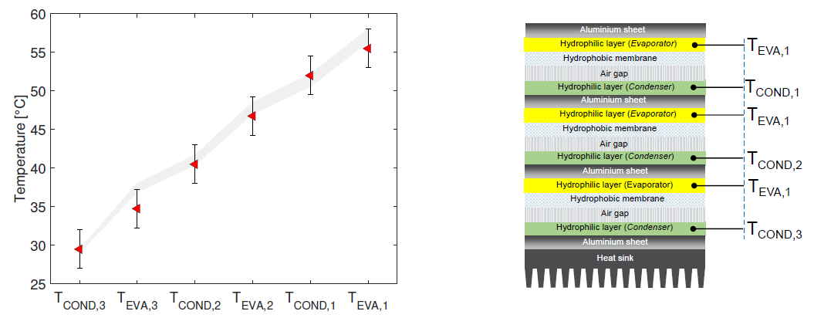
RESULTS – TEMPERATURE PROFILES
Low-temperature process suitable to be powered by low-grade heat

Slide 26
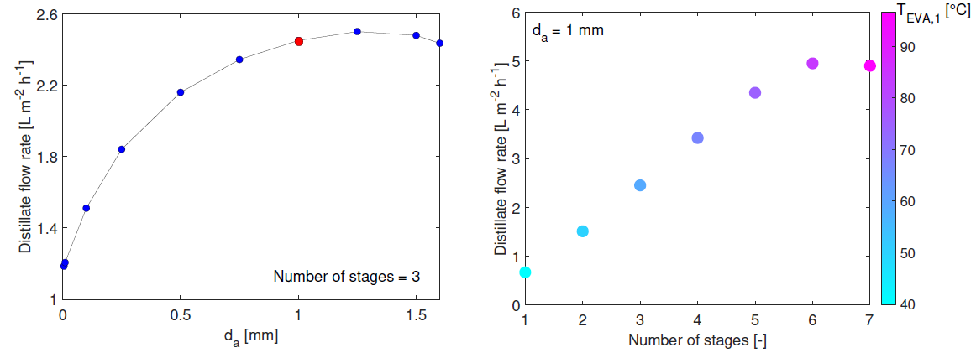
RESULTS – MODEL PREDICTIONS
Exhaust gas
Cooling circuit

Slide 27
TOPICS
Introduction
Our contribution (making desalination more sustainable)
  Solar Steam Generator (evaporation – concentrated solar power)
  Distiller (complete desalination – under 1 sun)
  Follow-up Distiller
      Waste heat driven Distiller
      Scale-up of the Distiller
Conclusions

Slide 28
CRITERIA TO BE RESPECTED
  Low Cost: the estimated production cost of the device has to be $20
  Hand Held: the device has to be easily transportable
  Robust: Resilient, Corrosion resistant
  Term use: the device has to operate for a minimum of 30 days
  Rate of production: the device has to produce a minimum of 3 liters of purified water per day
  Stand alone: no additions of chemicals, fuel, or other external materials
  Quality: from 35,000 mg/L seawater to 1000 mg/L and low contaminants level.

Slide 29
WORKING IN PROGRESS
Capillary forces → slow water feeding → difficult scalability
    Under the head of saltwater operating conditions
    Inclined stratigraphy to favor the outflow
    Split the needed area in N modules (mosaic-like configuration)
Cost of the device:
heat sink (most expensive component) has been removed

Slide 30
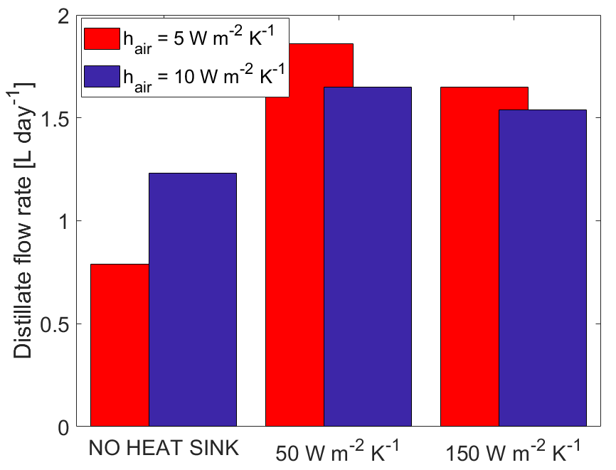
MODEL PREDICTIONS
1 sun (input solar flux); 3 stages (easy to operate); 1 module (60X38 cm^2)
3/4 modules are needed to satisfy the requirements in terms of productivity
(3 L per day)
Heat sink performances

Slide 31

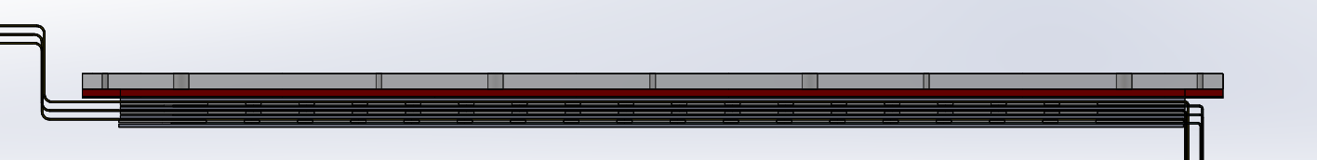
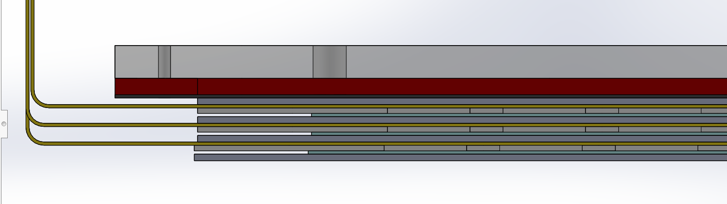
PRELIMINARY DEVICE - 3D CAD

Slide 32
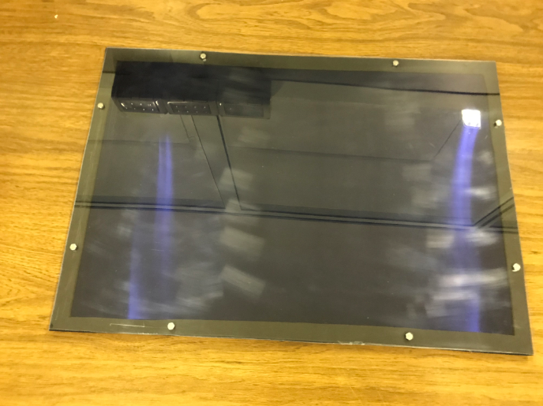
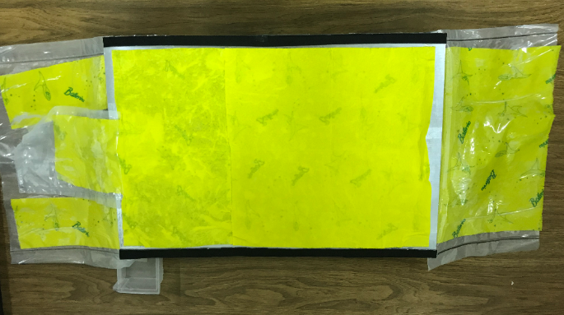
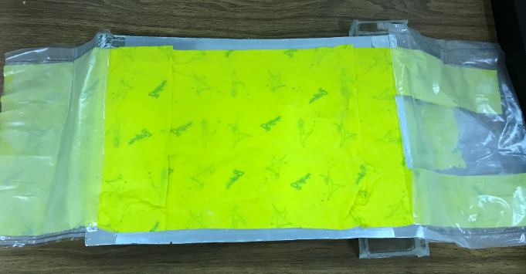
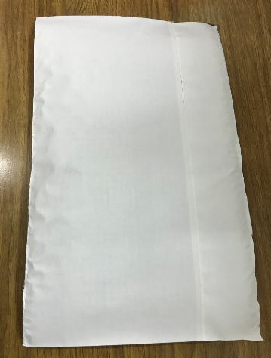
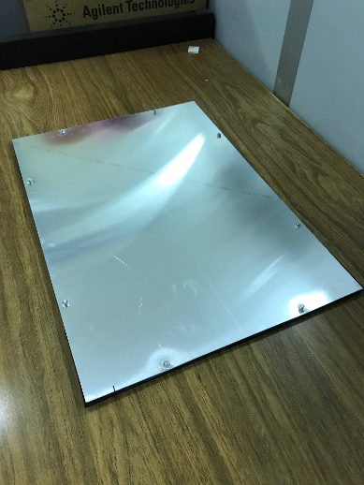
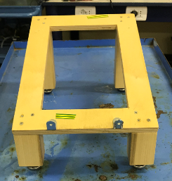
MAIN COMPONENTS
Selective absorber (tinox) + convection reducer (plexiglass cover)
Hydrophilic layer
Hydrophobic membranes (0.5 microns)
Aluminum sheets

Slide 33
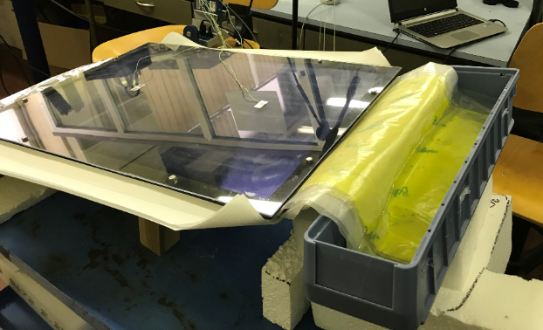
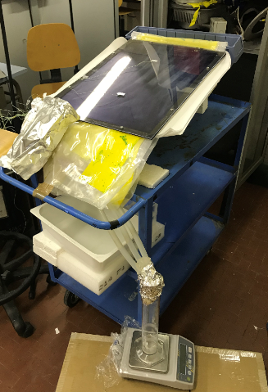
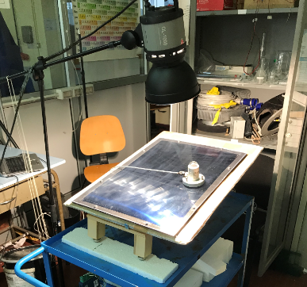
SOME PICTURE
Inclined device
Distilled water basin

Slide 34
WHAT HAS TO BE DONE
In-field experimental campaign
Cost analysis
Quality analysis of products

Slide 35
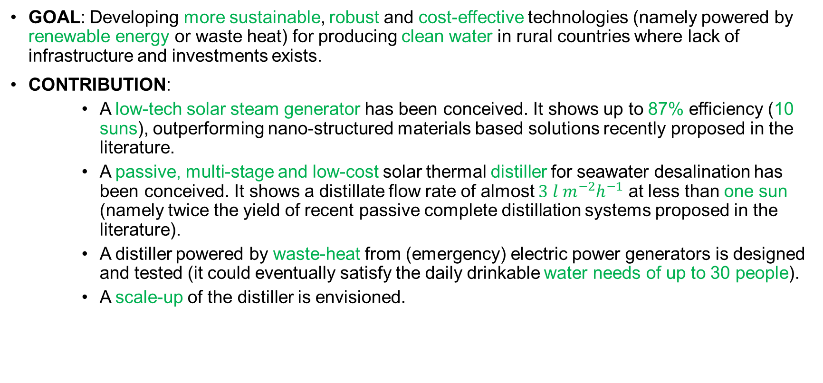
CONCLUSIONS
GOAL: Developing more sustainable, robust and cost-effective technologies (namely powered by renewable energy or waste heat) for producing clean water in rural countries where lack of infrastructure and investments exists.
CONTRIBUTION:
    A low-tech solar steam generator has been conceived. It shows up to 87% efficiency (10 suns), outperforming nano-structured materials based solutions recently proposed in the literature.
    A passive, multi-stage and low-cost solar thermal distiller for seawater desalination has been conceived. It shows a distillate flow rate of almost ${3 l m}^{−2}h^{−1}$ at less than one sun (namely twice the yield of recent passive complete distillation systems proposed in the literature).
    A distiller powered by waste-heat from (emergency) electric power generators is designed and tested (it could eventually satisfy the daily drinkable water needs of up to 30 people).
    A scale-up of the distiller is envisioned.

Slide 36
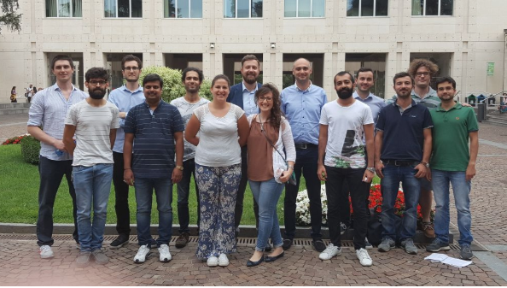



Thank you! Questions?
The multi-Scale ModeLing Laboratory
SMaLL
FUNDING

