Slide 1
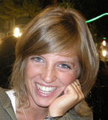
Personal presentation
Francesca Bussola
Forest and Fauna Service
of the Autonomous Province of Trento
francesca.bussola@provincia.tn.it
IPROMO
Mountains in a changing climate: Threats, challenges and opportunities
28 September-09 October 2020

Slide 2
Education
Bachelor’s degree in natural science at the University of Parma, Italy (2011)
Master’s degree in natural science at the University of Milan, Italy (2014)
Employment and main activities
Technician by the Research and Innovation Centre of Edmund Mach Foundation, Trento (Italy)
Public officer by the Forest and Fauna Service of Trento (Italy) – project manager of InnoForESt Horizon 2020

Slide 3


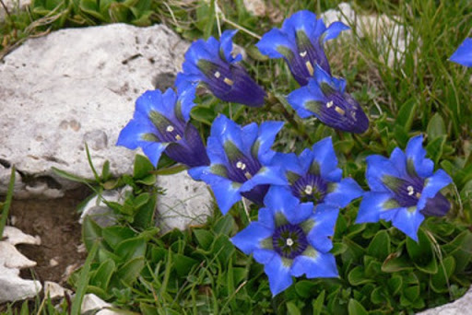

Other interests (volunteer work, hobbies etc.)
Gardening, music, natural world and National Geographic reading
I had been volunteer in the dogshome of Trento for years
Supporter of Greenpeace and One World Onlus

Slide 4
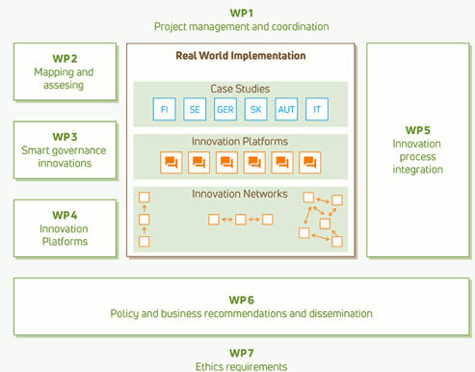
InnoForESt (2017-2020)
Smart information, governance and business Innovations for sustainable supply and payment mechanism for Forest Ecosystem Service

Slide 7
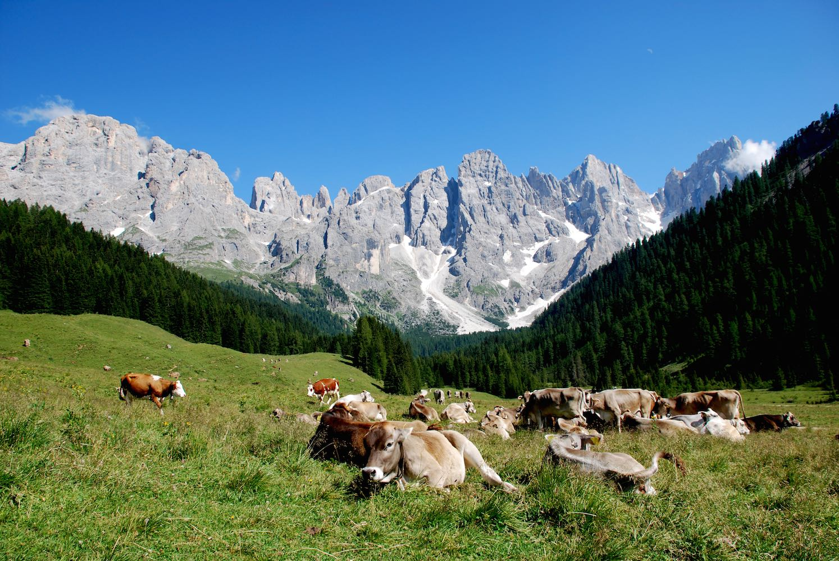
Thank for your attention!

