Slide 1

Personal presentation
Gent Imeraj
Electronic Engineer
gimeraj@epoka.edu.al
IPROMO
Mountains in a changing climate: Threats, challenges and opportunities
28 September-09 October 2020

Slide 2
Education
MSc: Electronic and Communication Engineering
BA: Electronic Engineering and Digital Communcation
Trainings on Project Cycle Management
Certified as a tour guide
Employment and main activities
Lab Specialist and Researcher | EPOKA University
Project Coordinator | “Albanian Alps Alliance”
Tour Guide | Independent operator
Coordinator of Rural Youth HUB | ANRD

Slide 3
Other interests (volunteer work, hobbies etc.)
Co-produced and starred at six filmings (https://www.youtube.com/watch?v=qo0mQIJgUwo)
Experience at outdoors activities, such as: hiking, biking, mountaineering, camping, wildlife observation.
Co-author / Contributor at producing the touristic map of Malesi e Madhe region, Nikaj-Mertur Natural Park, Shkreli Guest-houses touristic map
Participant at NASA Space Apps Challenge
Looking forward to a possibility to study in JAPAN

Slide 4

Presentation of a project you are working on 1/3
Project Coordinator@
Title: PRODUCT
Implemented by: Albanian Alps Alliance
Funded by: MAVA Foundation & IUCN
Territory: Delta of Buna, Velipoja reserve
Time-frame: December 2019, October 2020

Slide 5

Presentation of a project you are working on 2/3

Slide 6
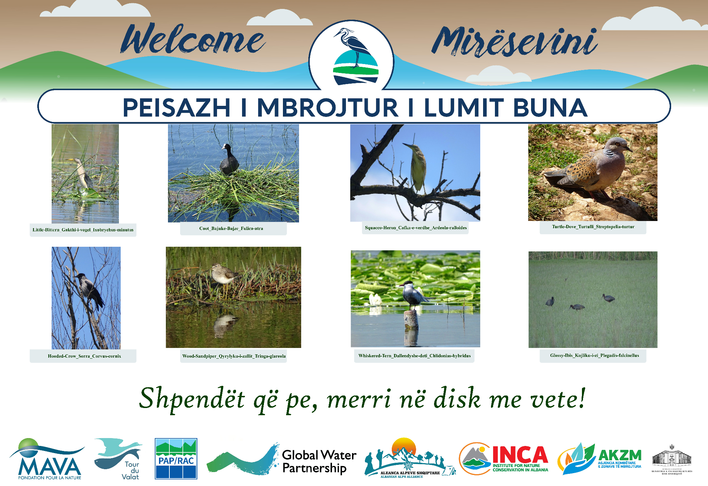
Presentation of a project you are working on 3/3

Slide 7
Thank for your attention!

