Slide 1
Personal presentation
Sofia Alexandra Garcés Santander
Knowledge Management and Monitoring and Evaluation - CONDESAN
alexandra.garces@condesan.org
IPROMO
Mountains in a changing climate: Threats, challenges and opportunities
28 September-09 October 2020

Slide 2
Education
MSc. International Land and Water Management, Adaptive Water Management Specialization, Wageningen University
Climate Change, Innovation and Entrepreneurship, Master Label Program, Climate-KIC, Wageningen University
Environmental Engineer
Employment and main activities
Knowledge Management and Monitoring and Evaluation Especialist - CONDESAN (Consortium for the Sustainable Development of the Andean Ecoregion)
Knowledge Management for two Projects in CONDESAN: Adaptation to Climate Change at Altitude (A@A) and Adaptation to the impacts of climate change on the water resources of the Andes (AICCA).
Monitoring and Evaluation of the progress of the AICCA Project.
Analysis of knowledge gaps adaptation to climate change in Andes Region.
Technical support in the definition of adaptation measures

Slide 3
Other interests (volunteer work, hobbies etc.)
Part of Climbing Club in Ecuador (Club de Ascencionismo Colegio San Gabriel)

Slide 4
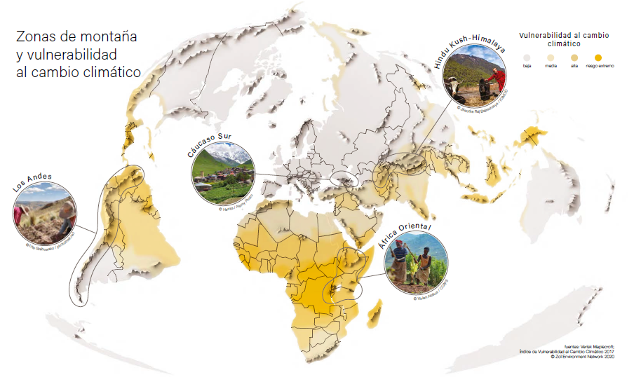
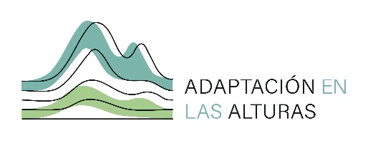

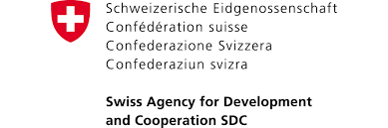
Presentation of a project you are working on 1/3
Adaptation at Altitude
Objective: Increase the resilience to climate change and the adaptation capacities of the mountain socio-ecosystems and their local communities, through the improvement of our knowledge on the strategies of adaptation to climate change and the transfer of knowledge. on science-policy platforms.

Slide 5
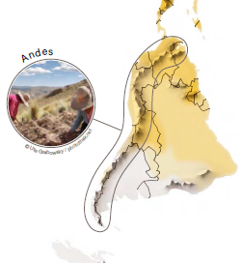
Presentation of a project you are working on 2/3
Andes
Generation of synthesis of knowledge on adaptation to climate change (WeAdapt)
Strengthening of long-term monitoring processes
Strengthening of national, regional and global spaces for science-policy dialogue and decision-making (national governments, IAM, international settings)
Promotion of exchange of experiences and regional training

Slide 6
Thank you!

