Slide 1
Personal presentation
Paul Duclos
Ministry of Foreign Affairs of Peru
paulduclos1@gmail.com
IPROMO
Mountains in a changing climate: Threats, challenges and opportunities
28 September-09 October 2020

Slide 2
Education
Law, Catholic University of Peru
LLM University of Nottingham
M.A. International Relations, Fletcher School of Law and Diplomacy
Employment and main activities
Diplomat in the Peruvian Embassies in Japan, India, the Netherlands and in the Mission of Peru of the United Nations (Political and security issues)
Director of Environment of the Ministry of Foreign Affairs.

Slide 3

Other interests (volunteer work, hobbies etc.)
Sports: Football and badmington.
Reading
History and Astronomy

Slide 4
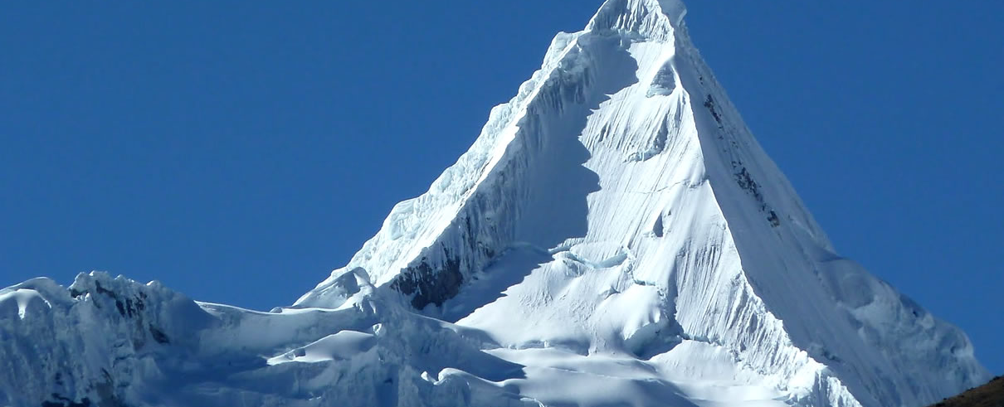
Presentation of a project you are working on
Peru seeks to assume the coordination of the Andean Mountain Initiative for the years 2021 and 2022.
This initiative was created in 2017 by the seven South American countries of the Andes: Argentina, Bolivia, Colombia, Chile, Ecuador, Peru and Venezuela, with the objective of strengthening a regional space to conserve mountains and promote a better diagnosis of risks and vulnerabilities to the effects of climate change, while promoting their sustainable development in conjunction with compliance with the Sustainable Development Goals of the 2030 Agenda .

Slide 5
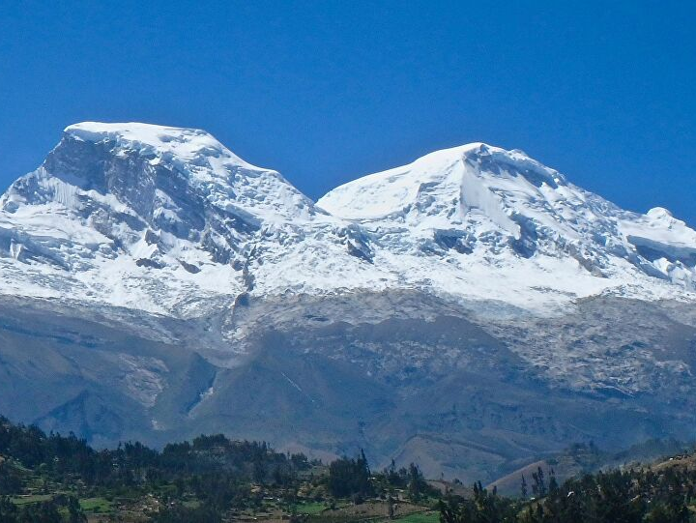
Presentation of a project you are working on
Mountains represent 35% of the entire surface of the country, and provide water for 26% of the area planted in the mountains and 68% of the coast. Also, 53% of the electrical energy consumed by the country is generated by hydroelectric plants, located in the mountains.
Peru also concentrates 71% of the tropical glaciers in the world and, at present, there is a worrying retreat of these glaciers, since in the last 30 years 22% of their surface has been lost.

Slide 6
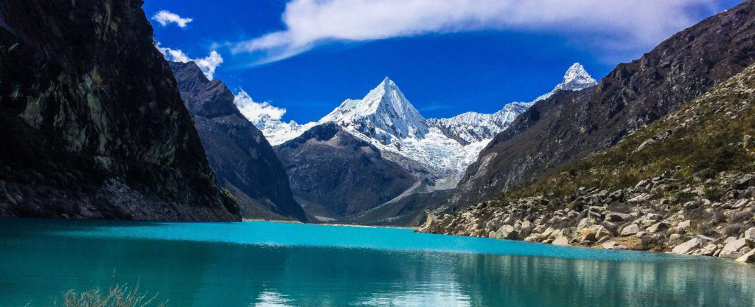
Presentation of a project you are working on
We are in the process of developing a comprehensive plan of action in order to be shared with the Andean countries, including the protection of the Andean forests and the promotion of the population in these areas.
The Swiss Agency for Development and Cooperation (SDC) provides financial support for activities related to the mountains program to the NGO CONDESAN (IAM Technical Secretariat).

