Slide 1
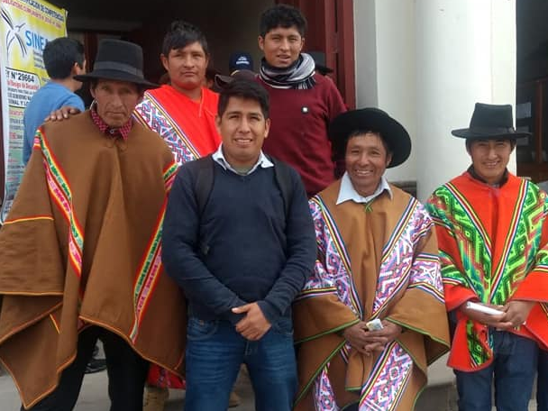
Personal presentation
Name: Juan Pablo Pineda Huamanñahui
Affiliation: Participant
E-mail: jpablo13.jpp@gmail.com
IPROMO
Mountains in a changing climate: Threats, challenges and opportunities
28 September-09 October 2020

Slide 2
Education
Institution | Degree(s) or Diploma(s) obtained:
Universidad Rey Juan Carlos – España | MBA
Universidad Tecnológica de los Andes - Perú | Agricultural engineer
Instituto Tecnológico Publico de Abancay – Apurímac | Agricultural technician
Employment and main activities
2013-2020 NGO CESAL www.cesal.org
Territorial Coordinator
Director of development projects in Apurímac region, andes of Perú:
  Quinoa value chain.
  avocado value chain
  Restoration of mountain ecosystems.
  Agriculture Sensitive to nutrition.

Slide 3
Other interests (volunteer work, hobbies etc.)
Interest
  Agroecology
  Rural development
  Climate change
Volunteer work
  Agroecology
Hobbies
  Play soccer
  Travel
  Hike in the montains

Slide 4
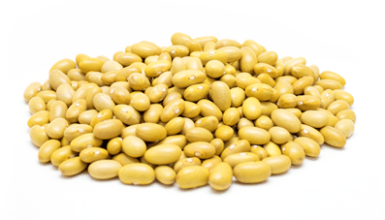



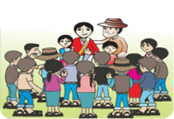







Presentation of a project you are working on 1/3
Promoting Value chain projects in the Andes of Perú
2013
2014
2017
2018
2019
2020
Strengthening the value chains of: Beans, Anise
Strengthening the organic quinoa chain value
Organics production of quinoa with 400 farmes
Financial inclusion of producers and agriculture cooperatives
Strengthening the organic avocado chain value
Productive innovation in the quinoa value chain
2020
2013
Alliances with large formal companies for collective sale of production
Volunteering specialized in business plans for producer associations
Promotion of credits from individual producers and cooperatives.
Strengthening and consolidation of agricultural associations and cooperatives.
Promotion of data and media for improve production ands sales of group of farmers.
Implementation of production equipment to small farmers in the andes.

Slide 5




Presentation of a project you are working on 2/3
Projects in climate change and environment
2015
Strengthen processes of the region's climate change strategy.
Restoration of high Andean forest ecosystems and management of agroecological systems and agroforestry systems with communities
Dissemination and implementation of measures to adapt to climate change in rural communities in the Ande of Perú – Apurímac Region
Implementation of the compensation mechanism with ecosystem services in Abancay - Perú
2013
2019

Slide 6
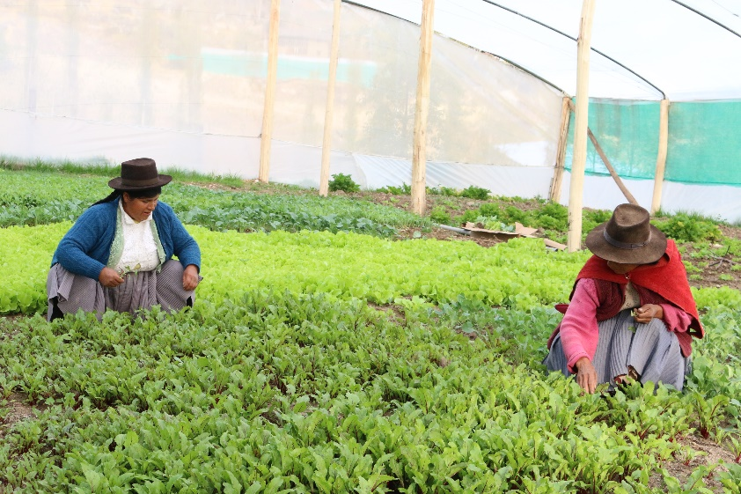
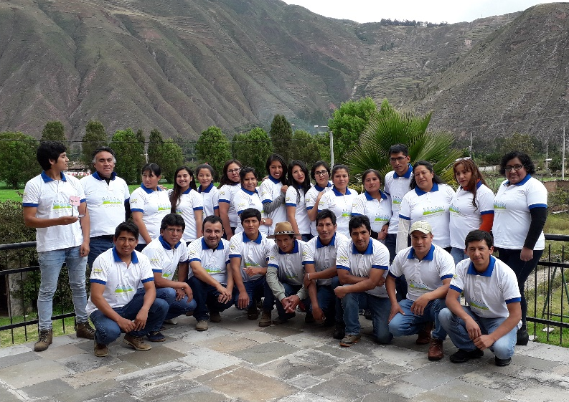
Presentation of a project you are working on 3/3
Promotion agroecology and nutrition in rural farmers in the andes.
Nutrition sensitive agriculture
Agroecology promotion in local farmers
Biodiversity in the farmers land
Good diet and nutrition in farmers
Rural service provider capacity building program
25 agricultural profesional
25 small interventions based on agroecology
Promotion of healthy diet in farmers

Slide 7
Thank for your attention!
(Optional)

