Slide 1
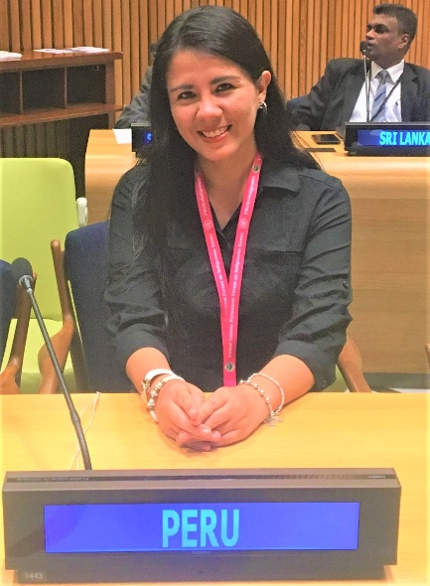
Personal presentation
Katherin Grines Delgado Añamuro
Ministry of Foreign Affairs
grines.delgado@gmail.com / kdelgadoa@rree.gob.pe
IPROMO
Mountains in a changing climate: Threats, challenges and opportunities
28 September-09 October 2020

Slide 2
Education
LLM Environmental Regulation and Sustainable Development, Newcastle University, England
Second Specialization Diploma in Environmental and Natural Resources Law, Pontifical Catholic University of Perú
Lawyer professional degree, Catholic University of Santa Maria
B.A. Law and Political Science, Catholic University of Santa Maria
Post Graduate Diploma in Mining and Environmental Law, Postgraduate School of the Peruvian University of Applied Sciences
Employment and main activities
Environmental specialist at the Environment Directorate of the Ministry of Foreign Affairs
Follow-up, in coordination with the competent sectors, to promote the corresponding activities for the fulfillment of the international commitments assumed in the framework of international treaties and agreements on environmental matters and sustainable development.

Slide 3
Other interests (volunteer work, hobbies etc.)
Social work in my local parish
Training on leadership abilities as well as doctrinal topics to young people in my local parish
Reading
Travelling
Regional foods

Slide 4

Presentation of a project you are working on 1/3
Intersectoral and regional coordination for Peru to assume the pro-tempore Regional Coordination of the Andean Mountain Initiative

Slide 5
Thank for your attention!
(Optional)

