Slide 1
Himalayan Blunder
IPROMO Course
Group 4
Nima, Geeta, Reeta, Navneet and Manas

Slide 2
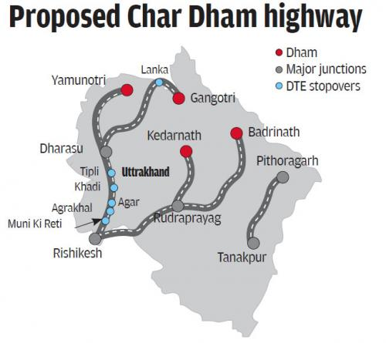
Introduction
The Char Dham Highway project entails widening of 900 kilometers of nationwide highways connecting the 4 holy Hindu shrines of Badrinath, Kedarnath, Gangotri and Yamunotri at an estimated value of over Rs 15,000 crore ($1.70 billion).
As half of the project, roads widened from 10m to 24m. The project additionally entails building of tunnels, bypasses, bridges, subways and viaducts.

Slide 3
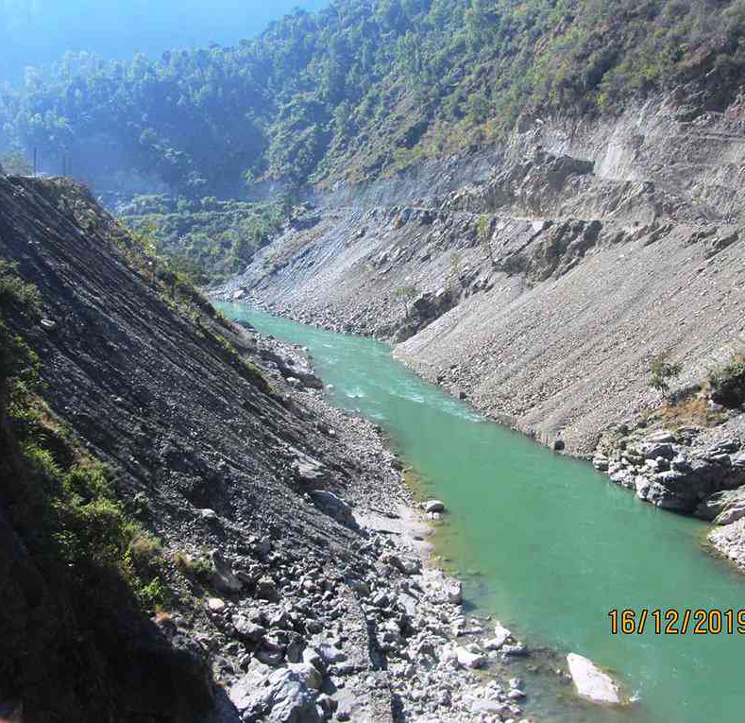
Possible Reasons
The improved highway circuit aims to ease traffic during the Char Dham Yatra, the backbone of Uttarakhand’s tourism and economy.
Military infrastructure built in fragile parts of the Himalaya.
Faster movement of troops, given the imminent threat at the border.

Slide 4
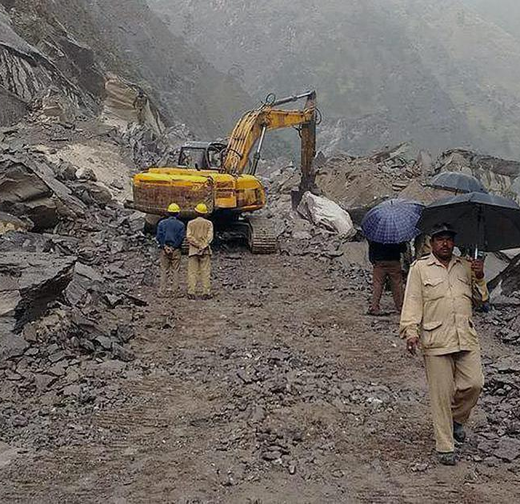
Impact
Nearly 700 hectares of forest land have already been lost to the project,
47,043 trees felled,
Natural drainage of streams and springs blocked by muck dumping.
Hills being cut vertically,
20 landslides have occurred in just four months of 2020, causing deaths and injuries.
Soil loss and loss of topsoil

Slide 5
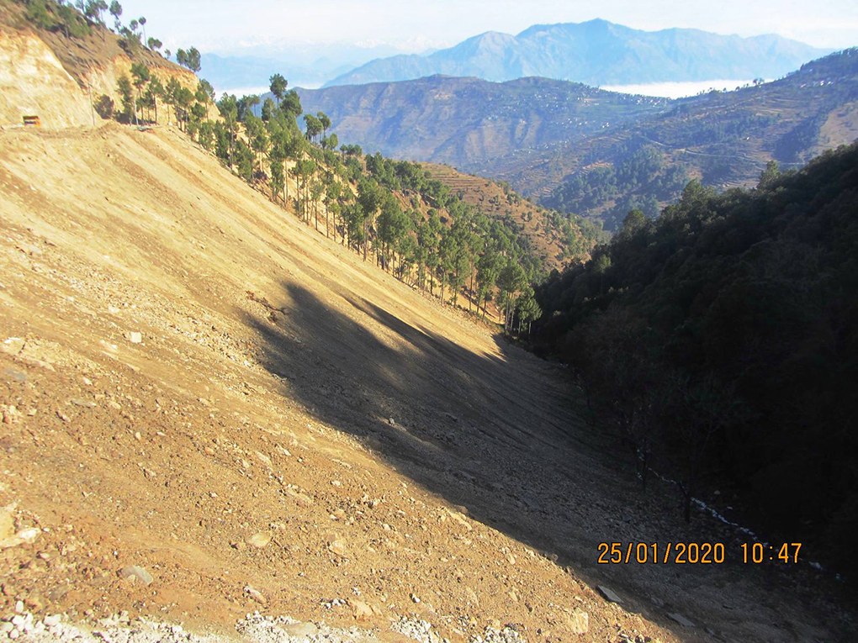
Some facts
Works such as hill cutting, digging and dumping of muck is in gross violation of the Forest Conservation (FC) Act, 1980, which had resulted in massive damage to the ecology of these valleys.
Carbon added to the atmosphere because of construction activity and higher number of road vehicles once the Char Dham project is complete, could potentially lead to “regional climate warming” around the 50 km radius where the shrines are located
Debris dumped down the gorges badly impacts the habitat of fish species like the common snow trout and brown trout, repress bio-films (food sources of invertebrates which are the cleaning agents of rivers) and destroy the habitat of algae, green bacteria and other aquatic flora and fauna.

Slide 6
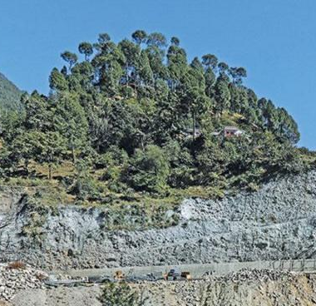
Technical Blunders
The 889-km project was misleadingly broken into 57 smaller projects of less than 100 km each by the government, thereby evading the necessity of an environmental impact assessment which is required for any project over 100 km.
Officials suppressed Ministry of Road Transport and Highways, circular released in 2018 on the contentious issue of road standards in hilly and mountainous terrains to go ahead with its road-widening plans and followed the circular of 2012.
(5.5-meter intermediate road width configuration as compared to a 10-meter double-lane paved shoulder model.)
Hills being cut vertically.
It has been reported that due to the mountains being cut at the dangerous angle of 90 degrees in many places, several landslides have already occurred at different points along the route

Slide 7
Efforts
The Supreme Court constituted high-powered committee (HPC), which reviewed ecological considerations associated to the project actions and submitted its report to the apex court docket.
Based on the recommendation of the HPC, the Supreme Court has ruled that the width of the Char Dham highway, shall not exceed the 5.5 metres specified in 2018 by the ministry of road transport and highways (MoRTH) for roads under construction in mountainous terrain.
The Supreme Court also ruled that plantation drive should be taken up in stretches affected by landslides and construction activity.

Slide 8

THANK YOU

