Slide 1
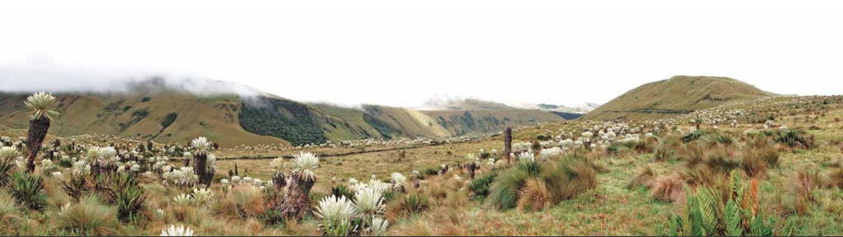
Los Páramos: Climate change and adaptation strategies in the Tropical Andes
Notes:
Title or focus of the lecture

Slide 2
Members of the group
Ana Belén Hurtado | Colombia | Ecology of Andean Forests | Alexander von Humboldt Research Institute
Katiana Murillo | Costa Rica | Communications on climate change | Latin American Communication Network on Climate Change (LatinClima)
Jonnathan Pérez Santamaría | Colombia | Politics and cooperation | Colombian Ministry of Foreign Affairs
Josue Celiscar | Haití | Resources management | FoProBiM
Kika Bradford | Brazil | Mountain recreation and tourism | Acceso PanAm
Paúl Cisneros | Ecuador | Environmental policy | Institute of Advanced National Studies (IAEN)
Mercy Ilbay | Ecuador | Climate change | Technical University of Cotopaxi
Alexandra Garcés-Santander | Ecuador | Climate Change Adaptation | CONDESAN

Slide 3
Notes:
In the tropical belt, there are mountains whose summits are covered by non-forested ecosystems, however those are highly biodiverse, socially, and economically important.
In the equatorial Andes and Costa Rica, this landscape is called páramo. According to their local languages, this name varies in the other continents, but they have a remarkable similarity with the Andean páramo.

Slide 4
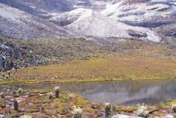
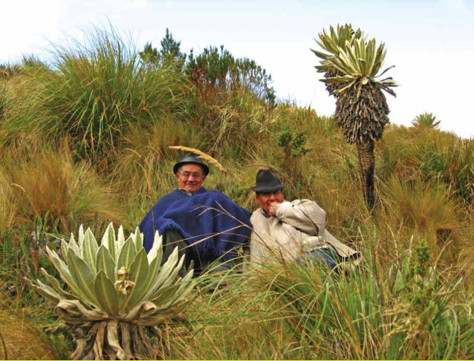
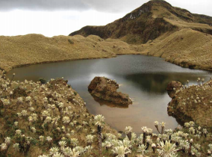
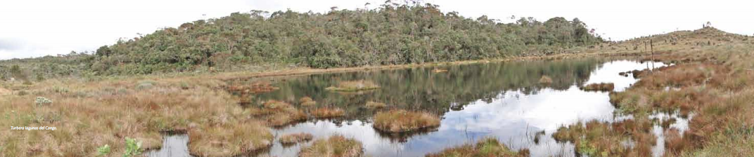
The páramos are dominated by grasslands and a mosaic of wetlands and peatlands with a presence of spectacular life forms such as the frailejón in the equatorial Andes and its African cousin, the giant Senecio.
Notes:
The páramo ecosystem is found generally at more than 3,000 meters above sea level and the temperature changes radically between day and night. The páramos are dominated by grasslands and a mosaic of wetlands and peatlands with a presence of spectacular life forms such as the frailejón in the equatorial Andes and its African cousin, the giant Senecio.
The soil in the páramos is rich in organic matter, retains, filters, and distributes water to lagoons, rivers, and streams. The processes of decomposition are prolonged due to the cold temperature in the ecosystem, so these soils are also very good retainers of carbon.

Slide 5
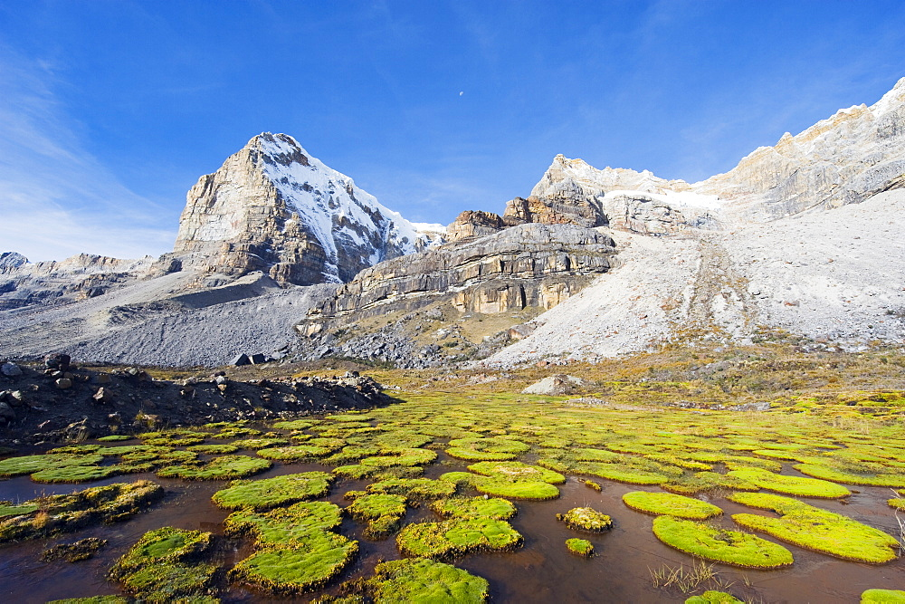
HYDROLOGICAL IMPORTANCE
Paramo is an ecological unit that regulates water flows and can retain large volumes of water in its soils and controlling its surface and subway flow.
Notes:
1. Approximately 11% of the earth's surface is in mountainous areas above 2000 m.a.s.l.
2. Paramo is an ecological unit that regulates water flows and can retain large volumes of water in its soils and controlling its surface and subway flow.
3. The increase of temperature would reduce its extension and would endanger the water supply of a good part of the population of the tropical Andes.
4. Paramos provide environmental services such as water supply basins for consumption, productive and hydro-energy activities.
5. Paramos behave like enormous sponges that are fundamental for the recharge of aquifers associated with Paramo areas.
6. They have an important water function: they are cold climate areas, which means much less evaporation and evapotranspiration than at lower altitudes.
7. Paramos feed large tributaries that go to the Pacific and Atlantic, such as the Amazon basin (López, Wright and Costanza, 2016).

Slide 6
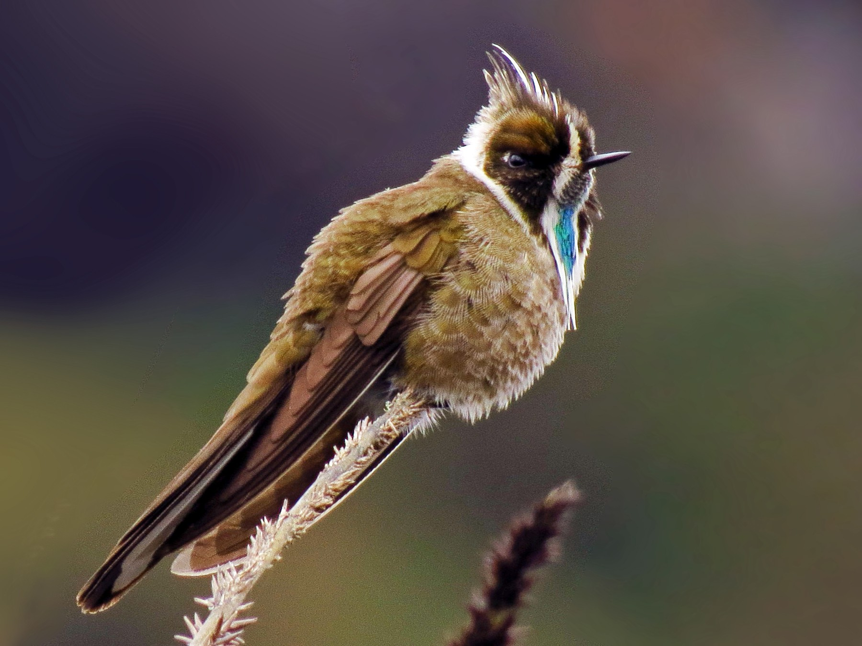
BIOLOGICAL IMPORTANCE
6.7% of the endemic plants and 5.7% of the vertebrate species in the world are between 3000 and 3500 m.a.s.l. (sub-paramo) and below the glaciers, 4500 - 5000 m.a.s.l., (superparamo or subnival)
Notes:
1. The natural systems of the high equatorial mountain are a set of ecosystems and landscapes in biogeographical islands.
2. Paramos are not the same, although they have common biophysical characteristics.
3. 6.7% of the endemic plants and 5.7% of the vertebrate species in the world are between 3000 and 3500 m.a.s.l. (sub-paramo) and below the glaciers (4500 - 5000 m.a.s.l.) (superparamo or subnival). (Llambí et al., 2012)
4. The plants and several of the animals in the paramo are not found in any other ecosystem in the world (Mena, Medina and Hofsede, 2001).
5. With respect to the fauna of the paramo, it is estimated that most species, especially mammals and birds, use the paramo as a corridor or transition zone for their activities in other life zones.

Slide 7
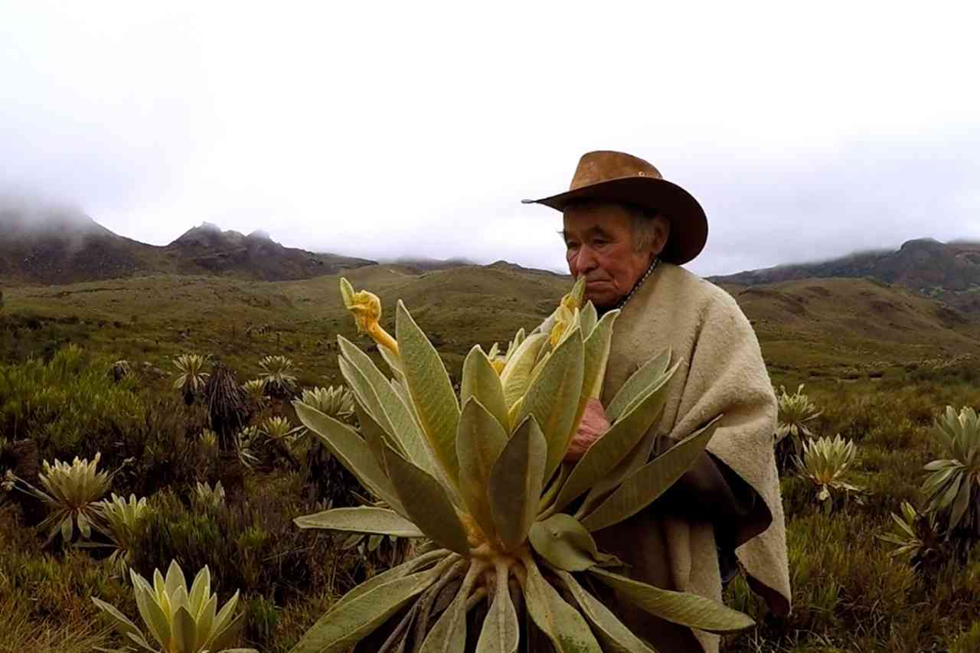
SOCIO-CULTURAL IMPORTANCE
Paramos (together with the Punas and Jalcas) formed the communication routes of the Inca culture, the Andean culture.
Notes:
1. Paramos are historical-biological heritage and evidence of spaces inhabited by pre-Hispanic ancestors.
2. The Spanish conquest and colonization transformed and altered the occupation and ancestral relations with paramos.
3. Paramos are centers of ethnic and cultural diversity, material of traditional knowledge, source of the cosmovision and determinant of forms of appropriation and territorial management.
4. Paramos (together with the punas and jalcas) formed the communication routes of the Inca culture, the Andean culture.
5. Water is the basis of Andean production, not only in relation to agriculture but also to industry (electricity) and health (drinking water).

Slide 8
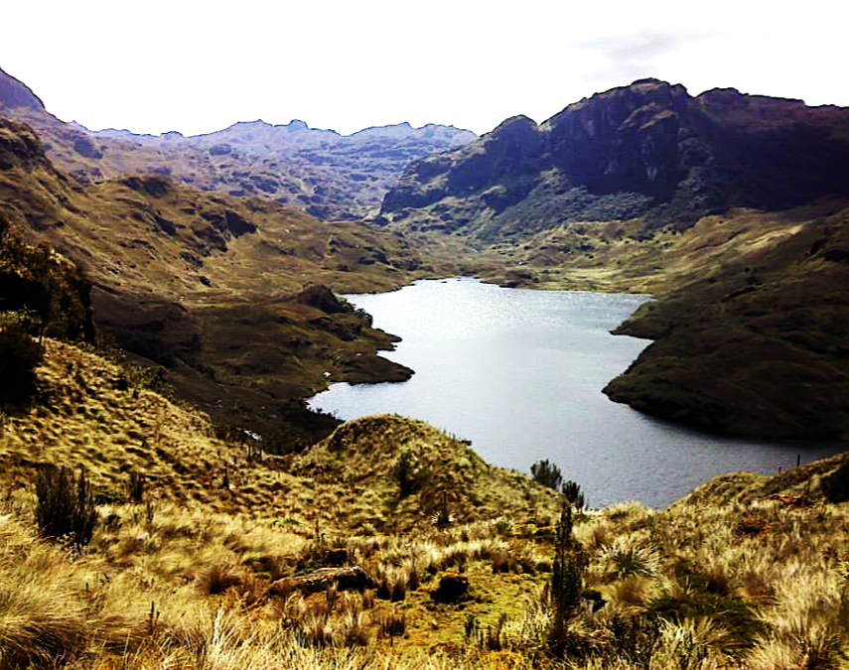
Main threats
Biodiversity loss
Soil compaction
Water quantity and quality depletion
Ecosystem degradation
Land-use change from conservation uses to productive uses

Slide 9

The cause of the main threats
Inequity in the access to productive land
Inequity in the access to water
The urban water demand
The urban food demand
The urban demand for leisure spaces
Quest of rural population to satisfy their basic needs and dignity

Slide 10
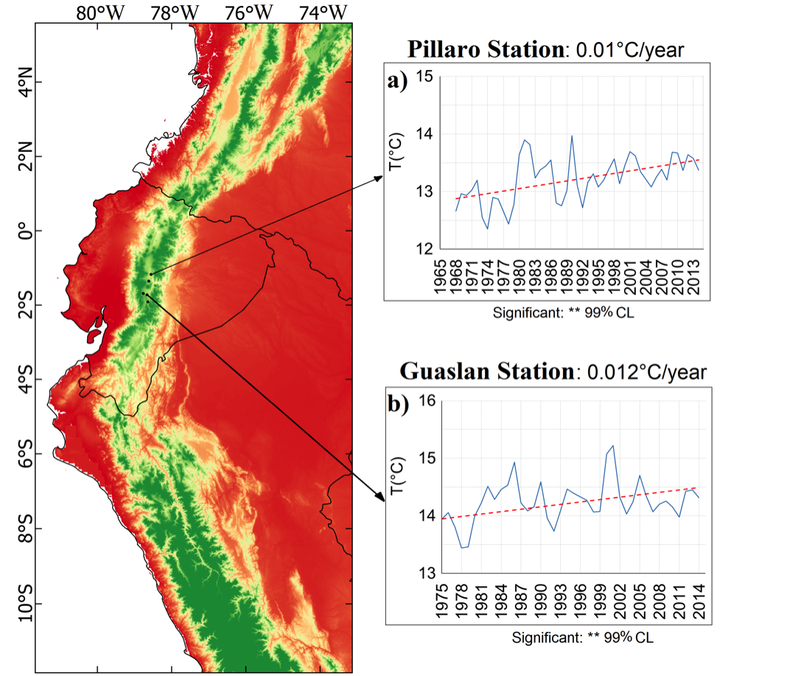
Observed Climate Trend Analysis of Ecuador
(1965-2014)
Temperature
Notes:
CL: confidence levels

Slide 11
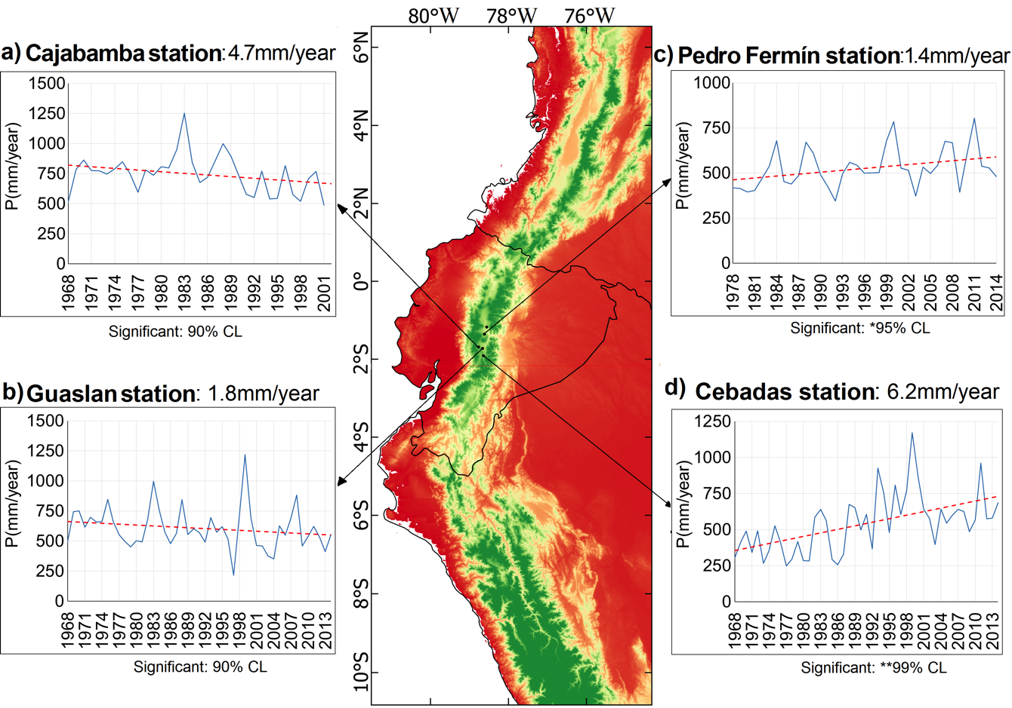
Observed Climate Trend Analysis of Ecuador (1968-2014)
Precipitation

Slide 12
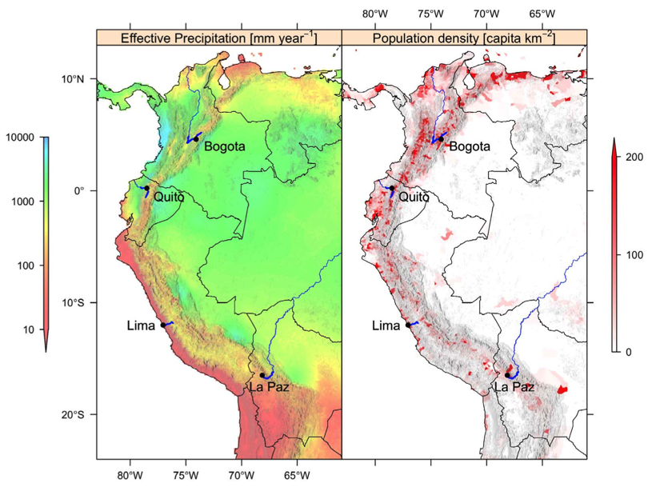
Effects of CC on water provision for cities are variable
“In all cases, the median projection of climate change suggests a relatively limited impact on water availability, but uncertainties are large. Despite these uncertainties, the expected demographic changes are very likely to outpace the impact of climate change on water availability and should therefore be the priority for local policy making” (Buytaert & De Bièvre, 2011:1).
Contextualizing the ´Meltdown narrative´
“What emerges from a review of selected research findings from Cotacachi, Ecuador to Elqui, Chile and several cases in-between and across time, is that environment is not the most important driver in times of flux, but also social processes and the (im)balance of power that determines, inevitably, to whom the water flows.” (Lamadrid, 2014:1)
Notes:
Globally, water resources for cities are under increasing stress. Holding 99% of the world’s tropical glaciers (Kaser, 1999), and glacier and snowmelt are especially important for basins draining into the Pacific Ocean, supplying up to 30% of the annual flow of some streams (Mark et al., 2005, Mark and Seltzer, 2003). The Andes are very diverse climatically and environmentally.
In the highlands of Ecuador, the climate is relatively moist, although seasonal. Therefore rainfall, in addition to glacier and snow-melt is important for the present hydrological regime. Water stress here may develop where snow and ice-melt is not buffering streamflow during periods of drought. This is a similar situation for the Callejon de Huaylas in Peru. However, drought is endemic in Diaguitas, Chile, where rainfall most years is negligent, except during ENSO episodes. Meteorological drought, thus does not really affect agriculture in arid regions, however this is detrimental to pastoralism, as Young et al. (2010) reveal. But a hydrological drought, where river runoff falls sharply, as when glaciers and snow disappear in the headwaters of the Elqui Valley, presents a much more significant problem. Irrigated agriculture is very sensitive to changes in water abundance, so an increase in cultivated area due to accelerated snow and ice-melt is very vulnerable to diminished flows, already projected for the future of the Elqui Valley.
Although glacier retreat is a very serious problem, as identified by the ‘meltdown’ narrative, the dynamic impacts of this varies across the Andes region. This is important to consider for the construction of adaptation measures tailored to specific locations. This situation, although of general concern to the people of the Andes, is especially problematic for smallholder farmers in the mountains dependent on melt-water for irrigation.
Two main stressors are climate change and population growth, but evaluating their relative impact is difficult, especially because of the complex topology of water supply. This is especially true in the tropical Andes, which is a region with strong climatic gradients and topographical limits to water resources. Models that account for some of the main variables affecting water availability in large Andean cities, heavily dependent on páramos, show that CC is important but less so tahn other variables such as demograpic growth.
The narrative of the causal chain of melting snow and ice caused by anthropogenic climate change leading to severe impacts on society, including small-scale irrigation communities on the margins, is used as a call to action for increased adaptation research, climate change reparations, and development action. Many difficulties arise when applying this narrative structure to certain Andean cases, such as urban water resources planning, since adaptation in this context is normative, favoring supply-side technocratic adaptation over demand-side adaptation.
Explain network graphs.

Slide 13
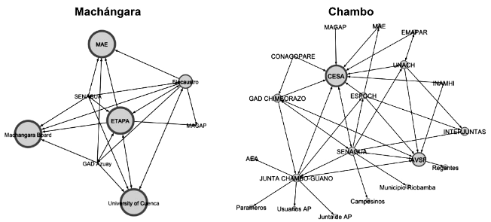

Slide 14
Adaptation to CC opportunities in Paramos
Participatory hydrological research with the communities of the paramos
Territorial planning to control the expansion of the agricultural frontier
Paramo conservation and restoration
Capacity building, communication and education
Strengthen good agricultural practices
Notes:
Mérida - Venezuela
Objective of interventions:
Safeguard the ecosystem services that paramos provide to communities
Participation of the communities from the conception of the initiatives to the implementation and monitoring.
Strengthen the capacities of the paramos populations
Improve knowledge and management of the paramos
Example 1: The community was part of the research since the initial phase. The process started by getting in touch with the community leaders and presenting them the objective of the research (water availability monitoring). Then the proposal was presented to the communities to validate in a more extensive way. The community helped in the installation of the equipment and taking good care of them. The Project developed an education program with the community to train them in paramos monitoring and raise awareness about water conservation and how data helps us manage our paramos. The information generated led the community to take better decisions about how to manage water for their irrigation systems.
The measure promoted not only community strengthening, but also generated a space for reflective dialogue around the water problem and production, including communities in the decision making about paramo conservation

Slide 15
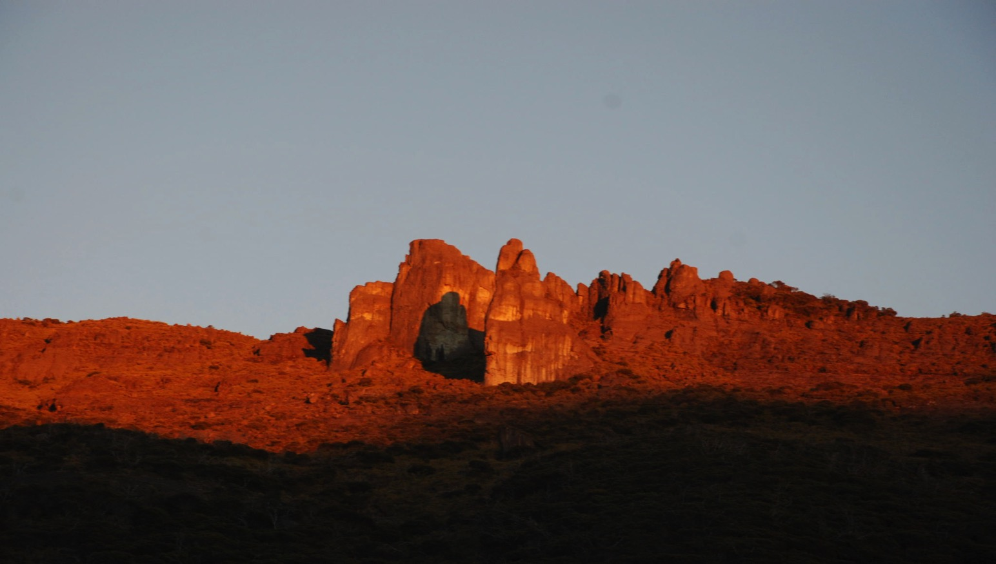
Thanks!

