Slide 1
Why Mountains Matter

Slide 2
cover about:
22%
of the earth’s land area

Slide 3
are home
14%
of the world’s population

Slide 4
provide
70%
of the world’s
fresh water

Slide 5
supply renewable energy

Slide 6
host about
25%
of terrestrial biodiversity

Slide 7
contribute to food security
with key mountain crops

Slide 8
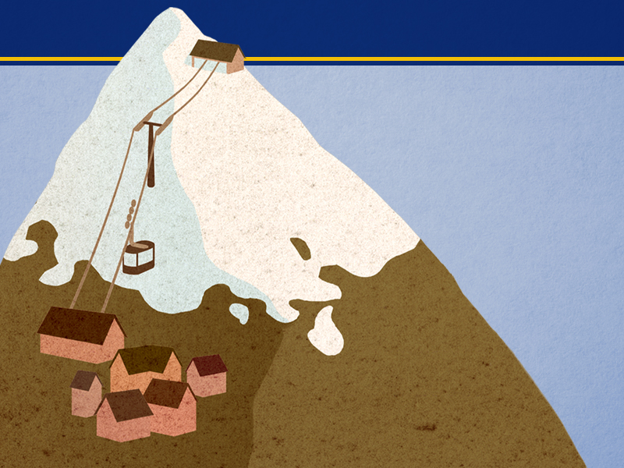
attract about
15-20%
of global tourism

Slide 10
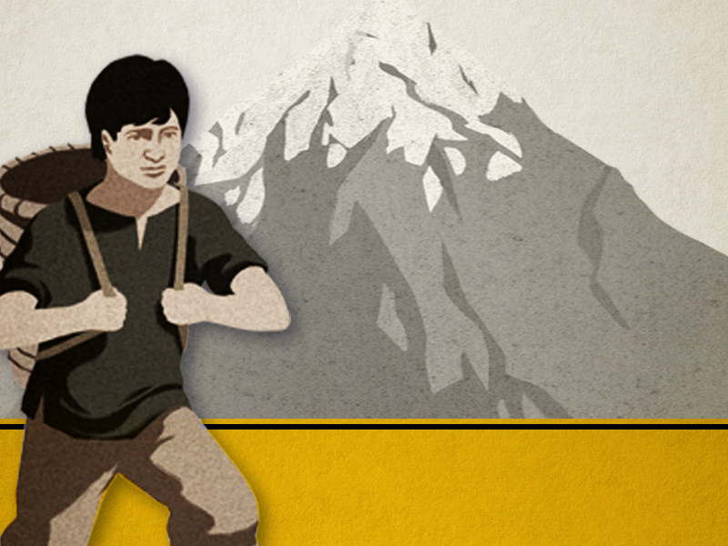
Mountain peoples are among
the world’s poorest and hungriest

Slide 11
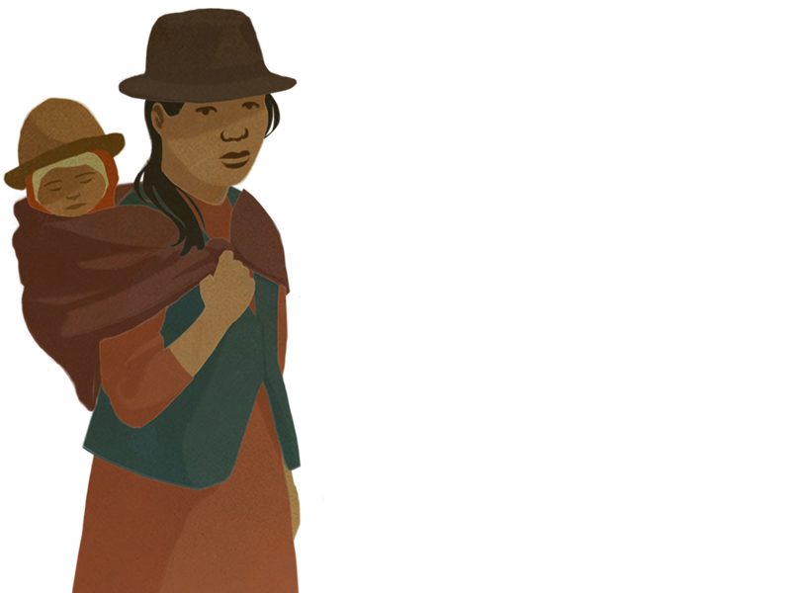
Harsh living conditions
which leads to migration

Slide 12
fragile ecosystems

Slide 13
Indicators of climate change

Slide 14
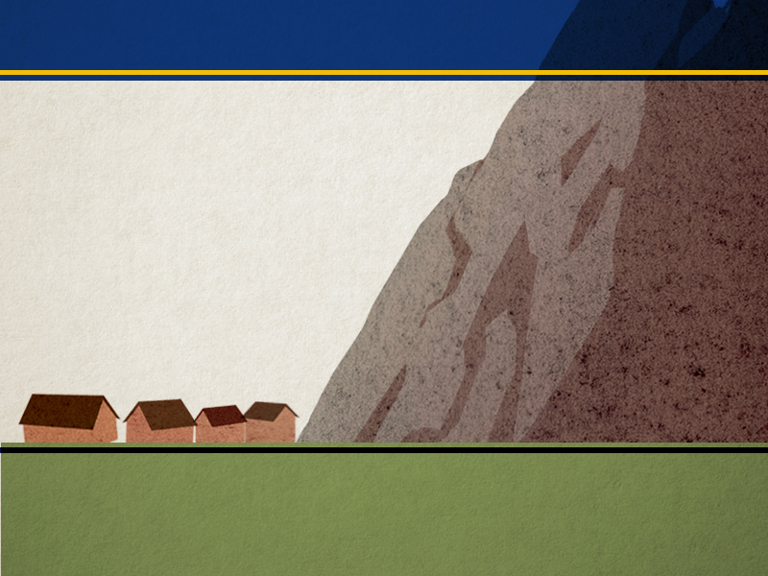
Vulnerable to extreme weather events
natural disasters

Slide 15
Mountain communities have traditional knowledge
solutions, adaptation options
to build resilience

Slide 16
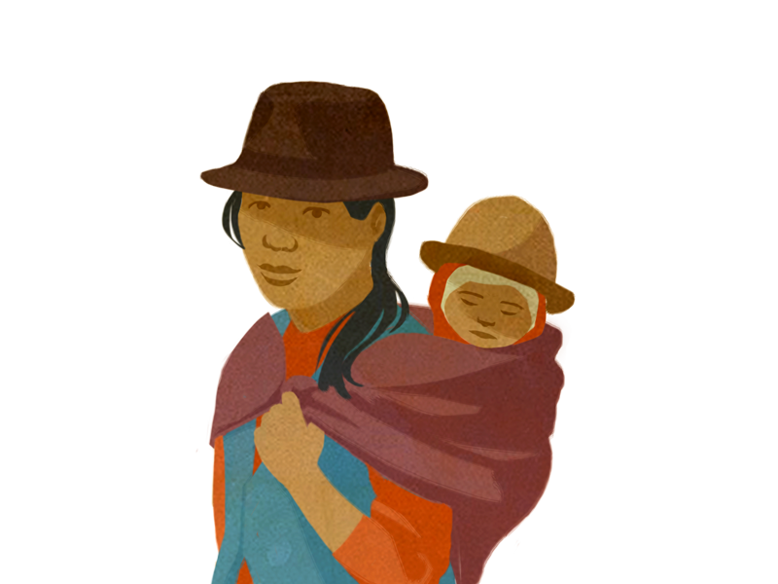
Mountain peoples’ voices often unheard

Slide 17
We need to join forces
to protect people and the environment
so that mountains can contribute
to a more sustainable future

Slide 18
thank you
www.mountainpartnership.org

