Slide 1
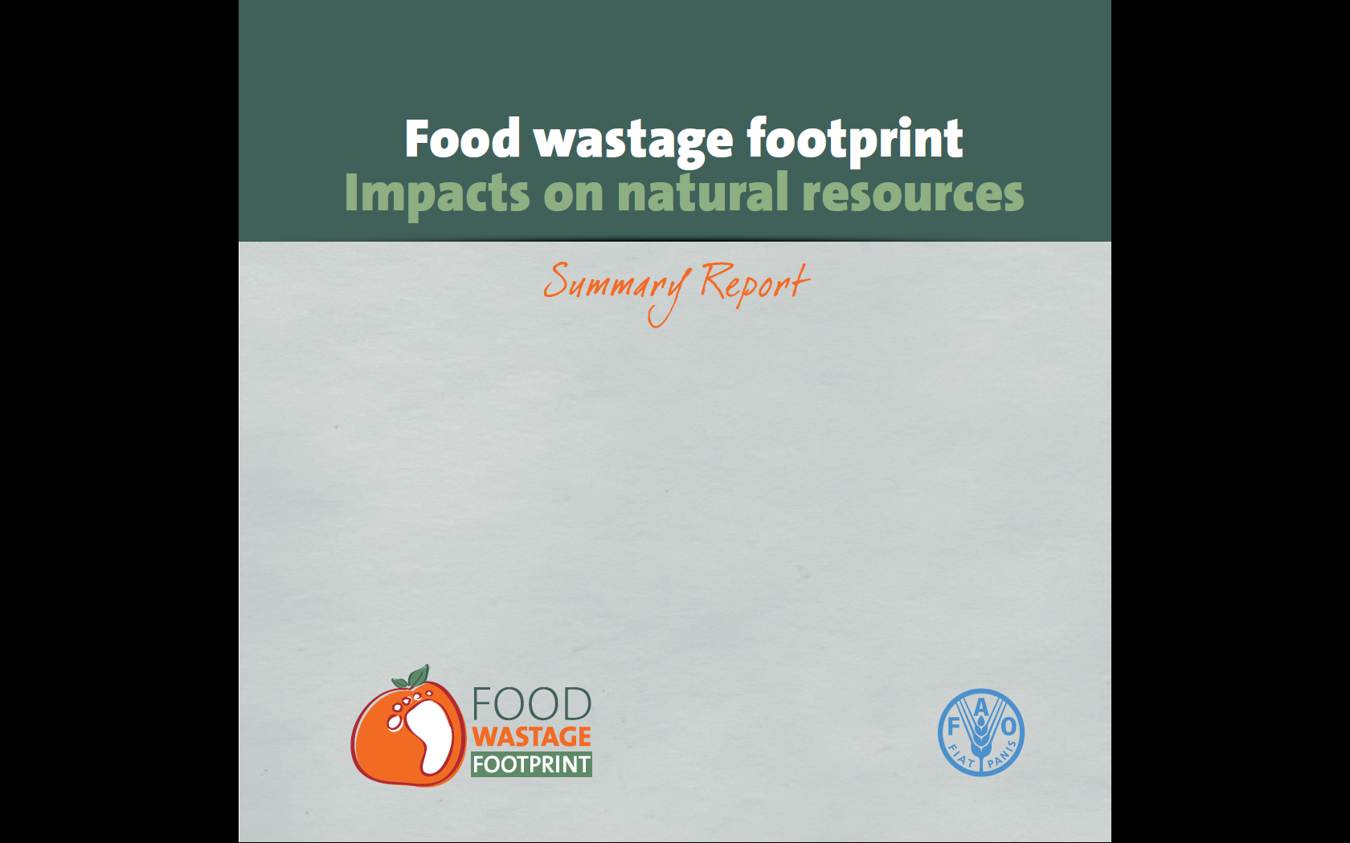

Full Cost Accounting of Food Wastage
State-of-art after the E-Forum

Slide 2
Full Cost Accounting of Food Wastage
Why bother?
After coal power generation, agriculture has globally the highest impact sector on the environment when measured in monetary terms
The economic loss incurred by food wastage has not triggered the necessary investments in reduction measures, despite decades of FAO assistance to countries on post-harvest losses; at the retail and consumer levels, it is economically “profitable” to waste food
FCA seeks to lower the “profitability” of unsustainable production and consumption practices by monetizing unpriced natural resources’ inputs to food production
Social costs are used to assess the contribution of ecosystems to human wellbeing and inform strategic decision-making

Slide 3


Food Wastage Footprint
Environmental Impacts
Environmental impact of 1.3 Gtonnes of food wastage/ year
3.7 Gt CO₂eq/year
=
3rd largest emitter if food wastage was a country
250 km³/year
=
3 times lake Geneva
CO₂
Carbon
Water
Land
Biodiv.
1.5 billion ha used to grow food that is wasted
=
30% of agricultural land
66% of endangered/vulnerable species threatened by food production

Slide 4
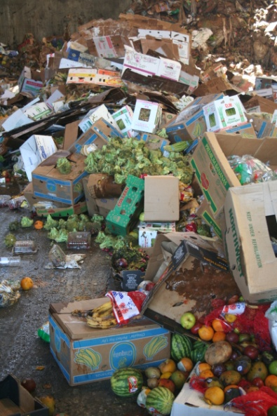



Food Wastage Footprint
Economic Impact
Economic quantification of 1.3 Gtonnes of food wastage
$
If using producer prices
<
<
If using trading prices
USD 750 billion / year
USD 920 billion / year
Superior to Saudi Arabia GDP
Inferior to South Korea GDP
This cost is much higher numbers when socio-environmental costs monetized
Full Cost Accounting of Food Wastage

Slide 5
Food Wastage Footprint
FCA Framework
Food wastage during
Production
Post-harvest
Processing
Distribution
Consumption
Reduced food availability => Food security concerns
Increased pressure on land for production => Planetary boundaries concerns
Increased waste management challenges => Landfill concerns
Loss of productivity
Direct and indirect impacts
Environmental impacts
Socio-economic impacts
Pillars of sustainable livelihoods
Direct impacts
Scarcity
Increased public costs
Income
Air
pollution
Climate change
Energy
Increased labour demand
Increased food prices
Food security
Land occupation
Land degradation
P-resources
Increased pesticide and nitrate exposure
Health and wellbeing
Water use
Water pollution
Land
Increased safety and displacement risks
Reduced vulnerability
Biodiversity loss
Ecosystem services
Water
Reduced access to ecosystem services (regulating, provisioning and supporting)
Deforestation
Loss of wild landscapes
(grasslands, wetlands)
Sustainable use of the natural resource base

Slide 6
Full Cost Accounting of Food wastage
CO₂
Carbon Accounting
Selected Carbon valuation methodologies
Marginal abatement cost
Market price of Carbon
Cost of reducing emissions
efficient mostly if > USD 20/t
Value of traded carbon emissions
depends on volatile markets
values are currently low
USD 5/t (was 45/t few years ago)
CO₂
Social cost of Carbon
Carbon taxes and fines
Full cost of a tonne of carbon (or equivalent GHG), emitted today, over the course of its lifetime in the atmosphere.
includes external costs + society willingness to pay to avoid future damages
wide range of variation (USD 8-85/tonne) depending on coverage and key parameters choice, such as discount rate, time-horizon, risk aversion and climate sensitivity.
Value defined by governments & intergovernmental organizations
values have a wide range and reflect political reality (EU/ETS is Euro 100), not damage costs
Notes:
Cf notes from Soren apart for the carbon taxes and fines

Slide 7
Full Cost Accounting of Food wastage
CO₂
Carbon Accounting
The Social Cost of Carbon framework
 | Uncertainty in Valuation
Uncertainty in Predicting Climate Change |  | Market | Non-Market | (Socially Contingent)
 | Projection (e.g. sea level Rise) | Coastal protection | Heat stress | Regional costs
 |  | Loss of dryland | Loss of wetland | Investment
 |  | Energy (heating/cooling)
 | Bounded Risks (e.g. droughts, floods, storms) | Agriculture | Ecosystem change | Comparative advantage & market structures
 |  | Water | Biodiversity
 |  | Variability | Loss of life
 |  |  | Secondary social effects
 | System change & surprises (e.g. major events) | Above, plus | Higher order social effects | Regional collapse
 |  | Significant loss of land and resources | Regional collapse
 |  | Non-marginal effects | Irreversible losses
Studies proposed:
Waldhoff et al. (2011)
Stern (2007)
The Social Cost of Carbon Risk Matrix adapted from Watkiss (2008) illustrating the gradient of difficulty (from green to red) in taking different climate effects categories into consideration

Slide 8
Full Cost Accounting of Food wastage
CO₂
Carbon Accounting
Draft Carbon monetization
Food Wastage GHG Emissions
= 3.7 Gt CO₂eq/year
USD 55 billion
(although with a range of 10-900 billion)
Waldhoff et al. (2011)
USD 315 billion
Stern (2007)
Remark: a wide range of social costs included such as health, insurance for damage, climate refugees, poverty, etc.

Slide 9
Full Cost Accounting of Food wastage
Water Use Accounting
Focusing on direct and indirect use of water
Total Economic Value
Use value
Non-use value
Direct use value
Indirect
use value
Bequest
value
Existence
value
Option value
Altruistic
Value as a necessary input for ecosystems and thus, their existence and their services, such as:
Biodiversity/species habitat
Water purification services
Mitigation of salinization
“Water pollution” from agricultural runoff will be accounted for as an external cost of fertilizer and pesticide use. However, water withdrawal beyond natural rate of flow may lead to a reduction in water purification services
Consumptive
e.g. Irrigation
Non-Consumptive
e.g. Recreation
Current scope of the FWF study

Slide 10
Full Cost Accounting of Food wastage
Water Use Accounting
Draft Water use monetization
Direct use (irrigation water)
Food wastage water use
= 250 km³/year
USD 0.56 billion
(using benefit transfer for USD 0.01/m³ in the UK)
USD 280 billion
(using benefit transfer for USD 0.25/m³ in Bangladesh)
Realistic estimate
USD 10-50 billion
Indirect use (ecosystem services)
Open questions
As water for irrigation is not viable if water cost more than USD 1/m³, could 10 cents/m³ be a realistic global estimate for the valuation?
There is need to account for water scarcities under direct use value: best method?
How to do benefits transfer of ecosystem services?
Notes:
The realistic number is based on taking into account which values are the most frequent values. It is less extreme than the other values for the large range. It corresponds to a range of 0.2 cent to 1 Dollar, instead of the extreme range from 0.01 to 5 Dollars

Slide 11
Full Cost Accounting of Food wastage
Land Use Accounting
Focusing on direct and indirect use of land
Total Economic Value
Use value
Non-use value
Direct use value
Indirect
use value
Option value
Existence
value
Bequest
value
Stewardship value
Provisioning: Food, fiber and timber production
Regulating: Carbon storage
Cultural: Tourism, recreational hunting
Supporting: Nutrient cycling, micro-climate
Regulating & Cultural: Watershed protection, flood attenuation, pollution assimilation
Regulating: Area used for waste recycling
Cultural: Area that becomes of recreational value
Provisioning: biodiversity possibly useful for humans

Slide 12
Full Cost Accounting of Food wastage
Land Use Accounting
Draft land use monetization
Land occupation
Land occupation by food wastage
= 1.5 billion ha/year
Trucost, 2013 uses land values dependent on provision of ecosystem services > USD 200 billion
Land degradation
Food wastage degradation potential (using crops degradation potential)
USD 130 billion
Large spectrum assessment of costs including damages on site (e.g. yield loss, drop in land value) and off site (e.g. flooding, sedimentation, health)
Pimentel, Harvey et al. (1995)
USD 10 billion
considering only financial costs from agriculture to society (i.e. treatment, prevention, administration and monitoring costs)
Pretty, Brett et al. (2011)
Question
Which methodology could be used to best estimate land occupation costs: opportunity cost, rental cost, possible production value, etc.?
Notes:
Note: The USD 200 billion is a partial estimate as it only includes the 19 couples agricultural sector/regions with the strongest land degradation as these are only ones showcased in TruCost report

Slide 13
Full Cost Accounting of Food Wastage
Biodiversity/Ecosystems Accounting
Total Economic Value
Use value
Non-use value
Direct use value
Indirect
use value
Existence
value
Altruistic
value
Bequest value
Option value
Direct harvest of wild species for pharmaceutics; pollination services of pollinators
Water purification, climate change mitigation (e.g. soil carbon sequestration in wetlands)
Pharmaceutics not yet discovered
Existence of the Great Barrier Reef
Knowledge that others can use the Great Barrier Reef (e.g. for tourism)
Conserving the Great Barrier Reef for future generations
Focus area for the FWF Project

Slide 14

Full Cost Accounting of Food Wastage
Biodiversity/ Ecosystems Accounting
Drivers of biodiversity loss (MEA, 2005) and draft indicators
Over-exploitation
Pollution
Fisheries depletion
Grassland degradation
(cf land use component)
N-eutrophication
P-eutrophication
Pollinator loss (linked to pesticides)
Loss
Climate change
Habitat change
Global Warming Potential
(cf carbon component)
Deforestation (cf land use component)
Invasive Species

Slide 15


Full Cost Accounting of Food Wastage
Biodiversity/ Ecosystems Accounting
Draft Biodiversity/Ecosystem Loss Monetization
Overfishing costs for lost/wasted fish
USD 50 billion/ year
N
Damages due to N runoff into protected areas
USD 20 billion/ year
Loss of pollinators
USD 20-25 billion/ year
Remark: the quantification of biodiversity impact is too rough, incomplete and difficult to estimate meaningfully

Slide 16
Full Cost Accounting of Food Wastage
Accounting
Accounting for part of the environmental externalities doubles

Slide 17
Full Cost Accounting of Food Wastage
The way ahead for environmental monetization
Improving the database
Identifying the adequate estimate for the social costs of Carbon
Reality check for upper estimates
Inclusion of water scarcities into costs evaluation
CO₂
Carbon
Water
Land
Biodiv.
Alternative land occupation valuations
Refined erosion rates per country
Improvement of current calculations
Inclusion of new parameter valuations: P-eutrophication, species’ loss

Slide 18
Full Cost Accounting of Food wastage
Challenges
Challenges ahead for Full-Cost Accounting
FULL-COST ACCOUNTING
DOUBLE COUNTING OF IMPACTS
DATA AVAILABILITY / BENEFIT TRANSFER OPPORTUNITY
SOCIAL COSTS ACCOUNTING
NARROWING ESTIMATES RANGE
Notes:
What I mean by Ethics in Social Costs is « how do you ethically value a life? »

Slide 19
Full Cost Accounting of Food Wastage
So what?
Monetizing the environmental and social cost of food waste has several limitations but acts as a wake-up call on the magnitude of the problem and future risks (e.g. increased mitigation costs, ecosystem services collapse, natural events)
Agriculture does not generate enough revenue to cover its environmental damage: natural capital cost is USD 2 369 billion when revenue is USD 1 567 billion – with an impact ratio of 1.5 (Trucost, 2013)
Integrating FCA in market prices would unrealistically inflate food prices!
Valuation studies identify hotspots requiring consideration in the food supply chain (price volatility from scarcity) in order to:
  anticipate decreased company profitability
  consider shadow pricing in sustainable procurement
  appraise natural resources assets and risks for investments
  evaluate trade-offs and opportunities among sectoral policies
  develop forward-looking regulation

Slide 20
THANK YOU
www.fao.org/nr/sustainability/food-loss-and-waste

