Slide 1





18 Organic World Congress, Istanbul, Turkey
Pre-Conference, 12 October 2014
SUSTAINABILITY AND
ORGANIC LIVESTOCK IN 2050
Nadia El-Hage Scialabba
Senior Natural Resources Officer
Food and Agriculture Organization of the United Nations
AND
Christian Schader and Adrian Muller, FiBL

Slide 2

INTRODUCTION

Slide 3

Introducing SOL-m
SOL-m = Sustainability and Organic Livestock modeling
An FAO-FiBL cooperation: 2011-2014
About global conversion of organic livestock production: impacts on food security and the environmental
Study the trade-offs and synergies between the main environmental and socio-economic challenges at global level

Slide 4
Research questions and objectives
Can organic agriculture meet global food demand in 2050?
Would organic scenarios lead to higher land occupation?
To inform the policy debate on pros and cons of livestock intensification and extensification strategies
To direct to research requirements for ensuring food availability within planetary boundaries

Slide 5
Modelling approach
General Algebraic Modeling System (GAMS)
FAOSTAT: Food Balance Sheets, Tradestat, Fertistat, Aquastat
Scientific literature: LCAs, Ecoinvent, Erb 2007, Seufert 2012
229 countries, 180 crops, 35 livestock activities
Ceteris paribus: biofuel, aquaculture , technological progress

Slide 6
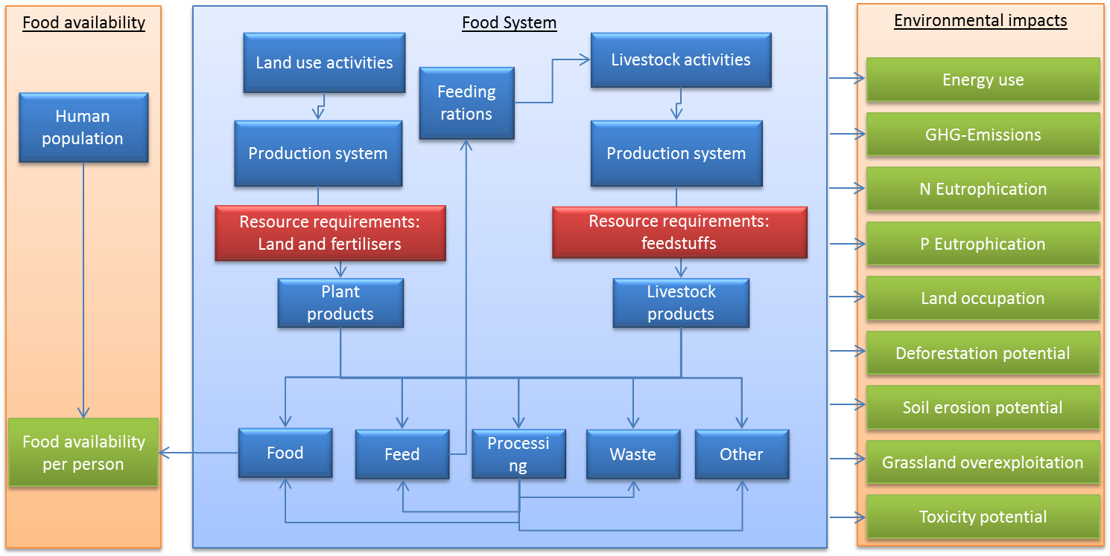
SOL-m mass flow components

Slide 7
Herd structure model
Maximum entropy approach for cows, pigs and chicken
Input: living animals, producing animals, production volume, normative values (ranges for production parameters)
Output: shares of animal types in a herd (e.g. calves, sires, beef cows, dairy cows)
Important for estimating feeding requirements and GHG

Slide 8
Agriculture land use worldwide (FAOSTAT, 2011)

Slide 9
SOL-m scenarios
Baseline: current land use (arable crops, permanent crops, grassland), livestock numbers/herd structures, feeding rations, commodity trade, prices, utilization of commodities (food, feed, seed, waste, other), population, nutrition.
Reference scenario: FAO projections 2050 on population numbers and nutritional requirements, as well as technical progress (yield potential) and intensification trends.
Full conversion to organic livestock production in 2050
management of grasslands according to organic standards
production of cropland for concentrates according to organic standards
increased share of other organic cropland (assuming specialized concentrate-producing farms will mostly do a conversion of their entire farm)
Reduction of concentrate use by 0, 25, 50, 75 and 100% in 2050
Looking for the optimal combination of
organic and concentrate use scenarios

Slide 10
ORGANIC SCENARIOS

Slide 11
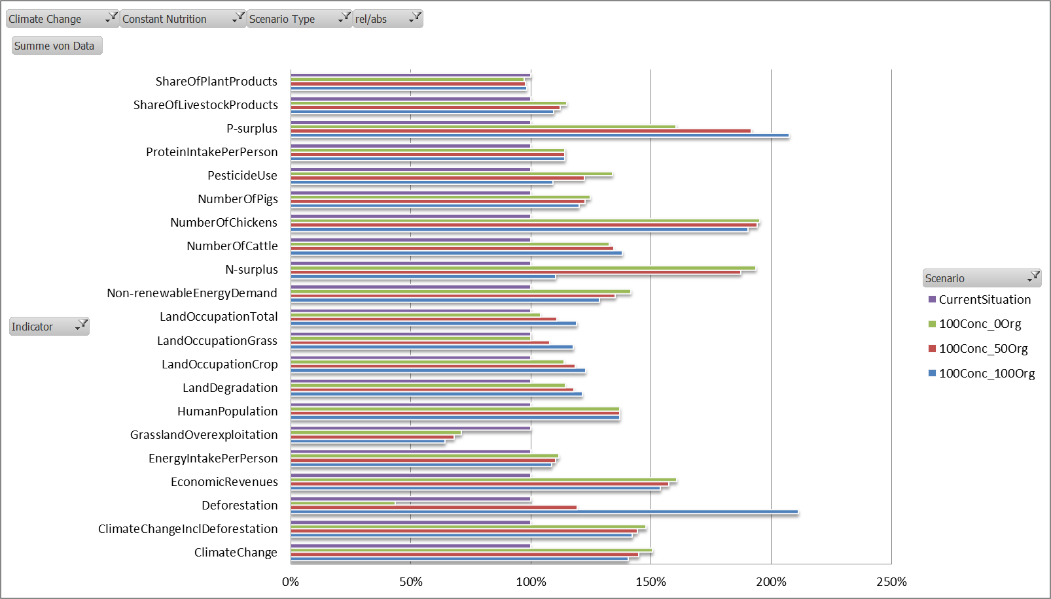
Organic livestock scenarios 2050 (100% concentrates)

Slide 12
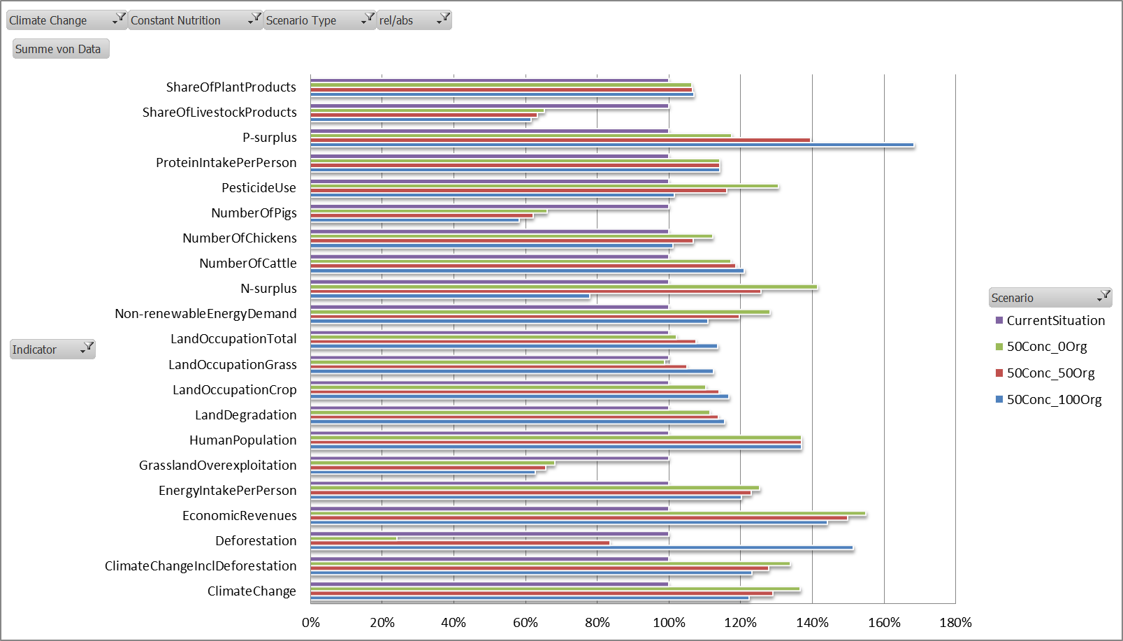
Organic livestock scenarios 2050 (50% concentrates)

Slide 13
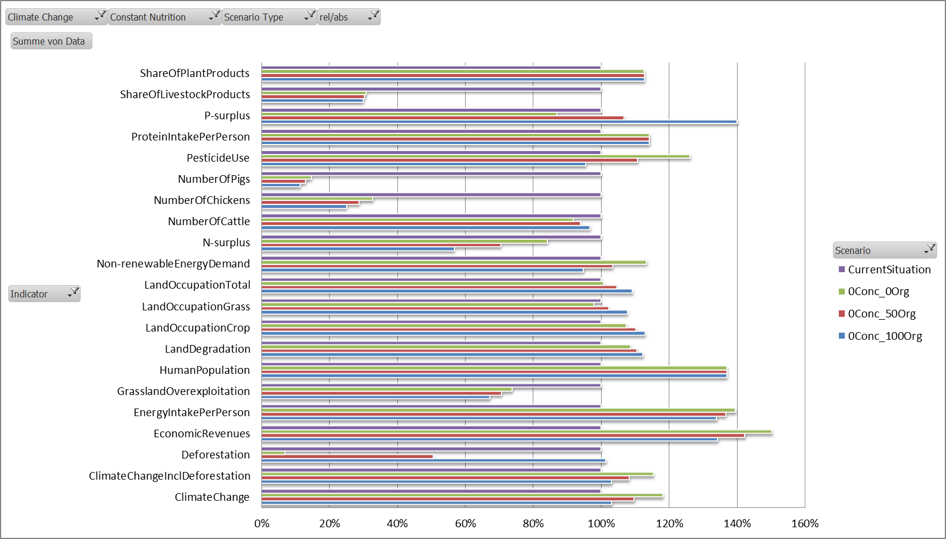
Organic livestock scenario 2050 (0% concentrates)

Slide 14
SOL-m results

Slide 15
Trade-offs and synergies
Business-as-usual: BAU is not an option, as environmental impacts will rise till 2050 and further pressure on food availability may increase
Low-input livestock systems: synergies between food availability and most environmental indicators
Full organic conversion:
Can produce sufficient food for 9.2 billion in 2050
Positive indicators: GWP, N, P, energy, water, toxicity potential
One negative impact: land, hence deforestation (+450 x 10⁶ ha)

Slide 16
Ideal scenarios for 2050
Organic livestock scenarios fare best when combined with reduced concentrate feeds :
-50% still requires additional 250 million ha cropland
Zero use of concentrate feed does not require more lands
Global environmental impacts can be mitigated if livestock production was based on grasslands and residue recycling
These extensification strategies can produce 3028 kcal/cap/day but with consumption of livestock products reduced by 3-4
Change in livestock availability
affects mainly monogastrics

Slide 17
RESEARCH REQUIREMENTS

Slide 18
Animal feed issues
About 36% of world consumption of cereals goes to feed: developing countries account to 42% of world total and will increase to 56% by 2050
Grasslands and pastures reduce inefficient use of arable lands
Reduced concentrate feed would yield more food for direct human consumption while providing multiple ecological services
With globally supplying sufficient calorie and protein, the share of ruminants and monogastrics differs

Slide 19
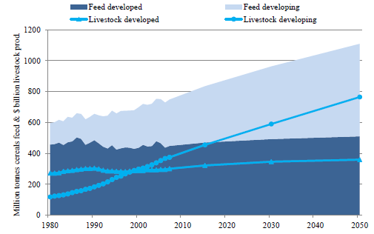
Cereal feed and livestock production
Alexandratos and Bruinsma, 2012

Slide 20
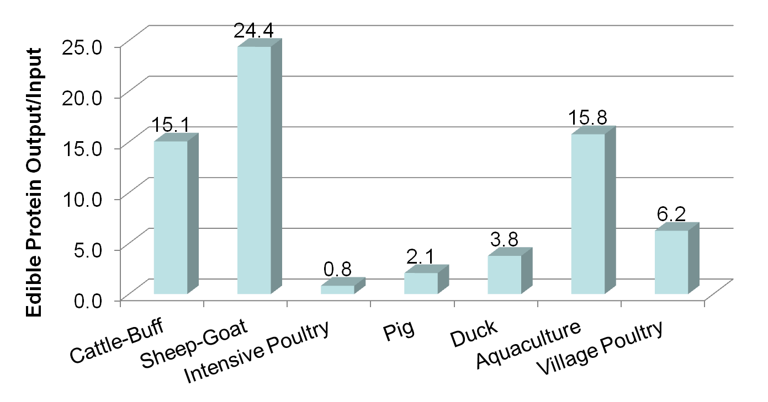
Food conversion efficiency
Mean based on data from India, Pakistan, Bangladesh, Thailand, Bhutan, Mongolia (FAO, 2014)

Slide 21
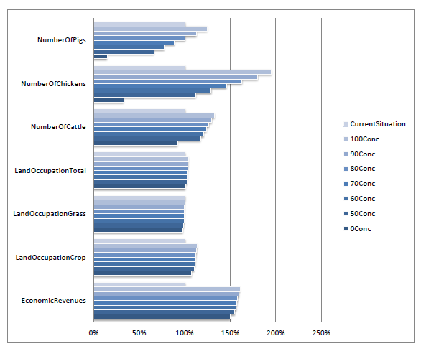
Concentrate feed reduction impacts

Slide 22
Feed sources
Grassfed ruminants will require a better knowledge of nutritional value of different type of grasslands for different spp.
Feed supply for monogastrics will require novel technologies to produce feed from agricultural residues, agro-industrial by-products and food waste.
Feed sources assessments are needed to estimate national/local:
Chemical composition and nutritional value of feed ingredients
Nutrient balance (identifying surplus and deficits)
Optimizing use of available feeds
Forecasting feed resources in time and space
Generating optimum livestock-feed relationship
Balancing trade-offs in biomass use
Export/import of feed ingredients and prices

Slide 23
CONCLUSION

Slide 24
Organic Plus
Up-scaling organic agriculture globally is technically feasible
But organic standards must be strengthened on animal feed
Existing standards on grassfed (USA) or pasture-fed (NZ, UK) could inform on steps towards concentrates-fee organic feed
Organic YES but through a more rational use of biomass and lands

Slide 25
Thanks
www.fao.org/nr/sustainability/sustainability-and-livestock

