Slide 1
Analysis of Micro Indicators on Food Security for Afghanistan
FAO Regional Training Workshop on Food Security Statistics
Bangkok, Thailand
29 November 2013

Slide 2
National Risk and Vulnerability Assessment (NRVA) 2007/8
About the Survey
Sample Size: 20,576 HHs
Sampling Methodology: Two Stage Stratified Sampling
Response Rate: 97 %
Period Covered: Mid Aug 2007 – End Aug 2008
Reference Period of Food Data: Weekly
Notes:
Is a multipurpose hh survey
Sampling methodology: representative by urban/rural and province level

Slide 3
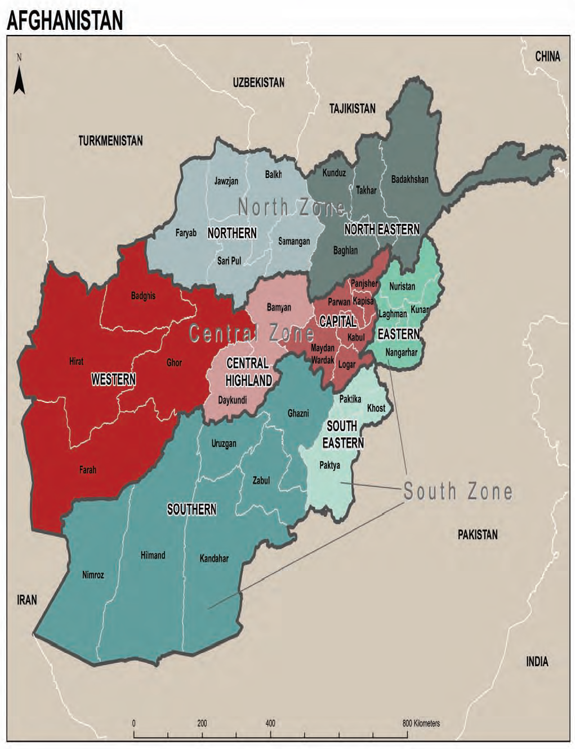
NRVA 2007/8 Survey
Questionnaire:
Developed in Teleform
Male, HH and Shaura
Female, HH and Shaura
Market Price
Geographic Regions of NRVA 2007/08 Survey
Indicators:
25 MDG
key indicators for AFG
Source: AMS 2010
Notes:
URBAN/RURAL stratification
By Area: region and province
Teleform: allow data scanning instead of manual data entry

Slide 4
NRVA 2007/8 Survey
Key Findings of the Survey
59 % of population engaged in Agriculture and Livestock sector
Wheat is an important Crop:
77% hh farming on irrigated land
94% hh farming on rain-fed land
Access to safe drinking water:
27% of the population
Notes:
Indicators:
Poverty
Population Structure
Labor force
Agriculture
Education
Health
Housing

Slide 5
NRVA 2007/8 Survey
Limitations of the Survey
Insecurity in some areas
Lack of female enumerators in some areas
Low literacy rate in rural areas
Female under reporting
Income under reporting
Food item categories were too broad
Recommendations
Break down the sub categories of food items
Specification of “other” option in the Questionnaire
Enhancement of the skills and knowledge of the enumerators
Notes:
Literacy rate national: 26
Male: 39
Female: 12
Urban:
Male: 62
Female: 33
Rural:
Male: 35
Female: 7

Slide 6
Analysis of DEC and MDER by Urban/Rural and Region
Category | DEC (survey) | DES (SOFI) | MDER
National | 2,570.0 | N/A | 1,665.0
Urban | 2,564.2 |  | 1,662.8
Rural | 2,571.4 |  | 1,665.5
By Region
Central | 2,713.5 | N/A | 1,693.9
Northeast | 2,680.9 |  | 1,652.6
West | 2,510.8 |  | 1,670.2
South | 2,185.1 |  | 1,660.4
Notes:
From table 1.1
Question: DES (SOFI)???

Slide 7
Analysis of Main Source of Acquisition
Category | Purchase (%) | Own Production (%) | Other (%) | Away from Home (%)
National | 75.56 | 18.92 | 3.14 | 2.38
Urban | 75.71 | 18.66 | 3.17 | 2.45
rural | 75.72 | 18.99 | 3.14 | 2.36
Gender
Male | 75.53 | 19.02 | 3.06 | 2.39
Female | 77.50 | 12.41 | 8.82 | 1.27
Notes:
Ref: Table 1.5 dietry energy consumption
Table 1.7 mv

Slide 8
Notes:
Table 4.1 inequality quintile
Some indictors on inequality if time allows
Talk about the survey and limitation of the survey
Food list like beaf
Rice :in flour
The food list is broad now.

Slide 9
Dispersion of Average Dietary Energy Consumption and Household Size by Income Quintile
Quintiles | Average HS | Average DEC kcal/person/day
Lowest | 7.9 | 1974.91
2 | 7.6 | 2353.99
3 | 7.3 | 2599.88
4 | 7.0 | 2792.97
Highest | 6.5 | 3289.27

Slide 10
Analysis of Macro Nutrients
Category | Share of DEC from protein (%) | Share of DEC from fat (%) | Share of DEC from carbohydrates (%)
Balanced MN Goal (%) | 10-15 | 15-30 | 55-75
National | 11.18 | 22.19 | 66.62
Urban | 11.15 | 22.20 | 66.58
rural | 11.18 | 22.19 | 66.63
Gender
Male | 11.18 | 22.20 | 66.61
Female | 10.92 | 21.80 | 67.27
Notes:
Table 1.10: should be used
1.11 show balanced diet
Ref: table 2.4
Question: national level???
Gender???

Slide 11
Notes:
Make graph table 2.1
another slide on most consumed food table 3.1

