Slide 1
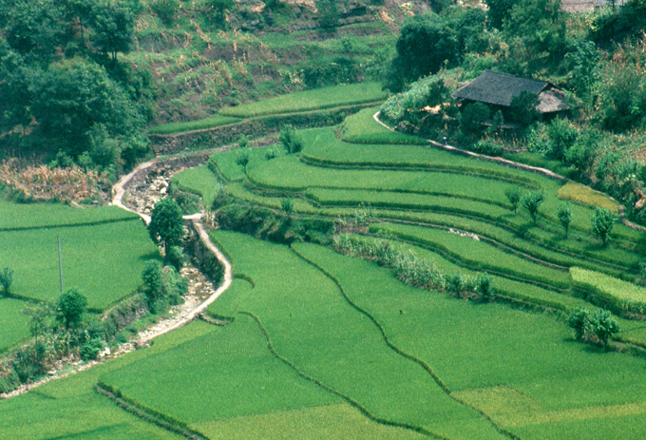
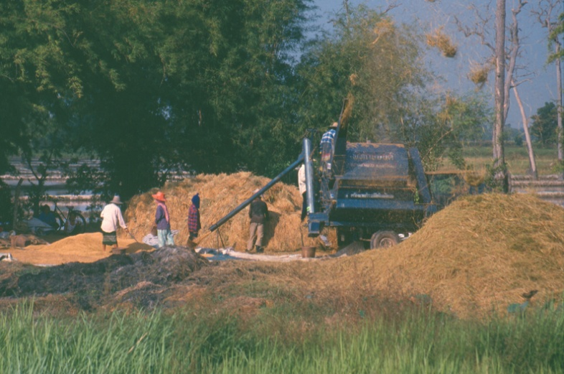
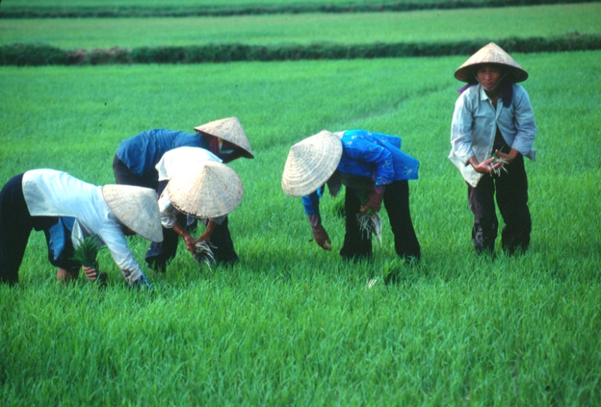
Rice culture, heritage and multi-functionality
David Dawe
Agricultural Development Economics Division and Regional Office for Asia and the Pacific, FAO
Bangkok, Thailand, 28 November 2013

Slide 2
Non-commodity outputs (externalities) from rice production
Preservation of cultural values
Flood prevention (paddy fields)
Mitigation of soil erosion (e.g. rice terraces)
In situ preservation of biodiversity
Eco-tourism
Bird habitats
Methane emissions
Water pollution from runoff of agro-chemicals
Health problems for farmers who do not apply pesticides properly

Slide 3
Externalities from rice production NOT the same everywhere
Vary by ecosystem, e.g. lowlands vs. uplands
Vary by level of economic development, e.g. negative health externalities more of a problem in poor countries
Vary in terms of their jointness (i.e. the extent to which rice production is necessary to give us the positive externalities)
They are difficult to measure because they are not usually valued in a market

Slide 4
Implications for policy
Variation in nature of the externalities suggests a flexible policy approach to encourage the positive externalities and discourage the negative externalities.
Price is often used as a convenient policy instrument, but it encourages both (+) and (-) externalities and applies to all rice ecosystems at the same time
Land zoning laws, taxes (not only subsidies)

Slide 5
Thank you for your kind attention

