Slide 1

Ir. Kees W. Kwant
NL Enterprise Agency,
Ministry of Economic Affairs
Vice Chair IEA bioenergy
Facilitating Commercialisation and Market Deployment of Environmentally Sound, Sustainable and Cost-competitive Bioenergy Technologies………
www.ieabioenergy.com

Slide 2
Vision and Mission
Vision:
To achieve a substantial bioenergy contribution to future global energy demands by
accelerating the production and use of - environmentally sound,
socially accepted and
- cost-competitive bioenergy
on a sustainable basis
Mission:
To facilitate the commercialisation and market deployment of
environmentally sound,
socially acceptable,
and cost-competitive bioenergy systems and technologies,
and to advise policy and industrial decision makers accordingly.
www.ieabioenergy.com

Slide 3
24 Contracting Parties
Australia
Austria
Belgium
Brazil
Canada
Croatia
Denmark
European Commission
Finland
France
Germany
Ireland
Italy
Japan
Korea
Netherlands
New Zealand
Norway
South Africa
Sweden
Switzerland
United Kingdom
United States
Open for countries with an active Bioenergy R&D
and implementation programme
www.ieabioenergy.com

Slide 4
Agreement Activities
Executive Committee
Bi-annual ExCo meetings/management of the IA
ExCo Workshops
Tasks
Coordination of national RD&D programmes, information exchange and joint projects
Task meetings, study tours and workshops
Publications, reports, newsletters, websites
Networking with industrial and other stakeholders
Budget:
Annual 2 M$, for tasks, taskleader and secretariate
Contribution by Membercountries

Slide 5
Task Structure
12 active Tasks
Task 31
Task 43
Biomass
Feedstocks
Sources
Task 30
Sources
Sustainable
Short
Forestry
Rotation
Crops
Task 37
Task 37
Task
Task 37
Task
Task
36
36
36
LFG/AD
LFG/AD
LFG/AD
MSW
MSW
MSW
Task 32
Task 32
Task 32
Task 33
Task 33
Task 33
Task 34
Task 34
Combustion
Task 34
Combustion
Combustion
Gasification
Gasification
Gasification
Pyrolysis
Pyrolysis
and
Pyrolysis
and
and
Cofiring
Cofiring
Cofiring
Task 39
Task 39
Process
Task 39
Process
Liquid
Liquid
Liquid
fuels
fuels
fuels
Task 42
Task 42
Task 42
Biorefineries
Biorefineries
Product
Biorefineries
Product
Task 29 Socioeconomic Drivers
Overview
Overview
Task 38 GHG Balances
Task 38 GHG Balances
Task 38 GHG Balances
Task 40 Sustainable Trade
Task 40 Sustainable Trade
Task 40 Sustainable Trade
Task 41 System Analysis
Task 41 System Analysis
y

Slide 6
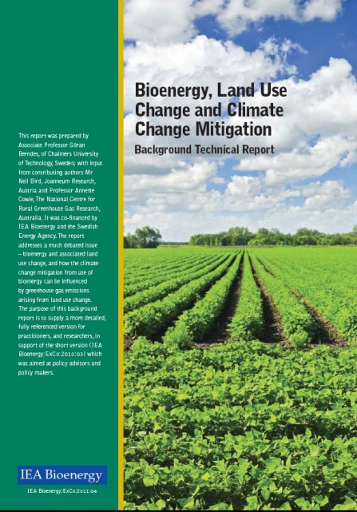
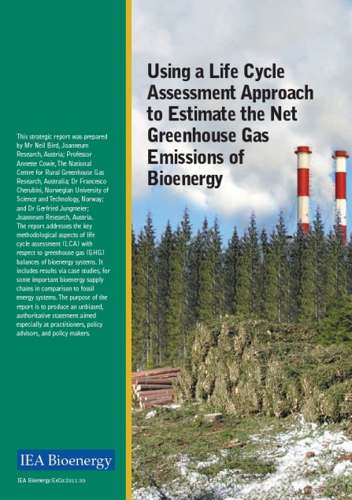
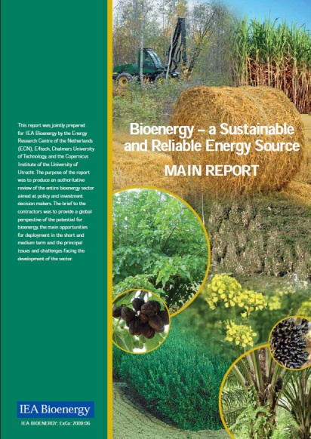
Results:
Strategic Position Papers
Using a LCA Approach to Estimate the Net GHG Emissions of Bioenergy
Bioenergy Land Use Change and Climate Change Mitigation
Bioenergy - a sustainable and reliable energy source. A review of status and prospects
Sustainable Production of Woody Biomass for Energy
Municipal Solid Waste and Its Role in Sustainability
Benefits of Bioenergy
Potential Contribution of Bioenergy to Future World Energy Needs
Synergies and Competition in Bioenergy Systems
Gaps in the Research of 2nd Generation Transportation Biofuels
6
Notes:
6

Slide 7
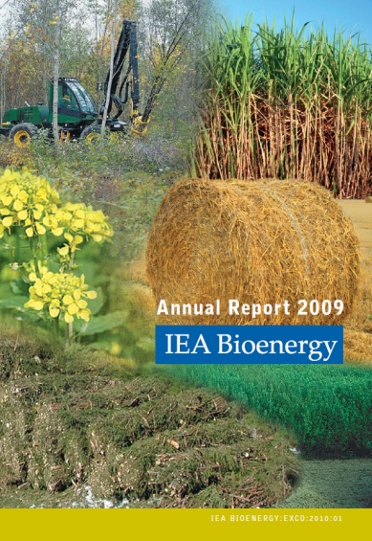
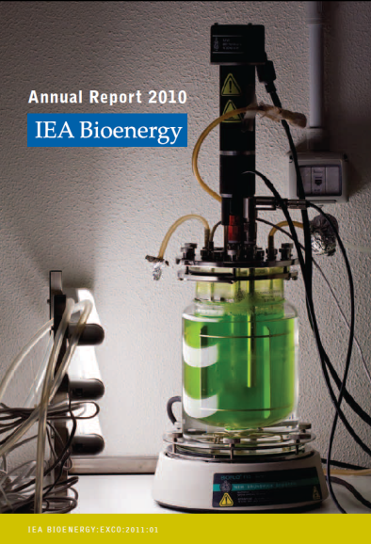
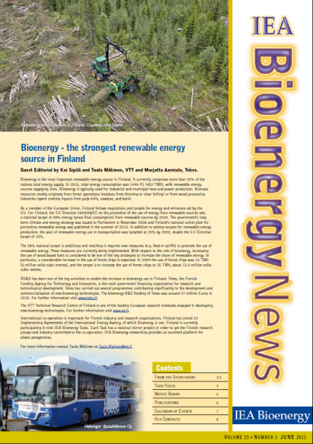
Annual Reports and Newsletters
The Annual Report (122 pp) contains a report from the Executive Committee and a detailed progress report on each of the Tasks. It also includes key information such as Task participation, Contracting Parties, budget tables, and the reports and papers produced by the Implementing Agreement. A feature article based on the work of a Task is also included.
IEA Bioenergy News covers the most recent ExCo meeting and workshop. It also features an editorial from a Member Country, news from the Tasks recent publications and upcoming events.
7
www.ieabioenergy.com
Notes:
7

