Slide 1
Outline of Session 6
INTRODUCTION TO TECHNOLOGY ROADMAPS:
What they are and why they are important
KEYNOTE PRESENTATIONS:
Arne Schweinfurth, GIZ ASEAN-RESP: Renewable Energy Guidelines on Biomass and Biogas Power Project Development in Indonesia
Jean-Francois Dallemand, European Commission: EU Bioenergy policy and lessons learned through the implementation of the NREAP
DISCUSSION:
Key experiences in development and implementation of bioenergy technology roadmaps in Southeast Asia
© OECD/IEA 2014
1

Slide 2
IEA Definition of Technology Roadmap
“A technology roadmap is a dynamic set of technical, policy, legal, financial, market & organizational requirements identified by all stakeholders involved in its development.
The goal is to deliver an earlier uptake of the specific energy technology into the marketplace”.
Assess potential
Define the Vision
Accelerate RD&D

Slide 3
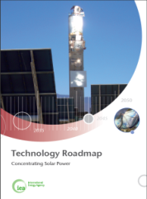
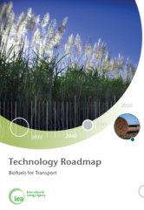
IEA Technology Roadmaps
Highlight pathway(s) to reach large scale use of low-carbon technologies, consistent with Energy Technology Perspectives publication
Focus on the key steps over the next 5-10 years, as well as long-term milestones, including:
Identify barriers and obstacles and how to overcome these
Identify key conversion pathways
Key RD&D gaps and how to fill them while ensuring sustainability
Identify market requirements and policy needs
Define international collaboration needs
Developed under consultation of industry, governmental and research institutions as well as NGOs
© OECD/IEA 2014
3
© OECD/IEA 2011

Slide 4
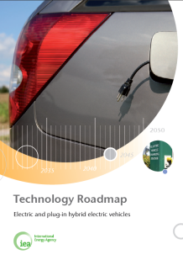
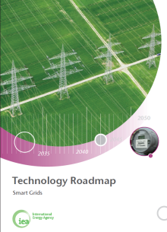
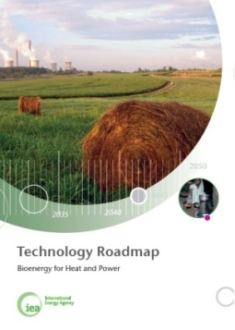
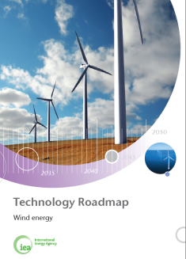
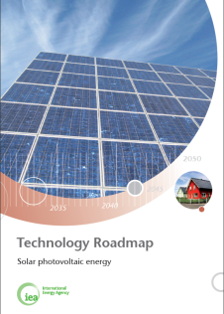
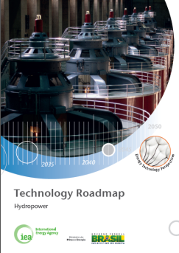
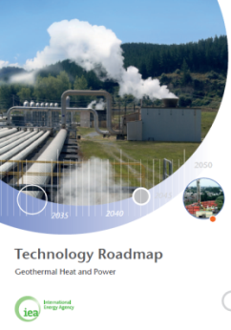
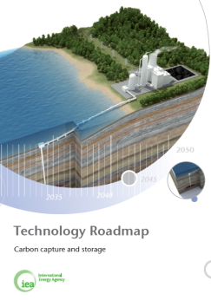
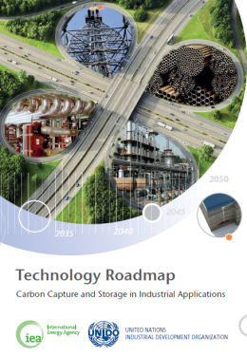
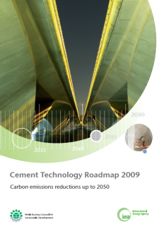
Technology roadmaps status
2009
2010
2011
2012
2013
High efficiency coal power
Chemical catalysis
Energy efficient building envelopes
All roadmaps available under: www.iea.org/roadmaps
Notes:
To date we have completed 14 roadmaps, covering both energy supply and demand technologies. The latest roadmap on Fuel Economy for Road Vehicles was just released last week. We are currently working on an additional 5 roadmaps which when completed will bring the total of global roadmaps to 20.
High-efficiency low-emissions coal (18 Sept 2012)
Hydropower - collaboration with Brazil (Fall 2012)
Chemical catalysis - with ICCA & Dechema (Fall 2012)
Energy efficient building envelope (Spring 2013)
Energy storage (end 2013)
In addition to these global roadmaps we have completed 1 national roadmap on Wind Energy Development in China and will release our 2nd national roadmap on the Cement Sector in India this fall. We have received numerous requests from other countries to support the development of national roadmaps and are currently evaluating these opportunities.

Slide 5
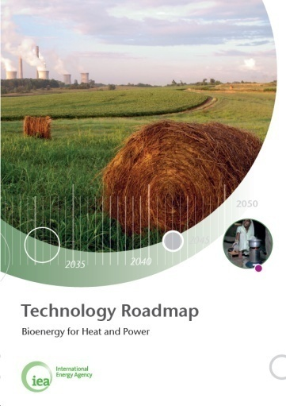
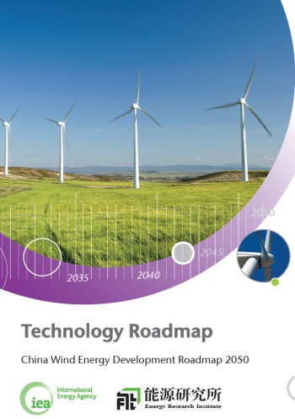
How2Guides: concept
What are we doing?
How2Guides are manuals for policy and decision makers to develop technology roadmaps tailored to national / regional circumstances
Why are we doing this?
To scale-up IEA capabilities to provide support to countries for national roadmap development
To enhance the impact of the IEA’s technology roadmap programme
Is this only for IEA Members?
Not at all – developing countries and emerging economies are a key audience for this initiative
Work streams
How2Guide for Wind Energy (released on 10 March 2014)
How2Guide for Bioenergy (expected Q1 2015)
How2Guide for Smart Grids (expected in 2015)
© OECD/IEA 2014
5
Notes:
Building on the IEA global series of technology roadmaps and established methodology, the IEA is launching a new series of manuals for policy and decision makers to support the development of technology roadmaps tailored to national / regional frameworks: the How2Guides.
The first publication of this new series is the How2Guide for Wind Energy (to be released in March 2014).
While wind energy is developing towards a mainstream, competitive and reliable technology, several barriers could delay progress including financing, grid integration issues, social acceptance and aspects of planning processes. National and regional roadmaps can play a key role in supporting wind energy development and implementation, helping countries to identify priorities and pathways which are consistent with local resources and markets.

Slide 6
How2Guide for Bioenergy
Key elements :
Define the process of developing and implementing a bioenergy technology roadmap
Roadmap methodology guidance through four steps, illustrated by case studies
Case studies from IEA Member and Partner countries (Southern Africa, South East Asia, South America)
Comprehensive decision support toolbox, including and referencing work of other international/regional organisations
© OECD/IEA 2014
6

Slide 7
How2Guide for Bioenergy – Regional expert workshops
Objectives:
indentify and share regional best practices as well as less successful experiences
understand regional drivers to bioenergy policy and technology deployment
present resources and tools which can be used in support of bioenergy roadmap planning and implementation
Thematic focus:
Southern Africa: waste-to-energy and biogas
South East Asia: Biomass resources and sustainability of biomass
South America: conventional and advanced biofuels
© OECD/IEA 2014
7

Slide 8
Outline of Session 6
INTRODUCTION TO TECHNOLOGY ROADMAPS:
What they are and why they are they important
KEYNOTE PRESENTATIONS:
Arne Schweinfurt, GIZ ASEAN-RESP: Renewable Energy Guidelines on Biomass and Biogas Power Project Development in Indonesia
Jean-Francois Dallemand, European Commission: EU Bioenergy policy and lessons learned through the implementation of the NREAP
DISCUSSION:
Key aspects to developing a bioenergy roadmap in Southeast Asia
© OECD/IEA 2014
8

Slide 9
Discussion questions for Session 6
To what extent have policy makers and regulators in the Southeast Asia region undertaken/supported the development of bioenergy technology roadmaps?
Which are the drivers for bioenergy roadmaps in the different countries? Are drivers in Southeast Asia different from those in other world regions?
Have project developers participated (and how) in the development of bioenergy technology policies and roadmaps? Which stakeholders are key to technology deployment?
Which indicators have been used to track progress with bioenergy technology roadmaps in the region? Were roadmaps adjusted in light of experiences gained through implementation?

Slide 10
Thank you for your attention!

