Slide 1

Results of the survey
Juliana De Oliveira Mota
Department of Nutrition and Food Safety
World Health Organization
deju@who.int
ITS SAFETY AND REGULATORY ASPECTS WITHIN THE REGIONAL CONTEXTS

Slide 2

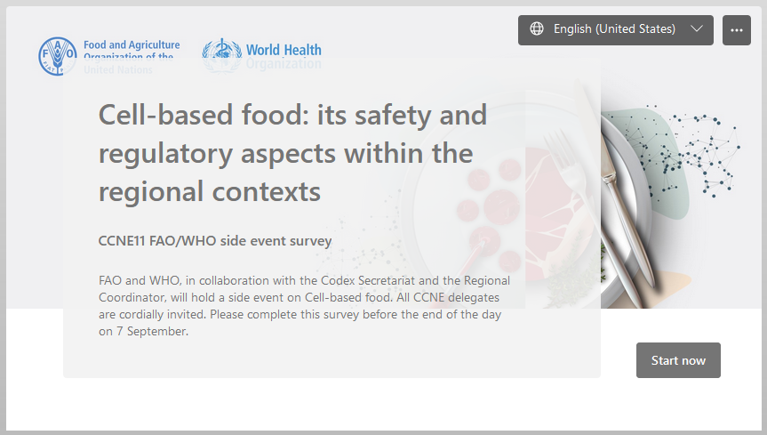
Survey

Slide 3
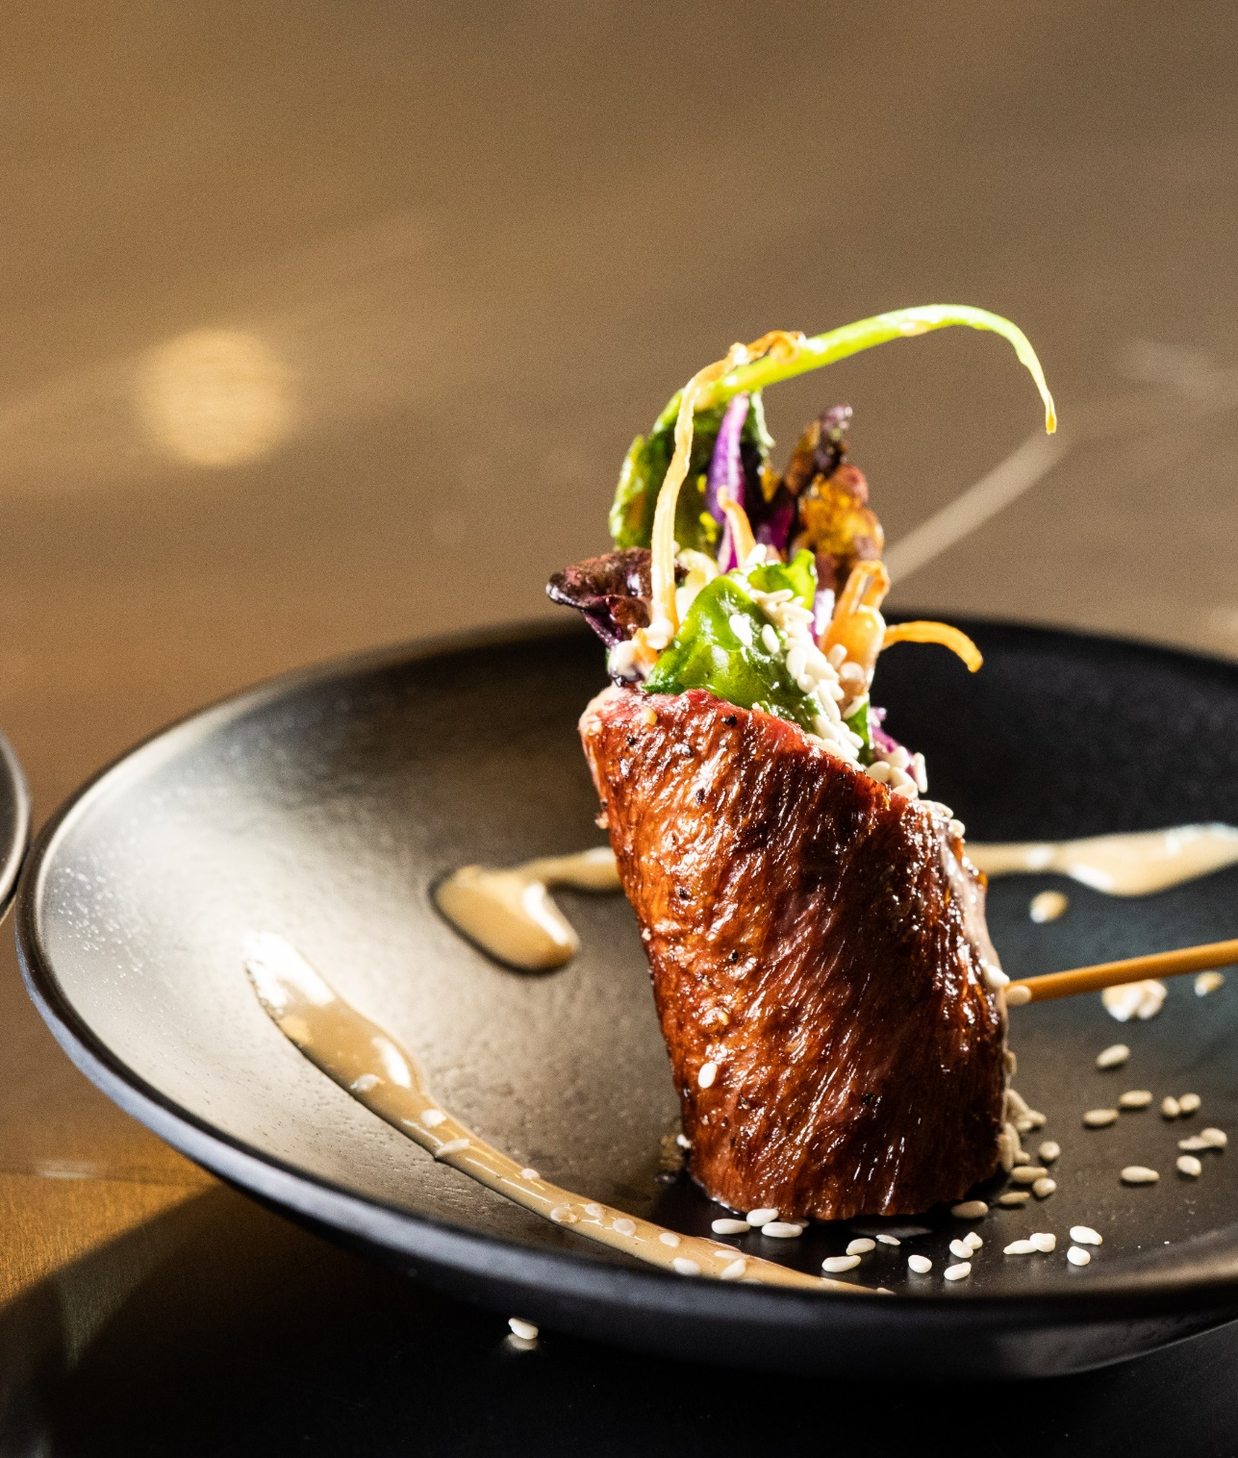
Participants to the survey
17 responses
14 countries

Slide 4
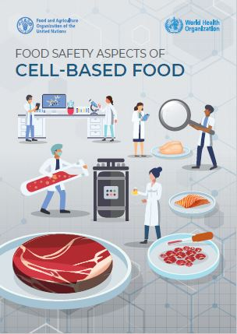
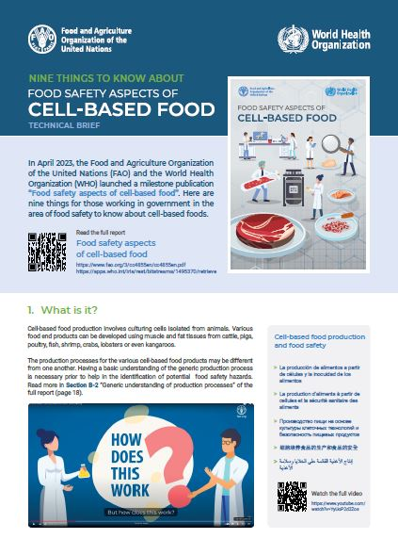

Slide 5
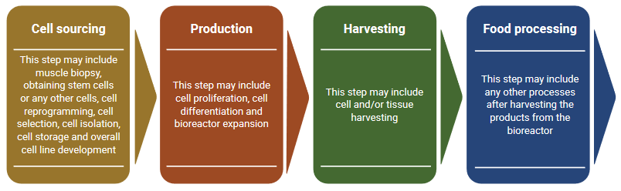
Four stages of the process

Slide 6
Four stages of the process
This is a completely new production process. People need to learn about this to understand relevant food safety issues.
This is a combination of both new processes and conventional processes. It does not seem to be too complicated to understand food safety issues.
This is similar to the production process of various conventionally produced food. It is not complicated to understand food safety issues.

Slide 7
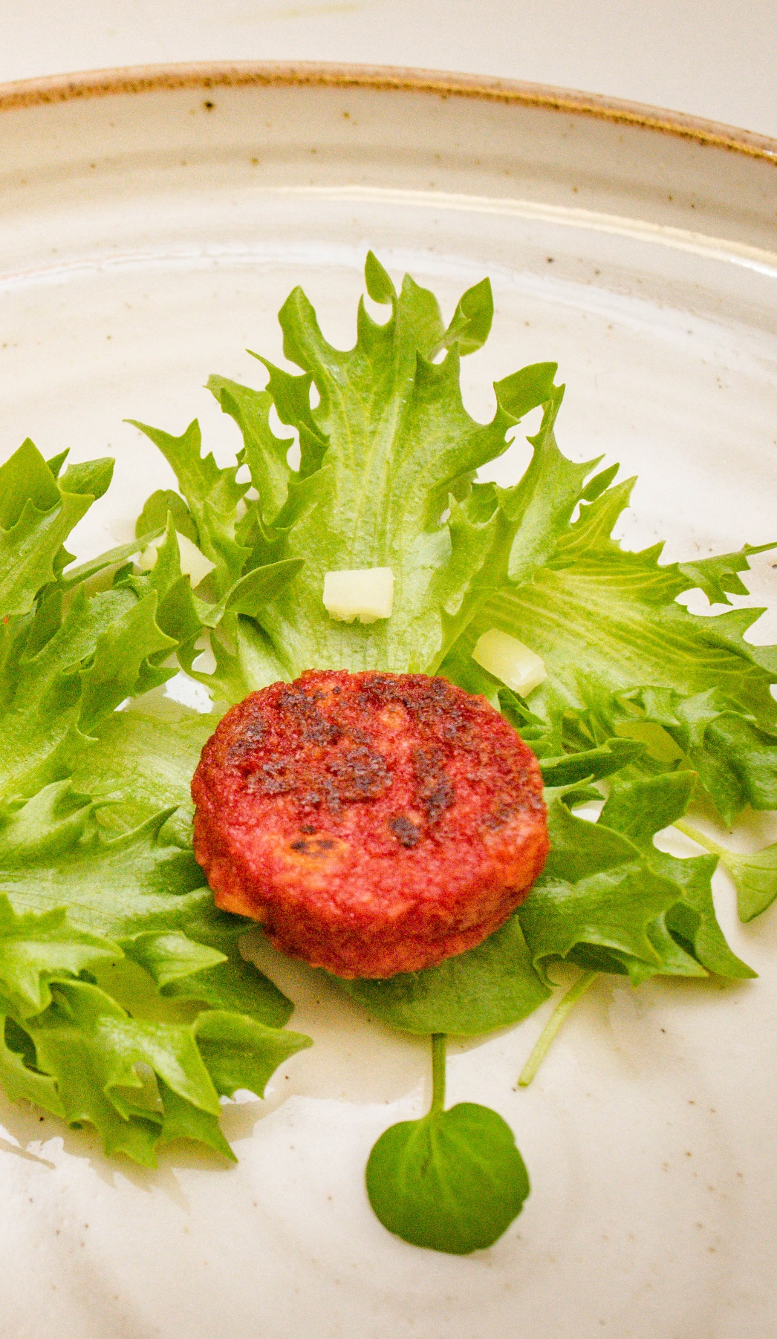
Terminology
Cultivated food
Animal free
Cell-based food
Cruelty free
Clean food
Cell cultivated

Slide 8
Terminology
Aliments issus
de cultures cellulaires
Cell-based food
الأغذية المنتجة من الخلايا

Slide 9
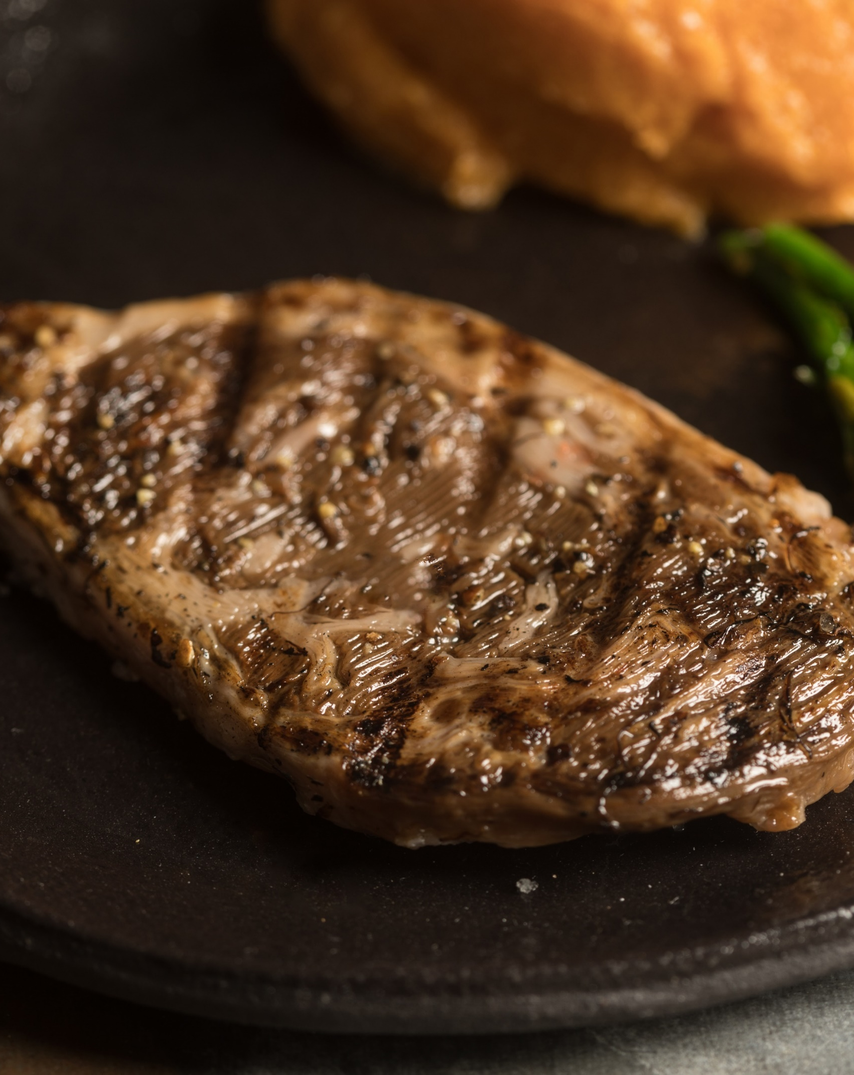
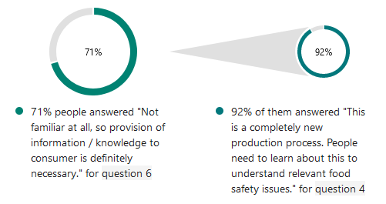
Consumer awareness

Slide 10







Topics of interest
Terminology and labelling
Food safety
Regulatory categorization /compliance issues
Halal
Communication
Trade issues
Regulatory harmonization and availability of (global/regional) food safety guidelines
Regional relevance

Slide 11
Topics of interest
Terminology and labelling
Food safety
Regulatory categorization /compliance issues
76%
Halal
Halal
Communication
Trade issues
Regulatory harmonization and availability of (global/regional) food safety guidelines
71%
Regional relevance

Slide 12
شكرًا
Juliana De Oliveira Mota
Department of Nutrition and Food Safety
World Health Organization
deju@who.int
ITS SAFETY AND REGULATORY ASPECTS WITHIN THE REGIONAL CONTEXTS

