Slide 1
The International FAO Antimicrobial Resistance Monitoring System (InFARM)
Alejandro Dorado Garcia, Animal Health Officer, InFARM team lead
Credits: Junxia Song, Sarah Hill, Agnes Agunos, Norma Sofisa Hurif, Aristeidis Tsachlaris

Slide 2




Notes:
In many countries today, we face a situation where large amounts of AMR data are scattered across different agencies and institutions. This fragmentation often leads to frustration—sometimes even fear or despair—because the information cannot easily be used. But this challenge is also a tremendous opportunity: if we can transform dispersed data into harmonized information, we can make it truly useful.

Slide 3

Notes:
Our vision is to get to a place where AMR data—both nationally and globally—is harmonized, accessible, and transformed into information that supports:
Policy-making,
Monitoring the impact of interventions, and
Clinical decision-making for prudent antimicrobial use.
This is precisely why FAO developed InFARM, the International FAO AMR Monitoring System.

Slide 4
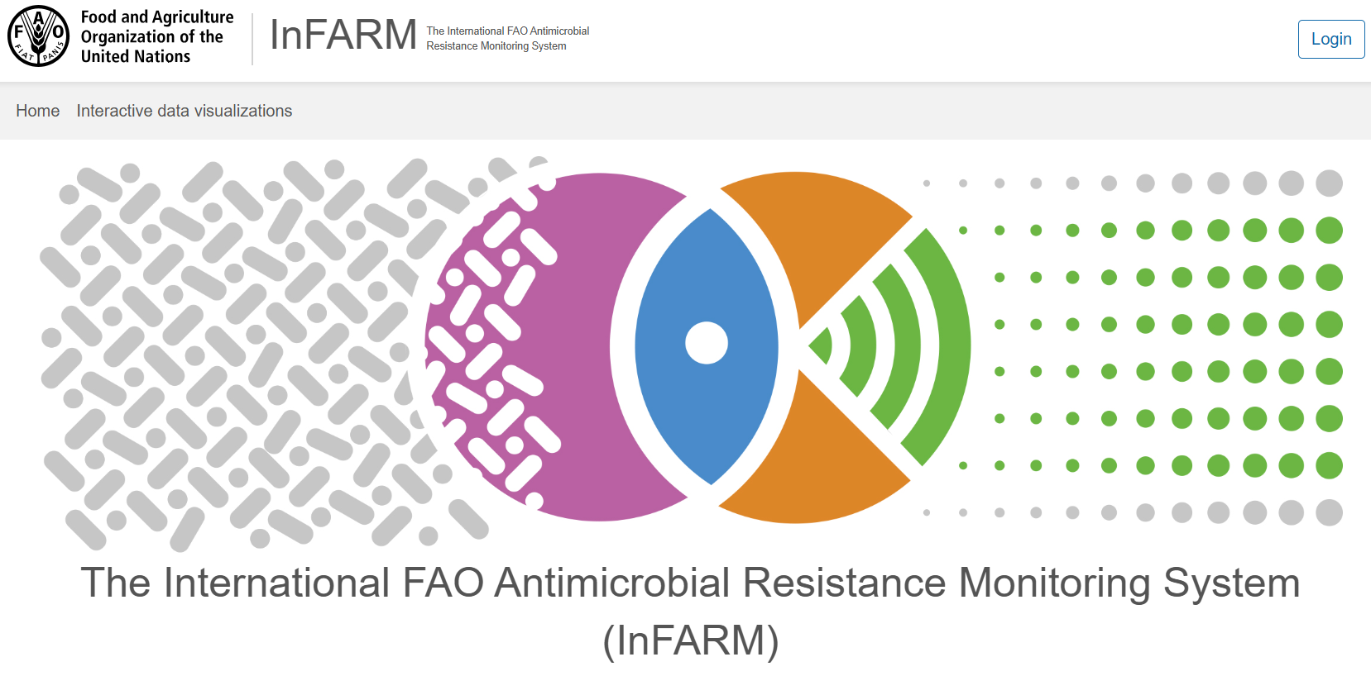





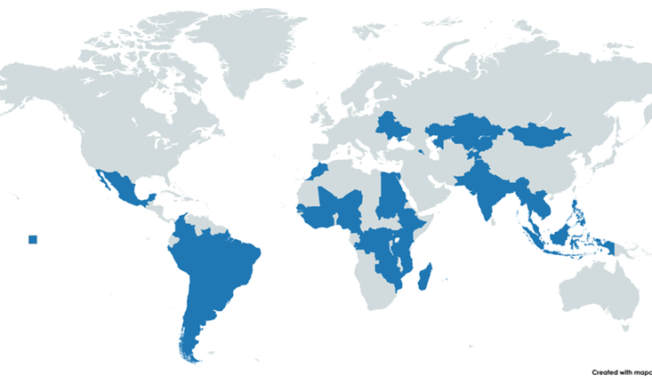
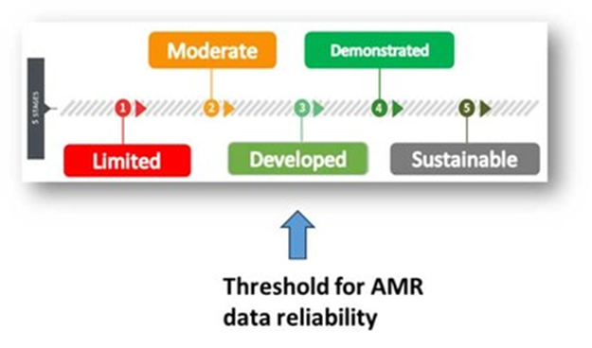
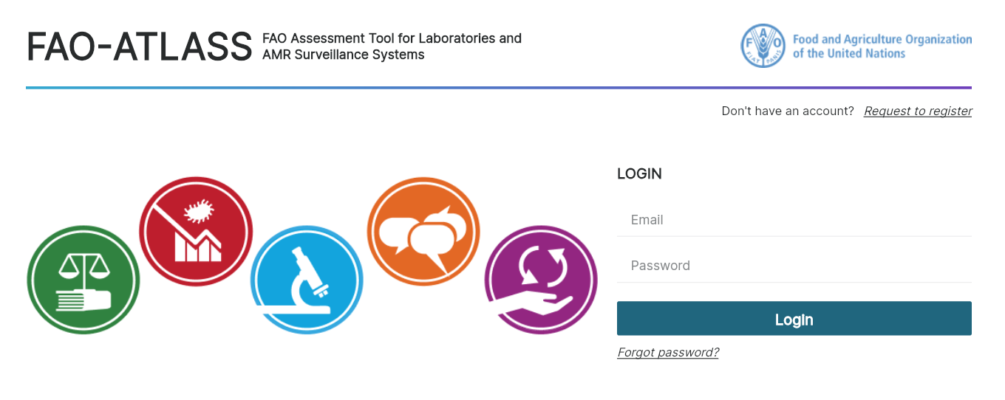
InFARM surveillance approach
Global information system
Digital IT platform + activities to assist countries
Collecting, collating, analyzing, visualizing, and effectively utilizing their AMR monitoring and surveillance data primarily from livestock, fisheries, and aquaculture, along with their associated food products.
Expanding to AMU in plants in 2025
Assessment tool for laboratories and AMR surveillance systems (ATLASS)
Digital application under development (beta version expected in September 2025)
FAO-ATLASS as a measurement of quality of AMR data received in the InFARM system
Notes:
InFARM is a global information system that combines:
A digital IT platform, and
Country support activities such as access to resources, tools, and practical guidance for applying WOAH and Codex standards.
It helps countries collect, collate, analyze, visualize, and use AMR data from livestock, fisheries, aquaculture, and related food products. In 2025, InFARM will also expand to antimicrobial use (AMU) in plants.
A flagship tool within InFARM is ATLASS—FAO’s Assessment Tool for Laboratories and AMR Surveillance Systems.
ATLASS provides a measurement of the quality of AMR data that enters the system.
A digital ATLASS application is under development, with a beta version expected in September 2025.

Slide 5
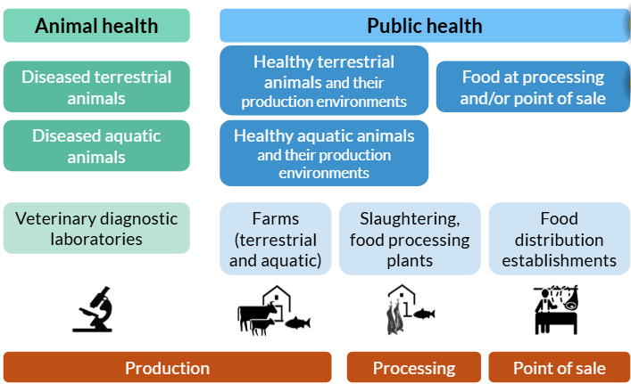
InFARM surveillance approach (purposes and programmes)
Notes:
InFARM offers a framework to harmonize data according to its primary purpose:
Animal health data to guide clinical decisions.
Public health data to inform policy and protect consumers.
The framework defines five surveillance programmes across the food chain, aligned with Codex guidelines for integrated foodborne AMR monitoring.

Slide 6

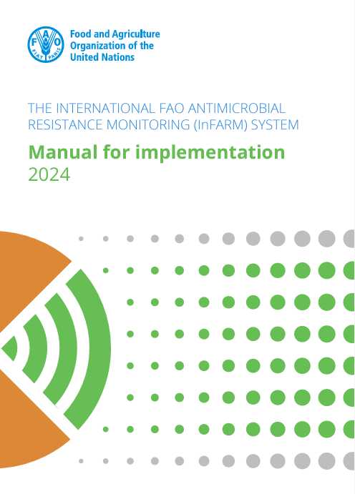
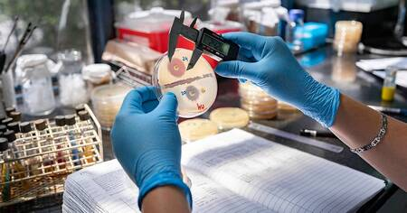
InFARM surveillance early implementation and expansion phases (2023 – 202)
Launch of the digital IT platform’s first open call for data in 2024
Regional trainings of InFARM focal points
Data call 2024: Over 50 countries enrolled, 49 submitting questionnaire on implementation and 28 submitting AMR data from more than 500,000 bacterial isolates
Ongoing: Second annual open call (June-Dec 2025), Compilation of first global baseline report (late 2025-early 2026)
Next: expansion (2025-2027) and consolidation (2028-2030)
Notes:
Implementation Journey
Early implementation & expansion phases (2023–2027)
First open call for data (2024): Over 50 countries enrolled; 49 submitted implementation questionnaires, and 28 submitted AMR data from more than 500,000 bacterial isolates.
Regional trainings: Capacity-building of national focal points.
Second open call (2025): Now underway (June–Dec 2025).
First global baseline report: Planned for late 2025–early 2026.
Expansion (2025–2027) and consolidation (2028–2030) phases will follow.

Slide 7
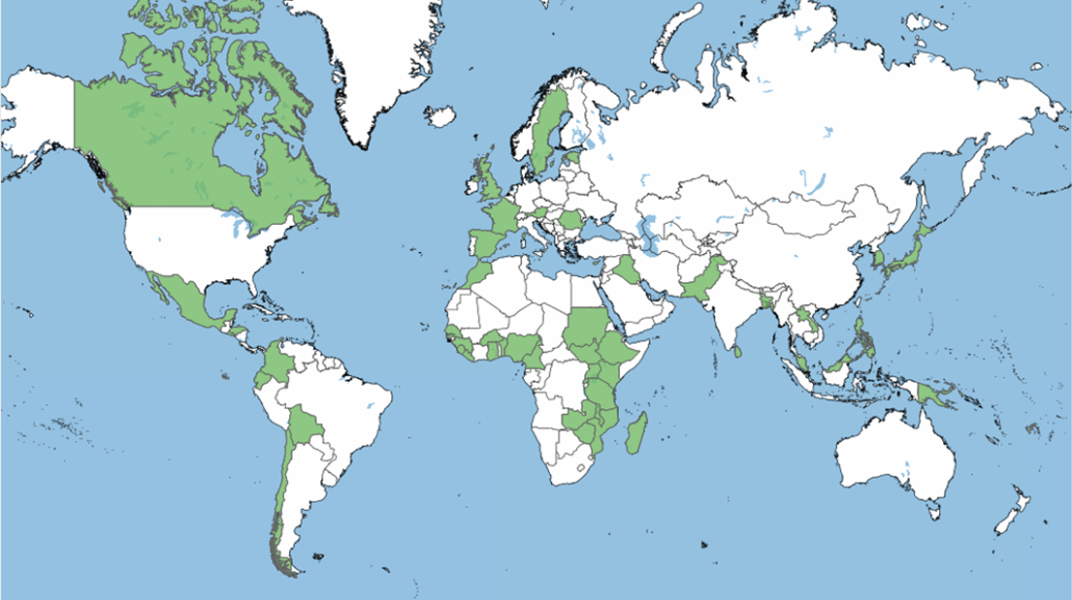
Participation
InFARM early implementation results (2024)
Figure. Map displaying countries enrolled in InFARM in 2024, n = 49 countries (28 submitting AMR data)
96 submissions of questionnaires (including the 6 different types of questionnaires: the 5 surveillance programmes, and another one for integration of programmes).
Africa (22% of countries, 59% of submissions
Asia (20% of countries, 14.6% of submissions)
Americas (16% of countries, 14.6% of submissions)
Europe (12% of countries, 9.4% of submissions)
Oceania (4.1% of countries, 2.1% of submissions).
Notes:
First Results from 2024 Data Call
49 countries enrolled, 28 submitted AMR data.
96 surveillance questionnaires received, covering all six categories (five surveillance programmes plus integration questionnaire).

Slide 8
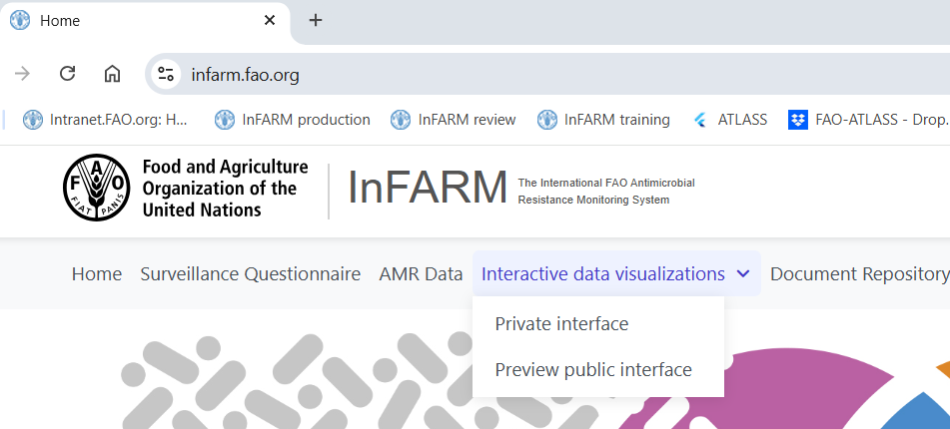
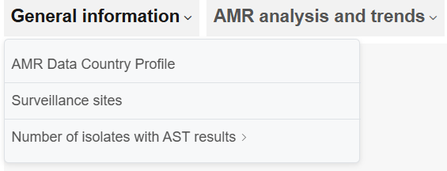
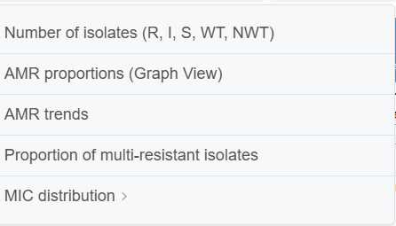
National descriptives available in the private interface
Notes:
Explain meaning of points and median and possibilities to stratify and add the filtering possibilities

Slide 9
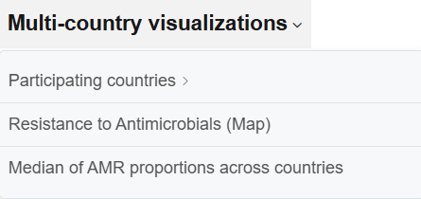
Multicounty visualization in the private interface
Notes:
Explain meaning of points and median and possibilities to stratify and add the filtering possibilities

Slide 10
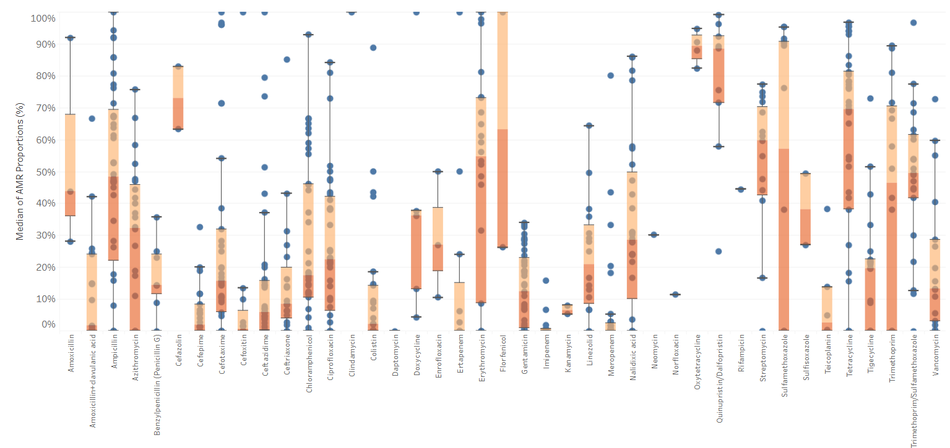
Examples of boxplots with median of prevalence across countries
Raw data in healthy terrestrial animals
No comparability is possible without
Filtering!!
Notes:
Explain meaning of points and median and possibilities to stratify and add the filtering possibilities

Slide 11
Benefits for countries participating in InFARM
Get access to a safe space to store AMR data across multiple surveillance programs and at customizable levels of confidentiality.
Get access to interactive data visualizations with easy export options for various uses, such as official reports, presentations, and publications.
Country benchmarking to contextualize national AMR prevalence and trends.
Get access to a centralized repository of documents to provide context to country AMR data, including national surveillance plans, protocols, and reports from the application of FAO assessment tools.
Improve coordination in AMR data generation, collection, collation, and analysis.
Contribute to global One Health AMR surveillance efforts.

Slide 12



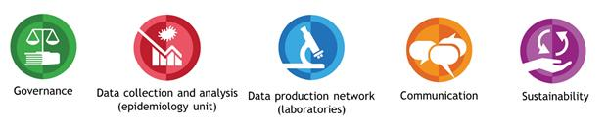
Thank You
Notes:
Facilitated by the WHO Regional Office for Europe and the WHO Collaborating Centre for AMR Epidemiology and Surveillance at the National Institute for Public Health and the Environment (RIVM) in the Netherlands, European data from EARS-Net and CAESAR are also reported to the WHO Global Antimicrobial Resistance Surveillance System (GLASS) [8] to support the WHO Global Action Plan on Antimicrobial Resistance [1].

