Slide 1
One Health Regional Coordination initiatives
Dr. Heba Mahrous
Veterinary Epidemiologist, One Health Technical Officer
WHO Regional Office for the Eastern Mediterranean
Advancing Integrated Surveillance of Foodborne Antimicrobial Resistance
30 September 2025 Muscat, Oman 12:00-13:15 GST

Slide 2
Outlines
One Health Regional QPT activities
Joint activities within EMRO
Country support

Slide 3
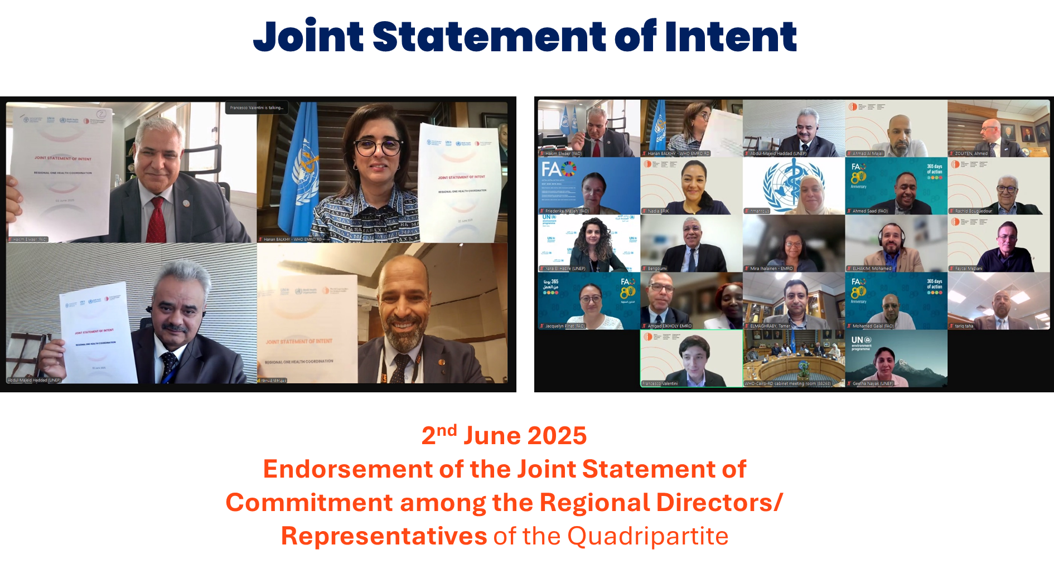
One Health Regional activities

Slide 4
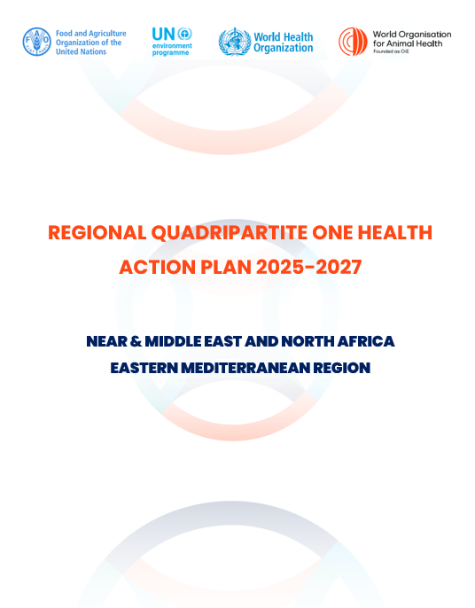
One Health Regional Quadripartite Action Plan
Purpose
To advance the OH implementation at regional and national level, to detect, prevent, and respond to health threats at the human-animal-environment interface using the One Health approach through collaborative efforts.
Operational objectives
Implement a comprehensive regional mechanism that establishes multisectoral approaches to enhance the health of humans, animals, and environment.
Efficiently and effectively use the OH approach in the prevention and control of health threats at the human-animal-environment interface which will minimize their negative consequences on the health system and well-being.
Promote the use of technology and tools for joint OH practices, enhancing data integration and information-sharing across sectors at the national and regional levels.

Slide 5



One Health Regional Quadripartite Coordination Mechanism
Regional One Health Executive Committee (Regional OHEC)
Regional One Health Coordination Group (Regional OHCG)
Regional One Health Technical Groups (Regional OHTG)
Represented by Respective Regional Heads of the Quadripartite organizations
One Health focal points from FAO, UNEP, WHO and WOAH coordinate among the different technical working groups and the steering committee
Technical officers from each Quadripartite organization. The scope of the OHTG for One Health approach covers zoonotic diseases, food safety, and AMR.
Meetings either virtual or hybrid
Monthly
Every 2-3 Monthly
Annually
(Regional OHEC)
(Regional OHCG)
Annually

Slide 6
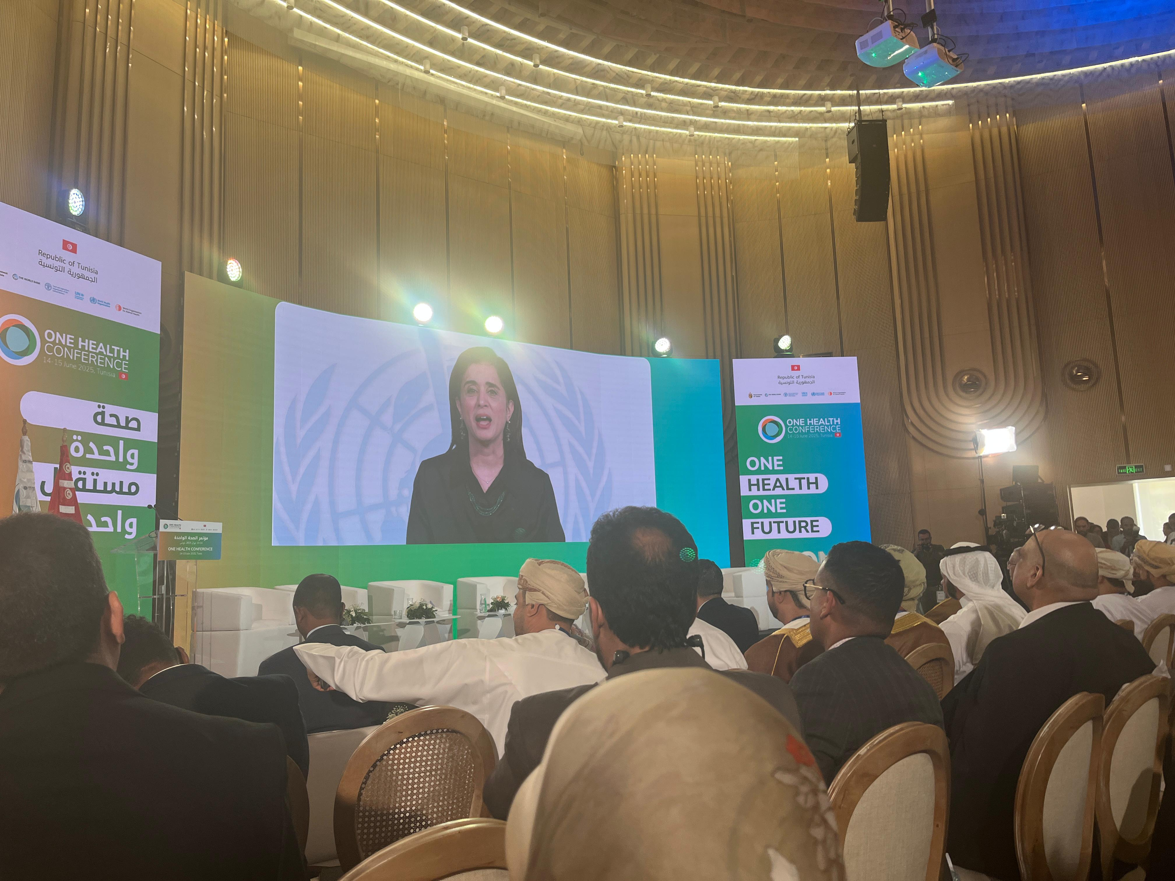
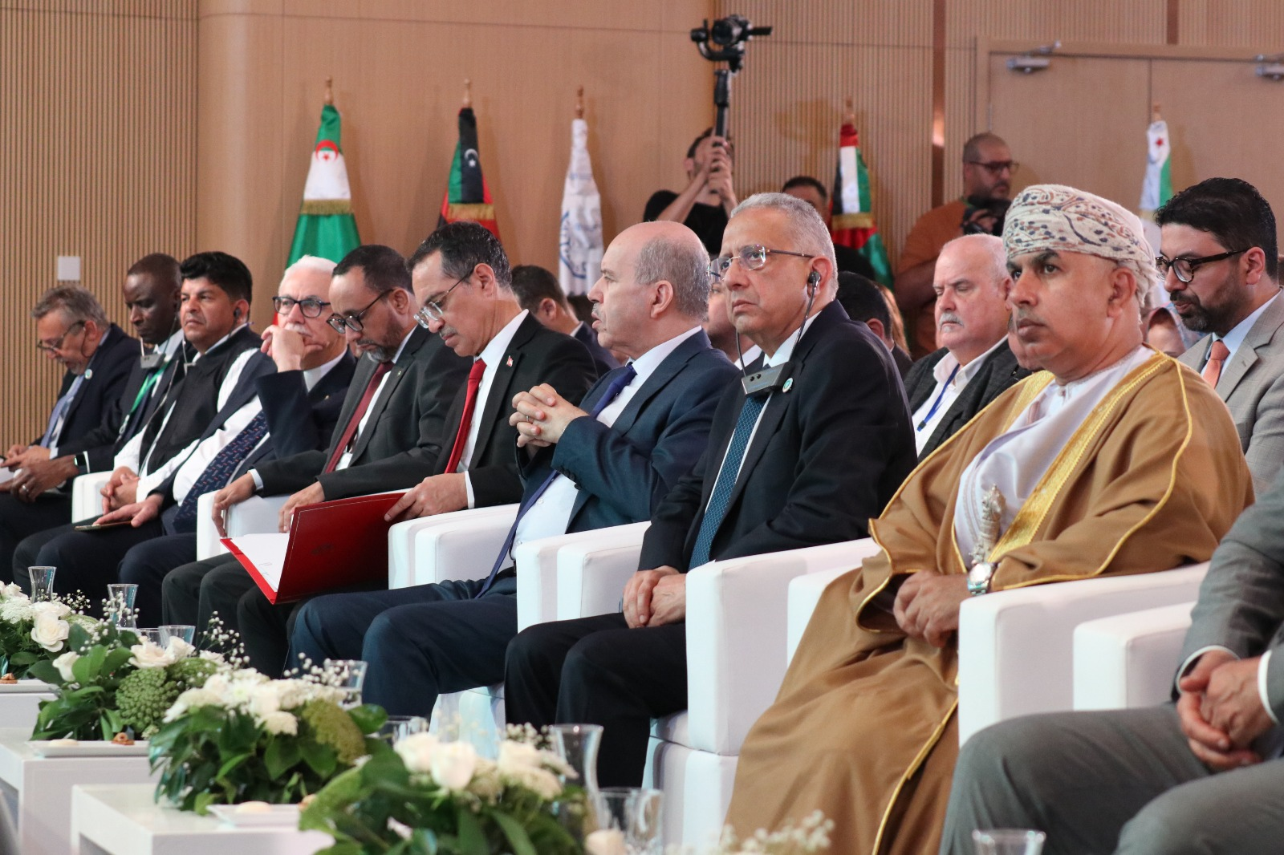
2nd One Health Regional Conference, June 14-15
Ministers of Health, Agriculture and Environment from 17 countries
Over than 400 attendees joined
Tunis declaration issued

Slide 7
One Health activities within EMRO
EMRO One Health taskforce
Zoonoses AMR
Food safety Environmental health
EMR Youth Council One Health Working group
Regional Health Alliance - Joint Action Plan 2025
Integrated Disease Surveillance (IDS)
Chemical Biological Radio Nuclear (CBRN): CBRN strategic plan (UAE MOH, WOAH, FAO, and NCEMA)
IHR, NAPHS, Simex and After-action reviews

Slide 8
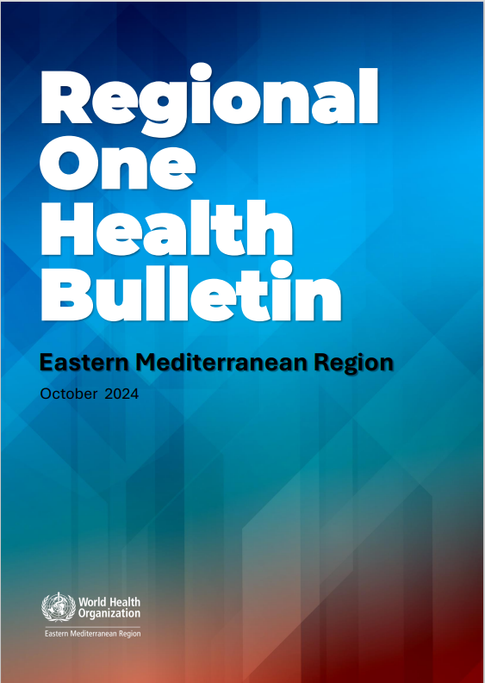
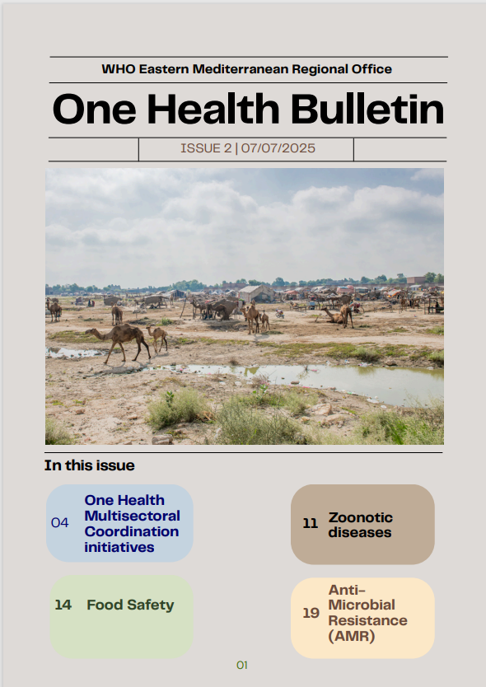
One Health Taskforce

Slide 9
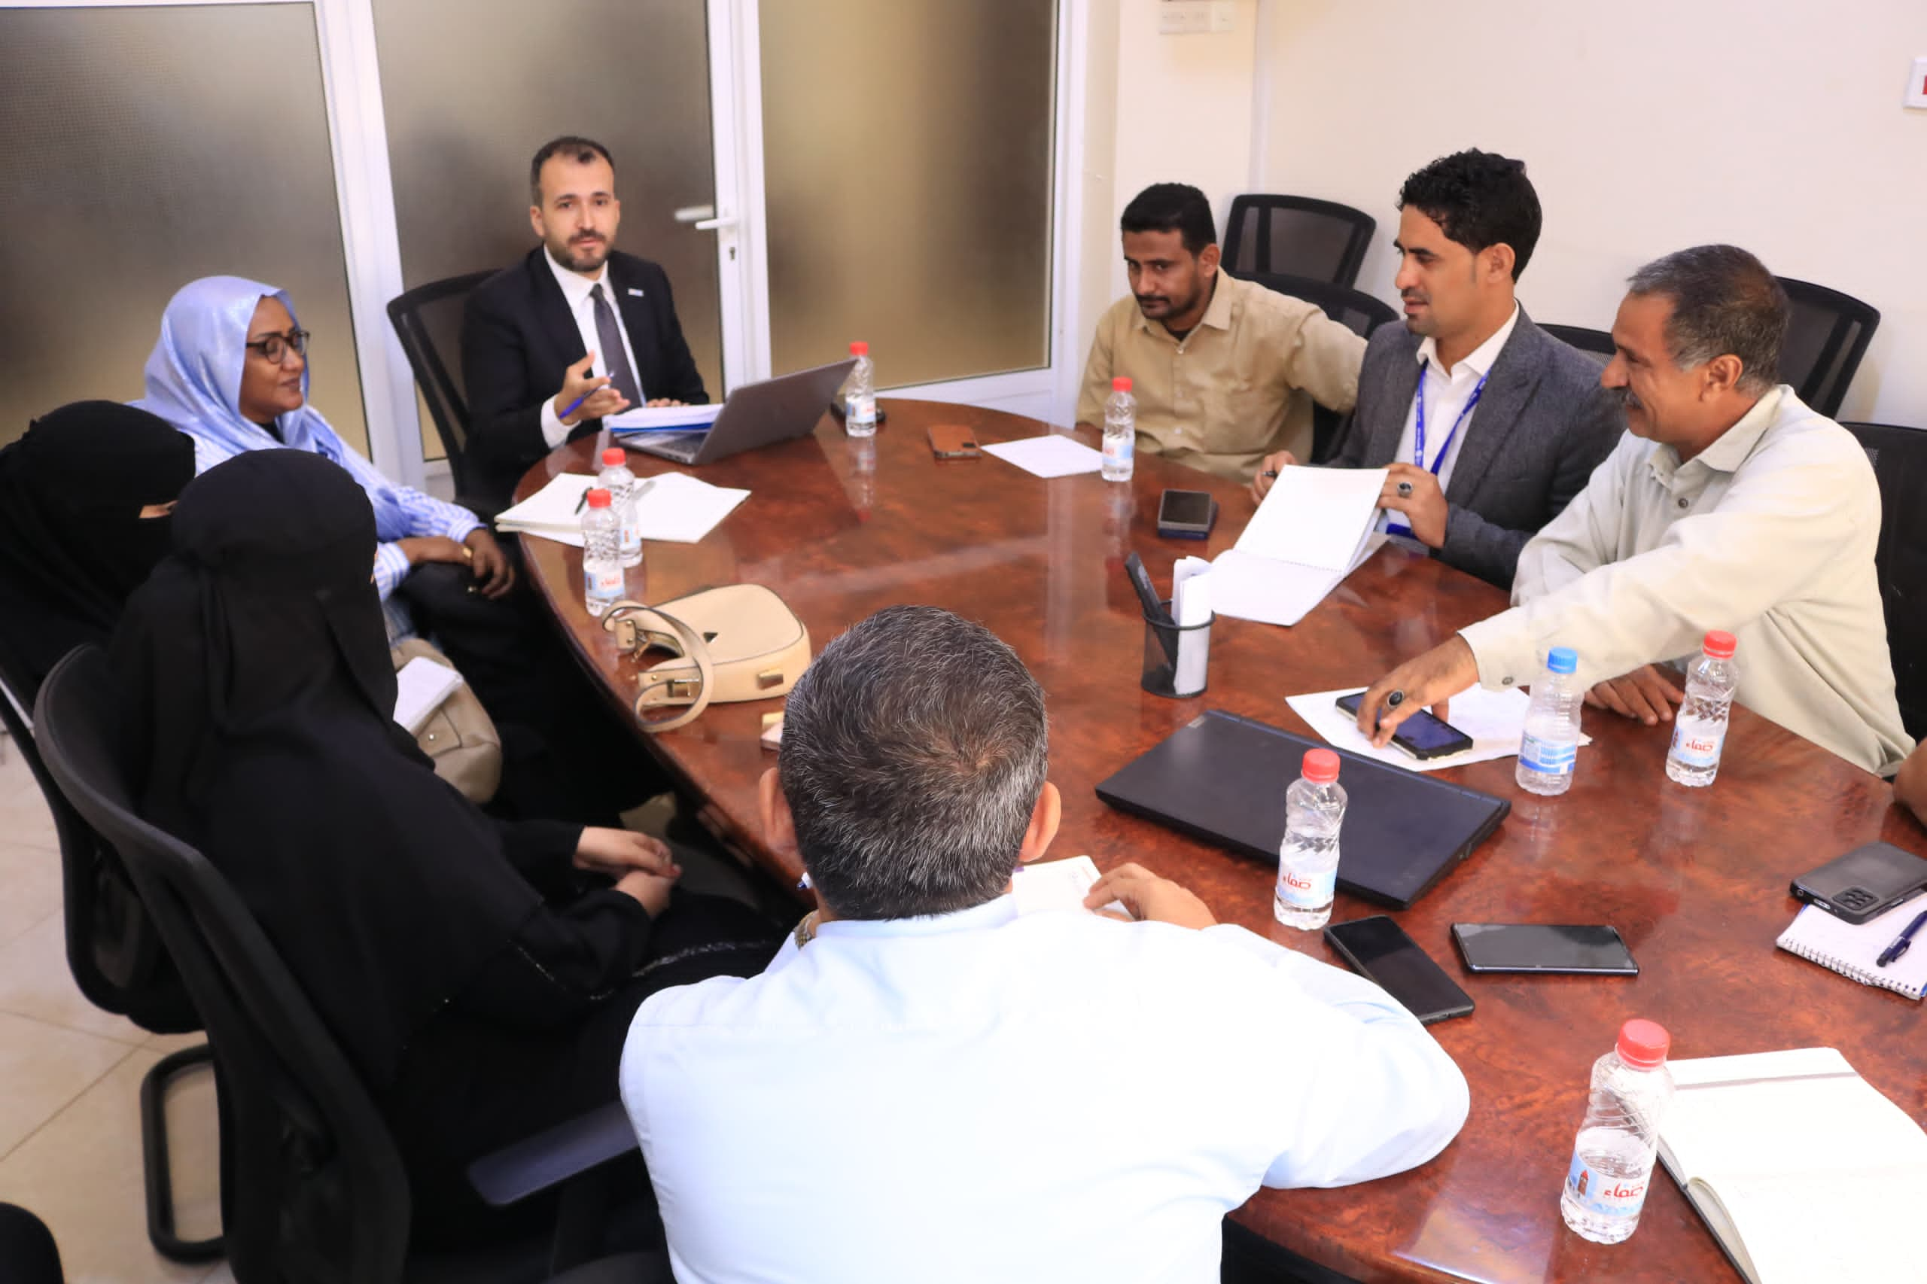
Pandemic fund
The Pandemic Fund proposals in the EMR offer a key opportunity to promote sustainable capacities for epidemic preparedness and health security under the one health umbrella.
EMRO staff have supported the development of proposals to address human–animal–environment health threats, align with IHR (2005), OH JPA and Regional OH Framework.
Strengthen multisectoral coordination, surveillance, workforce, and laboratory systems.
  1st call for proposals: Palestine, and Yemen
  2nd call for proposals: Egypt, Jordan, Lebanon, Pakistan, and Tunisia
  3rd round: 8 eligible Member States; Afghanistan, Djibouti, Iran, Iraq, Libya, Somalia, Sudan, and Syria

Slide 10
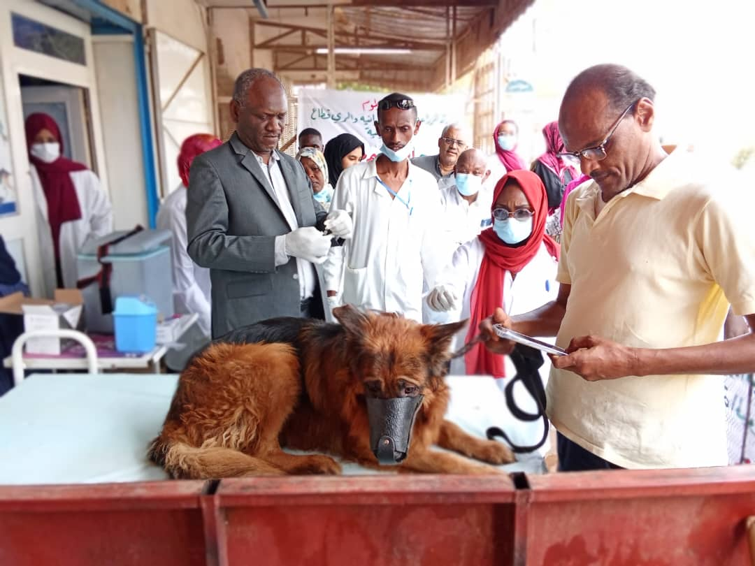
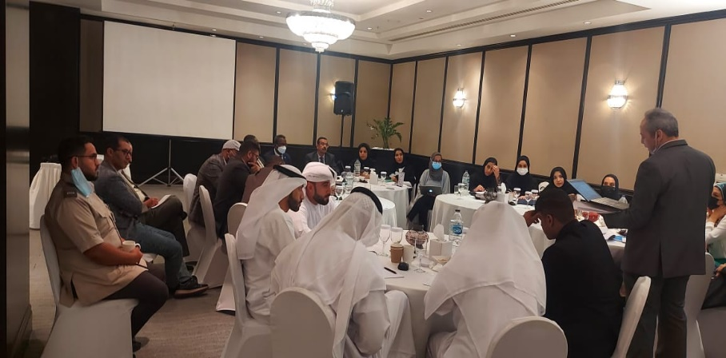
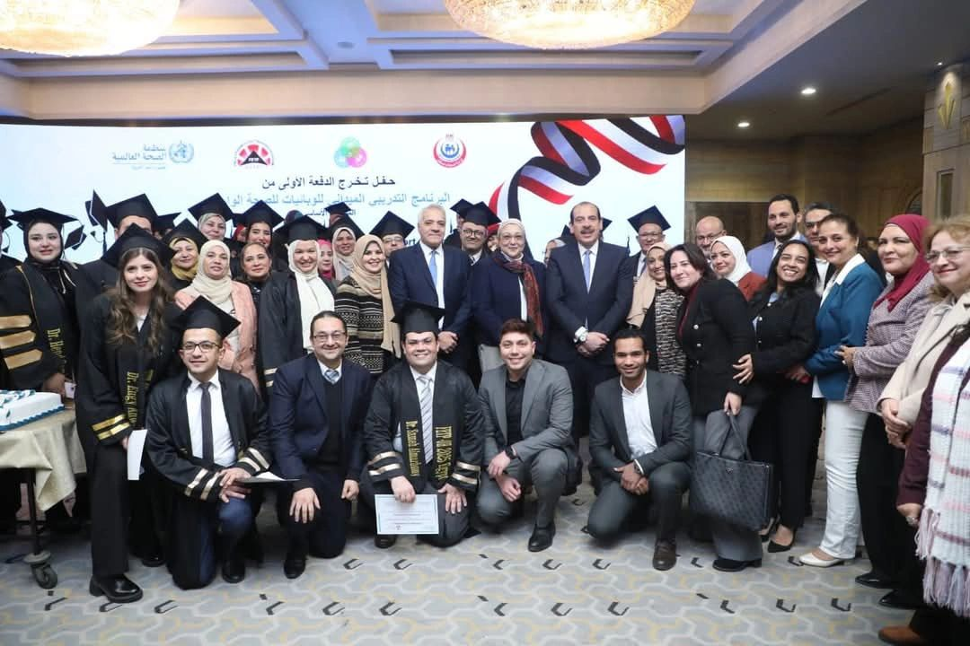
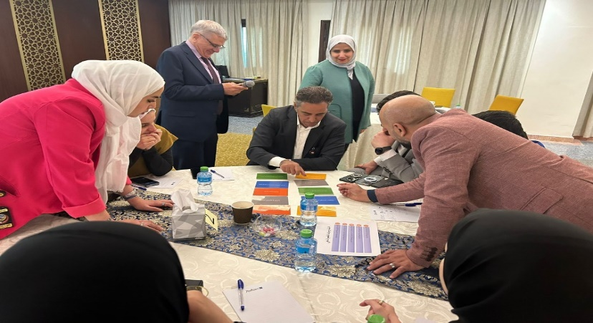
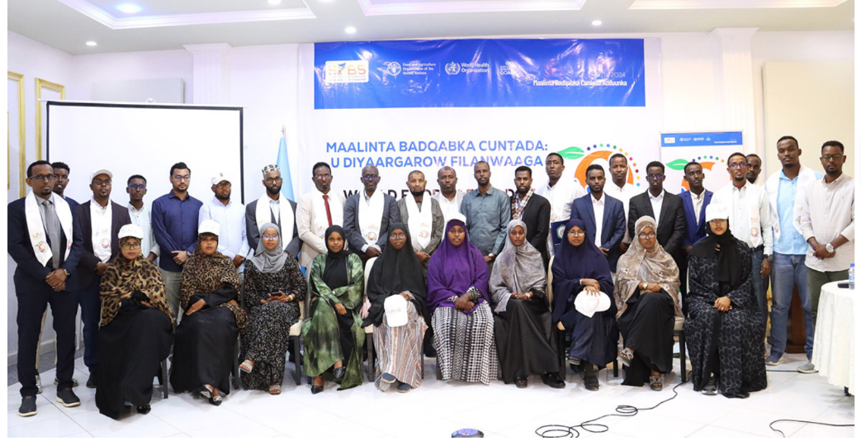
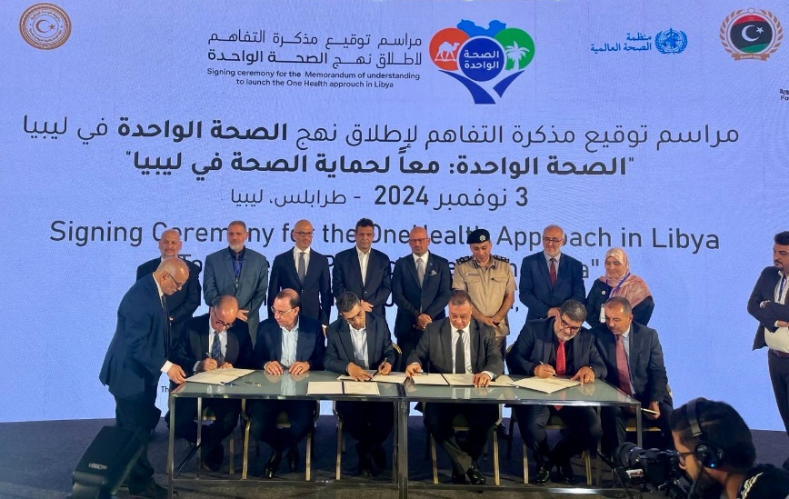

Slide 11
Thank you
شكرا جزيلا

