Slide 1
Highlights from the virtual CropLife International workshops 2023 on Codex enhancement
In support of the CCPR EWG
“Enhancement of the operational procedures of CCPR and JMPR”
In-session working group at CCPR54
27 June 2023

Slide 2
Member Companies

Slide 3
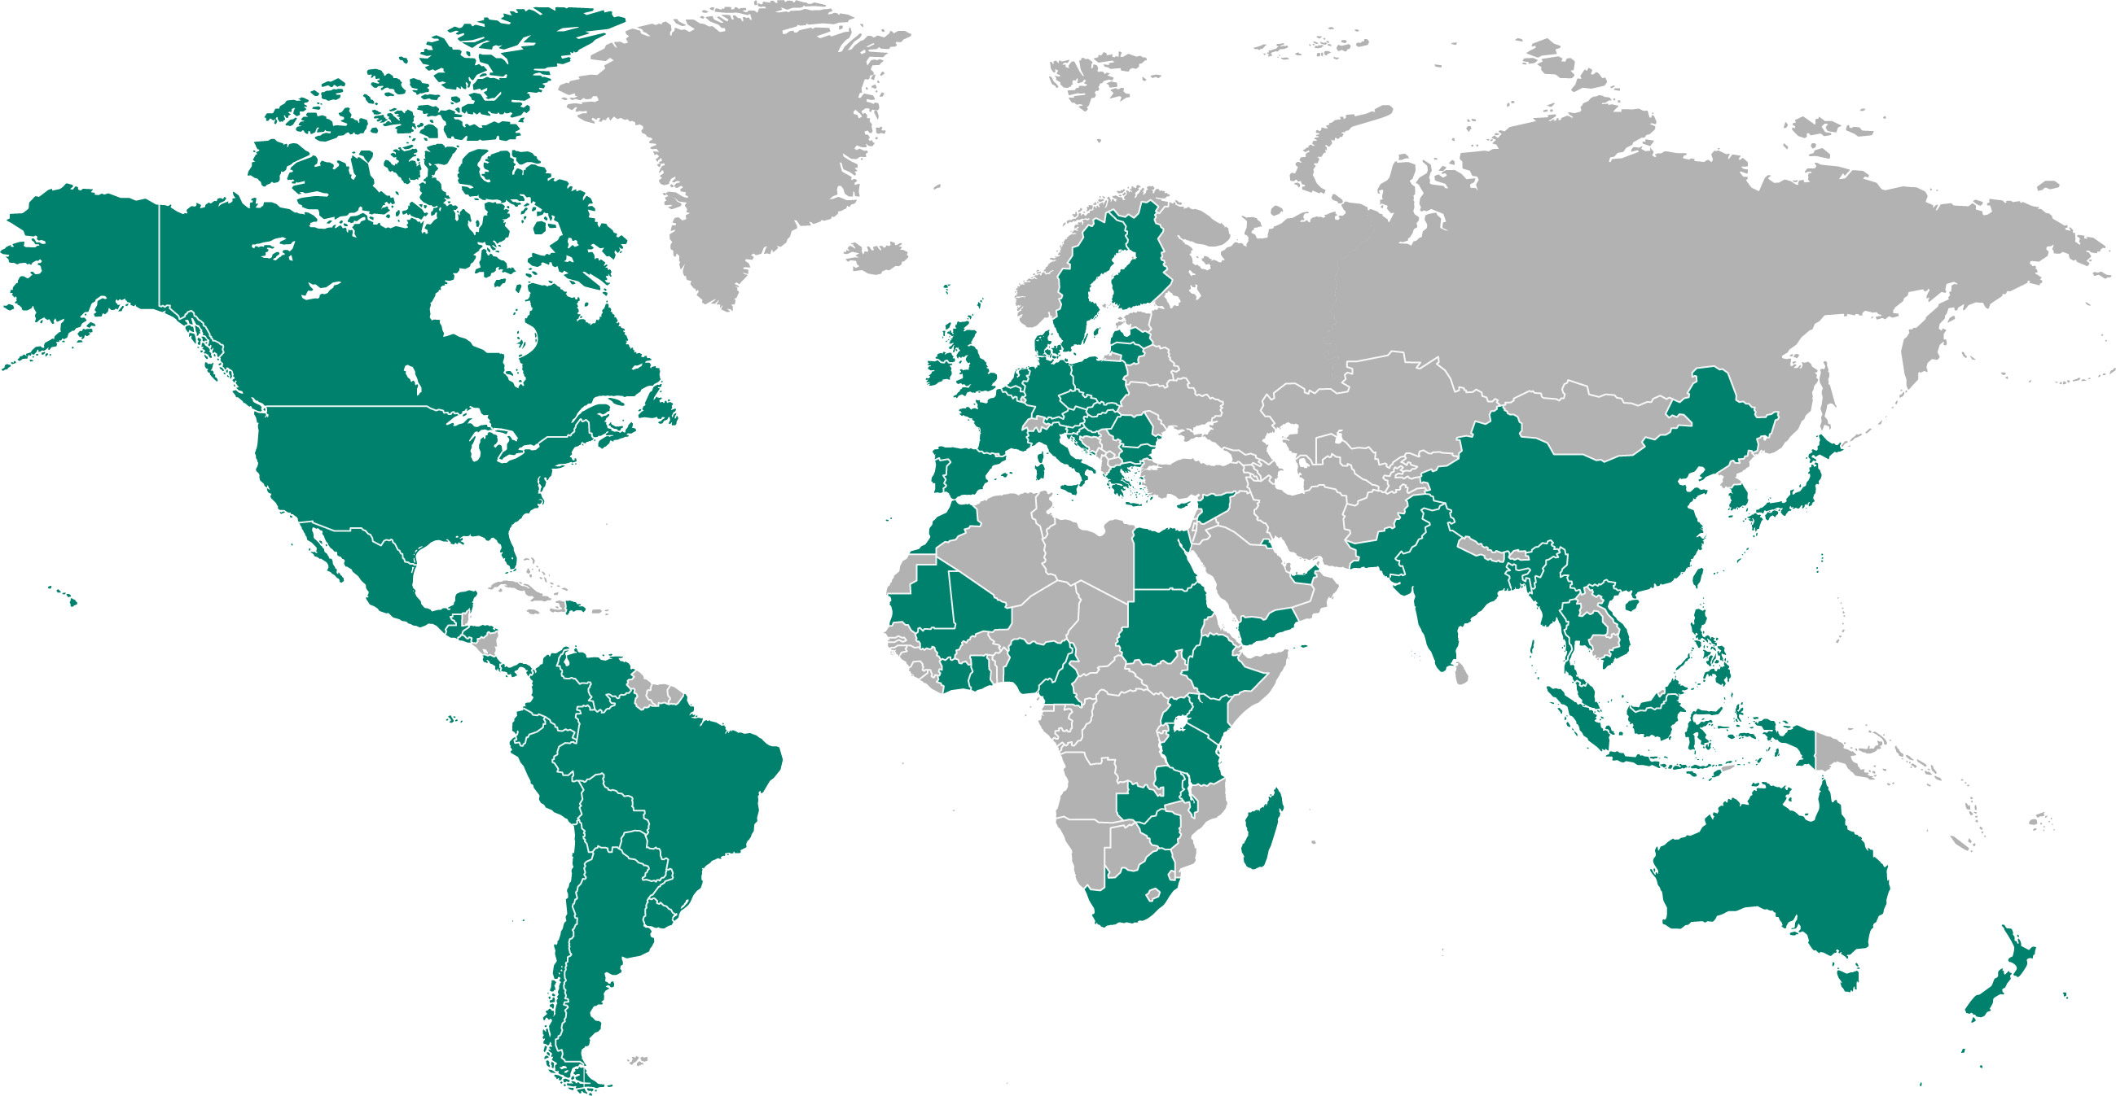
Crop Protection Network
94 National & Regional Associations
CropLife Canada
CropLife Europe
24 national associations
Japan Crop Protection Association
CropLife America
CropLife Asia
15 national associations
CropLife Latin America
26 national associations
CropLife Africa Middle East
22 national associations

Slide 4
What is great about Codex today?
Notes:
In 2022 and 2023 we held 3 virtual workshops with you, the CCPR delegates, Codex secretariats, JMPR secretariat and experts, Codex observers, industry and other Codex enthusiasts,

Slide 5
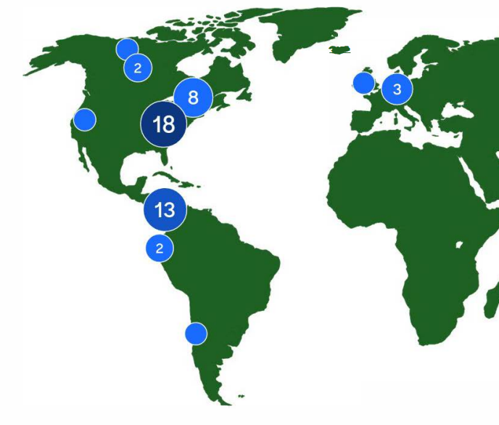
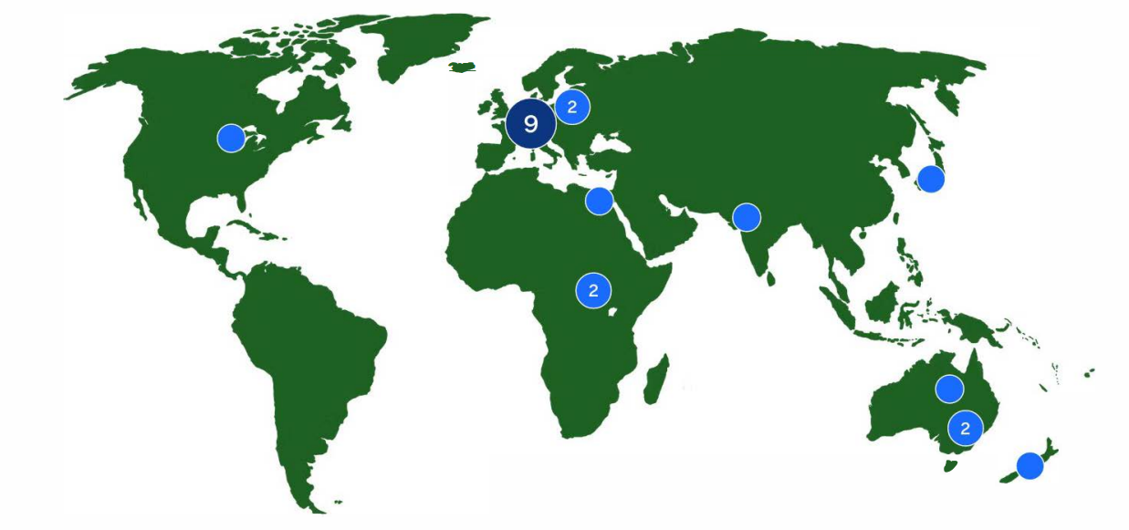
Geographical representation of CropLife International’s virtual Codex
workshops in 2023
Notes:
68 respondents 8% were representatives of CCPR/JMPR Secretariat, 33% were Codex member country representatives, 27% were representatives of governments or government regulatory organization, and 14% were Codex observers (e.g., grower/commodity groups).

Slide 6
What are your top three proposed improvements?
1st
2nd

Slide 7
Additional ideas from the workshop
Introducing virtual JMPR expert panel meetings and pre-discussions prior to virtual/in-person JMPR expert panel meetings.
Introducing e-submission tools and standardized templates (such as OECD submission tools for pesticides), and regular maintenance of the Codex MRL database.
Incentives for individuals to become JMPR experts
Considering participation of JMPR reviews in joint or parallel reviews.
‘a single representative use’ inclusive of national GAPs
Considering supporting permanent staffing to support JMPR expert panels.
Identifying and implementing a process for training experts for JMPR work.
Compare and contrast JMPR/CCPR with similar Codex expert groups and committees
Fee for service

Slide 8
Value of Codex MRLs
What is needed to convince governments to provide additional resources to JMPR

Slide 9
CropLife International’s recommendations
To improve JMPR resources and resourcing
Establish a pilot project for 3-5 years to create ‘permanent JMPR staff’ to provide support for the JMPR Expert Panels
Secondments from existing institutions, or recently retired experts from governments could be considered.
External consultants paid through a “fee system” allowing funding from industry
Increase the number of experts particularly in regions underrepresented in JMPR expert panels.
Ensure continued training of new experts for JMPR work by leveraging ongoing capacity building efforts

Slide 10
For questions, further exchange and discussion please feel free to contact us at CCPR or via email
Wibke Meyer wibke.meyer@croplife.org
Nevena Hristozova nevena.hristozova@croplife.org
and see CRD17 for details

