Slide 1
CCMAS43
43rd Session of the Codex Committee on Methods of Analysis and Sampling
Date and place of next session… and something more
Dr. Attila Nagy, chair of CCMAS
Budapest
Hungary
CCMAS43

Slide 2

CCMAS43

Slide 3

Future plans
44th Session of the Codex Committee on Methods of Analysis and Sampling (CCMAS)
Date of next session: 5-9 May, 2025
Place: somewhere in Budapest
CCMAS43

Slide 4
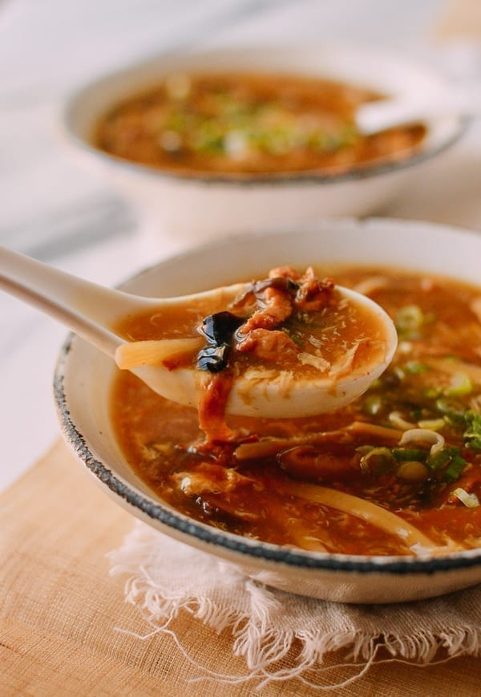
Hot and sour soup - ingredients
8 cups chicken broth or vegetable broth
8 ounces shiitake mushrooms, thinly-sliced with stems discarded
1 (8-ounce) can bamboo shoots, drained (optional)
1/4 cup rice vinegar, or more to taste
1/4 cup low-sodium soy sauce
2 teaspoons ground ginger
1 teaspoon chili garlic sauce
1/4 cup cornstarch
2 large eggs, whisked
8 ounces firm tofu, cut into 1/2-inch cubes
4 green onions, thinly sliced
1 teaspoon toasted sesame oil
Kosher salt and white or black pepper
CCMAS43

Slide 5
Hot and sour soup - instructions
Set aside ¼ cup of the chicken or vegetable broth for later use.
Add the remaining 7 ¾ cups chicken or vegetable broth, mushrooms, bamboo shoots, rice wine vinegar, soy sauce, ginger and chili garlic sauce to a large stock pot, and stir to combine. Heat over medium-high heat until the soup reaches a simmer.
While the soup is heating, whisk together the ¼ cup of broth (that you had set aside) and cornstarch in a small bowl until completely smooth. Once the soup has reached a simmer, stir in the cornstarch mixture and stir for 1 minute or so until the soup has thickened.
CCMAS43

Slide 6
Hot and sour soup - instructions
Continue stirring the soup in a circular motion, then drizzle in the eggs in a thin stream (while still stirring the soup) to create egg ribbons. Stir in the tofu, half of the green onions, and sesame oil. Then season the soup with salt and a pinch of white or black pepper to taste. If you’d like a more “sour” soup, feel free to add in another tablespoon or two of rice wine vinegar as well. Or if you’d like a spicier soup, add in more chili garlic sauce.
Serve immediately, garnished with the extra green onions.
CCMAS43

Slide 7
Ingredients for successful plenary
Professional colleague
  Krisztina
  Zsuzsa
  Secretariate – Verna, Lingping, Johnny, Ilaria, Robert
  Chairs – Susan, Roger, Ligia, Laura, Patrick, Richard, Richard, Péter, Soraya, Thea, Hilde, Stephan
  Translators – Ágnes, Rezső, Zoltán, Péter, Linda, Etelka
  Technical assistance – Zsófia, Bence, Boglárka, Viktor, Márta, Eszter, István, Dániel, Viktor, Tibor, László, Bence
Friendship, humour, flexibility, and lot of coffee ☺

Slide 8
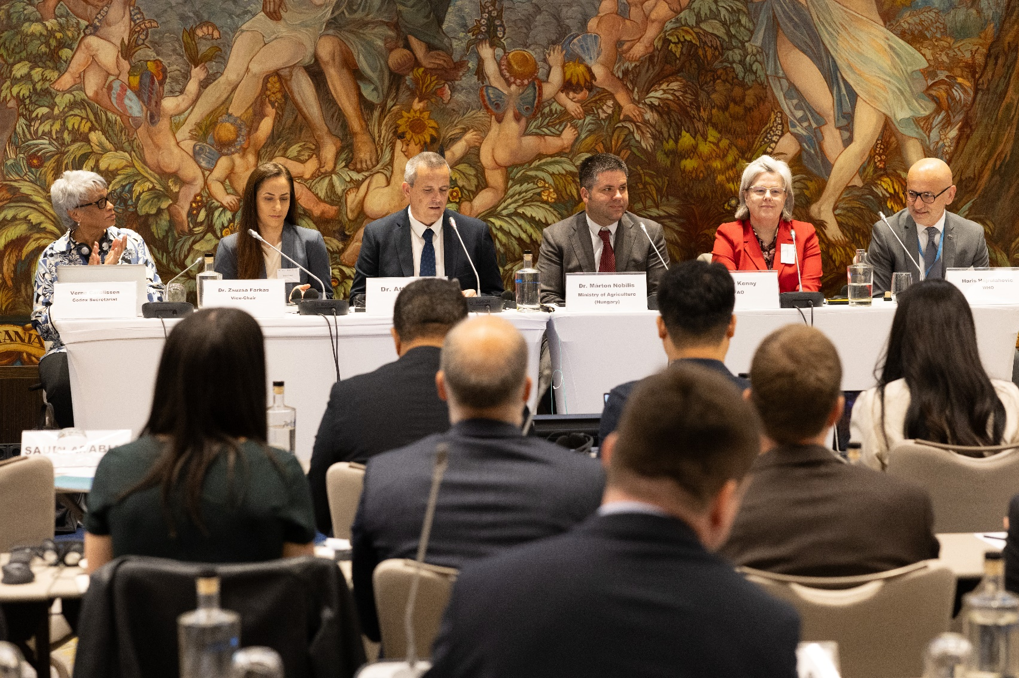

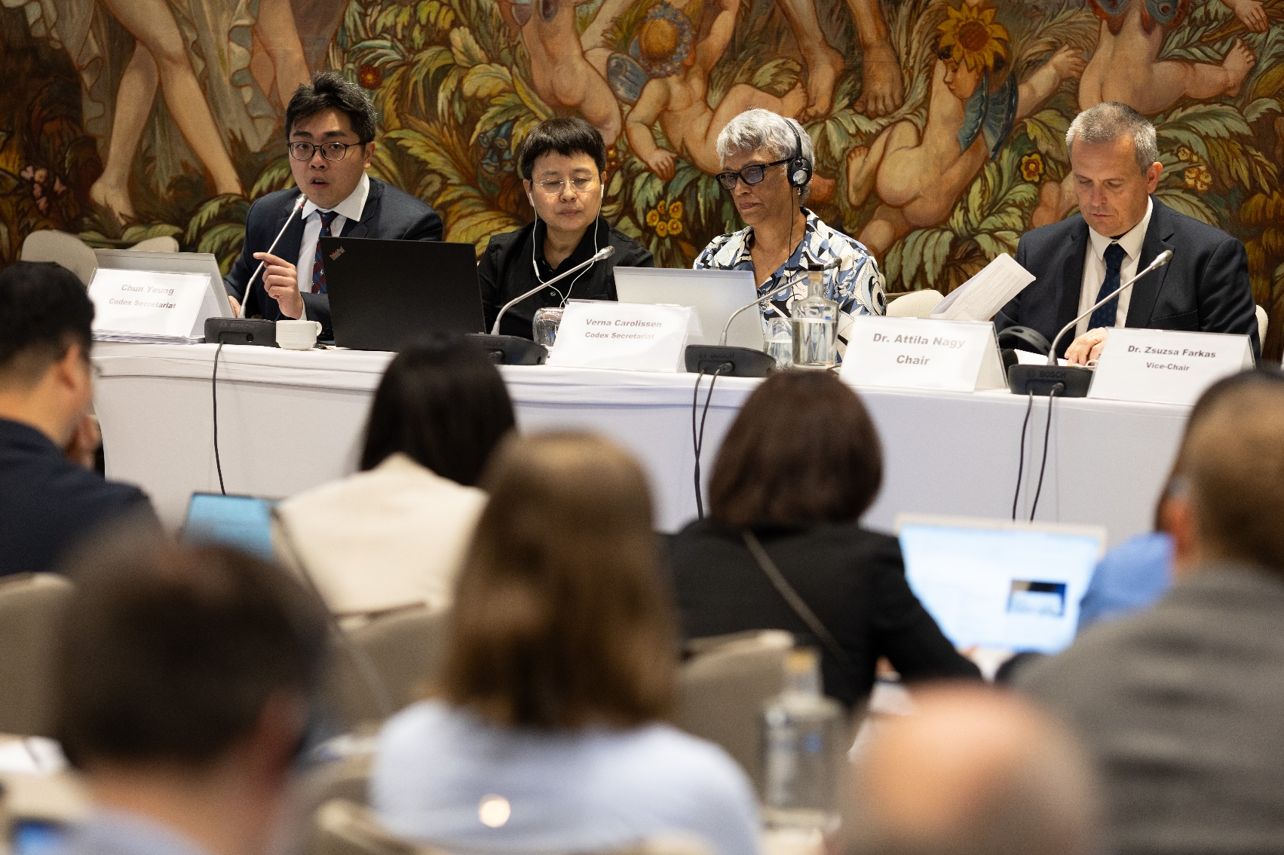
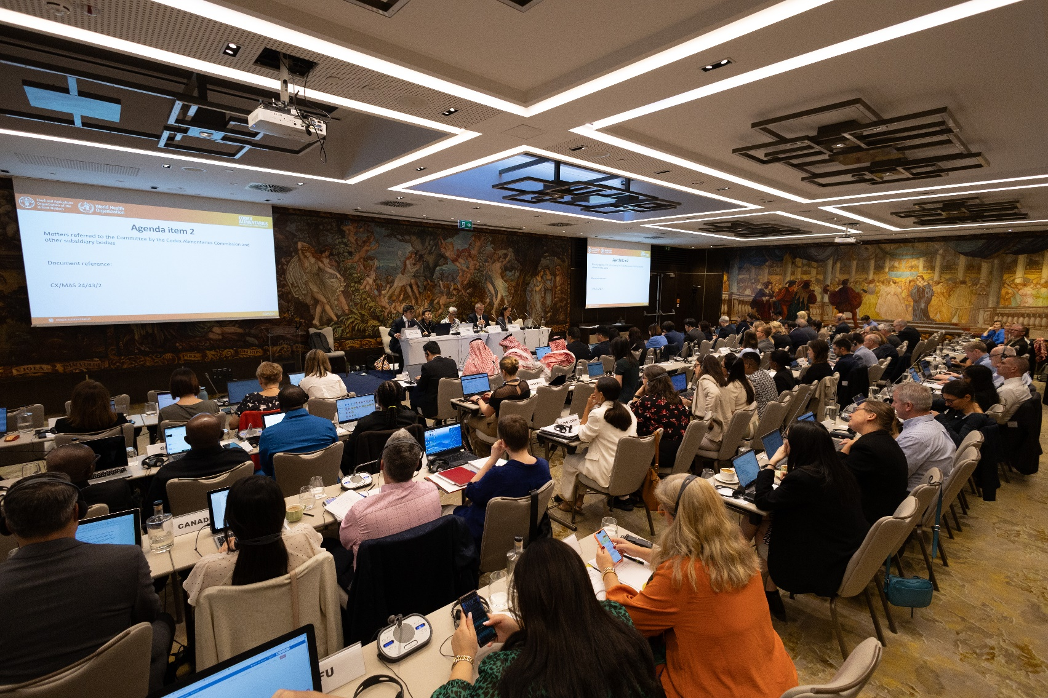
Köszönöm!
[køsønøm]
CCMAS43

